Slide 1
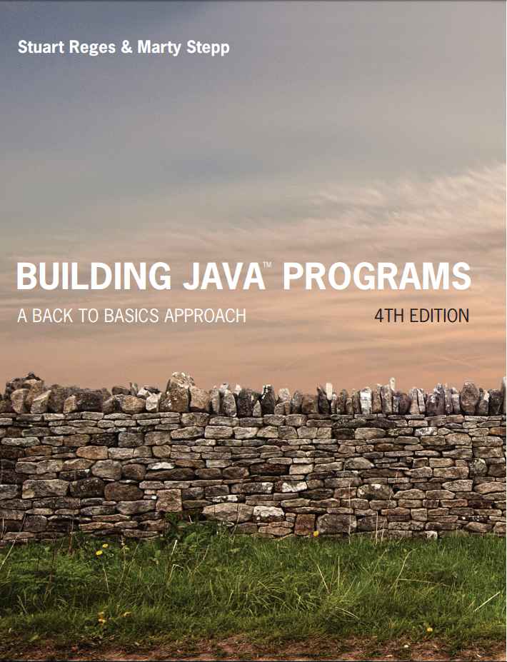
Building Java Programs
Fourth Edition
Chapter 2
Primitive Data and Definite Loops
Copyright © 2017, 2014, 2011 Pearson Education, Inc. All Rights Reserved
Notes:
If this PowerPoint presentation contains mathematical equations, you may need to check that your computer has the following installed:
1) MathType Plugin
2) Math Player (free versions available)
3) NVDA Reader (free versions available)

Slide 2
Data Types
type: A category or set of data values.
Constrains the operations that can be performed on data
Many languages ask the programmer to specify types
Examples: integer, real number, string
Internally, computers store everything as 1s and 0s
104 → 01101000
“hi” → 01101000110101
Notes:
ask them, how might the computer store "hi" using binary digits? (some kind of mapping; ASCII)

Slide 3
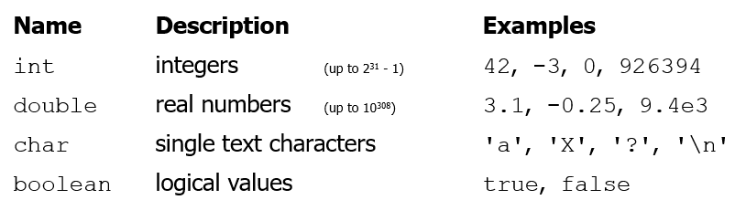
Java’s Primitive Types
primitive types: 8 simple types for numbers, text, etc.
Java also has object types, which we'll talk about later
Here are the four most commonly used primitive types:
Why does Java distinguish integers versus real numbers?
Notes:
We're basically going to manipulate letters and numbers.
We make the integer / real number distinction in English as well. We don't ask, "How many do you weigh?" or, "How much sisters do you have?"
Part of the int/double split is related to how a computer processor crunches numbers. A CPU does integer computations and a Floating Point Unit (FPU) does real number computations.
Why does Java separate int and double? Why not use one combined type called number?

Slide 4
Primitive data types
type | kind of number | memory (bits) | range | examples
byte | integer | 8 | -128 .. 127 | (byte) 5
char | character (integer) | 16 | \u0000 .. \uFFFF | 'a', '\u2603'
float | real number | 32 | -3.4e38 .. 3.4e38 | 3.14f, 1.1e7f
double | real number | 64 | -1.8e308 .. 1.8e308 | 3.14, 6.022e23
int | integer | 32 | -2³¹ .. 2³¹ | 42, -17, 0xff
long | integer | 64 | -2⁶³ .. 2⁶³ | 42L, 21874109487L
short | integer | 16 | -2¹⁵ .. 2¹⁵ | (short) 42

Slide 5
Expressions
expression: A value or operation that computes a value.
Examples:
The simplest expression is a literal value.
A complex expression can use operators and parentheses.

Slide 6
Arithmetic Operators
operator: Combines multiple values or expressions.
+ addition
- subtraction (or negation)
* multiplication
/ division
% modulus (a.k.a. remainder)
As a program runs, its expressions are evaluated.
1 + 1 evaluates to 2
System.out.println
Prints 12
How would we print the text

Slide 7
Integer Division with /
When we divide integers, the quotient is also an integer.
More examples:
Dividing by 0 causes an error when your program runs.

Slide 8
Integer Remainder with %
The % operator computes the remainder from integer division.
14 % 4 is 2
218 % 5 is 3
Applications of % operator:
Obtain last digit of a number: 230857 % 10 is 7
Obtain last 4 digits: 658236489 % 10000 is 6489
See whether a number is odd: 7 % 2 is 1, 42 % 2 is 0
Notes:
What is 8 % 20? It's 8, but students often say 0.

Slide 9
Precedence (1 of 2)
precedence: Order in which operators are evaluated.
Generally operators evaluate left-to-right.
1 – 2 – 3 = (1 – 2) – 3 = -1 – 3 = -4
But… Multiplicative operators (*, /, %) have a higher level of precedence than additive operators (+, -)

Slide 10
Precedence (2 of 2)
Parentheses can force a certain order of evaluation:
Spacing does not affect order of evaluation

Slide 11
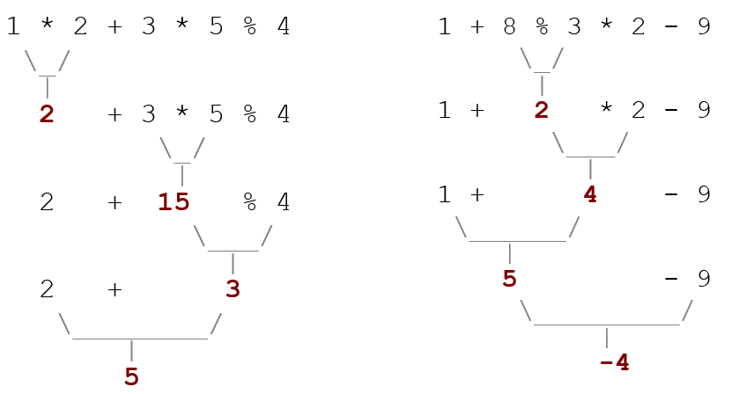
Precedence Examples
Notes:
Ask the students what 15 / 4 and 2 / 3 are, since the answers are non-obvious.

Slide 12
Precedence Questions
What values result from the following expressions?
Notes:
Answers:
1
15
37
47
9
16
-8
9

Slide 13
In-Class Assignment 1, Part 1
Create the class MathOps in BluJ
Use statements involving System.out.println to output the results of each of the math expressions on the preceding slide
After doing this, add one more System.out.println to display your name, like this:
Author: Kyle Muldrow

Slide 14
Real numbers (Type Double)
Examples: 6.022 , −42.0 , 2.143e17
Placing .0 or . after an integer makes it a double.
The operators +−* / % () all still work with double.
/ produces an exact answer:
Precedence is the same: () before * / % before + $−$
Notes:
Point out that it's odd for 42.0 to be considered a real number, but it is.

Slide 15
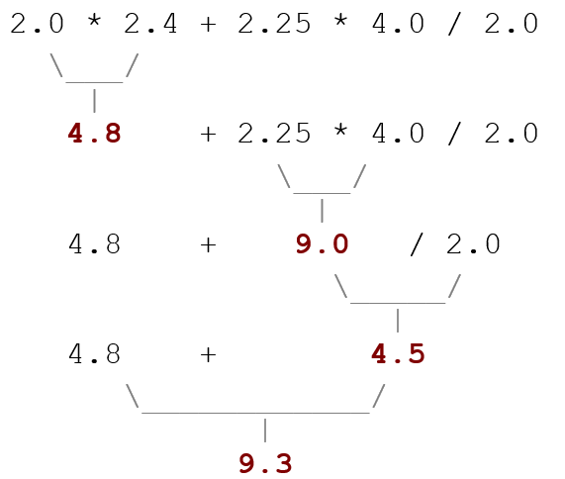
Real Number Example

Slide 16
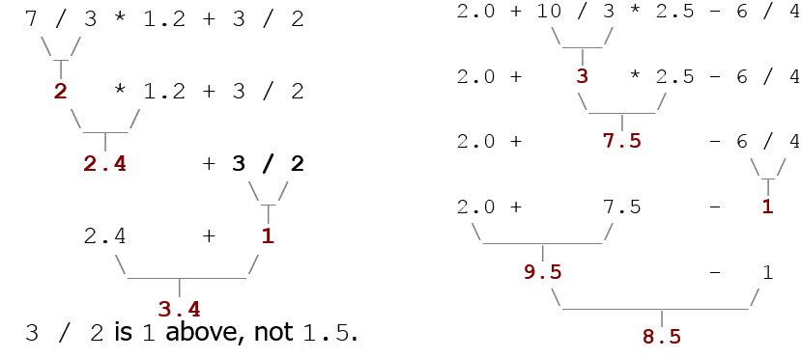
Mixing Types
When int and double are mixed, the result is a double.
The conversion is per-operator, affecting only its operands.
Notes:
I don't usually go through the expression on the right; I just show it very quickly and move on.

Slide 17
Casting
Used to change the type of a number to another type.
Example: Change 4.75 to int, like this:
(int) 4.75
Result will be 4
Must be careful to use parentheses when math operators are involved
(int) 9.7 / 3.4: This only converts 9.7 to int but still divides by 3.4, so result will be 2.64705….
(int) (9.7 / 3.4): This divides the numbers and coverts the result to int, so the result will be 2.

Slide 18
In-Class Assignment 1, Part 2
Use System.out.println to add a blank line of output after the math operations currently in class MathOps.
After the blank line and before the statement with your name, use statements involving System.out.println to output the results of each of the following math expressions:
(6 + 2.5) / (5 – 3)
25.4 / 5.2 (no negatives)
(int)25.4 / 5.2
(int)(25.4 / 5.2)
(int)(25.4) / (int)(5.2)

Slide 19
Variables

Slide 20
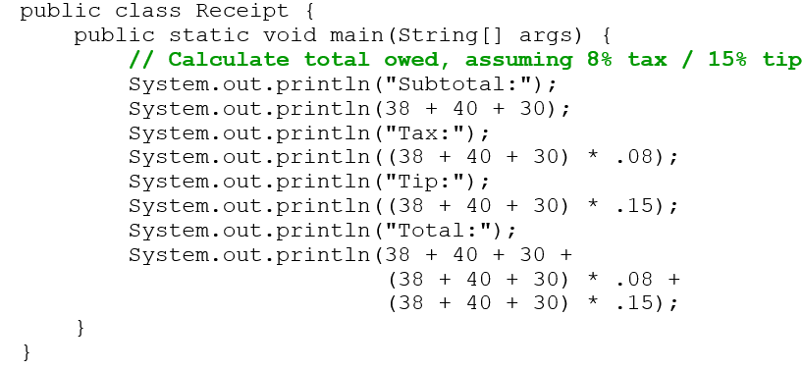
Receipt Example
What’s bad about the following code?
The subtotal expression (38 + 40 + 30) is repeated
So many println statements

Slide 21
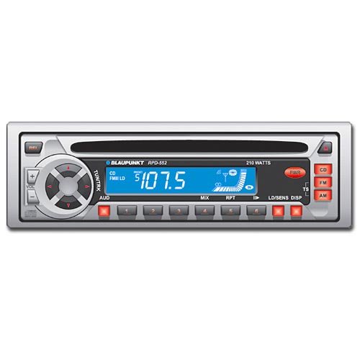
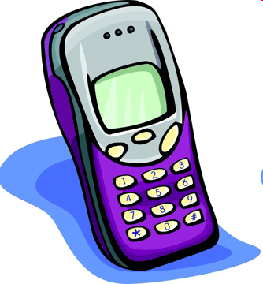
Variables (1 of 2)
variable: A piece of the computer’s memory that is given a name and type, and can store a value.
Like preset stations on a car stereo, or cell phone speed dial:
Notes:
a variable is also like the MS / MR buttons on a calculator
variables must be declared before they are used, just like methods

Slide 22
Variables (2 of 2)
Steps for using a variable:
Declare it - state its name and type
Initialize it - store a value into it
Use it - print it or use it as part of an expression
Notes:
a variable is also like the MS / MR buttons on a calculator
variables must be declared before they are used, just like methods

Slide 23
Declaration
variable declaration: Sets aside memory for storing a value.
Variables must be declared before they can be used.
Syntax:
type name;
The name is an identifier.
int x;
double myGPA;
x | blank
myG P A | blank

Slide 24
Assignment
assignment: Stores a value into a variable.
The value can be an expression; the variable stores its result.
Syntax:
name = expression;
int x; x = 3;
double myGPA; myGPA = 1.0 + 2.25;
x | 3
myG P A | 3.25

Slide 25
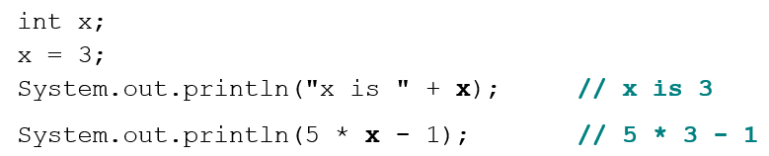
Using Variables (1 of 2)
Once given a value, a variable can be used in expressions:

Slide 26
In-Class Assignment 1, Part 3
At the beginning of the program in class MathOps, declare six variables with the following names: val1, val2, val3, val4, val5, val6.
Assign the following values to these variables within their declarations (also determine what type each should be):
(6 + 2.5) / (5 – 3)
25.4 / 5.2 (no negatives)
(int)25.4 / 5.2
(int)(25.4 / 5.2)
(int)(25.4) / (int)(5.2)
Change the output statements to use the variables and verify the results are the same as in Part 2.

Slide 27
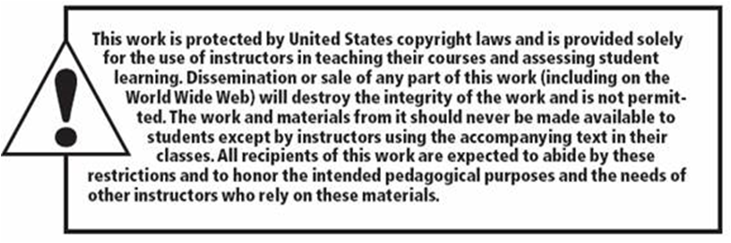
Copyright

