Slide 1
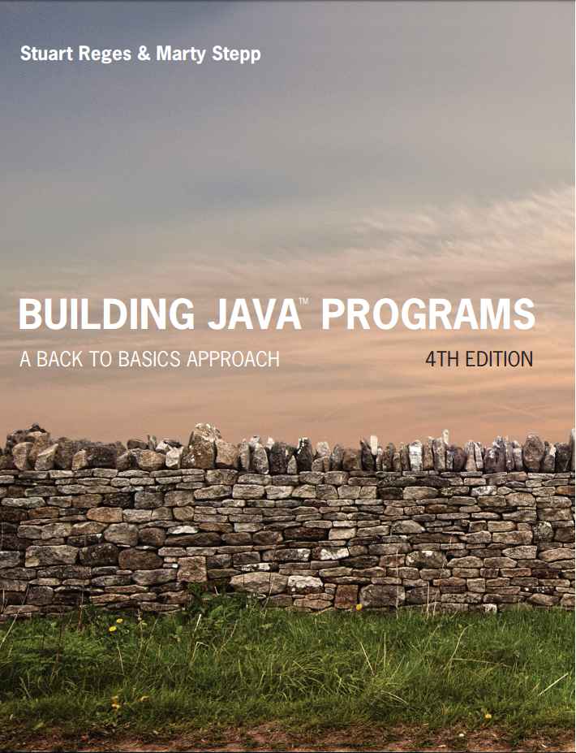
Building Java Programs
Fourth Edition
Chapter 2
Primitive Data and Definite Loops
Copyright © 2017, 2014, 2011 Pearson Education, Inc. All Rights Reserved
Notes:
If this PowerPoint presentation contains mathematical equations, you may need to check that your computer has the following installed:
1) MathType Plugin
2) Math Player (free versions available)
3) NVDA Reader (free versions available)

Slide 2
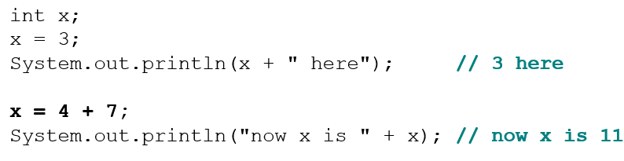
Using Variables (2 of 2)
You can assign a value more than once:
x | 3
x | 11

Slide 3
Declaration/Initialization
A variable can be declared/initialized in one statement.
Syntax:
type name = value;
double myGPA = 3.95;
int x
x | 14
myG P A | 3.95

Slide 4
Assignment and Algebra
Assignment uses = , but it is not an algebraic equation. = means, “store the value at right in variable at left”
The right side expression is evaluated first, and then its result is stored in the variable at left.
What happens here?
int x = 3;
x = x + 2; // ???
x | 5
Notes:
x = x + 2; increases the value stored in variable x by two.

Slide 5
Assignment and Types
A variable can only store a value of its own type.
int x = 2.5; // ERROR: incompatible types
An int value can be stored in a double variable.
The value is converted into the equivalent real number.
double myGPA = 4;
double avg
myG P A | 4.0
Why does avg store 5.0 and not 5.5 ?
avg | 5.0

Slide 6
In-Class Assignment 2, Part 1
Create the class Conversions in BluJ
Declare five variables of type double with the following names: feet, yards, inches, centimeters, kilometers
Give the feet variable a value of 12. Calculate variables for the other four variables by doing the following:
Divide feet by 3 to get yards
Multiply feet by 12 get inches
Multiply inches by 2.54 to get centimeters
Multiply yards by 0.00091 to get kilometers
Display the value of each variable using System.out.println

Slide 7
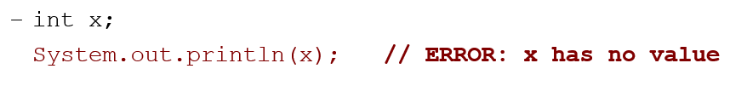
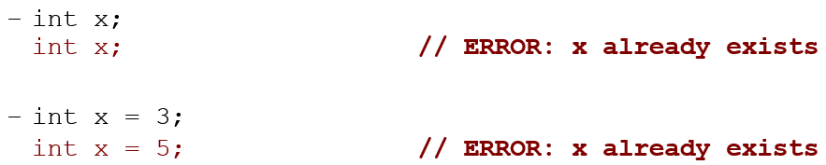
Compiler Errors
A variable can’t be used until it is assigned a value.
You may not declare the same variable twice.
How can this code be fixed?

Slide 8
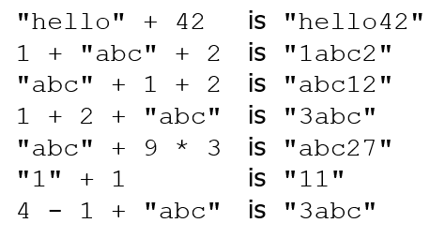
String Concatenation
string concatenation: Using + between a string and another value to make a longer string.
Use + to print a string and an expression’s value together.
System.out.println
Output: Grade: 83.5

Slide 9
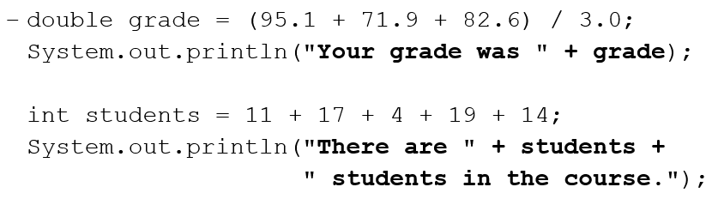
Printing a Variable’s Value
Use + to print a string and a variable’s value on one line.
Output:
Your grade was 83.2
There are 65 students in the course.

Slide 10
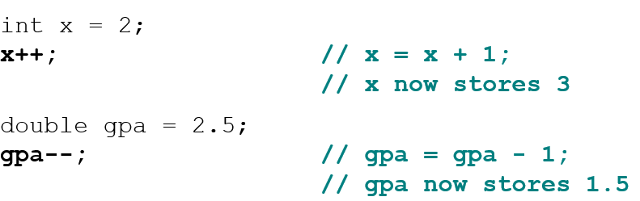
Increment and decrement
shortcuts to increase or decrease a variable’s value by 1
Shorthand Equivalent longer version
variable++; variable = variable + 1;
variable--; variable = variable - 1;

Slide 11
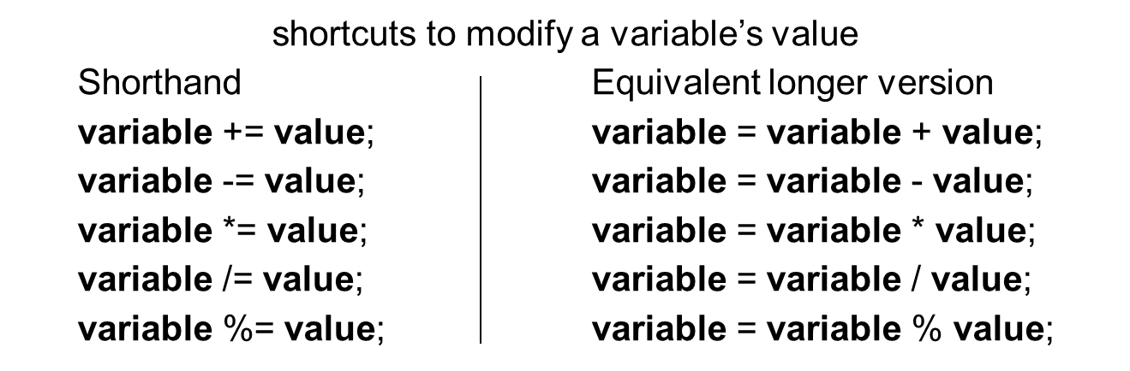
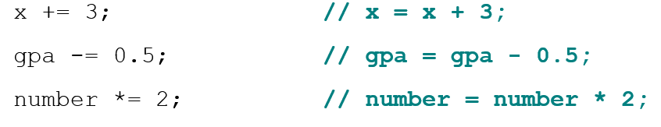
Modify-and-assign

Slide 12
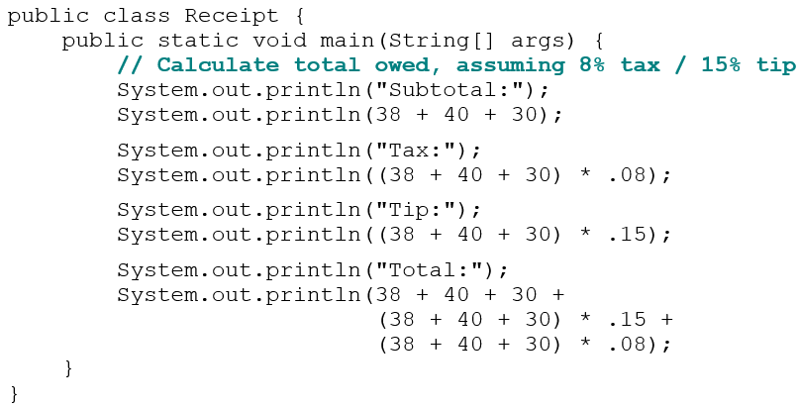
Receipt Question
Use + to print a string and a variable’s value on one line.

Slide 13
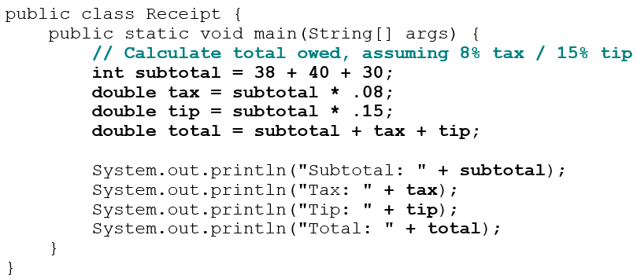
Receipt Answer

Slide 14
In-Class Assignment 2, Part 2
Change the Conversions class in BluJ to do the following:
Use System.out.println to add a blank line after the current output statements.
Copy and paste the five System.out.println statements after the blank line.
Use string concatenation (and type casting, when needed) in the last five System.out.println statements so that the output looks like this:
We started with 12 feet.
12 feet is 3 yards.
12 feet is also 144 inches.
144 inches is 365.76 centimeters.
3 yards is 0.00364 kilometers.

Slide 15
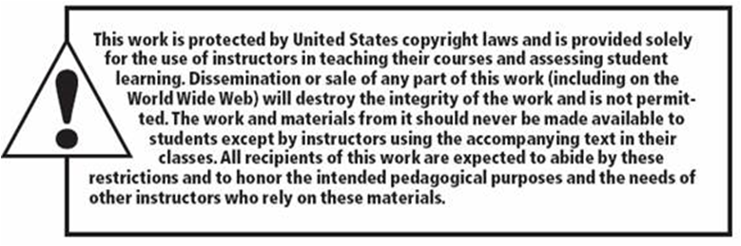
Copyright

