Slide 1

PR
SYSTEM
April 10th 2018

Slide 2
Introduction
PR System is an administrative tool which will replace the currents sheets used to make a purchase request

Slide 3
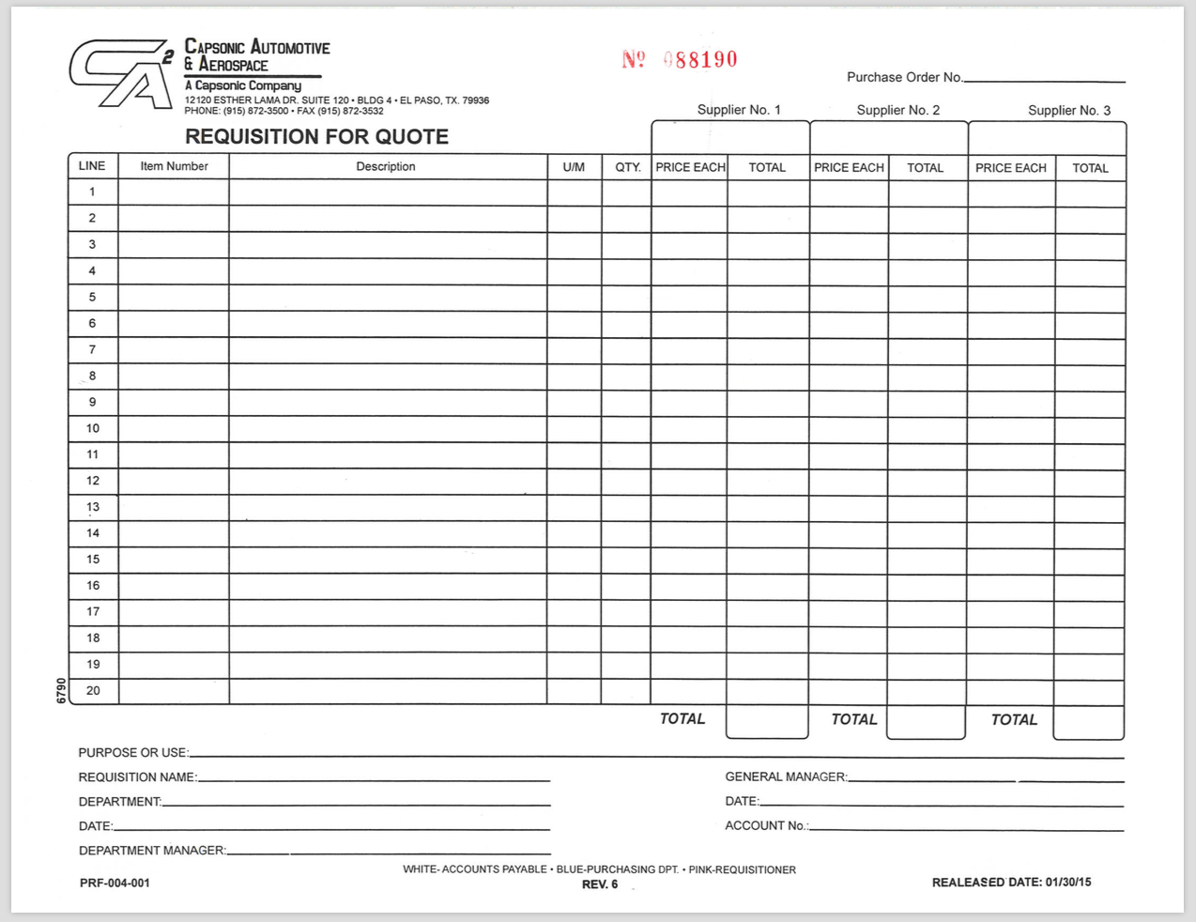

Slide 4
Roles
- User
- MRO
- Buyer
- Department Manager
- General Manager

Slide 5
Status
- Pending
Initial status when PR is created
- Rejected
PR does not proceed beyond this point
- Quote
Once the approver accepts it to be quoted
- Quoted
MRO submits the quotation

Slide 6
Status
- Quote approved
Quotation is approved by the manager
- Quote rejected
Quotation is rejected by the manager, must be revised
- Approved
PR is approved and ready to be purchased
- Finalized
Buyer adds a PO identification number and closes the request

Slide 7
WORKFLOW

Slide 8
Flow Process
User
Department Manager
General Manager
Finance
MRO
Purchasing Manager
Pending
MRO Quoted
DM Rejected
PM Rejected
MRO Quote
PM Approved
DM Rejected
DM Approved
DM Approved
GM Rejected
GM Approved
Finalized
Finance Quote
DM Approved
DM Rejected
GM Approved
GM Rejected
DM Approved
Finalized

