Slide 1
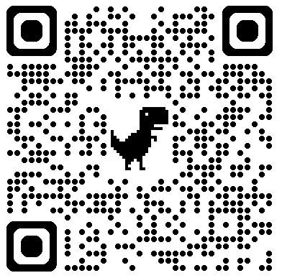
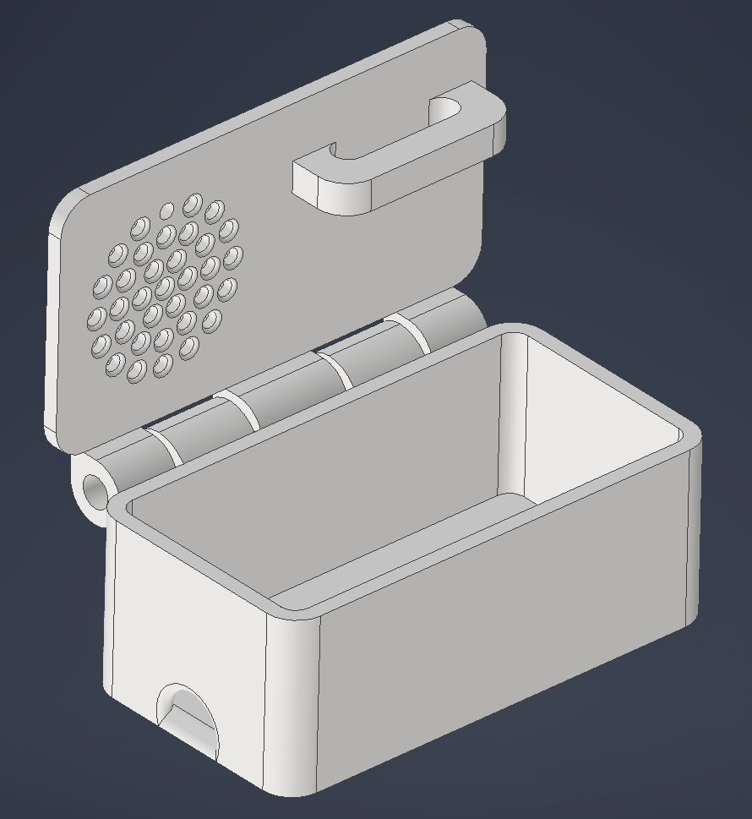
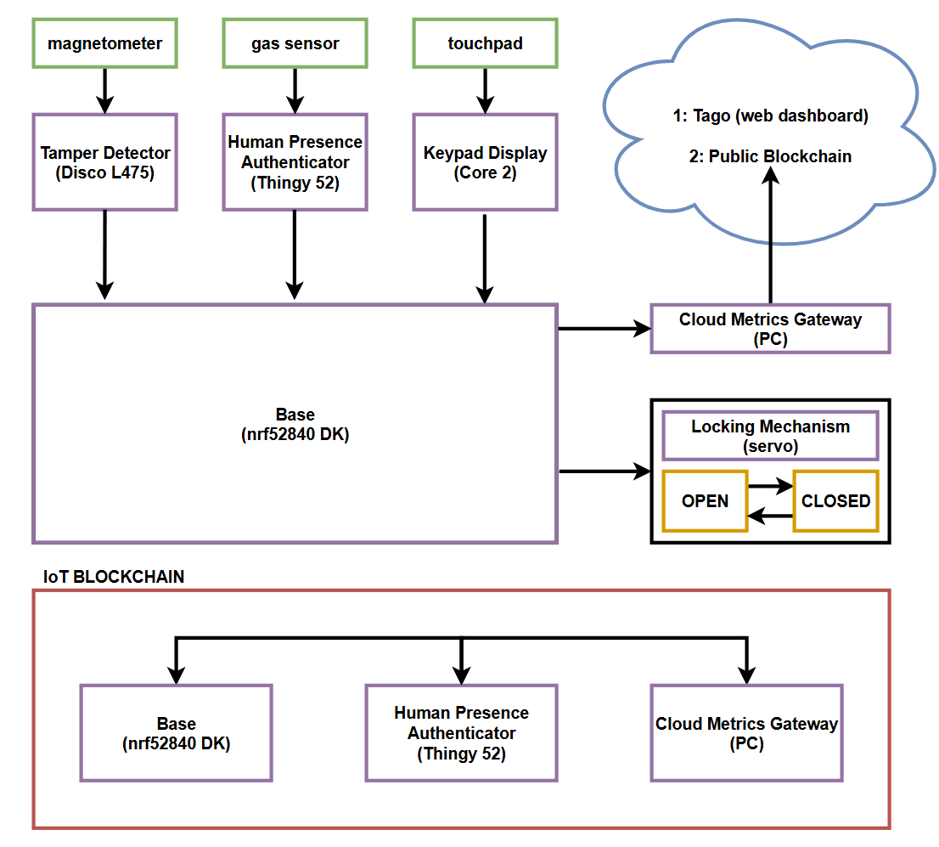
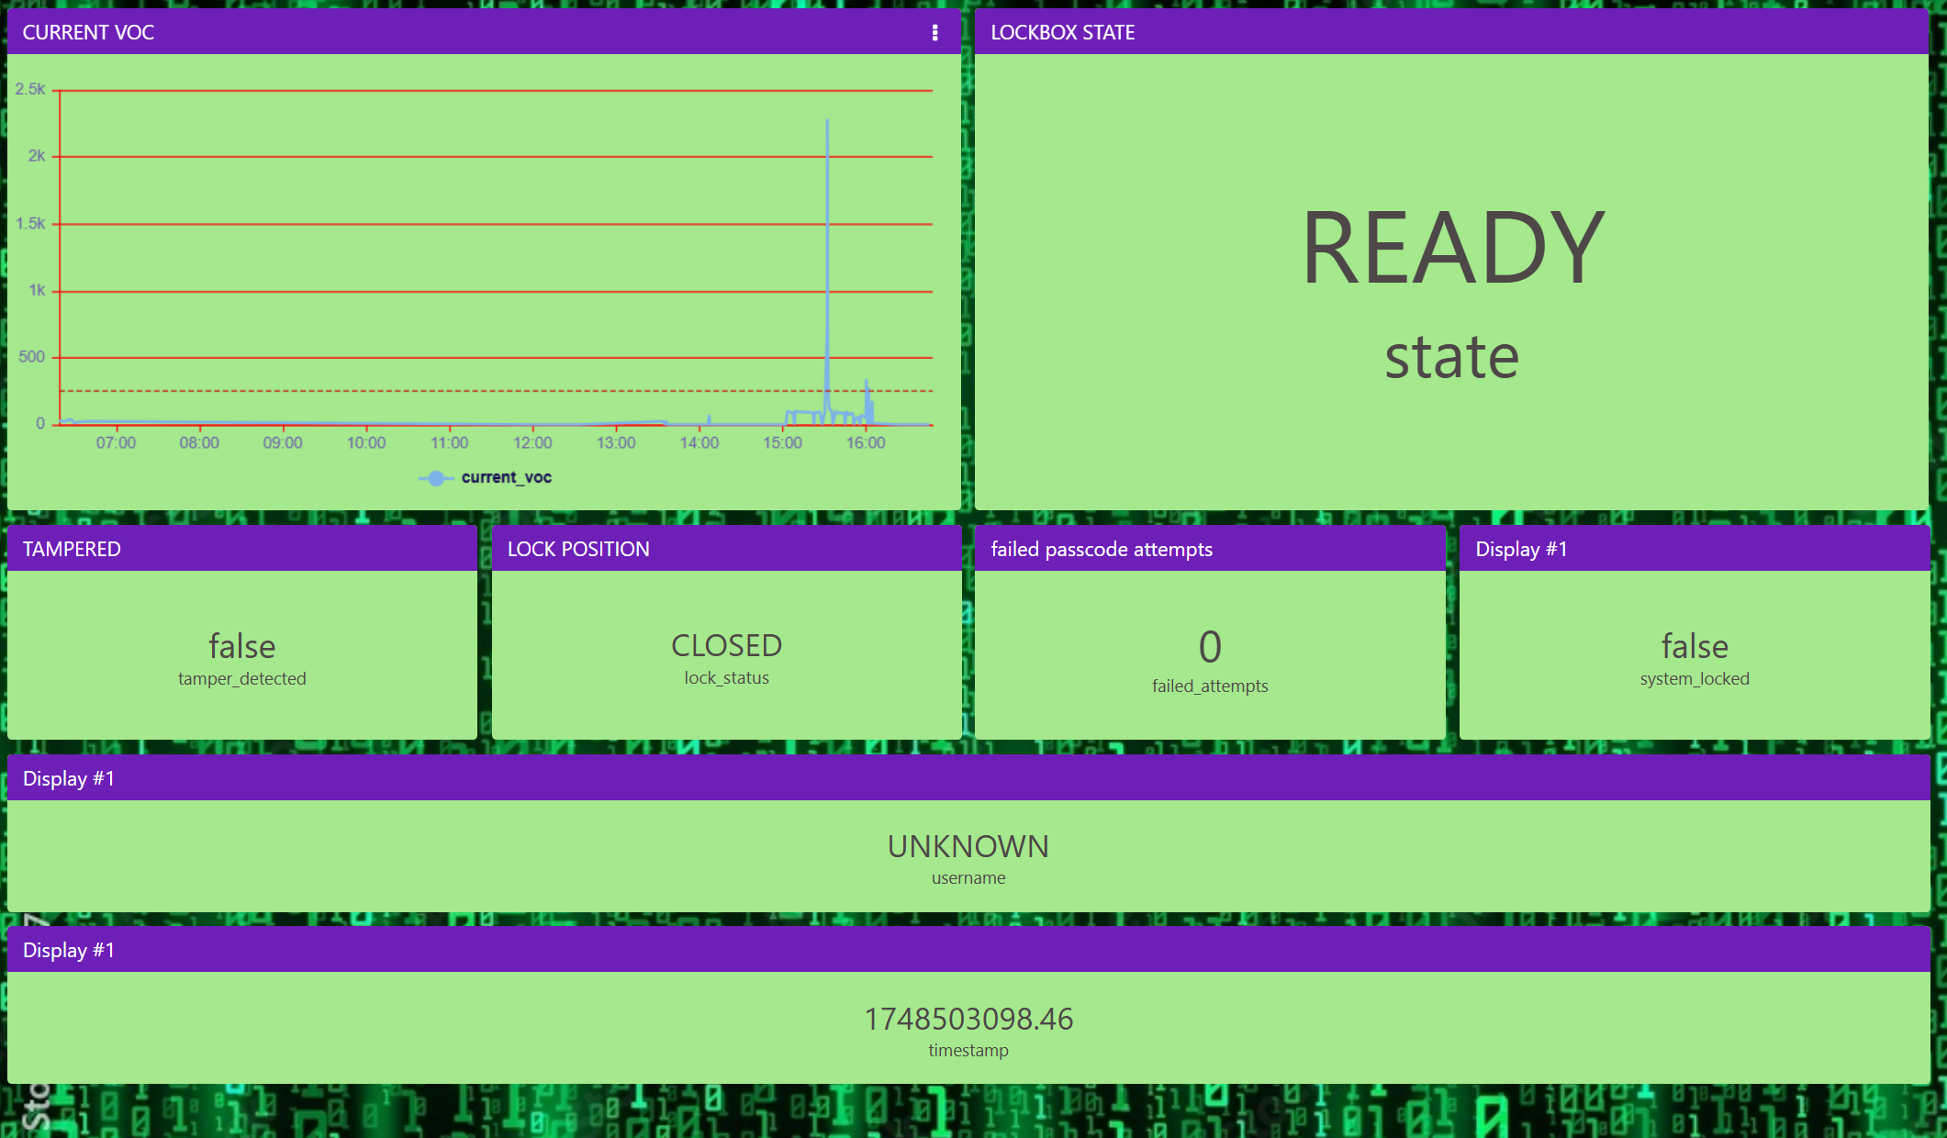
BlowChain: Tamper-Proof Secure-Logging Lock-Box
General Hints & Tips
Do not change the colour/size/logos/positioning of the Slide Master.
This is a standard format across all Innovation Expo posters.
Do not add other corporate logos. This is an infringement of copyright, unless you have express permission to do so.
Do use this space as creatively as you wish.
Avoid using large background colours – doesn’t print well.
Stick to the basic fonts & sizes (left) – these read clearly. If you need to reduce the text size, you are trying to put too much on your poster.
As a check, print “scaled to fit” onto A4 and read at arms length.
Save your poster as you work on it.
You shouldn’t need to change the sizing of this file, it should already be landscape format with width: 41cm and height: 28.7 cm (A3 with 5 mm borders all around).
The title may look to close to the top edge – don’t be tempted to change it. It allows for the extra 5mm from the printing.
Niall Waller, James McAuley, Dhanan Balasaravanan
What's The Problem ?
Traditional Lockboxes:
Single shared access code → weak security & no accountability.
Manual logs → unreliable auditing.
Digital Alternatives:
Internet-dependent → vulnerable to remote attacks.
Centralized databases → risk of data modification breaches.
How Does it Work ?
What Did We Found Out ?
Human interaction met KPI goals with registering sensor happening 98% of the time.
GATT BLE Communication is One-To-One thus we used 1 GATT service with multiple observation/advertisers.
Blockchain validation and performance is limited by the storage space, most blocks were
Minting and transaction loading happened every 5 seconds with 3 transactions possible per block.
Feature | Benefit
Human Presence Detection (CO₂ + particle sensors) | Prevents spoofing by verifying access attempt is by a human.
Blockchain Immutable Logs | Tamper-proof record of all events.
Dynamic Access Tokens (NFT-based credentials) | Time-bound, revocable permissions per user (no static codes).
Tamper Detection (Magnetometer trigger) | Alerts + logs forced entry attempts in real time.
Offline-First Design (BLE-only to base station) | No direct internet exposure → immunity to remote hacking.
What’s Our Solution ?
BlowChain proposes an advanced digital lockbox, combining environmental sensing, offline architecture, and blockchain based accountability to remove user error from lockbox security.
Who Needs It ?
Real estate (secure property showings).
Rental units (self-check-in with logs).
Shared facilities (granular access control).
Companies that create or access intellectual property that needs to be stored.
GitHub Wiki:
Subheadings – Helvetica Neue Bold 14pt
Body Text – Helvetica Neue 14pt (min 12pt)
Don’t have the above fonts installed?
Substitutes for Bodoni MT:
Didot on Apple
or Times New Roman (Apple & Windows)
Substitutes for Helvetica Neue:
Helvetica (Apple)
or Arial (Apple & Windows)
References & Acknowledgments
Building Blockchain Projects – Narayan Prusty.
Zephyr Documentation – especially Bluetooth.
Thank you Matt, Michael & especially all the tutors for the experience.

Slide 2
TITLE OF YOUR PROJECT (BODONI MT 48PT)
Your Names and Team ID (A, B, etc) (Helvetica Neue 24pt)
MAIN HEADINGS – BODONI MT 18PT ALL CAPS
Subheadings – Helvetica Neue Bold 14pt
Body Text – Helvetica Neue 14pt (min 12pt)
Don’t have the above fonts installed?
Substitutes for Bodoni MT:
Didot on Apple
or Times New Roman (Apple & Windows)
Substitutes for Helvetica Neue:
Helvetica (Apple)
or Arial (Apple & Windows)
General Hints & Tips
Do not change the colour/size/logos/positioning of the Slide Master.
This is a standard format across all Innovation Expo posters.
Do not add other corporate logos. This is an infringement of copyright, unless you have express permission to do so.
Do use this space as creatively as you wish.
Avoid using large background colours – doesn’t print well.
Stick to the basic fonts & sizes (left) – these read clearly. If you need to reduce the text size, you are trying to put too much on your poster.
As a check, print “scaled to fit” onto A4 and read at arms length.
Save your poster as you work on it.
You shouldn’t need to change the sizing of this file, it should already be landscape format with width: 41cm and height: 28.7 cm (A3 with 5 mm borders all around).
The title may look to close to the top edge – don’t be tempted to change it. It allows for the extra 5mm from the printing.

Slide 3
BlowChain: Tamper-Proof Secure-Logging Lock-Box
General Hints & Tips
Do not change the colour/size/logos/positioning of the Slide Master.
This is a standard format across all Innovation Expo posters.
Do not add other corporate logos. This is an infringement of copyright, unless you have express permission to do so.
Do use this space as creatively as you wish.
Avoid using large background colours – doesn’t print well.
Stick to the basic fonts & sizes (left) – these read clearly. If you need to reduce the text size, you are trying to put too much on your poster.
As a check, print “scaled to fit” onto A4 and read at arms length.
Save your poster as you work on it.
You shouldn’t need to change the sizing of this file, it should already be landscape format with width: 41cm and height: 28.7 cm (A3 with 5 mm borders all around).
The title may look to close to the top edge – don’t be tempted to change it. It allows for the extra 5mm from the printing.
Niall Waller, James McAuley, Dhanan Balasaravanan
What’s Our Solution ?
BlowChain proposes an advanced digital lockbox, combining environmental sensing, offline architecture, and blockchain based accountability to remove user error from lockbox security.
What's The Problem ?
Traditional Lockboxes:
Single shared access code → weak security & no accountability.
Manual logs → unreliable auditing.
Digital Alternatives:
Internet-dependent → vulnerable to remote attacks.
Centralized databases → risk of data modification breaches.
Feature | Benefit
Human Presence Detection (CO₂ + particle sensors) | Prevents spoofing by verifying access attempt is by a human.
Blockchain Immutable Logs | Tamper-proof record of all events.
Dynamic Access Tokens (NFT-based credentials) | Time-bound, revocable permissions per user (no static codes).
Tamper Detection (Magnetometer trigger) | Alerts + logs forced entry attempts in real time.
Offline-First Design (BLE-only to base station) | No direct internet exposure → immunity to remote hacking.
How Does it Work ?
Who Needs It ?
Real estate (secure property showings).
Rental units (self-check-in with logs).
Shared facilities (granular access control).
Companies that create or access intellectual property that needs to be stored.
GitHub Wiki:
Subheadings – Helvetica Neue Bold 14pt
Body Text – Helvetica Neue 14pt (min 12pt)
Don’t have the above fonts installed?
Substitutes for Bodoni MT:
Didot on Apple
or Times New Roman (Apple & Windows)
Substitutes for Helvetica Neue:
Helvetica (Apple)
or Arial (Apple & Windows)

Slide 4
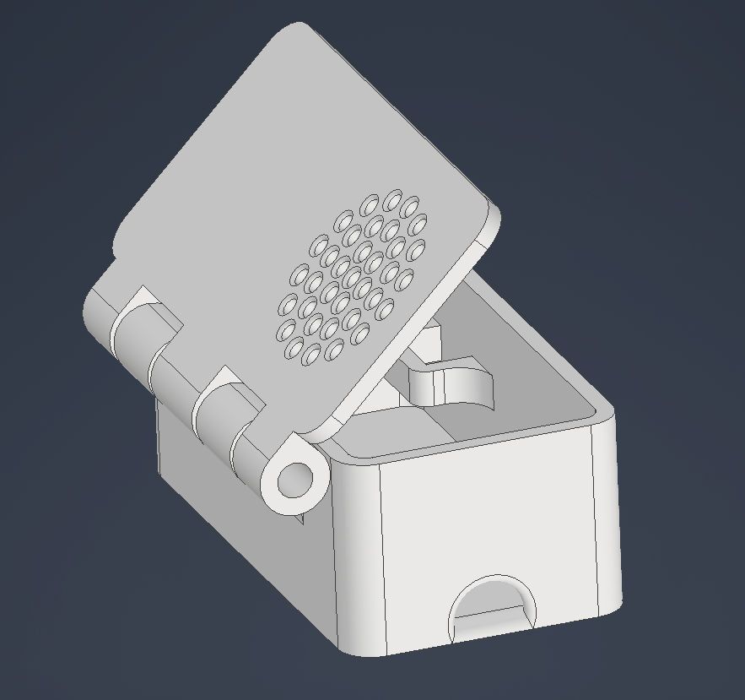
BlowChain: Tamper-Proof Secure-Logging Lock-Box
General Hints & Tips
Do not change the colour/size/logos/positioning of the Slide Master.
This is a standard format across all Innovation Expo posters.
Do not add other corporate logos. This is an infringement of copyright, unless you have express permission to do so.
Do use this space as creatively as you wish.
Avoid using large background colours – doesn’t print well.
Stick to the basic fonts & sizes (left) – these read clearly. If you need to reduce the text size, you are trying to put too much on your poster.
As a check, print “scaled to fit” onto A4 and read at arms length.
Save your poster as you work on it.
You shouldn’t need to change the sizing of this file, it should already be landscape format with width: 41cm and height: 28.7 cm (A3 with 5 mm borders all around).
The title may look to close to the top edge – don’t be tempted to change it. It allows for the extra 5mm from the printing.
Niall Waller, James McAuley, Dhanan Balasaravanan
What's The Problem ?
Traditional Lockboxes:
Single shared access code → weak security & no accountability.
Manual logs → unreliable auditing.
Digital Alternatives:
Internet-dependent → vulnerable to remote attacks.
Centralized databases → risk of data modification breaches.
What’s Our Solution ?
BlowChain proposes an advanced digital lockbox, combining environmental sensing, offline architecture, and blockchain based accountability to remove user error from lockbox security.
Feature | Benefit
Human Presence Detection (CO₂ + particle sensors) | Prevents spoofing by verifying access attempt is by a human.
Blockchain Immutable Logs | Tamper-proof record of all events.
Dynamic Access Tokens (NFT-based credentials) | Time-bound, revocable permissions per user (no static codes).
Tamper Detection (Magnetometer trigger) | Alerts + logs forced entry attempts in real time.
Offline-First Design (BLE-only to base station) | No direct internet exposure → immunity to remote hacking.
How Does it Work ?
Who Needs It ?
Real estate (secure property showings).
Rental units (self-check-in with logs).
Shared facilities (granular access control).
Companies that create or access intellectual property that needs to be stored.
What Did We Found Out ?
…
…
…
GitHub Wiki:
Subheadings – Helvetica Neue Bold 14pt
Body Text – Helvetica Neue 14pt (min 12pt)
Don’t have the above fonts installed?
Substitutes for Bodoni MT:
Didot on Apple
or Times New Roman (Apple & Windows)
Substitutes for Helvetica Neue:
Helvetica (Apple)
or Arial (Apple & Windows)
Who Would We Like To Thank ?
Ourselves
…
…

Slide 6
BlowChain: Tamper-Proof Secure-Logging Lock-Box
General Hints & Tips
Do not change the colour/size/logos/positioning of the Slide Master.
This is a standard format across all Innovation Expo posters.
Do not add other corporate logos. This is an infringement of copyright, unless you have express permission to do so.
Do use this space as creatively as you wish.
Avoid using large background colours – doesn’t print well.
Stick to the basic fonts & sizes (left) – these read clearly. If you need to reduce the text size, you are trying to put too much on your poster.
As a check, print “scaled to fit” onto A4 and read at arms length.
Save your poster as you work on it.
You shouldn’t need to change the sizing of this file, it should already be landscape format with width: 41cm and height: 28.7 cm (A3 with 5 mm borders all around).
The title may look to close to the top edge – don’t be tempted to change it. It allows for the extra 5mm from the printing.
Niall Waller, James McAuley, Dhanan Balasaravanan
What's The Problem ?
Traditional Lockboxes:
Single shared access code → weak security & no accountability.
Manual logs → unreliable auditing.
Digital Alternatives:
Internet-dependent → vulnerable to remote attacks.
Centralized databases → risk of data modification breaches.
How Does it Work ?
What Did We Found Out ?
Human interaction met KPI goals with registering sensor happening 98% of the time.
GATT BLE Communication is One-To-One thus we used 1 GATT service with multiple observation/advertisers.
Blockchain validation and performance is limited by the storage space, most blocks were
Minting and transaction loading happened every 5 seconds with 3 transactions possible per block.
Feature | Benefit
Human Presence Detection (CO₂ + particle sensors) | Prevents spoofing by verifying access attempt is by a human.
Blockchain Immutable Logs | Tamper-proof record of all events.
Dynamic Access Tokens (NFT-based credentials) | Time-bound, revocable permissions per user (no static codes).
Tamper Detection (Magnetometer trigger) | Alerts + logs forced entry attempts in real time.
Offline-First Design (BLE-only to base station) | No direct internet exposure → immunity to remote hacking.
What’s Our Solution ?
BlowChain proposes an advanced digital lockbox, combining environmental sensing, offline architecture, and blockchain based accountability to remove user error from lockbox security.
Who Needs It ?
Real estate (secure property showings).
Rental units (self-check-in with logs).
Shared facilities (granular access control).
Companies that create or access intellectual property that needs to be stored.
GitHub Wiki:
Subheadings – Helvetica Neue Bold 14pt
Body Text – Helvetica Neue 14pt (min 12pt)
Don’t have the above fonts installed?
Substitutes for Bodoni MT:
Didot on Apple
or Times New Roman (Apple & Windows)
Substitutes for Helvetica Neue:
Helvetica (Apple)
or Arial (Apple & Windows)
References & Acknowledgments
Building Blockchain Projects – Narayan Prusty.
Zephyr Documentation – especially Bluetooth.
Thank you Matt, Michael & especially all the tutors for the experience.

