Slide 1

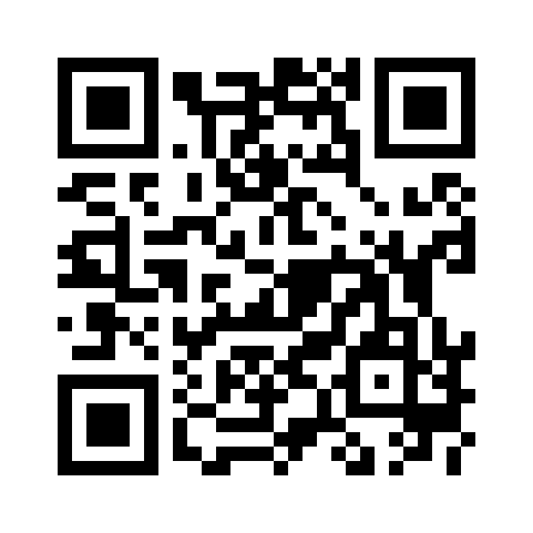
Introducing Azure Load Testing to your CI/CD Pipelines
John Folberth, Microsoft, Senior Cloud Solutions Architect
https://aka.ms/AzureLoadTestingFeedback

Slide 2


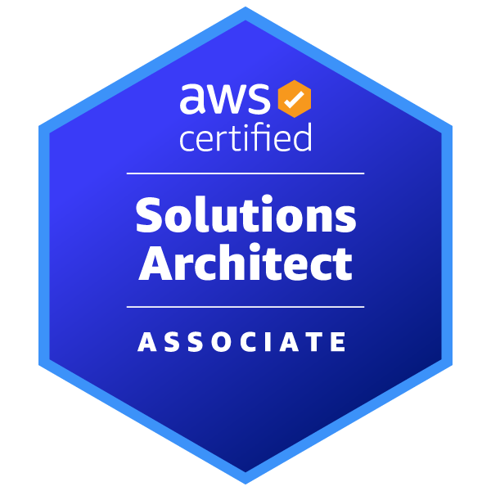

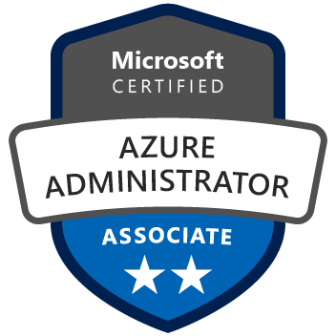









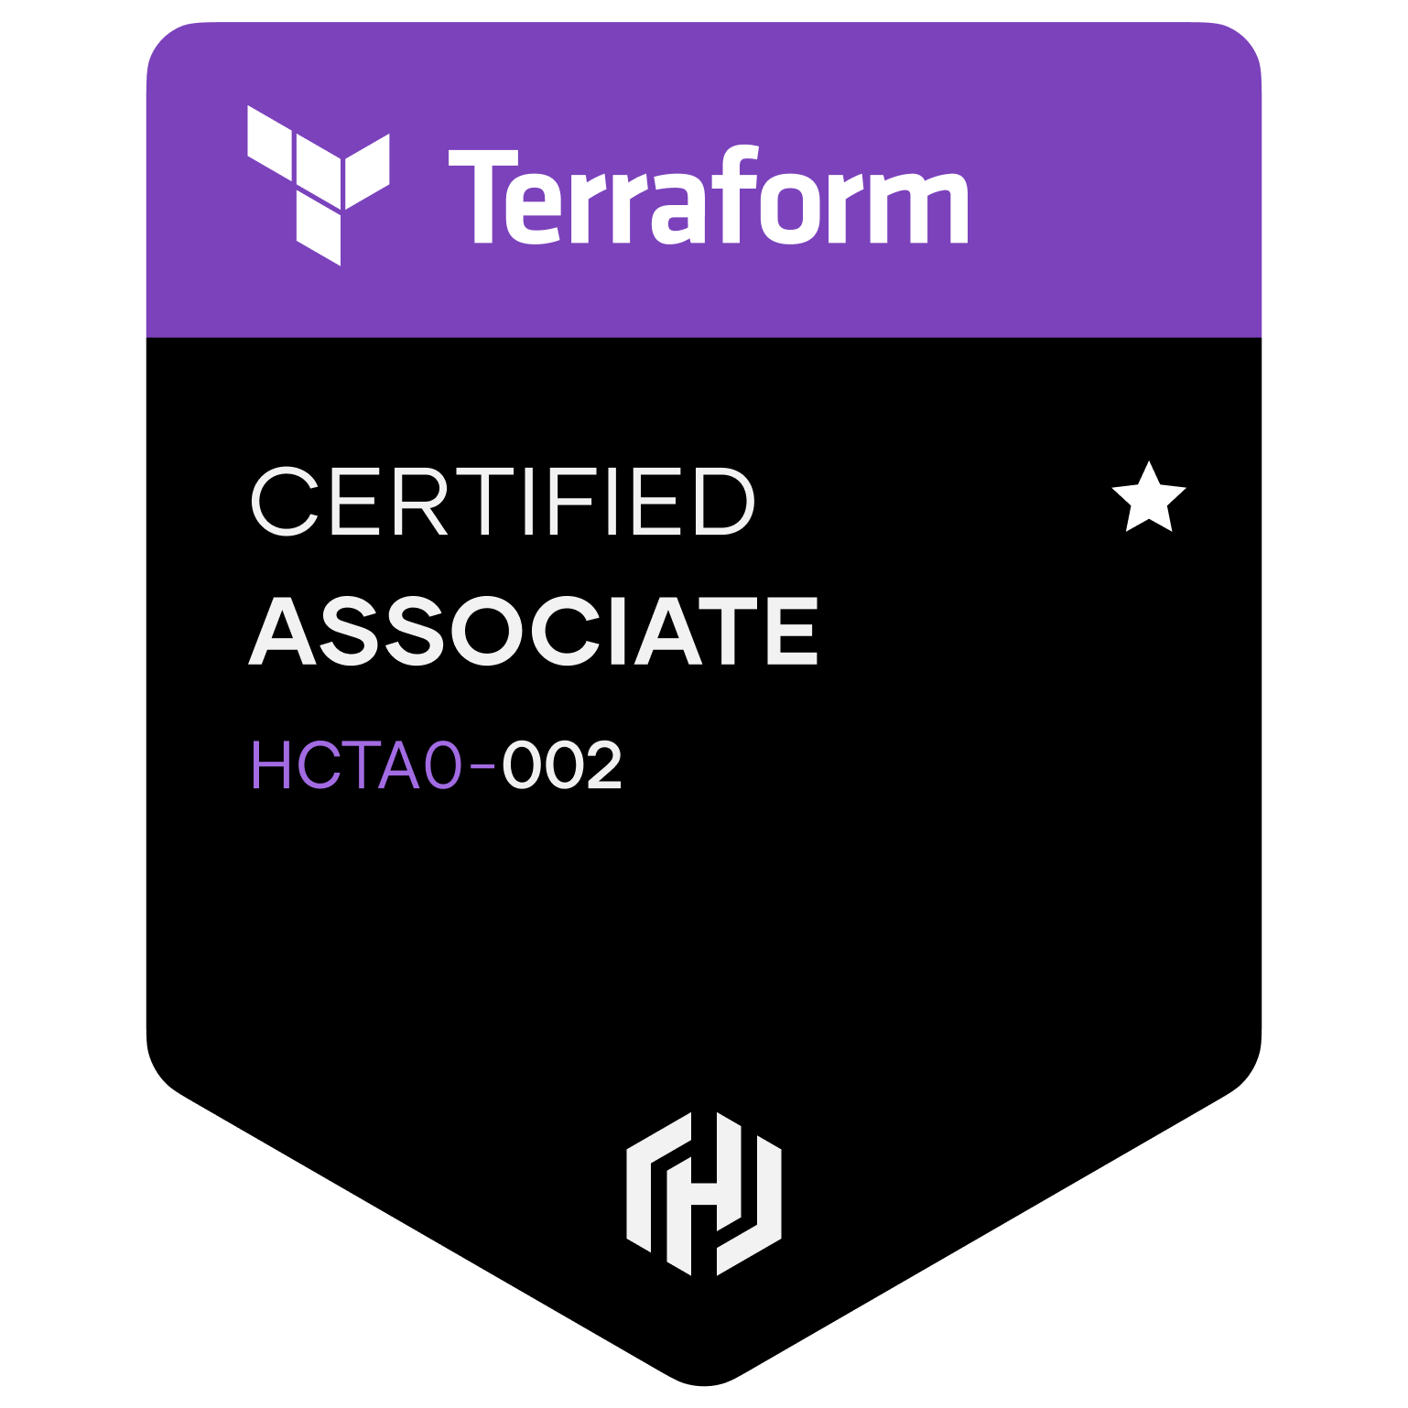
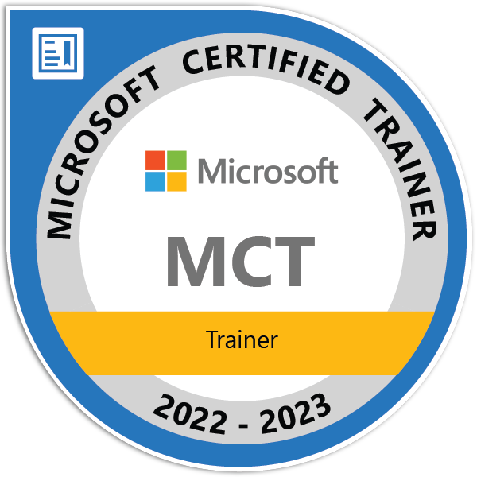

John Folberth
John-Folberth
JFolberth
j_Folberth
John.Folberth@microsoft.com
Concentrates on IaC, DevOps, and Azure
Microsoft Certified Trainer (MCT)
DevOps Advocate
https://blog.johnfolberth.com
Tech reviewer on “Building Application with Azure Resource Manager: Leverage IaC to Vastly Improve the Life Cycle of your Applications”
Spoken at various User Groups and Conferences on topics ranging from Infrastructure as Code, DevOps YAML Pipelines, and modern Data Analytics Platforms
Experience as Lead DevOps engineer on multiple accounts
Served as Tech Lead on a Cloud Center of Excellence team implementing Azure for a health insurance company standing up Web and Data Platforms
https://aka.ms/AzureLoadTestingFeedback

Slide 3
Agenda
What is Azure Load Testing?
Demo Azure Load Testing
How to Include in DevOps processes
Demo CI/CD Pipeline
https://aka.ms/AzureLoadTestingFeedback

Slide 4
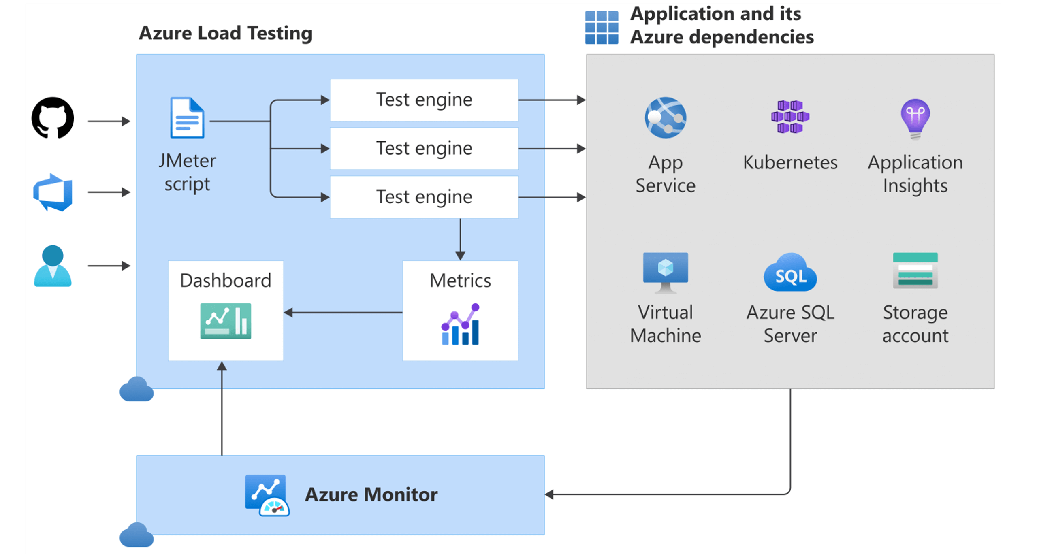
What is Azure Load Testing?
Native Azure Tooling to simulate traffic
Written in JMeter
"JMeter is an open source Java Application designed to load test functional behavior"
Can perform simple stress tests via UI/IaC
Region based Azure Resource
Additional Tooling
Azure DevOps Task
GitHub Action
https://aka.ms/AzureLoadTestingFeedback

Slide 5

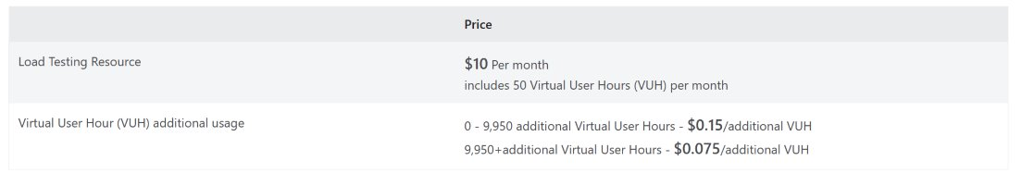
What about the costs?
Base cost per instance
$10 a month
50 "Virtual Testing Hours"
Cost after 50 hours of testing
Will pay for compute consumed
1000 web request
2000 cosmos read/writes
https://aka.ms/AzureLoadTestingFeedback

Slide 6

Demo Time Part 1
Review Test configuration
Run Test
View Source Code
Review Test Results
https://aka.ms/AzureLoadTestingFeedback

Slide 7
How to Include in DevOps processes
Good DevOps Practices
Attempt to have all steps automated
Deployment is idempotent when possible
Infrastructure and App Code deployed together
Reuse deployment steps where you can
Balance of developer empowerment and security/audit controls
This will look different for each organization
https://aka.ms/AzureLoadTestingFeedback

Slide 8
SDLC Overview
Approval Gate
Approval Gate
Separate Resource in separate Resource Group
Scale
Cleaner
Recommend on per environment/ per larger application/ per region test is from
Cost efficient
Unless desired recommend only tst environment
ADO needs RBAC role Test Contributor Role
Install Azure Load Testing task in ADO
Build
Dev
Tst
Load Test
Prod
https://aka.ms/AzureLoadTestingFeedback

Slide 9
Updates for Modern DevOps Practices
Convert ARM-> Bicep
Leverage YAML Templates
Create Approvals on stages
Changes to solution structure
Include CodeSpace/DevContainer
https://aka.ms/AzureLoadTestingFeedback

Slide 10
Thank You
Please provide feedback!
https://aka.ms/AzureLoadTestingFeedback

