Slide 1
Course Introduction
Expectations, Failure, Fun

Slide 2

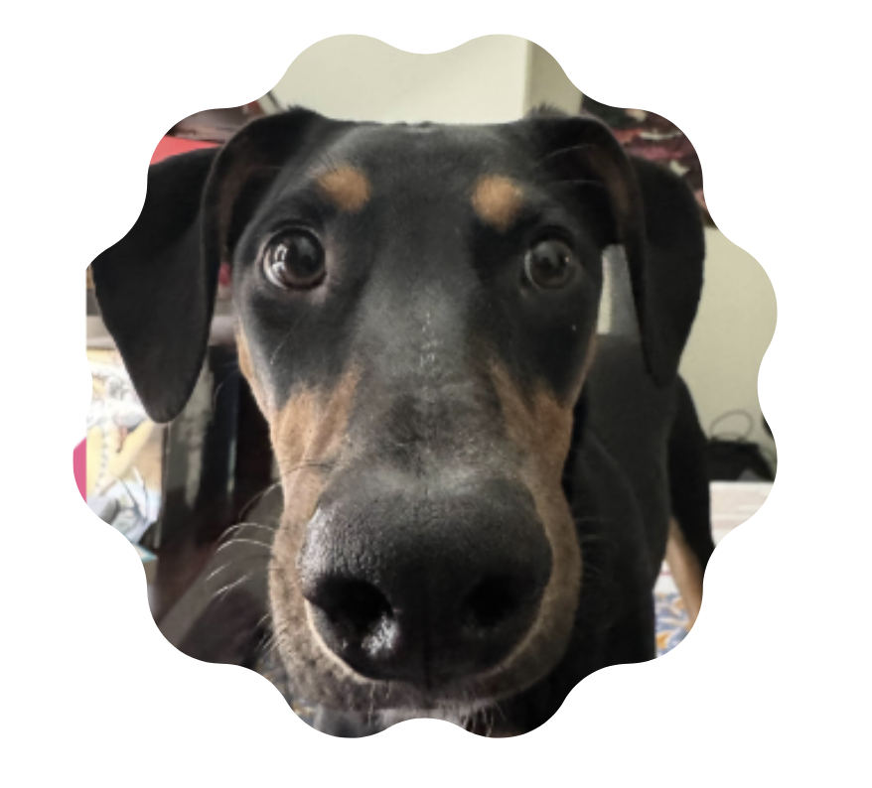
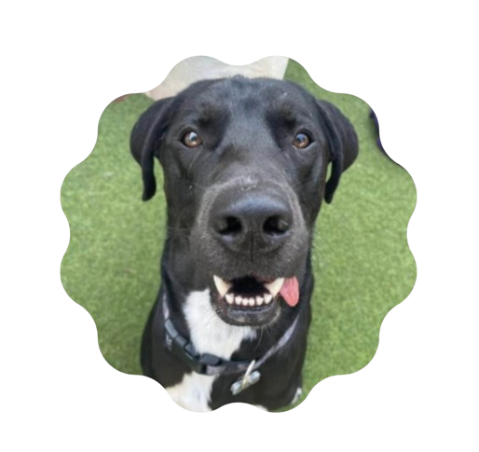
Who Am I?
Jack Forden
Marquette alumni ‘22, -> Graduate Program: ‘25
Focus Areas:
CS-Education, Student Retention, Languages, CS History, OS, Compilers
Outside of Academics
Competitive Games +++
CS2
Tarkov
Chillies aficionado
Favorite things:
FMAB
Wilder Woods(FEVER/Sky, Patience)
Toes in the water
Game Design
Tournament organizing for Broken Arrow
https://www.ba-hub.net/
Extreme couponing

Slide 3
What is this course?

Slide 4
What Does Success in This Course Mean?
Success in this course is not about making money
That would be nice though…
Success in this course is about learning how systems fail
This course’s success metrics:
We build something that executes
We understand why we failed in the past
We learn the methodology
Data cleaning and feature engineering
Signal processing concepts
System design thinking
Risk management basics
You leave this course knowing exactly why get rich quick schemes don’t work
Well…because we are going to build one

Slide 5
Why Trading is Hard
Everything works against you
Speed
HFT firms spend millions to save milliseconds
Our systems are going to take seconds or longer
Information Asymmetry
The price we see is a memory, not reality
Order books constantly shift and move
The Noise Problem
Our brain wants to see patterns that don’t exist
Random walks look like trends
Psychology
We will watch our money evaporate in real-time
Every red bar feels personal

Slide 6
Why Automation Fails Faster
Automation doesn’t fix problems – it amplifies them
Human Trading Failures
Emotional Decisions
Second Guessing
Fatigue
Automated Trading Failure Modes
Bad Logic
No emotional circuit breaker
Ride losses to zero
Perfect Consistency
Wrong at high speeds

Slide 7
What is Finance in this course?

Slide 8
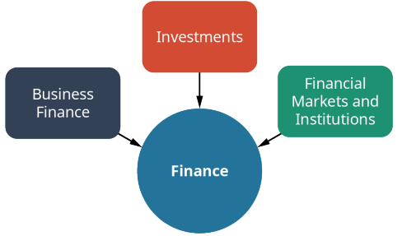
What is Finance as a whole?
Finance
The study of the management, movement, and raising of money
The study of understanding the uses and sources of cash, as well as the concept of a risk-reward trade-off
Finance is a tool that can help us be better decision makers
Finance is divided into three primary areas in the domestic market
Business finance
Investments
Financial markets and institutions
Notes:
https://assets.openstax.org/oscms-prodcms/media/documents/PrinciplesofFinance-WEB.pdf

Slide 9
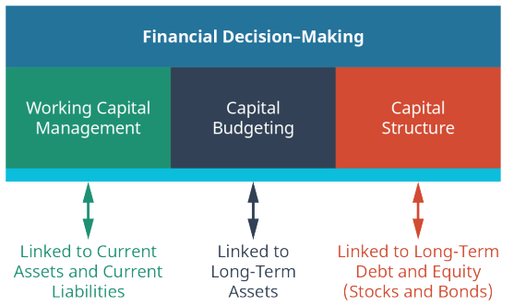
What is Finance: Business Finance
Business Finance looks at how managers can apply financial principles to maximize the value of a firm in a risky environment
In the case of corporations, shareholders own the company who hire managers to run the company with the intent to maximize shareholder wealth
How does this decision impact the wealth of the shareholders
In business finance, managers focus on three broad areas
1. Working Capital Management is the study and management of short-term assets and liabilities
The CFO and finance team set company policy on how to manage WCM
Determines credit policy, establishes minimum criteria for extension of credit, terms of lending, etc.

Slide 10
What is Finance: Business Finance
2. Capital budgeting is the process of determining which long-term or fixed assets to acquire in an effort to maximize shareholder value.
Decisions ideally add the greatest value to a firm
Estimating the value of potential investments by forecasting the size, timing, and risk of cash flows associated with the investments
Finance departments develop and compile cash flow estimates to develop a portfolio of investment projects that maximize the value of the firm
3. Capital structure is the process by which managers focus more specifically on long-term debt and increasing shareholder wealth.
Capital structure questions require financial managers to work with economists, lenders, underwriters, investment bankers, and other sources of external financial information and financial capital

Slide 11
What is Finance: Investments
Investments are products and processes used to create and grow wealth
Application of the different types of financial instruments, delivery vehicles, regulation, and risk-and-return opportunities
Stocks, bonds, derivative securities(futures and options)
Investments also include mutual funds, exchange-traded funds(ETFs), and investment vehicles such as
401k, 403b, Roth, IRA’s
Real Assets such as Gold, real estate, and commodities are also common investment opportunities

Slide 12
What is Finance: Financial Markets and Institutions
Financial Markets and Institutions are the firms and regulatory agencies that oversee our financial system
There is significant overlap with the prior two categories of finance
A firm that is involved in profit seeking ultimately requires good financial management
Much of the US regulatory structure for financial markets and institutions developed in the 1930’s as a response to the stock market crash of 1929 and the subsequent great depression.
In the US, the desire for safety and protection of investors and the financial industry led to the development of
Security and Exchange Commission
Formed from the Securities Act of 1933 and 1934
Major bank regulation in 1933 and 1935 gave rise to government backed bank deposit insurance(FDIC)
These regulatory acts separated investment banking from commercial banking.

Slide 13
Why Study Finance?
Finance is the lubricant that keeps our economy running smoothly
There are many career opportunities in the field of finance
BLS predicts that close to an additional 500,000 new finance and accounting related jobs will be created by 2029
Traditional Financial Roles:
Financial Manager, Investment relations associate, budget analysist, credit analyst, finance analyst, personal financial advisor, loan officer, insurance underwriter, financial examiner, finance professor
Immerging Financial Roles
Digital Transformation Analyst, regulatory technology specialist, Cryptocurrency & Digital Asset Strategist, AI‑Driven Financial Risk Modeler, FinTech Product Manager, Blockchain & Smart‑Contract Auditor, Real‑Time Financial Data Analyst
Notes:
2. Digital Transformation Analyst
Guides financial institutions through modernization using AI, automation, and blockchain to redesign processes and drive efficiency.
3. RegTech (Regulatory Technology) Specialist
Builds and manages automated compliance systems that monitor transactions, flag risks, and ensure alignment with fast‑changing regulations.
4. Cryptocurrency & Digital Asset Strategist
Focuses on blockchain‑based financial products, digital asset valuation, token regulation strategy, and risk analysis. [linkedin.com]
5. AI‑Driven Financial Risk Modeler
Develops ML‑based models to predict credit risk, market volatility, and stress‑test scenarios for financial institutions. [forbes.com]
6. FinTech Product Manager
Oversees financial technology products such as digital banking apps, embedded finance tools, and payment platforms. [linkedin.com]
7. Blockchain & Smart‑Contract Auditor
Examines smart‑contract code, evaluates tokenized assets, and ensures security/compliance in decentralized financial systems. [stcusa.com]
8. Real‑Time Financial Data Analyst
Leverages cloud‑based platforms and AI dashboards to provide instant financial insights for decision‑making.

Slide 14
Why Study Finance?
A career in finance is just one reason to study finance
Finance is an excellent decision making tool
Analytical thinking
Life and asset planning
An understanding of finance and financial markets opens a broader world of available financial investment opportunities
It also helps us plan our lives
understand how to make smarter decisions

Slide 15
Finance as Coordination Under Uncertainty
Finance is how societies coordinate decisions about scarce resources

Slide 16
Risk in Finance
Finance tells us that an increase in risk results in an increase in expected return
Risk at its most basic level is uncertainty
The study of finance attempts to quantify risk in a way that helps individuals and organizations assess an appropriate trade-off for risk
Risk-Return tradeoffs are all around us in our everyday decision-making
Jaywalk or walk down to the crosswalk
Accept the first job offer after graduation or hold out for the offer you really want?
A better understanding of finance makes these types of decisions easier

Slide 17
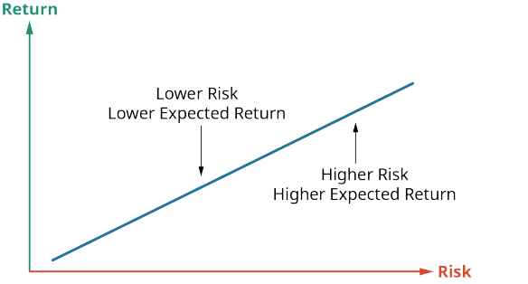
Return in Finance
Return is compensation for making an investment and waiting for the benefit
Interest earned on an investment in a bond
Dividend from the purchase of a stock
Higher income received and greater job satisfaction from a degree
Investors would not be satisfied if the average return on stocks and bonds were the same as that for a risk-free savings account
Stocks and bonds have a higher risk, thus investors expect a greater average return
The study of finance provides us with the tools to make better and more consistent assessments of the risk-return tradeoff in all decision making
Portfolios of investment securities tend to demonstrate the characteristics of a normal return distribution
There are many types of risk: default, inflation, diversifiable, political
The study of finance helps us better navigate and plan

Slide 18
Risk vs Return
This semester is fraught with risk
The technologies we are going to engage with are experimental and often untested for the type of work we are trying to do
No textbooks
No resources
All exploration
The Risk
Demo’s don’t work as we expect
The technology isn’t as robust or able to produce the type of results we may hope
It doesn’t work :/
The Reward
We get super rich and it works super well (not going to happen)
We learn about our rapidly evolving digital landscape(Agentic Systems)
We learn fundamentals about trading (basics and quantitative methods)
We learn the methodologies (data cleaning, financial analysis, statistical methods)

Slide 19
Who is in the Market
What do we even mean when we talk about the “Market”

Slide 20
The “Market”
Our environment for this semester is complex
The market is essentially the intersection where buyers and sellers congregate to trade assets
A market can be a store, Facebook marketplace, or in our case security exchanges
This course is going to view the market as a high-dimensional, real-time data environment
Every “tick” will represent a decision made
By a human, agent, or hybrid
The simplistic view of our environment is purely the security exchanges(NYSE, NASDAQ)
This view undercuts the players that drive the markets
They players have a direct impact on the environment we are trying to understand
Players
Institutional/market makers - Dealers
Provides the pipes, execute trades, report data
Brokers
Those that enable trades in markets to happen, match buyers and sellers
Speculators(us)
Retail investors
Quants who seek returns through pattern recognition
Students who want to learn

Slide 21
The “Market” and it’s many Participants
Primary market is for new securities
New shares are issues when a firm first enters the stock market via IPO(initial public offering)
Once the initial purchasing happens, these purchasers may then trade them
Secondary market is for used securities
The stock market largely deals with used securities
Stock markets trade equity securities daily
Most of this takes place among individual and institutional investors who own shares in publicly traded companies
These trades have little effect on the firm itself; however, the information provide by transactions is costly
Real time statement by investors of the firm's perceptions
Companies are responsible for monitoring and publishing billions of trades across multiple markets
Every second hundreds of thousands of trades are executed

Slide 22
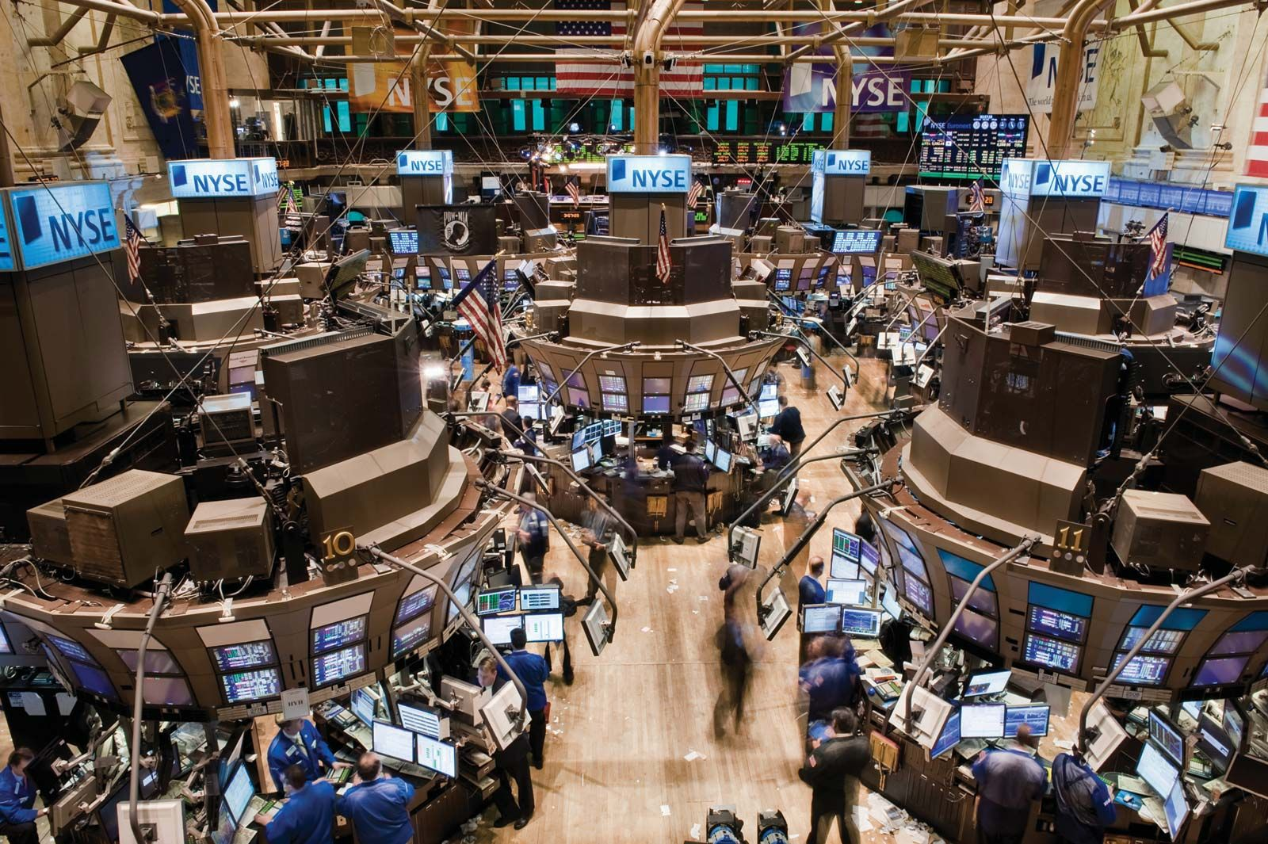
The Major Players: NYSE and NASDAQ
NYSE(New York Stock Exchange)
Founded in 1792 the NYSE is the worlds largest stock exchange
Designated Market Makers act as auctioneers to ensure fair trade
Hybrid approach
NYSE is one of the few remaining trading floors where humans are still actively trading in person
Traditionally home to "Blue Chip" industrial giants like Coca-Cola or Ford.
NASDAQ(National Association of Securities Dealers)
Founded in 1971 as the first fully electronic stock market
No physical trading floor
Known for high-growth tech companies like Apple, Microsoft, and Google
Both of these markets allow companies to go public and raise money for growth by selling shares to investors
Who then can trade the shares
They NYSE and NASDAQ are often reflectors of the overall health and sentiment of the global economy
Notes:
https://www.youtube.com/watch?v=i6MQxJz3t2Y

Slide 23
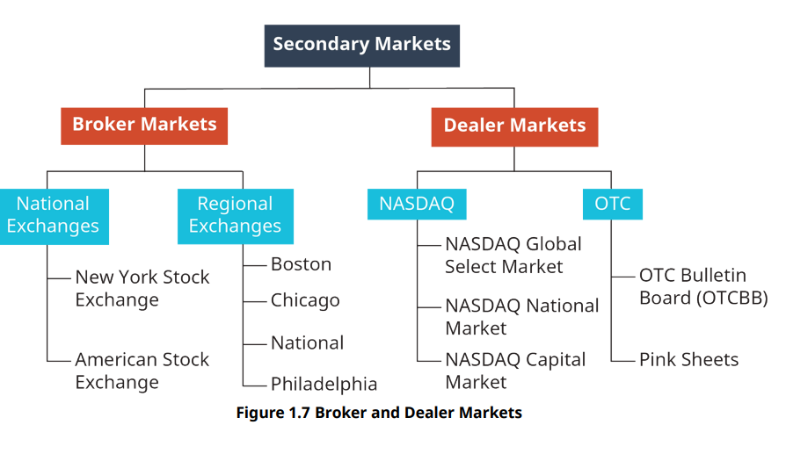
Key Market Players
Dealers
Own the securities that they buy or sell. When a dealer engages in a financial transaction, they are trading from their own portfolio.
Dealers do not participate in the market in the same manner as an individual or institutional investor
Dealers do not try to make money by ensuring their investments are worth as much as possible. Instead, dealers attempt to “make markets”
They are willing and able to buy and sell at the current bid and ask price
Dealers make money from the volume of trading and the spread between their bid price(what they are willing to pay) and their ask price(price they are willing to sell)
Let’s look at how this works in practice

Slide 24

Market Maker – Citadel Securities
When you sell a stock, you are typically not selling to another retail investor
If you use a brokerage app to sell a share of Apple stock, you usually aren't selling it directly to another person. You are selling it to a dealer like Citadel.
Citadel buys at your asking price, then immediately tries to sell it to someone else at a slightly higher price to capture the spread
Spread: the movement of a stocks price from buy to sell price – will go over in more detail in our next lecture
Citadel
#1 in retail market making with ~35% of US listed retail volume through the platform
645 billion in trades executed daily
Citadel might offer to buy a stock at $100.00 and they might sell it at $100.01
When you execute billions of trades a day, it adds up

Slide 25
Brokers
Brokers act as facilitators in a market
They bring together buyers and sellers for a transaction
Brokers typically act on commission from a sale of an asset
Brokers are required for clients because security exchanges require membership in the exchange to accept orders
A seat on an exchange last sold for 3.7 million
Seats have been absolved to now revolve around monthly membership fees at about $7,200 per year
Discount brokers are increasingly more popular
Discount brokers execute trades for clients while offering very low or no commission on many of their trade executions
Robin hood
Gives the trade to citadel(who pays them)
How does this work in practice?

Slide 26
Dealers and Brokers
Steps and how each company makes money
1. I want to sell 1 share of a company for $50.00, this is the bid price
2. I click sell !
3. Robinhood’s algorithm sees that Citadel Securities is offering the best deal right now, so we ping citadels servers
4. By law, Citadel must give you the "Best Execution." If the public exchange (NYSE) is buying at $50.00, Citadel might actually buy it from you for $50.01
Why? To keep Robinhood happy and keep the regulators off their back, they often give you a slightly better price than the "official" one. You just made an extra penny.
5. Citadel now owns your share for $50.01. They immediately (in microseconds) try to sell it to a buyer for $50.02.
They keep the $0.01 spread as their "fee" for taking the risk of holding that share.
6. Citadel then sends a tiny fraction of a cent (e.g., $0.001) back to Robinhood as a "thank you" for sending them that trade.
This happens for every trade, that’s every transaction, billions of times a day

Slide 27
Financial Intermediaries
Commercial banks or mutual fund investment companies
Act as an intermediary to enable easier and more efficient exchanges among transacting parties
A commercial bank accepts deposits from savers and investors and creates loans for borrowers
An investment company pools funds from investors to inexpensively purchase and manage portfolios of stock and bonds
This is noticeably different from brokers and dealers selling their own portfolios
Financial intermediaries may accept money from investors and may create a completely different security all together
We will discuss mutual funds in greater depth next week
Large institutions can spread fixed costs (like technology, regulatory compliance, and staff salaries) over millions of customers, making services cheaper for everyone.

Slide 28
Market Players, Managers, and you
Changes in the environment are felt by all players in a market
Brokers, Dealers, Financial Intermediaries, and retail investors
Throughout this semester we are going to try to quantify the scale of change
How particular actions reverberate and branch out into the industry
inaction, rumor, sentiment
We are going to try to observe, identify, predict causality, and ultimately – trade
When considering what can change in a market it’s important to understand the economic foundations that companies and retail investors focus on when trying to identify the correct risk/reward ratio
Understanding Risk takes two approaches
A wider approach of the entire environment
A more specific analysis of the individual security in the environment
This course must focus on both approaches
Let’s learn about them in a bit more detail

Slide 29
From Finance to Systems

Slide 30
From Finance to Systems
Moving from Static Balance sheets to dynamic data streams
Ticks as events

Slide 31
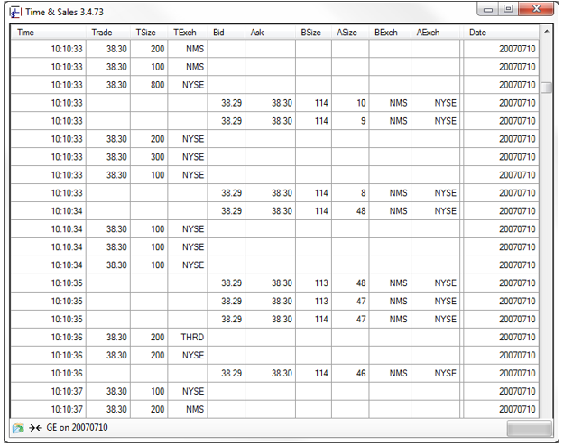
Tick Data
The following information is associated with a trade
Stock or contract symbol, price, size(number of shares), Market Exchange(where the trade occurred) and a Timestamp
An individual trade is referred to as a tick
Tick data is a stream of trades that may occur while the market is open
Ex: a series of trades for GE:
During any particular day, there may be thousands if not millions of trades for a particular financial symbol

Slide 33
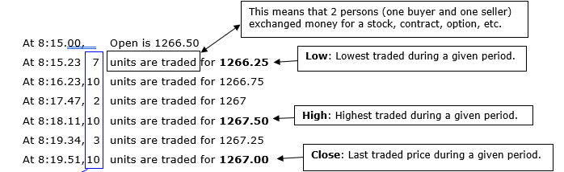
Tick Data
There is a trade at 8:14.59 AM at the price of 1266.50. The following tick data represents a set of trades from 8:15.01 to 8:20 AM:
The Volume refers to the total number units traded during this period. A unit may be a share of stock, a contract, an option, etc.
During the 5 minute period, 7+10+2+10+3+10 or 42 units were traded.
So during the 8:15.01 to 8:20 AM period the opening price was 1266.50, the highest traded price was 1267.50, the lowest traded price was 1266.25, and the last traded price was 1267.00. There were 42 units traded during this period.
Notes:
These results are converted to a single row which contains the Open, High, Low, Close, Volume, Data, and Time values.
Thus, it is possible to collapse dozens, if not hundreds, of tick data rows into one single OHLCV row.

Slide 34
The Anatomy of a Market Event
We look at prices on google for a particular stock and often, we read a lie
We see that NVDA is trading at $150.00
The truth is, this is a gravestone
It marks where it last traded
This is no guarantee of future trade price
Who
Buyer/seller
What
Agreement on price, disagreement on value
Where
Some exchange
When
Microsecond timestamp
Why?
Unknown, but we can infer: momentum? News? Fat finger? Algorithm?

Slide 35
AI Orchestration frameworks

Slide 36
AI Orchestration Frameworks
Imagine you are running a tournament
You need a system that keeps track of all of the players, the rules, the tools people use, etc
An orchestration framework is like your tournament organizer
It makes sure every agent knows their job and communicates with others then things change
Why does this matter?
Without orchestration
Agents might duplicate work
Miss important steps
Work against each other
The framework connects agents to the right data, tools, and APIs
Helps agents remember that happened before
Learn from past mistakes

Slide 37
N8N
N8N is an AI Orchestration framework that enables multiple different workflow creations
Why do I like it?
It’s free
We can locally host it
We can also use the education discount
Unlike other solutions, it allows us to build multiple agents together
N8N allows us to build
Work flows
Chat flows
Chatbots
Agents
Text generators
Let’s see what this looks like
Let’s setup our accounts

Slide 38
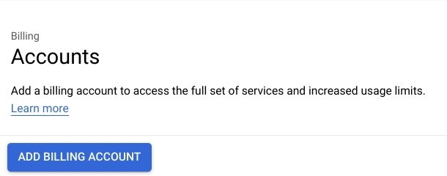
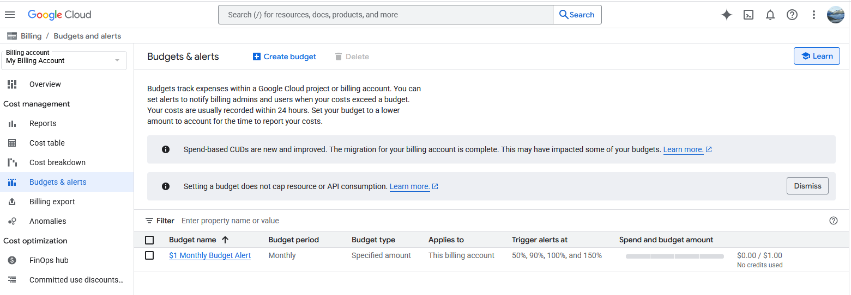
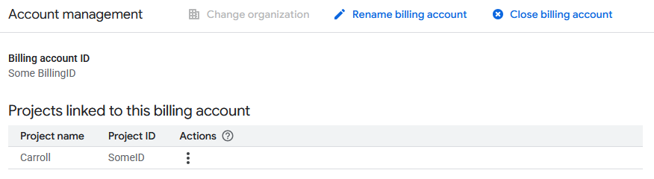
Setting up N8N: Part 1
Setting up a Google Cloud Compute profile
We need to create a Virtual Machine that we can use to host our N8N server
1. Click here
2. Set up a billing account
The first step is to create a billing account. Google requires this in the case we go over the free tier threshold, but fear not, we will take steps to avoid charges.
To do this, there is a pane on the left labeled Billing, we simply click on add billing account
Select your billing account which will navigate you to a budget overview pane, you can then select budgets and alerts, then create budget following the steps to set up a $1 budget alert

Slide 39
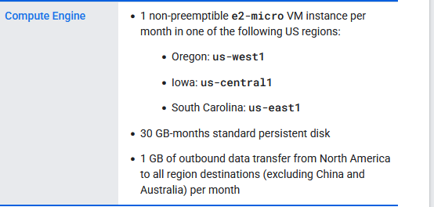
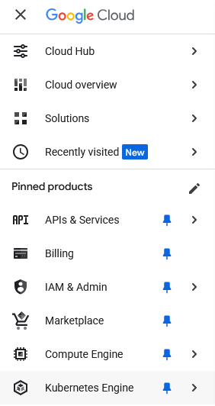
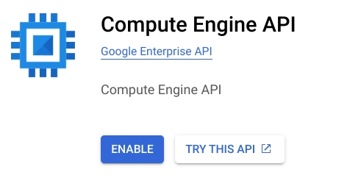
Setting up N8N part 2
Setting up a GC Virtual Machine
To remain in the free tier, google gives us exact specifications on what constitutes a free VM. please review the requirements before preceding.
Select the navigation view located on the top left, select Compute Engine. Then simply click enable
Notes:
note on firefox, it sometimes does not render unless you use the direct link

Slide 40
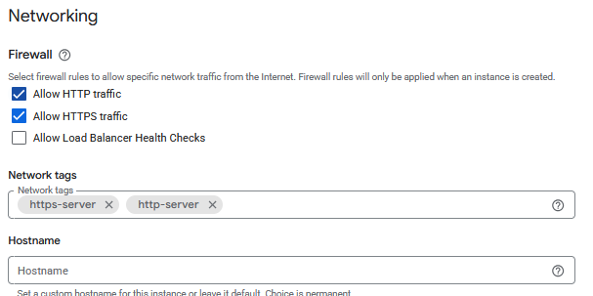
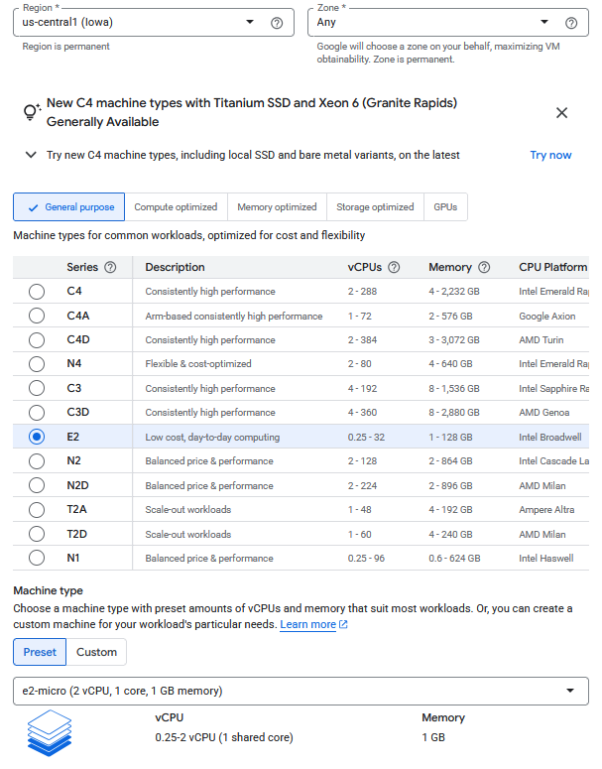
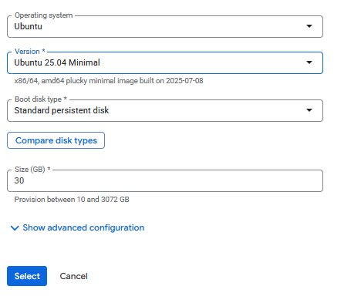
Setting up N8N part 2
Notes:
https://docs.cloud.google.com/free/docs/free-cloud-features#compute

Slide 41
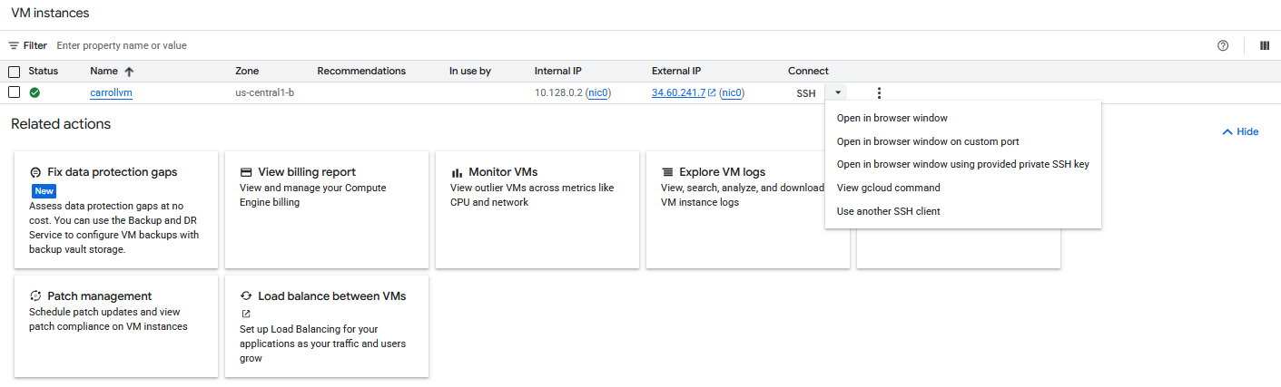
Accessing the VM

Slide 42
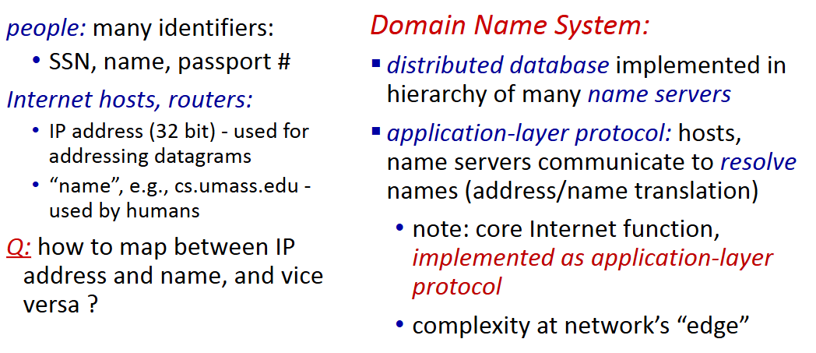
Generating a DNS name for our VM
DNS: Domain Name System

Slide 43
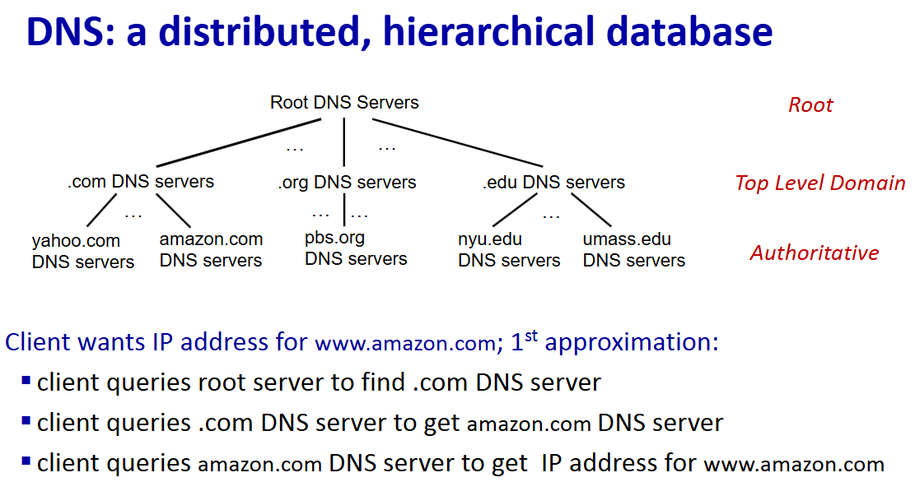

Slide 44
Inserting a Record into a DNS
Our goal is to register some domain name with a DNS registrar
We can do this for free using
https://www.noip.com/
The hostname does not matter much
Feel free to name it whatever you want!
The IPv4 should be the IP address of your machine
How do we find this?

Slide 45

Finding our machines IP Address
Two main ways
1. We can use google's UI
BOOO BOOO
2. We can use curl
Curl ifconfig.me
Let’s see how this is done!

Slide 46
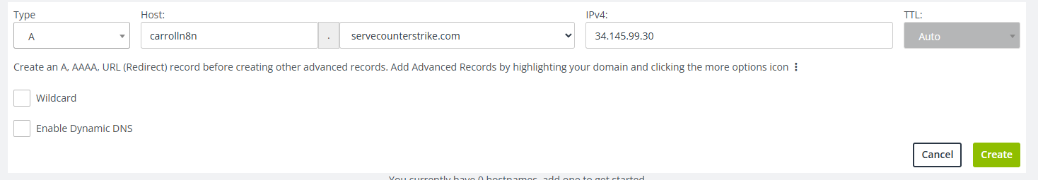
A valid DNS entry should look something like this

Slide 47
Installing N8N
Full Guide found on canvas

Slide 48
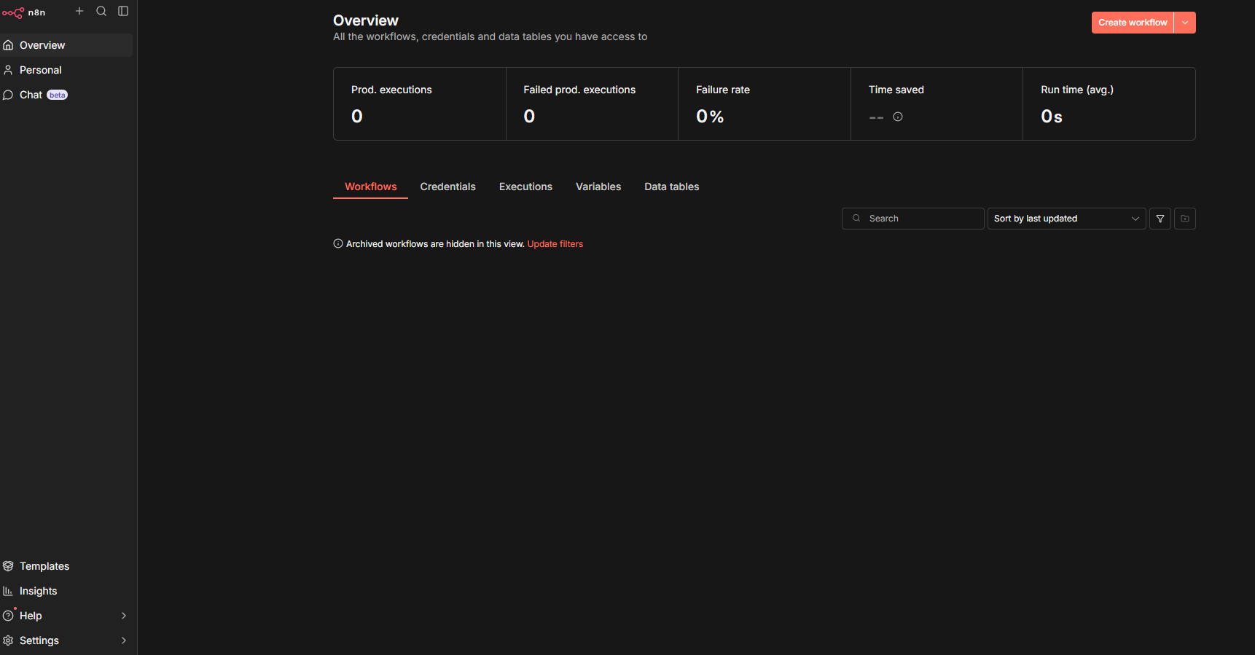
Understanding N8N’s Layout
Notes:
The Canvas is our *workstation*. It allows us to visualize and arrange our individual **nodes**.

Slide 49
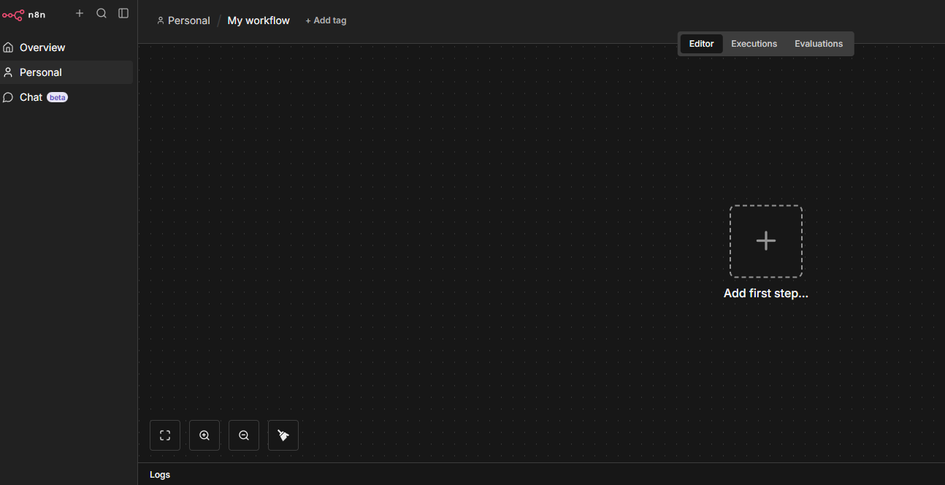
Understanding the Canvas
Select “Create Workflow”
Let’s walk through this canvas starting with our left panel first

Slide 50
Left Side Panel
On the left side of the Editor UI, there is a panel which contains the core functionalities and settings for managing your workflows. Expand and collapse it by selecting the small arrow icon.
Overview: Contains all the workflows, credentials, and executions you have access to. During this course, create new workflows here.
Personal: Every user gets a default personal project. If you don’t create a custom project, your workflows and credentials are stored here.
Projects: Projects let you group workflows and credentials together. You can assign roles to users in a project to control what they can do. Projects aren’t available on the Community edition.
Admin Panel: n8n Cloud only. Access your n8n instance usage, billing, and version settings.
Templates: A collection of pre-made workflows. Great place to get started with common use cases.
Variables: Used to store and access fixed data across your workflows. This feature is available on the Pro and Enterprise Plans.
Insights: Provides analytics and insights about your workflows.
Help: Contains resources around n8n product and community.
What’s New: Shows the latest product updates and features.

Slide 51
Top Bar
Workflow Name: By default, n8n names a new workflow as "My workflow", but you can edit the name at any time.
+ Add Tag: Tags help you organize your workflows by category, use case, or whatever is relevant for you. Tags are optional.
Publish: This button publishes the current workflow. By default, workflows are not published.
Share: You can share and collaborate with others on workflows on the Starter, Pro, and Enterprise plans.
Save: This button saves the current workflow.
History: Once you save your workflow, you can view previous versions here.

Slide 52
Canvas
The canvas is the gray dotted grid background in the Editor UI. It displays several icons and a node with different functionalities:
Buttons to zoom the canvas to fit the screen, zoom in or out of the canvas, reset zoom, and tidy up the nodes on screen.
A button to Execute workflow once you add your first node. When you click on it, n8n executes all nodes on the canvas in sequence.
A button with a + sign inside. This button opens the nodes panel.
A button with a note icon inside. This button adds a sticky note to the canvas (visible when hovering on the top right + icon).
A dotted square with the text "Add first step." This is where you add your first node.

Slide 53
Nodes
In graph theory, a node represents a specific point in a network where data is processed.
You can think of a node as a station on an assembly line. At each station, a worker (or machine) performs a specific task, pausing to inspect, modifying the product, or passing it quickly to the next stage.
In n8n, nodes are the functional units that give our system power.
It is through the strategic arrangement of these nodes that we transform our ideas into agentic systems.
Based on their function, n8n classifies nodes into four types:
App or Action Nodes
Trigger Nodes
Core Nodes
Cluster Nodes
You can open the node panel:
Click the + icon in the top right corner of the canvas.
Click the Tab key on your keyboard.
Notes:
App or Action Nodes add, remove, and edit data; request and send external data; and trigger events in other systems. Refer to the Action nodes library for a full list of these nodes.
Trigger Nodes start a workflow and supply the initial data. Refer to the Trigger nodes library for a list of trigger nodes.
Core Nodes can be trigger or app nodes. Whereas most nodes connect to a specific external service, core nodes provide functionality such as logic, scheduling, or generic API calls. Refer to the Core Nodes library for a full list of core nodes.
Cluster Nodes are node groups that work together to provide functionality in a workflow, primarily for AI workflows. Refer to Cluster nodes for more information.

Slide 54
Executing a node or workflow
Node buttons
If you hover on a node, you'll notice that three icons appear on top:
Execute the node (Play icon)
Deactivate/Activate the node (Power icon)
Delete the node (Trash icon)

Slide 55
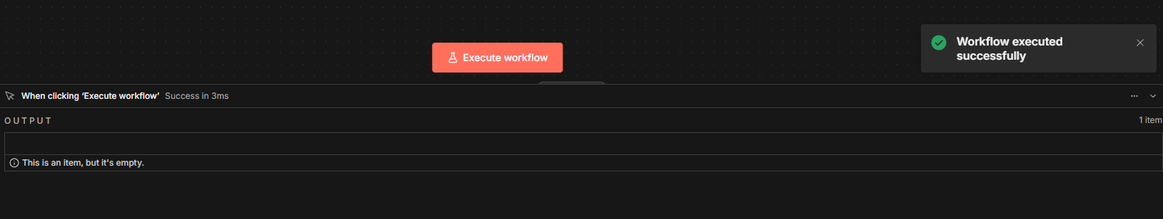

Slide 56
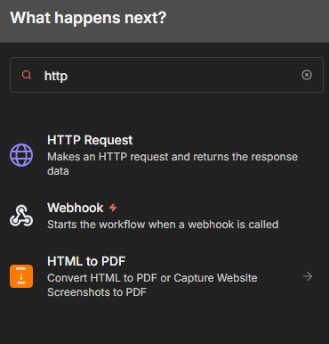
HTTP Node Request
Press “tab” or click the plus icon to open the node panel
Search for HTTP Request
HTTP Requests: Fundamental web protocol for asking servers for data.
When you type a URL into your browser, you are essentially sending a request to a server asking for information.

Slide 57
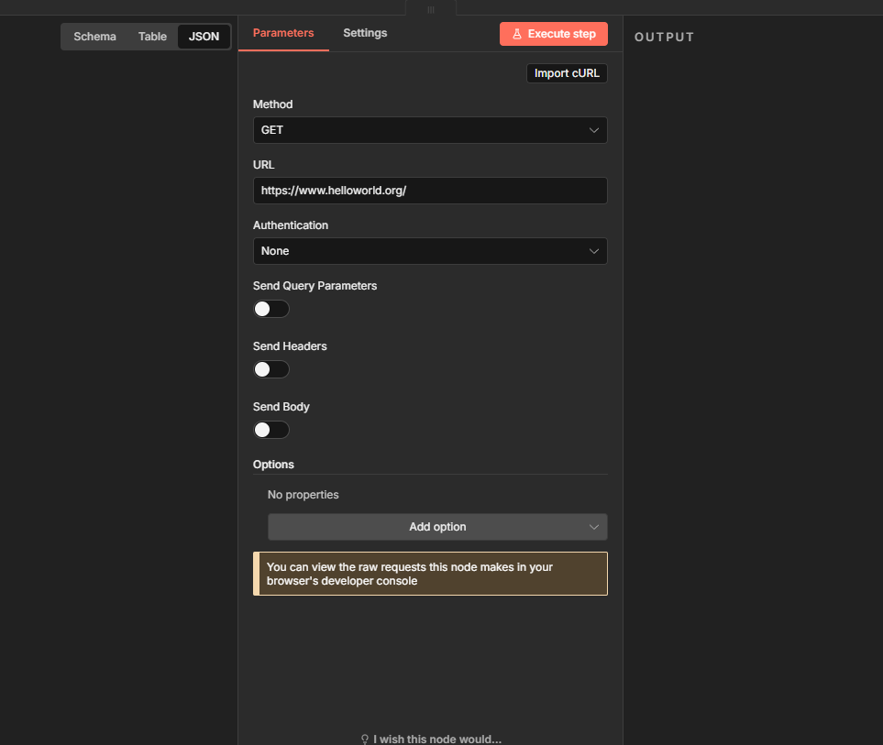
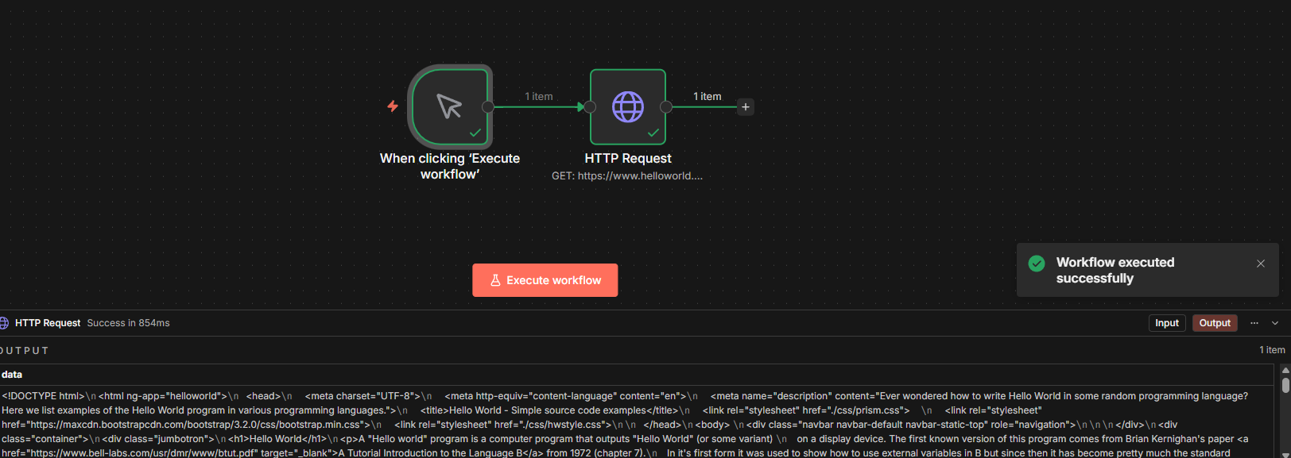
Get Requests
GET Request: Retrieves data without changing the server; most common method.
N8N HTTP Node: Acts like a browser to fetch data for workflows.
HTML Output: Responses come as raw HTML;

Slide 58
Just like that, our first workflow!
Huzzah, we have significantly complicated what was a simple process
Welcome to computer science!
15 hours to automate something you could have done manually in 10 minutes

Slide 59
So now what?
N8N is our orchestration framework
It’s main goal is to simply automate processes
Modern field of Automation Experts
Generally
We want to use N8N, or similar systems, to automate repeatable tasks
Throughout this semester, we are going to use N8N and other tools to try and automate decision and trading principles with a specific focus on the US stock market(maybe crypto, maybe prediction markets)
Warning
We are going to fail
N8N is a new technology
Much of what we are trying to do is experimental.
I want you to experiment. There is no correct answer
Learn, Learn, Learn, Learn, Learn – Try whatever

Slide 60
Our First Experiment
Moving Averages

Slide 61
How do investors make buy and sell decisions?
This is perhaps the golden question of what makes a trader
There are many ways that people make buying and selling decisions
What to buy(or sell)
When to buy(or sell)
It is possible, and more common, to weave these two decisions together into a single model as you analyze buy and sell signals
But first, let’s consider how we might even get the price of a particular security

Slide 62
Alpaca
Paper Trading

Slide 63
Alpaca
Alpaca allows us to execute paper trades
Create an account:
https://app.alpaca.markets/brokerage/new-account

Slide 64
What is an API?
- API: Application Protocol Interface
This is a set of rules and protocols that allows different software programs to communicate with each other and exchange data
It’s the translator that describes how some software X can request specific data from software Y
Ultimately, it is an abstraction, just like N8N is
It abstracts the inner mechanisms
How the data is maintained
How the data is ultimately returned
How the host machine operated
OS, language, etc.
Ask/Response format
If you pose a properly formatted API request, the expectation is you get a response
Code 200
If you pose an incorrect API request, you often get an error code, Each with their own meanings
Code 4xx – client side error(you)
Code 5xx – server error(them)

Slide 65
Using Alpaca’s API to Grab Data
API Reference
https://docs.alpaca.markets/reference/issuetokens
Alpaca allows us to grab historic data over a given set of dates for the provided securities

Slide 66
Let’s Structure our goals
1. Get a given security from a user
2. Identify the correct API route to ping
3. Form our ask request

Slide 67
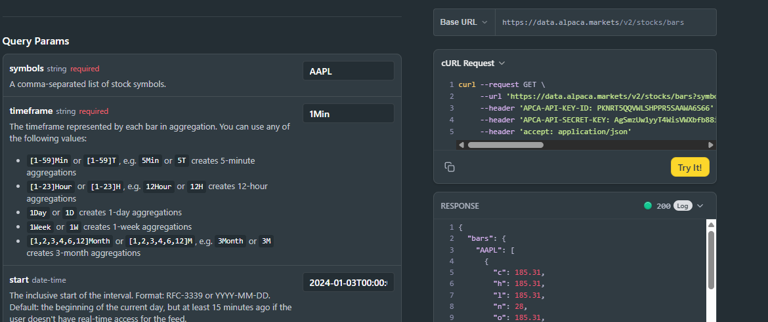
Price of the security
Using Alpaca, we can grab the price, take some time to try and find the correct api endpoint
Alpaca allows us to test a given API which makes placing it into N8N seamless
The C is the security price at the end of the tick
More on the rest next time
We can copy the curl request and import it directly into n8n

Slide 68
Configuring Nodes
Each node may have it’s own unique fields that require editing
Some common themes persist between nodes
When you add a new node to the Editor UI, the node is automatically activated. The node details will open in a window with separate options
Parameters
This is information that we want to pass in to our node
Settings
These typically allow us to control the nodes design and execution flow
Docs
Should we need, we can go to the official n8n documentation to understand more about the node

Slide 69
Parameters
A Parameter is always going to be unique to the specific node and environment we are working in
Our manual input trigger node does not require a parameter
The node docs will often help you understand what the requirements might be
When we import a curl request, these fields are auto filled
They can be manually changed later
We will get to this in a bit

