Slide 1
Fractionally Differentiated Features
Adding a Notion of Memory to a Dataset

Slide 2
Last Time
Our main objective was to remove both the noise and notion of time from our dataset.
This removed values that did not really tell us anything(noise)
This removed a false structure from our dataset, so our model doesn’t accidently believe time is a direct indicator of future performance.
It’s like a child, we don’t want to teach it the wrong lessons
The dollar bars properties are invariant by the change of the origin time
They sample the market at a constant rate of informational arrival(volume/dollars) rather than clock time

Slide 3
Let’s Refocus Our Goal
We want:
Agentic decision making
The ability to act based on the sentiment of the market
Money
(profitable trading)
Everything we have done so far is building the foundations to make that happen
Dollar bars were the first step in this path
To understand our next step, we need to understand how we go from dataset to decision
This happens through a process called supervised learning

Slide 4
Supervised Machine Learning
Supervised learning is a category of machine learning that uses labeled datasets to train algorithms to predict outcomes and recognize patterns.
We provide labeled training sets and hope to learn the relationships between the input and outputs
Inputs: features
Corrected outputs: labels
Algorithms analyze a large dataset of these training pairs to infer what a desired output value would be when asked to make a prediction on new data

Slide 5
The Engine Under the Hood
Pattern Recognition:
Supervised ML is essentially a high-powered version of connect the dots
It looks at our features(dollar bars, RSI, volatility, market cap, whatever we choose to label as a feature) and tries to find a mathematical function that maps them to a label(buy,sell,hold)
Stages
The Training phase
The model looks at thousands of post examples
Every time, it asks: if the price dropped by 2% and volume spiked, what happened next?
The Inference phase
When a model sees the same pattern in live data, it applies the rule it learned from the past to predict the future
In order for this to work, the “rules” of the market must stay relatively consistent
If the environment changes too much, the patterns the model learns from becomes useless
….but wait, isn’t the market all about rapid environment changes?

Slide 6
Memory is Predictive Power
Models need some notion of memory to draw signals of performance from
“Trend is your friend”
This raises a concern with our raw dollar bars
We have a raw series of prices ($150, $153, etc)
Day X in the dollar bar data has zero impact on Day X + 1
If we train a model on prices from 2020 and test in on 2024, the model will fail because the statistical properties(range of values) is completely different
Ultimately the statistical properties (mean, variance) do not change over time. If you train a model on past data, you assume the future looks statistically similar.

Slide 7
Dollar Bars Examined
We lobotomized our data. Dollar bars have zero notion of history
For each bar, the current price P_{t}​ is the sum of all past changes
Consider:
imagine a "Drunk Walker" leaving a bar (the starting price, P₀​)
Every minute he takes one step
He flips a coin to decide: heads -> north, tails-> south
These are our returns or changes
A price is a “cumulative sum”
If we want to know where the walker is 100 minutes after he leaves the bar, you have to add up every single step he took since leaving the bar
Position at Minute 1 = Start + Step 1
Position at Minute 2 = Start + Step 1 + Step 2
Position at Minute 100 = Start + Sum of all 100 Steps
The above logic is how graphs are charted

Slide 8
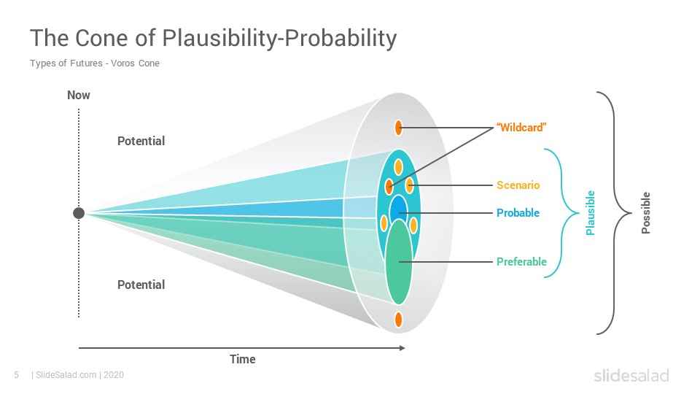
Visualizing the "Spread" of Uncertainty
When the walker takes a single step
The “cloud” of where he might be is tiny
There are only two possible spots(north or south)
Let’s consider
What is the probability of a coin flip?
For our walker, what does that mean?
(mean)If we flip a coin 100 times, 1000 times, 10,000 times
Where do we estimate the most likely place for him to be is?
(tails) What happens to the extremes in this case?

Slide 9
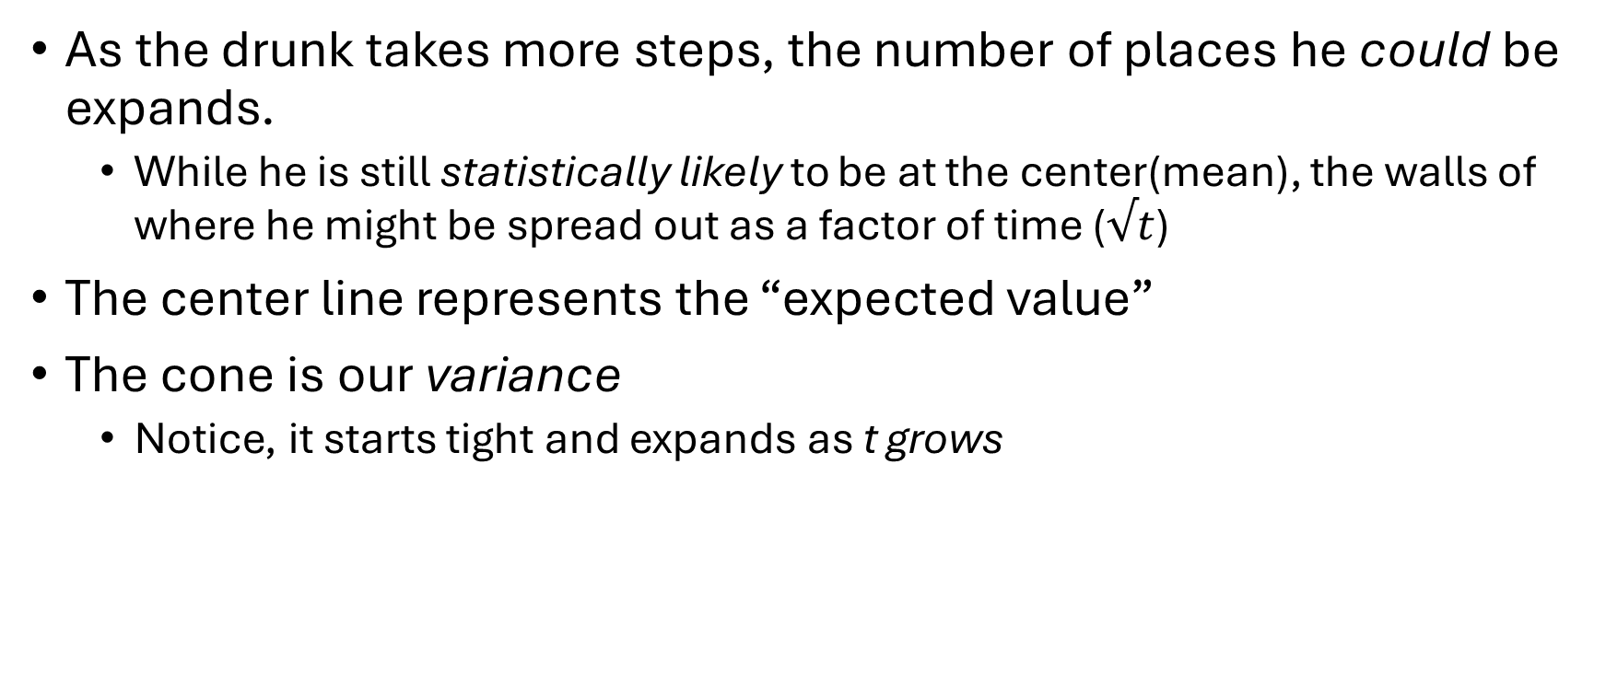
Probability Visualized
As the drunk takes more steps, the number of places he could be expands.
While he is still statistically likely to be at the center(mean), the walls of where he might be spread out as a factor of time ($√t$)
The center line represents the “expected value”
The cone is our variance
Notice, it starts tight and expands as t grows

Slide 10
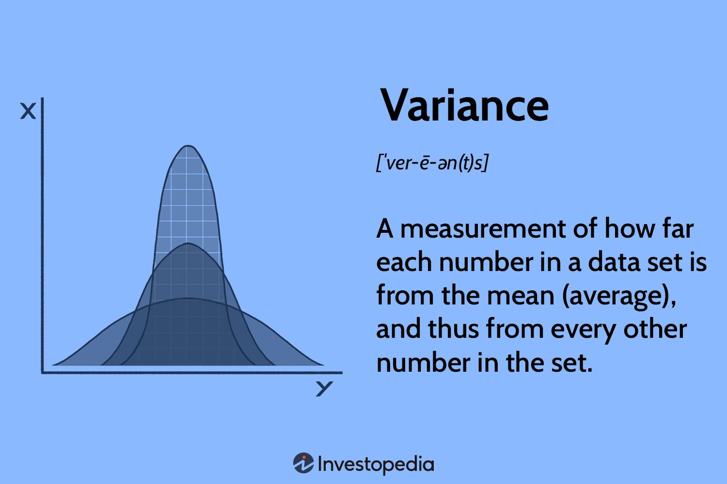
Understanding Variance
Variance measures how far a set of numbers are spread out from their average value(mean)
Each new step is random, it adds a new layer of uncertainty
We add the uncertainty of step 100 on top of the uncertainty of step 99, on top of 98, etc.
Mathematically, if the variance of one step is σ², the variance after t steps is t× σ²
Because the variance equals t × σ², as time (t) goes to infinity, the variance goes to infinity. This presents the wandering problem(infinite variance).

Slide 11
What do the “Math Police” Want?
For Machine learning to work, our model needs to trust our data
We can’t allow this idea of wandering or infinite variance
Does anyone remember what RSI tells us?
Imagine we train an AI to “buy” whenever the RSI is low and the price is $100
In 2004, $100 might be an all-time high (A "Sell" signal)
In 2024, $100 might be a massive crash bottom (A "Buy" signal)
Because the price (the walker) has "wandered" so far from its 2004 starting point, the number 100 no longer means the same thing to the model.
Our goal is to create stationary data, let’s formalize the rules

Slide 12
What makes something Stationary
For a dataset to be considered stationary, we have three rules
1. The average value shouldn’t drift over time
Price Fails: If you look at NVDA in 2015, the average price was maybe $5. In 2024, the average price was $900. The mean has drifted massively
AI get’s completely lost trying to compare the data
2. Constant Variance: The range of the dataset should not expand or contract wildly
Price Fails: When a stock trades at $100, a “big day” might be a $2 move. When a stock trades at $1000, a “big day” is a $20 move.
As price grows, the variance(volatility in dollar terms) grows with it. The technical term for this is heteroscedasticity
3. No Memory (Independence): Knowing yesterdays value shouldn’t automatically tell you todays value
Price Fails: Prices have a long memory. If the price closed at $500 yesterday, your best guess for today is $500. This is heavily dependent on the past.
Requires us to sum every step taken in history

Slide 13
Stationary is Stability
Mean Stability: The "average" shouldn't drift. If your drunk walker is in a hallway, the mean is the center of the hall. It doesn't move.
Variance Stability: The "width" of the possible moves stays the same. The walker doesn't get more erratic the longer he walks.
Covariance Stability: The relationship between two points in time (e.g., today vs. 5 days ago) only depends on the distance between them, not the actual date.

Slide 14

Stationary vs Non-Stationary
Our current reality is dollar bars that are non-stationary
They behave like a drunk walker. If he walks for a million years, he could end up on the other side of the galaxy
We never reset the uncertainty
A shock that happened in 2022 is still included in the price calculations for 2024
This accumulation of history causes the range of possible values to expand indefinitely as time passes
Our goal is to create Stationary Data
We allow the data to move around, but the variance is limited to staying closer to the mean
It’s like putting the drunk guy in a child leash as we lead him home.

Slide 15
Data Cleaning Continued
Our goal is once again to transition this data into more useable information through a process known as data cleaning
Reminder
Data is raw, chaotic, messy
Information is refined signals that a model can use to make a decision
We have gone through two layers of filtering so far
Ticks -> OHCVL -> Dollar bars
All assets on NASDAQ + NYSE -> top 1000
We need another layer
We want to transform our data into a state that satisfies the “math police” without losing the story the market is telling us

Slide 16
Cleaning Data for a "Reasonable" Model
Imagine you are training an AI to control a Smart Thermostat
The Raw Data (Non-Stationary):
The raw sensor reading is 72(F)
What is the context(the external environment)?
The cost of combating Drift
Imagine the outside temperature is 110.
If you only look at the room temperature, the data looks "fine." It looks stable.
In reality the AC might be ready to blow a fuse because it’s under immense pressure
Our AC unit struggles because it is fighting an unbounded process using a bounded tool
This ability to combat drift is incredibly important
If a stock stays at $150 for two years, while the rest of the market crashes around it
This isn’t sideways data, it’s an incredible signal of stability and strength
In non-stationary systems, the "absolute value" (Price or Temperature) hides the true story.
We clean the data so the model can see the relative struggle, not just the final number.

Slide 17
The Drunk Walker in a New Suit
He looks better, he's moving more logically based, but he's still drunk
We have removed the clock time noise
We are now sampling based on economic activity
But…the result is still a series of absolute prices
The lingering problem
Even if the walker only takes a step at a time, he’s still drunk!
Our cleaned dollar bars tell the model: “the price is $150!”
The model asks: “is that expensive?”
Reimagining:
We need to stop looking at the dollar bar as the destination(price)
We need to start looking at it as the Signal(change) that remembers it’s path

Slide 18
The Industry Standard
Dollar Returns
This allows us to convert our absolute price into a series of percentage changes
This is the percentage change from day X to day X+1
Return=(Price Today−Price Yesterday) / Price Yesterday
In math terms:
Raw price is a cumulative sum; it carries the baggage of every trade ever made
By subtracting yesterday's price, we are differentiating (taking the difference)
We are deleting the cumulative history and leaving only the innovation
It allows us to create a delta Δ that shows the change from day x to day x+1
+2%, -2%, +5%, -10%
Let’s run this through our three rules to see how the outcome shifts

Slide 19
Stationary Check: Returns
1. The average value shouldn’t drift over time
Returns passes: If NVDA goes up 1% in 2015, and 1% in 2024, those numbers are mathematically identical (0.01). Whether the stock is trading at $5 or $900, the daily percent change usually hovers around an average of 0.0% to 0.05%. This results in a stable mean
2. Constant Variance: The range of the dataset should not expand or contract wildly
Returns passes: By converting to percentage terms, you normalize this.
A $2 move on $100 is 2%. A $20 move on $1000 is also 2%. The "scale" of the data stays consistent regardless of the price level
3. No Memory (Independence): Knowing yesterdays value shouldn’t automatically tell you todays value
Returns passes: This is where you "strip the memory." If the stock went up 1% yesterday, that tells you almost nothing about whether it will go up or down today.
Returns are largely independent noise. You have deleted the history of where the walker came from and are looking only at his last step
Back to our dunk person example:
(dollar bars) you get a phone call from the walker and he says: “I am at mile marker 50”
Prediction: our best guess is his next step has him somewhere near mile marker 50
(returns) you get a phone call from the walker and he says: “I just took a step north”
Prediction: Does knowing he stepped North today tell you where he is on the map?

Slide 20
It is never that easy!
Although stationary data is a necessary property for inferential purposes and machine learning, it is rarely the case in signal processing that we wish all memory to be erased
At the end of the day, memory is the basis for the model’s predictive power
As an example:
Equilibrium models need some memory to assess how far the price process has drifted away from the long term expected value to generate a forecast
Our Delema
Returns are stationary, however memory-less, and prices have memory, however they are non-stationary

Slide 21
Issues to consider
We know supervised learning algorithms typically require station features
They reason is that we need to map a previously unseen(unlabeled) observation to a collection of labeled examples, and infer from them the label of that new observation
If our features are not stationary, we cannot map the new observation to a large number of known examples
We know that stationary does not ensure predictive power
Stationarity is a necessary, non-sufficient condition for the high performance of a ML algorithm

Slide 22
The fundamental trade off
We are stuck at this trade-off between stationarity and memory
We can always make a series more stationary through some mathematical operations but it comes at the cost of erasing some memory
Defeats the purpose of the ML algorithm!
This leads us to the fundamental question of
What is the minimum amount of differentiation that makes a price series stationary while preserving as much memory as possible?
How do we go about calculating this, how do we go about verifying this?

Slide 23
Why We Usually Fail
Standard finance forces us to choose integers
The history has trained sheep to only think of two choices
At d=0, the weights applied to history are effectively just 1.0 on the current observation. We treat the price as a "cumulative sum" of every shock that has ever happened
At d=1, We calculate Pt​−Pt−1​. In terms of weights, we apply a weight of 1.0 to today and −1.0 to yesterday. The weight for the day before yesterday (t−2) is 0. The weight for last year is 0. All history beyond 1 lag is mathematically erased
The Engineering question
Is there somehow a number that can exist between 0 and 1
Choosing d=1 is mathematically arbitrary. Why must we subtract exactly 100%
Why not 40% from yesterday, 10% from two days…so on

Slide 24
Fractional Differentiation
Instead of setting the differentiation to either 0 or 1, we treat the differentiation order D as a continuous variable
Ex: what happens if we differentiate by d=0.4
This process is called Fractional Differentiation
We use a binomial series expansion to distribute the subtraction over a long history
The Result
d=0 (Free Walk): The drunk walker wanders infinitely away (Variance explodes).
d=1 (Reset): The walker is teleported back to the start every minute (Memory erased).
d=0.4 (Bungee Cord): The walker can move and establish a trend, but the weights (the tension) slowly pull the variance back towards the mean.

Slide 25
The Hidden Drift
The Binomial Expansion technically requires an infinite history of prices to calculate the correct value for today
We don’t have that, at most we have our start time of ‘22 as an example, but don’t have any data before it
So, what do we do?
Most people solve this by using an "Expanding Window”
Using all available data from the start of the file up to today.
Time 100: You apply 100 weights to calculate the value.
Time 1,000: You apply 1,000 weights to calculate the value.
As time goes on, you are adding more and more negative weights to the calculation.
Remember that the weights (ω) are negative (e.g., -0.4, -0.12).
This causes the resulting values to mechanically drift downward over time, purely because the window is getting longer, not because the price is changing.

Slide 26
Fixed-Width Window
Our expanding window failed because the memory length kept changing(growing) causing the values to shift
To fix this, we need to force memory to have a constant lifespan
We need some sort of window…that slides
A sliding window perhaps!
The algorithm
We set a tolerance (τ), typically 1e-5
We calculate the weights until they drop below the threshold
If weight #500 is smaller than τ, we stop there
Result:
We have a stationary feature that preserves the trend without carrying the infinite baggage of the past

Slide 27
The Optimization Search
Our goal
We want to find the smallest possible differential value that satisfies the math police(stationary)
We can automate this process using the augmented Dickey-Fuller test
The Augmented Dickey-Fuller Test:
This is the standard statistical test used to determine if a time series is stationary or if it behaves like a random walk
The Algorithm
Transform the dollar bars using the current D value
Calculate the p-value(result of the above test)
Check if the result is less than 0.05
NO: the series is still non-stationary, increase D
Yes: Stop, you found the sweet spot!
At this specific point, we satisfy the "Math Police" (Stationarity) while keeping ~95% correlation with the original price history (Maximum Memory)
Emphasize that we could just use d=1 (standard returns) and pass the test easily. The entire point of this loop is to do the minimum amount of damage to the data necessary to pass the test

Slide 28
The Implementation Task

