Slide 1
TeamFourStar
Update: Things have gone wrong

Slide 2
Theory vs Testing
Question for the back testers
Your job was to prove mathematically that we achieved stationarity. Did anyone happen to check how many dollar bars we actually produced?
I didn’t

Slide 3
The Paradox
I wondered why my diff_parquet file sizes were so much smaller than my original datasets
We added a row, so surly it should be more, right?
We took a dataset, and we ran a massive computation to add a brand new column to it. We added data. So surely, the file size should be larger, right? Where did the megabytes go?

Slide 4
I can’t NaN this one away
Strategists and Analysts
What was the purpose of the expanding window and threshold for fractional differentiation
How does it work

Slide 5
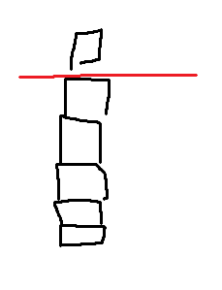
The Theory of Infinite Memory: True fractional differentiation uses an "expanding window." Today's price relies on every historical price since the asset started trading.
To calculate a single fractionally differentiated price, we need a full "window" of historical prices to multiply against our weights.
If our weight threshold dictates we need 10,000 historical rows, row #10,000 is the first day we can actually run the calculation.
So…how did I handle these dropped days?

Slide 6
Can’t NaN my way out of this
Rows 1 through 9,999 do not have enough history behind them. Our code automatically fills them with NaN (Not a Number).
Imagine our loop is testing a very small 'd' value, like 0.01. Because the value is so small, the weights decay incredibly slowly. To get down to our threshold, the math requires a window of 10,000 historical rows to calculate today's value.
If we go to the very first row of our 5-year dataset, we don't have 10,000 rows of history behind it; we have zero. We can't do the math. The same is true for row 2, and row 100, and row 9,999. Our code physically cannot calculate a value until it reaches row 10,000.

Slide 7
My dropna() loop caused the Augmented Dickey-Fuller (ADF) test to evaluate completely different timeframes on every iteration.
Loop 1 (d=0.01): The weights decayed so slowly that we dropped 4.5 years of data. The test only evaluated the surviving 6 months.
Loop 20 (d=0.20): The weights decayed faster, dropping only 1 year. The test evaluated 4 years of data.
The Illusion: my code didn’t find the true mathematical threshold. It just found the specific d value that deleted enough of the macro trend to trick the test into seeing a flat line.

