Slide 1
Training an AI Model
Finally…Machine Learning

Slide 2
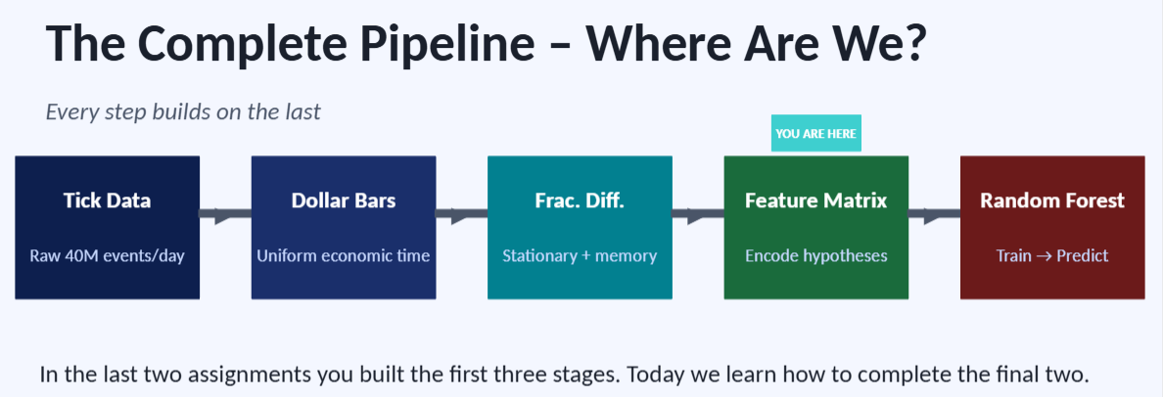
Quick Recap
We learned in our prior steps:
We cannot feed AI the RAW prices
Noise, wander, etc
We cannot use simple returns
We needed some way to retain memory
We used fractionally differentiation to create new dollar bars(d=x)
This gives AI stationary, mathematically sound data that still retains a memory of the overarching market trend
So, we have the data!
Now we learn what we do with it

Slide 3
Part 1: ML Foundations
What are we actually building, and how does it work?

Slide 4
What is Machine Learning?
Teaching a computer to write its own rules
Traditional programming: YOU write the rules. ML: the algorithm finds the rules itself by looking at examples.
Traditional Programming
Machine Learning
① You observe the market
① You collect historical data + correct answers
② You write IF/ELSE rules by hand
② You feed both into the algorithm
vs
③ "IF RSI > 70 AND price drops → sell"
③ The algorithm writes the rules itself
④ You run the program
④ You run the program
⑤ Problem: markets change; your rules go stale
⑤ Advantage: rules adapt to the patterns in data

Slide 5
The Three Flavors of Machine Learning
We are only using one of these — but you should know all three
← US
🏷️
🔍
🎮
Supervised
Learning
Unsupervised
Learning
Reinforcement
Learning
You give the algorithm labeled examples: data + correct answers. It learns to map inputs to outputs.
You give the algorithm data with NO labels. It discovers hidden structure and patterns on its own.
An agent takes actions in an environment and learns from rewards and penalties over time.
Finance:
Finance:
Finance:
OUR APPROACH: Historical bars labeled up/down. Predict direction of next bar.
Regime detection: cluster market conditions into 'trending', 'choppy', 'crisis' without labeling them first.
Execution algos: a bot learns optimal order-splitting strategies by being rewarded for minimizing market impact.
In supervised learning, the quality of your labels (y) and features (x) determines everything. Garbage in → garbage out.

Slide 6
The Machine Learning Approach
Supervised Learning
This is essentially a high-powered version of “connect the dots”
You show the algorithm historical data and the correct answer
Using the correct answers, it writes its own mathematical formula to connect them
Think of a spam filter
You show a program 10,000 emails labeled “spam” and 10,000 labeled “not spam”
How might you identify common trends in these?
Anything that is typically seen in mass spam emails or texts?

Slide 7
Supervised Learning Continued
We do this using
Features(x): The inputs, these are the measurable conditions of the market at any given dollar bar
Ex: our fractionally differentiated prices, volatility, momentum
This is where the feature analyst and strategist will be spending their time.
When in doubt, EMA your way out
(really)
This is where you design and build the bias, the decisions, the thought process of your algorithm
Labels(y): The outputs
It is nearly impossible to predict the price of an asset in the future
Consider the difficulty of finding a single specific needle in a pile of 1M identical looking needles
Not so easy
It is much easier to predict direction over the next five days
1=up, 0=down

Slide 8
Does Anyone Remember 20 Questions?
What was the purpose of 20 questions
How did the game flow work?
What was the ending goal and result?
Let’s play
Rules:
Me vs You, 1xAll right now!
I am thinking of something (person, place, thing – it must have been physical at one point)
You all need to think of all of the questions up front.

Slide 9
The Building Block: Decision Trees
A flowchart the algorithm writes itself
How a Tree Thinks
RSI_14 > 60?
A decision tree asks a series of yes/no questions about your features, splitting the data at each step until it reaches a prediction.
The algorithm searches all possible splits and picks the one that best separates the 'UP' bars from the 'DOWN' bars at each node.
Each leaf at the bottom is a final prediction:
"If you reached this leaf → predict UP"
YES
NO
ATR_14 > 1.5?
EMA_14 > Close?
↑ UP
↓ DOWN
↓ DOWN
↑ UP
Each split is chosen to best separate UP days from DOWN days using one feature threshold.

Slide 10

The Danger of Memorization
Overfitting
This is the deadliest sin in machine learning.
If a decision tree grows too deep, it stops learning the general trend
It instead starts memorizing historical flukes
Consider someone who get’s really really good at a single task being asked to do something else
An overfit model looks like a genius on historical data(100% accuracy) but will lose money instantly in live trading
It looks for the historical replicas that will never happen again

Slide 11
The Building Block
A decision tree acts like a giant game of 20 questions
We look at our features(x) and figures out the best way to split up this data to separate the “Up” days from the “Down” days
How it works:
It might learn a rule like:
IF Volatility is high AND the fractionally differentiated price is below threshold $X$, THEN the next 5 days will be DOWN.
This works great for a single decision tree!
The problem arises from using just a single tree.
It’s like tasking a highly opinionated person for advice
They know what worked for them, but that doesn’t always translate to everyone's use case.

Slide 12

The Brain: Random Forests
If one decision tree is prone to memorizing noise, what if we just use more?
A random Forest algorithm creates hundreds of different, randomized decision trees.
Each tree is trained on a slightly different, random subset of the data
We also restrict the features they are allowed to look at
When its time to make a decision, all the tree’s vote
We average their predictions together

Slide 13
The Problem & The Solution
One tree memorizes. A forest generalizes.
The Problem: Overfitting
The Solution: Random Forest
A deep tree keeps splitting until it perfectly classifies every training bar
Build hundreds of shallow trees instead of one deep one
100% accuracy on training data → sounds amazing
Each tree trains on a RANDOM subset of rows (bootstrapping)
But it has memorized historical flukes, not real patterns
Each split can only consider a RANDOM subset of features
On new, unseen data it collapses. It's looking for exact replicas that will never happen again
Every tree sees a slightly different view of the data
Like studying only the practice exam answers, useless when the real questions change
To predict: all trees vote, majority wins, wisdom of the crowd cancels out individual memorization
Analogy: one overconfident expert vs. a diverse panel of 200 specialists. The panel's consensus is almost always more reliable.

Slide 14
Inside a Random Forest
How 200 imperfect trees become one reliable prediction
①
②
③
④
Bootstrap
Sampling
Feature
Subsampling
Grow
Shallow Trees
Vote &
Aggregate
→
→
→
Each tree draws a random 63% of training rows (with replacement). Different rows → different perspectives.
At each split, only √(total features) candidates are considered. Prevents all trees asking the same question.
Each tree grows to max_depth (e.g. 5). Shallow = generalized patterns, not memorized noise.
All 200 trees predict independently. Final answer = majority class. Probability = fraction voting 'UP'.
Why This Works, The Bias-Variance Tradeoff
Each individual tree has HIGH VARIANCE (sensitive to its specific random subset). But when you average 200 high-variance trees, the random errors cancel each other out. What remains is the true underlying signal, the pattern that consistently appeared across all the different subsets of data.

Slide 15
Part 2: Feature Matrices
Turning bars of price data into machine food

Slide 16
What is a Feature Matrix?
The data format every ML model expects
The Spreadsheet Analogy
What it looks like in code:
Imagine a spreadsheet where:
• Every ROW is one dollar bar (a moment in time)
• Every COLUMN is one measurement about that moment
The algorithm reads across each row and asks:
'Given all these signals at this moment, did the market go up or down next?'
Timestamp
Close
EMA_14
RSI_14
ATR_14
Label
09:32:01
148.20
147.80
54.2
1.32
1 (↑)
09:34:47
149.50
148.10
61.7
1.41
0 (↓)
09:38:03
148.90
148.30
58.4
1.38
1 (↑)
...
...
...
...
...
...
← Features (x) → Label (y)
One row per bar. Features are calculated ONLY from past data.

Slide 17
Building the Target Variable (y)
After building the target, always drop NaN rows — shift(-1) creates a NaN on the last row.
What exactly are we trying to predict?
The question we are asking the model:
"Given the market conditions at this bar, will the NEXT bar close higher or lower?"
y = 1
→ UP (next bar closes higher)
y = 0
→ DOWN or FLAT (closes equal or lower)
df['target'] = (df['close'].shift(-1) > df['close']).astype(int) # 1=up, 0=down/flat

Slide 18
Our Experiment: A classic A/B test
The only difference is the input data. Everything else stays identical.
Pipeline A
Pipeline B
d = 0 | Non-Stationary
d = x | Stationary + Memory
Uses raw closing prices from dollar bars
Uses fractionally differentiated prices
Retains 100% of long-term memory
Stationary: mean & variance are stable
vs
Violates stationarity assumptions
Preserves maximum predictive correlation
High risk of spurious correlations
The model sees trends, not absolute levels
The model may "remember" absolute price levels that will never repeat
Theoretically: best of both worlds
Leakage risk. The model might look great on paper but fails live.
Theoretically sound. Will the data prove it?

Slide 19
Part 3: Technical Indicators
Encoding your economic hypotheses as numbers

Slide 20
We know about technical indicators
Does anyone remember some of the ones we have talked about in lecture so far?

Slide 21
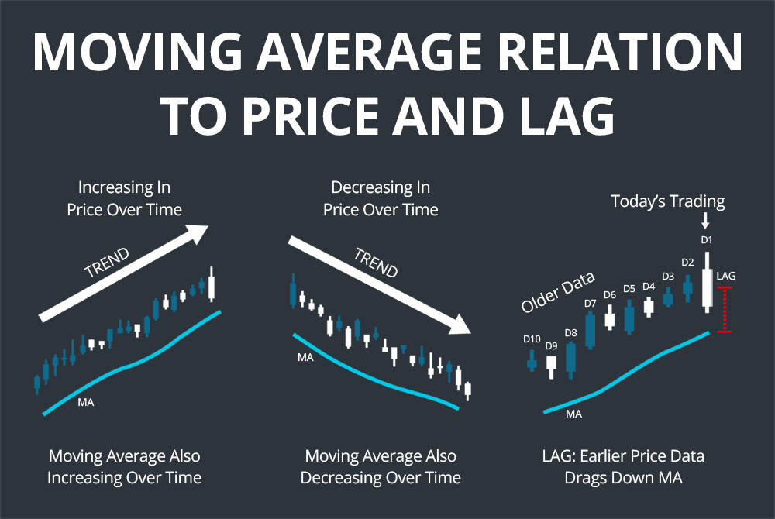
SMA: The low pass filter
Let’s once again, revisit our simple moving average
The goal is to remove high-frequency noise(ticks) to reveal the low-frequency trend
We treated a moving average as a single calculation
Price > average
Buy signal
We also ultimately introduced lag
You cannot smooth the present without using the past.
The green trend line happens after the orange peaks
This is the engineering price we pay for clarity
So how do we calculate it?
Notes:
I want you to look at this diagram. The jagged orange line is the market, chaotic, noisy, and hard to trade. The smooth green line is your Moving Average.
It looks beautiful, right? It looks like it solved the problem.
But look closer. Look at the peaks. The red peak happens after the blue peak. This is the engineering price we pay for clarity. It is called Group Delay or Lag.

Slide 22
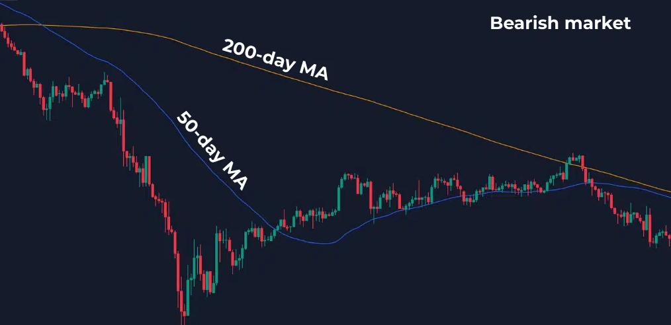
Fighting Lag — The Exponential Moving Average (EMA)
The SMA Flaw: “Democracy”
In a simple moving average, the price from 19 days ago has the exact same vote as the price today.
This is an engineering failure as data from 3 weeks ago is stale
The EMA Solution
We introduce EMA to encode recency bias
We add a multiplier to give more weight to more recent data points
We forget the past exponentially faster than the SMA
The Result
The EMA signal is shifted closer to now
The trade off
More sensitive to noise but catches the trend change quicker
Notes:
"The problem with the Moving Average we built in Week 1 (the SMA) is that it is a 'Democracy.'
If you calculate a 20-day SMA, the price from 20 days ago has the same 'vote' as the price right now.
Ask yourself: Is the price of Nvidia 20 days ago as important as the price 2 minutes ago? Of course not. In dynamic systems, Recency Matters."

Slide 23
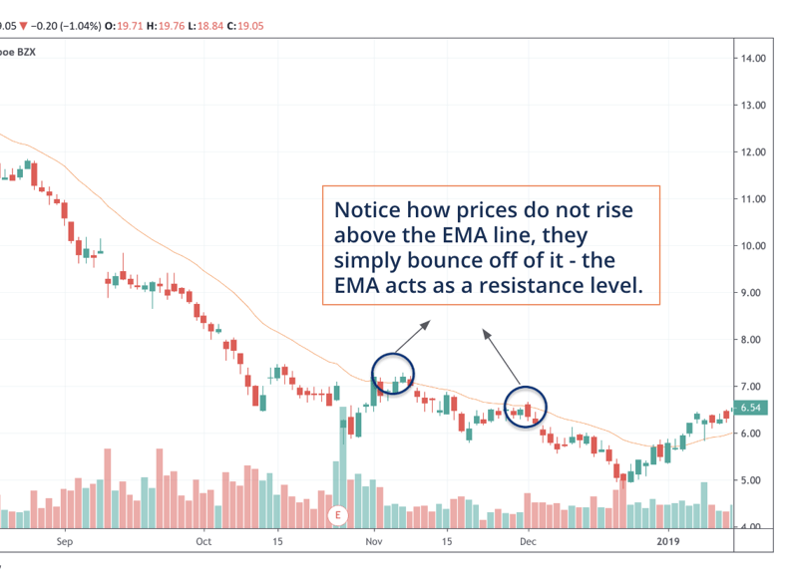
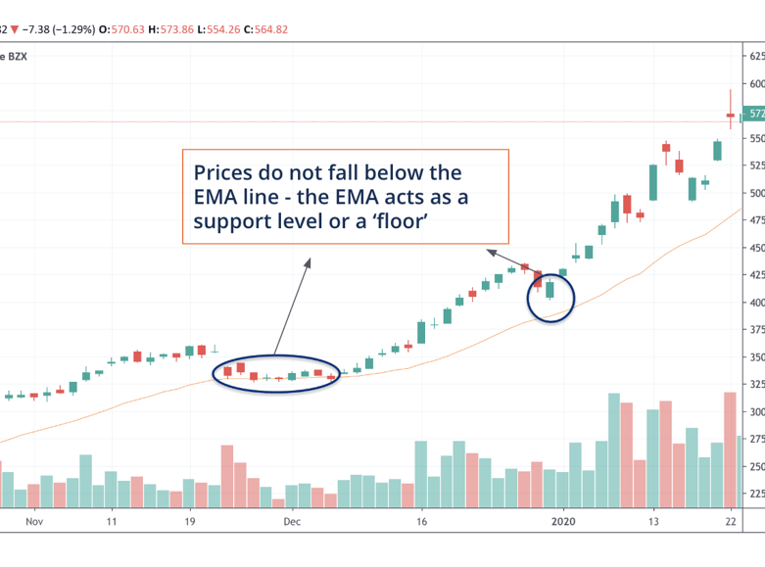
From Data To Information
EMA’s highlight trends
Highlighting and identifying price trends is the principal goal of an EMA
By identifying price directions, the EMA allows investors and traders to spot buying and selling signals
Price is above the EMA line, likely to rise
Price under the EMA line, likely to fall
EMA builds support and resistance bands
Support levels are known as floors they act as a limit for how far prices are expected to fall
Conversely, Resistance levels can act as ceilings in downtrends

Slide 24
Indicators Are Economic Hypotheses in Code
The Strategist's job: pick the right signals
A technical indicator is simply a mathematical summary of recent price history that encodes a specific theory about how markets behave.
📈
↔️
🌊
📊
Trend /
Momentum
Mean
Reversion
Volatility
Statistical
Moments
Is the market going in a direction? How fast?
Has the price stretched too far? Will it snap back?
How wild is the price moving right now?
What is the shape & spread of recent returns?
EMA, MACD, RSI
Bollinger Bands, Z-score
ATR, Rolling Std Dev
Skewness, Kurtosis
The Strategist must choose at least one from EACH category.

Slide 25
Category 1: Trend & Momentum
Is the price building up speed in a direction?
EMA (Exponential Moving Average)
Formula: EMA_t = price_t × k + EMA_(t-1) × (1 − k) where k = 2 / (n + 1)
A moving average that weights recent prices more heavily. When price > EMA, the trend is up. When EMA_short crosses above EMA_long, that's a buy signal.
Period: Common: 9, 14, 20, 50 bars
df['ema_14'] = df['close'].ewm(span=14).mean()
RSI (Relative Strength Index)
Formula: RSI = 100 − [100 / (1 + (avg_gain / avg_loss))]
Measures how hard the market has been buying vs. selling over the last N bars. RSI > 70 = overbought (may reverse down). RSI < 30 = oversold (may bounce up).
Period: Common: 14 bars
import ta; df['rsi_14'] = ta.momentum.RSIIndicator(df['close'], 14).rsi()
"When in doubt, EMA your way out." — Your professor

Slide 26
Categories 2 & 3: Mean Reversion + Volatility
How stretched is the market, and how wild is it?
Bollinger Bands (Mean Reversion)
ATR (Average True Range)
Upper = SMA + 2σ | Lower = SMA − 2σ
TR = max(High−Low, |High−PrevClose|, |Low−PrevClose|)
ATR = EMA(TR, 14)
When price touches the upper band it's 2 standard deviations above average — statistically extreme and likely to revert.
Measures the average price range per bar. High ATR = volatile market. Low ATR = quiet market. Useful for position sizing.
Z-Score (Mean Reversion)
Rolling Std Dev (Volatility)
z = (price − rolling_mean) / rolling_std
σ_t = std(close_{t-n} … close_t)
Measures how many standard deviations the current price is from its own recent average. |z| > 2 suggests potential reversal.
The simplest volatility measure. High std dev = the market is noisy and unpredictable. Good baseline volatility feature.

Slide 27
Category 4: Statistical Moments
What does the shape of recent returns tell us?
Imagine you're grading 20 test scores. The average tells you the center. The standard deviation tells you how spread out they are.
Skewness tells you if the distribution leans left or right. Kurtosis tells you if there are extreme outliers.
Rolling Mean (μ)
Rolling Skewness
Rolling Kurtosis
μ_t = (1/n) Σ close_{t-n..t}
skew = E[(x−μ)³] / σ³
kurt = E[(x−μ)⁴] / σ⁴ − 3
Baseline trend level. When current price > rolling mean, upward momentum.
Positive skew = occasional large upward moves. Negative skew = fat left tail (crash risk). Markets often have negative skew.
High kurtosis = fat tails, more extreme moves than a normal distribution predicts. Common in equity markets.
df['rm_20'] = df['close'].rolling(20).mean()
df['skew_20'] = df['close'].rolling(20).skew()
df['kurt_20'] = df['close'].rolling(20).kurt()

Slide 28
The Complete Pipeline(again)Where Are We?
Every step builds on the last
YOU ARE HERE
Tick Data
Dollar Bars
Frac. Diff.
Feature Matrix
Random Forest
▶
▶
▶
▶
Raw 40M events/day
Uniform economic time
Stationary + memory
Encode hypotheses
Train → Predict
Our Feature Analyst is responsible for helping the strategist perform the calculations over every bar
How does the back tester prove one pipeline is better than the other?

Slide 29
Part 4: The Leakage Trap
The silent killer of financial machine learning models

Slide 30
The Time Machine Bug(Data Leakage)
How to silently build a model that's useless in real life
Case Study
A student shuffles their data before splitting 80/20. Their model achieves 94% accuracy on the test set. They're thrilled.
They deploy it live. It loses money on day one. What happened?
What shuffle does
The test set lie
The fix
Randomly mixes rows from Jan 2020 and Jan 2022 into the same set. The model can "see" future data while training.
Test rows are adjacent to training rows in time. The model memorized neighbors, not patterns. It's a look-ahead cheat.
Never shuffle. Use the first 80% of rows (earliest dates) as train. The final 20% as test. The model is only ever evaluated on the future.
Standard sklearn train_test_split() shuffles by default. You MUST pass shuffle=False.

Slide 31
The Golden Rule: Time-Ordered Splitting
Train on the past. Test on the future. Always.
TEST SET
(last 20%)
TRAINING SET (first 80% of rows by time)
← Past (Jan 2020)
▶
Future (Dec 2024) →
# CORRECT — time-ordered split (no shuffle)
split_idx = int(len(df) * 0.8)
X_train = feature_df.iloc[:split_idx]
X_test = feature_df.iloc[split_idx:]
y_train = target.iloc[:split_idx]
y_test = target.iloc[split_idx:]
DO NOT use train_test_split() — it shuffles by default. Use .iloc[ ] with a time index instead.

Slide 32
Remember: Building the Target Variable (y)
What exactly are we trying to predi
The question we are asking the model:
"Given the market conditions at this bar, will the NEXT bar close higher or lower?"
y = 1
→ UP (next bar closes higher)
y = 0
→ DOWN or FLAT (closes equal or lower)
df['target'] = (df['close'].shift(-1) > df['close']).astype(int) # 1=up, 0=down/flat
After building the target, always drop NaN rows — shift(-1) creates a NaN on the last row.

Slide 33
Part 4: Training & Evaluating
Running the model and understanding what it's telling you

Slide 34
The sklearn Recipe — Five Lines of Code
The model itself is the easy part
Once your data is clean, split, and feature-engineered, training looks like this:
from sklearn.ensemble import RandomForestClassifier
from sklearn.metrics import classification_report
# Step 1: Build the model (same config for BOTH pipelines)
model = RandomForestClassifier(n_estimators=200, max_depth=5, random_state=42)
# Step 2: Train on the PAST (training set)
model.fit(X_train, y_train)
# Step 3: Predict on the FUTURE (test set)
y_pred = model.predict(X_test)
# Step 4: Evaluate
print(classification_report(y_test, y_pred))
n_estimators=200
max_depth=5
random_state=42
200 different decision trees vote. More trees = more stable, slower.
Caps tree depth. Prevents overfitting. Start here — tune later.
Ensures results are reproducible. Use same value for both pipelines!

Slide 35
Reading Your Report Card
What do these numbers actually mean for trading?
precision recall f1-score support
0 0.58 0.62 0.60 423
1 0.61 0.57 0.59 441
accuracy 0.59 864
macro avg 0.60 0.60 0.59 864
Accuracy
Precision
Recall
F1-Macro
59%
0.61
0.57
0.59
Out of all predictions made, how many were correct?
When the model predicted 'UP' — how often was it actually up?
Of all the actual 'UP' moves — how many did the model catch?
Harmonic mean of precision and recall. Balanced score.
59% > 50% random. In finance, even 54% accuracy with good position sizing can be profitable.
High precision = fewer false alarms. Every wrong 'buy' signal costs real money in commissions and slippage.
Low recall = missing profitable trades. Depending on your strategy, missing moves can be as costly as wrong ones.
Best single-number summary. Compare F1-macro across Pipeline A vs B to declare a winner.

Slide 36
Part 5: The Shootout
Design the experiment, then form your hypothesis

Slide 37
The Experiment Design
A rigorous shootout requires everything held constant except the input
📋
⚙️
🌲
✂️
📊
Same
Tickers
(30–50)
→
Same
Features
(calc on A & B)
→
Same
Model
(RF, n=200)
→
Same
Split
(80/20 time)
→
Same
Metrics
(F1-Macro)
🔬 The ONLY difference: Pipeline A uses raw close prices (d=0). Pipeline B uses fractionally differentiated prices (d=x).
Data Curator
Load subset, audit quality, build Set A + Set B, create the target variable, time-split
Feature Analyst
Build indicator functions on both sets. Output: dict of feature DataFrames for each ticker × pipeline
Strategist
Choose 30–50 representative tickers (diverse sectors + volatility). Curate features from all 4 categories
Backtester
Train RF on each pipeline. Print classification_report. Compare F1-Macro. Conclude: did B beat A?

Slide 38
Form Your Hypothesis Before You Run
Science isn't 'run it and see' — it's 'predict, then test'
The Strategist's pre-experiment write-up should answer:
Why should Pipeline B outperform A in theory?
Why might Pipeline A still perform surprisingly well?
What F1-Macro score would you consider a meaningful win for B over A?
Writing the hypothesis first prevents post-hoc rationalization — the most common mistake in quantitative research.

Slide 39
The Checklist
Before your team starts coding, every member should be able to answer these:
Data Curator
Can I load, clean, and split the data with a strict time-ordered 80/20 cut? Can I build the binary target variable?
Feature Analyst
Can I build indicator functions that take a DataFrame → return a feature matrix? Do I avoid using future data (shift)?
Strategist
Have I chosen ≥1 indicator from each of the 4 categories? Did I document WHY each indicator encodes a valid market hypothesis?
Backtester
Do I understand what classification_report outputs and can I explain F1-Macro to the Strategist in plain English?
Everyone
Does the SAME model config train on BOTH pipelines? Is the experiment fair?
Good luck. The market is indifferent to effort, but rigorous methodology always wins in the long run.

