Slide 1

~ Joewin Francis N

Slide 2
Problem Statement 15
Problem: Protecting User Password Keys at rest (on the Disk).
Category: System Software, Security
Scope: Developing an application for file encryption which is in turn protected by user passphrase

Slide 3
Proposed Solution
A data encryption tool, IntelliCrypt, which prioritizes confidentiality above all which makes it the ideal choice to protect data that is highly sensitive in nature. It follows a zero-knowledge model, keeping the encryption information separate from the files. This is achieved by separating the authentication element, which follows the “Challenge Handshake Authenication Protocol”, from the rest of the functionality. The tool achieves a high level of confidentiality by implementing a "scorched-earth” defense mechanism that causes the encrypted data to self-destruct if tampering is detected. This design choice also enables the encrypted files to serve as a honeypot since the loss of data would indicate tampering or an attempt to bypass authentication. Additionally, the tool also helps users encrypt entire storage devices like USBs using the Linux Unified Key System (LUKS).

Slide 4
Features of IntelliCrypt
Zero-Knowledge Encryption:
Follows a zero-knowledge model, keeping the encryption key completely separate from the encrypted files. User password is never stored in the files themselves, significantly enhancing security. Even if an attacker steals an encrypted file, they cannot decrypt it without the additional information stored securely elsewhere.
"Fort Knox" Defense with Tamper-Evident Protection:
Implements a "Fort Knox" defense mechanism that detects any unauthorized modification attempts made to the encrypted files or the database containing key derivation information. Triggers a "scorched earth" protocol by overwriting the data with garbage values if tampering is detected. This ensures data confidentiality even if an attacker breaches some security layers.
Configurable Security with Balanced Approach:
Offers a configuration option to balance the "Fort Knox" defense and potential data loss. Default: "Scorched earth" on tamper attempt (maximum security but risk of data loss). Optional: Refuses decryption with incorrect key (prevents data loss but at the cost of a potential breach in confidentiality). Allows users to choose the level of risk they're comfortable with.
Database for Central Management:
Stores authentication information and key derivation data in a secure database thereby requiring the users to have access to the database to even attempt to decrypt the files which further helps in mitigating unautorized access.
Honeypot Potential:
Encrypted files can act as honeypots. Data destruction triggered by tampering attempts alerts users to potential security breaches.
Drive Encryption:
Enables users to encrypt entire storage devices like USBs, hard disks, or solid-state drives using the Linux Unified Key System (LUKS).

Slide 5
Process Flow
Planning and Research
Design high-level architecture
Develop and Implement Individual modules
Integrate Modules into the tool
Testing and Exception Handling
Bug Fixes
Create a setup to make the tool installable
Deployment
Maintenance

Slide 6
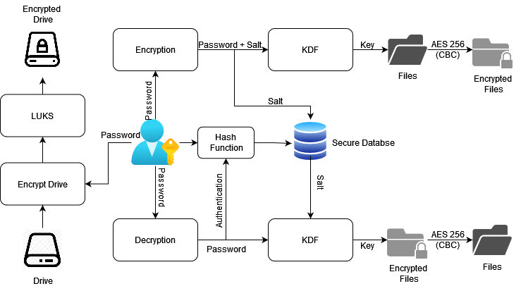
Architecture Diagram

Slide 7
Technologies used
Operating System: Linux
Programming Languages: Python, SQL
Cryptographic Algorithms: AES – 256 (CBC), SHA3-512, SHA256, MD5, PBKDF
Other Technologies: LUKS

Slide 8
Team Members and Contributions
Joewin Francis N: Everything

Slide 9
Conclusion
In essence, IntelliCrypt is a data security tool built with the primary focus of keeping your data confidential. It leverages advanced encryption methods to scramble your files, making them unreadable without the proper key. Some if its key features include:
High Security
Zero-Knowledge Encryption
Fort Knox Defense using the Scorched-Earth protocol
Honeypot Potential
Drive Encryption
Overall, IntelliCrypt offers a robust approach to data encryption, aiming to keep your information confidential and secure.

