Slide 1




JFrog loves plugins
Build Integration
JFrog CI Plugins
Vulnerability Scan
JFrog IDE Plugins
Operation
JFrog CLI & CLI Plugins
Cleanup
JFrog Users Plugins
Customized UI
JFrog UI Plugins ?
</>
HTML
https://github.com/kyle11235/jfrog-ui-plugins

Slide 2
General Customization Approach
Artifactory Backend Server
native UI API
JFrog REST API
conplex
token
your backend server
your REST API
your custom UI
your login page
Disadvantage:
reinvent login page / user authentication process
requires a backend program to avoid cross-domain issues / revent REST API
indirect access to native UI API

Slide 3
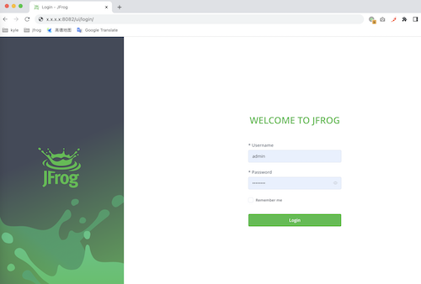
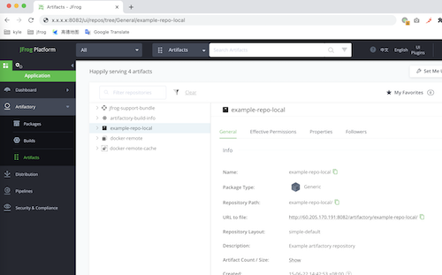
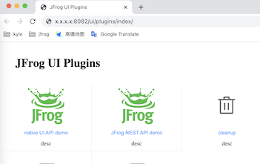
JFrog UI Plugins' Approach
Artifactory Backend Server
native UI API
JFrog REST API
native UI
1. password
2. cookie
3. cookie
JFrog UI Plugins
3. cookie + token
1. plugins.js
2. token
Advantage:
focus on UI, easy development with your favorite js framework
direct access to JFROG REST API (no need to revent login process / backend program)
direct assess to native UI API (no need to manipulate API url)

Slide 4
Demo & Code explanation

