Slide 1
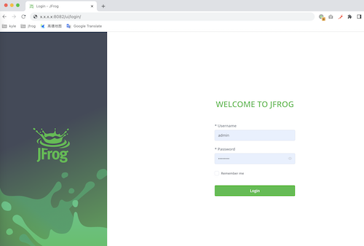
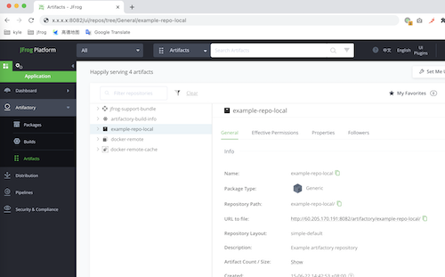
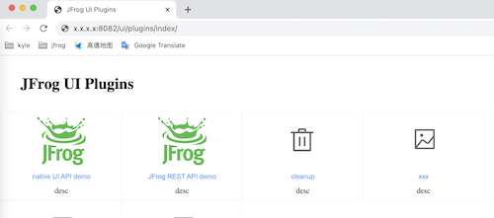
Why JFrog UI Plugins
Artifactory Backend Server
native UI API
JFrog REST API
conplex
admin token, permission management ?
your backend server
your REST API
native
your custom UI
1. password
2. cookie (native UI API token)
3. cookie
your login page
JFrog UI Plugins
plugins.js
token

