Slide 1
Retail Performance Engine
The Complete Debit Card Lifecycle Platform
Notes:
Welcome everyone. Today we're introducing the Retail Performance Engine -- a complete platform that gives credit unions intelligence and results at every stage of the debit card member lifecycle. Four products, one platform.

Slide 2
Your members' debit card journey has 4 stages.
Notes:
Let's start with a question. Your members go through 4 stages with their debit card -- from getting the card, to using early services, to swiping regularly, to premium engagement. How many of those stages can you actually see and measure?

Slide 3
What's at Stake -- The Cost of Lifecycle Blind Spots
40%
2.5x
35%
$12+
New accounts that never activate
Higher attrition with 1 service vs 3+
Everyday spend going to competitors
More revenue per premium account
Notes:
Here's what's at stake. These are industry benchmarks showing the cost of blind spots at each lifecycle stage. Whether it's dormant new accounts, low service adoption, competitor card leakage, or missed premium revenue -- every gap costs your credit union real dollars.

Slide 4
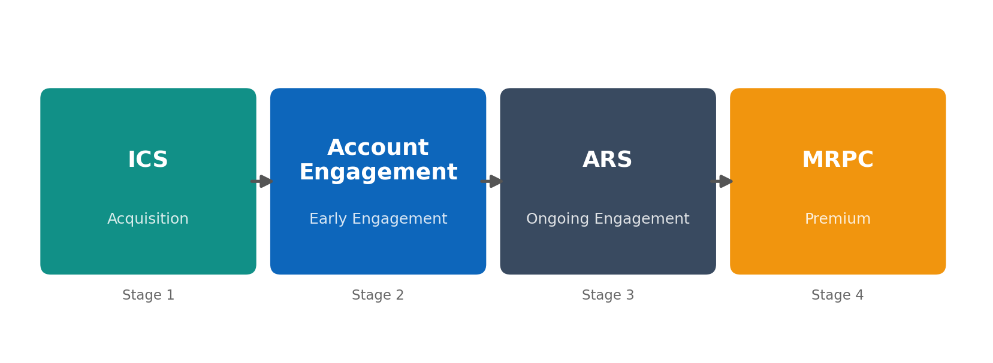
One Platform. Four Products. Complete Lifecycle Intelligence.
ICS -- Know where new accounts come from and which sources perform best
Account Engagement -- Track service adoption in the critical first 90 days
ARS -- Move members up the swipe ladder and prove mailer ROI
MRPC -- Premium debit with bundled services and recurring fee revenue
Notes:
RPE solves this with four connected products. ICS handles acquisition intelligence. Account Engagement tracks service adoption in the critical first 90 days. ARS manages ongoing card usage and campaign intelligence. And MRPC delivers premium engagement with recurring fee revenue. Each product hands off to the next.

Slide 5
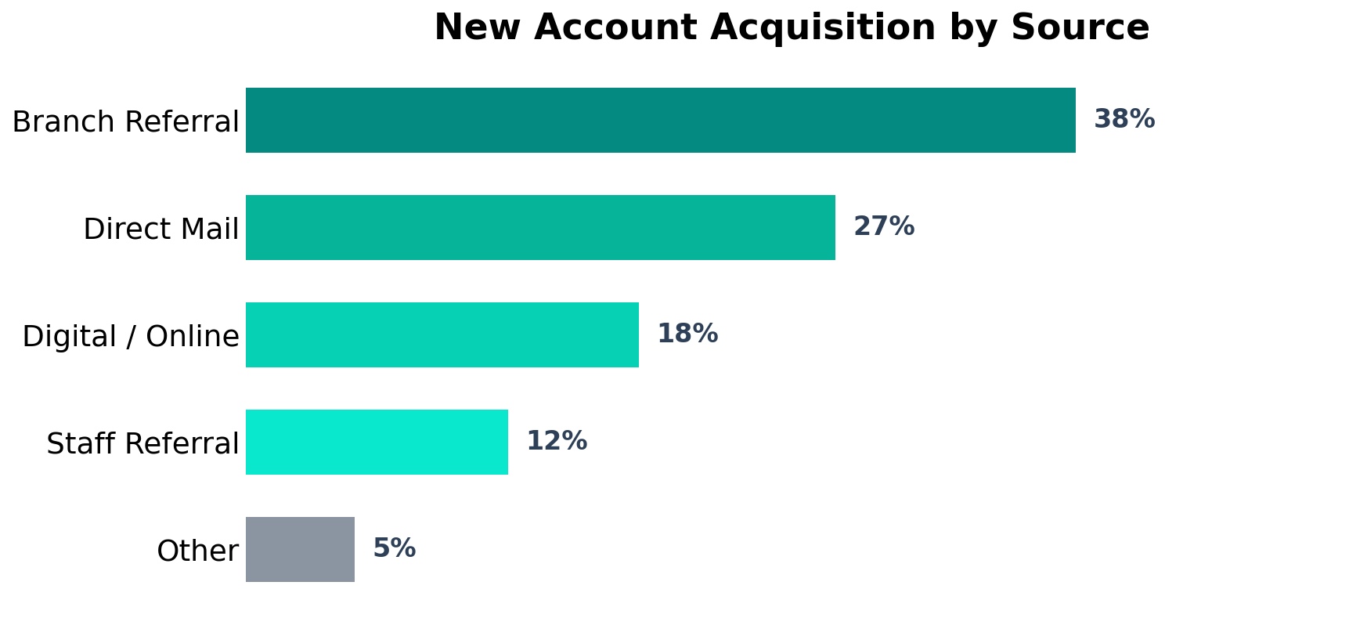
Know where your new debit card accounts are coming from
Referral, direct mail, branch, digital
Acquisition source tracking
By source and channel
New account activation rates
Referral conversion tracking
Branch and staff performance
Acquisition efficiency by channel
Cost per activated account
Notes:
ICS -- Instant Card Solutions -- tracks where your new debit card accounts are coming from. Branch referrals, direct mail, digital channels. You see which sources actually produce active cardholders, not just accounts on paper.

Slide 6
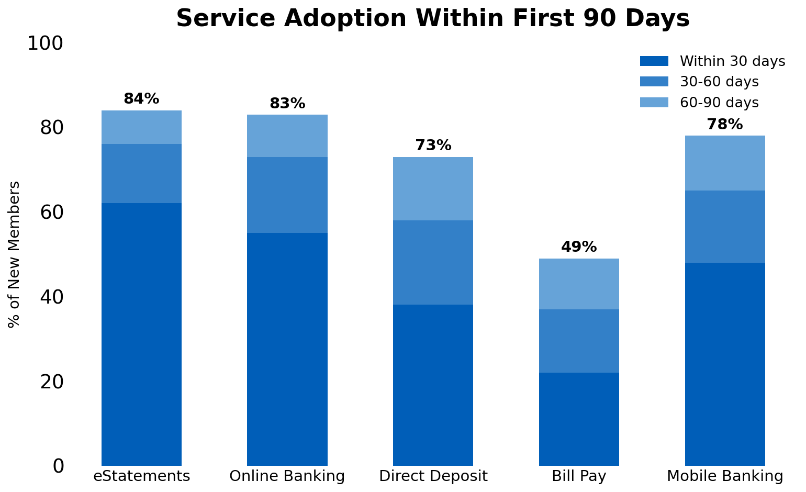
The deeper the relationship starts, the longer it lasts
eStatements, online banking, direct deposit, bill pay, mobile
Service adoption tracking
How quickly new members engage with multiple services
Adoption velocity
Opportunities flagged in the first 90 days
Cross-sell identification
Early adoption predicts long-term membership
Retention correlation
Notes:
Account Engagement monitors the critical first 90 days. Members who adopt 3 or more services early -- eStatements, online banking, direct deposit -- are far more likely to stay long-term. This product flags who's engaging and who's drifting.

Slide 7
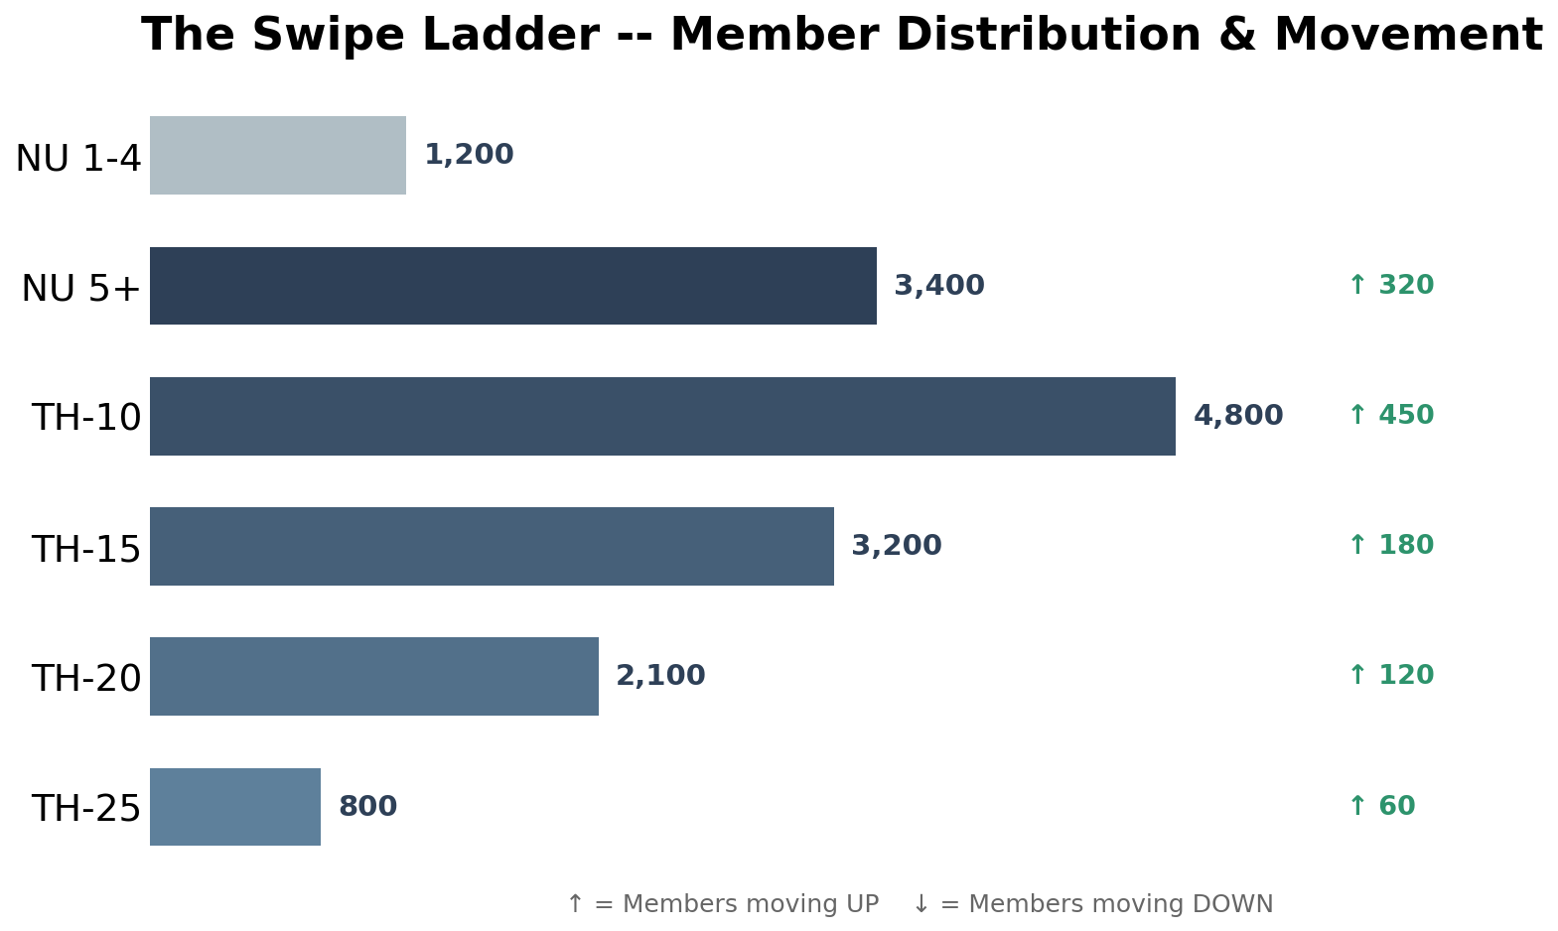
Move members up the swipe ladder
ARS tracks exactly where they are and which direction they're moving
Every member on the ladder
Move members UP to the next tier
Targeted mailer campaigns
Catch members moving DOWN -- intervene before dormancy
Early detection
Response intelligence across campaigns
First-time vs repeat tracking
Notes:
ARS puts every member on a swipe ladder. From non-users through threshold 25. We track exactly where they are and which direction they're moving. Targeted mailer campaigns move members UP to the next tier. Early detection catches members moving DOWN before they go dormant.

Slide 8
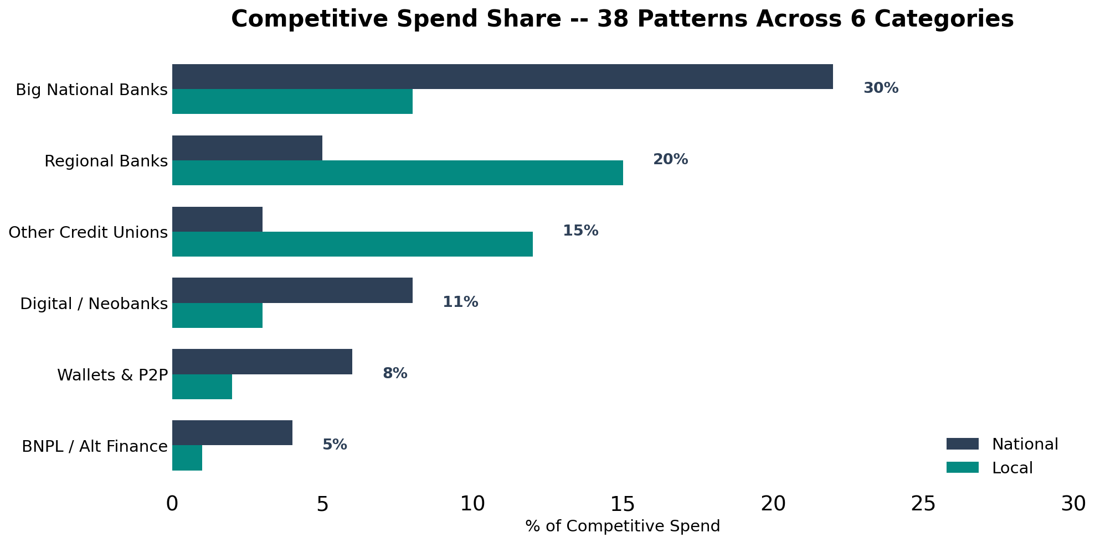
We analyze 38 competitive patterns across 6 categories
Analyzed for every client
38 competitive patterns
From community banks to Chase and Chime
Local AND national
Know exactly where you're losing wallet share
Spend share by category
Big banks, regional, CUs, neobanks, wallets, BNPL
6 competitor types
Notes:
Here's something unique. We analyze 38 competitive patterns across 6 categories. Big national banks, regional banks, other credit unions, digital neobanks, wallets and P2P, and buy-now-pay-later. Local AND national. You see exactly which competitors are capturing your members' spend, in which categories.

Slide 9
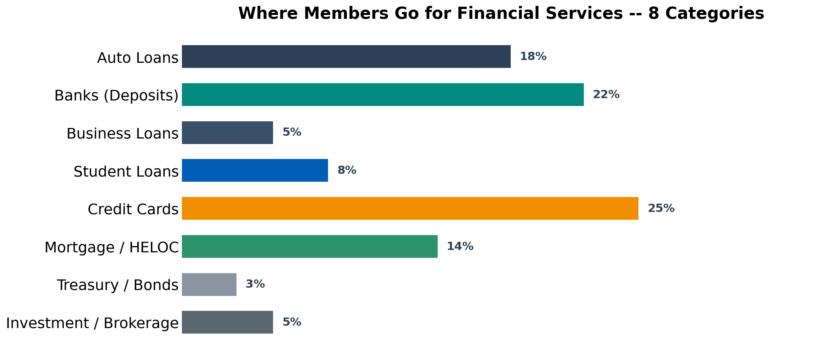
See where your members go for financial services
Auto loans, banks, business loans, student loans, credit cards, mortgage/HELOC, treasury, investments
8 financial service categories
Identifies cross-sell opportunities you can't see otherwise
Services outside your CU
Dollar-weighted by service bucket
Opportunity sizing
Lending, investing, and deposit products
Competitive positioning
Notes:
Debit card transactions reveal more than spending habits -- they reveal your members' entire financial lives. When a member makes payments to an auto lender, a mortgage company, or a brokerage, RPE captures it. That's cross-sell intelligence you can't get anywhere else.

Slide 10
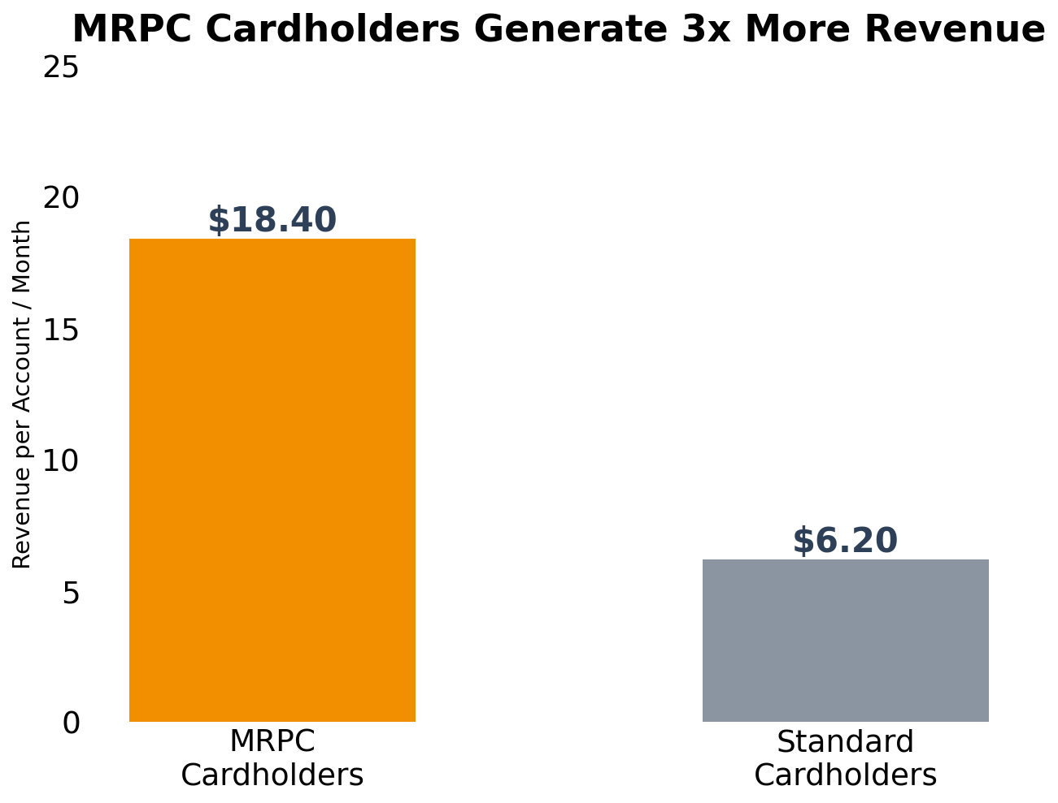
A premium debit card with bundled services
MRPC vs standard cardholder comparison
Revenue per account
Recurring fee income plus higher interchange
Monthly fee + card usage
Premium cardholders use more services
Bundled service adoption
Expanding premium membership base
Program growth
Notes:
MRPC is our premium debit card product. It's a card with bundled services and a monthly fee that generates significantly more revenue per account. The data speaks for itself -- MRPC cardholders generate more recurring fee income plus higher card usage.

Slide 11
Complete Visibility. Every Stage. Every Metric. One Platform.
847/mo
72%
34.2%
$18.40
ICS New Accounts
Engagement Activated 30d
ARS Penetration
MRPC Revenue/Acct
Notes:
Here's the complete picture. Every lifecycle stage is now measurable and actionable. ICS tells you where accounts come from. Engagement shows who's adopting services. ARS tracks spending and campaign ROI. MRPC delivers premium revenue. One platform, complete visibility.

Slide 12
300+ Credit Unions Trust RPE
to Manage Their Debit Card Lifecycle
Notes:
We're not just talking about potential. Over 300 credit unions already use RPE to manage their debit card lifecycle. They're seeing real results at every stage.

Slide 13
Ready to See Your Complete Debit Card Lifecycle?
Visit us at Booth #123
Notes:
We'd love to show you what RPE can do for your credit union. Stop by our booth or scan the QR code to schedule a demo. Thank you.

