Slide 1
January 2026

Slide 2
Presentation Summary

Slide 3
Section Title Slide
Section Description or Subtitle

Slide 4

Using a Photo with Bulleted List
Keep it Simple
Limited Bullet Points
Less is More
Clean and Simple
Whitespace is your friend

Slide 5
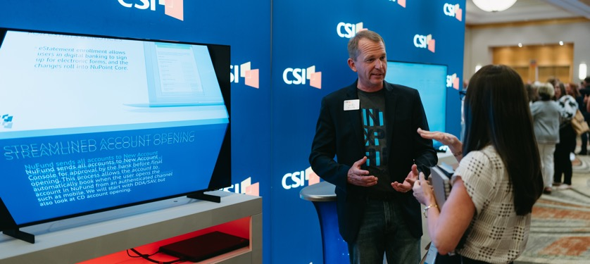

Using Two Photos with Bulleted List
Keep it Simple
Limited Bullet Points
Less is More
Clean and Simple
Whitespace is your friend

Slide 6

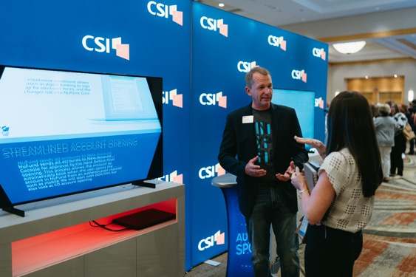

Using Three Photos with Bulleted Lists
Add a Headline Here
Add a Headline Here
Add a Headline Here
Keep it simple
Limited bullet points
Less is more
Clean and simple
Keep it simple
Limited bullet points
Less is more
Clean and simple
Keep it simple
Limited bullet points
Less is more
Clean and simple

Slide 7
Color Bar Content
Keep it simple
Limited bullet points
Less is more
Clean and simple
Whitespace is your friend

Slide 8
Gray Blank Slide for Mixing It Up
Use this to break up the monotony and add some visual interest

Slide 9





Slide for Stats
Hold more than $2.2 trillion in loans for local communities
With a small area for a short description
Community banks represent 97% of banking industry
Employ nearly half million employees across the US
X% payments are processed through community banks
X% US deposits are with community banks

Slide 10





Making a List With Icons
You can use icons instead of bullet points.
This helps add visual interest.
It also adds more context to your list.
There are more icons at the end of this file.
You can put them in a shape, or not.

Slide 11









Brand Re-positioning
Brand Re-positioning
Bust the myth that CSI is a small Midwest core provider
Media Relations Roadshow
Consultant Strategy
Increased Presence at Key Events
Analyst Strategy
Sales Enablement
Targeted Campaigns (utilizing AI)
Refresh Ad Campaign
Visual Identity

Slide 12
Our Mission
We deliver comprehensive solutions and open technologies that empower community and regional banks to achieve their distinct goals.
Our Vision
We will cement our position as the preferred partner and help shape the future of banking by fueling growth and retention for our customers and delivering solutions that enable them to rival every competitor.

Slide 13




Our Values
Embrace ambition
Celebrate integrity
Work to serve

Slide 14
CSI: A National Player
Core Coverage
2023
Notes:
[CLICK]

Slide 15




















































Additional Resources
Cut and paste icons to use in your presentation
Select “Shape Fill” to change the icon’s color
Select “Shape Outline” and increase an outline’s weight to make a bolder icon
Click-shift while dragging icon’s corner anchor point to resize without distortion

Slide 16














































































Additional Resources

Slide 17














































































Additional Resources

Slide 18
Questions & Discussion

