Slide 1
Supermarket Database Project
Andrew Patilis, Danny Cheng,
James Gengerke, Ryan Kinard

Slide 2
Database Design
A supermarkets Inventory with
Departments with Product Details for Items
Product Name
Product UPC (Universal Product Code)
Product Brand
Total in Stock per Product
Retail Price in USD
Wholesale Price in USD
Product Origin via the Vendor
3rd Normal Form – No Transitive Dependencies

Slide 3
Story
Used by a local supermarket or chain of supermarkets
Keep track of product and stock
Meant for the backend
Use for checking item price via the UPC code or product name
Use for checking stock of items via the UPC code or product name

Slide 4
Data Dictionary
Company: the company who makes the product; in vendorInfo, the companies method of shipping to the retail location in complete pallets.
Commissary: a warehouse/storage facility where bought product is stored for distribution; often shipped out as mixed pallets.
productUPC: the UPC (Universal Product Code) of a given product; this is different for every product.
vendorCode: indicator of a products origin; a Commissary or a Company

Slide 5
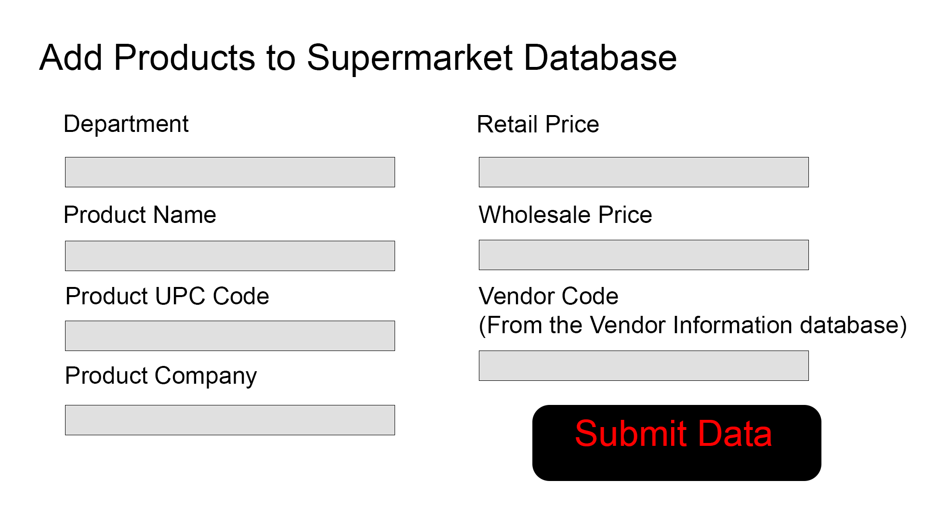
Data Input Screen Mockup Values –> SQL update query

Slide 6
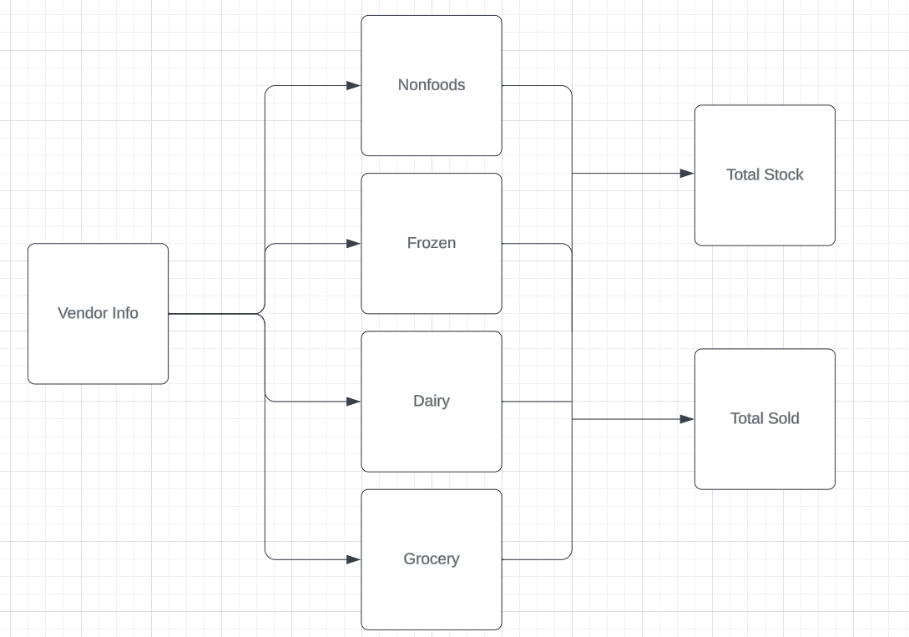
ER Diagram

Slide 7
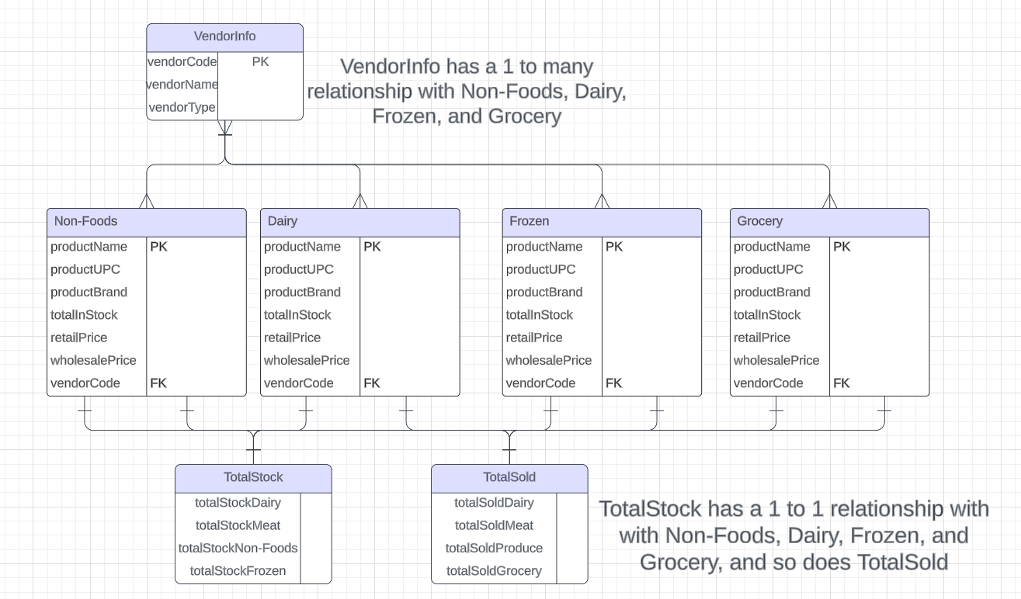
Mapped ER Diagram

Slide 8
Special Tables
Total Sold
How many products have been sold over the course of the day in each department.
Total in Stock
How many total products are available for sale in each department.
A sum of all in stock items for each department.
Vendor Code
Origin of Products
Shipped from an organizations Commissary
Shipped from an outside company

Slide 9
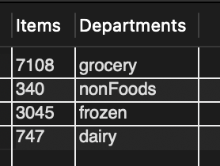
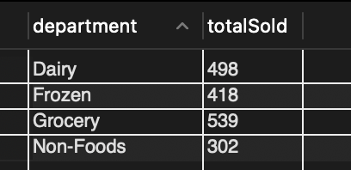
Total Sold Table
Total in Stock table
Shows the amount of product sold in each department for the current day.
Shows the amount of product currently in stock in each department.
Sum of each products in stock value.

Slide 10
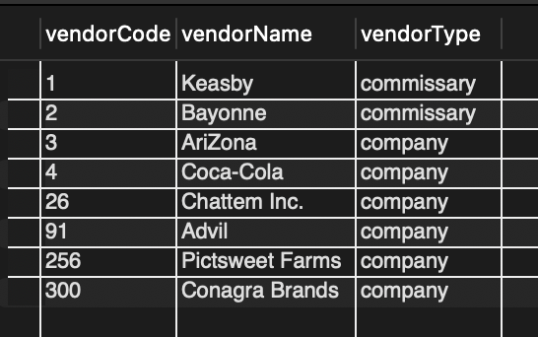
Vendor Info (Vendor code Primary key)
Origin of Products
Where the facility is or what company owns it
If a company and not a commissary
Type of ownership
company
commissary

Slide 11
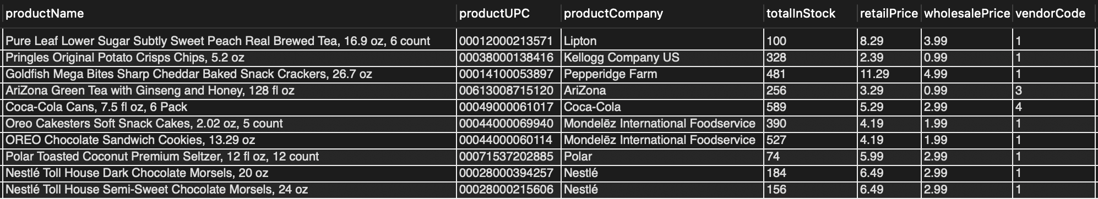
Main Table example grocery table
Stores All of the main data
Data retrieved from these tables for review

Slide 12
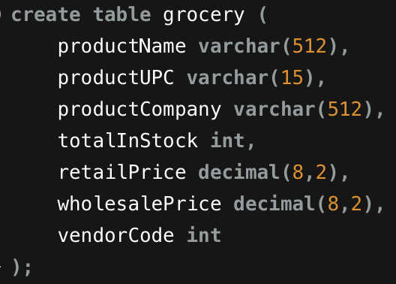
Main table SQL
Create the table
Insert data using queries similar to the one below
Includes many rows for each item
The insert screen would create a insert query and run that upon submission of the data

Slide 13
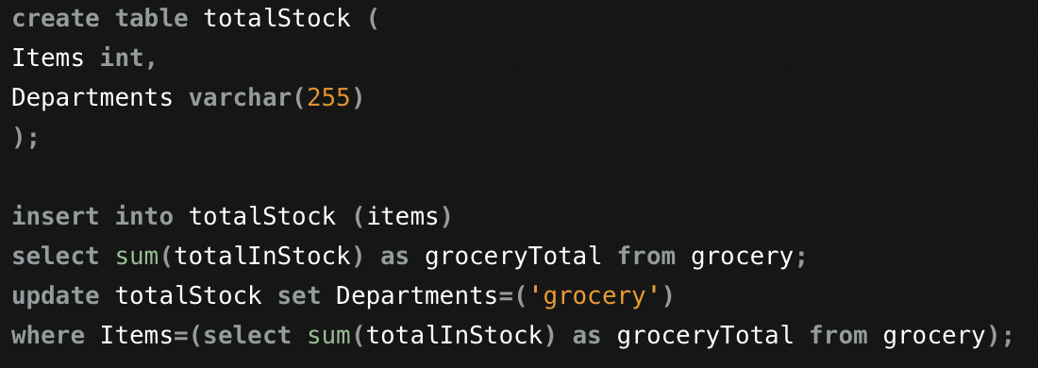
Total stock summary table SQL
For each Department, sums the total in stock and displays it with an identifier for the department it retrieved the data from.
Multiple versions of the second query here for each department.

Slide 14
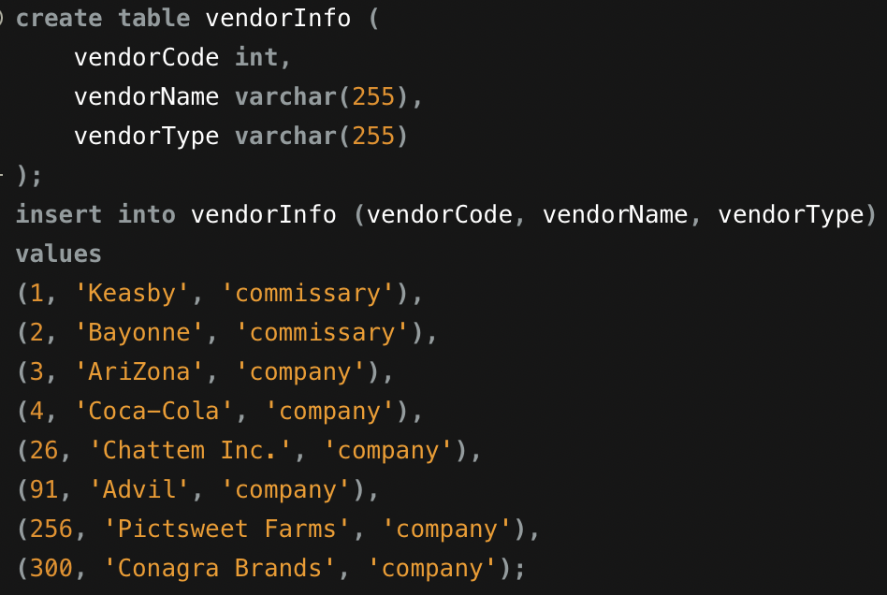
Vendor info SQL
Simple table with the values needed to connect vendorCode to the main tables
vendorCode in practice would be a foreign key
This data would need to be input using a separate data entry screen in practice

Slide 15
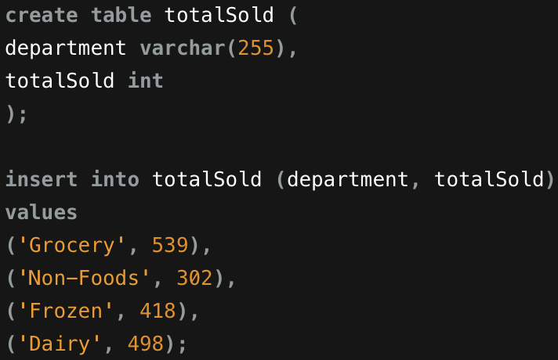
Total sold SQL
Currently displays set values
In practice, this would collect sales from Point of Sale systems and display it here as the sales occur during the day; it would be reset daily

Slide 16
Conclusion
Used on the backend of a supermarket
Maintain ease of operation
Keep track of product
Does this in 3rd Normal Form
Stores all necessary data to keep operating effectively

