Slide 1
Parsl
The Parallel Scripting Library
for Python
Joel Griffith
February 19, 2019

Slide 2
Parallel Processing
Single Thread (single core)
Multi-thread (single core)
Multi-core

Slide 3
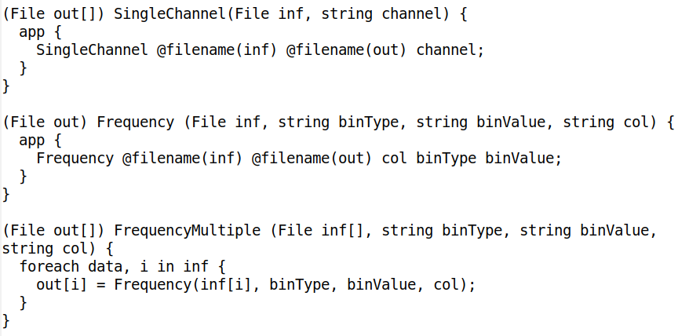
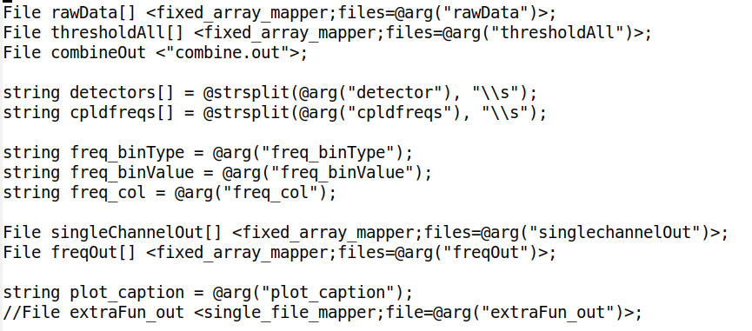
A Little History
2007: Swift
  Implicitly parallel scripting
  language for high-
  performance computing

Slide 4
A Little History
2007: Swift
  Implicitly parallel scripting
  language for high-
  performance computing
  Interest in using, but not in
  learning

Slide 5
A Little History
2007: Swift
  Implicitly parallel scripting
  language for high-
  performance computing
  Interest in using, but not in
  learning
  → ParallelWorks

Slide 6
A Little History
2007: Swift
  Implicitly parallel scripting
  language for high-
  performance computing
  Interest in using, but not in
  learning
  → ParallelWorks
2016: Parsl
  Python library for
  parallelization of scientific
  and HPC programming
  NSF development grant

Slide 7
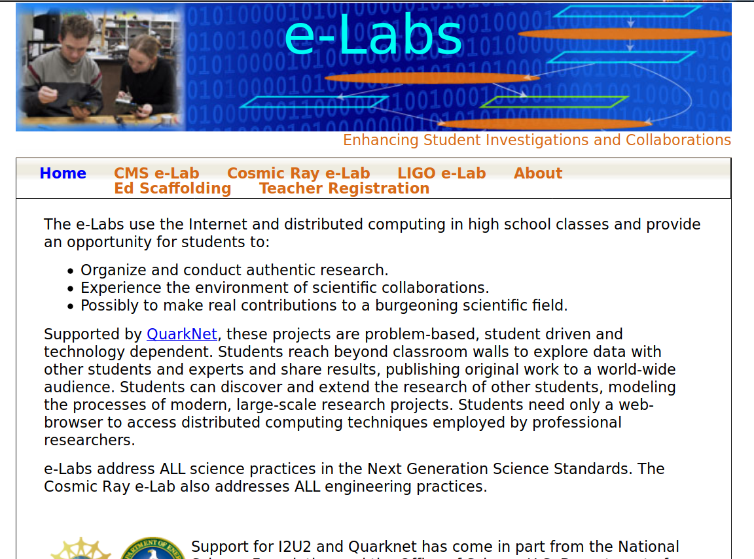
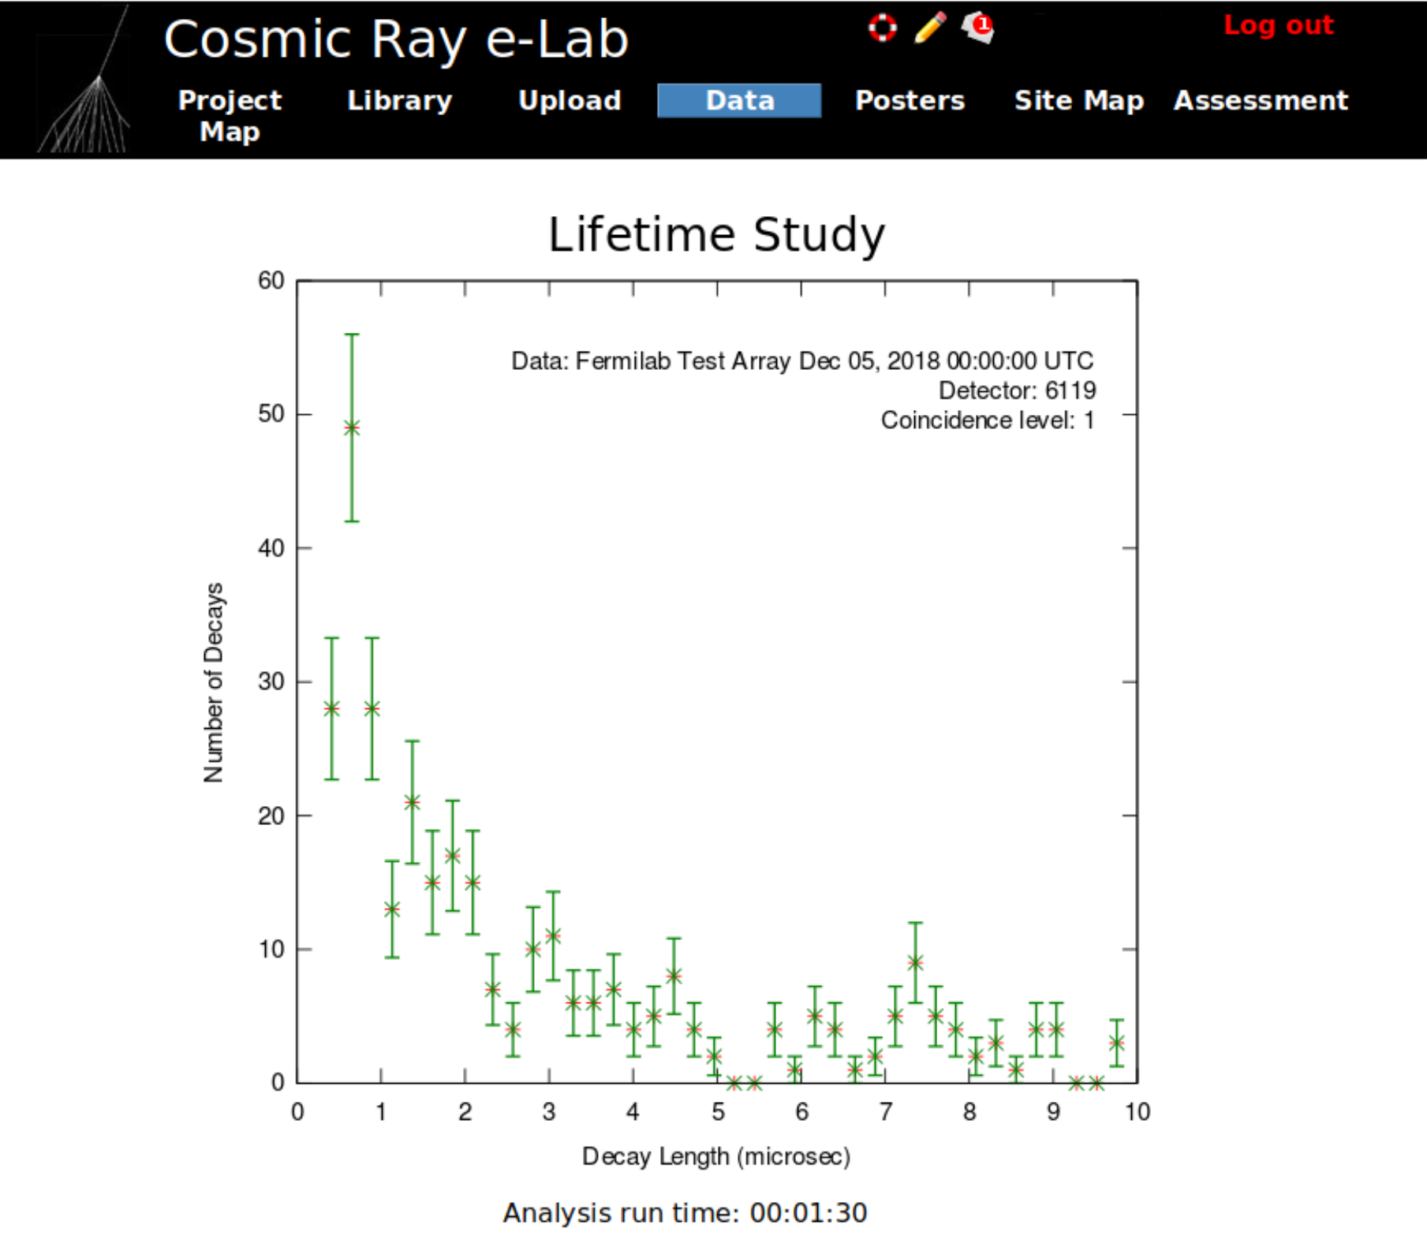
QuarkNet and Parsl
Swift
i2u2.org

Slide 8
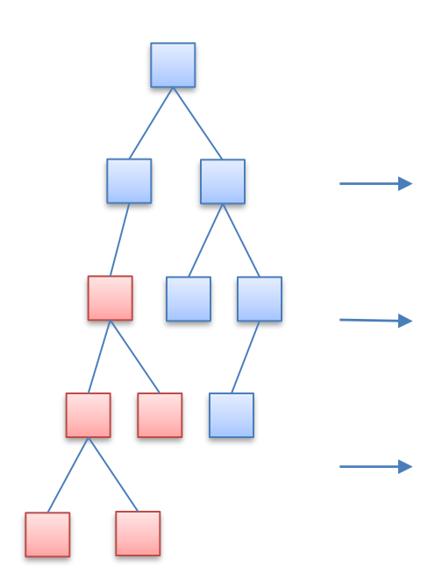
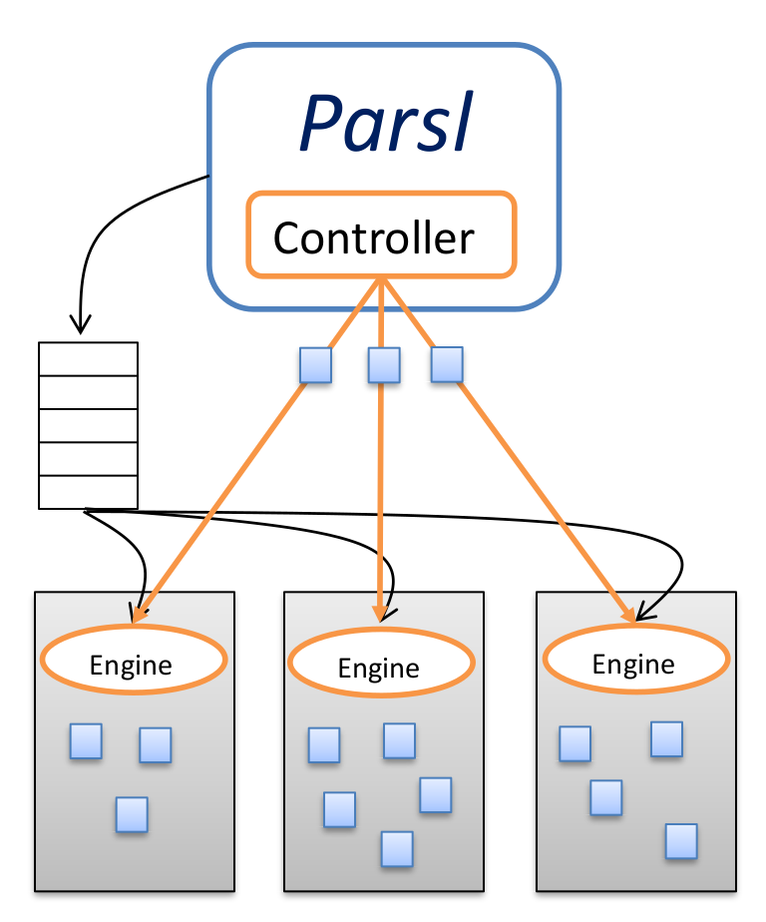
Parallelization in Parsl

Slide 9

Cosmic Rays

Slide 10
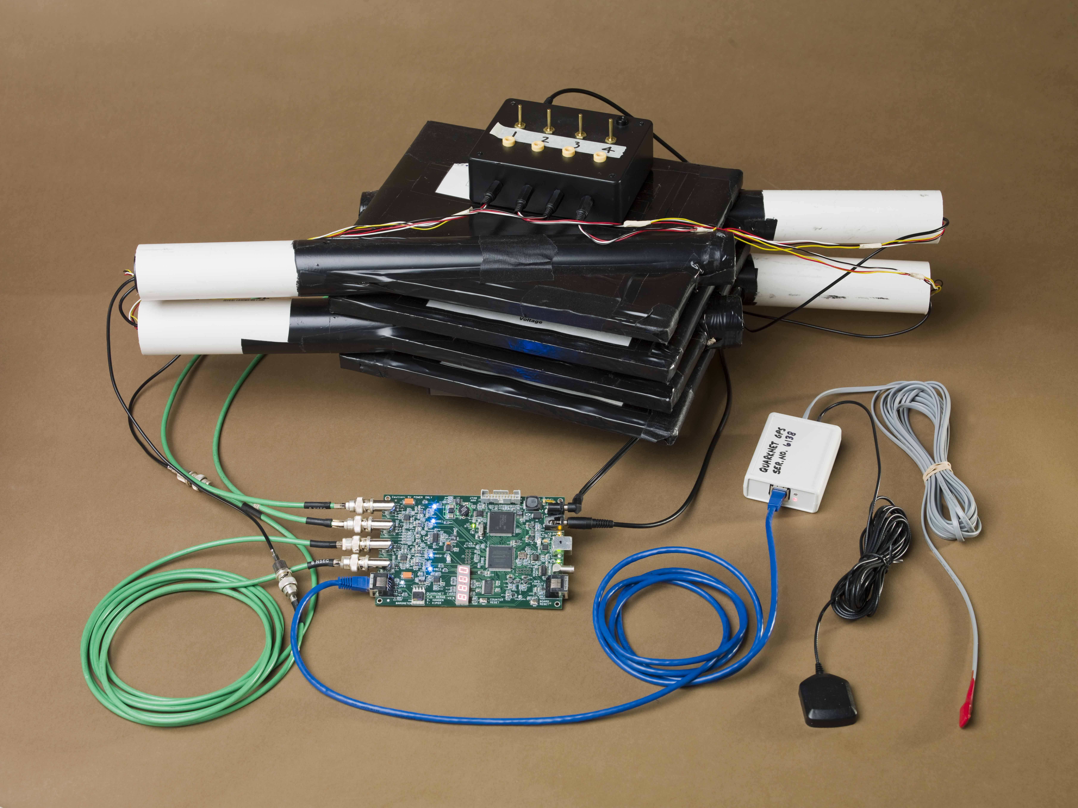
Cosmic Rays

Slide 11
More Info
Web: parsl-project.org
GitHub: github.com/parsl
Docs: parsl.readthedocs.io/en/stable/
Slack: parsl-project.slack.com/
Email list: groups.google.com/forum/#!forum/parsl-user

