Slide 1
Metabolomic Differences Between Black and White Men with Metastatic Prostate Cancer
Presenter: Zhongyi (James) Guo
Email: zhongyi.guo@stanford.edu

Slide 2
“Prostate cancer has the largest racial disparities of any cancer in the United States.” [1]

Slide 3
Incidence Rate
Per 100,000 persons (2017–2021, Age-Adjusted)
188.7
Black
White
1.64x
114.9
National Cancer Institute (https://seer.cancer.gov/statfacts/html/prost.html)

Slide 4
Death Rate
Per 100,000 persons (2017–2021, Age-Adjusted)
37.2
Black
White
2.06x
18.1
National Cancer Institute (https://seer.cancer.gov/statfacts/html/prost.html)

Slide 5
Previous Evidence
Among Black men
Upregulated lipid metabolism in prostatectomy specimens [2]
Acyl carnitines and sphingolipid enrichment in prostatic fluid [3]
Few studies used blood samples
White-dominant populations [4-7] || prostate cancer vs. prostate cancer-free [8]
None on Black–White differences

Slide 6
Aim
Introduce a pilot study that bridges the gap

Slide 7
Research Question
What is the difference in blood-based metabolomic profiles between Black and White men with metastatic hormone-sensitive prostate cancer (mHSPC) in the United States?

Slide 8
PICO
P: 34 men (17 Black, 17 White) with mHSPC enrolled from the International Registry for Men with Advanced Prostate Cancer
I: Black Race
C: White Race
O: Metabolomic profile from blood plasma

Slide 9
“Table 1”
 | Overall (n = 34) | Black (n = 17) | White (n = 17)
Age at Enrollment (n, %)
50 – 59 years | 8 (23.4) | 5 (29.4) | 3 (17.6)
60 – 69 years | 16 (47.1) | 7 (41.2) | 9 (52.9)
70 – 79 years | 10 (29.4) | 5 (29.4) | 5 (29.4)
Body Mass Index (n, %)
< 25 kg/m² | 9 (26.5) | 4 (23.5) | 5 (29.4)
25 - < 30 kg/m² | 11 (32.4) | 4 (23.5) | 7 (41.2)
≥ 30 kg/m² | 12 (35.2) | 7 (41.2) | 5 (29.4)
Not Available | 2 (5.8) | 2 (11.8) | 0

Slide 10
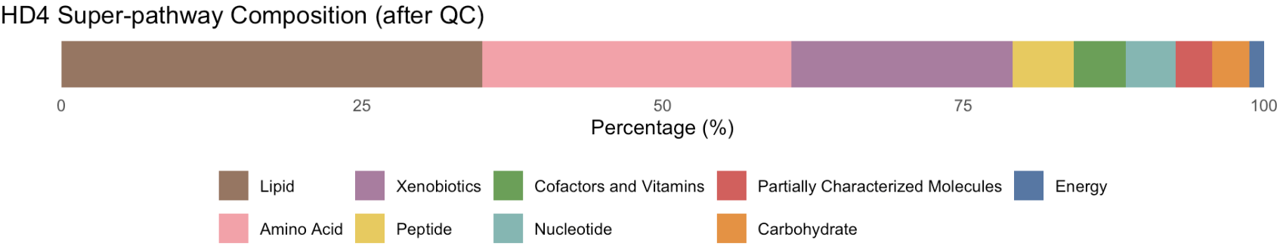
Two Panels (Part I)
1. Global Discovery Panel (HD4)
Quantified various classes of metabolites
Total after quality control: 886 metabolites
27
11
310
228
163
45
38
37
27

Slide 11
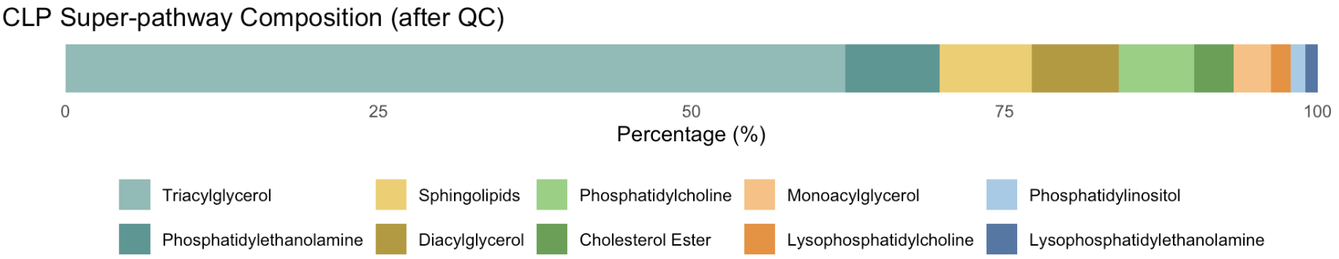
Two Panels (Part 2)
2. Complex Lipidomics Panel (CLP)
Quantified lipids only
Total after quality control: 832 lipids
26
25
13
8
518
63
61
58
50
10

Slide 12
Statistical Analyses
Welch’s t-test
Principal Component Analysis (PCA)
Partial Least Square-Discriminant Analysis (PLS-DA)
Random Forest
All analyses were performed in Jupyter Notebook with an R kernel (version 4.3.1); Some visualizations were enhanced using Photoshop.

Slide 13
Motivation
Look for metabolites consistently found across all analyses

Slide 14

Welch’s T-Test
Motivation
Compare mean metabolite concentrations (Black vs White)
Multiple hypothesis testing
Performing ~1,700 t-tests can inflate false positive (Type I error)
Used false discovery rate adjusted q-values
Statistical significance: q < 0.1

Slide 15

T-Test Results
42 global metabolites
6 Elevated in Black men: mostly amino acid-related
e.g., serotonin (q = 0.03),
N-acetylcitrulline (q = 0.09),
N-acetyl-cadaverine
(q = 0.09)
36 Elevated in White men: mostly lipid-related
e.g., various dicarboxylates and acyl carnitine derivatives
0 complex lipids
statistically significant

Slide 16
PCA
Motivation
reduce high-dimensional metabolite data into a few principal components (PC) to capture the major patterns of variation

Slide 17
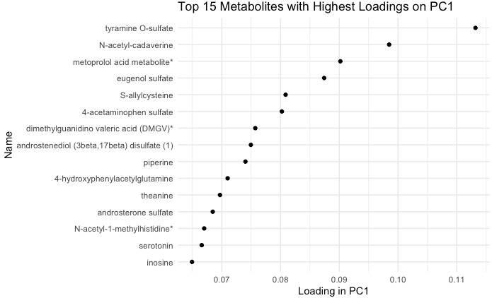
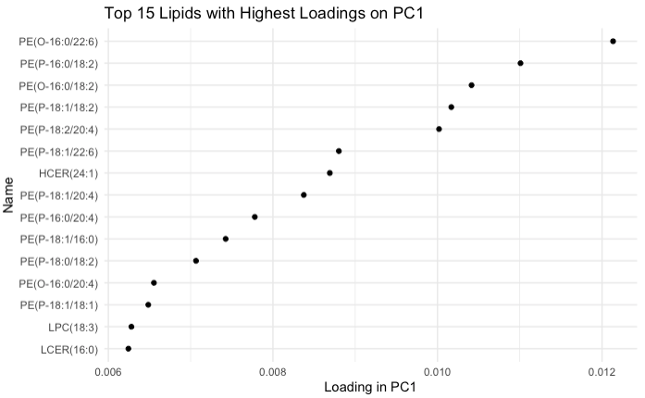
Top 15 Compounds with Highest Loading
HD4
Loading: weight of a metabolite’s contribution to PC1
HD4: Serotonin and N-acetyl-cadaverine from t-test again
CLP: Phosphatidylethanolamine (PE)
CLP
Notes:
Higher -> this metabolite captured higher variation in PC1 -> higher potential to be biologically meaningful

Slide 18
PLS-DA
Motivation
a supervised dimensionality reduction method
maximizes the separation between Black and White individuals

Slide 19
VIP Scores
Variable Importance in Projection
Quantifies a metabolite’s importance in the model’s ability to distinguish between groups
Notes:
Higher -> more important for explaining the separation between groups

Slide 20
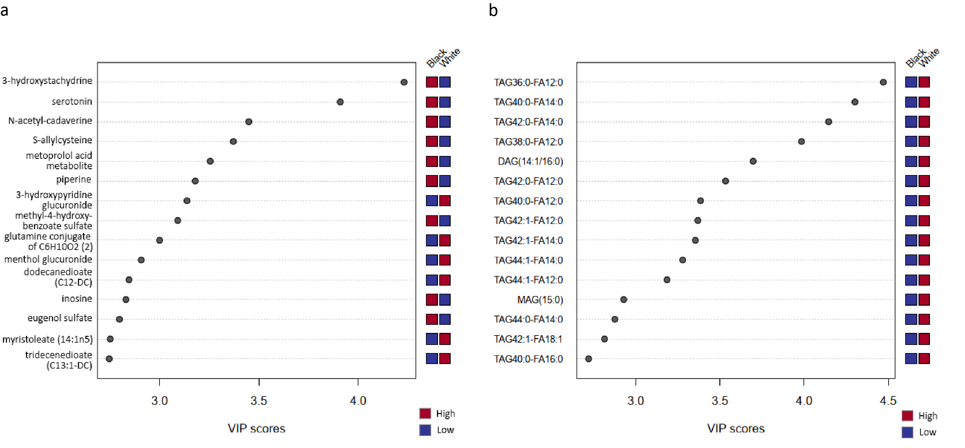
HD4: Serotonin and N-acetyl-cadaverine again! 3-hydroxystachydrine highest
CLP: Triacylglycerol (TAG) class
HD4
CLP

Slide 21
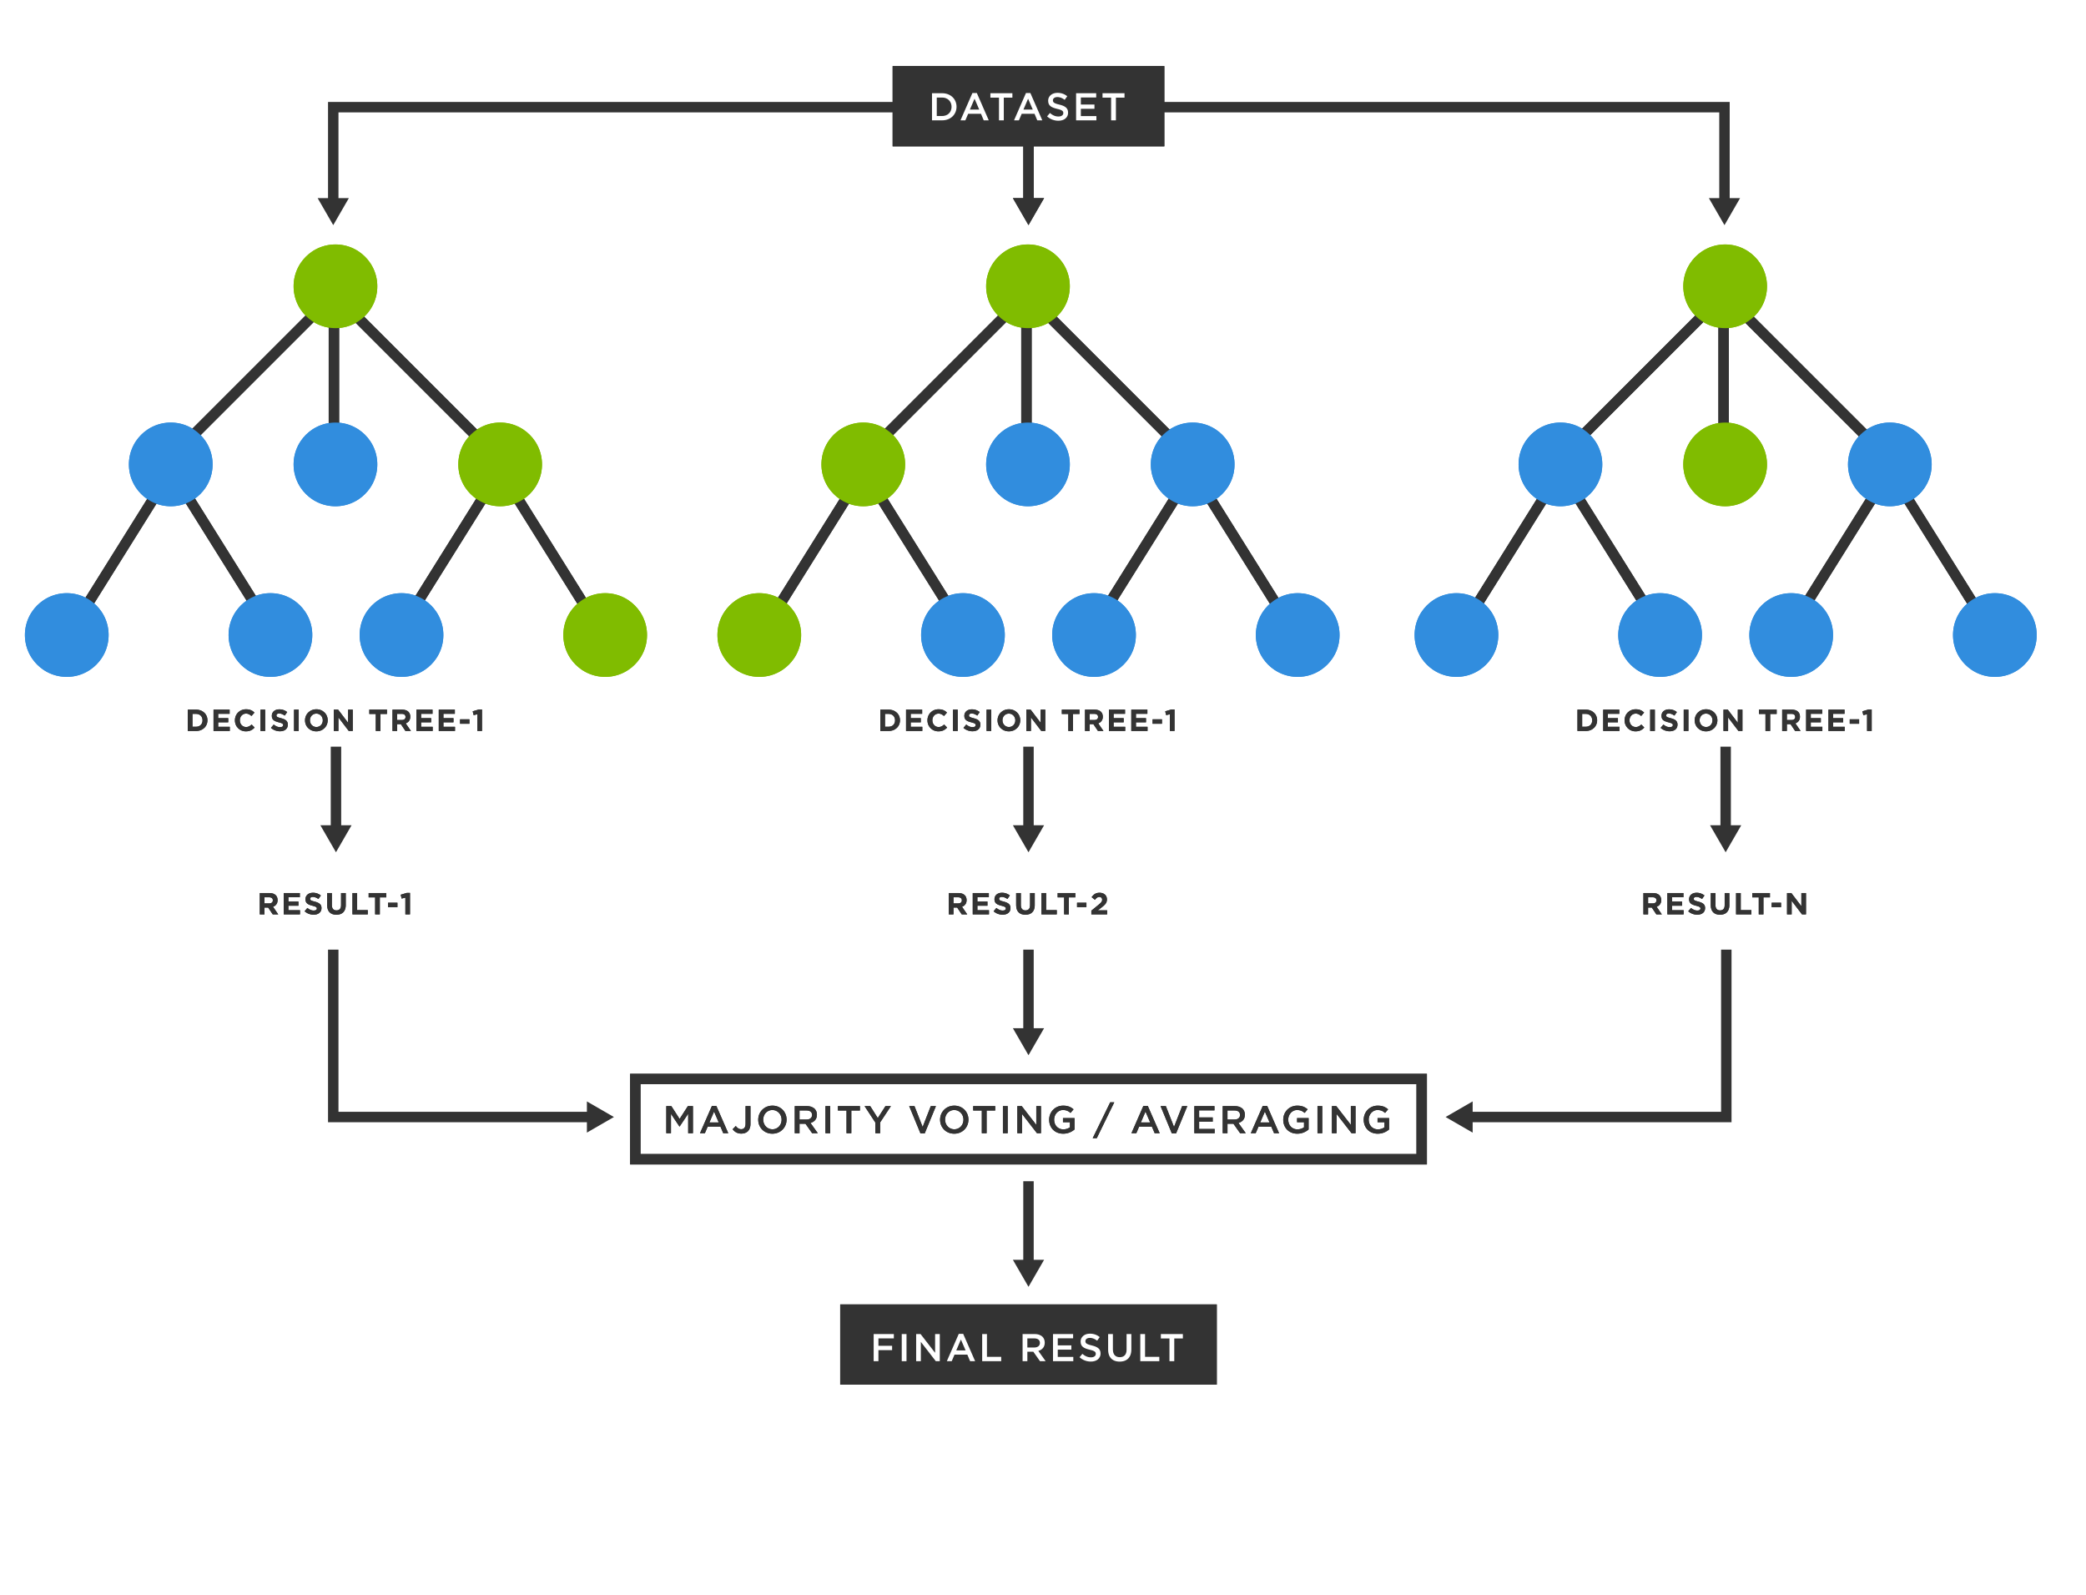
Random Forest (RF)
Motivation
a machine learning classifier

Slide 22
MDA Scores
Mean Decrease Accuracy
Measures how much the model’s accuracy drops when we permute the values of that metabolite across all samples
Notes:
Higher -> model relies more heavily on that metabolite -> This metabolite contributes more predictive power than others -> more likely to be biologically meaningful

Slide 23
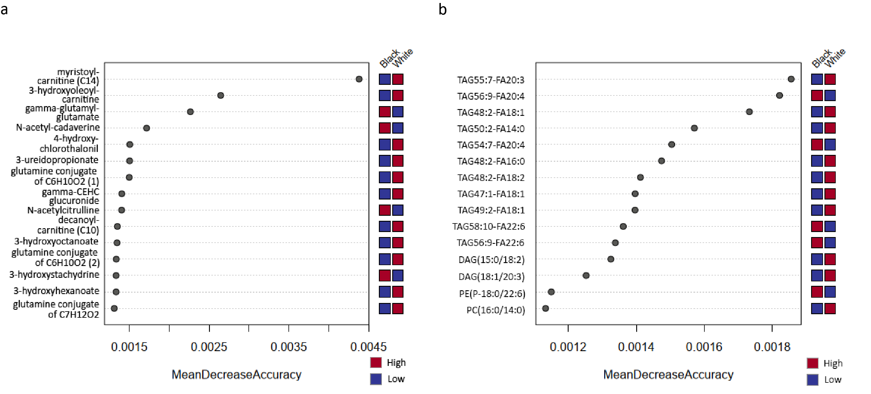
HD4
N-acetyl-cadaverine (from t-test and PLS-DA) and N-acetylcitrulline (from t-test) again
3-hydroxystachydrine (from PLS-DA) again
Acyl carnitine derivatives and glutamine derivatives were also found
CLP
TAG again
HD4
CLP

Slide 24
Conclusion
HD4: Serotonin, N-acetylcitrulline, and N-acetyl-cadaverine were consistently found across multiple analyses
CLP: TAGs were found across multiple analyses
Ontological perspectives
Serotonin: synapse
N-acetylcitrulline: arginine synthesis
N-acetyl-cadaverine: brain GABA (inhibitory neurotransmitter) synthesis
TAGs: related to PE conversion (cell membrane)

Slide 25
Limitations
Limited statistical power
Small sample size (n = 50)

Slide 26
Thank you all!
Especially
Professor Rebecca Graff at UCSF
Professor John Witte at Stanford
And also my Chinese “family” :3

Slide 27
References
[1] Gulati et al., Racial disparities in prostate cancer mortality: a model-based decomposition of contributing factors, JNCI Monographs, Volume 2023, Issue 62, November 2023, Pages 212–218. doi: 10.1093/jncimonographs/lgad018
[2] Berchuck et al. The Prostate Cancer Androgen Receptor Cistrome in African American Men Associates with Upregulation of Lipid Metabolism and Immune Response. Cancer Res. 2022;82(16):2848-2859. doi:10.1158/0008-5472.CAN-21-3552
[3] Trock et al. Mp45-11 metabolomics of black-white differences in risk of prostate cancer biochemical recurrence. J Urol. 2022;207(Supplement 5):e766. doi:10.1097/JU.0000000000002611.11
[4] Zheng et al. Distinct Metabolic Signatures of Hormone-Sensitive and Castration-Resistant Prostate Cancer Revealed by a1 H NMR-Based Metabolomics of Biopsy Tissue. J Proteome Res. 2020;19(9):3741-3749. doi:10.1021/acs.jproteome.0c00282

Slide 28
[5] Lin et al. A distinct plasma lipid signature associated with poor prognosis in castration‐resistant prostate cancer. Int J Cancer. 2017;141(10):2112-2120. doi:10.1002/ijc.30903
[6] Lin et al. Aberrations in circulating ceramide levels are associated with poor clinical outcomes across localised and metastatic prostate cancer. Prostate Cancer Prostatic Dis. 2021;24(3):860-870. doi:10.1038/s41391-021-00338-z
[7] Lin et al. Overcoming enzalutamide resistance in metastatic prostate cancer by targeting sphingosine kinase. eBioMedicine. 2021;72:103625. doi:10.1016/j.ebiom.2021.103625
[8] Lin et al. Relationship between Circulating Lipids and Cytokines in Metastatic Castration-Resistant Prostate Cancer. Cancers. 2021;13(19):4964. doi:10.3390/cancers13194964

Slide 29
[9] Mak et al. Combined impact of lipidomic and genetic aberrations on clinical outcomes in metastatic castration-resistant prostate cancer. BMC Med. 2022;20(1):112. doi:10.1186/s12916-022-02298-0
[10] Mak et al. Modulation of Plasma Lipidomic Profiles in Metastatic Castration-Resistant Prostate Cancer by Simvastatin. Cancers. 2022;14(19):4792. doi:10.3390/cancers14194792
[11] Scheinberg et al. PCPro: a clinically accessible, circulating lipid biomarker signature for poor-prognosis metastatic prostate cancer. Prostate Cancer Prostatic Dis. 2024;27(1):136-143. doi:10.1038/s41391-023-00666-2

