Slide 1
Static Taint Analysis with Ghidra
Master’s Project
Student: Jacob Gilhaus
Advisor: Dr. Ning Zhang

Slide 2

Outline
Background
Firmware security
Ghidra
Taint Analysis
Related Work
Design
Implementation
DEMO
Evaluation
Discussion
Conclusion
https://github.com/NationalSecurityAgency/ghidra/

Slide 3

Background
Firmware
Security implications
Firmware update risk, frequency
Introduce their own bugs
In IoT, cost is a big factor
Ghidra
NSA reverse engineering tool released to the public in 2019, similar to IDA PRO
Taint Analysis
“The process of software engineers checking the flow of user input in application code to determine if unanticipated input can affect program execution in malicious ways.”
thecyberwire.com
https://github.com/NationalSecurityAgency/ghidra/
Notes:
Firmware definition:
“Permanent (?!) software programmed into a read-only memory.”
-Oxford Languages
Better: Software that controls the low-level control and integrates with the device’s hardware
Taint analysis can be implemented and enabled within programming languages as well
PERL?

Slide 4
Related Work
Binary Ninja
Taint analysis with memcpy
River Loop Security
Similar, integrate Ghidra instead
P-code
FirmXRay
RFC 9019
Firmware update standardization effort
SaTC
Shared keywords
Karonte
Taint engine, multi-binary focused
Notes:
Binja competing tool
RLS took advantage of Ghidra being released to illustrate its capabilities
FirmXRay worked on bare-metal firmware with Ghidra
RFC outlines update process to be standardized to up IoT security
SaTC is our inspiration
Karonte is a taint engine tool used by SaTC
ANGR based, symbolic execution
IPC

Slide 5
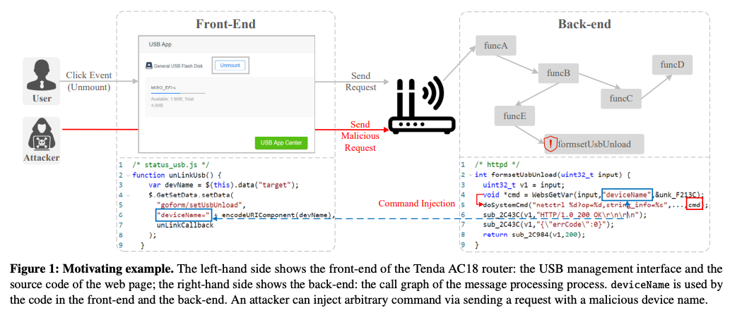
SaTC
“Sharing More and Checking Less”
Leveraging Common Input Keywords to Detect Bugs in Embedded Systems
Ghidra and ANGR taint analysis
Notes:
Did a deep dive on this paper
Explain shared keywords with image

Slide 6


Design
Previous works were exploit specific
Leveraged different toolchain
Didn’t extract full potential from Ghidra
Coarse, no CFG
Instruction-level
Separate scripts for Buffer Overflow and Command Injection
Notes:
Improved and expanded Ghidra functionality on SaTC

Slide 7
Ghidra API
Headless
Tons of resources, but limited examples
Symbol Table
Functions
Flow Type
Modeling Options
Simple and Basic Block Models
Notes:
Also a graphing and visualization module, but requires more work

Slide 8
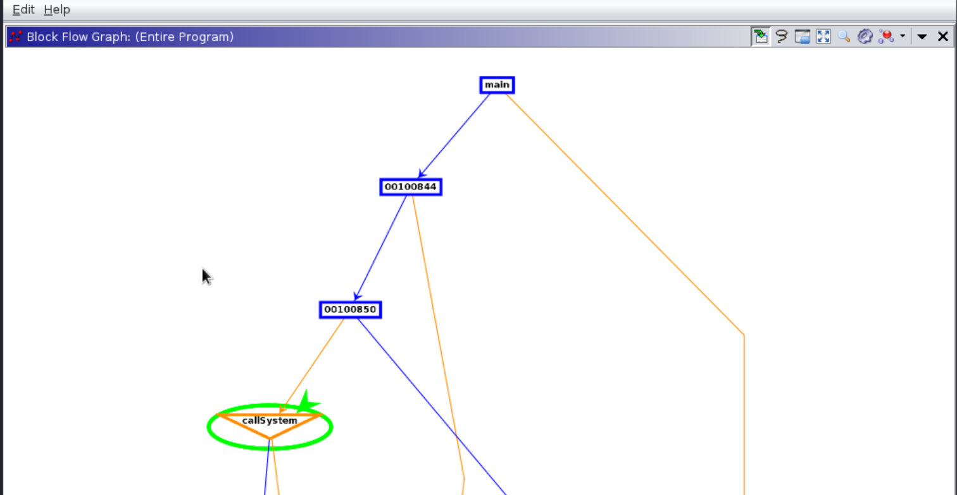
Design: Block-level
Any branch, end of function, or conditional must be the last instruction in a block
Middle-ground between function-level and instruction-level
Notes:
No need to look at every instruction
We just need to know where the program might offer multiple paths

Slide 9
Design: Fine-grained
SaTC was very coarse
Callmap simply collected a dictionary of functions and their addresses to calls
Instead, use control-flow
Still depth-first
Faster, more efficient
Can explore deeper
Notes:
Doesn’t explore every function, only those in the control-flow
Follows from bbm, since simple to call getDestinationblocks()
Can explore deeper than the instruction method, finds more paths

Slide 10
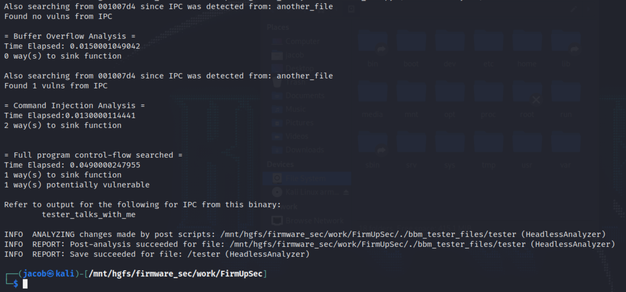
Design: Generality
Exploit independent, control-flow capable
1 primary script
Multi-binary compatible
Takes input from a file
Notes:
SaTC ran multiple scripts which slowed down the overall tool
Especially since they were instruction-level
Control-flow can be helpful in finding all paths, identifying issues in the update process as an example

Slide 11
Demo
GitHub Repository
Kali on VMware with shared folder
Ghidra and necessary JDK
BufO and CMDI, but in a new framework
IPC checks
Full control-flow from main
Try to identify cryptographic library functions
Block paths can still be deep, but much clearer in this model
Notes:
Setup
Ghidra decompiler needs to function with your system
BRIEF mention of M1 chip
Explain the main functionality
Update ties into work done in other projects
Emphasize
Main.py
Taint_config.py
Ghidra_analysis
Use bof script to point out points we talked about
Bbm script
Demo
Simple binaries
Show detection of all 3 main vulns and a multi-binary example
Emphasize the timing
Run on a real-world binary

Slide 12
Evaluation
Netgear R6200v2 Timing example (seconds and paths to sink)
2 Binaries: httpd and check_fw
httpd | BufO | CMDI | Control-flow
BBM | 0.362 (5 paths) | 0.331 (3 paths) | 6.475 (39 paths)
SaTC | 4.946 (4 paths) | 2.499 (1 path) | X
check_fw | BufO | CMDI | Control-flow
BBM | 0.006 (0 paths) | 0.003 (0 paths) | 0.276 (4 paths)
SaTC | 0.018 (0 paths) | 0.014 (0 paths) | X
Notes:
Testing on a real firmware
Both big and small files
Keywords aren’t referenced in check_fw
Control-flow still allows analysis since it is a small file
Remind that control-flow finds paths from main
Bof and cmdi start at the location of the referenced keyword
When comparing apples to apples, the bbm taint engine is often faster and can find additional paths
When combined BBM is faster for HTTPD
Also adds new functionality
SaTC IPC also uses multiple scripts
Possible to combine these scripts in the future?

Slide 13
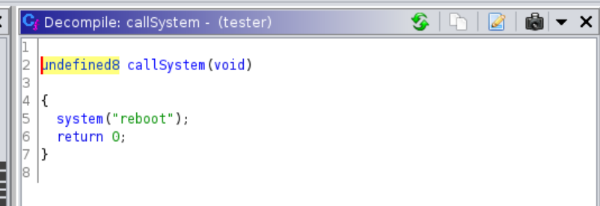
Discussion
Some issues remain
Primarily reverse engineering related
Would like to recover arguments more easily
Branch semantic information
Crypto identification false positives
Benchmarks for this kind of taint analysis?
Notes:
Uncertainty in reveng
Reason for symbolic execution and ANGR?
PCODE from RLS?
Crypto had lots of false positives
Would work much better in reverse
Benchmarks were hard to come by
Settled for examples to test and manual verification of paths through Ghidra GUI

Slide 14
Conclusion
The BBM taint engine takes advantage of many more Ghidra features
Finds more paths thanks to control-flow design and improved comparable speeds
New features exhibit the potential for using Ghidra to perform more general taint analysis, find library functions on certain paths, and still gracefully account for multi-binary and IPC scenarios

Slide 15
Questions?
Thanks to Dr. Zhang, Yuhao Wu, and the lab for being great resources during this project
* References in the paper draft associated with this presentation

