Slide 2
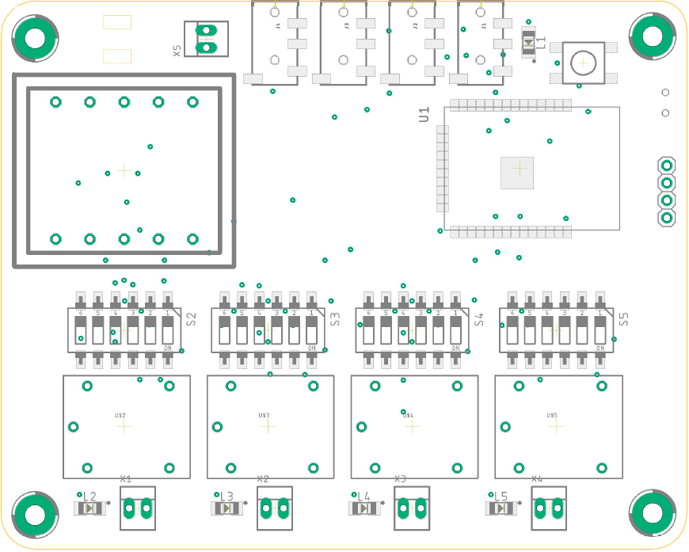




Power
Reset
220 VAC
Sensor 1
Sensor 2
Sensor 3
Sensor 4
Flash
Smart Garden
Serial
220 VAC
24 VAC
ESP 32
Output | Configuration
24 VAC | 000011
9 VDC | 100100
5 VDC | 101000
3,3 VDC | 110000
5V
Rx
GND
Tx
04/33
Sensor 1
14/32
Sensor 2
27/35
Sensor 3
26/34
Sensor 4
16
Output 1
17
Output 2
18
Output 3
19
Output 4
1
1
1
1
0
0
0
0
+
-
+
-
+
-
+
-
Output 1
Output 2
Output 3
Output 4

Slide 3
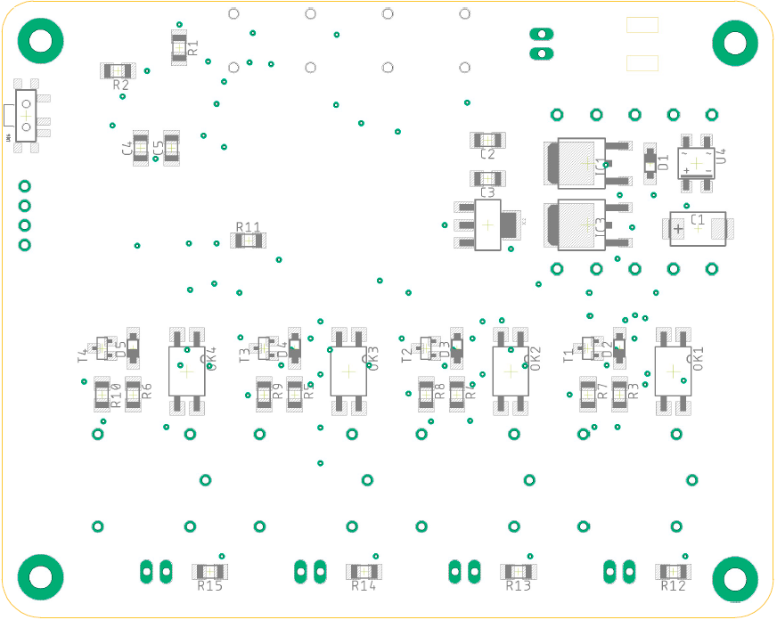

220 VAC
Flash
Smart Garden
by
J.G.Aguado
11/2020

Slide 4
Power
Reset
220 VAC
Sensor 1
Sensor 2
Sensor 3
Sensor 4
Flash
Smart Garden
Serial
220 VAC
24 VAC
ESP 32
Output | Configuration
24 VAC | 000011
9 VDC | 100100
5 VDC | 101000
3,3 VDC | 110000
5V
Rx
GND
Tx
04/33
Sensor 1
14/32
Sensor 2
27/35
Sensor 3
26/34
Sensor 4
16
Output 1
17
Output 2
18
Output 3
19
Output 4
1
1
1
1
0
0
0
0
+
-
+
-
+
-
+
-
Output 1
Output 2
Output 3
Output 4

Slide 5
220 VAC
Flash
Smart Garden
by
J.G.Aguado
11/2020

