Slide 2
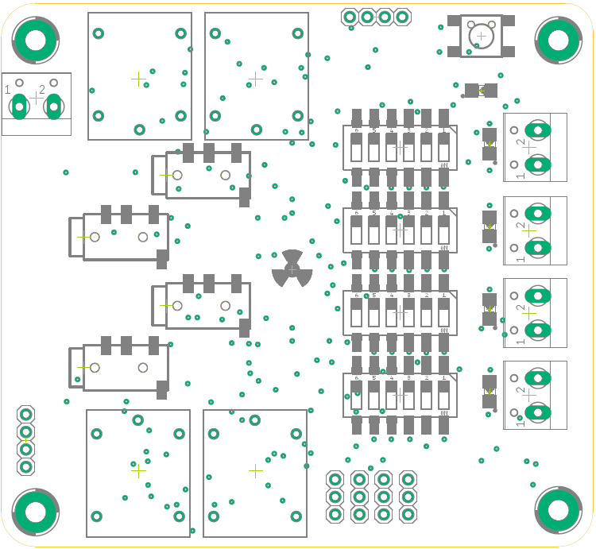


-
G
+
P
P
Smart Garden
Reset
Power
24 VAC
1
0
04/33
Input 1
16
Output 1
14/32
Input 2
1
17
Output 2
9
0
-
+
-
+
+
-
+
-
Output 4
Output 3
Output 2
Output 1
35/27
12
24
Input 3
1
18
Output 3
0
34/26
Input 4
19
Output 4
1
SERIAL
0
Rx
4
Tx
5V
GND
3
G
OUTPUT | SETUP
24 VAC | 000011
12 VDC | 100100
9 VDC | 101000
5 VDC | 110000
I
2
G
O
1
G

Slide 3
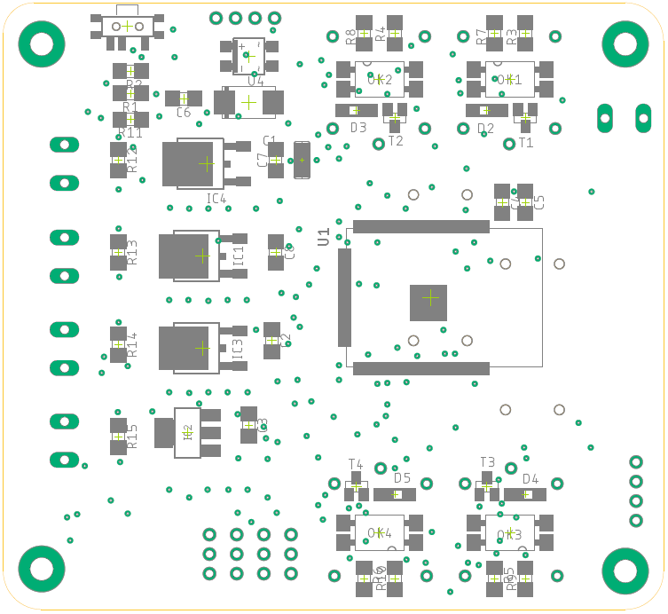
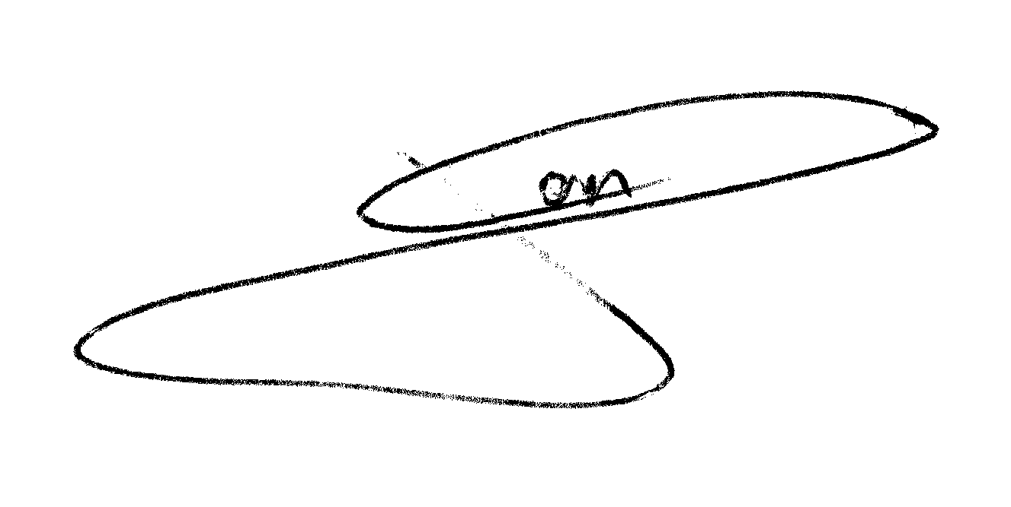
Flash
Smart Garden
by
J.G.Aguado
12/2020

Slide 4
-
G
+
P
P
Smart Garden
Reset
Power
24 VAC
1
0
04/33
Input 1
16
Output 1
14/32
Input 2
1
17
Output 2
9
0
-
+
-
+
+
-
+
-
Output 4
Output 3
Output 2
Output 1
35/27
12
24
Input 3
1
18
Output 3
0
34/26
Input 4
19
Output 4
1
SERIAL
0
Rx
4
Tx
5V
GND
3
G
OUTPUT | SETUP
24 VAC | 000011
12 VDC | 100100
9 VDC | 101000
5 VDC | 110000
I
2
G
O
1
G

Slide 5
Flash
Smart Garden
by
J.G.Aguado
12/2020

