Slide 2
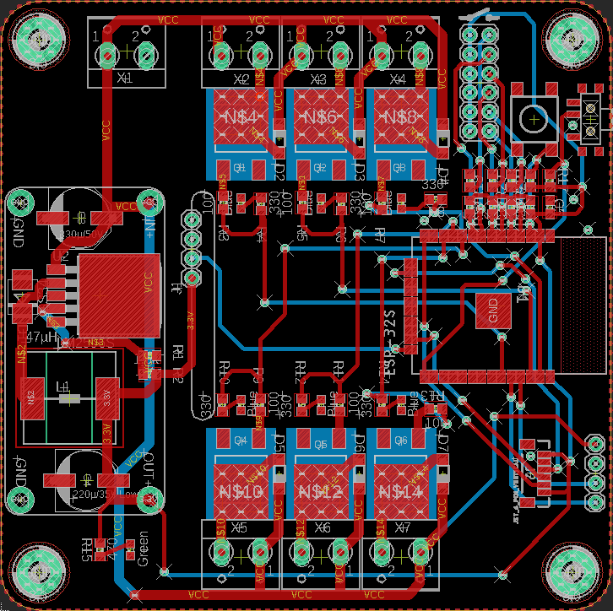



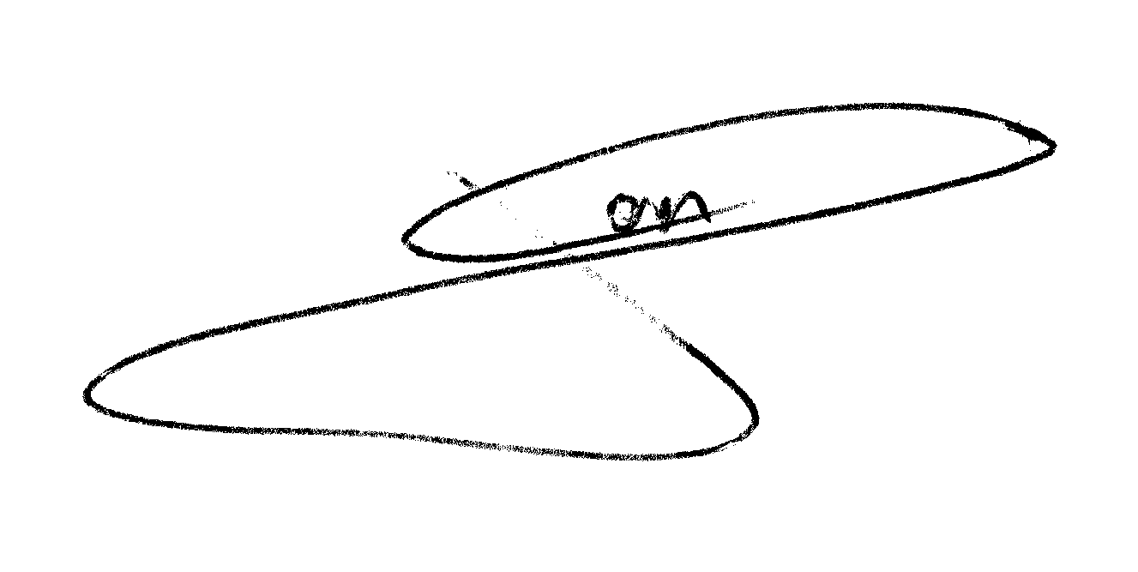
+
-
-
+
-
+
-
+
Reset
Power input 5-24 VDC
Flash
21
Output 1
23
Output 3
22
Output 2
Smart Lights
RF
Link
26
Output 5
25
Output 4
27
Output 6
ID SENSOR
SERIAL
Tx
Rx
5V
GND
Power
by
J.G.Aguado
12/2021
-
+
-
+
-
+

Slide 3
+
-
-
+
-
+
-
+
Reset
Power input 5-24 VDC
Flash
21
Output 1
23
Output 3
22
Output 2
Smart Lights
RF
Link
26
Output 5
25
Output 4
27
Output 6
ID SENSOR
SERIAL
Tx
Rx
5V
GND
Power
by
J.G.Aguado
12/2021
-
+
-
+
-
+

Slide 4
+
-
-
+
-
+
-
+
Reset
Power input 5-24 VDC
Flash
21
Output 1
23
Output 3
22
Output 2
Smart Lights
RF
Link
26
Output 5
25
Output 4
27
Output 6
ID SENSOR
SERIAL
Tx
Rx
5V
GND
Power
by
J.G.Aguado
12/2021
-
+
-
+
-
+

