Slide 2
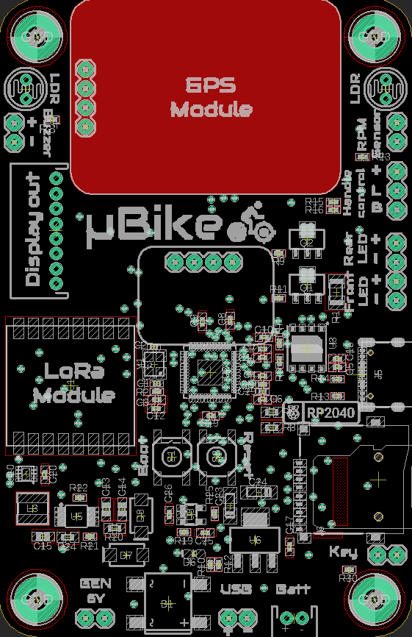



LDR
GPS
Module
LDR
+
-
RPM
Sensor
Buzzer
B
L
Handle control
µBike
+
Display out
Rear LED
+
-
Front LED
IMU Module
+
-
LoRa
Module
Boot
Reset
Key
GEN
6V
USB
Batt
+
-

Slide 3
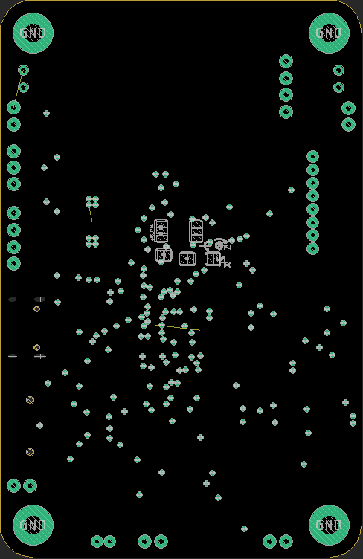
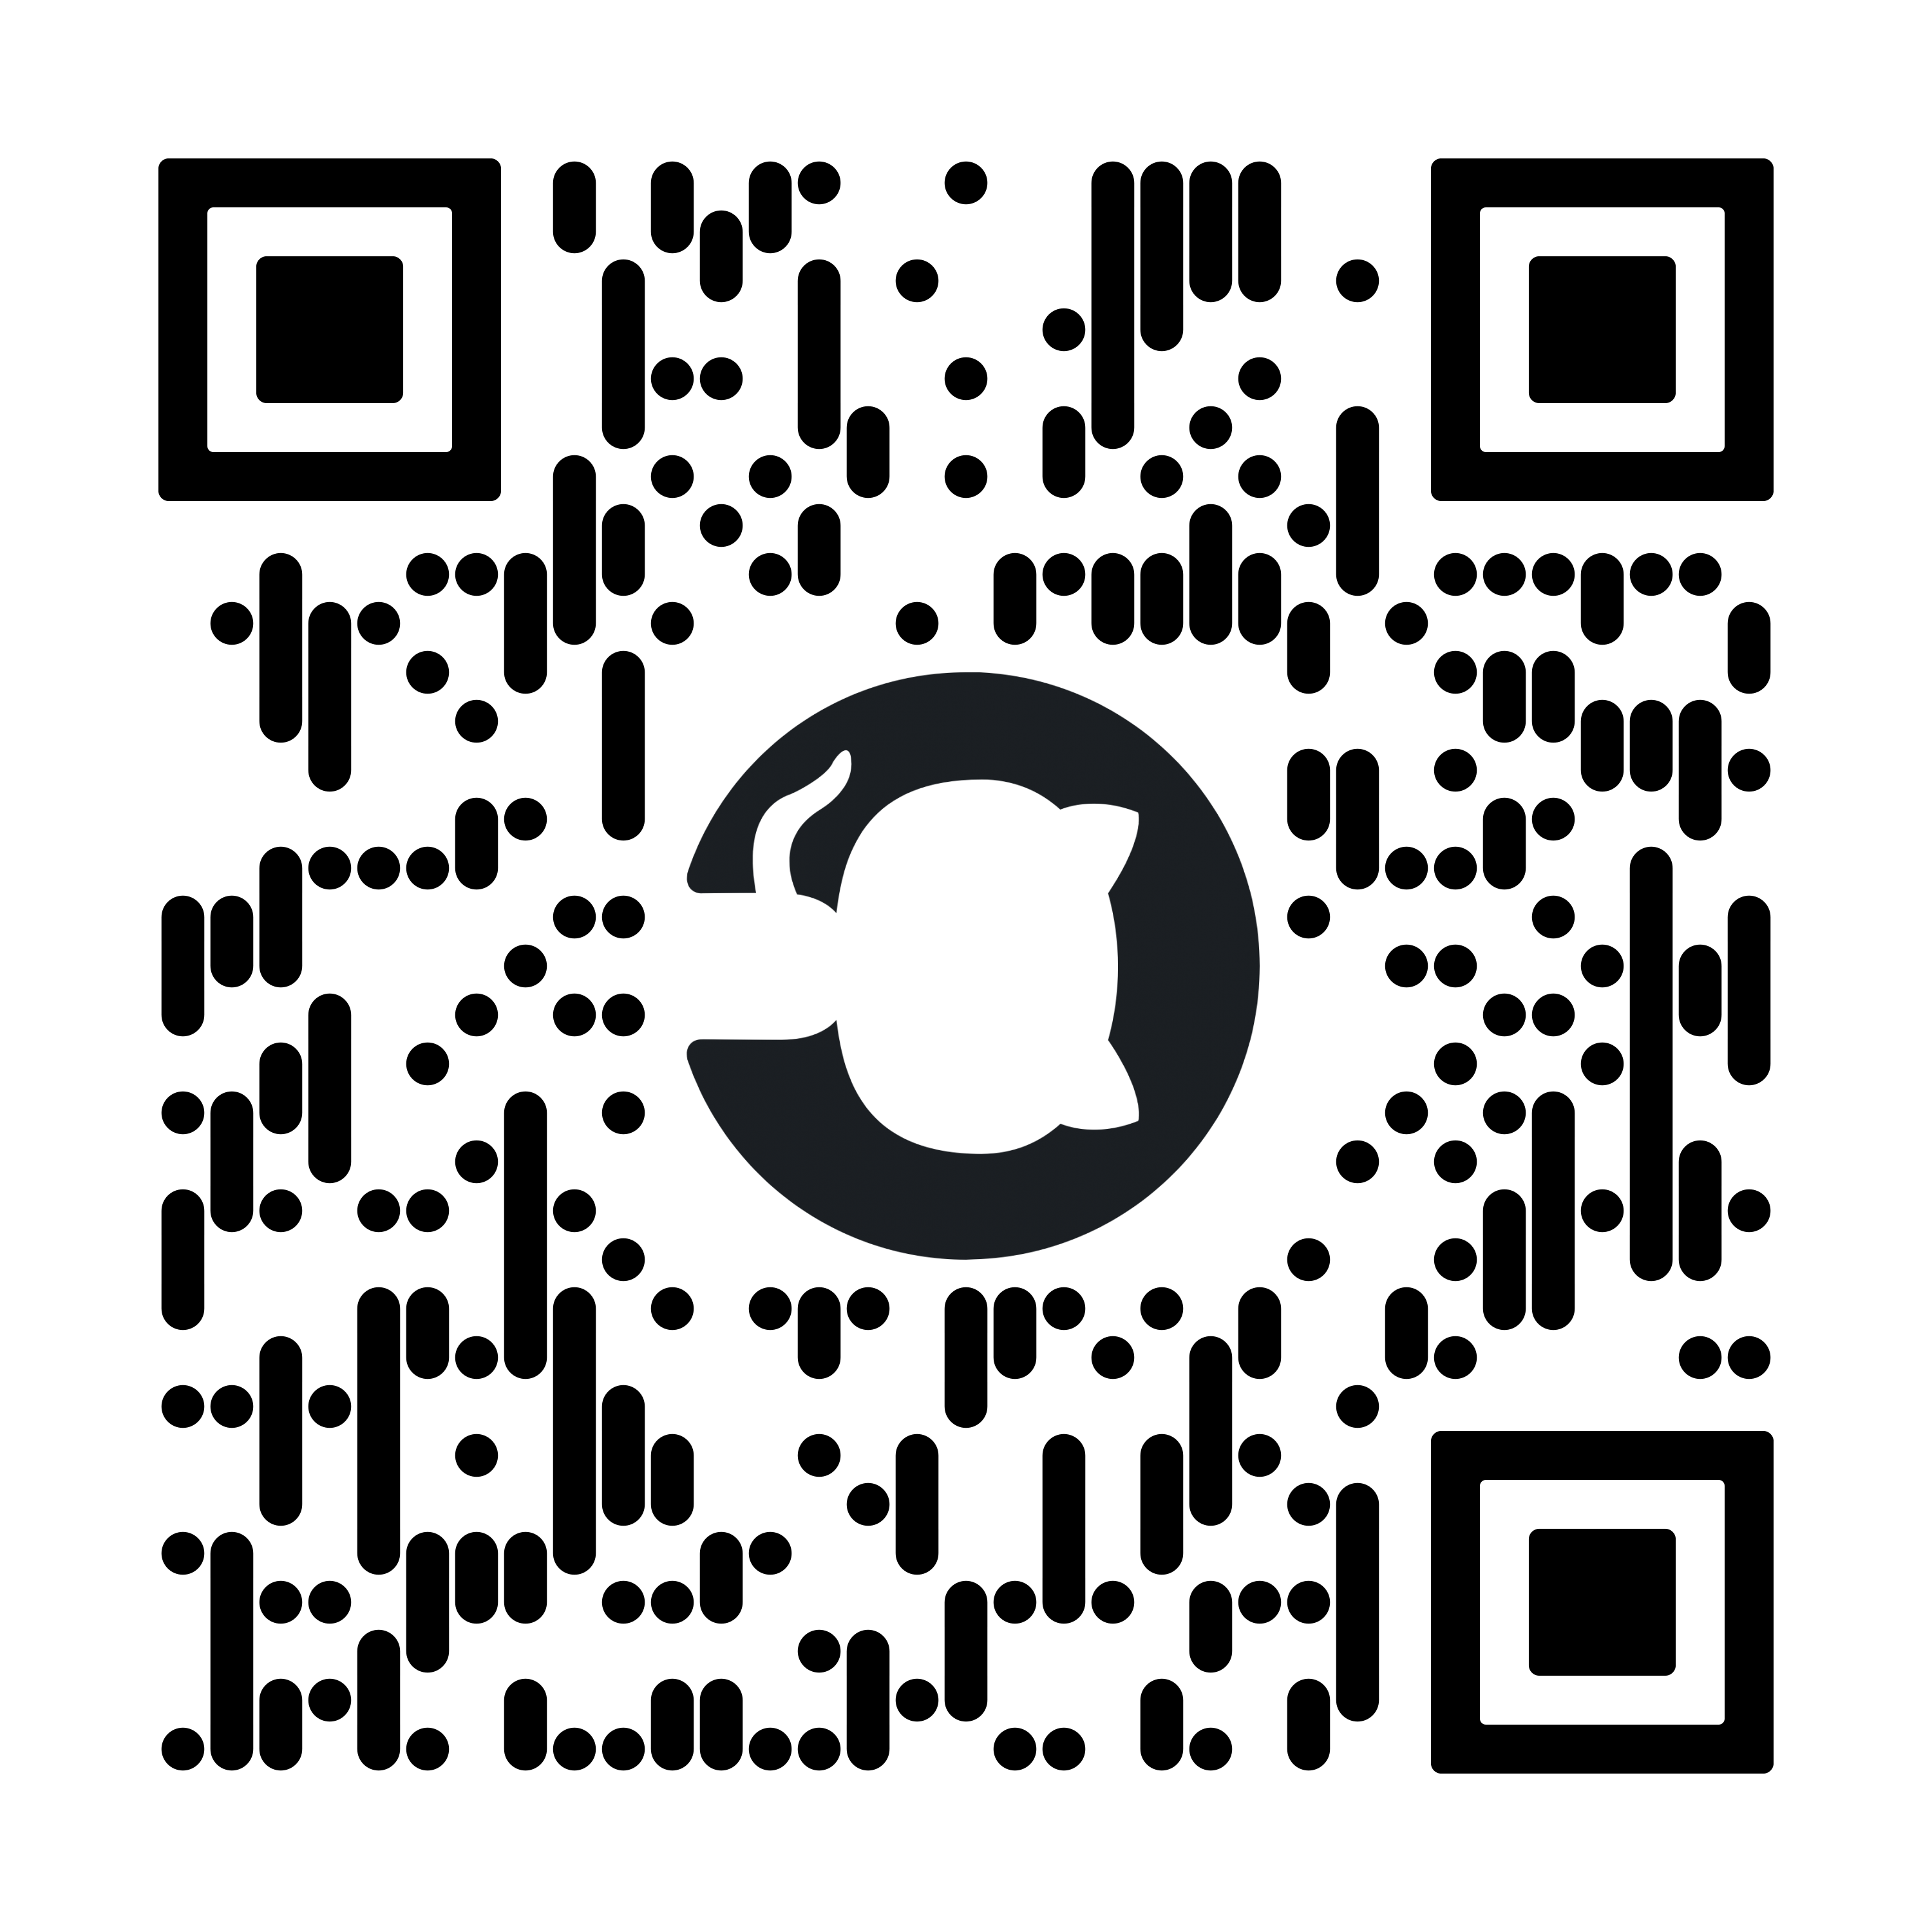



Jon García Aguado
+34 699 285 040
jon-garcia@hotmail..com
www.github.com/JGAguado

Slide 4
LDR
GPS
Module
LDR
+
-
RPM
Sensor
Buzzer
B
L
Handle control
µBike
+
Display out
Rear LED
+
-
Front LED
IMU Module
+
-
LoRa
Module
Boot
Reset
Key
GEN
6V
USB
Batt
+
-

Slide 5
Jon García Aguado
+34 699 285 040
jon-garcia@hotmail..com
www.github.com/JGAguado

