Slide 2
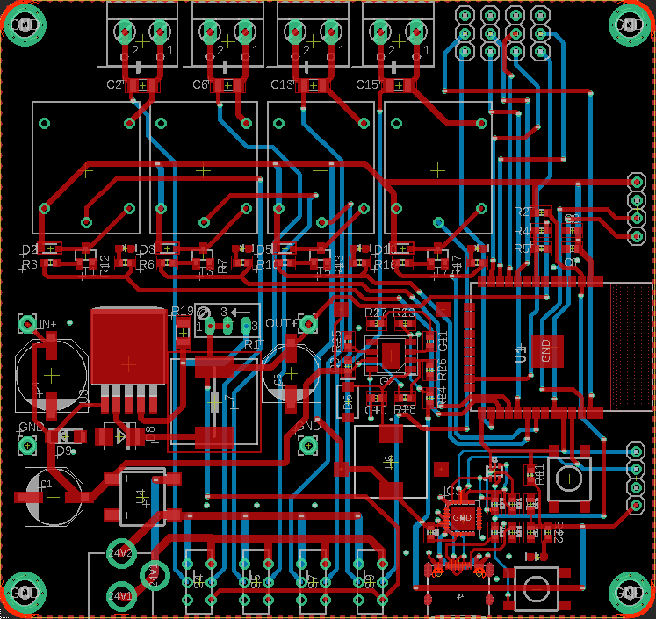


-
+
-
+
-
+
-
+
-
+
-
+
-
+
-
+
- | - | - | -
23 | 25 | 26 | 27
4 | 5 | 14 | 15
19
Output 4
I2C
3V
GND
SCL
SDA
16
Output 1
17
Output 2
18
Output 3
Flash
SERIAL
Smart Garden
Tx
3V
Rx
GND
24 VAC
24VAC
24VAC
24VAC
24VAC
Power
Reset
VDC
VDC
VDC
VDC

Slide 3
-
+
-
+
-
+
-
+
-
+
-
+
-
+
-
+
- | - | - | -
23 | 25 | 26 | 27
4 | 5 | 14 | 15
19
Output 4
I2C
3V
GND
SCL
SDA
16
Output 1
17
Output 2
18
Output 3
Flash
SERIAL
Smart Garden
Tx
3V
Rx
GND
24 VAC
24VAC
24VAC
24VAC
24VAC
Power
Reset
VDC
VDC
VDC
VDC

Slide 4
Smart Garden

Slide 5
Smart Garden

