Slide 2
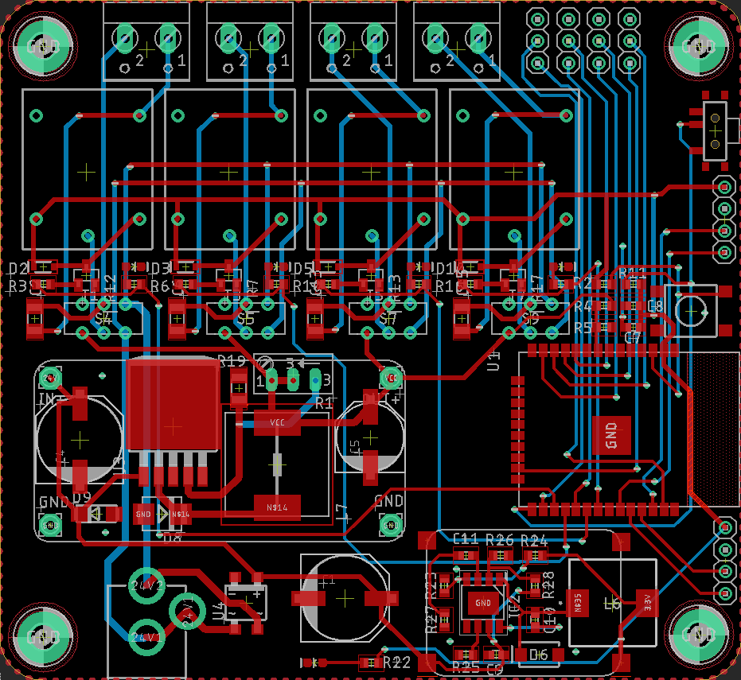


-
+
-
+
-
+
-
+
- | - | - | -
23 | 25 | 26 | 27
4 | 5 | 14 | 15
Flash
3V
GND
SCL
SDA
I2C
Reset
16
Output 1
17
Output 2
18
Output 3
19
Output 4
Smart Garden
24 VAC
Rx
Tx
3V
GND
SERIAL
Power

Slide 3
-
+
-
+
-
+
-
+
- | - | - | -
23 | 25 | 26 | 27
4 | 5 | 14 | 15
Flash
3V
GND
SCL
SDA
I2C
Reset
16
Output 1
17
Output 2
18
Output 3
19
Output 4
Smart Garden
24 VAC
Rx
Tx
3V
GND
SERIAL
Power

Slide 4
Smart Garden

Slide 5
Smart Garden

