Slide 2
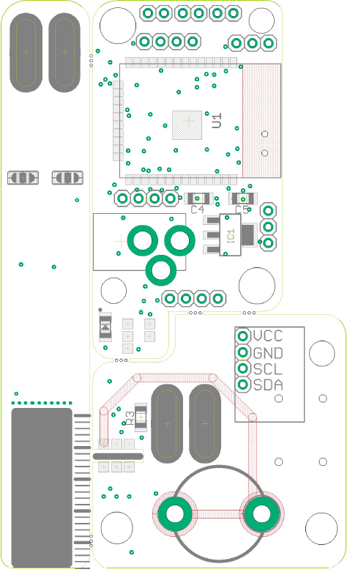

LED
Pumps 1|2
+ - 12 13
27 - 14
Probe 1
Water level
ESP 32
Horizontal
Vertical
Probe 2
+ - 2 15
RGB
GND
Ambient
SmartPot
Tx
5V
Rx
Power
VCC
by J.G.Aguado
GND
SCL
SDA
BME 280
Ambient
SmartPot
by J.G.Aguado
10/2020

Slide 3
LED
Pumps 1|2
+ - 12 13
27 - 14
Probe 1
Water level
ESP 32
Horizontal
Vertical
Probe 2
+ - 2 15
RGB
GND
Ambient
SmartPot
Tx
5V
Rx
Power
VCC
by J.G.Aguado
GND
SCL
SDA
BME 280
Ambient
SmartPot
by J.G.Aguado
10/2020

