Slide 2
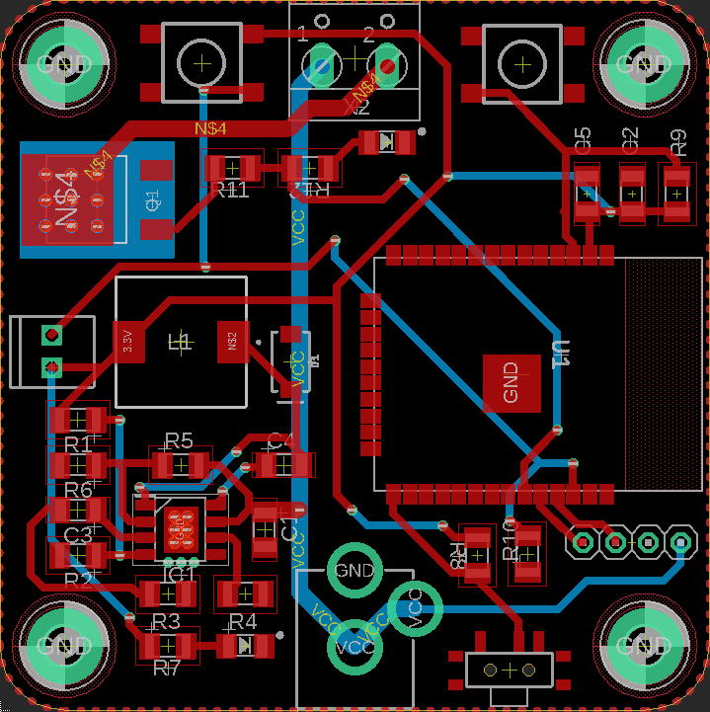


+
-
+
-
Button
Reset
Smart Lights
X1
21
Output
Input
22
Ext.
Button
12 VDC
+
-
SERIAL
Rx
Tx
GND
Flash
5V
Power

Slide 3
+
-
+
-
Button
Reset
Smart Lights
X1
21
Output
Input
22
Ext.
Button
12 VDC
+
-
SERIAL
Rx
Tx
GND
Flash
5V
Power

Slide 4
Smart Lights
X1
Maker Edition
Maker:
Date:

