Slide 2
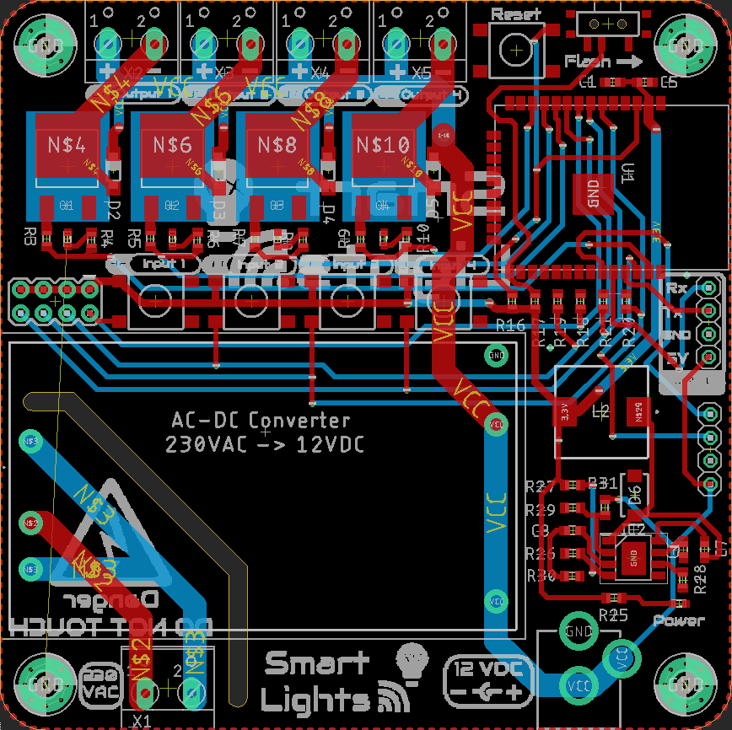


Reset
-
+
-
+
-
+
+
-
Flash
21
Output 1
36
Output 2
37
Output 3
25
Output 4
32
Input 1
33
Input 2
34
Input 3
35
Input 4
Tx
Rx
GND
3V3
SERIAL
3V3
SCL
SDA
GND
I2C
Power
Smart Lights
X4
12 VDC
230
VAC
-
+

Slide 3
Reset
-
+
-
+
-
+
+
-
Flash
21
Output 1
36
Output 2
37
Output 3
25
Output 4
32
Input 1
33
Input 2
34
Input 3
35
Input 4
Tx
Rx
GND
3V3
SERIAL
3V3
SCL
SDA
GND
I2C
Power
Smart Lights
X4
12 VDC
230
VAC
-
+

Slide 4

Smart Lights
X4
Danger DO NOT TOUCH

