Slide 1


PulsarCast
Scaling Pub-Sub over the distributed web
João Gonçalo da Silva Antunes
Instituto Superior Técnico
INESC-ID

Slide 2
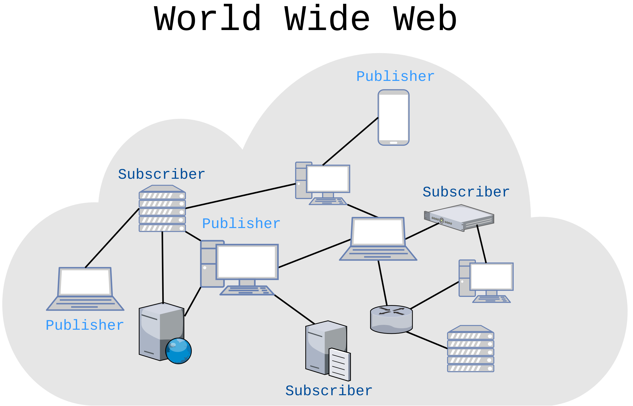
Motivation

Slide 3
Problems
Lack of a pub-sub system that:
Scales for a really large number of participants (web)
Provides reliability:
  Delivery guarantees
  Data persistence

Slide 4
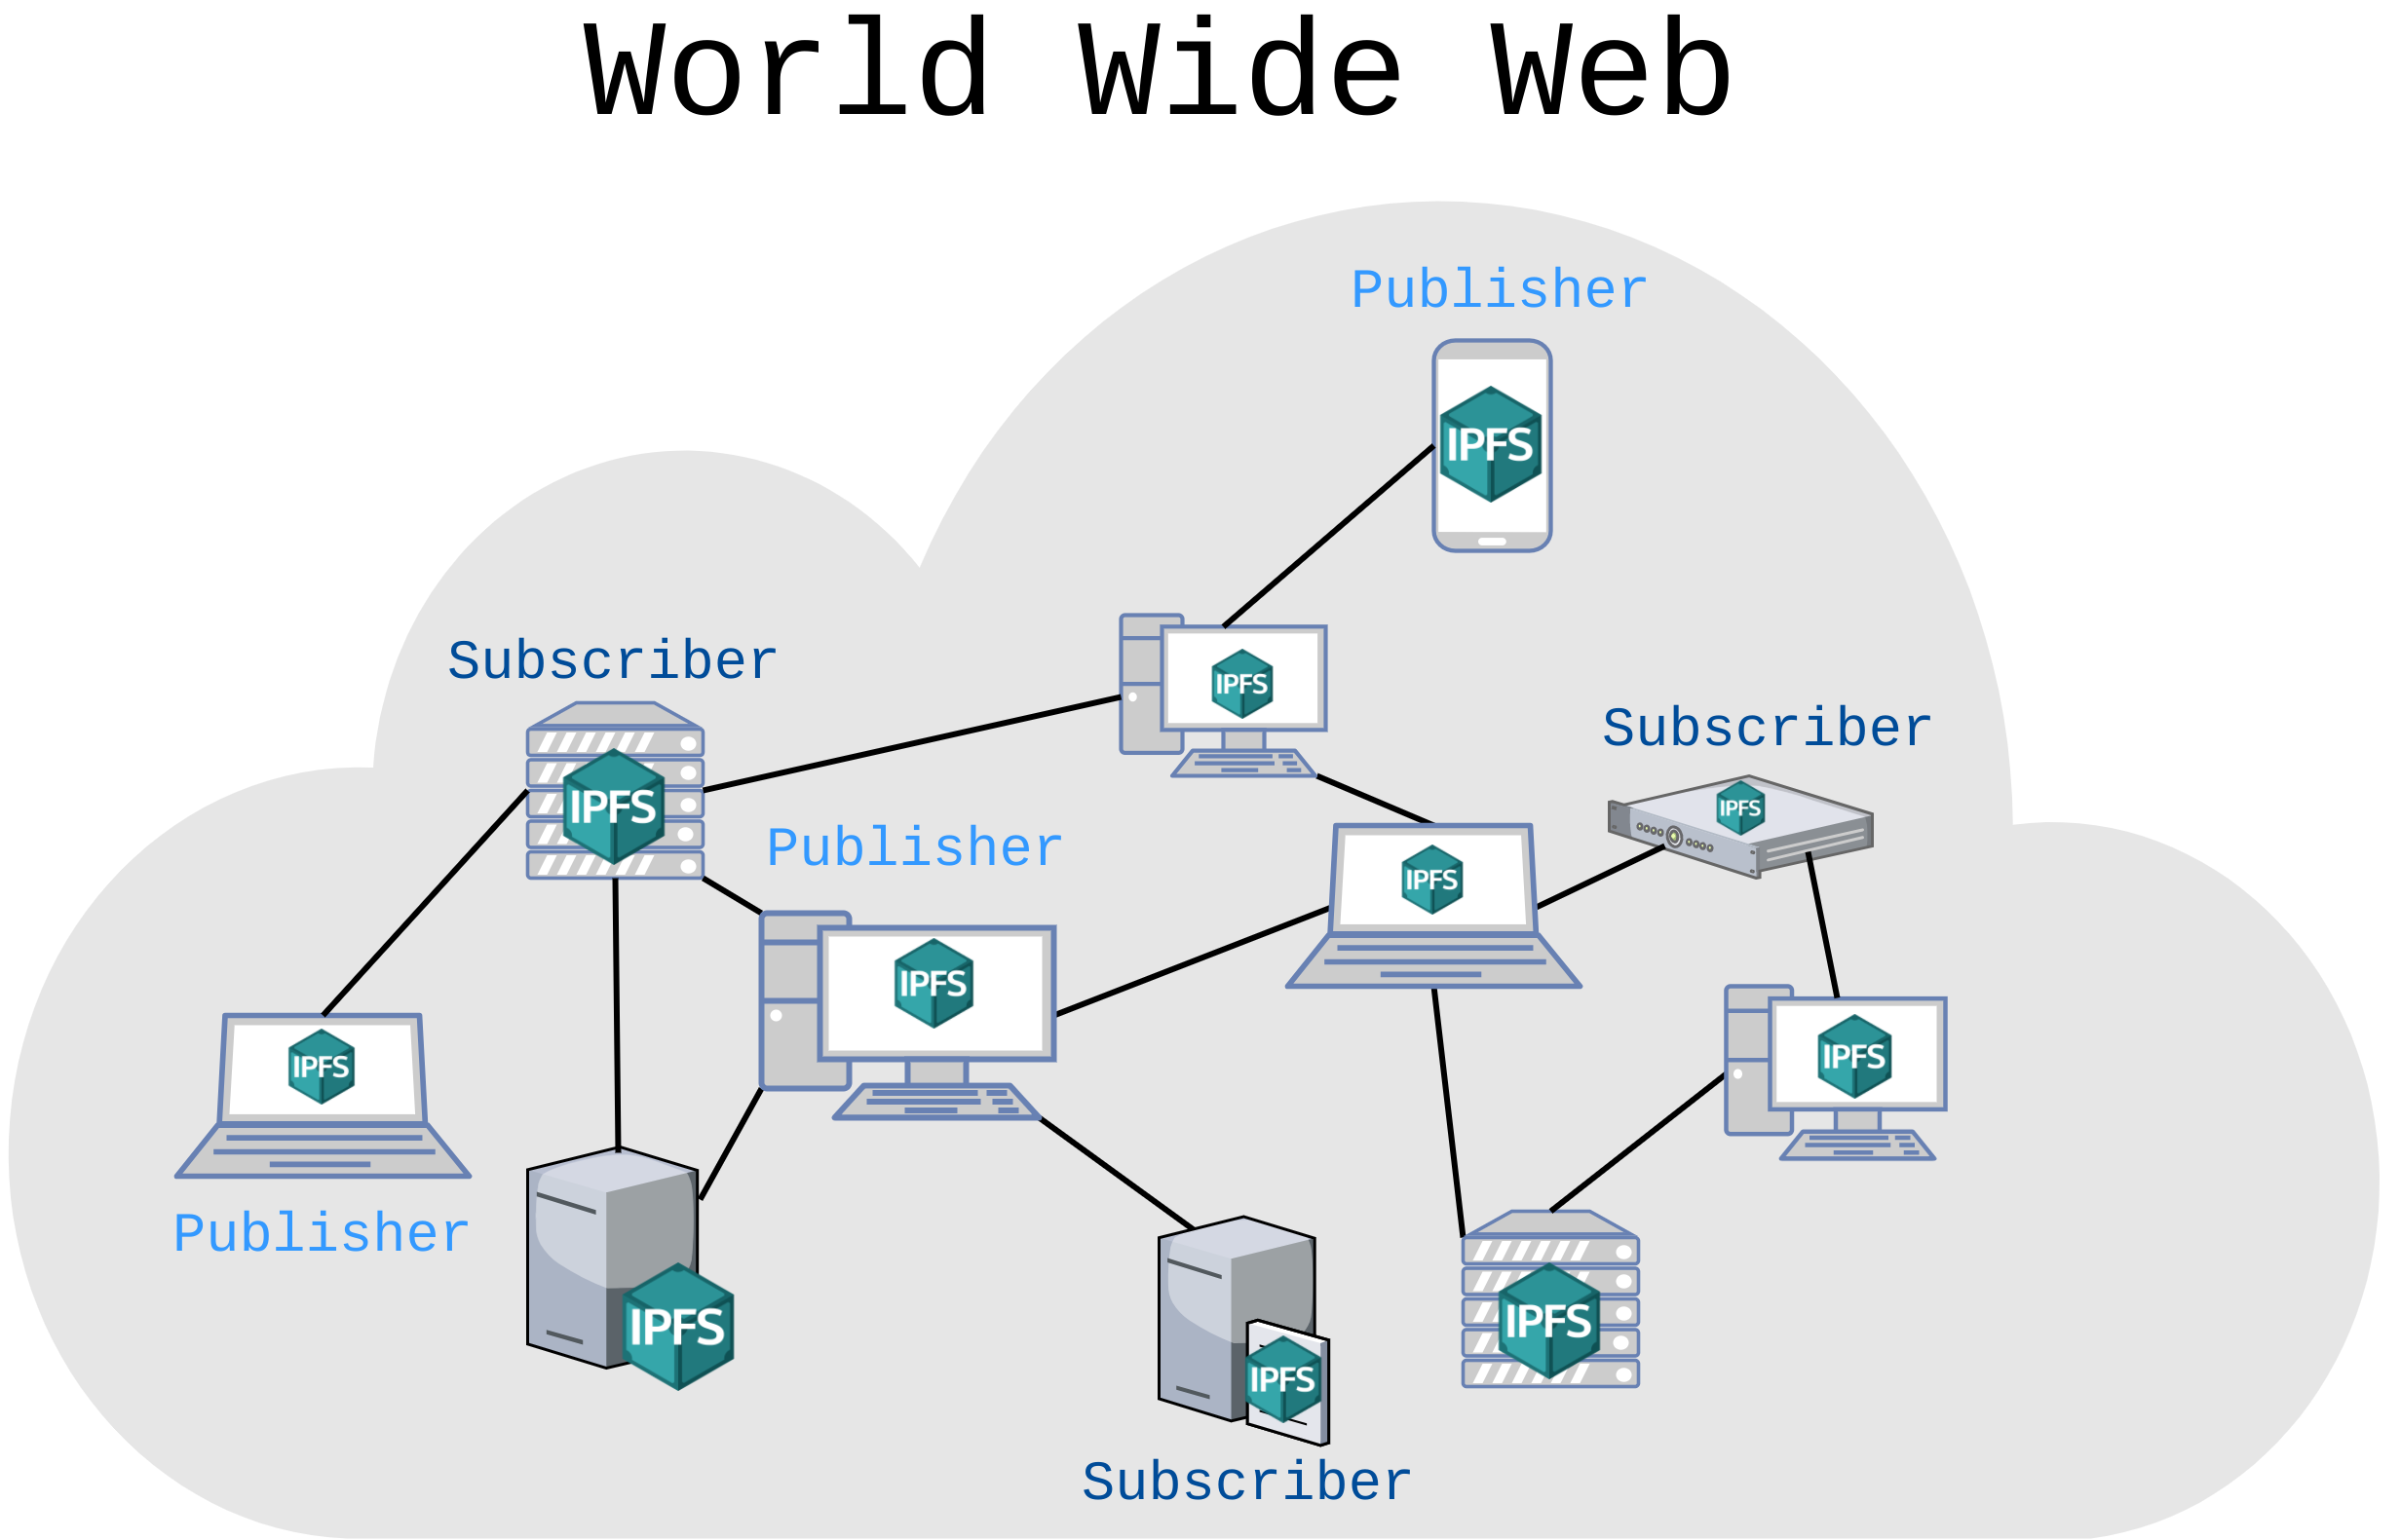
Objectives
Decentralised pub-sub system using IPFS:
  Highly scalable
  Reliable
  Assures persistence
Develop a solution that meets these requirements
Evaluate its performance on multiple environments

