Slide 1
Dénes Csala, Sgouris Sgouridis
Masdar Institute
Visualizing the
Energetic Sustainability
of Global and National
Agricultural and Food Systems
A brief presentation of
The Food Energy Flows
Exploratorium

Slide 2
Visualizing the
Energetic Sustainability
of Global and National
Agricultural and Food Systems
A brief presentation of
The Food Energy Flows
Exploratorium

Slide 3
agenda
Concept
Defining agriculture and food systems from the energy perspective
Energy return on energy investment (EROEI) in these systems
Methodology
Results
EROEI evolution globally and for individual nations
System energy input breakdown
Food energy flows visualized on Sankey diagrams
Global EROEI distribution
Insights
Notes:
Wealthy countries could afford to do that because of fossil fuels. 2 problems with that. Depletion and global warming.

Slide 4


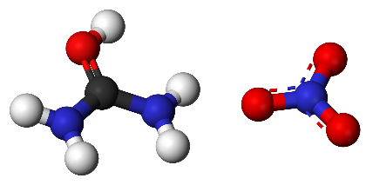




concept
fossil fuels
fertilizers
produced primary crops
x
crop energy content
human & animal labor
electricity
Agricultural System Energy Input
Agricultural System Energy Output
Notes:
Wealthy countries could afford to do that because of fossil fuels. 2 problems with that. Depletion and global warming.

Slide 5
concept
fossil fuels
fertilizers
+ secondary food products
(animal and processed)
+ imports
produced primary crops
x
crop energy content
human & animal labor
electricity
Agricultural System Energy Input
Food System Energy Output
Food System Energy Input
Agricultural System Energy Output
Notes:
Wealthy countries could afford to do that because of fossil fuels. 2 problems with that. Depletion and global warming.

Slide 6




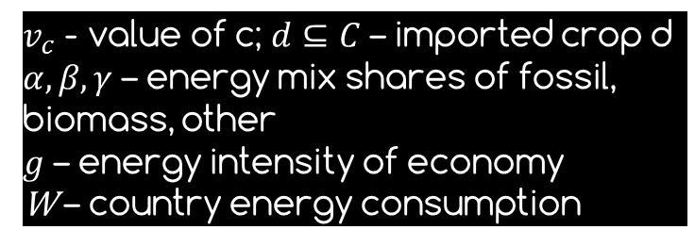



methodology
Food energy
flows
Food energy
data
[World Bank]
Food
data
[FAOSTAT]

Slide 7
results
EROEI
2.35
1.46
1.33
1.19
Total Agricultural System Energy Input in 2011: 5990 TWh
Total Energy Content of Primary Crops in 2011: 14050 TWh
Total Food System Energy Input in 2011: 7243 TWh
Total Energy Content of Food in 2011: 10589 TWh
Total Agricultural System Energy Input in 2011: 64 TWh
Total Energy Content of Primary Crops in 2011: 86 TWh
Total Food System Energy Input in 2011: 124 TWh
Total Energy Content of Food in 2011: 148 TWh
Global
Italy
Notes:
Wealthy countries could afford to do that because of fossil fuels. 2 problems with that. Depletion and global warming.

Slide 8
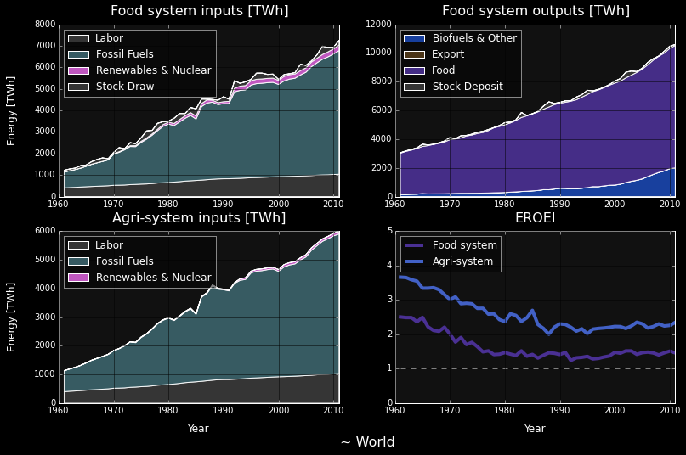
results
Fossil share 61 % in 1961 79 % in 2011
Agri EROEI 3.66 in 1961 2.35 in 2011
Food EROEI 2.50 in 1961 1.46 in 2011
Sgouridis, Csala (expected 2015)
GRAPH: Own work using open energy and GDP data from World Bank and food balance and trade, labor and fertilizer data from FAOSTAT
Notes:
Wealthy countries could afford to do that because of fossil fuels. 2 problems with that. Depletion and global warming.

Slide 9
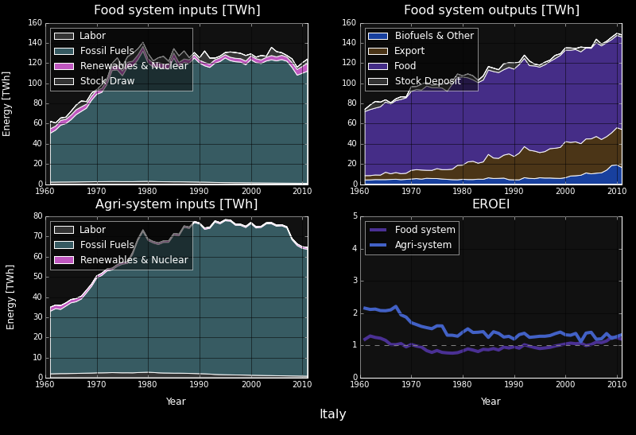
results
Fossil share 78 % in 1961 90 % in 2011
Agri EROEI 2.15 in 1961 1.33 in 2011
Food EROEI 1.19 in 1961 1.19 in 2011
Sgouridis, Csala (expected 2015)
GRAPH: Own work using open energy and GDP data from World Bank and food balance and trade, labor and fertilizer data from FAOSTAT
Notes:
Wealthy countries could afford to do that because of fossil fuels. 2 problems with that. Depletion and global warming.

Slide 10

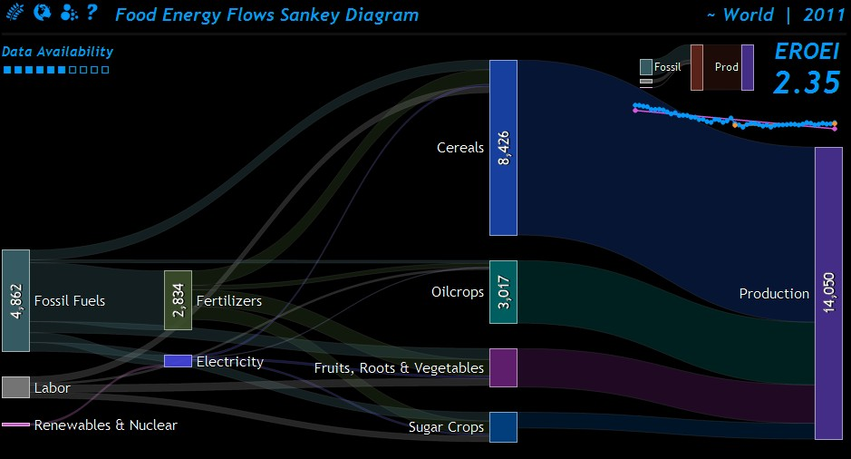
results
* All values in TWh
Sgouridis, Csala (expected 2015)
GRAPH: Own work using open energy and GDP data from World Bank and food balance and trade, labor and fertilizer data from FAOSTAT
Notes:
Wealthy countries could afford to do that because of fossil fuels. 2 problems with that. Depletion and global warming.

Slide 11
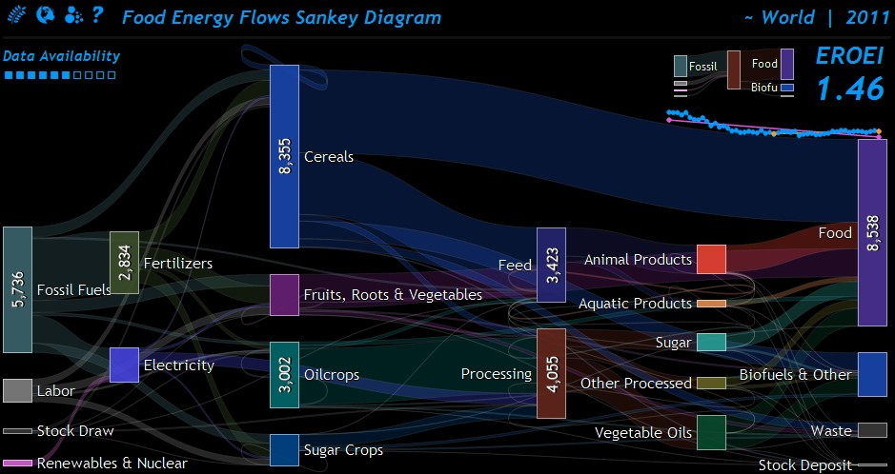
results
* All values in TWh
Sgouridis, Csala (expected 2015)
GRAPH: Own work using open energy and GDP data from World Bank and food balance and trade, labor and fertilizer data from FAOSTAT
Notes:
Wealthy countries could afford to do that because of fossil fuels. 2 problems with that. Depletion and global warming.

Slide 12
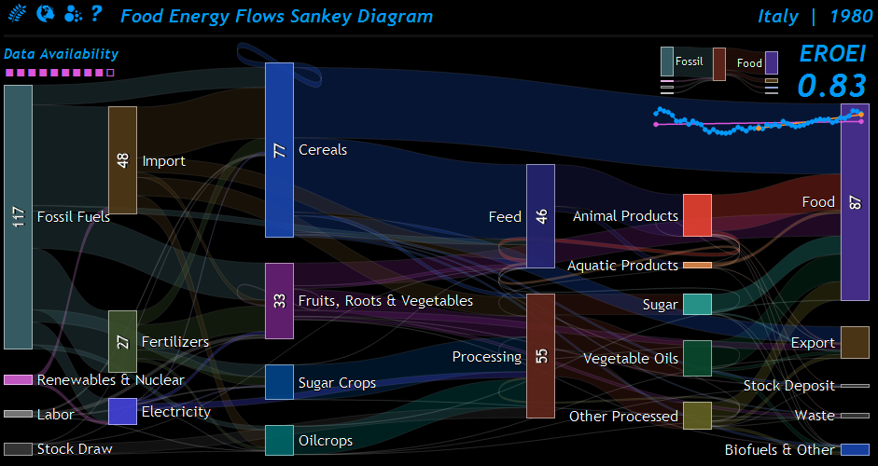
results
* All values in TWh
Sgouridis, Csala (expected 2015)
GRAPH: Own work using open energy and GDP data from World Bank and food balance and trade, labor and fertilizer data from FAOSTAT
Notes:
Wealthy countries could afford to do that because of fossil fuels. 2 problems with that. Depletion and global warming.

Slide 13
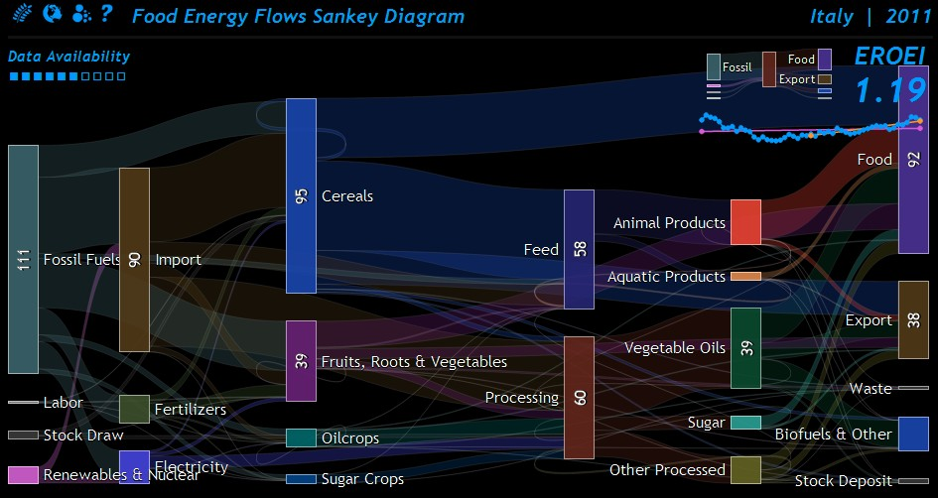
results
* All values in TWh
Sgouridis, Csala (expected 2015)
GRAPH: Own work using open energy and GDP data from World Bank and food balance and trade, labor and fertilizer data from FAOSTAT
Notes:
Wealthy countries could afford to do that because of fossil fuels. 2 problems with that. Depletion and global warming.

Slide 14
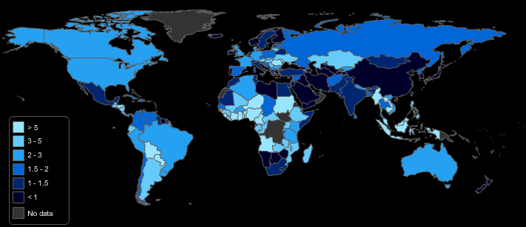
Agri-sytem EROEI map
* All values in TWh
Sgouridis, Csala (expected 2015)
GRAPH: Own work using open energy and GDP data from World Bank and food balance and trade, labor and fertilizer data from FAOSTAT
Notes:
Wealthy countries could afford to do that because of fossil fuels. 2 problems with that. Depletion and global warming.

Slide 15
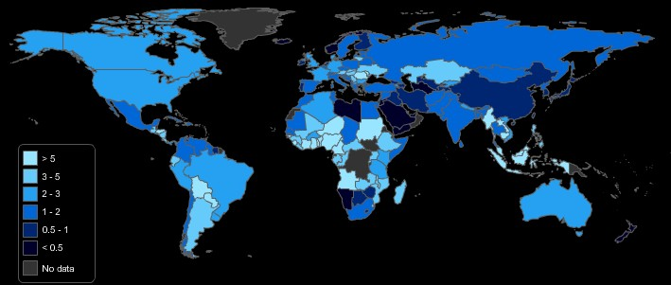
Food sytem EROEI map
* All values in TWh
Sgouridis, Csala (expected 2015)
GRAPH: Own work using open energy and GDP data from World Bank and food balance and trade, labor and fertilizer data from FAOSTAT
Notes:
Wealthy countries could afford to do that because of fossil fuels. 2 problems with that. Depletion and global warming.

Slide 16
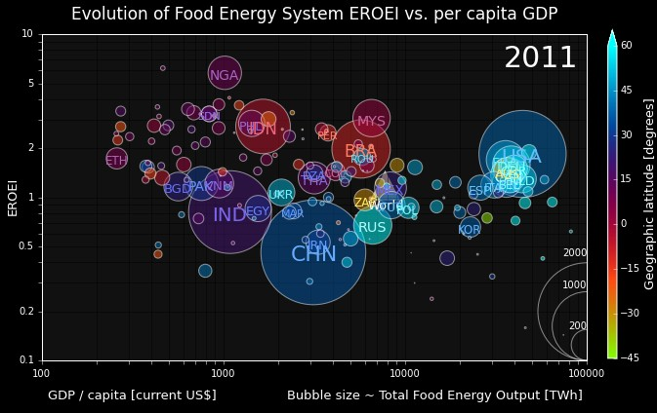
insights
Steady decline of EROEI over time
Correlation with GDP
Dynamic crop shift obscures the full picture
Fossil input not sustainable
Sgouridis, Csala (expected 2015)
GRAPH: Own work using open energy and GDP data from World Bank and food balance and trade, labor and fertilizer data from FAOSTAT
Notes:
Wealthy countries could afford to do that because of fossil fuels. 2 problems with that. Depletion and global warming.

Slide 17
Dénes Csala, Sgouris Sgouridis
Masdar Institute
Visualizing the
Energetic Sustainability
of Global and National
Agricultural and Food Systems
Visit the interactive website of this project at: http://food.csaladen.es
thank you

