Slide 1
Modeling Dynamic Transitions in the Global Air Transportation System
A System Dynamics Tool for Competitive Industry Assessment
A Thesis Presented to the Masdar Institute of Science and Technology in
Partial Fulfillment of the Requirements for the Degree of
Master of Science in
Engineering Systems and Management
Presented by: Dénes CSALA
Advised by: Dr. Sgouris SGOURIDIS
Supervised by: Dr. Scott KENNEDY
Dr. R. John HANSMAN
Abu Dhabi, 23. 04. 2013
Notes:
System needs to change drastically if it is to transition into a sustainable state.
High stakes for technology-driven change – innovation –high cost of R&D, manufacturing, change parts of existing infrastructure and operational procedures if a significant improvement in high energy efficiency is to be achieved.
We assess different transition options, using a system dynamics model of the industry that we built
Advanced features (modularity, extensibility, autocalibration, GUI)
Quantitative strategy assessment to using a composite indicator V that we defines, combined econ and enviro benefits

Slide 2
Outline
Introduction
Background
Problem definition
Methodology
GAIDT System Dynamics Model
Description
Structure
Calibration
Global Aviation Dynamic Transitions
Experiment Design
Simulation Results
Conclusions

Slide 3
1. Introduction

Slide 4
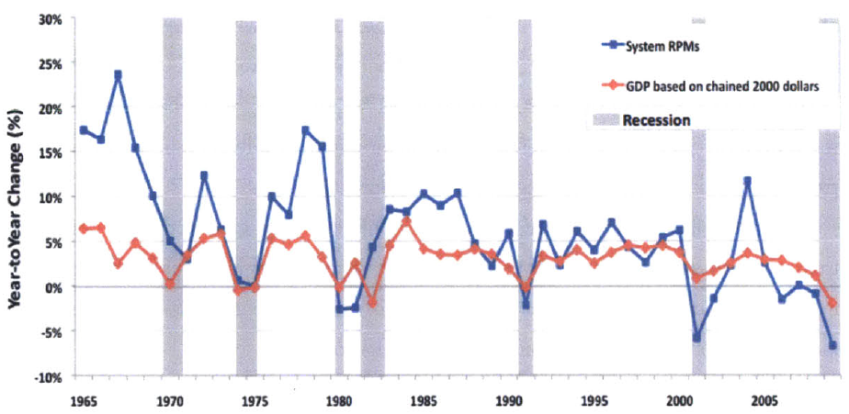
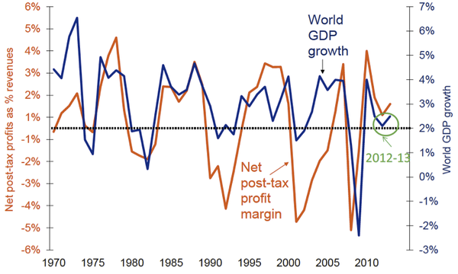
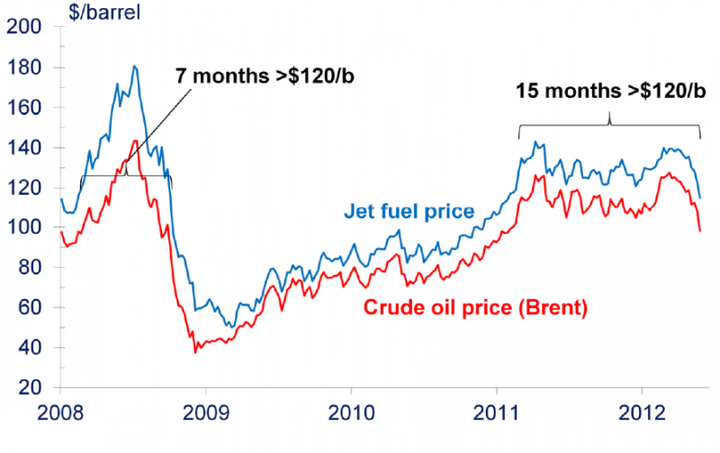
1. a. Background
Airline Fuel Expenditures: 30+ %
Reduce fuel burn!
Source: Morrison, Bonnefoy, based on BTS, Bureau of Economic Analysis and National Bureau of Economic Research data, 2009
Centre for Aviation, based on IATA, Platts and RBS data, 2013
Notes:
The commercial aviation system has been growing at a faster rate than background economic growth
Tightly couple ecosystem of airlines, manufacturers, airport regulators & traveling public
Influenced by the exogenous but still coupled fuel prices and economic growth
Profits have followed a similar cyclical trend – this phenomenon have been studied by many researcher and it has been found
Combined with the endogenous dynamics or aircraft ordering, airline and manufacturer competition induced alternating periods of under and over-capacity
Cyclical (~10 years), lag (~1 year) in rise,
Air transport can be looked as fairly credible GDP forecaster for fall
Fuel has become the main cost component of airlines in the second decade of the 21st century
Accounts for almost one third of airline operating expenditures
Of course oil price forecasting is very insecure, but there is a consensus that high prices will stay
Clearly, there is a need to reduce fuel – burn

Slide 5
1. a. Background
IPCC: 5-15% by 2050!
Technological Efficiency Improvements
Operational Efficiency Improvements
Demand Shift
Carbon Pricing
Alternative Fuels
Reduce fuel burn!
Source: D. S. Lee, 2009, Sgouridis, 2007; Rutherford & Zeinali, 2009; Lee et al, 2001
Notes:
Aviation carbon emission on a continuous rise
Aviation proper now about 2.8% of global emissions
Other industries severely pressured to reduce emissions and further growth is forecasted here, this is expected to rise
IPCC forecast between 5 and 15 by 2050
Various ways have been identified to reduce aviation carbon emissions
All except alternative fuels are achieved through reducing fuel burn – that is increasing fuel efficiency
Ambitious targets are set in US and Europe
Using the normal incremental innovation procedures in technological and operational improvements, maximum yearly 1% improvement can be achieved, many researchers reasoned
To achieve these goals radically new technologies, a disruptive innovation is needed that breaks away from the usual innovation pattern
Demand may ne induced by reducing operating costs: future efficiency improvement might not lead to proportional fuel savings

Slide 6
1. b. Problem definition
Incremental innovation

Radical innovation
?
Source: Airbus, 2013; Boeing, 2013; Norris & Wagner, 2009
Notes:
- The reduction of fuel burn and consequently emissions in aviation is generally hindered by high capital intensity and time constraints, leading to an inherent lag in the adoption of new technologies along with the uncertainty of the cost of change
- New aircraft development programs span over a decade and cost billions of dollars
- It is always dilemma for manufacturers whether to proceed with large radical innovation projects

Slide 7
1. b. Problem definition
Research Questions:
Is there a first mover advantage for innovating manufacturers in the commercial aviation system?
Is incremental innovation more beneficial than radical innovation? Should we delay radical innovation?
System Level Implications:
What are the benefits (financial and environmental) of innovation for the players and the gains for the system as a whole ?
Assessment can greatly help decision makers to develop appropriate policies and competitive strategies to facilitate the global aviation system sustainable transition
Quantitative strategy assessment needed!
Notes:
- This problem raises a lot of questions and there is a need to explore the dynamic behavior of the competitive aviation industry under transition
We will investigate whether there is any first mover advantage
Impact and diffusion rate of transitions options ?
Benefit (financial and environmental) of transition options ?
Robustness ?
Assessment can greatly help decision makers to develop appropriate policies and competitive strategies to facilitate the global aviation system sustainable transition
It is desirable to be able to quantitatively compare different transition options, so
Quantitative strategy assessment needed!

Slide 8
1. b. Problem definition
Radical Innovation options that can be investigated:
TS1, a continuation of the historical trends seen in recent years
TS2, a reflection that external pressures may be such that improvements beyond TS1 will be necessary, and
TS3, a future state in which significant additional pressure (in the form of regulations and or taxes) may force significant technology introduction
Radical Innovation can include but it is not constrained to the following technologies in development:
Propulsion (High Bypass Ratio, Geared Turbo Fan, Open Rotor, Variable Cycle, Boundary Layer Ingestion, Nacelles)
Aerodynamics (Adaptive / Variable Camber Trailing Edge, Improved Wing Design, Winglet/Wingtip fence, Riblets, Hybrid Laminar Flow Control, Advanced Wing Configurations)
Structural (Metal improvements, Composites, Active Smart Wings, Self-healing materials, Nanotechnologies)
Source: PARTNER 43, ICAO CAEP LTTG excersize; J. J. Alonso, PARTNER 43
Notes:
Using the different preset technology scenarios identified in the International Civil Aviation Organization’s Committee on Aviation Environmental Protection (ICAO/CAEP) Long-Term Fuel Burn Technology Goals (LTTG) exercise and used in (PARTNER, 2012), the manufacturers’ strategies have been adjusted to apply the technology advancements and mission specification changes on their new aircraft offerings in the 2020-2030 period, complying with the outlined transition options .
Induced drag: drag due to lift – increase aspect ratio – longer wingspan, have a cool wing Inviscid drag

Slide 9
1. b. Problem definition
Mission Specifications:
Unaltered : completely redesigned aircraft that can seamlessly integrate into today’s aviation infrastructure
Changed: more aggressive redesign with more benefits, possible interference with existing infrastructure and system lock-ins
Design Cruise Speed Reduction
Wingspan Increase
Payload/Range Redesign
Tech in 2020/2030
Tech in 2020/2030 + Changes
Fractional fuel-burn reductions (baseline = 1.00) resulting from redesigns of new Narrow Body aircraft with different mission specifications and different levels of technology
Technology level | Baseline | CSR (0.8625) | WI (1.35) | CSR + WI
Baseline | 0.9440 | 0.8650 | 0.9323 | 0.8542
TS1 – 2020 | 0.7500 | 0.6920 | 0.7413 | 0.6839
TS1 – 2030 | 0.7056 | 0.6527 | 0.6971 | 0.6448
TS2 – 2020 | 0.7056 | 0.6527 | 0.6971 | 0.6448
TS2 – 2030 | 0.6594 | 0.6109 | 0.6510 | 0.6031
TS3 – 2030 | 0.5654 | 0.5222 | 0.5606 | 0.5177
TS – Technology Scenario, CSR – Cruise Speed Reduction, WI – Wingspan Increase
Source: PARTNER 43, ICAO CAEP LTTG excersize
Notes:
When redesigning the aircraft, we can have aircraft that will seamlessly integrate into today’s aviation infrastructure or
We can allow for more flexibility in changing some mission specifications. That results in a more aggressive redesign and carries more benefits, but it might interfere with the existing infrastructure and system lock-ins.
Decrease speed: reduce fuel burn, increase flight time
Increase wing –span: reduce fuel-burn, prohibit access to some airports
Today’s aircraft are often not flown close to their designed range which is inefficient.
Emirates flies a huge A380 between Dubai and Jeddah, a less than 2000km route with a plane that has a design range of 15000km. Definitely some room for improvement there
The beneficial impact form wingspan increase is more limited (8-13% CSR, ~1% WI)

Slide 10
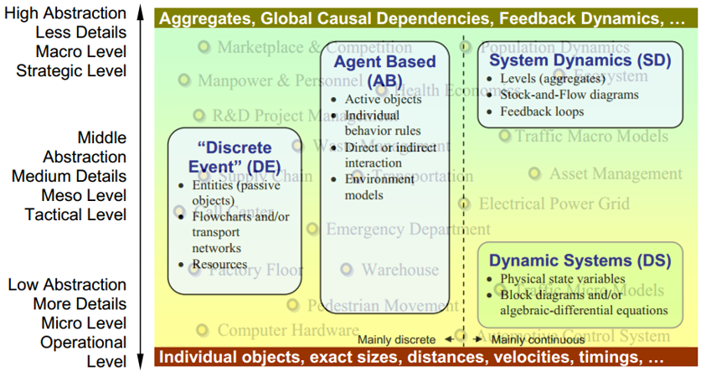
1. c. Methodology
Qualitative Empirical Narratives
Theoretical Frameworks
Statistical Models (Econometric, Neural Network)
Game theory
Quantitative Simulation Modeling Methods
System Dynamics
Agent-Based
Discrete Event
Dynamic Systems
Quantitative Simulation Modeling Methods Realm
Source: adapted from Borschev & Filippov, 2004
Notes:
The first two techniques are mainly narrative approaches and are very valuable in the initial understanding of the system. However, since for this study a quantifiable output is desired, only using qualitative empirical narratives and theoretical frameworks is not sufficient.
Pure statistical models are also not ideal for the purpose of this study because of their limited explanatory power. Also Lyneis (1999) showed that a system dynamics model has a much better forecast accuracy than an econometric model, for the specific case of airline profit cycles.
Game theory is a useful tool for identifying the possible strategy options that will be investigated and provides a clear picture of the outcome. However, its information carrying capacity is limited for the requirements of this study it needs to be aided by other models.
The System Dynamics (SD) methodology is typically used in long-term, strategic models and assumes a high level of aggregation of the objects being modeled. Top-down approach, the system’s building block are causal loops and stocks and flow. Items are represented in SD models by their quantities so they lose any individual properties, histories or dynamics. It has a strong explanatory power and reflects mental models but it has a rigid structure.
ABM (also sometimes related to the term multi-agent system) is an essentially decentralized, individual-centric (as opposed to system level) approach to model design. When designing an agent based model the modeler identifies the active entities, the agents puts them in a certain environment, establishes connections, and runs the simulation. The global behavior then emerges as a result of interactions of many individual behaviors. It is very flexible but lack explanatory power and has a steep learning curve.
In DE simulation, the operation of a system is represented as a chronological sequence of events. It has a good ability to model decisions, but it is very rigid in structure as you have predefine both the varaibles as well as the events.
DS theory (closely related to control theory) think of it as exact system dynamic. Variables have physical counter-parts, which are hard to identify for sociotechnical systems
On the strategic level is best to choose a system that can handle high abstraction such as SD or ABM. SD was preferred because of its stronger explanatory power and existing works
ABM extension would be a nice addition to the model.

Slide 11
2. Global Aviation Industry
Dynamic Transition
(GAIDT)
System Dynamics Model

Slide 12
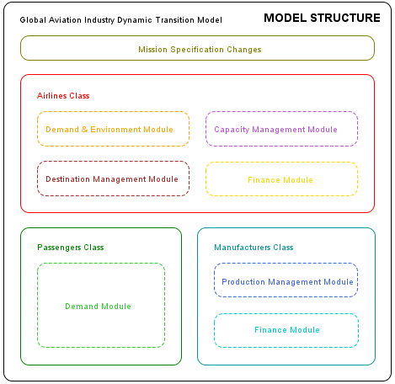
2. a. Description
Built upon Sgouridis’ GAID model
Dynamic structure to remove some of SD limitations
Modular to allow for future expansion
Model Dimensions
Aircraft Type (Narrow Body, Wide Body)
Manufacturer Type (Boeing, Airbus)
Airline Type (only one)
Passenger Type (only one)
Destination Type (only one)
Notes:
To mitigate one of main limitations of SD, the rigid structure, initially a dynamic structure was attempted resulting in hybrid model, referred to as object-oriented system dynamics, later, the structure was kept, but due to lack of time and data availability, however the benefits offered by this approach are not used by this study
Each of the classes and modules is then replicated, depending on the model’s dimensions.
The model dimension types have been predefined, however, the size of each of these dimensions does no need to be preset.
The size of the dimensions defines the level of insight we want to gain into the industry dynamics.
Each of the GAIDT modules is composed of a parameterized system dynamics sub-model, having the capability of receiving inputs either from other modules or from historical data.

Slide 13
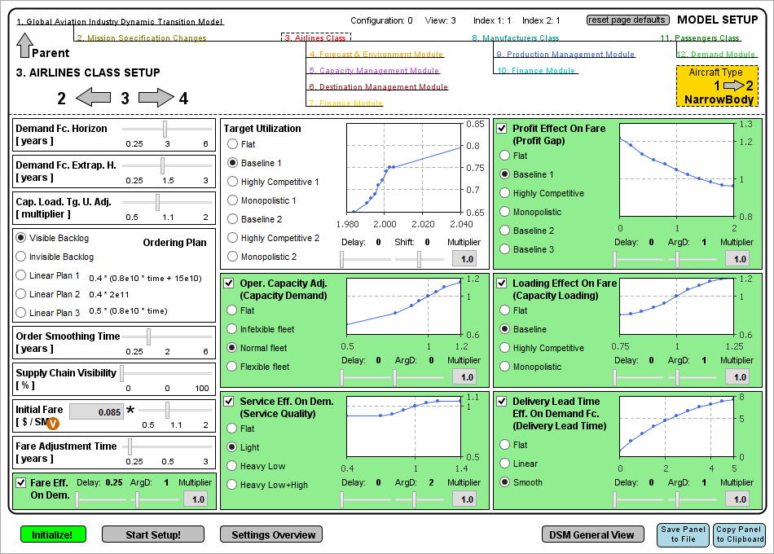
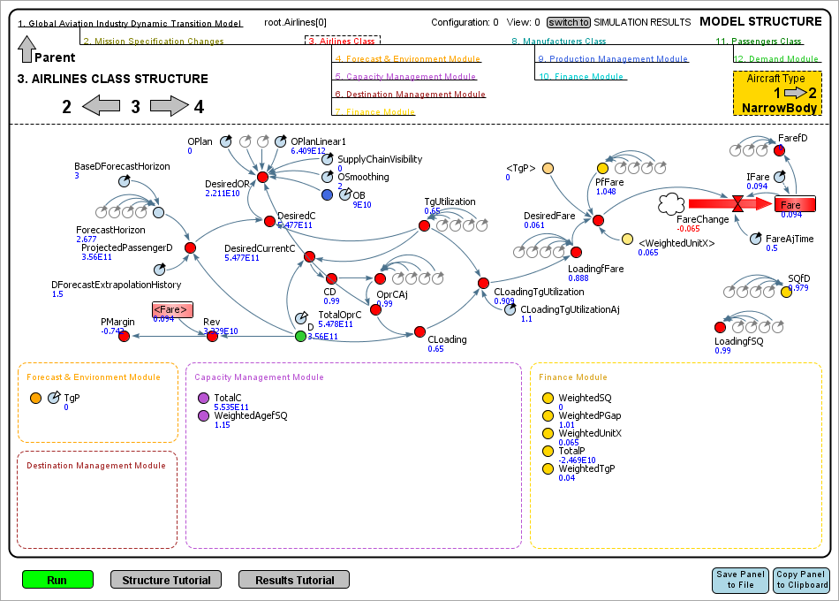
2. b. Structure
Notes:
This class aggregates information form the airline modules. Based on demand forecasts and planned profit margin, decides on the orders and fare.
Key variables: Desired Order Rate, Fare

Slide 14
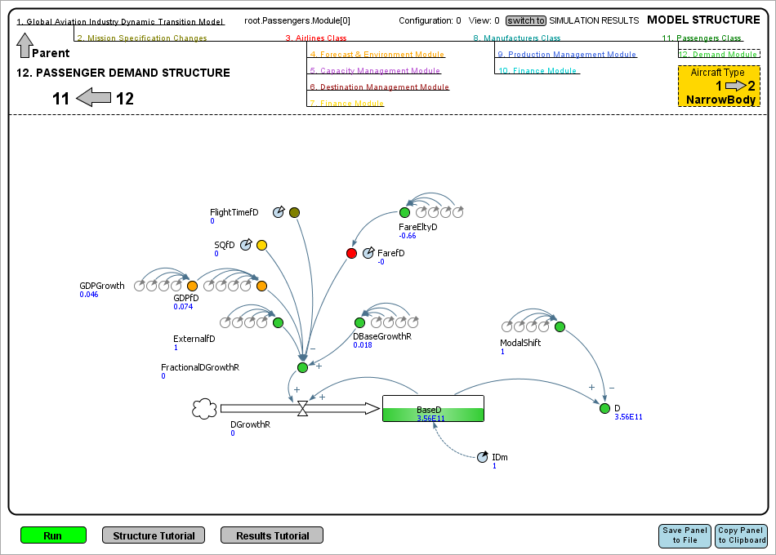
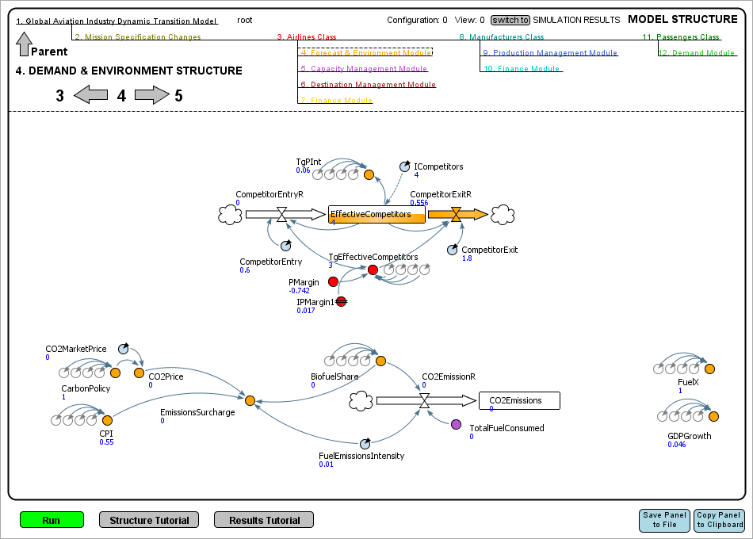
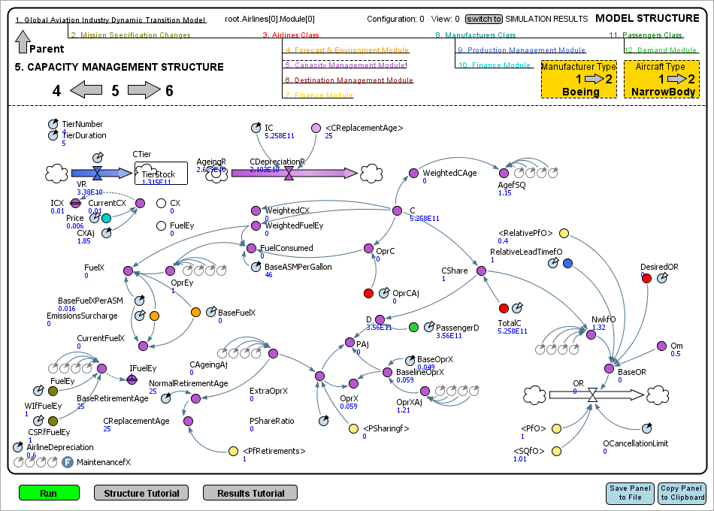
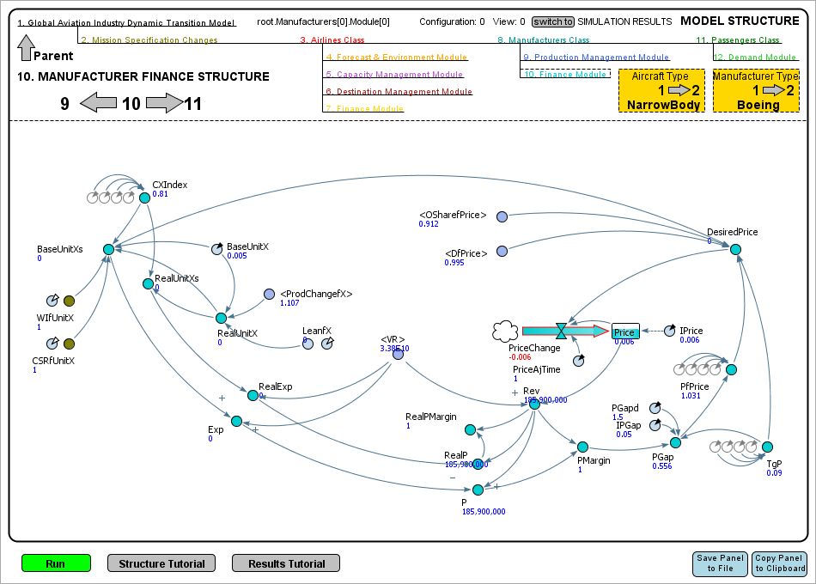
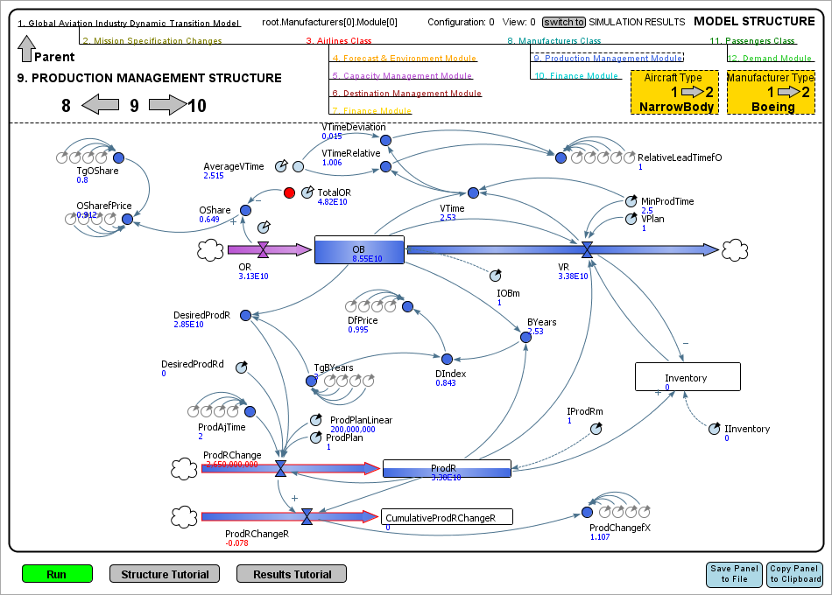
2. b. Structure
Notes:
4. Governs the airline competition and global forecast variables such as expected GDP growth and fuel prices. In addition, it calculates emissions and emissions surcharge based on, carbon policy, price and biofuel usage.
Key variables: Effective Competitors, CO2 Emissions, GDP Growth, Fuel Cost
5. Governs the capacity management of airlines. Decides on the capacity order rate based on requested dimension order rate from the Airlines Class, capacity retirement and operational profitability and quality. Accounting for ageing and depreciation, it calculates capacity, fuel and operating costs.
Key variables: Capacity, Order Rate, Fuel Cost, Operating Cost
9. Manages aircraft production based on airline order rates.
Key variables: Order Backlog, Production Rate, Delivery Rate
10. Calculates manufacturer profits based on production input. It also sets the price of aircraft, based on production costs and profitability targets.
Key variables: Price, Base Unit Costs, Profit Margin
12. Calculates the passenger demand based on GDP growth, fare, airline service quality, flight time and external effects. It also allows for modeling modal shift policies.
Key variables: Demand

Slide 15
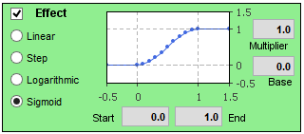
Calibration
Calibrated against:
Passenger Demand
Airline Profit
Airline Profit Margin
Fare
Load Factor
Capacity Order Rate
Capacity Order Backlog
CO2 Emission Rate
Autocalibration
Notes:
We conducted a staged calibration starting with module calibration and fine-tuning with global calibration.
First, each of the classes with their respective modules were calibrated separately, using different sources for their inputs – either previous simulation data or historical values.
Then, an experimental global calibration was also conducted, varying every module’s parameters at once.
Autocalibration – model can automatically deduce the type of relationships/transfer functions of effects
Although ready and working, not enough test have been conducted and it has not been used for this study

Slide 16
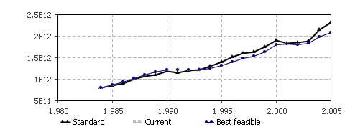
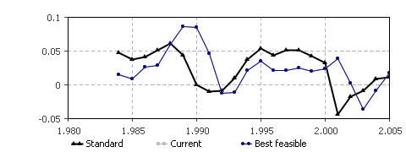
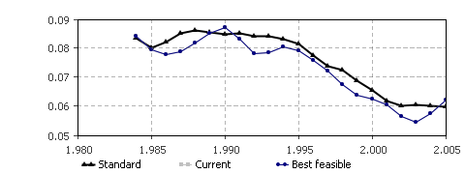
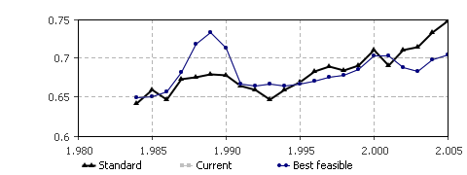
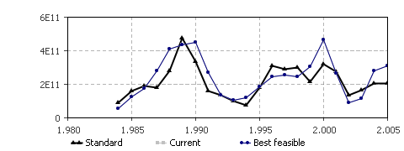
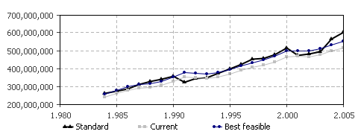
2. c. Calibration
Demand [RPM]
Output
Actual
Actual
Output
Airline Profit Margin [%]
Actual
Output
Actual
Output
Fare [$ / ASM]
Capacity Load Factor [%]
Total Capacity Order Rate [ASM]
Emissions [tCO2]
Output
Actual
Actual
Output

Slide 17
3. Global Aviation
Dynamic Transitions

Slide 18
3. a. Experiment Design
Manufacturer strategy options
2020 & 2030 → 11 experiments
In addition TS-SQ & TS BAU
Airbus Boeing | BAU | INNOVATE | FOLLOW
BAU | BAU | INNOVATES | –
INNOVATE | INNOVATES | BOTH INNOVATE | FOLLOWS
FOLLOW | – | FOLLOWS | –
Aircraft Type | Introduction (EIS) | Family average fuel-burn improvement
Airbus A320neo | 2015 | 15 % over A320
Boeing 737MAX | 2017 | 16.25% over B737NG
Airbus A350 | 2017 | 17.33% over A340
Boeing B787 | 2011 | 20% over 767
Source: Airbus 2013, Boeing 2013
Notes:
In addition to innovation strategies, we need to consider
SQ – no innovation, current offerings (these aircraft are referred to as current)
BAU – proceeding with current aircraft development plans – incremental
Innovate is refereed to as radical
And within this framework, the manufacturers will have the choice of the following strategy options

Slide 19
3. a. Experiment Design
All strategies are played for 3 different fuel-price scenarios:
Current, high fuel price (stays at 2012 levels until 2040 – on par with Airbus and FAA predictions)
High fuel price (fuel doubles by 2020, then stagnates)
Low fuel price (fuel drops by 20% by 2020, then stagnates)
Transition strategies and system dimensions
One-dimensional transition
Narrow Body only
Wide Body only
Multi-dimensional transition
Both Narrow Body and Wide Body
Notes:
For multi-dimensional transitions, it is assumed that the changes get into effect at the same time across all dimensions, as having different entry times would add significant complexity to the experiment design

Slide 20
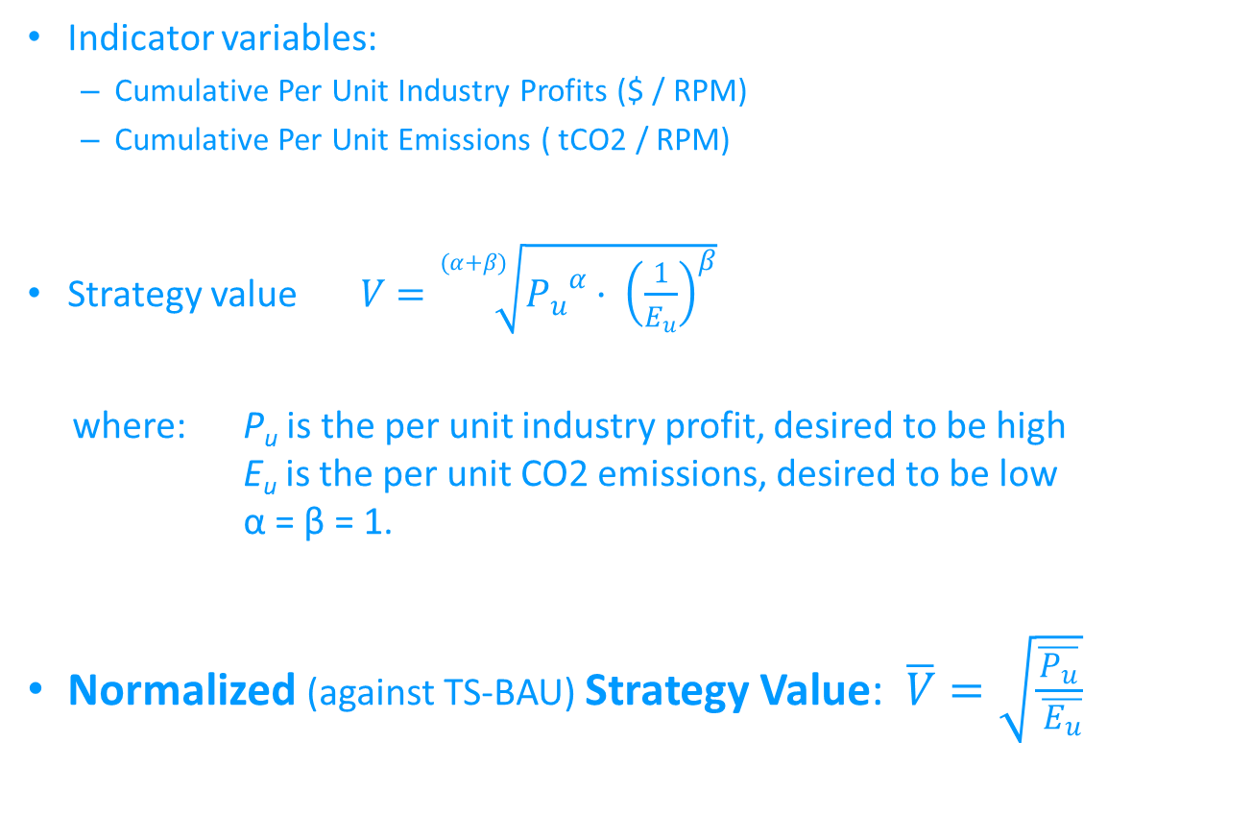
3. a. Experiment Design
Indicator variables:
Cumulative Per Unit Industry Profits ($ / RPM)
Cumulative Per Unit Emissions ( tCO2 / RPM)
Strategy value $V=\sqrt[(α+β)]{{P_{u}}^{α}· {\left(\frac{1}{E_{u}}\right)}^{β}}$
where: P_{u} is the per unit industry profit, desired to be high E_{u} is the per unit CO2 emissions, desired to be low α = β = 1.
Normalized (against TS-BAU) Strategy Value: $\overline{V}=\sqrt{\frac{\overline{P_{u}}}{ \overline{E_{u}}}}$
Notes:
In order to assess the efficiency of the system, cumulative per unit industry profits and cumulative per unit emissions were chosen as indicator variables
Then a composite indicator was created that combines economic and environmental performance
In order to enable comparison, everything was normalized against the BAU strategy value
This gave birth to the normalized strategy value composite indicator

Slide 21


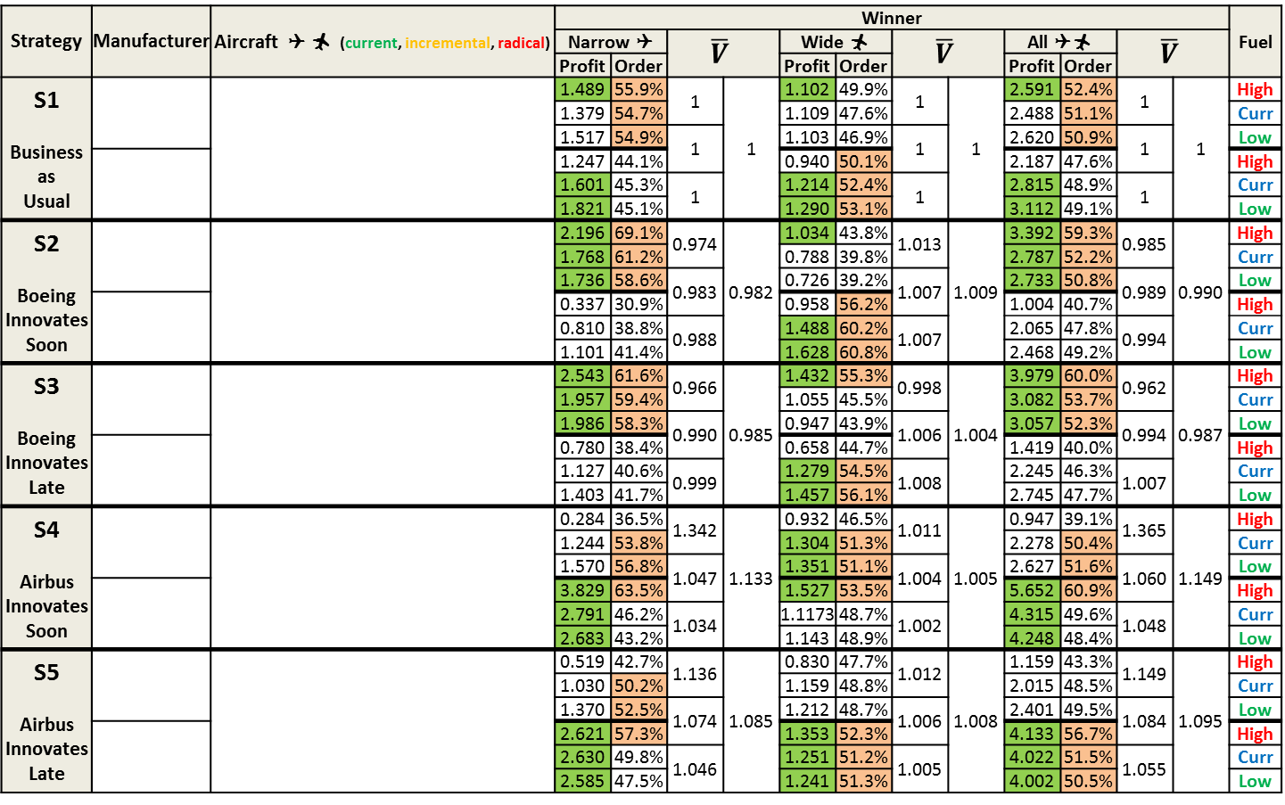
3. b. Simulation Results
Strategy | Manufacturer | Aircraft   (current, incremental, radical) | Winner |  |  |  |  |  |  |  |  |  |  |  | Fuel
 |  |  | Narrow  |  | $$\overline{V}$$ |  | Wide  |  | $$\overline{V}$$ |  | All  |  | $$\overline{V}$$
 |  |  | Profit | Order |  |  | Profit | Order |  |  | Profit | Order
S1 Business as Usual |  |  | 1.489 | 55.9% | 1 | 1 | 1.102 | 49.9% | 1 | 1 | 2.591 | 52.4% | 1 | 1 | High
 |  |  | 1.379 | 54.7% |  |  | 1.109 | 47.6% |  |  | 2.488 | 51.1% |  |  | Curr
 |  |  | 1.517 | 54.9% | 1 |  | 1.103 | 46.9% | 1 |  | 2.620 | 50.9% | 1 |  | Low
 |  |  | 1.247 | 44.1% |  |  | 0.940 | 50.1% |  |  | 2.187 | 47.6% |  |  | High
 |  |  | 1.601 | 45.3% | 1 |  | 1.214 | 52.4% | 1 |  | 2.815 | 48.9% | 1 |  | Curr
 |  |  | 1.821 | 45.1% |  |  | 1.290 | 53.1% |  |  | 3.112 | 49.1% |  |  | Low
S2 Boeing Innovates Soon |  |  | 2.196 | 69.1% | 0.974 | 0.982 | 1.034 | 43.8% | 1.013 | 1.009 | 3.392 | 59.3% | 0.985 | 0.990 | High
 |  |  | 1.768 | 61.2% |  |  | 0.788 | 39.8% |  |  | 2.787 | 52.2% |  |  | Curr
 |  |  | 1.736 | 58.6% | 0.983 |  | 0.726 | 39.2% | 1.007 |  | 2.733 | 50.8% | 0.989 |  | Low
 |  |  | 0.337 | 30.9% |  |  | 0.958 | 56.2% |  |  | 1.004 | 40.7% |  |  | High
 |  |  | 0.810 | 38.8% | 0.988 |  | 1.488 | 60.2% | 1.007 |  | 2.065 | 47.8% | 0.994 |  | Curr
 |  |  | 1.101 | 41.4% |  |  | 1.628 | 60.8% |  |  | 2.468 | 49.2% |  |  | Low
S3 Boeing Innovates Late |  |  | 2.543 | 61.6% | 0.966 | 0.985 | 1.432 | 55.3% | 0.998 | 1.004 | 3.979 | 60.0% | 0.962 | 0.987 | High
 |  |  | 1.957 | 59.4% |  |  | 1.055 | 45.5% |  |  | 3.082 | 53.7% |  |  | Curr
 |  |  | 1.986 | 58.3% | 0.990 |  | 0.947 | 43.9% | 1.006 |  | 3.057 | 52.3% | 0.994 |  | Low
 |  |  | 0.780 | 38.4% |  |  | 0.658 | 44.7% |  |  | 1.419 | 40.0% |  |  | High
 |  |  | 1.127 | 40.6% | 0.999 |  | 1.279 | 54.5% | 1.008 |  | 2.245 | 46.3% | 1.007 |  | Curr
 |  |  | 1.403 | 41.7% |  |  | 1.457 | 56.1% |  |  | 2.745 | 47.7% |  |  | Low
S4 Airbus Innovates Soon |  |  | 0.284 | 36.5% | 1.342 | 1.133 | 0.932 | 46.5% | 1.011 | 1.005 | 0.947 | 39.1% | 1.365 | 1.149 | High
 |  |  | 1.244 | 53.8% |  |  | 1.304 | 51.3% |  |  | 2.278 | 50.4% |  |  | Curr
 |  |  | 1.570 | 56.8% | 1.047 |  | 1.351 | 51.1% | 1.004 |  | 2.627 | 51.6% | 1.060 |  | Low
 |  |  | 3.829 | 63.5% |  |  | 1.527 | 53.5% |  |  | 5.652 | 60.9% |  |  | High
 |  |  | 2.791 | 46.2% | 1.034 |  | 1.1173 | 48.7% | 1.002 |  | 4.315 | 49.6% | 1.048 |  | Curr
 |  |  | 2.683 | 43.2% |  |  | 1.143 | 48.9% |  |  | 4.248 | 48.4% |  |  | Low
S5 Airbus Innovates Late |  |  | 0.519 | 42.7% | 1.136 | 1.085 | 0.830 | 47.7% | 1.012 | 1.008 | 1.159 | 43.3% | 1.149 | 1.095 | High
 |  |  | 1.030 | 50.2% |  |  | 1.159 | 48.8% |  |  | 2.015 | 48.5% |  |  | Curr
 |  |  | 1.370 | 52.5% | 1.074 |  | 1.212 | 48.7% | 1.006 |  | 2.401 | 49.5% | 1.084 |  | Low
 |  |  | 2.621 | 57.3% |  |  | 1.353 | 52.3% |  |  | 4.133 | 56.7% |  |  | High
 |  |  | 2.630 | 49.8% | 1.046 |  | 1.251 | 51.2% | 1.005 |  | 4.022 | 51.5% | 1.055 |  | Curr
 |  |  | 2.585 | 47.5% |  |  | 1.241 | 51.3% |  |  | 4.002 | 50.5% |  |  | Low
⇧ 
 
2010 2015 2020 2025 2030 2035 2040
⇧ 
 
⇧ 
 
2010 2015 2020 2025 2030 2035 2040
⇧ 
 
⇧  
  
2010 2015 2020 2025 2030 2035 2040
⇧ 
 
⇧ 
 
2010 2015 2020 2025 2030 2035 2040
⇧ 
 
⇧ 
 
2010 2015 2020 2025 2030 2035 2040
⇧  
  
Notes:
Innovators are rewarded regardless of fuel price, as both Boeing and Airbus win their INNOVATE strategies, regardless of fuel price (S2, S3 and S4, S5), and regardless of the introduction times of their new aircraft. In All and Narrow.
We can see that innovators usually win their scenarios, especially if the fuel prices are high.
Widebody scale much smaller, and we will see that this is confirmed in the other strategies too

Slide 22
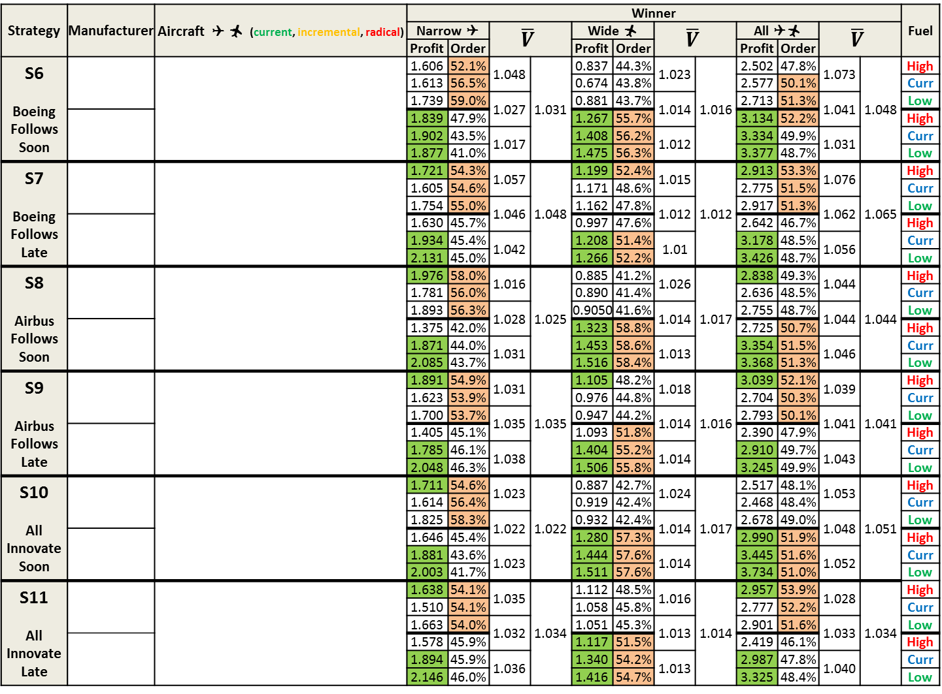
3. b. Simulation Results
Strategy | Manufacturer | Aircraft   (current, incremental, radical) | Winner |  |  |  |  |  |  |  |  |  |  |  | Fuel
 |  |  | Narrow  |  | $$\overline{V}$$ |  | Wide  |  | $$\overline{V}$$ |  | All  |  | $$\overline{V}$$
 |  |  | Profit | Order |  |  | Profit | Order |  |  | Profit | Order
S6 Boeing Follows Soon |  |  | 1.606 | 52.1% | 1.048 | 1.031 | 0.837 | 44.3% | 1.023 | 1.016 | 2.502 | 47.8% | 1.073 | 1.048 | High
 |  |  | 1.613 | 56.5% |  |  | 0.674 | 43.8% |  |  | 2.577 | 50.1% |  |  | Curr
 |  |  | 1.739 | 59.0% | 1.027 |  | 0.881 | 43.7% | 1.014 |  | 2.713 | 51.3% | 1.041 |  | Low
 |  |  | 1.839 | 47.9% |  |  | 1.267 | 55.7% |  |  | 3.134 | 52.2% |  |  | High
 |  |  | 1.902 | 43.5% | 1.017 |  | 1.408 | 56.2% | 1.012 |  | 3.334 | 49.9% | 1.031 |  | Curr
 |  |  | 1.877 | 41.0% |  |  | 1.475 | 56.3% |  |  | 3.377 | 48.7% |  |  | Low
S7 Boeing Follows Late |  |  | 1.721 | 54.3% | 1.057 | 1.048 | 1.199 | 52.4% | 1.015 | 1.012 | 2.913 | 53.3% | 1.076 | 1.065 | High
 |  |  | 1.605 | 54.6% |  |  | 1.171 | 48.6% |  |  | 2.775 | 51.5% |  |  | Curr
 |  |  | 1.754 | 55.0% | 1.046 |  | 1.162 | 47.8% | 1.012 |  | 2.917 | 51.3% | 1.062 |  | Low
 |  |  | 1.630 | 45.7% |  |  | 0.997 | 47.6% |  |  | 2.642 | 46.7% |  |  | High
 |  |  | 1.934 | 45.4% | 1.042 |  | 1.208 | 51.4% | 1.01 |  | 3.178 | 48.5% | 1.056 |  | Curr
 |  |  | 2.131 | 45.0% |  |  | 1.266 | 52.2% |  |  | 3.426 | 48.7% |  |  | Low
S8 Airbus Follows Soon |  |  | 1.976 | 58.0% | 1.016 | 1.025 | 0.885 | 41.2% | 1.026 | 1.017 | 2.838 | 49.3% | 1.044 | 1.044 | High
 |  |  | 1.781 | 56.0% |  |  | 0.890 | 41.4% |  |  | 2.636 | 48.5% |  |  | Curr
 |  |  | 1.893 | 56.3% | 1.028 |  | 0.9050 | 41.6% | 1.014 |  | 2.755 | 48.7% | 1.044 |  | Low
 |  |  | 1.375 | 42.0% |  |  | 1.323 | 58.8% |  |  | 2.725 | 50.7% |  |  | High
 |  |  | 1.871 | 44.0% | 1.031 |  | 1.453 | 58.6% | 1.013 |  | 3.354 | 51.5% | 1.046 |  | Curr
 |  |  | 2.085 | 43.7% |  |  | 1.516 | 58.4% |  |  | 3.368 | 51.3% |  |  | Low
S9 Airbus Follows Late |  |  | 1.891 | 54.9% | 1.031 | 1.035 | 1.105 | 48.2% | 1.018 | 1.016 | 3.039 | 52.1% | 1.039 | 1.041 | High
 |  |  | 1.623 | 53.9% |  |  | 0.976 | 44.8% |  |  | 2.704 | 50.3% |  |  | Curr
 |  |  | 1.700 | 53.7% | 1.035 |  | 0.947 | 44.2% | 1.014 |  | 2.793 | 50.1% | 1.041 |  | Low
 |  |  | 1.405 | 45.1% |  |  | 1.093 | 51.8% |  |  | 2.390 | 47.9% |  |  | High
 |  |  | 1.785 | 46.1% | 1.038 |  | 1.404 | 55.2% | 1.014 |  | 2.910 | 49.7% | 1.043 |  | Curr
 |  |  | 2.048 | 46.3% |  |  | 1.506 | 55.8% |  |  | 3.245 | 49.9% |  |  | Low
S10 All Innovate Soon |  |  | 1.711 | 54.6% | 1.023 | 1.022 | 0.887 | 42.7% | 1.024 | 1.017 | 2.517 | 48.1% | 1.053 | 1.051 | High
 |  |  | 1.614 | 56.4% |  |  | 0.919 | 42.4% |  |  | 2.468 | 48.4% |  |  | Curr
 |  |  | 1.825 | 58.3% | 1.022 |  | 0.932 | 42.4% | 1.014 |  | 2.678 | 49.0% | 1.048 |  | Low
 |  |  | 1.646 | 45.4% |  |  | 1.280 | 57.3% |  |  | 2.990 | 51.9% |  |  | High
 |  |  | 1.881 | 43.6% | 1.023 |  | 1.444 | 57.6% | 1.014 |  | 3.445 | 51.6% | 1.052 |  | Curr
 |  |  | 2.003 | 41.7% |  |  | 1.511 | 57.6% |  |  | 3.734 | 51.0% |  |  | Low
S11 All Innovate Late |  |  | 1.638 | 54.1% | 1.035 | 1.034 | 1.112 | 48.5% | 1.016 | 1.014 | 2.957 | 53.9% | 1.028 | 1.034 | High
 |  |  | 1.510 | 54.1% |  |  | 1.058 | 45.8% |  |  | 2.777 | 52.2% |  |  | Curr
 |  |  | 1.663 | 54.0% | 1.032 |  | 1.051 | 45.3% | 1.013 |  | 2.901 | 51.6% | 1.033 |  | Low
 |  |  | 1.578 | 45.9% |  |  | 1.117 | 51.5% |  |  | 2.419 | 46.1% |  |  | High
 |  |  | 1.894 | 45.9% | 1.036 |  | 1.340 | 54.2% | 1.013 |  | 2.987 | 47.8% | 1.040 |  | Curr
 |  |  | 2.146 | 46.0% |  |  | 1.416 | 54.7% |  |  | 3.325 | 48.4% |  |  | Low
⇧ 
 
2010 2015 2020 2025 2030 2035 2040
⇧ 
 
⇧  
  
2010 2015 2020 2025 2030 2035 2040
⇧  
  
⇧ 
 
2010 2015 2020 2025 2030 2035 2040
⇧ 
 
⇧  
  
2010 2015 2020 2025 2030 2035 2040
⇧  
  
⇧ 
 
2010 2015 2020 2025 2030 2035 2040
⇧ 
 
⇧  
  
2010 2015 2020 2025 2030 2035 2040
⇧  
  
Notes:
As expected, innovation has a higher strategy value, when the fuel prices are high
As the fuel price gets lower and lower, the technology innovations begin to lose their value.
Again we can see that the strategy values of Wide-Body strategies are only 1/3 of those of Narrow Body
High prices favor Boeing more and low or current fuel prices favor Airbus.
In fact, if the fuel-prices stay at current levels or go down, Boeing can only win if it chooses to innovate sooner or later (S2, S3).
However, if fuel prices continues to rise, the only viable option for Airbus is to innovate (S4, S5).
Another interesting remark is that when decoupled from fuel price and averaged, most strategy scenarios have a strategy value higher than 1. This leads to the conclusion, that innovation strategies is more beneficial than following the normal development path, regardless of fuel prices. That means radical innovation is more beneficial than incremental innovation. In the next slide we will see by how much.

Slide 23
3. b. Simulation Results
All dimensions
Narrow Body
Wide Body
Low Emissions
High Profits
Airbus moves first: S4, S5, S6, S7
Early transitions: S2, S4, S6, S8, S10
8% emissions savings, 15% profit gains
Strategy Value Map
Notes:
It can be seen that the maximum improvement potential is in the Narrow Body market, especially for the case of high fuel prices.
All emissions lower than 1 profits can be higher or lower, very sensitive to fuel price.
Also, if the fuel prices stay at today’s levels or lower, the current development strategies (BAU) might have a higher value than other innovating transition options.
Airbus moving first strategies generally have a higher strategy value (S4, S5, S6, S7) than Boeing moving first, yield higher profits but less emissions reductions
Earlier transitions have a higher strategy value than late transitions (S2, S4, S6, S8, S10), even considering that in the LATE scenarios, then BAU development is followed until the innovation introduction time (2030)
Radical innovation can result in emissions savings of 8% and 15% more profits and incremental innovation.
This calls for an innovation in the whole aviation industry and hints that radical changes to aircraft redesign might lead to an industry with more profits and less emissions.

Slide 24
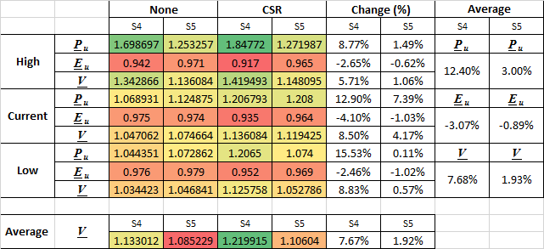
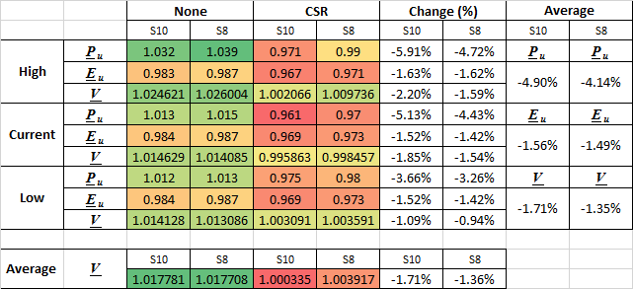
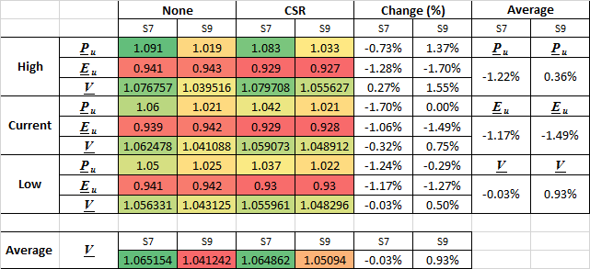
3. b. Simulation Results
Narrow
Wide
All
Notes:
- To investigate the effect of mission specification changes on top of technology innovations, CSR was applied to a choice from the most profitable strategies (S4, S5).
- CSR marginal improvements in Narrow
- CSR is not beneficial in Wide
- CSR has no effect in all

Slide 25
4. Conclusions

Slide 26
4. Conclusions
First-movers are not at disadvantage, innovators win in the overwhelming majority of the cases
Innovators gain more profits if the competitor does not move
Generally, innovation results in higher profits, but they highly depend on fuel prices, and if prices continue to rise, they can vary between + 15% < and – 11%
Any innovation results in net emissions reductions (up to 8% !)
Strategy values highly depend on fuel prices, but if prices continue to rise, any kind of innovation is beneficial for the industry as a whole
Early transitions options are preferred

Slide 27
Future potential
Validate model and test for robustness
Experiment with different values for α and β to accurately model different goals for participants, stakeholders, regulators, activists, etc.
Devise a method to efficiently value the cost of future technology
Expand model dimensions, 3 or more manufacturers
Include dynamic airline dimension
Include dynamic passenger & destination dimensions
Augment with Agent-Based part to better model player logic

Slide 28
Thank you!
Hereby I would like to express my gratitude to: Dr. Sgouris SGOURIDIS
Dr. Scott KENNEDY, Dr. R. John HANSMAN
& Ág, An,
Tü, Pé, La
Ko, Eu, Gh, Mo,
Ay, Sh, Na, Se,
Da, En, Hu, Hu, Ta
Zo, Ná, Ga, Sz, Ma
Abu Dhabi, 23. 04. 2013

Slide 29
Multidimensional Autocalibration
Dimensions size not known before model startup – No exact parameters can be defined for calibration
Individual parameters of dimensions need to be coded into a single parameter
Numeric base conversions needed to decode the results
0 0 0 0 0
⁞
1 2 0 3 5
⁞
3 3 3 3 6
5D Model
D1 size: 4
D2 size: 4
D3 size: 4
D4 size: 4
D5 size: 7

