Slide 1
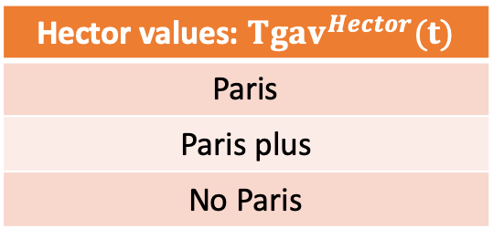
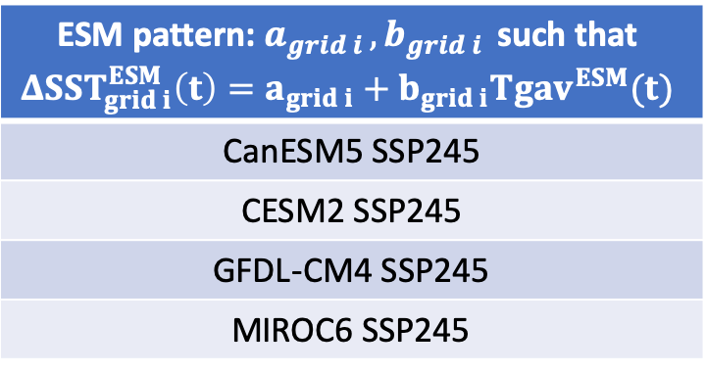
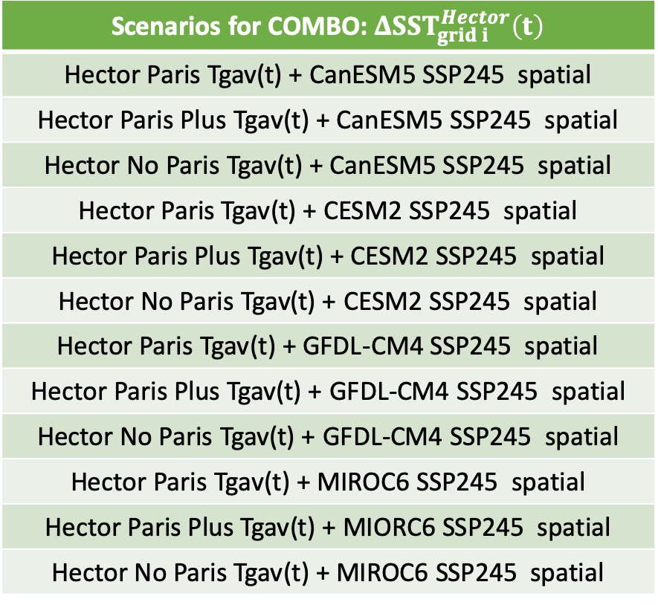
ESM pattern: $a_{grid i }, b_{grid i }$ such that $$ΔSST_{grid i}^{ESM}\left(t\right)=a_{grid i}+b_{grid i}Tgav^{ESM}(t)$$
CanESM5 SSP245
CESM2 SSP245
GFDL-CM4 SSP245
MIROC6 SSP245
Scenarios for COMBO: $ΔSST_{grid i}^{Hector}\left(t\right)$
Hector Paris Tgav(t) + CanESM5 SSP245 spatial
Hector Paris Plus Tgav(t) + CanESM5 SSP245 spatial
Hector No Paris Tgav(t) + CanESM5 SSP245 spatial
Hector Paris Tgav(t) + CESM2 SSP245 spatial
Hector Paris Plus Tgav(t) + CESM2 SSP245 spatial
Hector No Paris Tgav(t) + CESM2 SSP245 spatial
Hector Paris Tgav(t) + GFDL-CM4 SSP245 spatial
Hector Paris Plus Tgav(t) + GFDL-CM4 SSP245 spatial
Hector No Paris Tgav(t) + GFDL-CM4 SSP245 spatial
Hector Paris Tgav(t) + MIROC6 SSP245 spatial
Hector Paris Plus Tgav(t) + MIORC6 SSP245 spatial
Hector No Paris Tgav(t) + MIROC6 SSP245 spatial
+
Hector values: $Tgav^{Hector}(t)$
Paris
Paris plus
No Paris

