Slide 1
SST pattern scaling notes

Slide 2
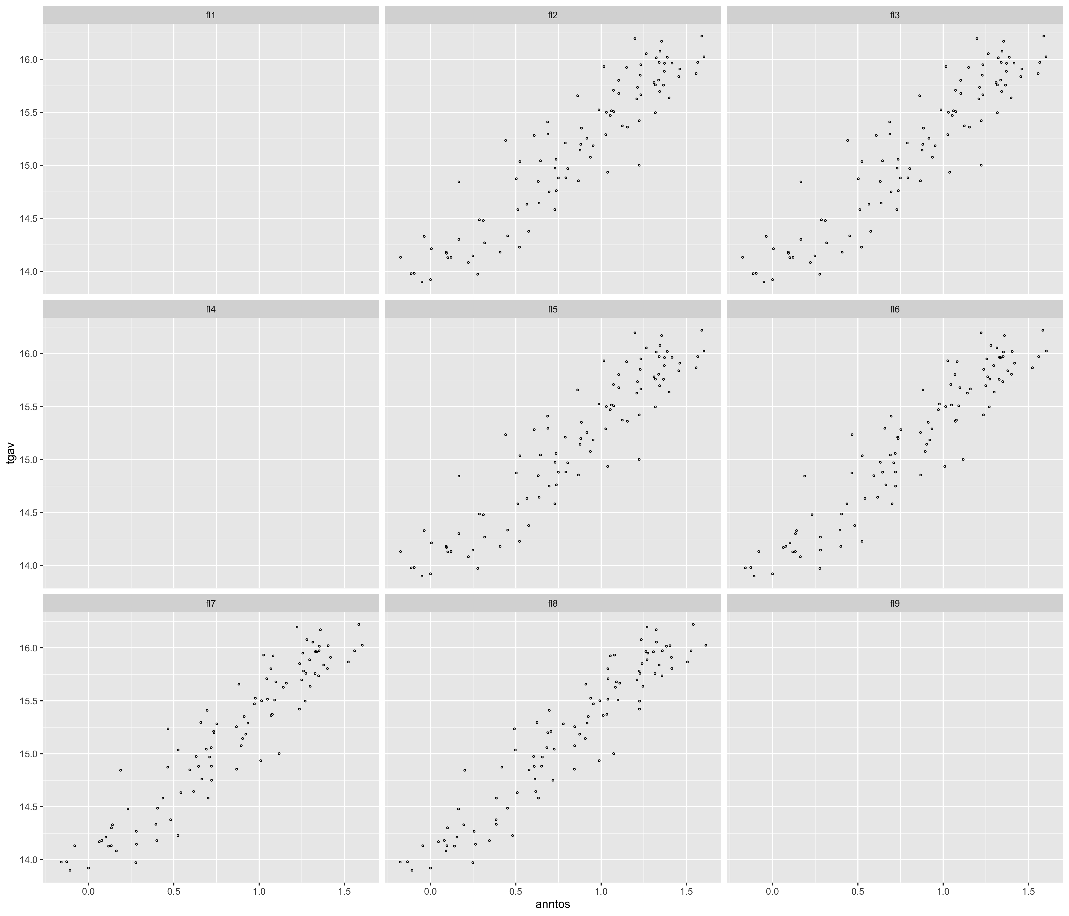
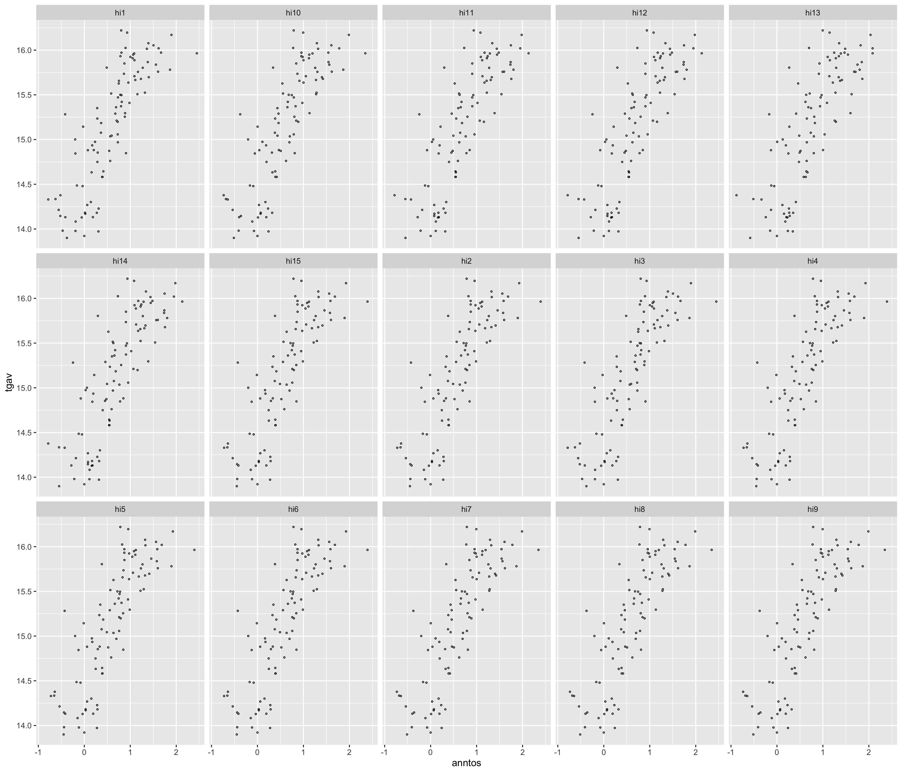
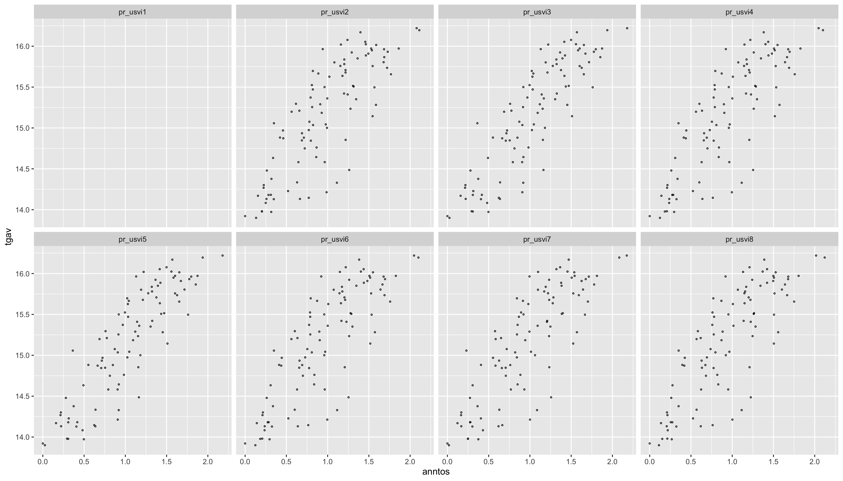
Pattern scaling CESM RCP4.5 data – feasible? yes

Slide 3
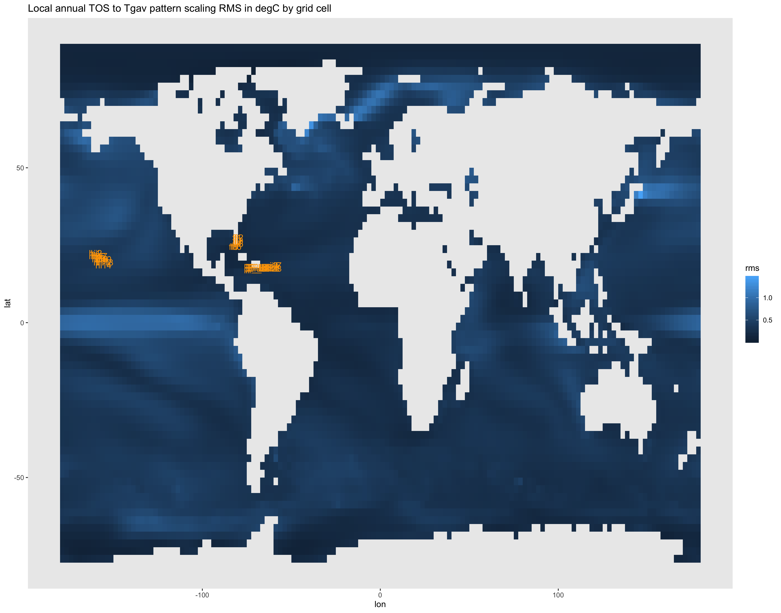
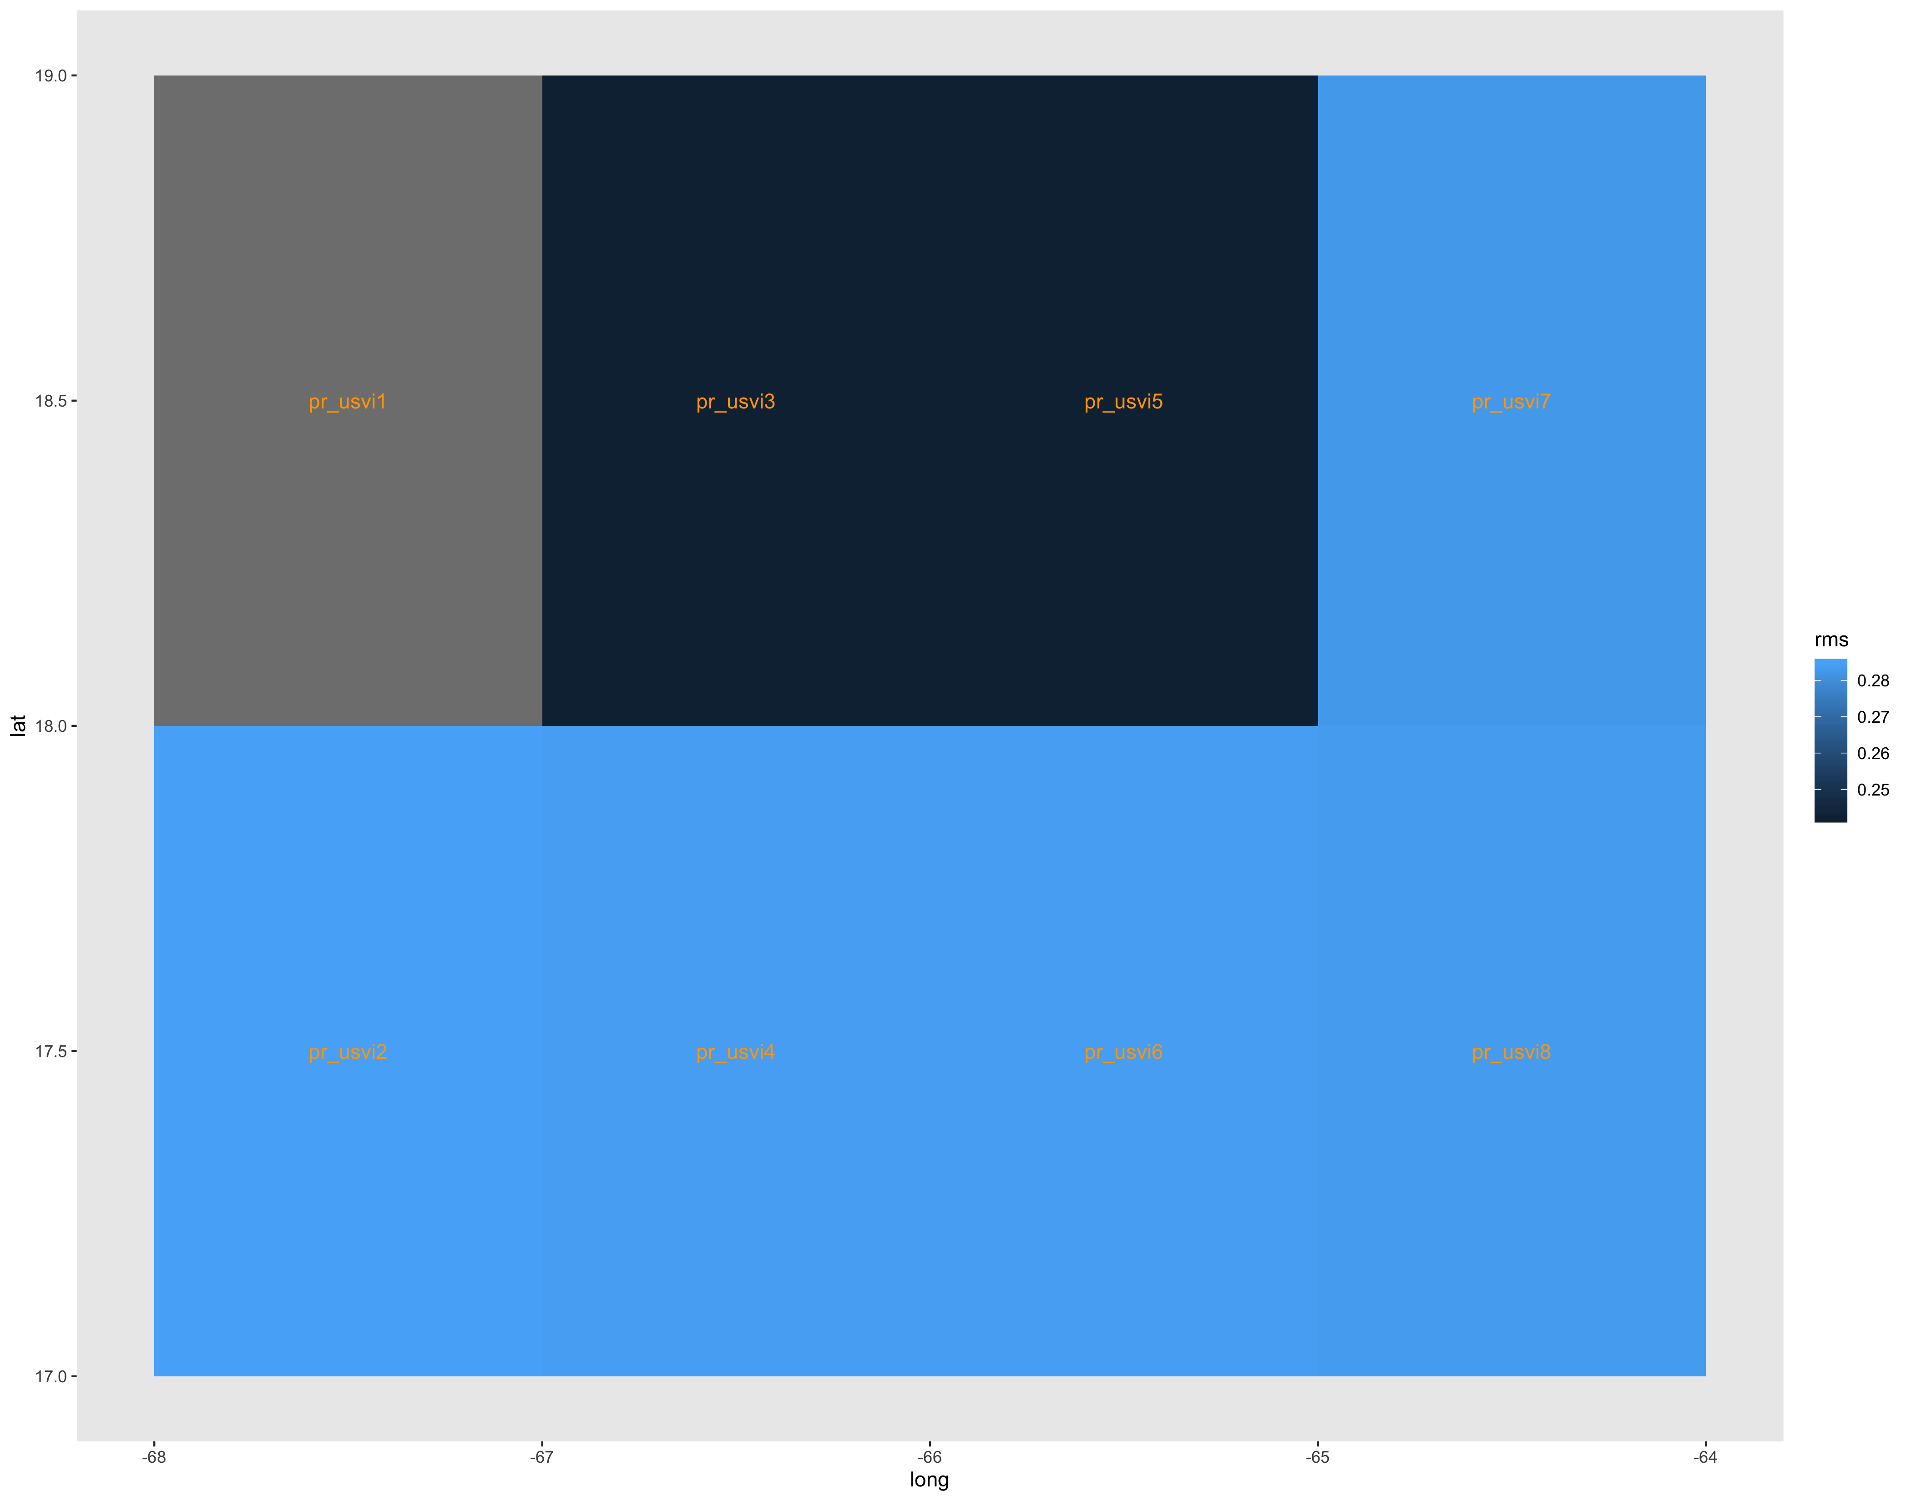
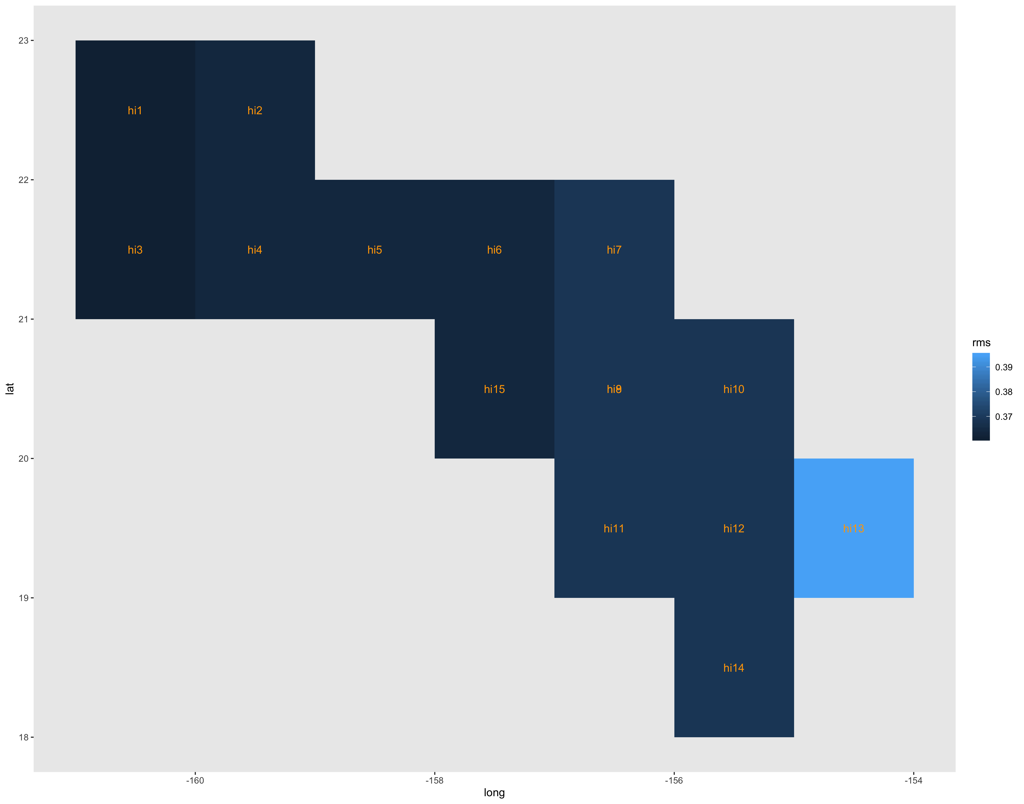
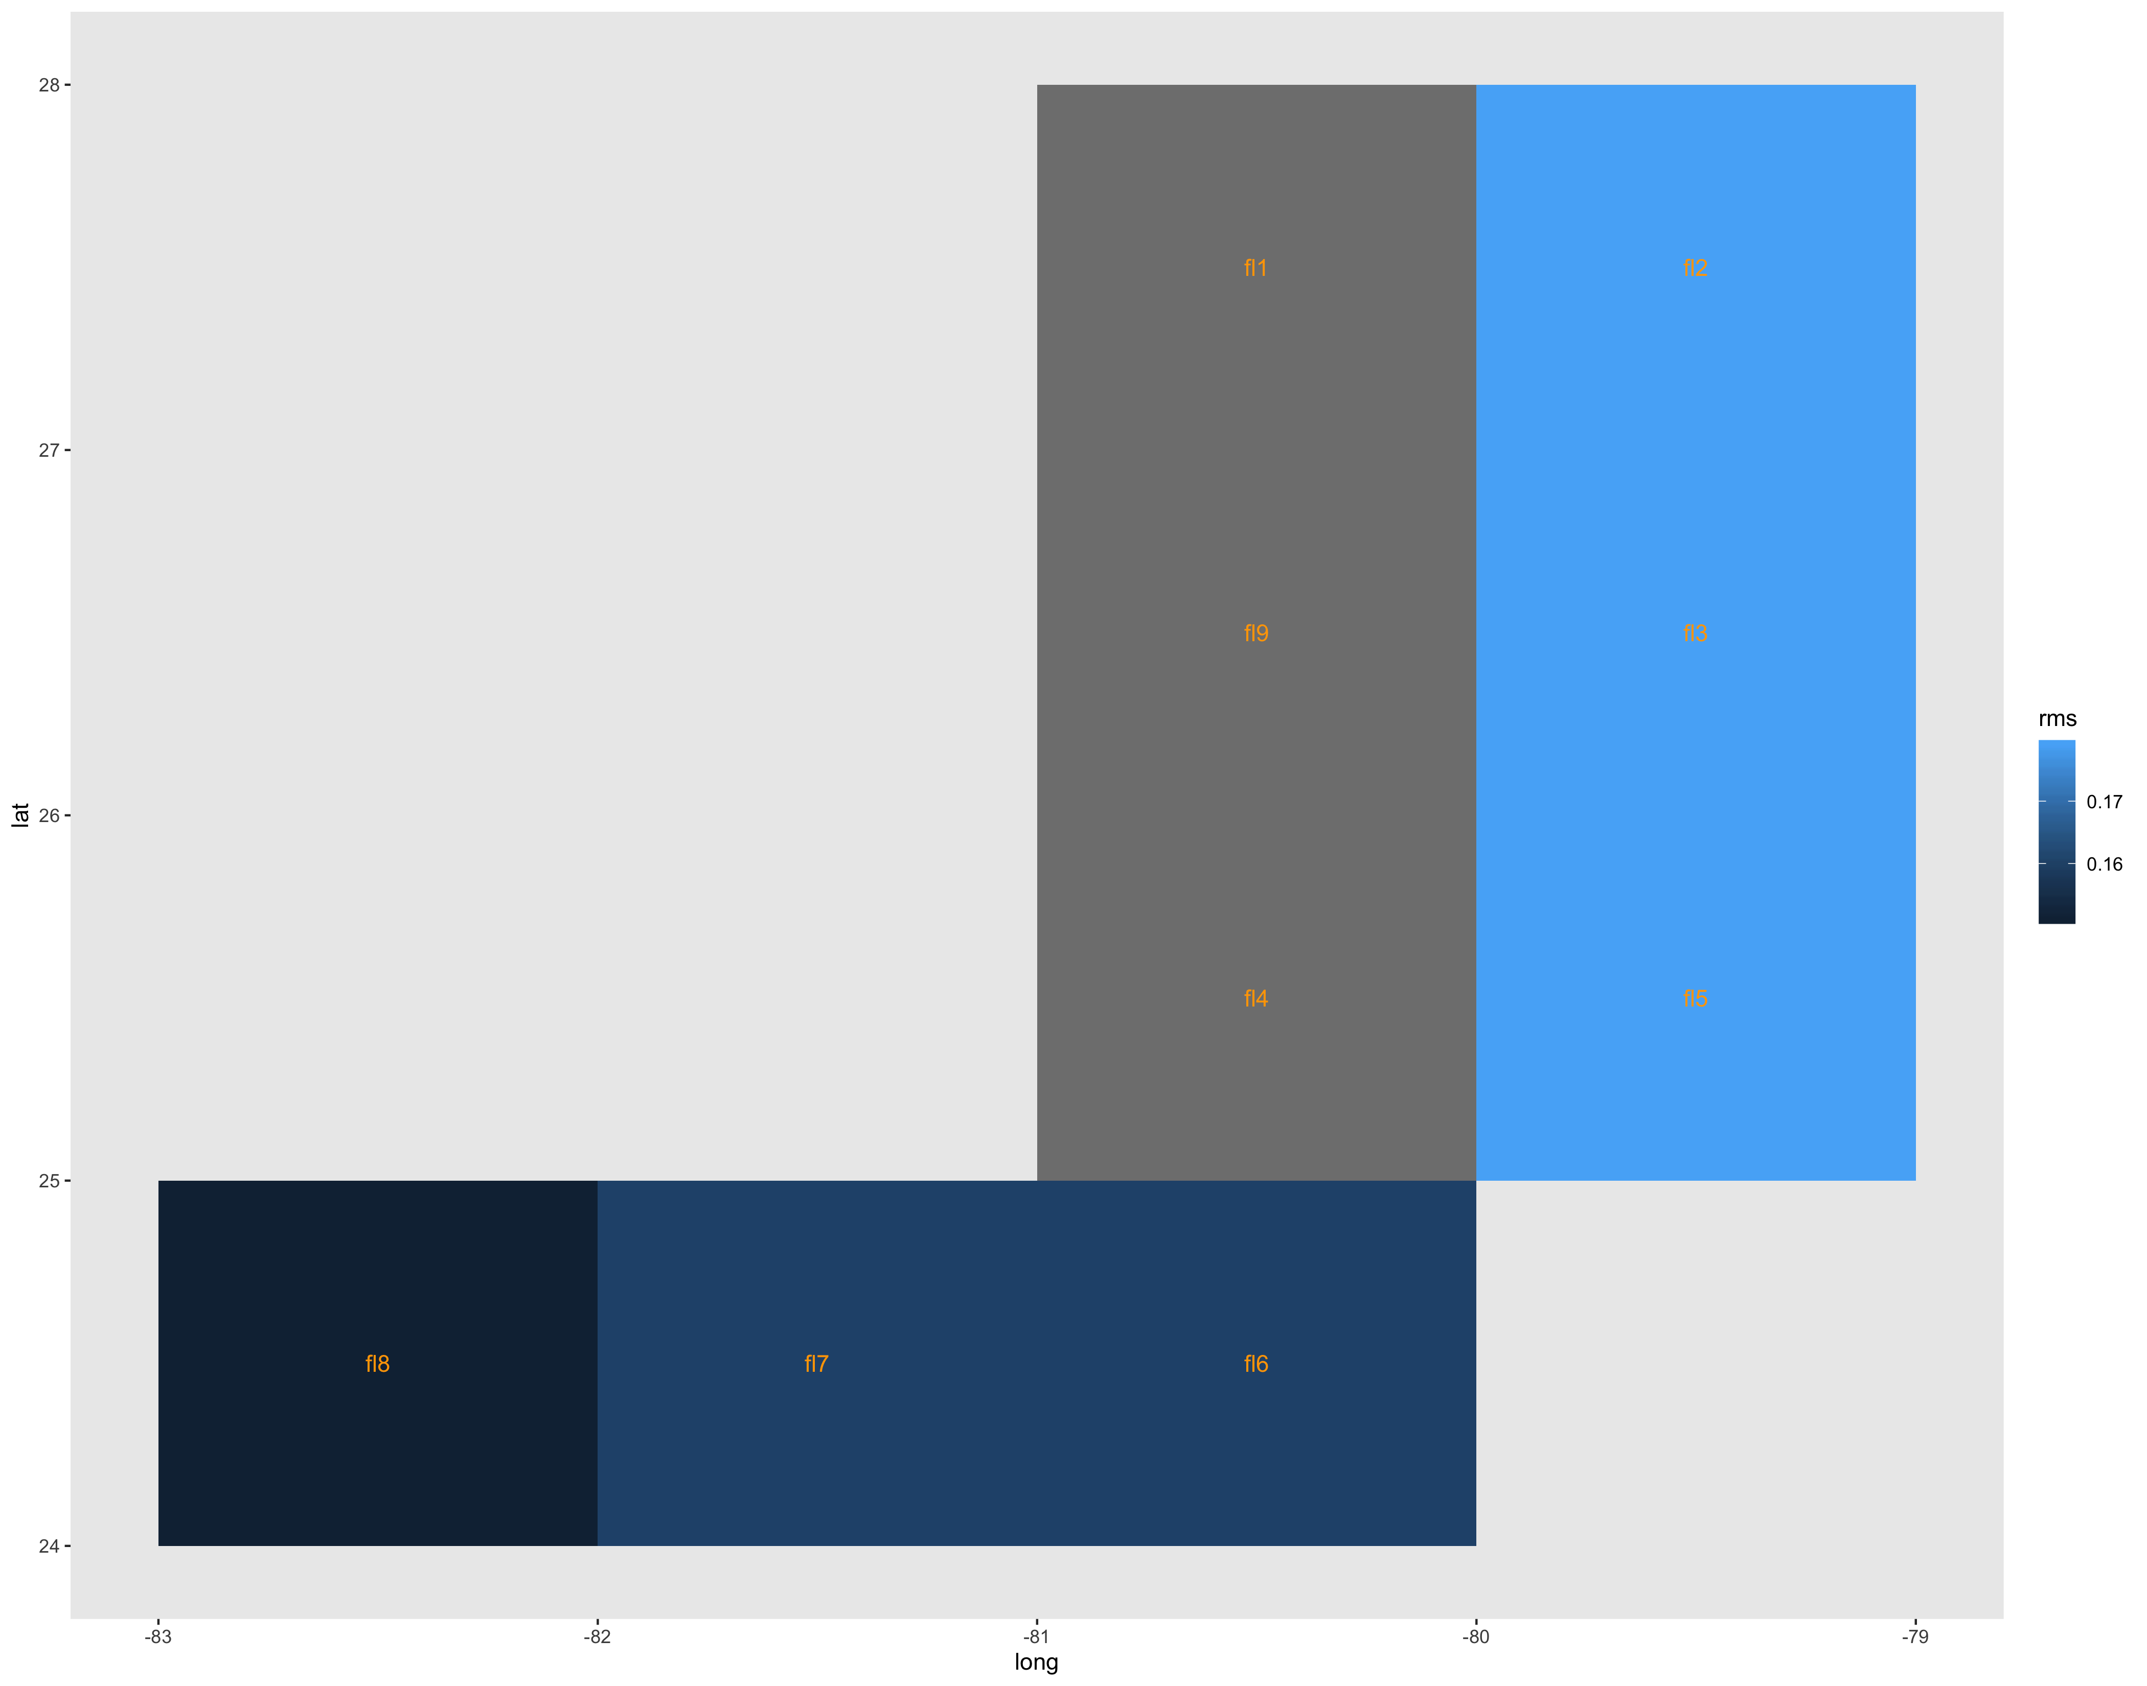
How does it do globally and at sites? - sorry for the different scales on each plot

Slide 4
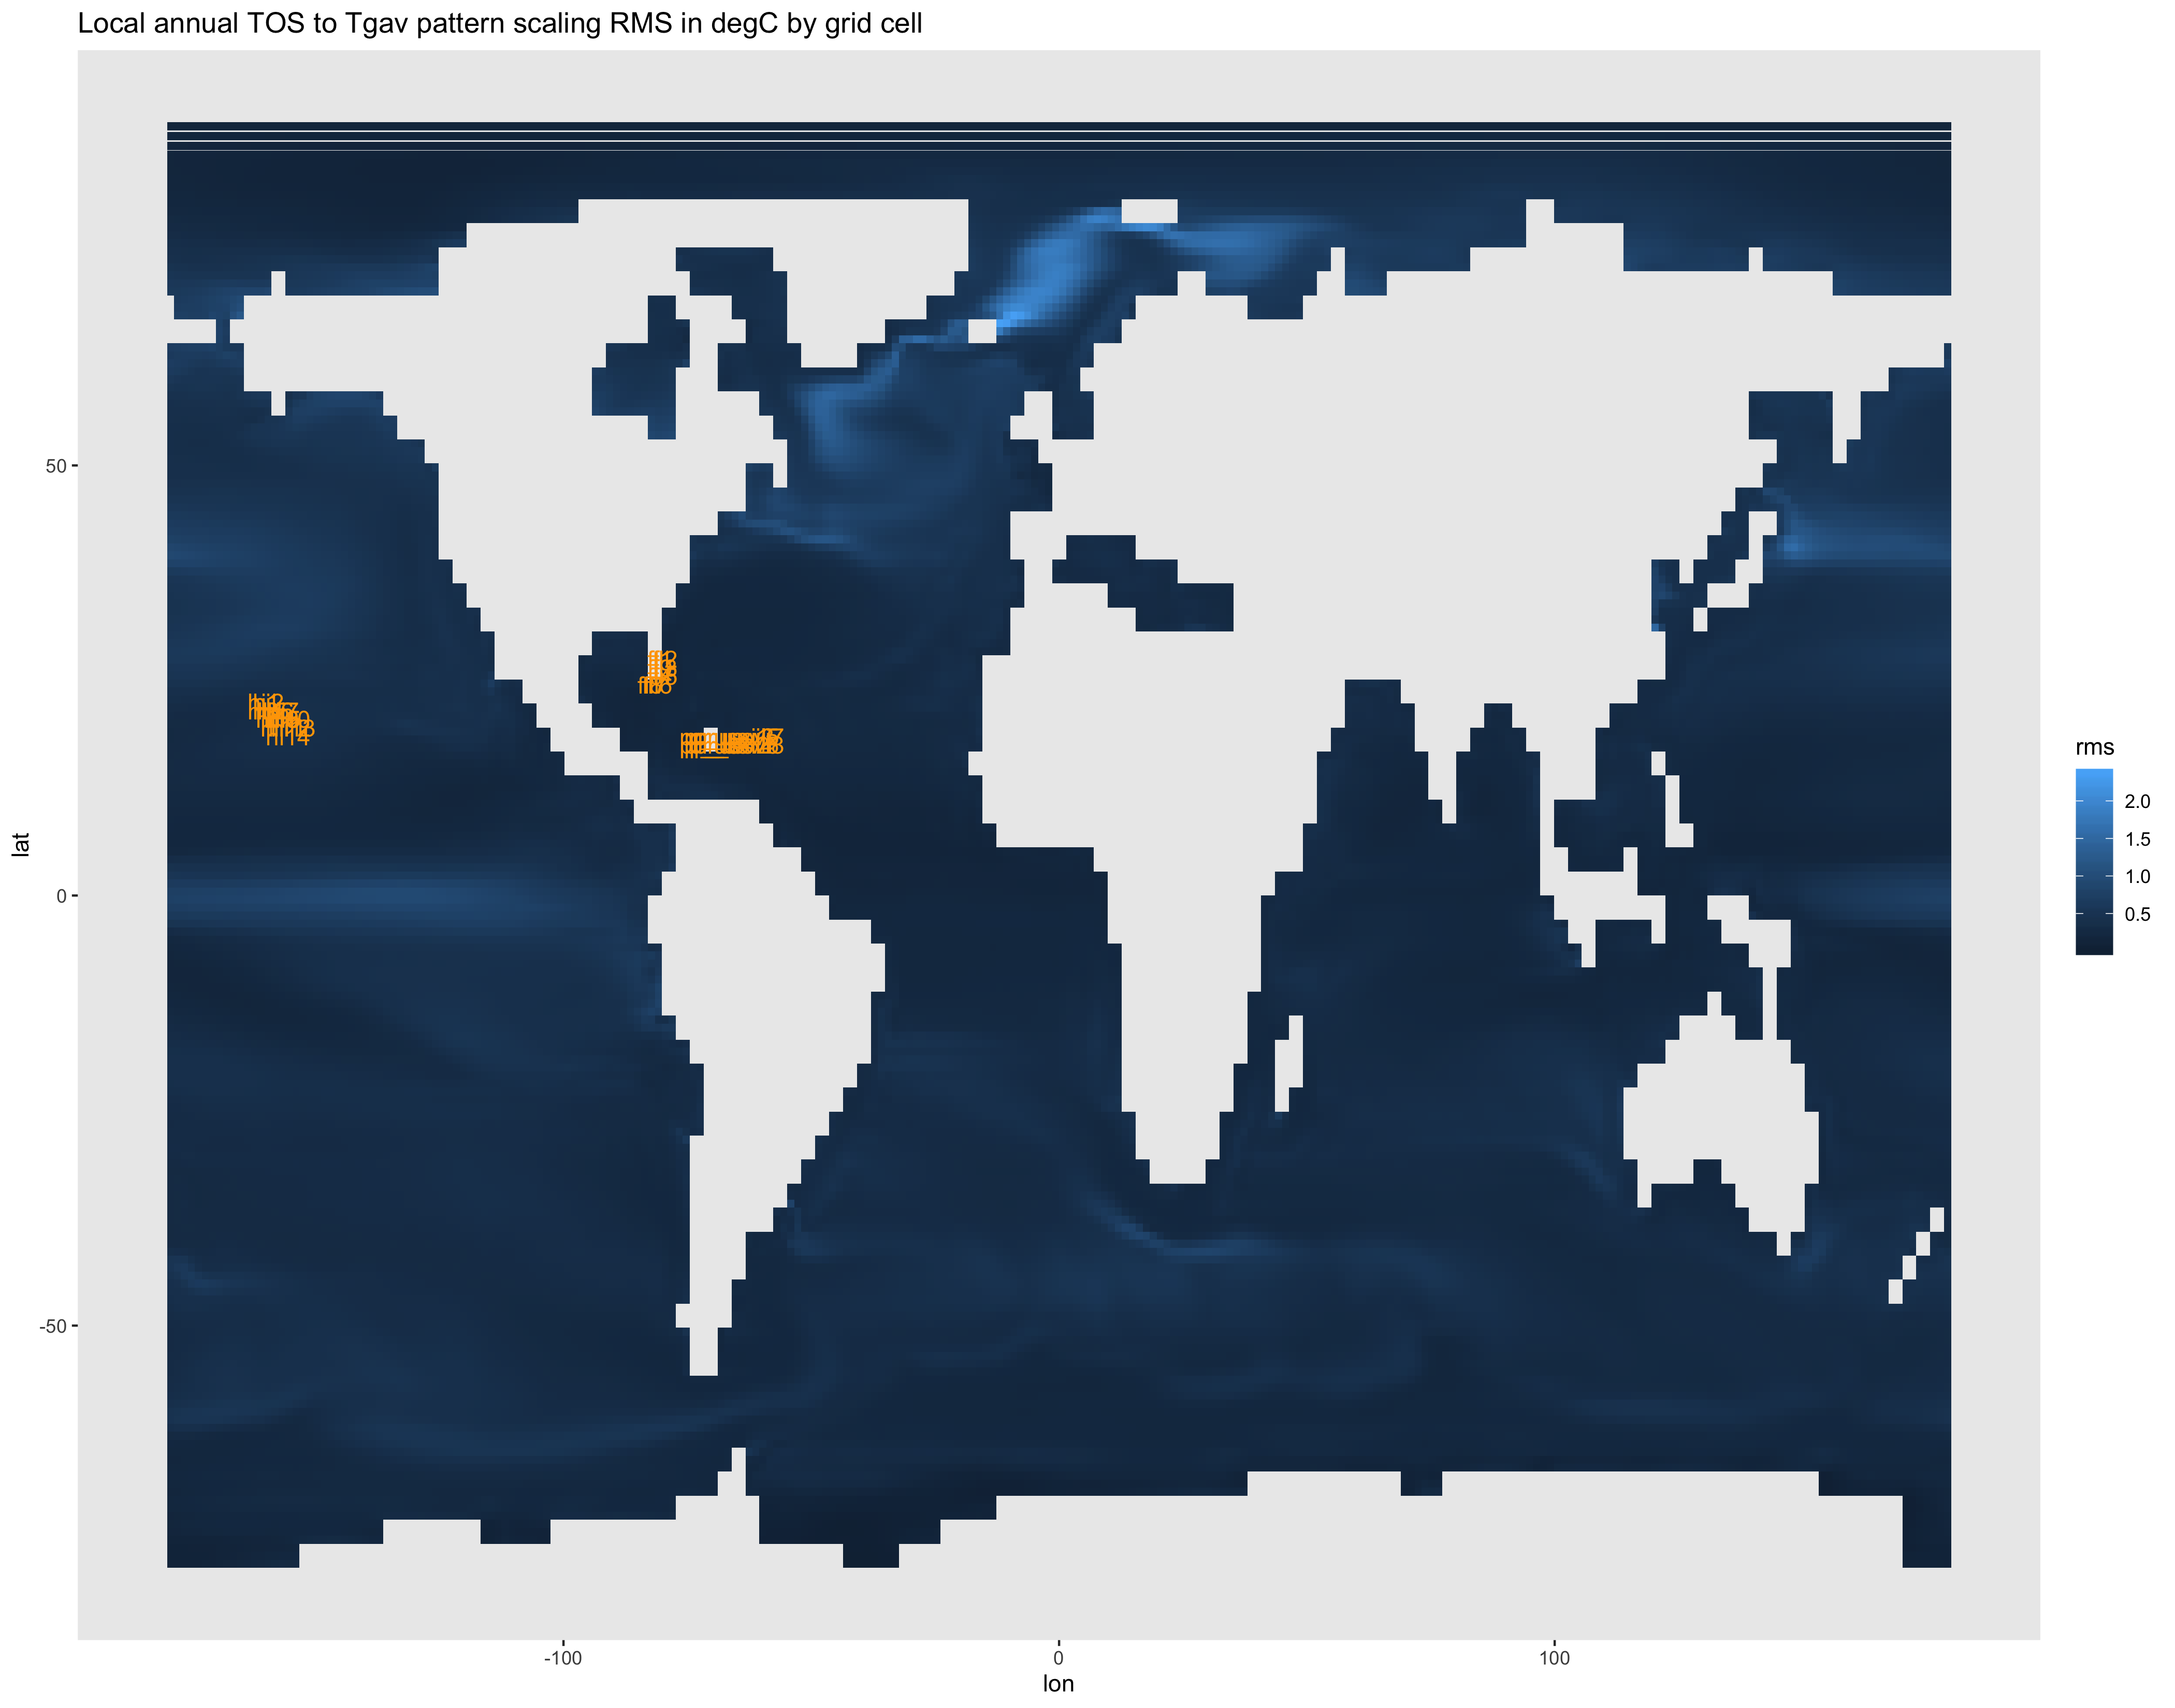
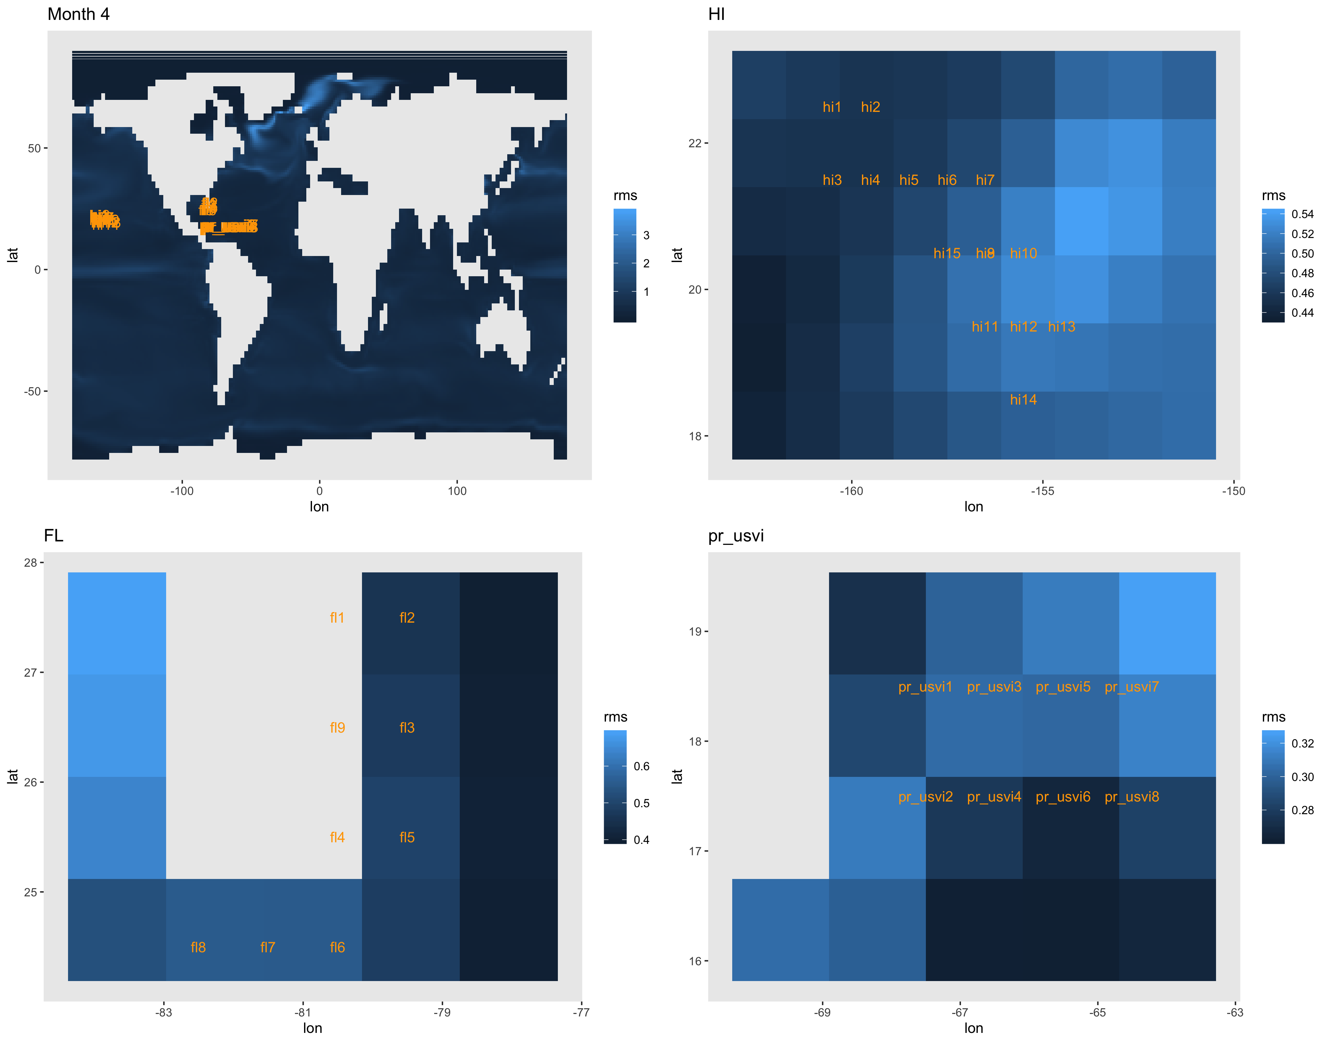
The where pattern scaling systematically struggles are over the major currents
The systematic errors persist in other models, on a smaller size spatial grid, and at the monthly scale
The currents where the errors are move a bit over the months
Conclusion: SST over major currents probably isn’t directly related to Tgav, making pattern scaling of SST globally a challenge.
Monthly pattern scaling preserves annual averages in all cases checked so far – proof may be possible
CanESM2 RCP4.5 pattern scaling – annual data
CanESM2 RCP4.5 pattern scaling – April SST to Tgav patter

Slide 5
Desired enhancements to COMBO – not quick
Better documentation and flexibility of all deltas. There’s a good chance we are not using the correct base year (2007) for calculating our deltaSSTlocals
.OUT files included with COMBO seem to definitely be SST data. Or at least should be SST data based on how it is used in the code …. But there are values included over land cells, so where are those coming from?
Land mask code currently excluded from `scengen_extractv5.m` = these land values DO get averaged in with the SST values over grid cells of interest because the code works with the average over a 3x3 grid cell.
A 3x3 grid cell average over a 2.5 degree grid is a LOT of area.
We specifically still exclude land cells from that averaging because we don’t have data there.
Use data from every year rather than every 10 (our results) or 25 (original)
Use data from the specific grid cell and not the average of 3x3 surrounding it
Work on spatial data with a smaller grid – half degree or smaller?
Actually work on monthly data rather than working on annual + assorted historical scaling COMBO seems to use currently
re-work in R + packrat? Major changes to matlab data reading functions in the R2019a release mean COMBO will not work with newer versions of Matlab. Hardcoding of paths also means code needs adjustment before it can be run on a mac, even with an older version of Matlab.

