Slide 1
We want to run Hector under numerous emissions scenarios (only focusing on CO2 for now), under numerous climate sensitivities to look at the probability of staying above a certain ocean acidification value. (anything lower than X will result in widespread ecosystem changes.)

Slide 2
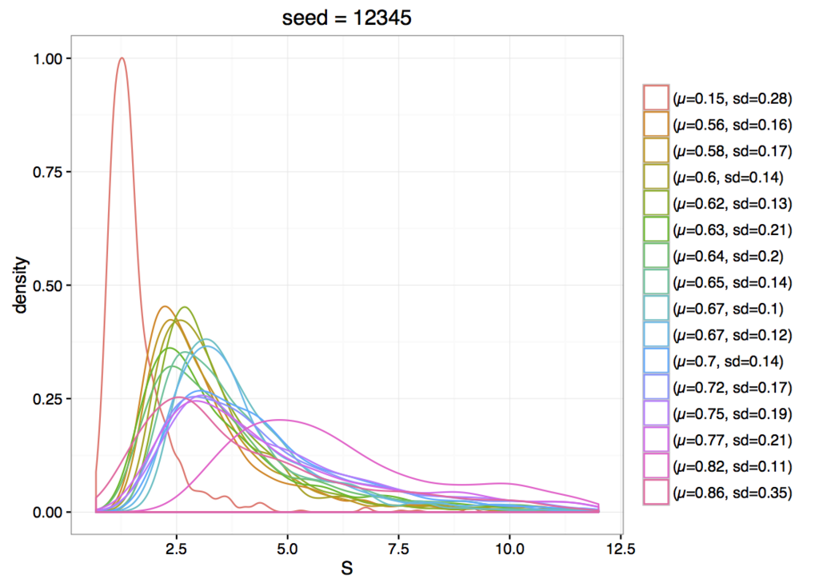
Step 1:
Vary climate sensitivity
Roe and Baker 2007
16 different climate sensitivities from the literature

Slide 3
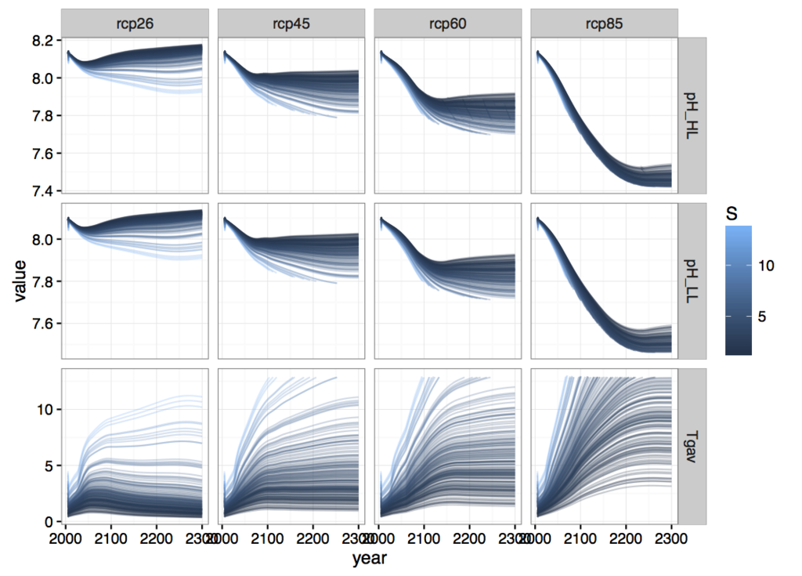
Step 2:
Vary emissions and sensitivity
Test case: only ran RCPs →
Interested in cumulative CO2 emissions at 2100
Holding CO2 emissions constant after 2005 with ~10 different cumulative emissions tracks
Holding all non-co2 constant at 2005 levels
Spoke with Bob Kopp about this
May bring him in as a coauthor

Slide 4
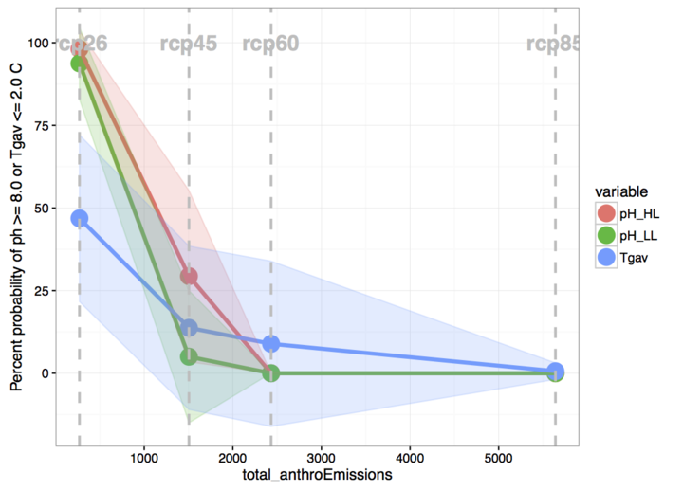
Step 3:
X axis - Total cumulative emissions at 2100
Y axis - Probability of staying above (below) a certain threshold
Notice that temp (blue line) and ocean pH (red and green) follow different paths.

