Slide 1
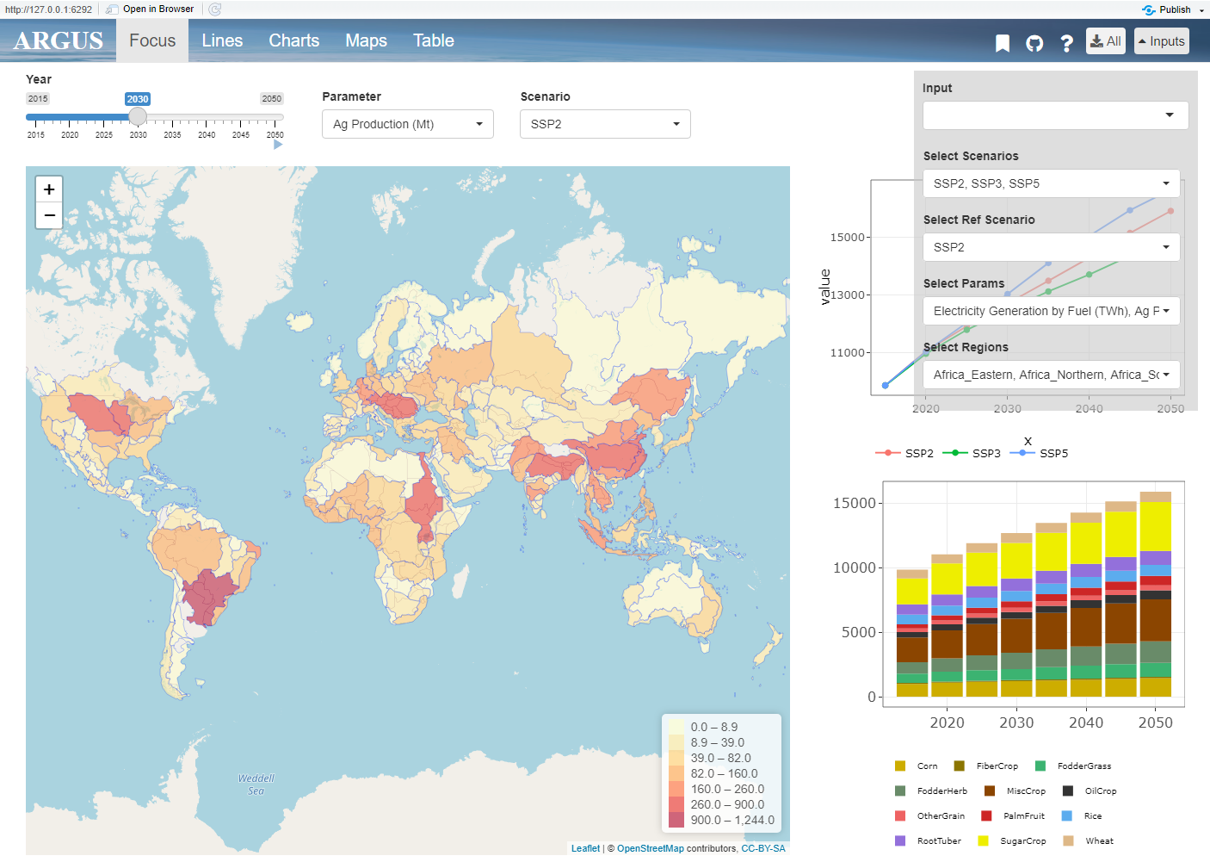
layout.png
Tabs
Inputs
Overview Map

Slide 2
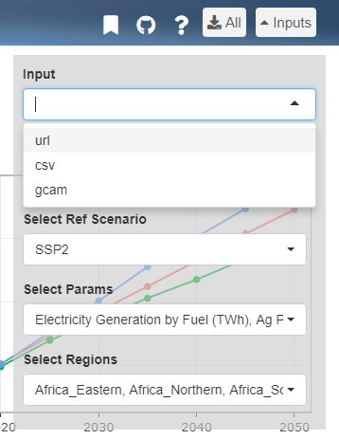
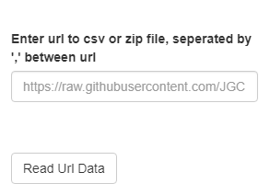
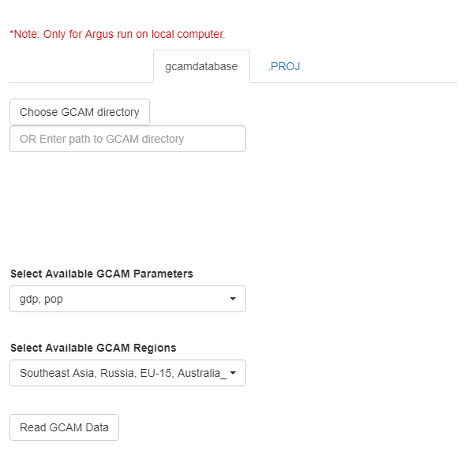
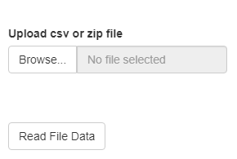
input.png

Slide 3
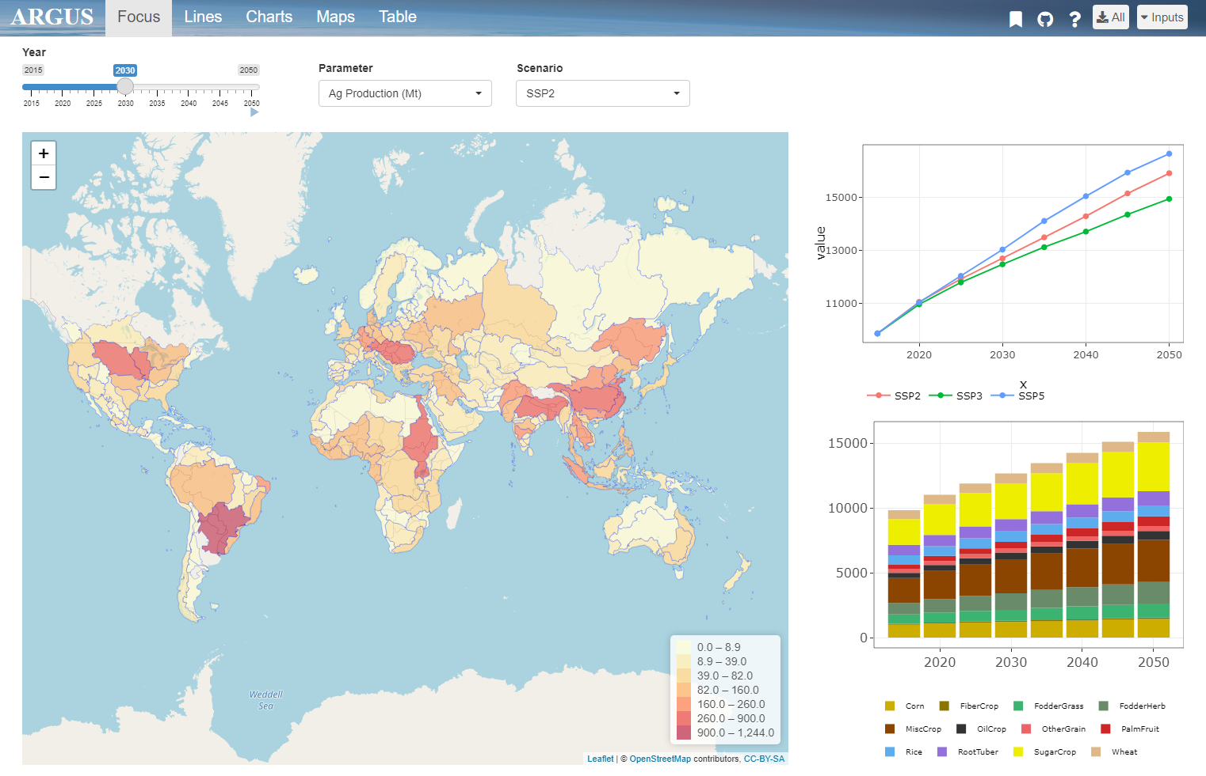
top_bar.png
1. Bookmarking
2. Github
4. Download
3. Help

Slide 4
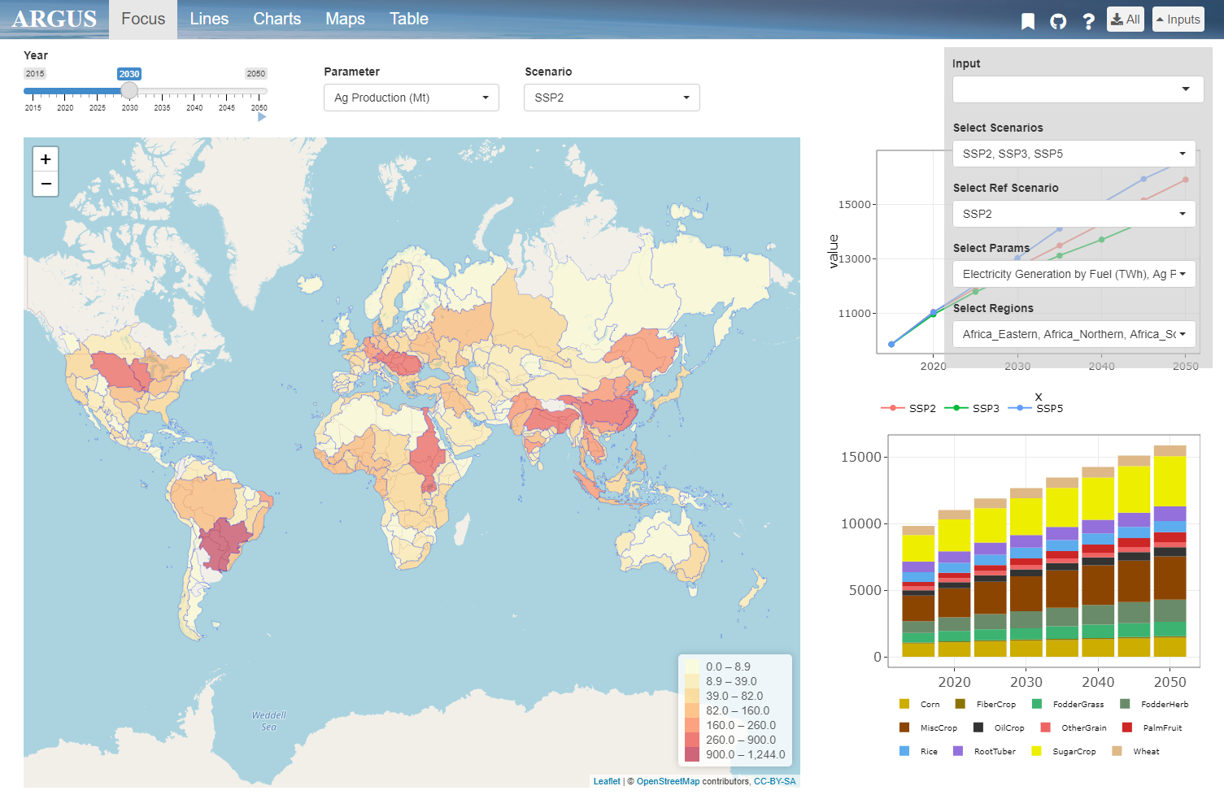
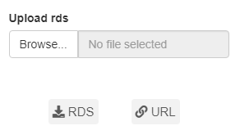
bookmark.png

Slide 5
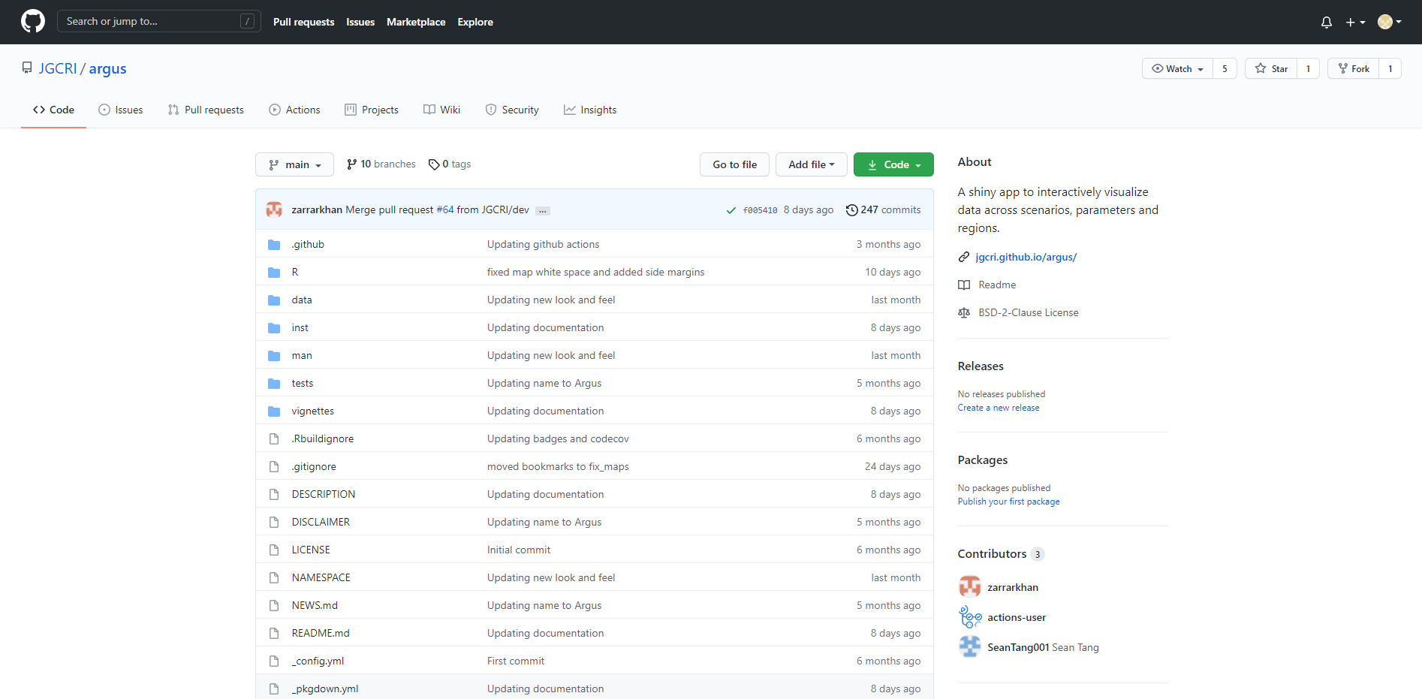
github.png

Slide 6
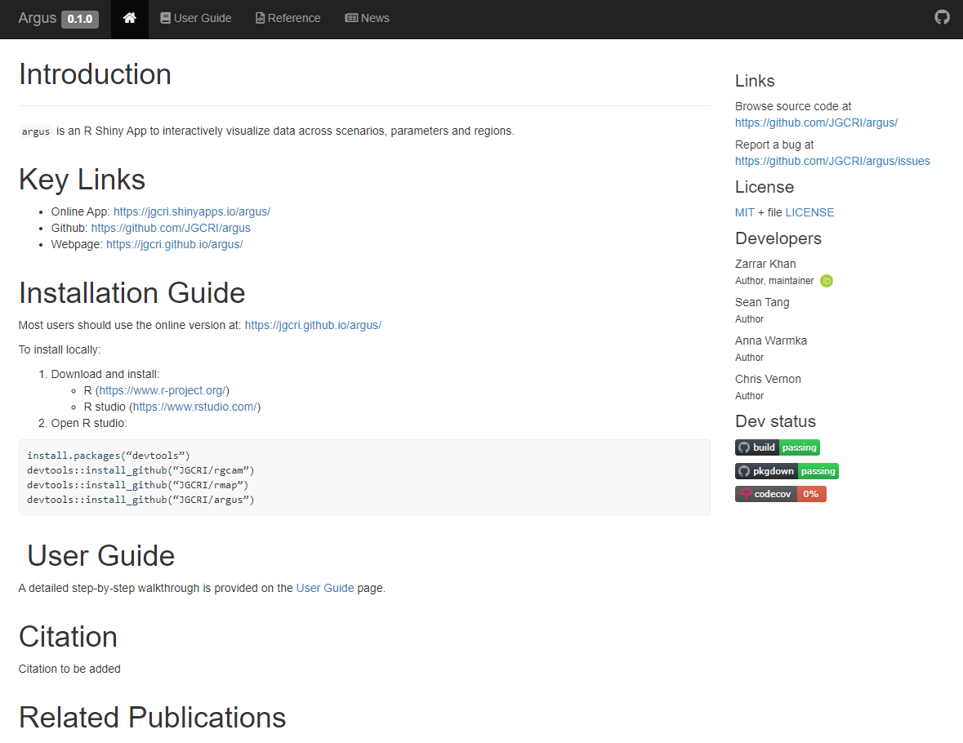
help.png

Slide 7
focus.png
Parameters
Scenario
Year Scrollbar
Overview Map
Comparative Charts

Slide 8
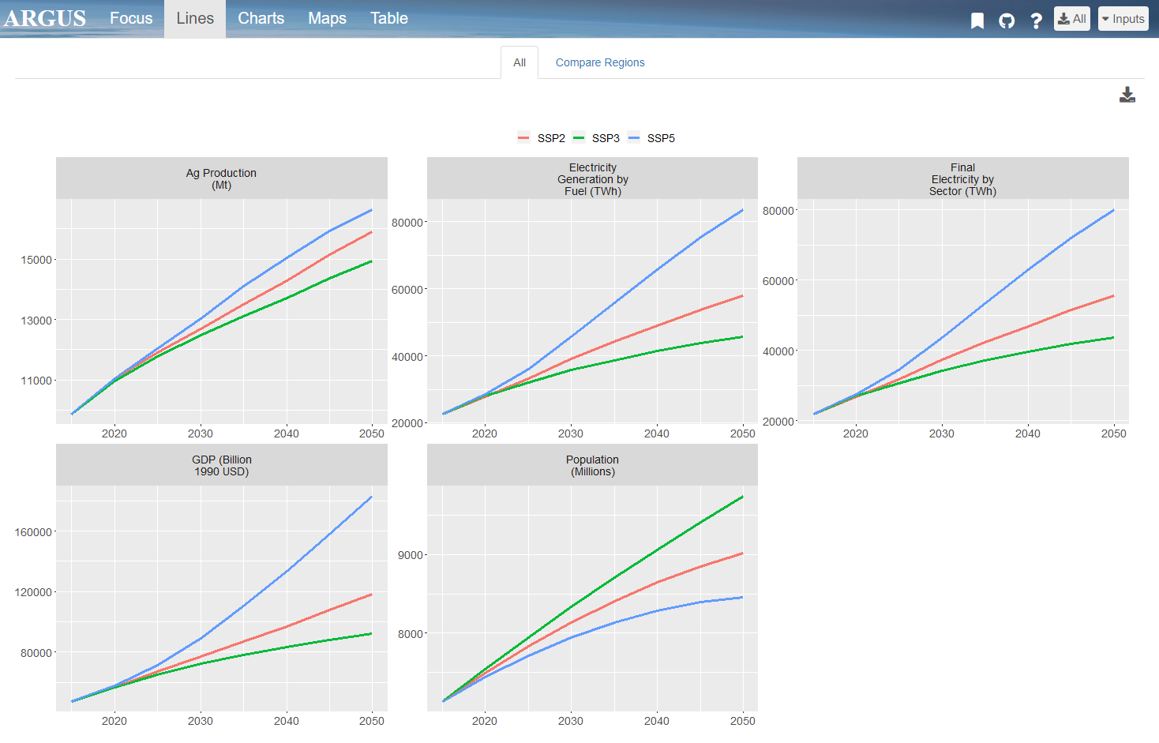
line_all.png
Different Scenarios
Download Page
Different Parameters

Slide 9
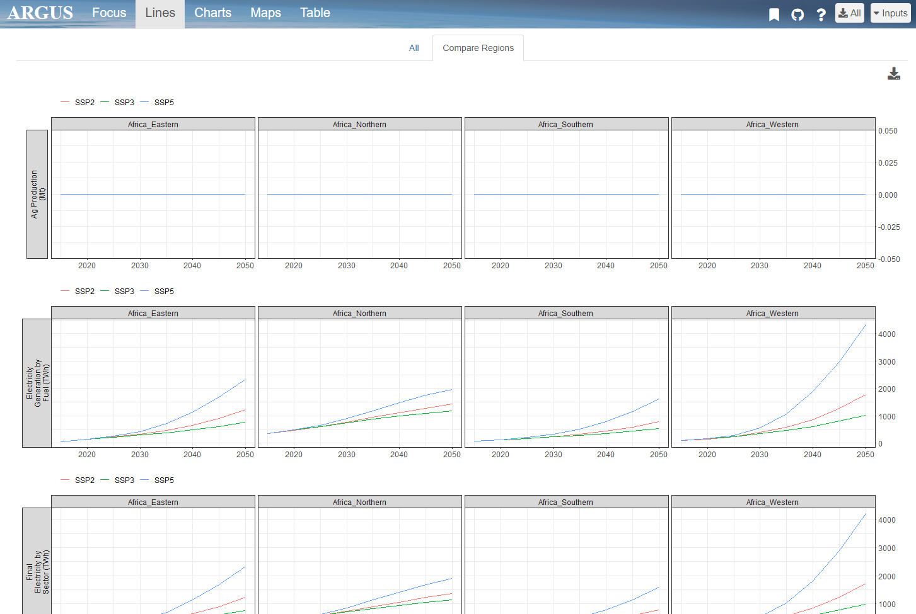
line_comp.png

Slide 10
charts.png

Slide 11
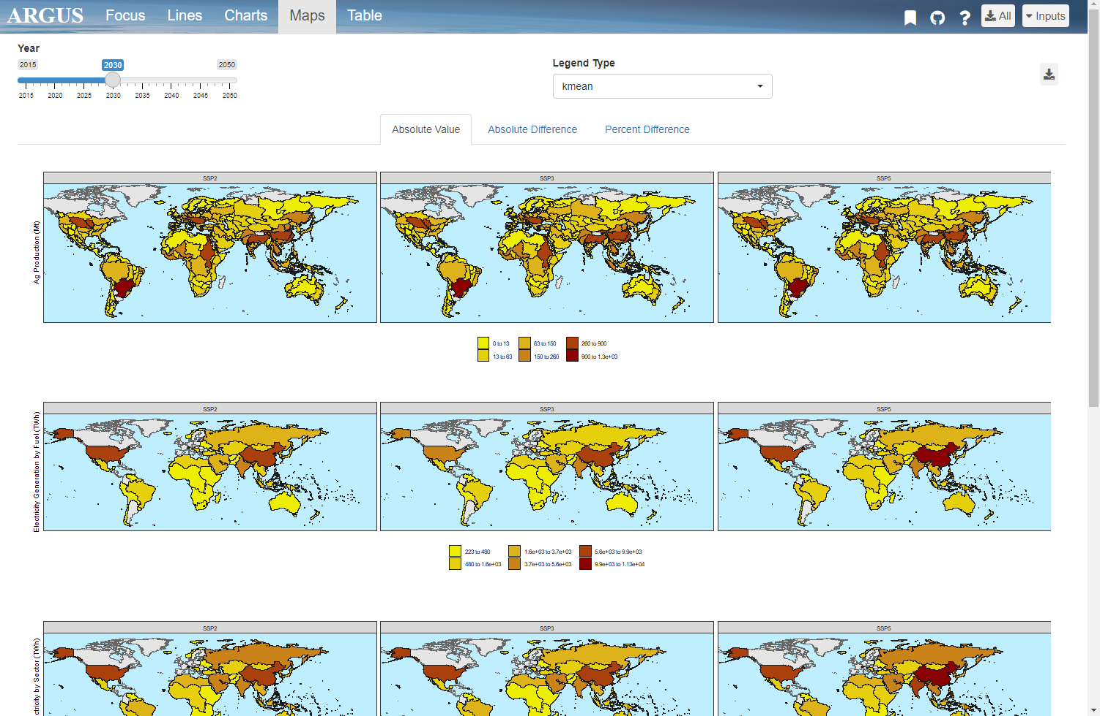
maps.png
Different Scenarios
Legend Type
Year Scrollbar
Download Page
Different Parameters

Slide 12
Launch App
User Guide

