Slide 1
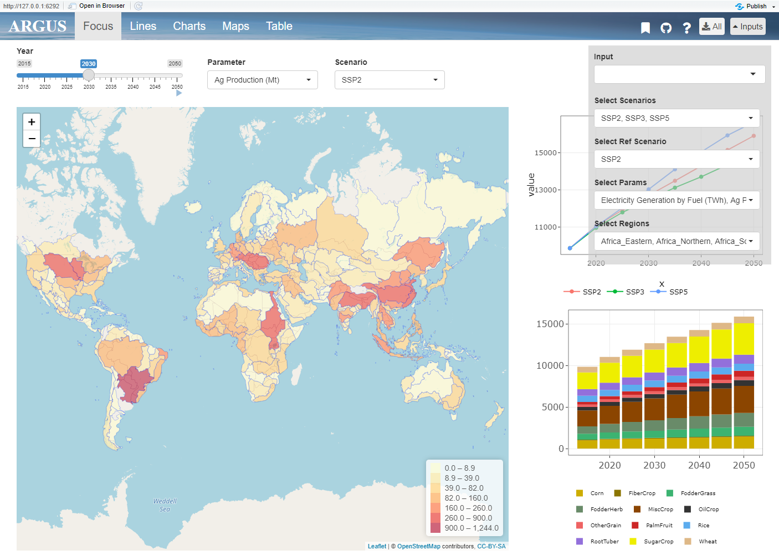
layout.png
Tabs
Inputs
Tab Contents

Slide 2
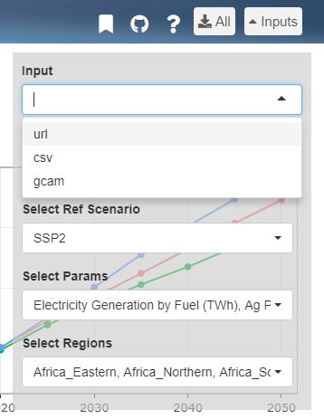
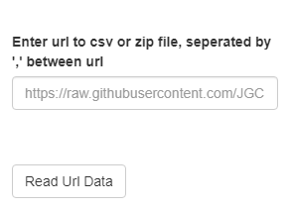
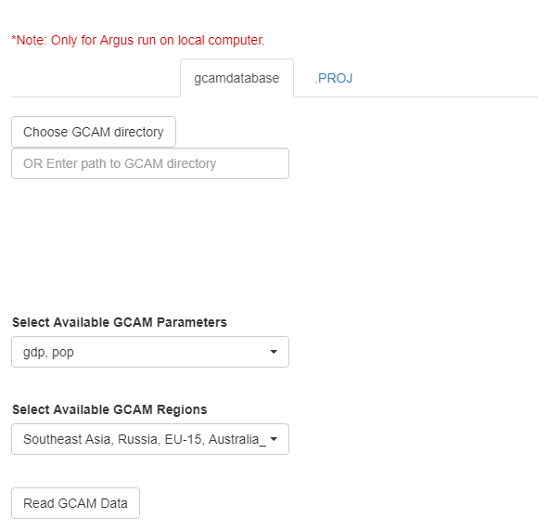
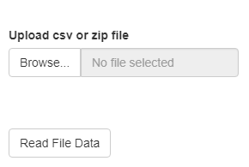
input.png

Slide 3
input_format.png
Minimum
Optional Columns
subRegion | value | param | scenario | class | year | units
CA | 5
FL | 10
TX | 7
MN | 2
Regional Data
OR
Minimum
Optional Columns
Latitude | Longitude | value | param | scenario | class | year | units
34.04 | -118 | 5
28 | -83 | 10
28 | -95.4 | 7
45 | -93.3 | 2
Coordinate Data

Slide 4
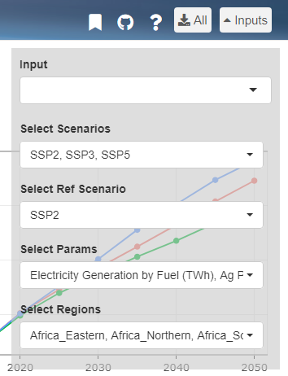
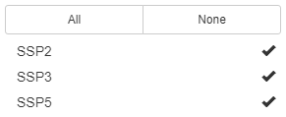
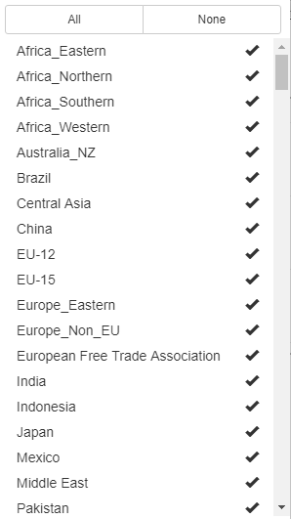

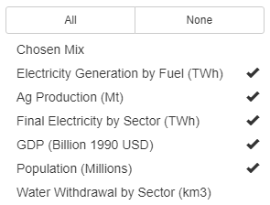
selections.png

Slide 5
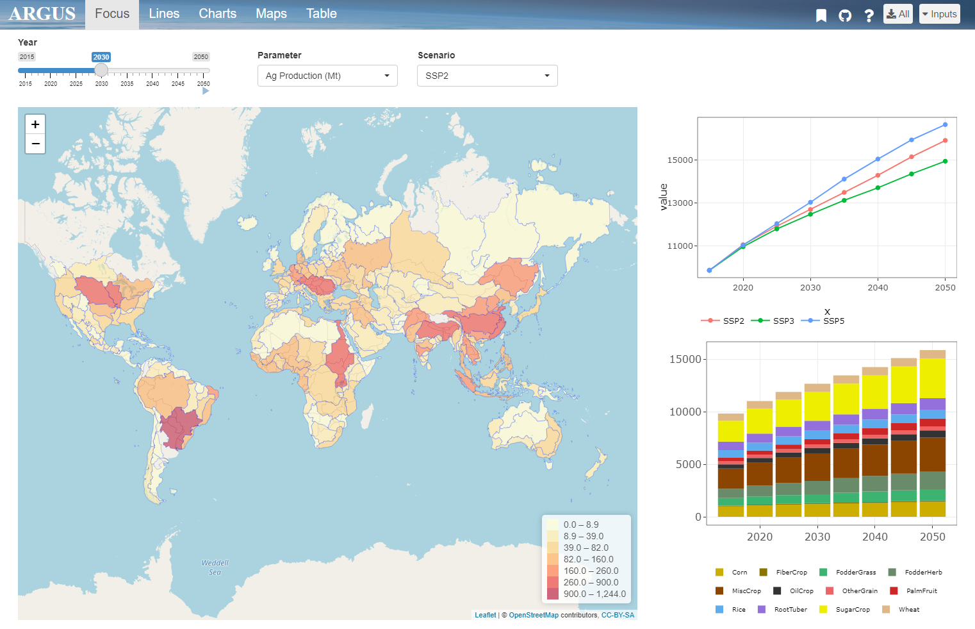
top_bar.png
1. Bookmarking
2. Github
4. Download
3. Help

Slide 6
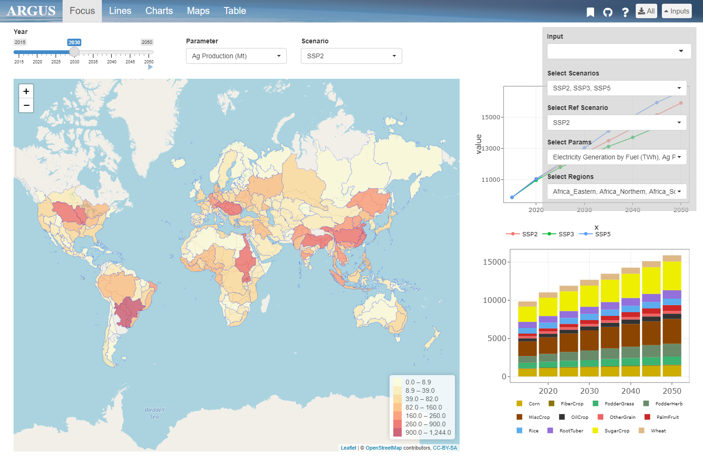
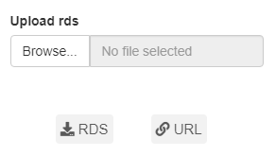
bookmark.png

Slide 7
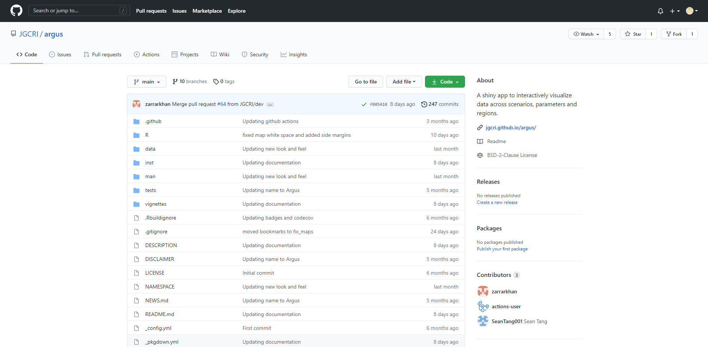
github.png

Slide 8
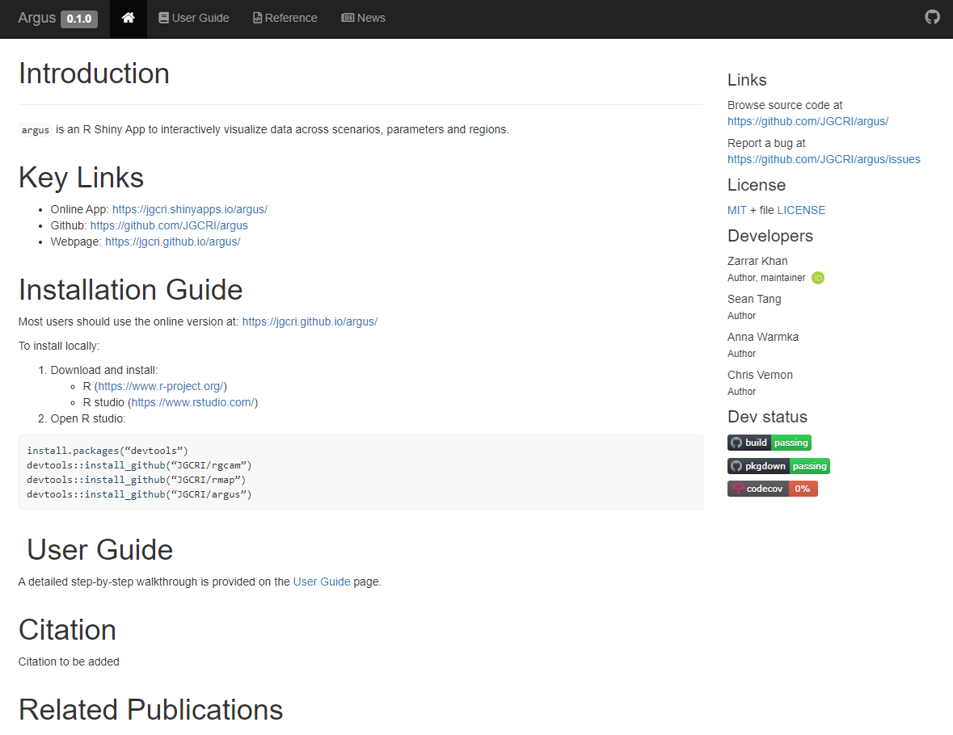
help.png

Slide 9
focus.png
Parameters
Scenario
Year Scrollbar
Overview Map
Comparative Charts

Slide 10
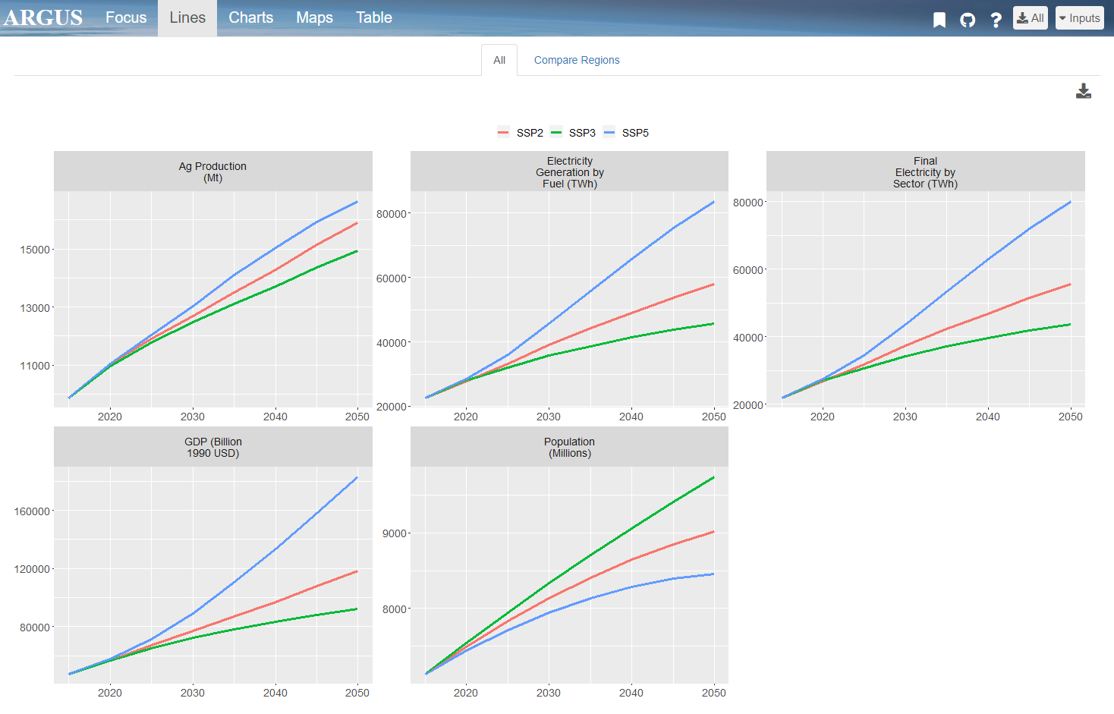
line_all.png
Different Scenarios
Download Page
Different Parameters

Slide 11
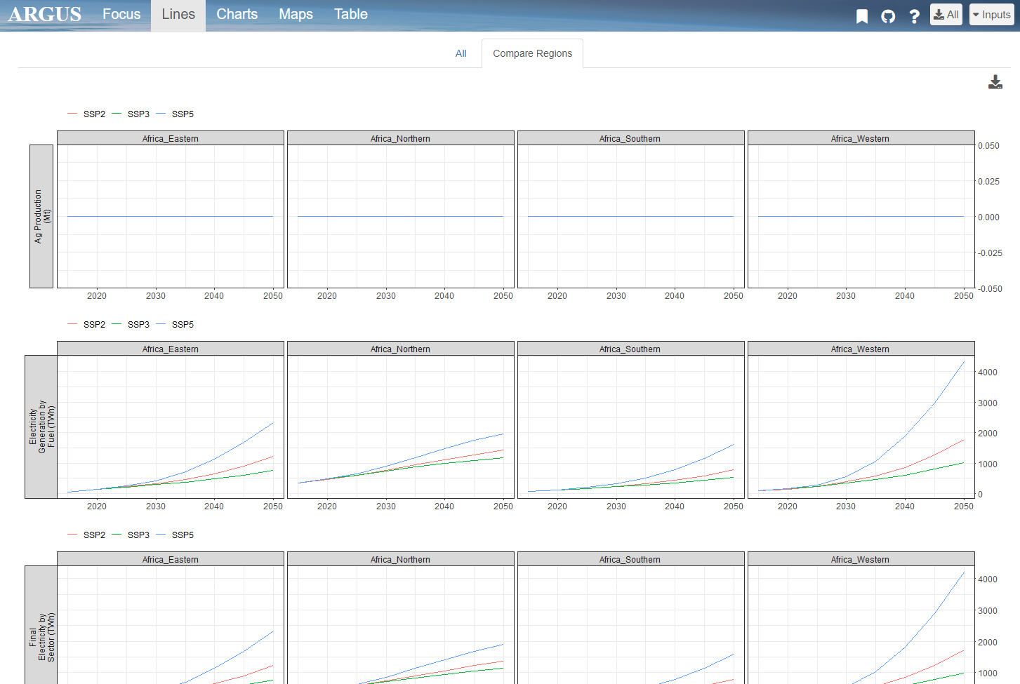
line_comp.png

Slide 12
charts.png

Slide 13
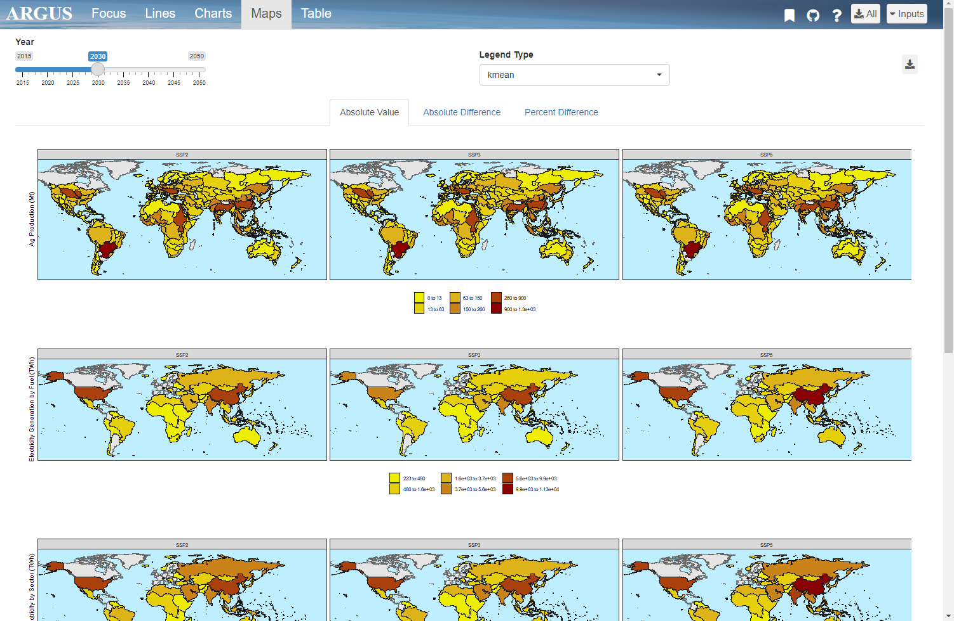
maps.png
Different Scenarios
Legend Type
Year Scrollbar
Download Page
Different Parameters

Slide 14
Launch App
User Guide

