Slide 1
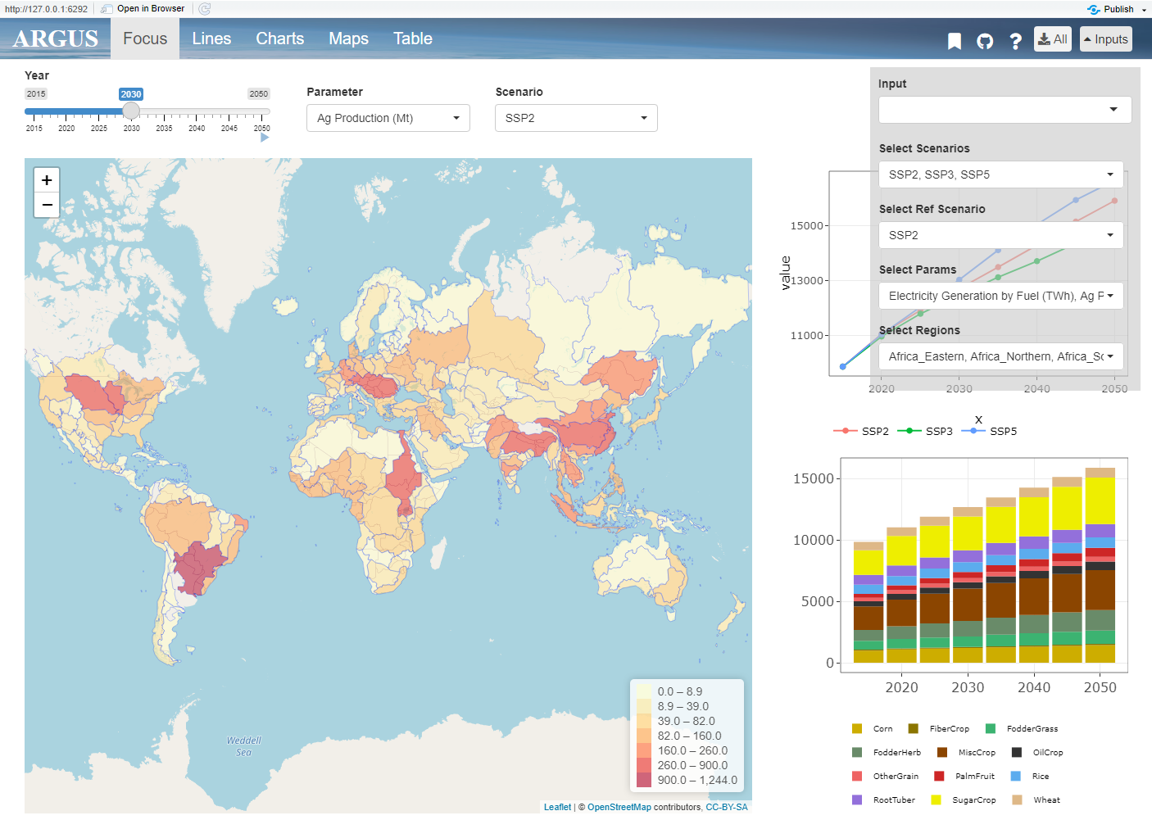
layout.png
Tabs
Inputs
Tab Contents

Slide 2
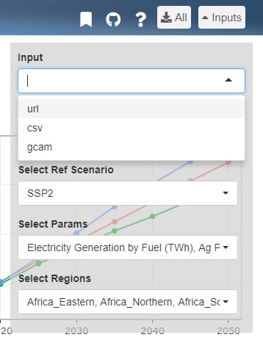
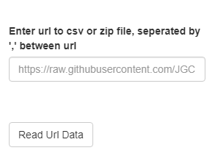
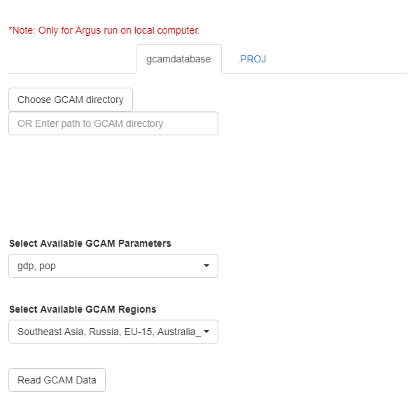
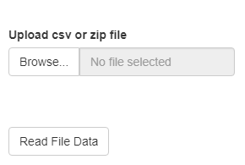
input.png

Slide 3
input_format.png
Minimum
Optional Columns
subRegion | value | param | scenario | class | year | units
CA | 5
FL | 10
TX | 7
MN | 2
Regional Data
OR
Minimum
Optional Columns
Latitude | Longitude | value | param | scenario | class | year | units
34.04 | -118 | 5
28 | -83 | 10
28 | -95.4 | 7
45 | -93.3 | 2
Coordinate Data

Slide 4
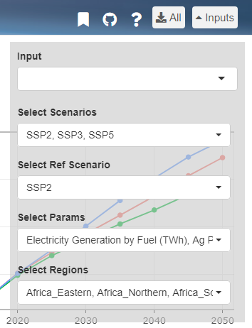
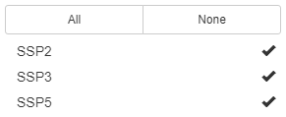
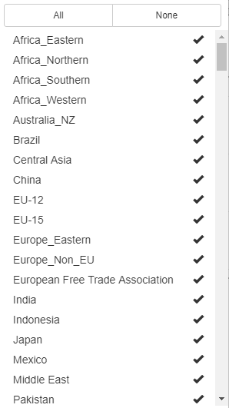

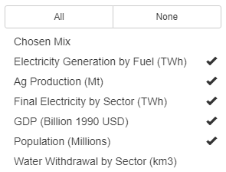
selections.png

Slide 5
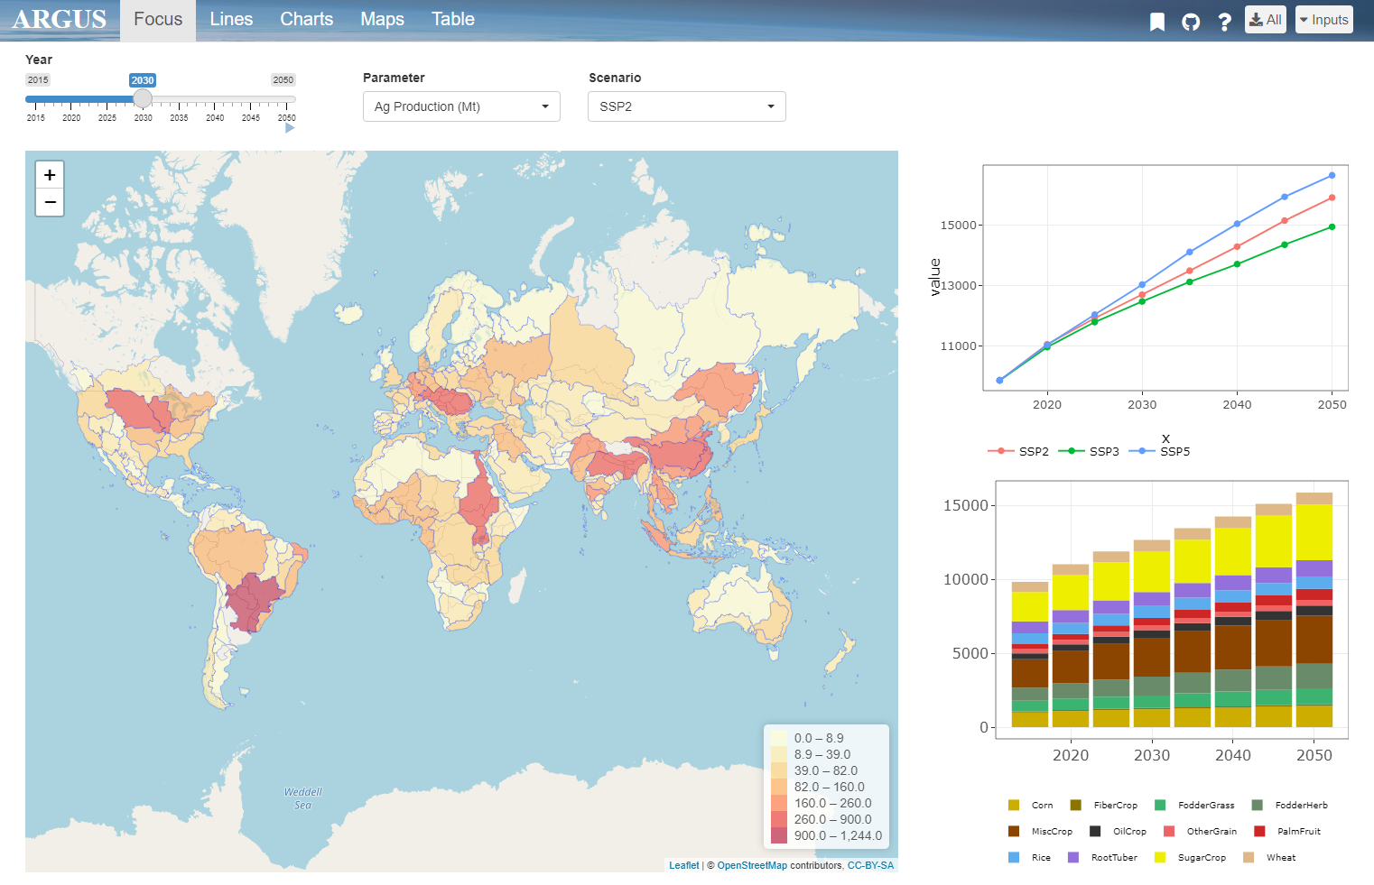
top_bar.png
1. Bookmarking
2. Github
4. Download
3. Help

Slide 6
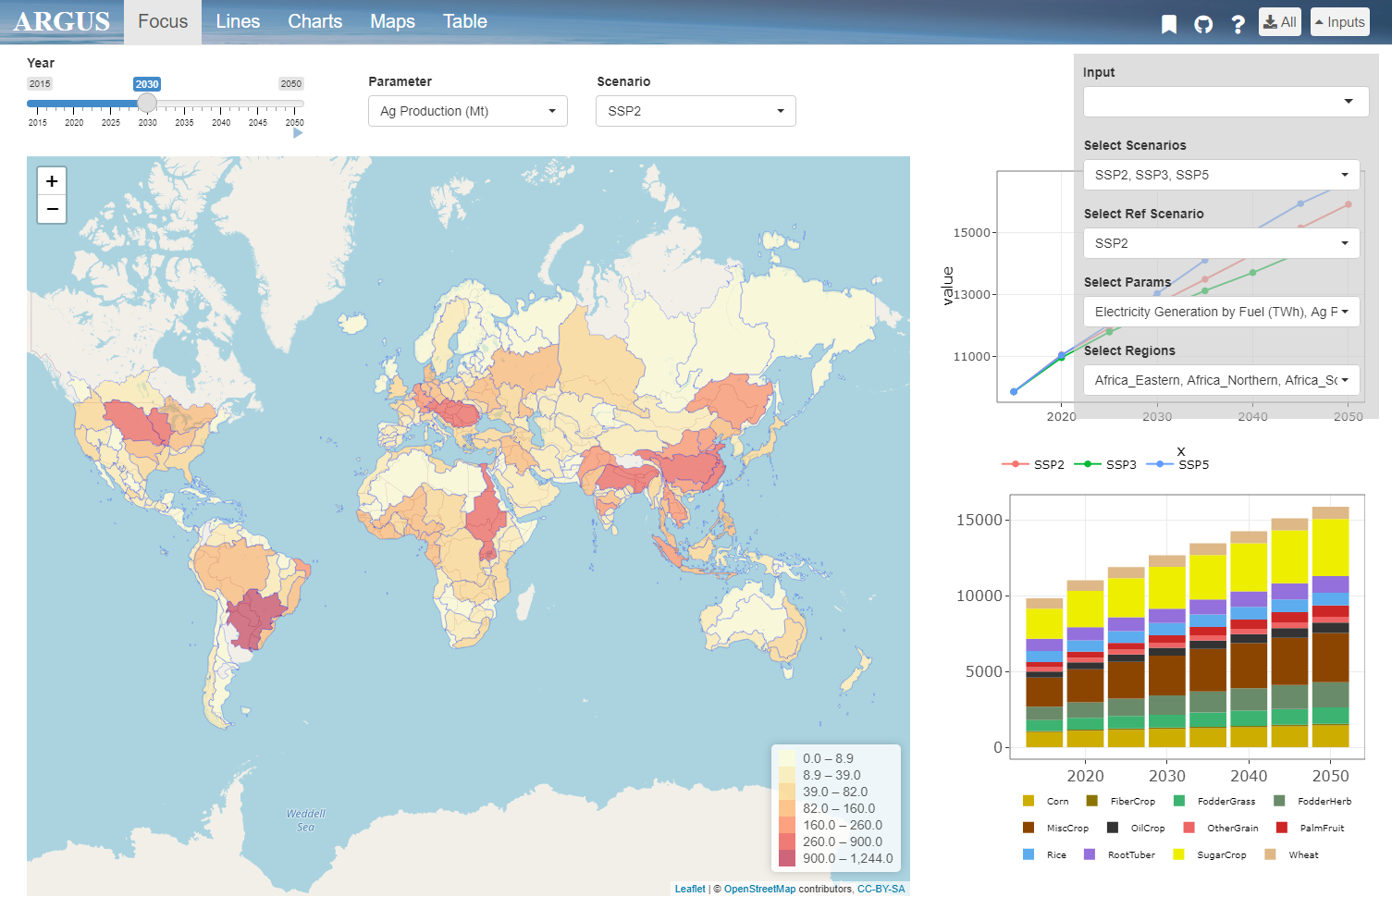
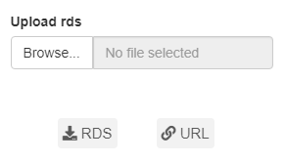
bookmark.png

Slide 7
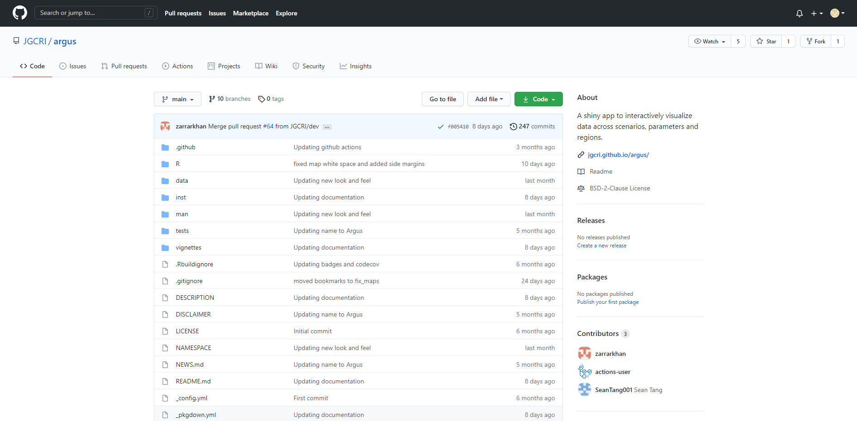
github.png

Slide 8
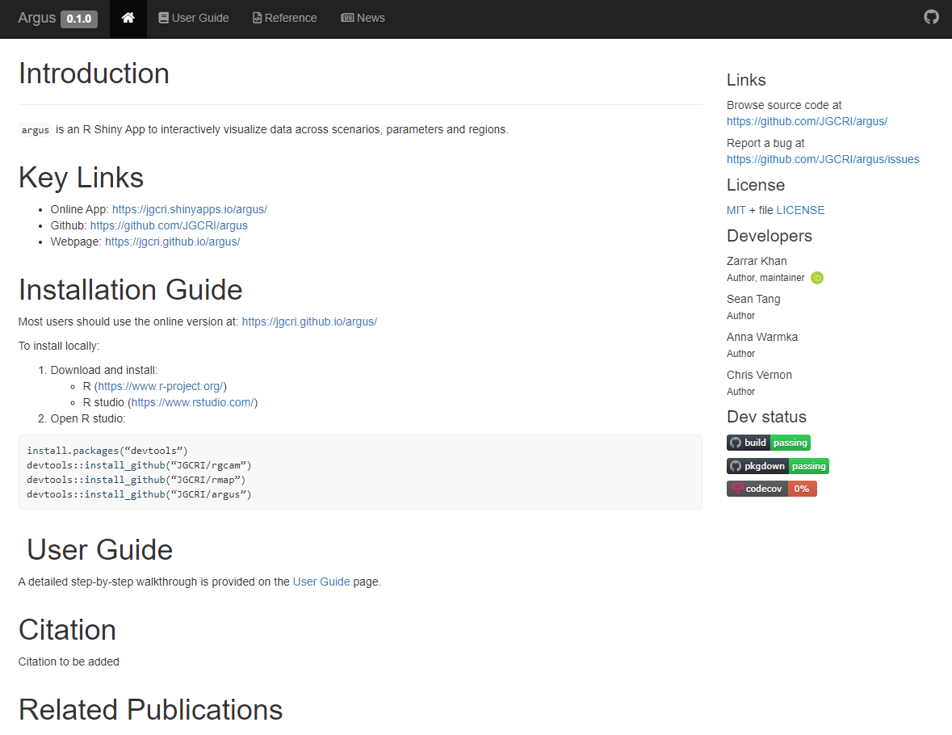
help.png

Slide 9
focus.png
Parameters
Scenario
Year Scrollbar
Overview Map
Comparative Charts

Slide 10
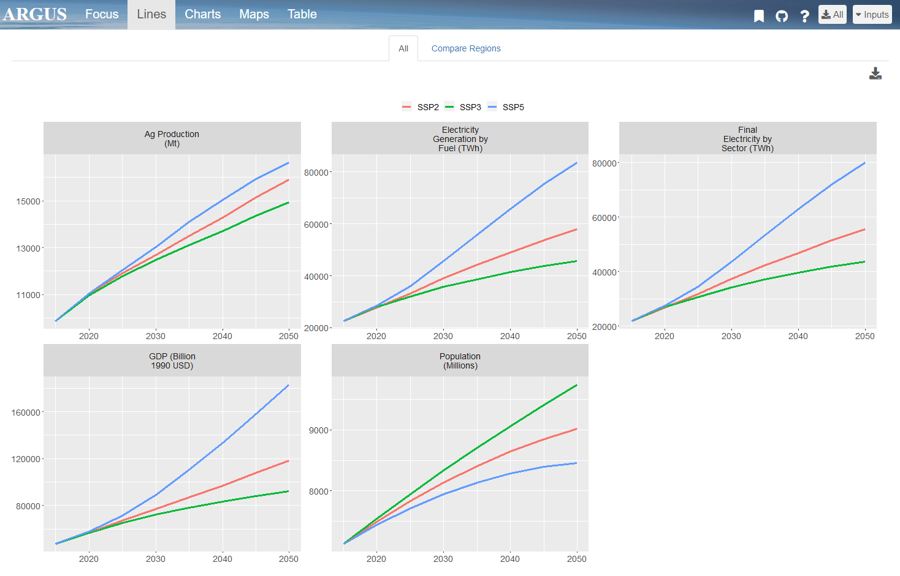
line.png
Different Scenarios
Compare Regions
Download Page
Different Parameters

Slide 11
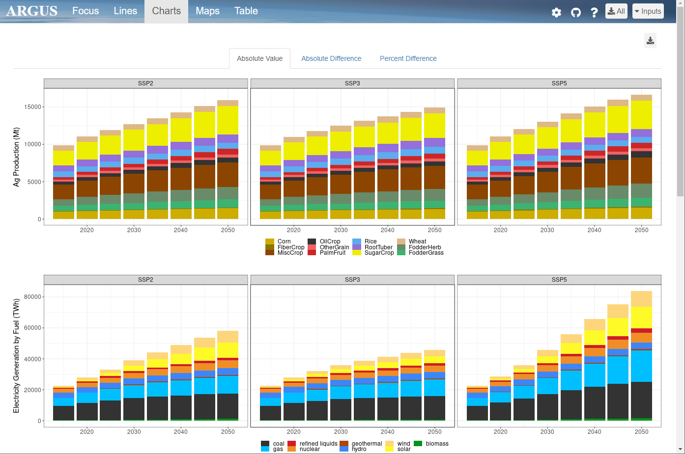
charts.png
Different Scenarios
Difference Maps
Download Page
Different Parameters

Slide 12
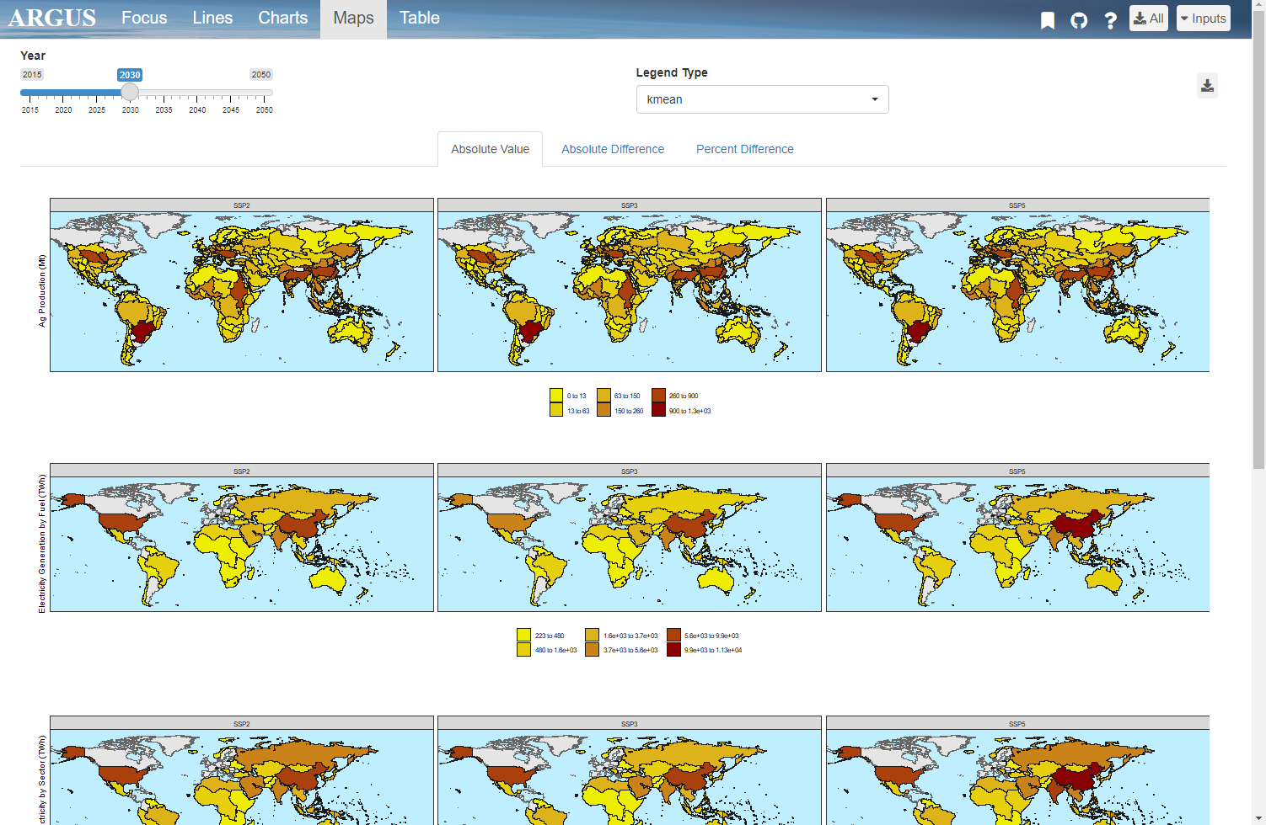
maps.png
Different Scenarios
Legend Type
Difference Maps
Year Scrollbar
Download Page
Different Parameters

Slide 13
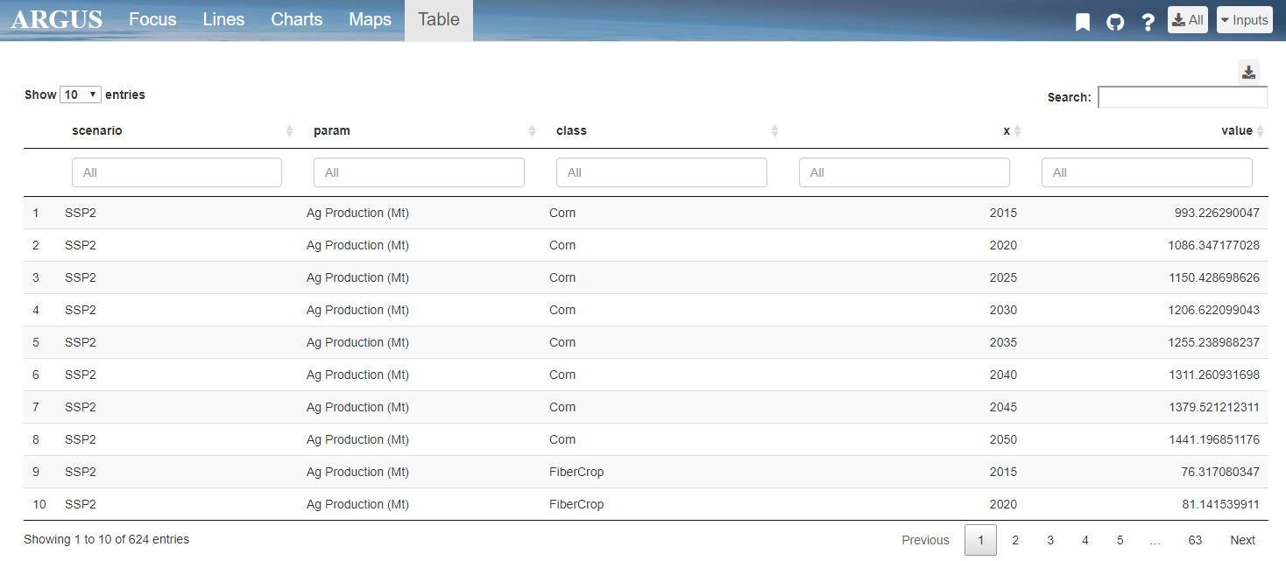
table.png
Column Filters
Search Bar
Download Page
Page Navigation

Slide 14
Launch App
User Guide

