Slide 1
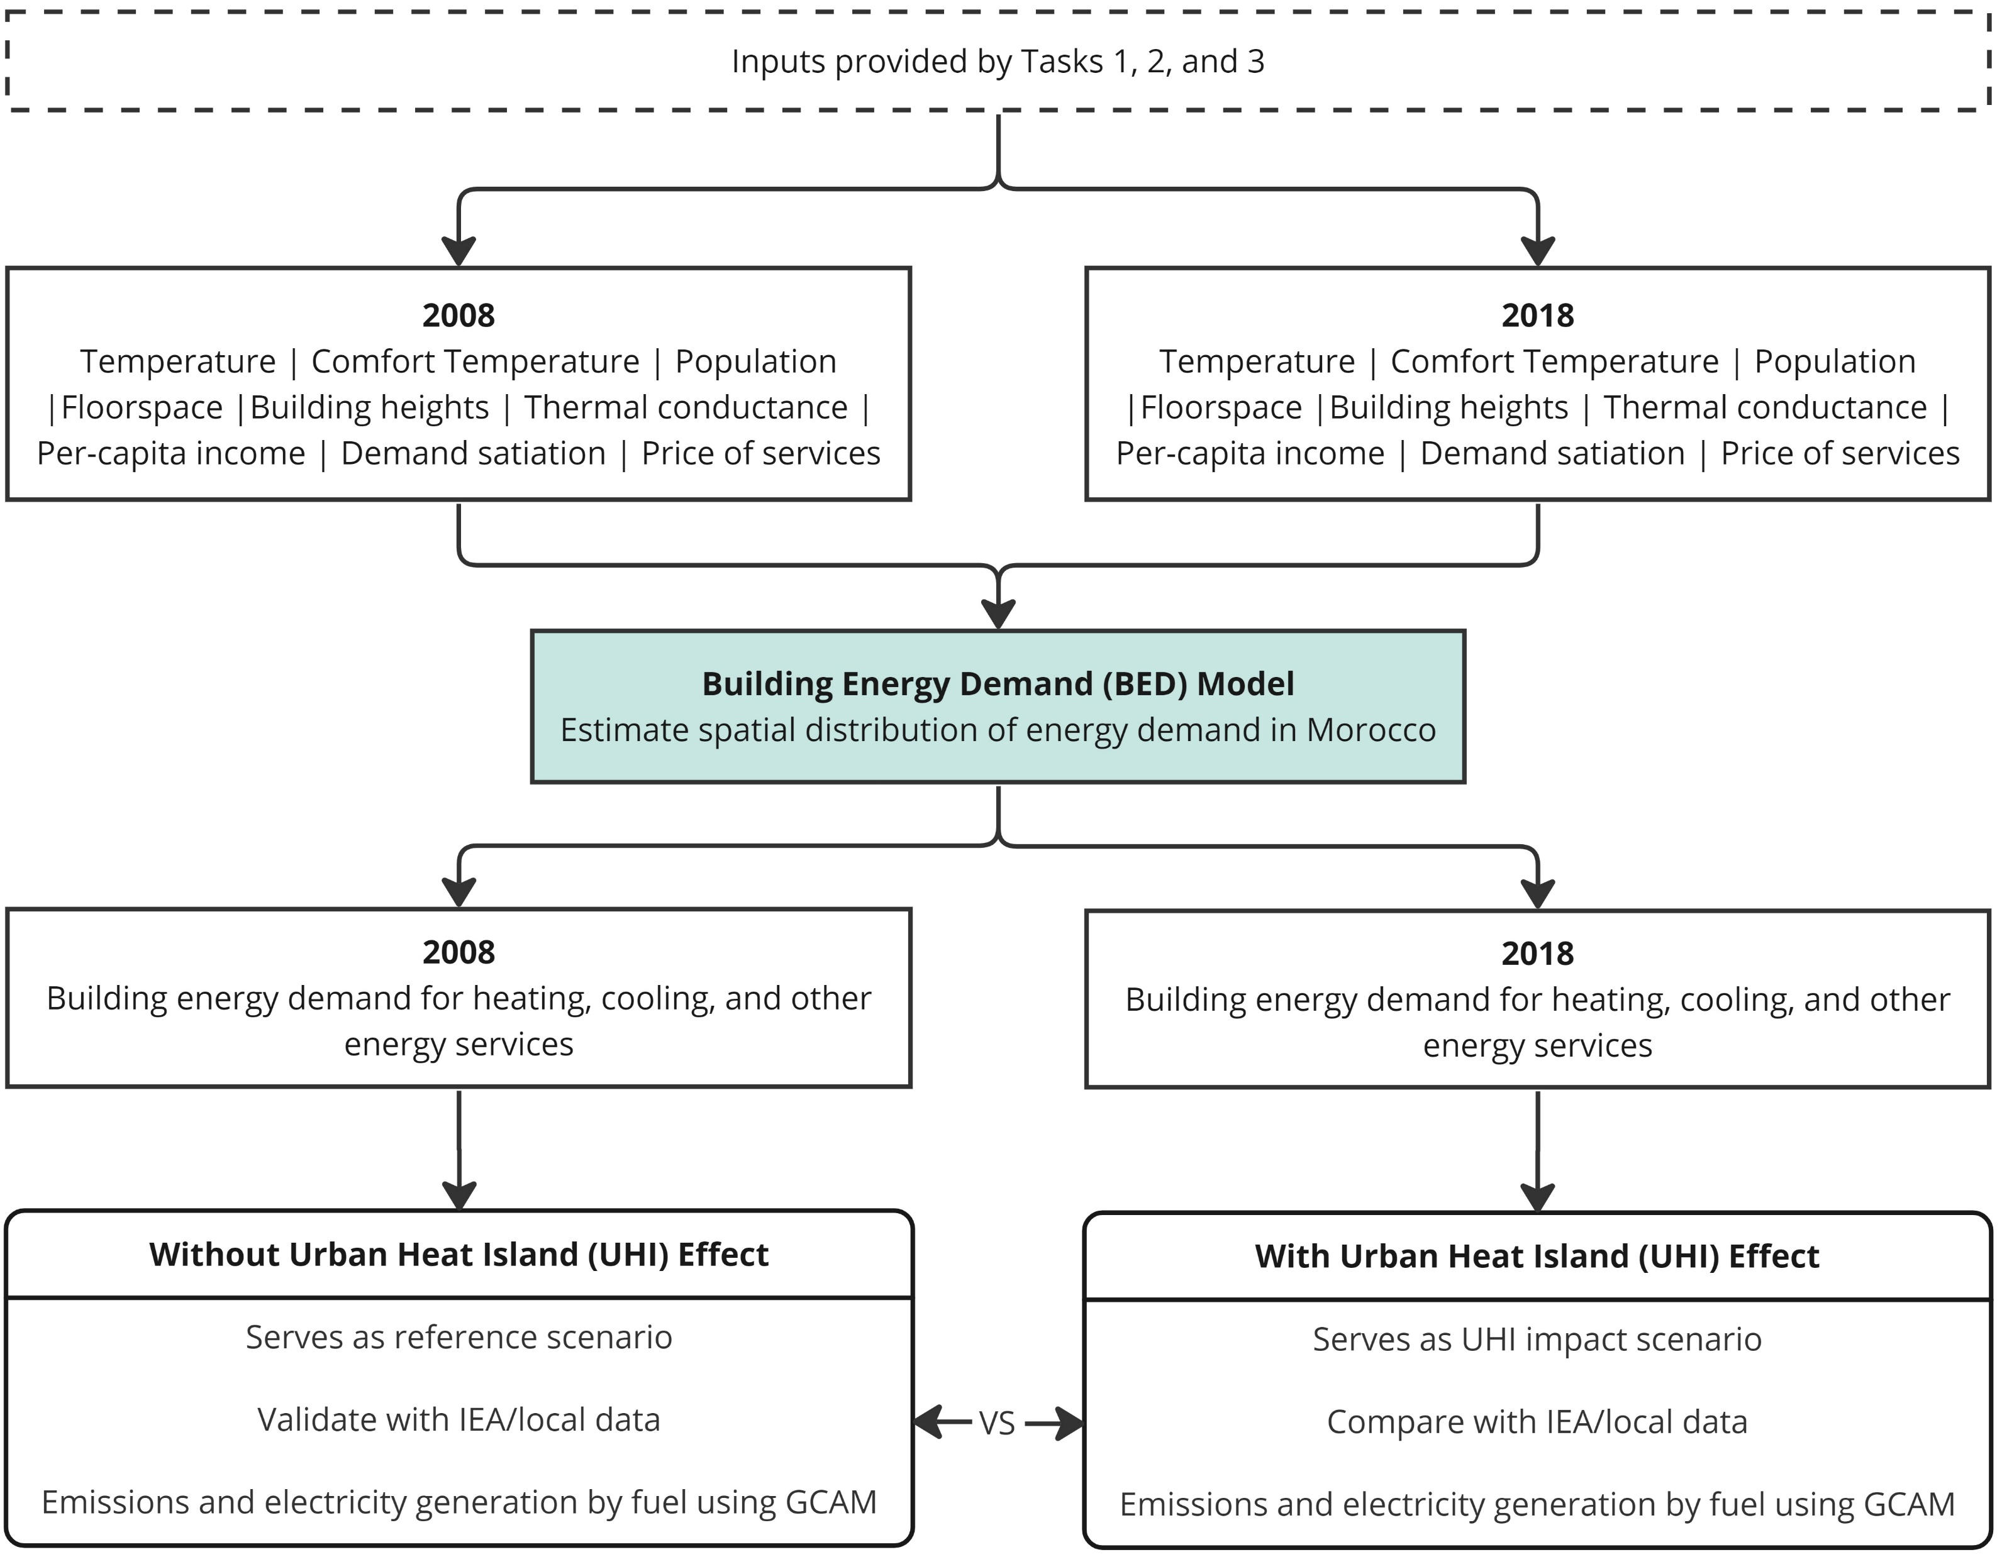
Task 4: Building Energy Demand (Zarrar Khan, Mengqi Zhao)
The objective of task 4 is to explore the impact of urban heat island (UHI)-induced changes in near-surface temperature and floor space on building energy heating and cooling demand, and how this shift will affect the corresponding electricity generation and emissions.

Slide 2
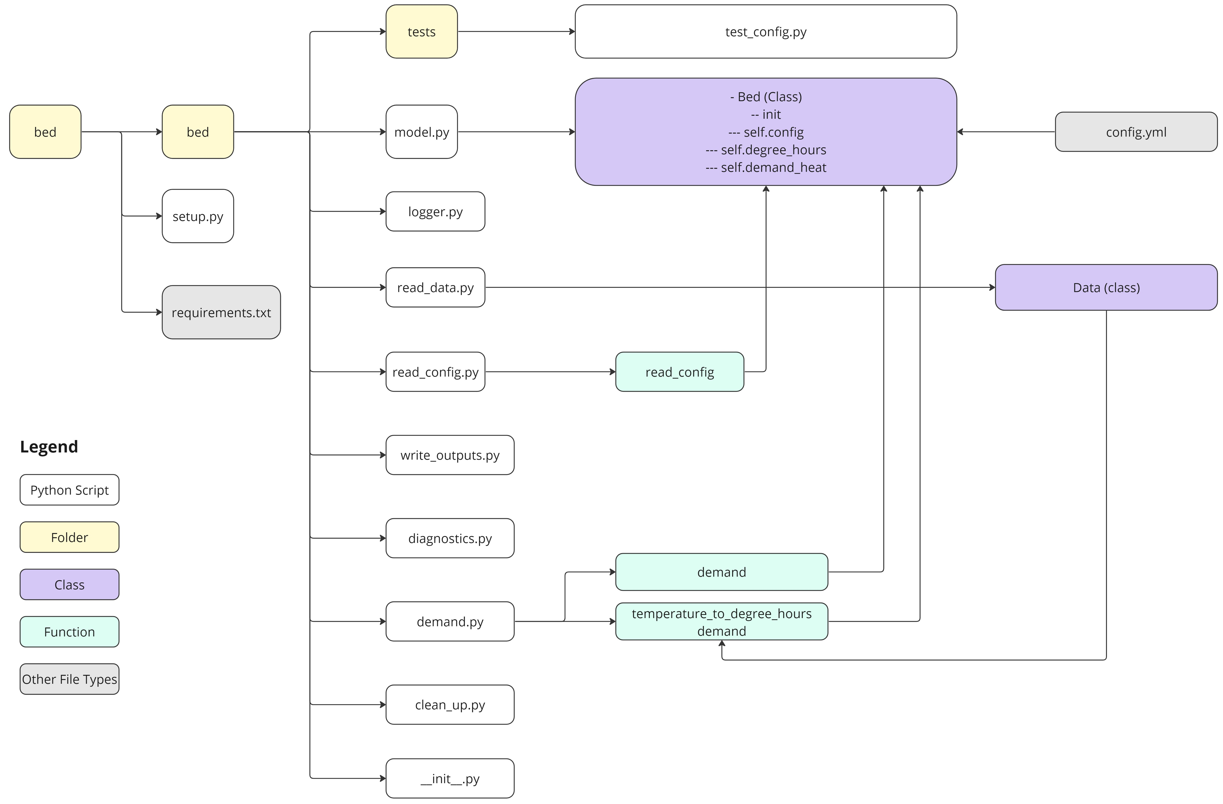
Building Energy Demand (BED) Model
Building Energy Demand (BED) model is a Python package to process high-resolution data (e.g., near-surface temperature from WRF at 1-km resolution) and estimate spatial distribution of building energy demand.
The outputs from the BED model can be used together with outputs from a modified version of the Global Change Analysis Model - GCAM-Morocco to explore emissions, water demand, and electricity generation by different fuel types in Morocco.
More broadly, the BED model is developed for researchers to explore the shifts of building energy demand at fine resolutions in response to environmental and socio-economic changes.

