Slide 1

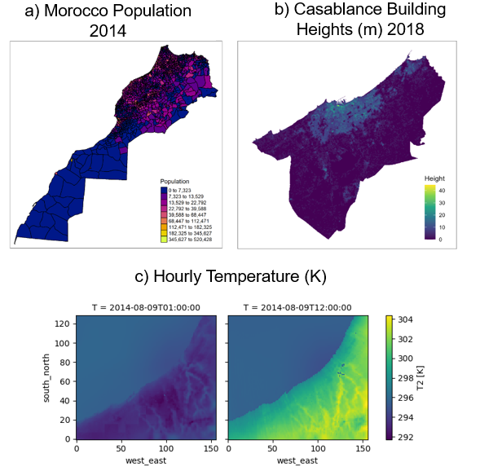

Land Use Science in Action
September 2023
Assessing the impact of urban land conversion on local and regional surface climate and its socio-economic consequence
Task 4: Analyzing the building energy demand response and corresponsing implications for the wider energy system.
Urban heat islands (UHIs) in growing cities can have varying degrees of impacts on human health, as well as energy demands for cooling.
Remote sensing and modeling provide essential information for comprehending and managing urbanization's climate and societal impacts.
By combining gridded data for temperature, building characteristics, population, and behaviour we are able to model the building energy demand response to UHI
This demand response can then be used to calculate corresponding changes in power supply and related parameters such as emissions.
How is land use/cover being changed?
Why is this Important?
Urban expansion has been rapid and significant over the last few decades, especially in developing countries where the population is becoming increasingly urban, and where changing land rights and ownership have led to expansion of suburban areas. Its ecological impact is significant and long lasting on the landscape, and the rate of land transformation is at least proportional to population growth and economic development.
The urban heat island (UHI) effect is a phenomenon where urban areas experience higher temperatures than their surroundings because urban surfaces like concrete and asphalt absorb and retain heat, and buildings block natural cooling processes. The UHI effect is significant as it can lead to increased energy consumption for cooling, health risks from heat-related illnesses, and altered local weather patterns.
How satellite data are being used to inform decision making and Earth Action?
Satellite data plays a pivotal role by providing essential information for mapping urbanization, studying urban heat island effects, assessing regional climate impacts, and analyzing building energy demand, all of which are crucial for addressing the rapid and significant urban expansion happening globally, particularly in developing countries.
References
Khan, Z. Iyer, G. Patel, P., Kim, S., Hejazi, M., Burleyson, C. & Wise, M. Impacts of long-term temperature change and variability on electricity investments. Nat. Commun., 2021, 12(1), pp. 1-12.
Figure 1: Examples of underlying data to be used for calculating gridded building energy demands. a) Population in Morocco 2014 b) Casablanca Building Heights 2018 c) Hourly Temperature (K)
Co-PI: Zarrar Khan, Pacific Northwest National Laboratory, MD, USA; Email: zarrar.khan@pnnl.gov
The opinions expressed are solely the PI's and do not reflect NASA's or the US Government's views.
.

