Slide 1
Assessing UHI impacts in Western North Africa Task 4 – Building Energy Demand
Zarrar Khan, Mengqi Zhao
Pacific Northwest National Laboratory (PNNL)
Notes:
Stock Image

Slide 2
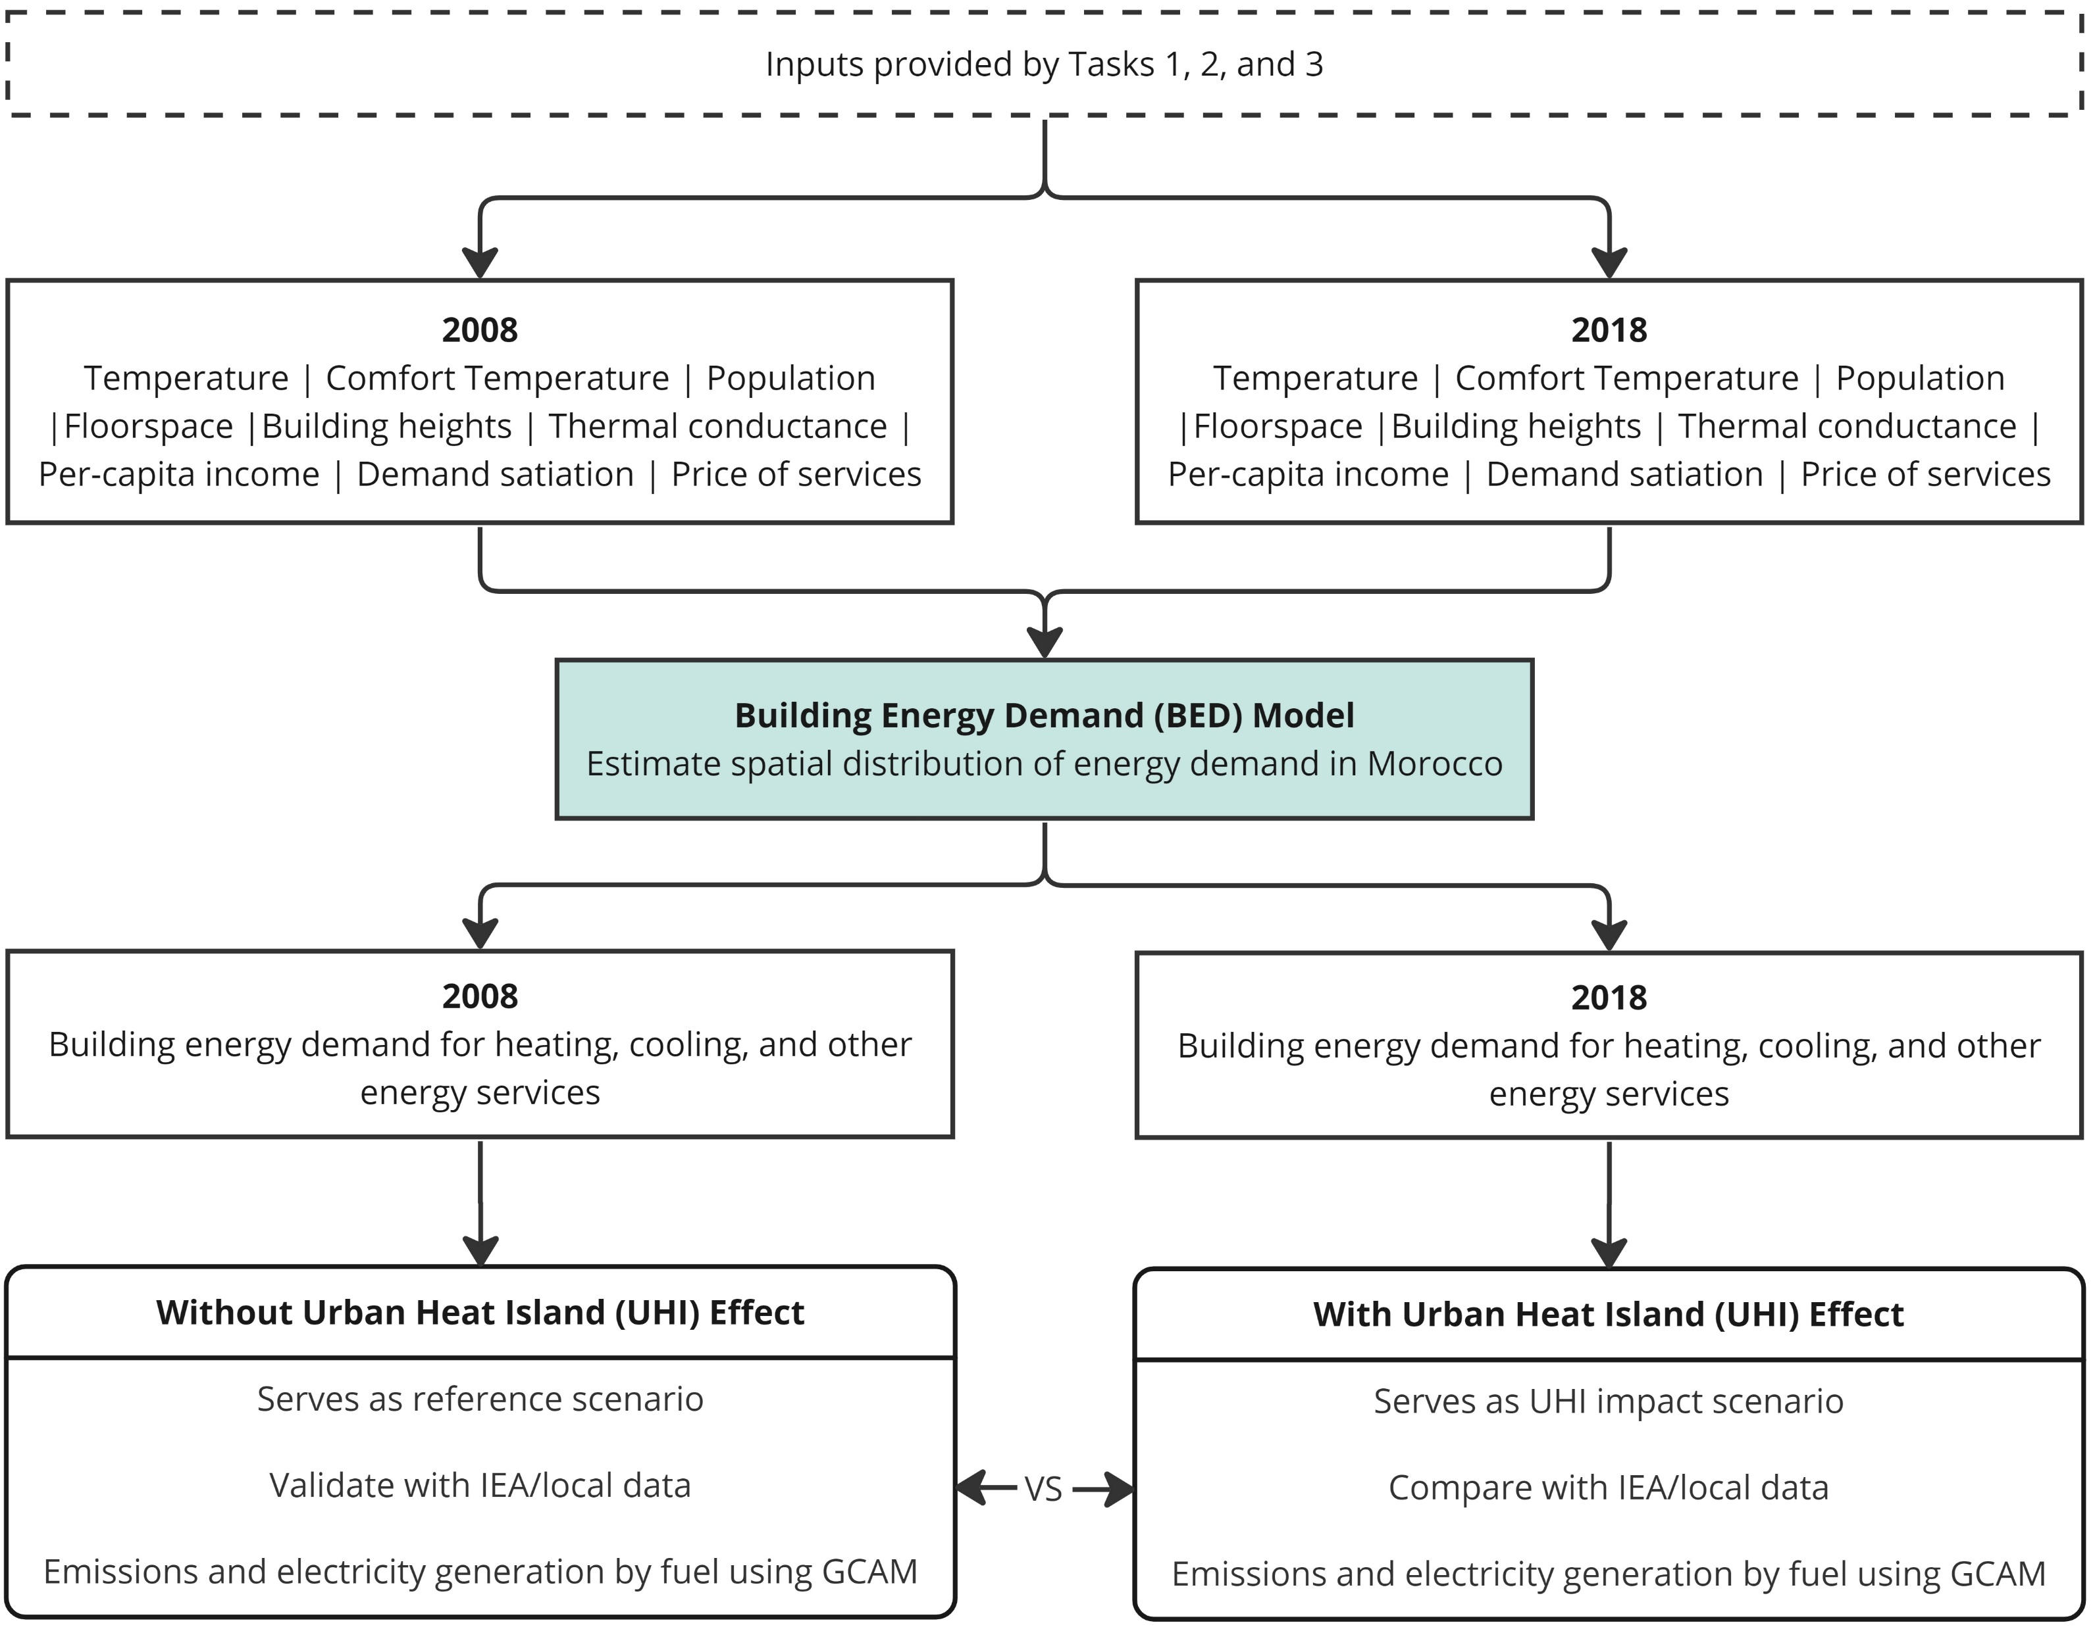
Task 4 – Building Energy Demand - Objectives
The objective of task 4 is to explore the impact of urban heat island (UHI)-induced changes in near-surface temperature and floor space on building energy heating and cooling demand, and how this shift will affect the corresponding electricity generation and emissions.
2004
2014

Slide 3
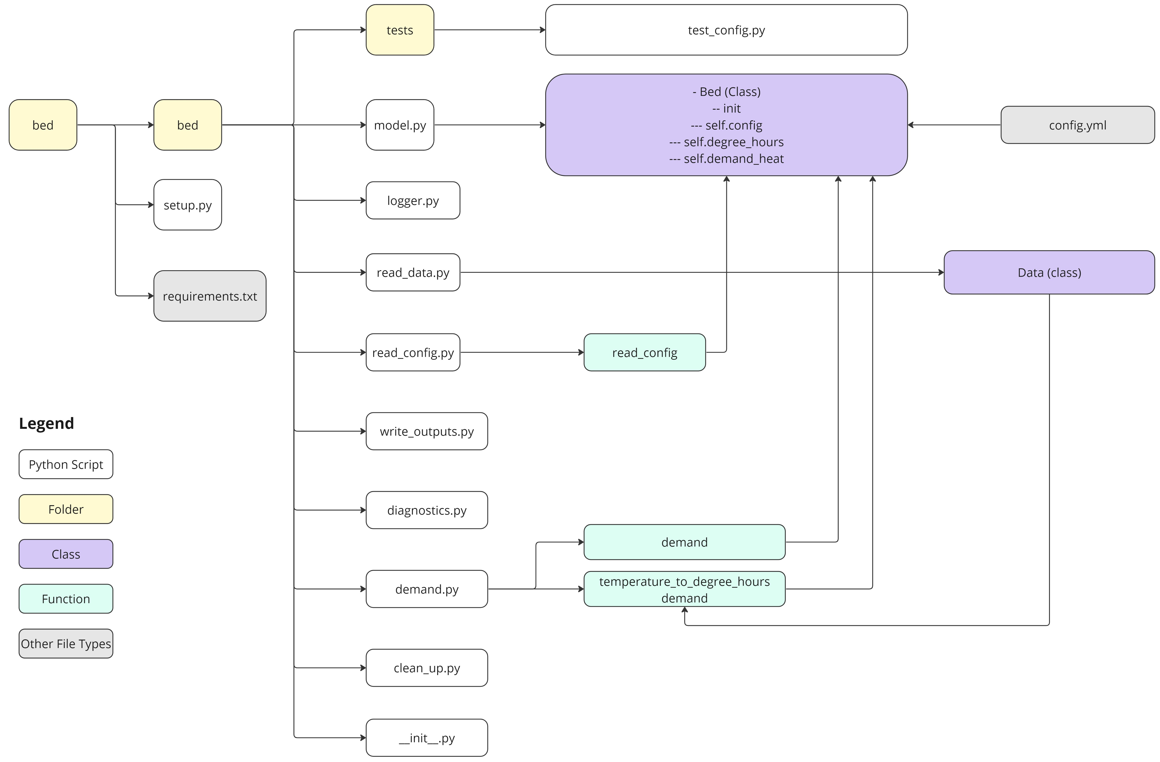
Build Energy Model (BED)
https://github.com/JGCRI/bed
Building Energy Demand (BED) model is a Python package to process high-resolution data (e.g., near-surface temperature from WRF at 1-km resolution) and estimate spatial distribution of building energy demand.
The outputs from the BED model can be used together with outputs from a modified version of the Global Change Analysis Model - GCAM-Morocco to explore emissions, water demand, and electricity generation by different fuel types in Morocco.
More broadly, the BED model is developed for researchers to explore the shifts of building energy demand at fine resolutions in response to environmental and socio-economic changes.

Slide 4
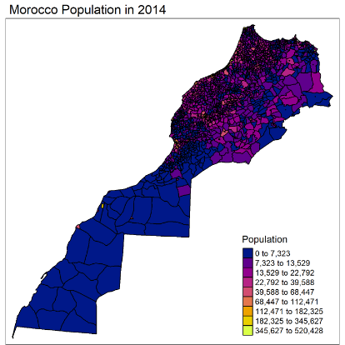
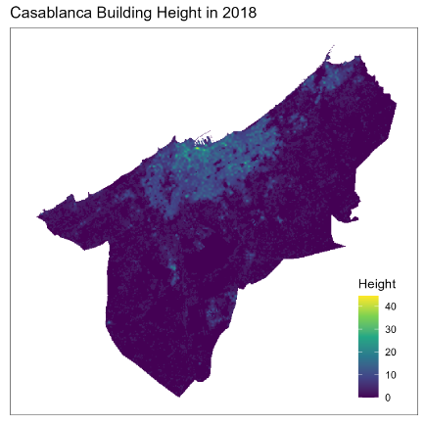
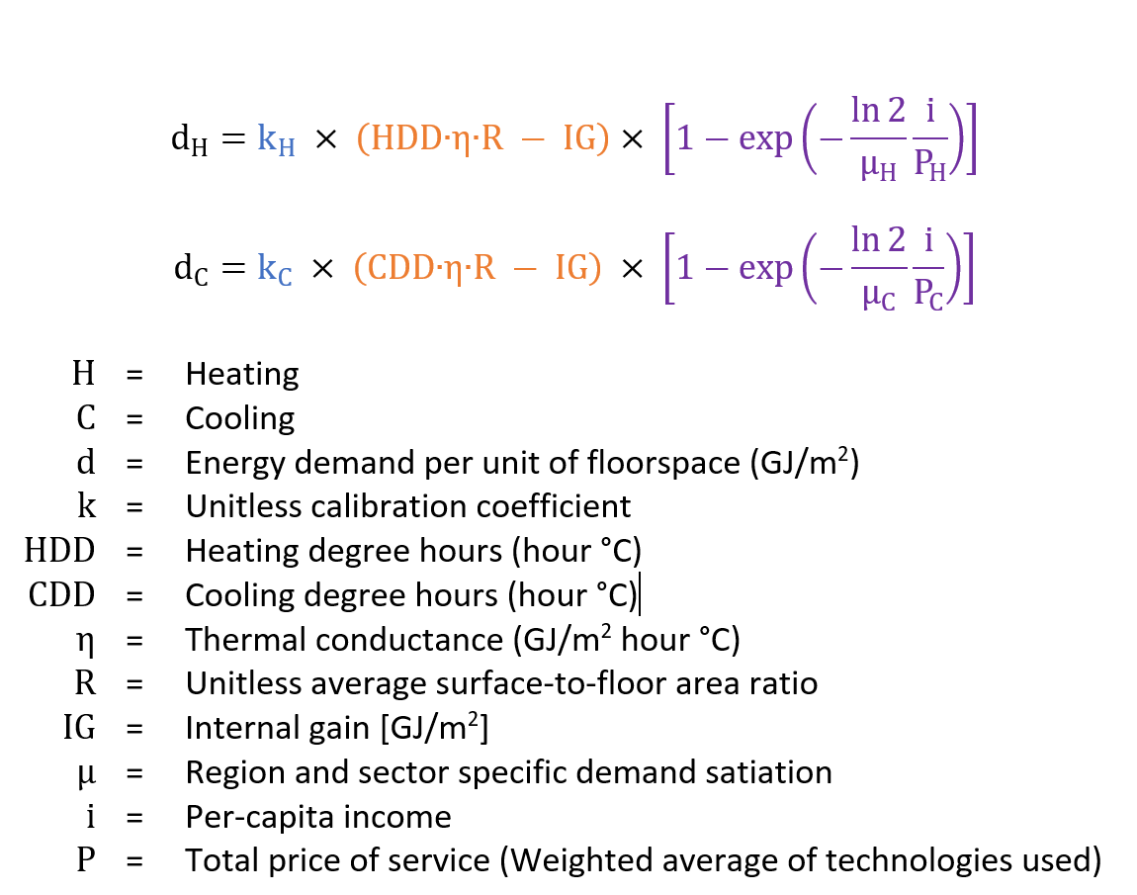
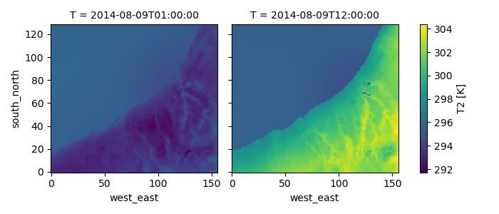
a) Morocco Population 2014
b) Casablance Building
Heights (m) 2018
c) Hourly Temperature (K)

Slide 5
Task 4 - Plan
Project Dates: 01/01/2022 to 12/31/2024
Date | Planned Task | Status
June 2023 | Build python model structure on Github with meta-repo, testing, documentation Get test data from NASA/ASU team – 2m Air Temperature (Still needed) | Complete
Sep 2023 | Complete BED model (calculate gridded building demand for the two years for given region) | In-Progress
Oct 2023 | Complete JOSS paper for BED v1.0 | Not Started
Nov 2023 | Submit JOSS paper for BED v1.0 | Not Started
Dec 2023 | Start Morocco GCAM breakout and study building contributions to elec gen and emissions | Not Started
Feb 2024 | Write Paper 2 - UHI building energy demand, elec gen and emissions paper | Not Started
Mar 2024 | Submit Paper 2 – UHI Buildings, Elec gen and emissions – Co-authors (NASA/ASU) | Not Started
Apr 2024 | Start spatial AI/ML techniques to improve BED forecasting | Not Started
Jul 2024 | Finish implementation of spatial AI/ML techniques in BED forecasting | Not Started
Sep 2024 | Prepare Paper 3 – Bed v2 with spatial AI/ML | Not Started
Oct 2024 | Submit Paper 3 – Bed v2 with spatial AI/ML | Not Started
Dec 2024 | Present at AGU | Not Started

Slide 6
Zarrar Khan
zarrar.khan@pnnl.gov
Mengqi Zhao
Mengqi.zhao@pnnl.gov

