Slide 1




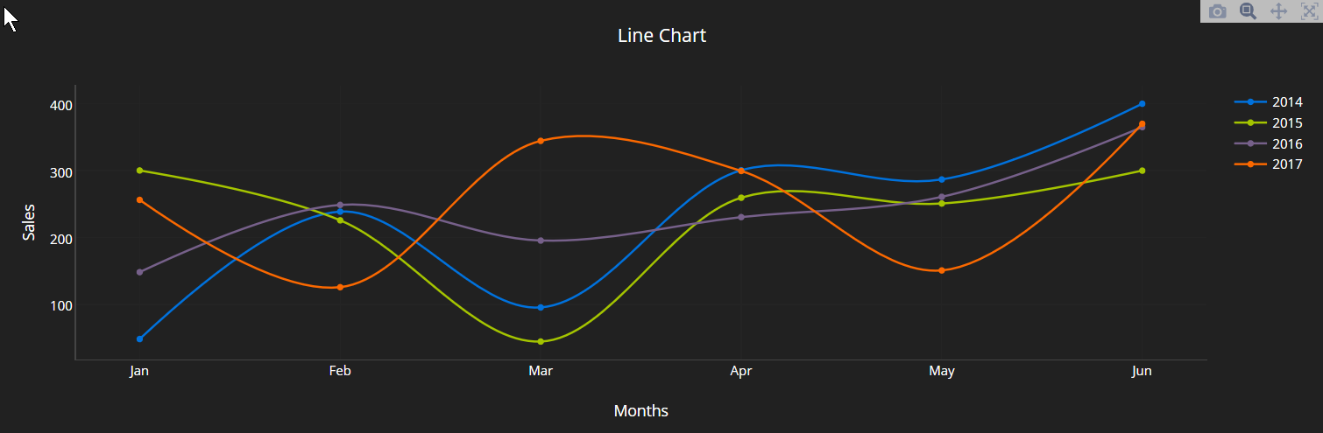
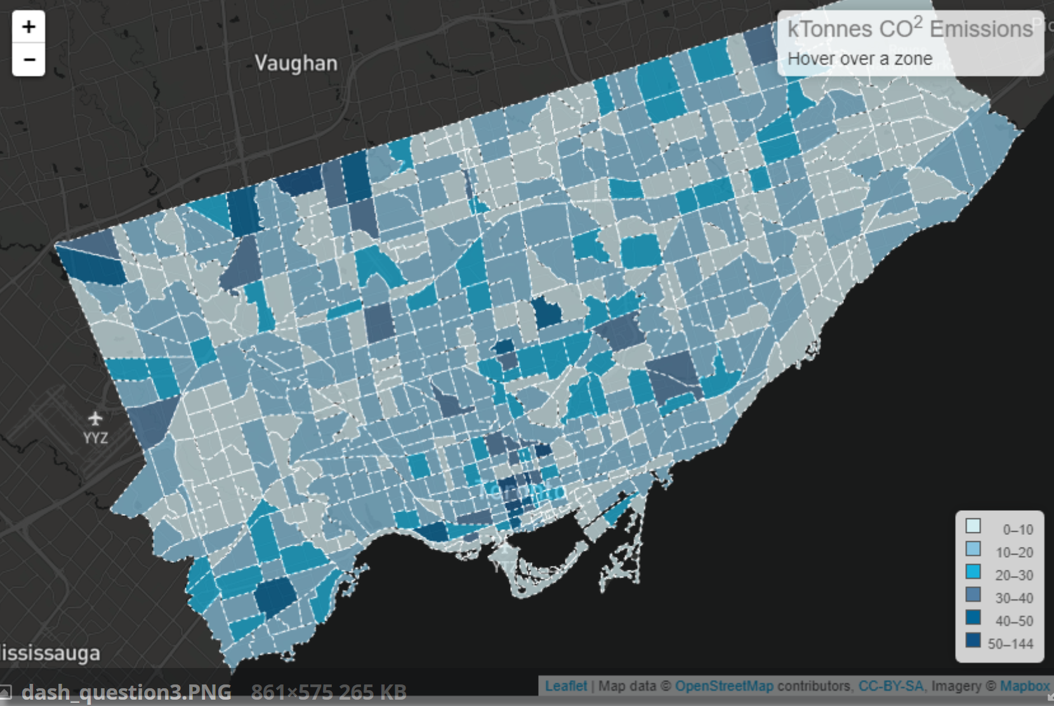
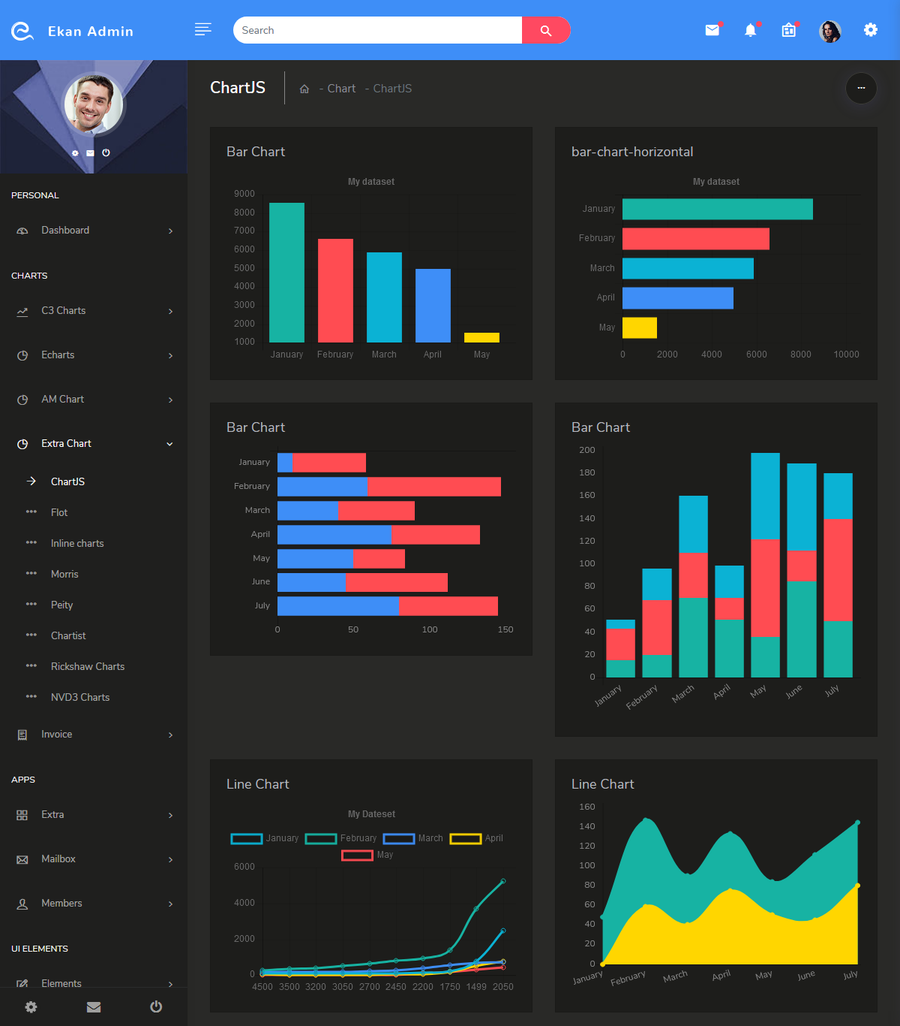

Focus Multi
Foresight
Dataset: CMIP6
Base Year: 2015
Base Scenario: Scenario 1
Underlayer: County
Parameter: Water Demands
Difference: Abs % - -
Overlayer: Basin

Slide 2

Focus Multi
Foresight
Dataset: CMIP6
Base Year: 2015
Base Scenario: Scenario 1
Underlayer: County
Parameter: -
Difference: Abs % - -
Overlayer: Basin
Water Supply
Water Demands
Landuse
Scarcity

