Slide 1
Foresight
Database Design

Slide 2
Dashboard Data Flows

Slide 4
Design

Slide 5


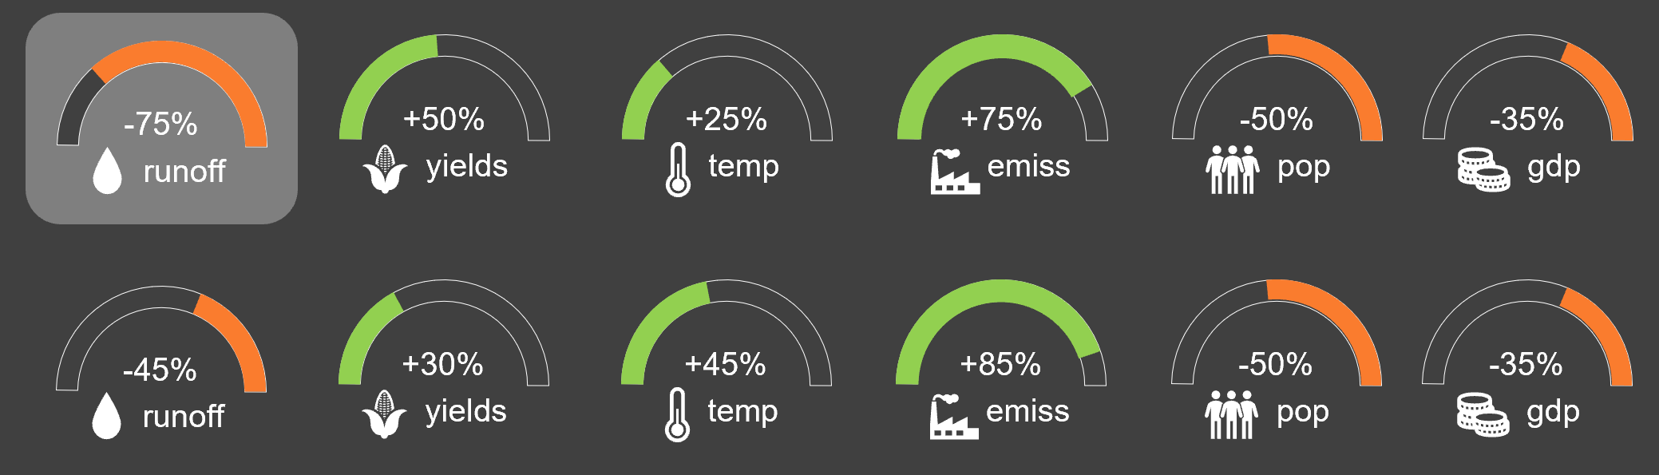



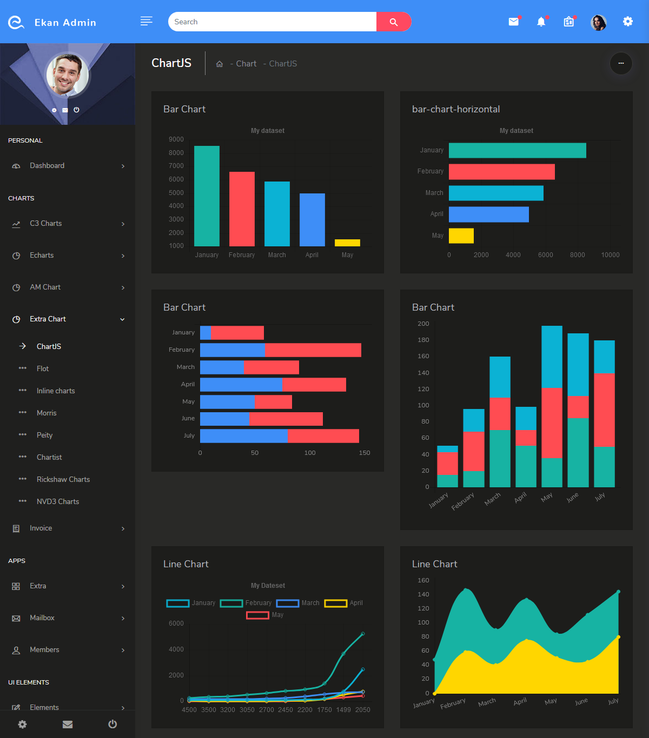
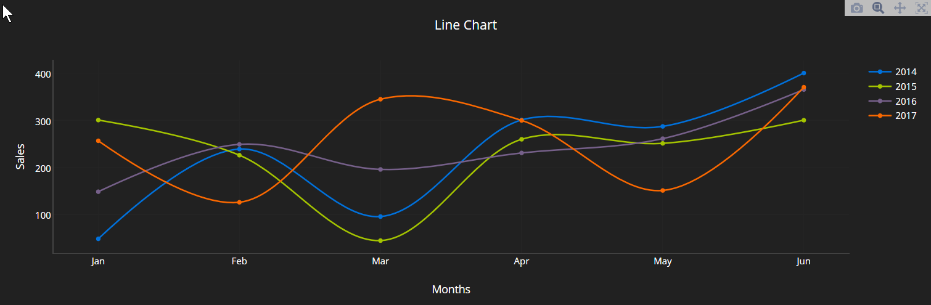
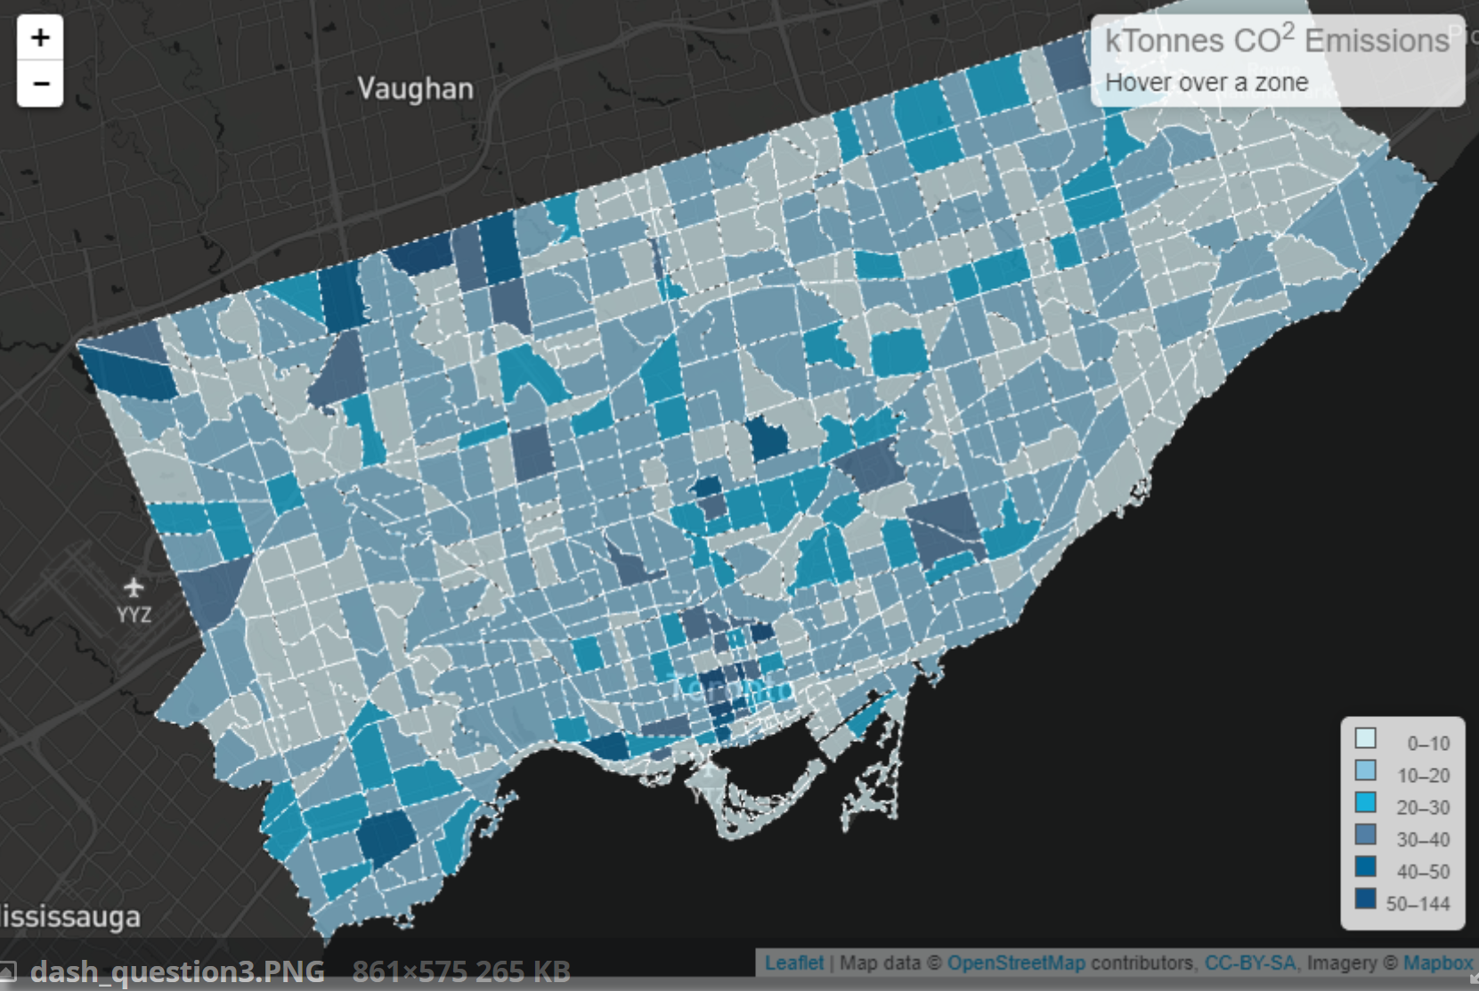




Dashboard Page Idea 1 - Zarrar
Dataset: Foresight v1
Start Year: 2015
Compare Temporal
End Year: 2100
Abs Diff %Diff
Scenario 1
1.5 º C
Compare Scenarios
Abs Diff %Diff
Scenario 2
2 º C

Slide 6






Dashboard Page Idea Test - Zarrar
Scenario 1
1.5 º C
-75%
+50%
+25%
+75%
-50%
-35%
runoff
yields
temp
emiss
pop
gdp
Scenario 2
2 º C
-45%
+30%
+45%
+85%
-50%
-35%
runoff
yields
temp
emiss
pop
gdp

Slide 7





Visualize: Share what we did
Focus Multi
Foresight
Dataset: CMIP6
Base Year: 2015
Base Scenario: Scenario 1
Underlayer: County
Parameter: Water Demands
Difference: Abs % - -
Overlayer: Basin

Slide 8

Visualize: Share what we did
Focus Multi
Foresight
Dataset: CMIP6
Base Year: 2015
Base Scenario: Scenario 1
Underlayer: County
Parameter: -
Difference: Abs % - -
Overlayer: Basin
Water Supply
Water Demands
Landuse
Scarcity

Slide 9
DynamoDB
Draw an entity diagram
Identify the relationship between entitites (1:1,1:N, N:M)
List down all the access patterns for each entity
Identify the primary key (Hash + Sort) for each entity
Identify the secondary indexes for additional access patterns if required

Slide 10
1. Entity Diagram, 2. Relationships, 3. Identify Access Patterns
Scenario
scen_id
name
type
scen_ref
scen_diff
year
Region
reg_id
name
type
Param
- param_id
Name
Units
value
Class1
- class1_id
Name
value
Class2
- class2_id
Name
value
Find a region by name
Find a region by type
Find all scenarios
Find all class 1
Find all class 2
Find all scenarios
Find all params
Find all class 2

Slide 11
4 Primary Key
Entity | Partition Key (PK) | Sort Key (SK)
Region | REG#<reg-id>
Scenario | REG#<reg-id> | SCE#<type>#<scen-id>
Param | REG#<reg-id> | PAR#
Class 1 | REG#<reg-id>
Class 2 | REG#<reg-id>

