Slide 1
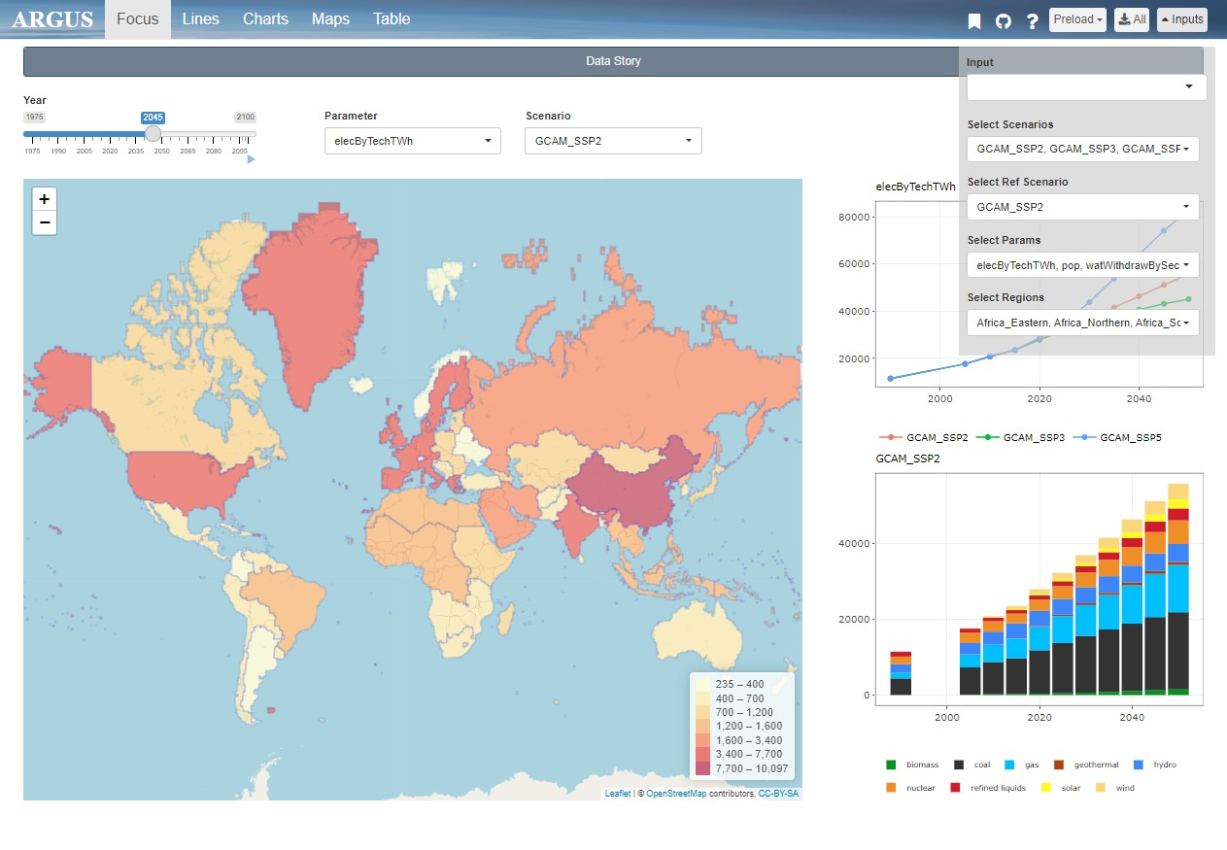
layout.png
Tabs
Inputs
Tab Contents

Slide 2
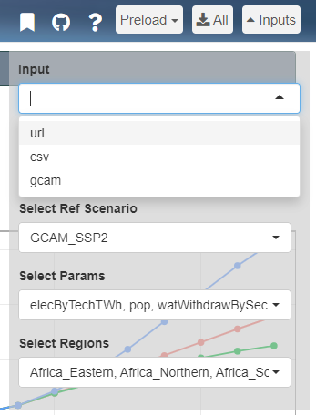
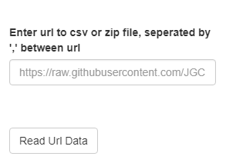
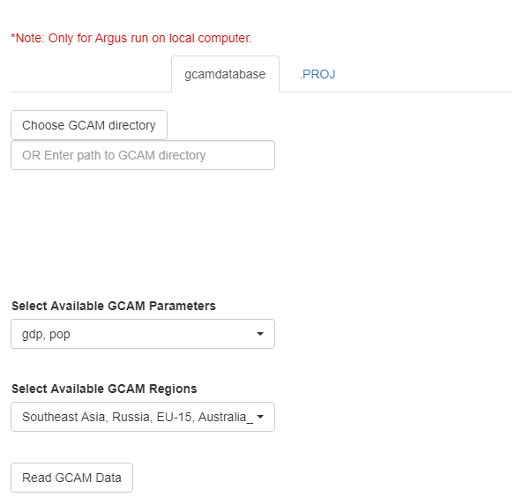
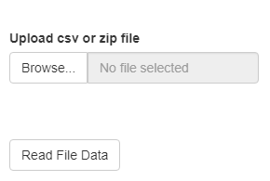
input.png

Slide 3
input_format.png
Minimum
Optional Columns
subRegion | value | param | scenario | class | year | units
CA | 5
FL | 10
TX | 7
MN | 2
Regional Data
OR
Minimum
Optional Columns
Latitude | Longitude | value | param | scenario | class | year | units
34.04 | -118 | 5
28 | -83 | 10
28 | -95.4 | 7
45 | -93.3 | 2
Coordinate Data

Slide 4
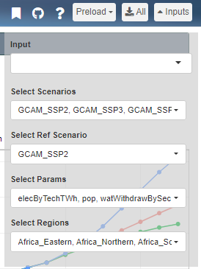

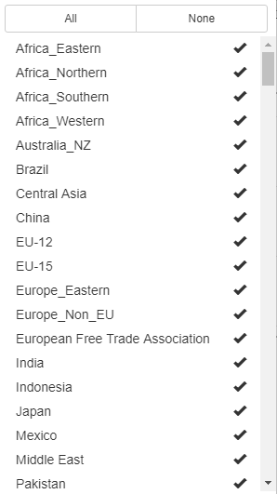


selections.png

Slide 5
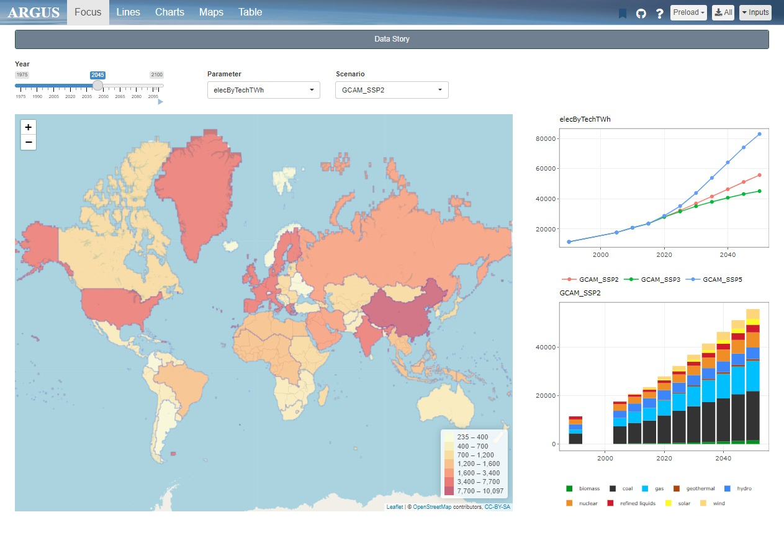
top_bar.png
1. Bookmarking
2. Github
3. Help
4. Download
5. Preload

Slide 6

bookmark.png

Slide 7

github.png

Slide 8
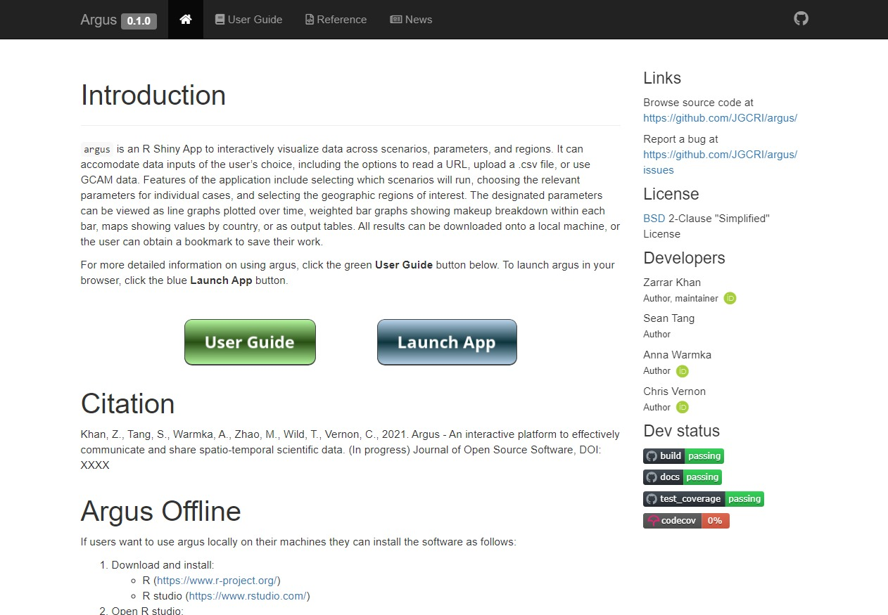
help.png

Slide 9
focus.png
Parameters
Data Story
Scenario
Year Slide Bar
Overview Map
Comparative Charts

Slide 10
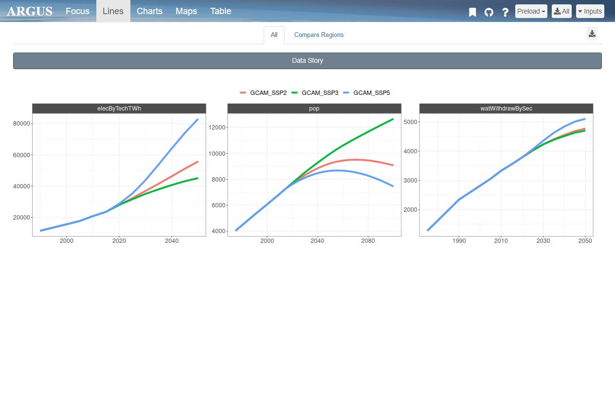
line.png
Different Scenarios
Compare Regions
Download Page
Different Parameters

Slide 11
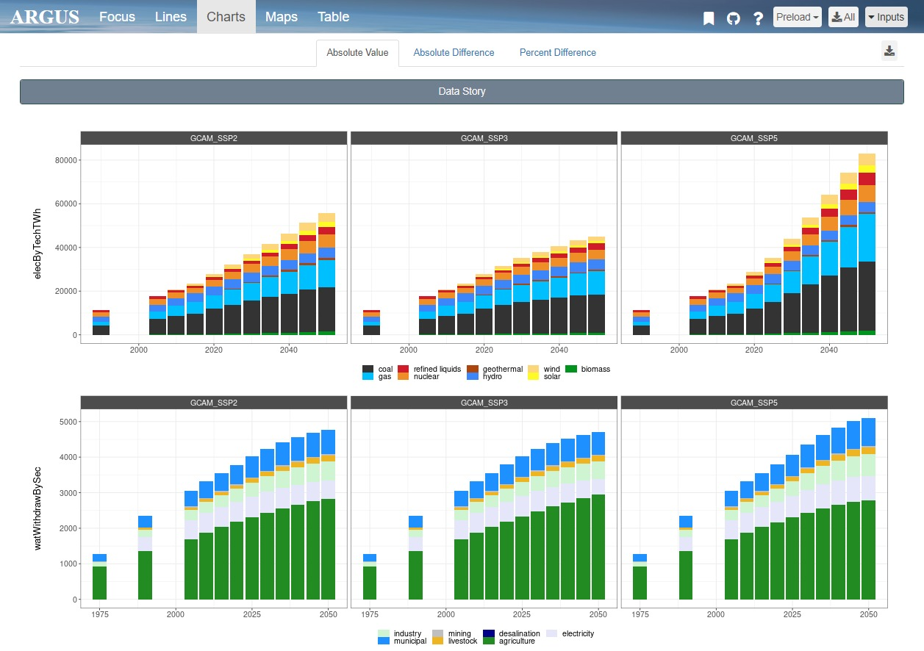
charts.png
Different Scenarios
Difference Maps
Download Page
Different Parameters

Slide 12
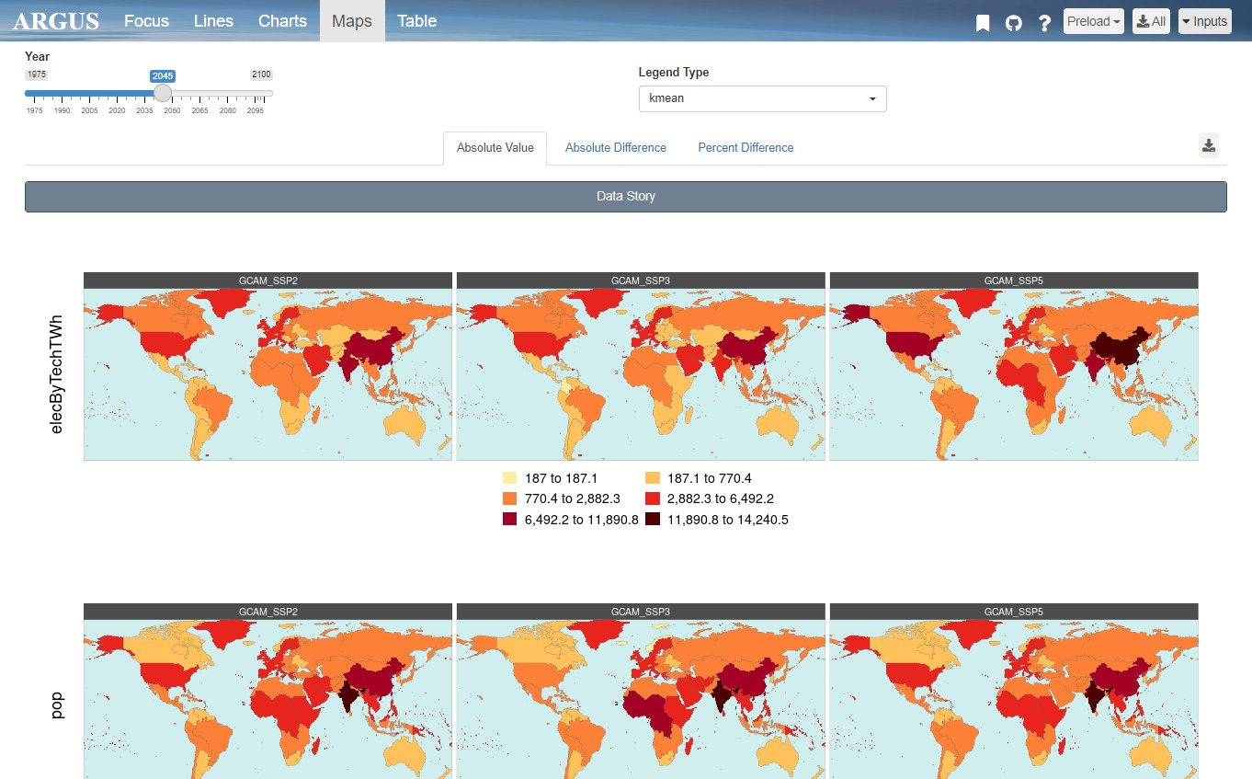
maps.png
Different Scenarios
Legend Type
Difference Maps
Year Slide Bar
Download Page
Different Parameters

Slide 13
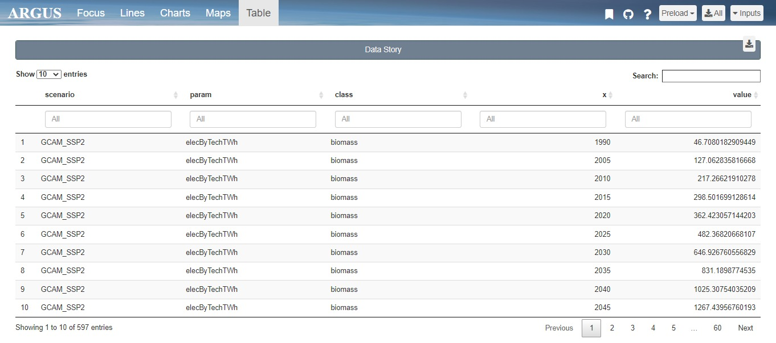
table.png
Column Filters
Search Bar
Download Page
Page Navigation

Slide 14
Launch App
User Guide

Slide 15
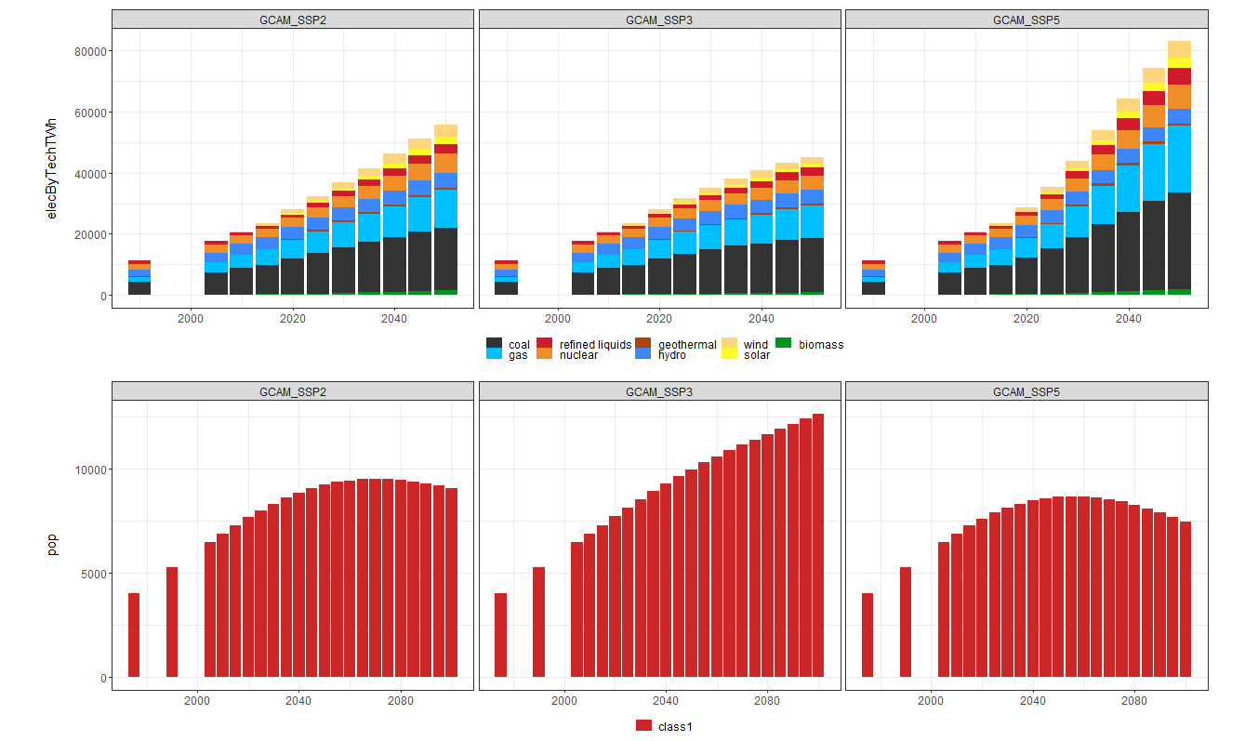
Story board
MY TITLE
Existing scientific literature shows that health and agricultural impacts attributable to air pollution are significant and should be considered in the integrated analysis of human and Earth-system interactions. The implementation of policies that affect the power sector, the composition of the vehicle fleet or the investments and deployment of different energy sources will in turn result in different levels of air pollution. Even though the various methodologies for estimating the impacts of air pollution, such as exposure-response functions, are extensively applied by the scientific community, they are normally not
Title (Optional):
Enter optional title here …
Story:
Add your story here …
Upload rmarkdown

Slide 16

