Slide 1
New GCAM regions with gcambreakout
Taryn Waite
GCAM Annual Meeting 2024
Notes:
Stock image of cloud formations

Slide 2
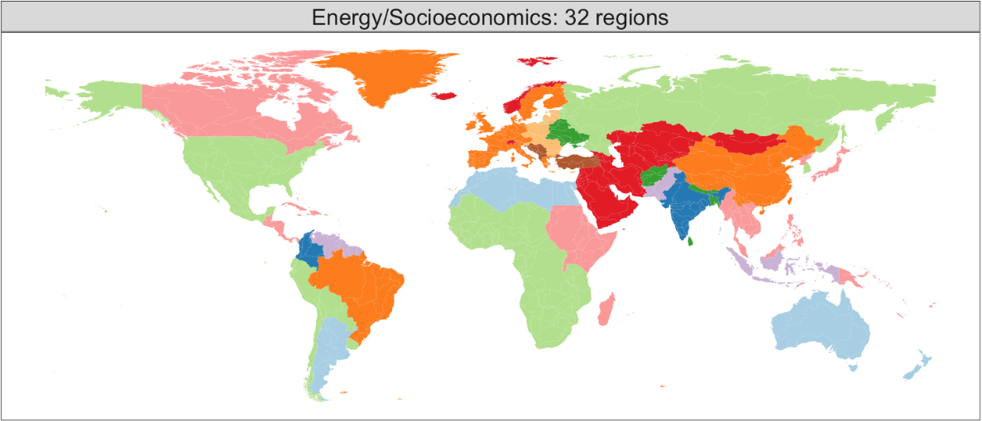
Adding new GCAM regions with gcambreakout
What does it mean to “break out” a region in GCAM?
Disaggregate a country or group of countries from an aggregate GCAM energy-economic region (e.g., Africa_Northern, Southeast Asia, EU-15)
What is gcambreakout?
R package to automate initial steps of breaking out a region
Only a starting point; manual validation and adjustments are still needed
How does gcambreakout work?
Modifies the GCAM data system to produce new input XMLs that include the new region
No changes to the model C++ code
GCAM’s default 32 energy-economic regions

Slide 3
Basics of gcambreakout
Most data inputs to gcamdata are at the country level (by iso code)
IEA energy balances, CEDS emissions data, land use and crop data, etc.
gcamdata aggregates data to the region level using iso-region mapping (./input/gcamdata/inst/extdata/common/iso_GCAM_regID.csv)
By adjusting this mapping, we can define new regions based on their iso code(s)
Processing of country level data for new regions will be handled automatically by gcamdata
Some data inputs (usually assumptions) are read in at the region level; the new region needs to be added to these inputs
Framework for gcambreakout:
Define new region in mapping and let gcamdata handle country-level data processing
Inherit any region-level assumptions from the new region’s ‘parent’ region
Above is done by modifying input files and R code
Caveat on data availability:
To run gcambreakout, user must have access to proprietary IEA energy balances and CEDS data (cannot run gcambreakout using prebuilt data)
IEA energy balances can be purchased from IEA and used to run the CEDS

Slide 4
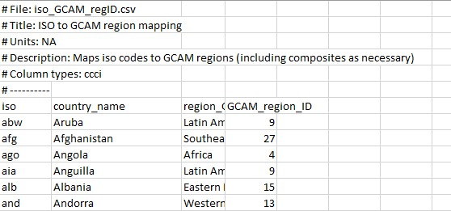
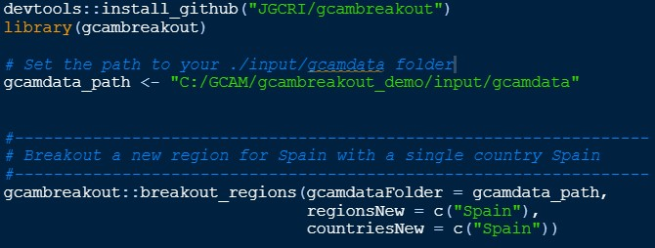

How to use gcambreakout
Start with a working version of GCAM (versions 7.0, 6.0, and 5.4 are currently supported)
Choose the country or countries to include in the new region (can be any country_name found in ./input/gcamdata/inst/extdata/common/iso_GCAM_regID.csv)
If choosing multiple countries, they must be from the same “parent” region (shared GCAM_region_ID)
Install gcambreakout in R
Run breakout_regions() to update gcamdata input files and scripts
Re-build gcamdata (devtools::load_all()) and run driver() or driver_drake() to generate updated XMLs
Run GCAM
To revert all changes, run gcambreakout::restore(<gcamdata_path>)

Slide 5
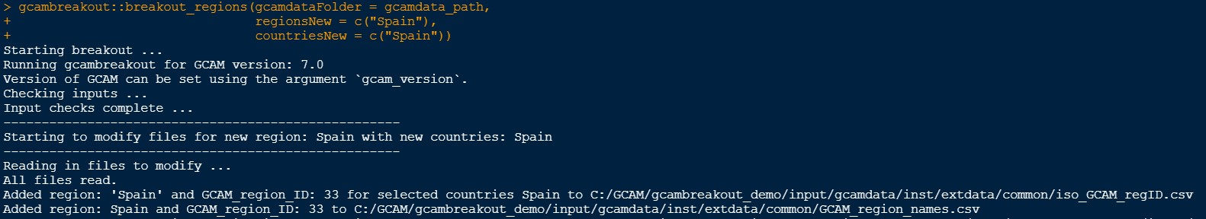

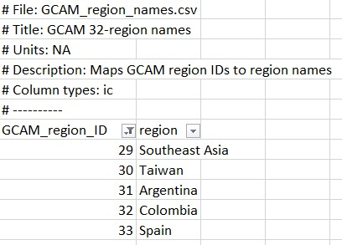
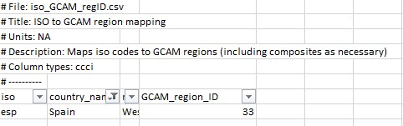
Changes to gcamdata input files
1. Adding the new region(s) to gcamdata’s region definition files
inst/extdata/common/

Slide 6
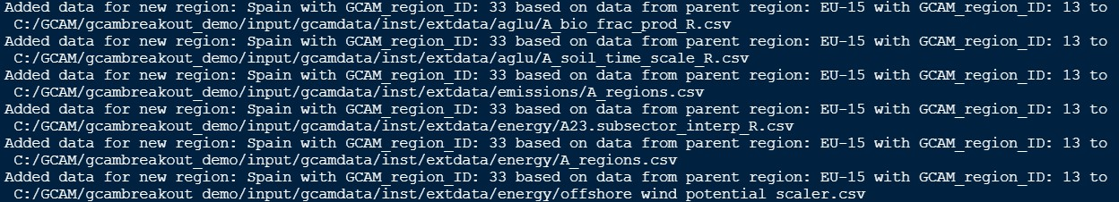
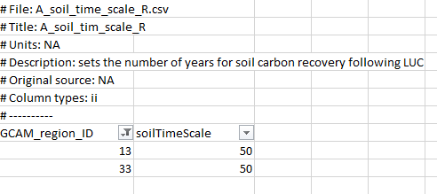
Changes to gcamdata input files
2. Adding the new region(s) to other input files with GCAM regions (using assumptions from parent region)
Parent region (EU-15)
Spain

Slide 7
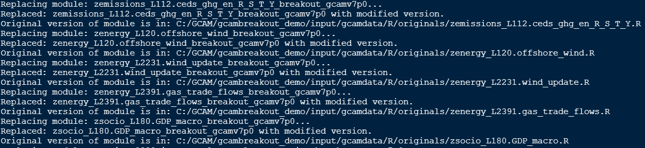
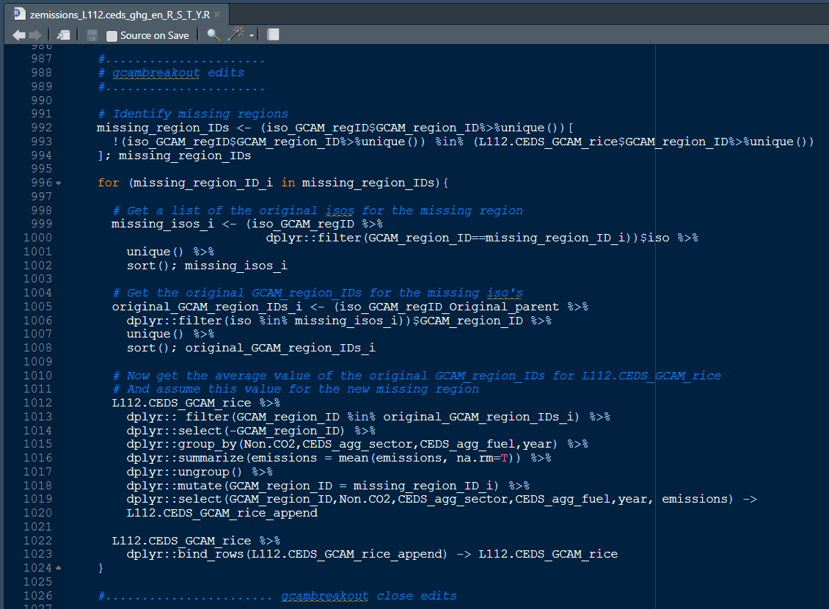
Changes to gcamdata R code files
To find where changes were made in an R script, search for the string “gcambreakout edits”

Slide 8
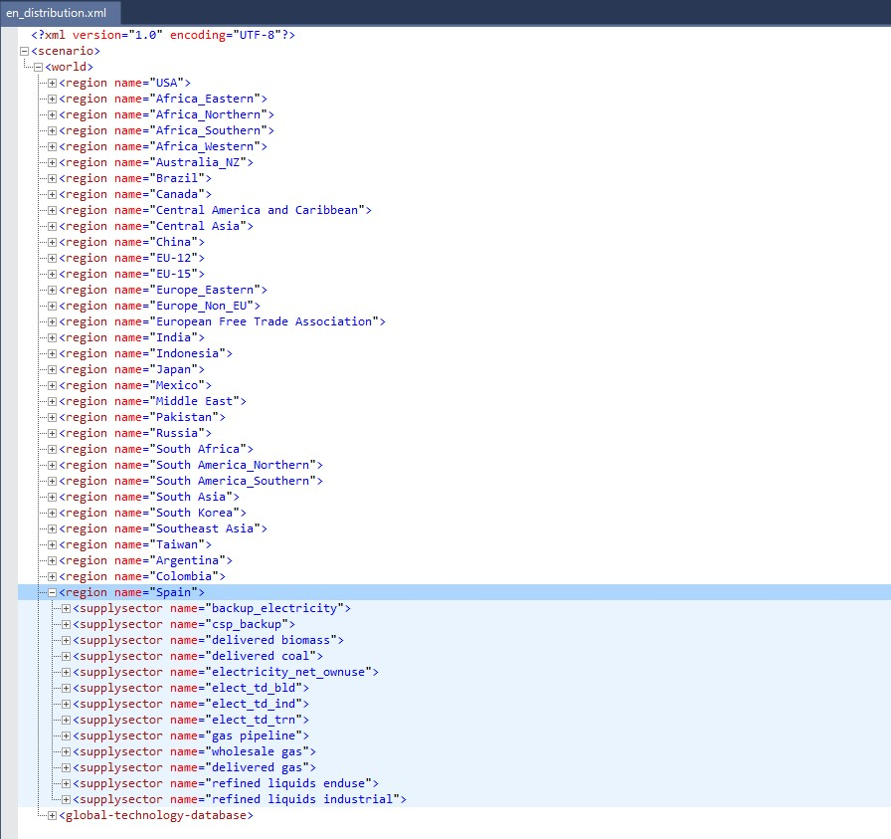
Updated XMLs
(after running driver() or driver_drake())

Slide 9
Caveats and considerations
Data availability:
To run gcambreakout, user must have access to proprietary IEA energy balances and CEDS data (cannot run gcambreakout using prebuilt data)
If breaking out a country included in an aggregate region in the IEA energy balances (e.g., “Other non-OECD Asia), energy balances will be downscaled by population
This may not be accurate and local data are likely needed to adjust energy balances
gcambreakout not intended to produce fully functional, polished regional break outs
Just a starting point to set up the structure
Be sure to validate results and make changes where needed
GCAM versions currently supported by gcambreakout: v7.0, v6.0, v5.4
Package is updated periodically with releases, but expect lags
gcambreakout is not tested for all possible regions; debugging may be necessary
Some guidelines on debugging on GitHub: https://jgcri.github.io/gcambreakout/articles/debug.html
Questions can be raised in GitHub issues: https://github.com/JGCRI/gcambreakout/issues

