Slide 1
GCAM Training Session 1
Notes:
Stock Image

Slide 2
Session Overview
1) GCAM Overview
2) GCAM Tools and Resources
3) General GCAM Process
4) Walkthrough / Assignment

Slide 3
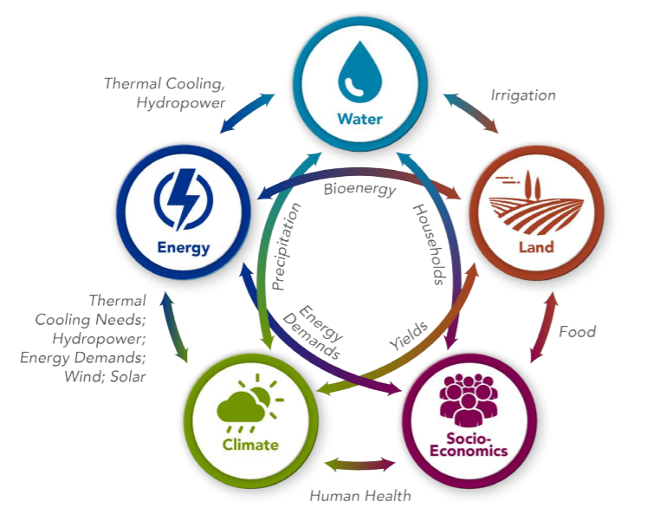
Overview of GCAM

Slide 4
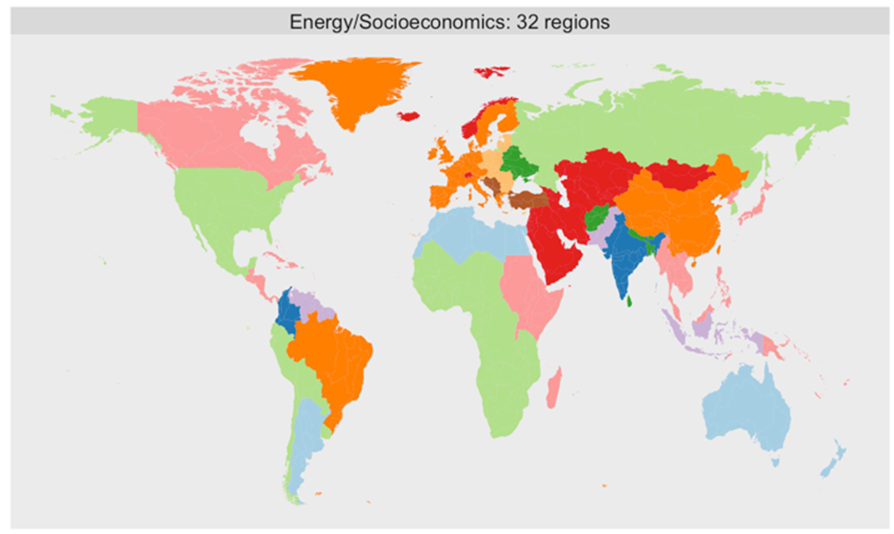
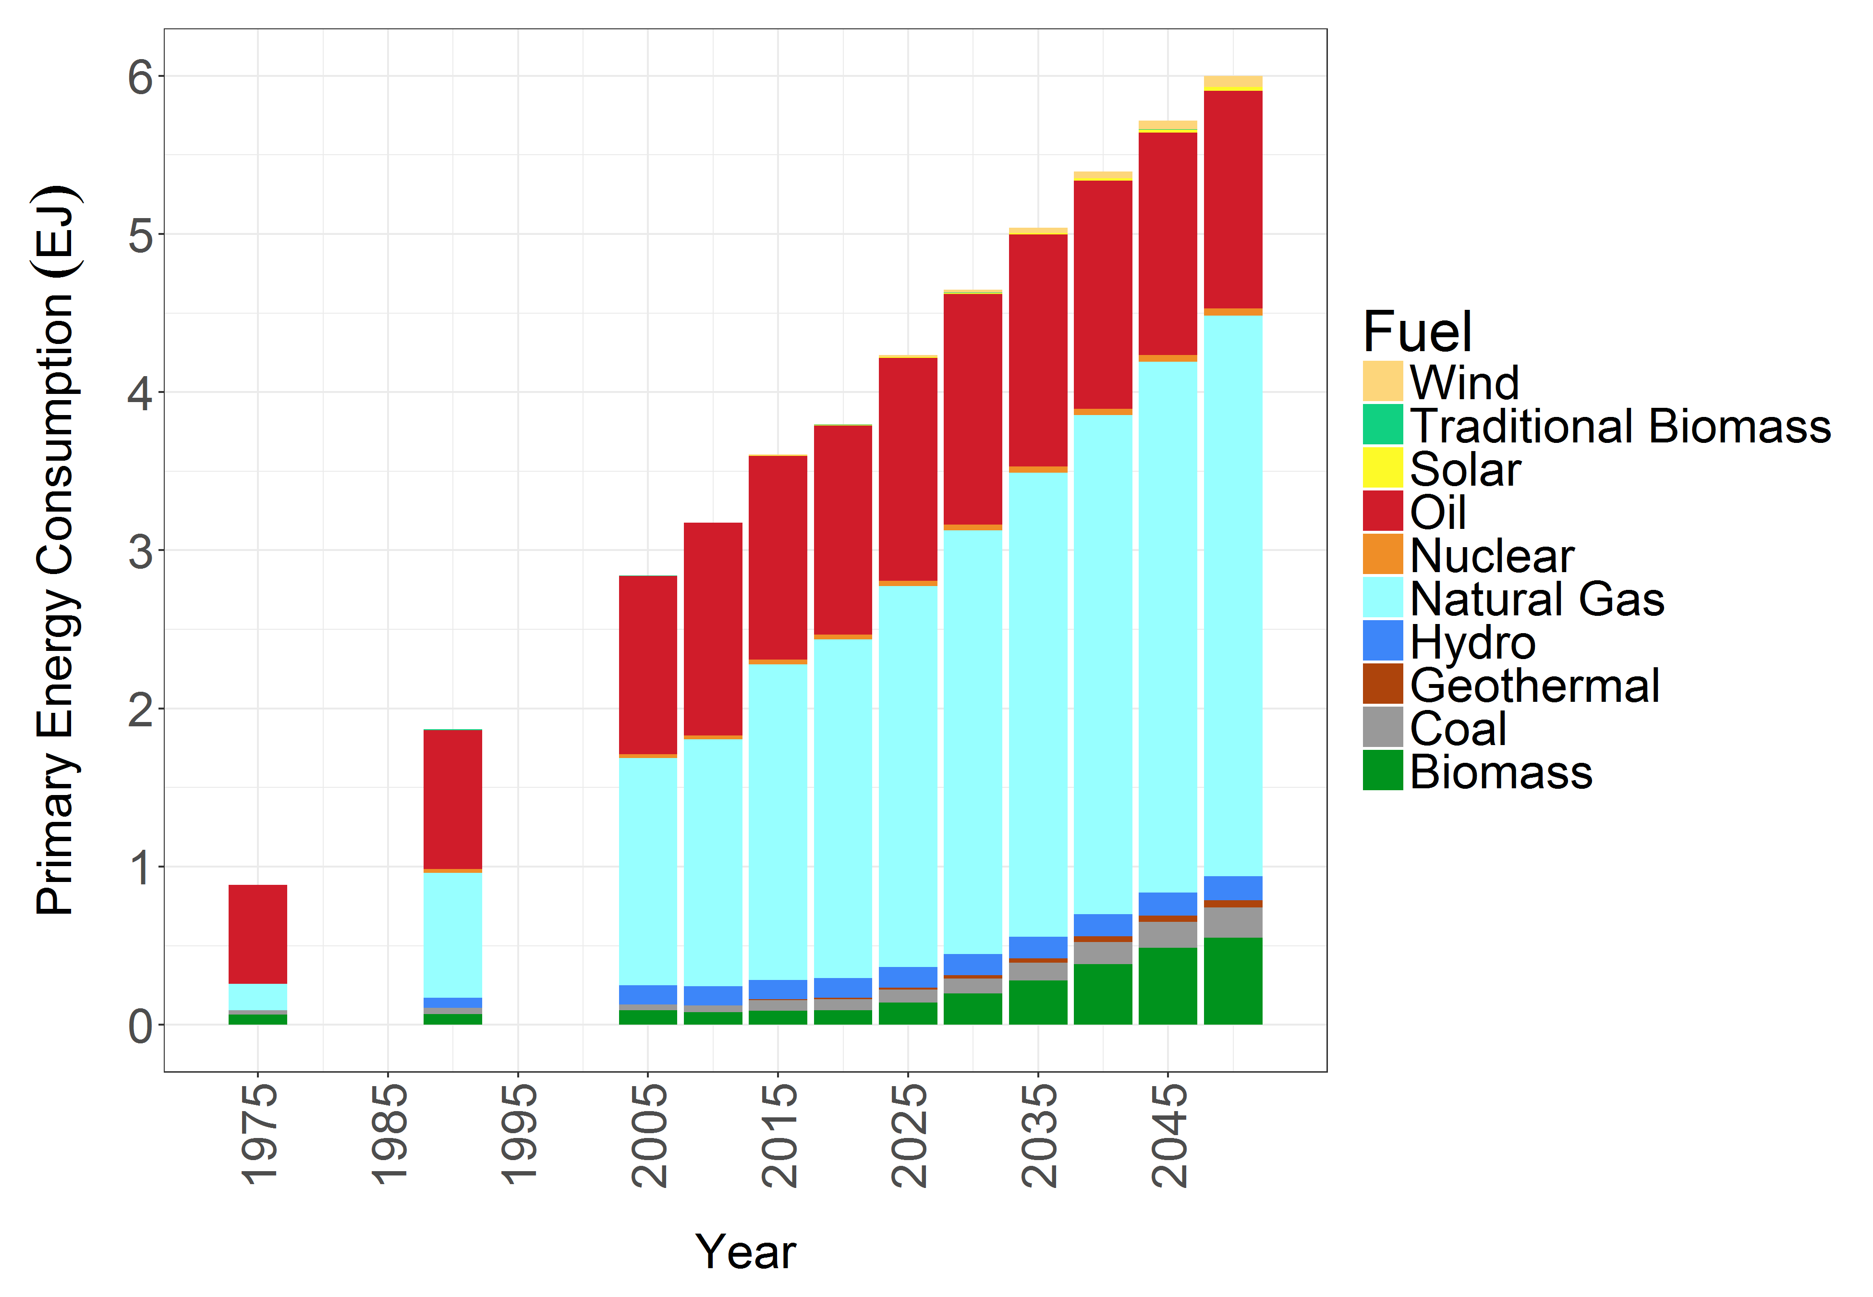
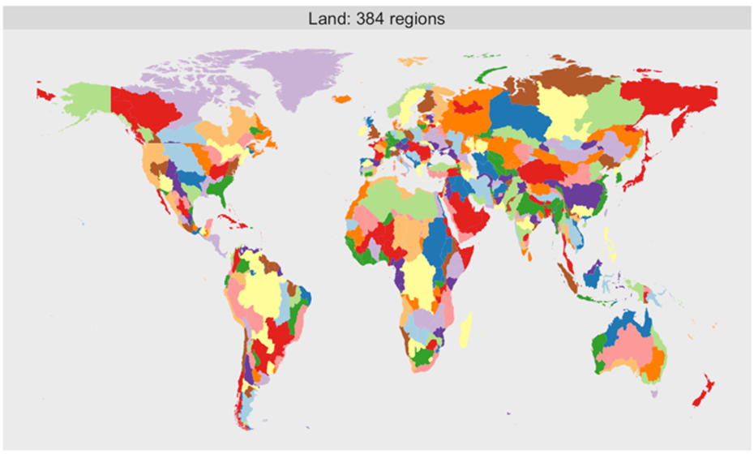
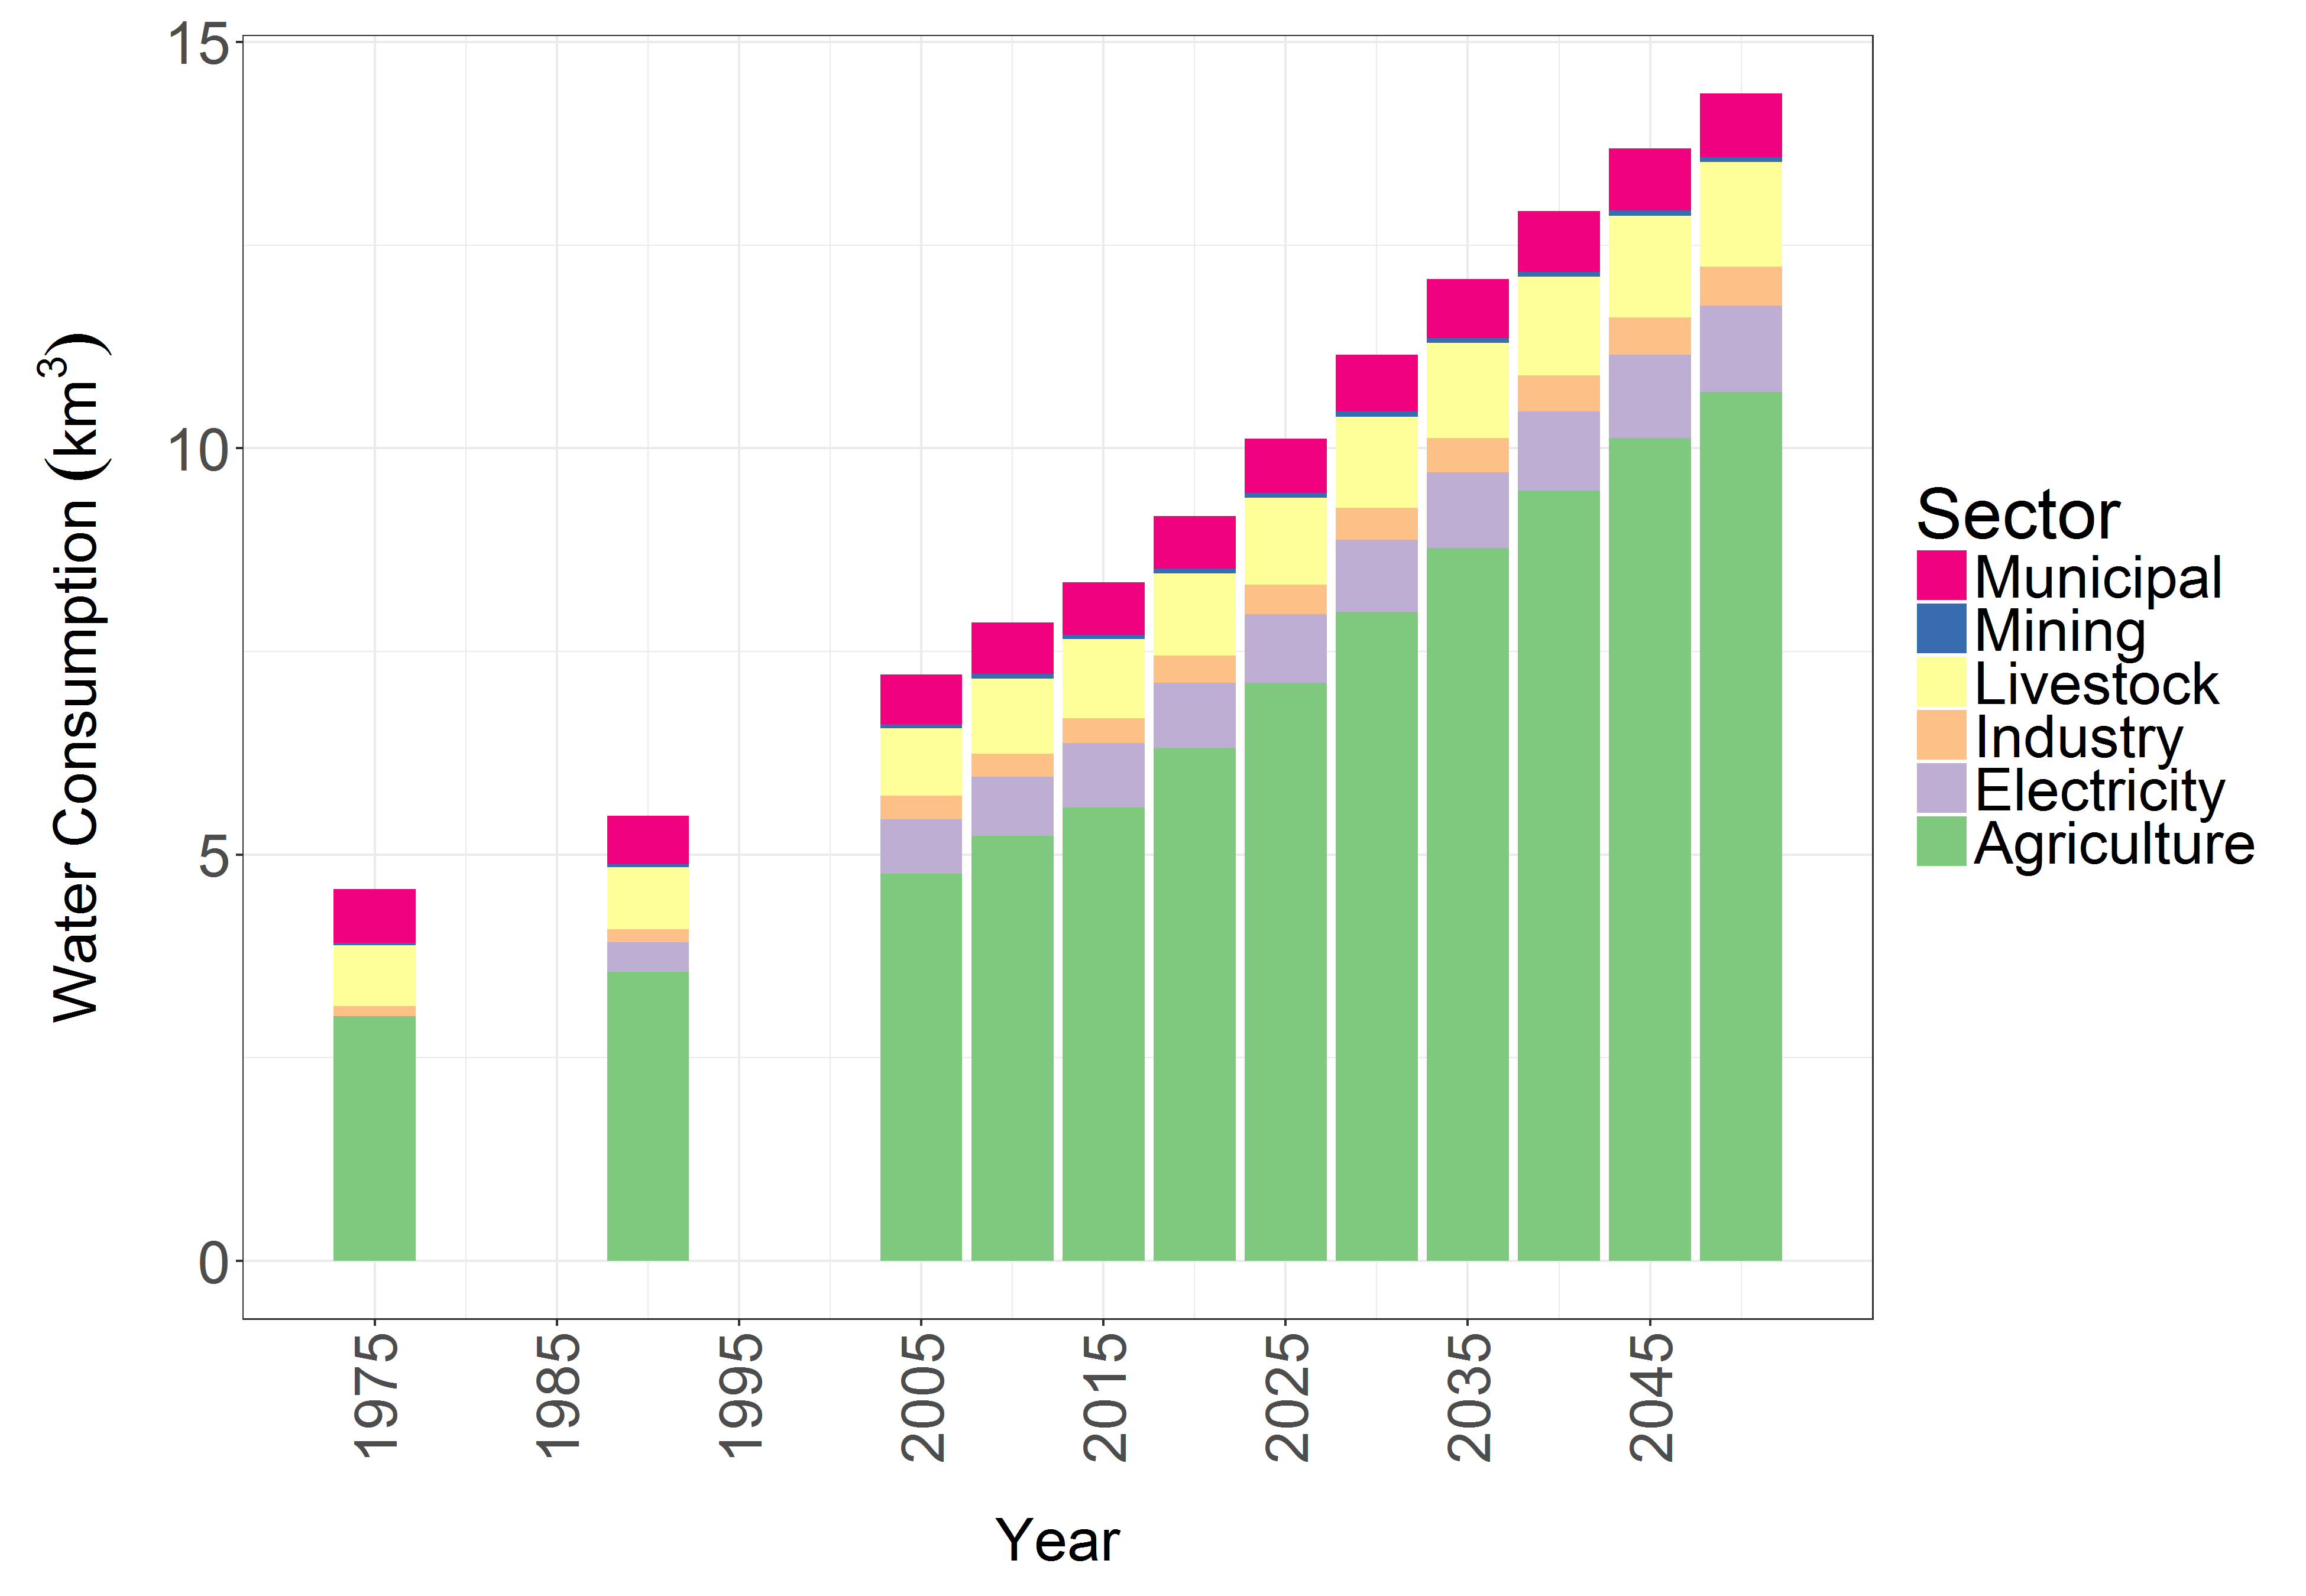
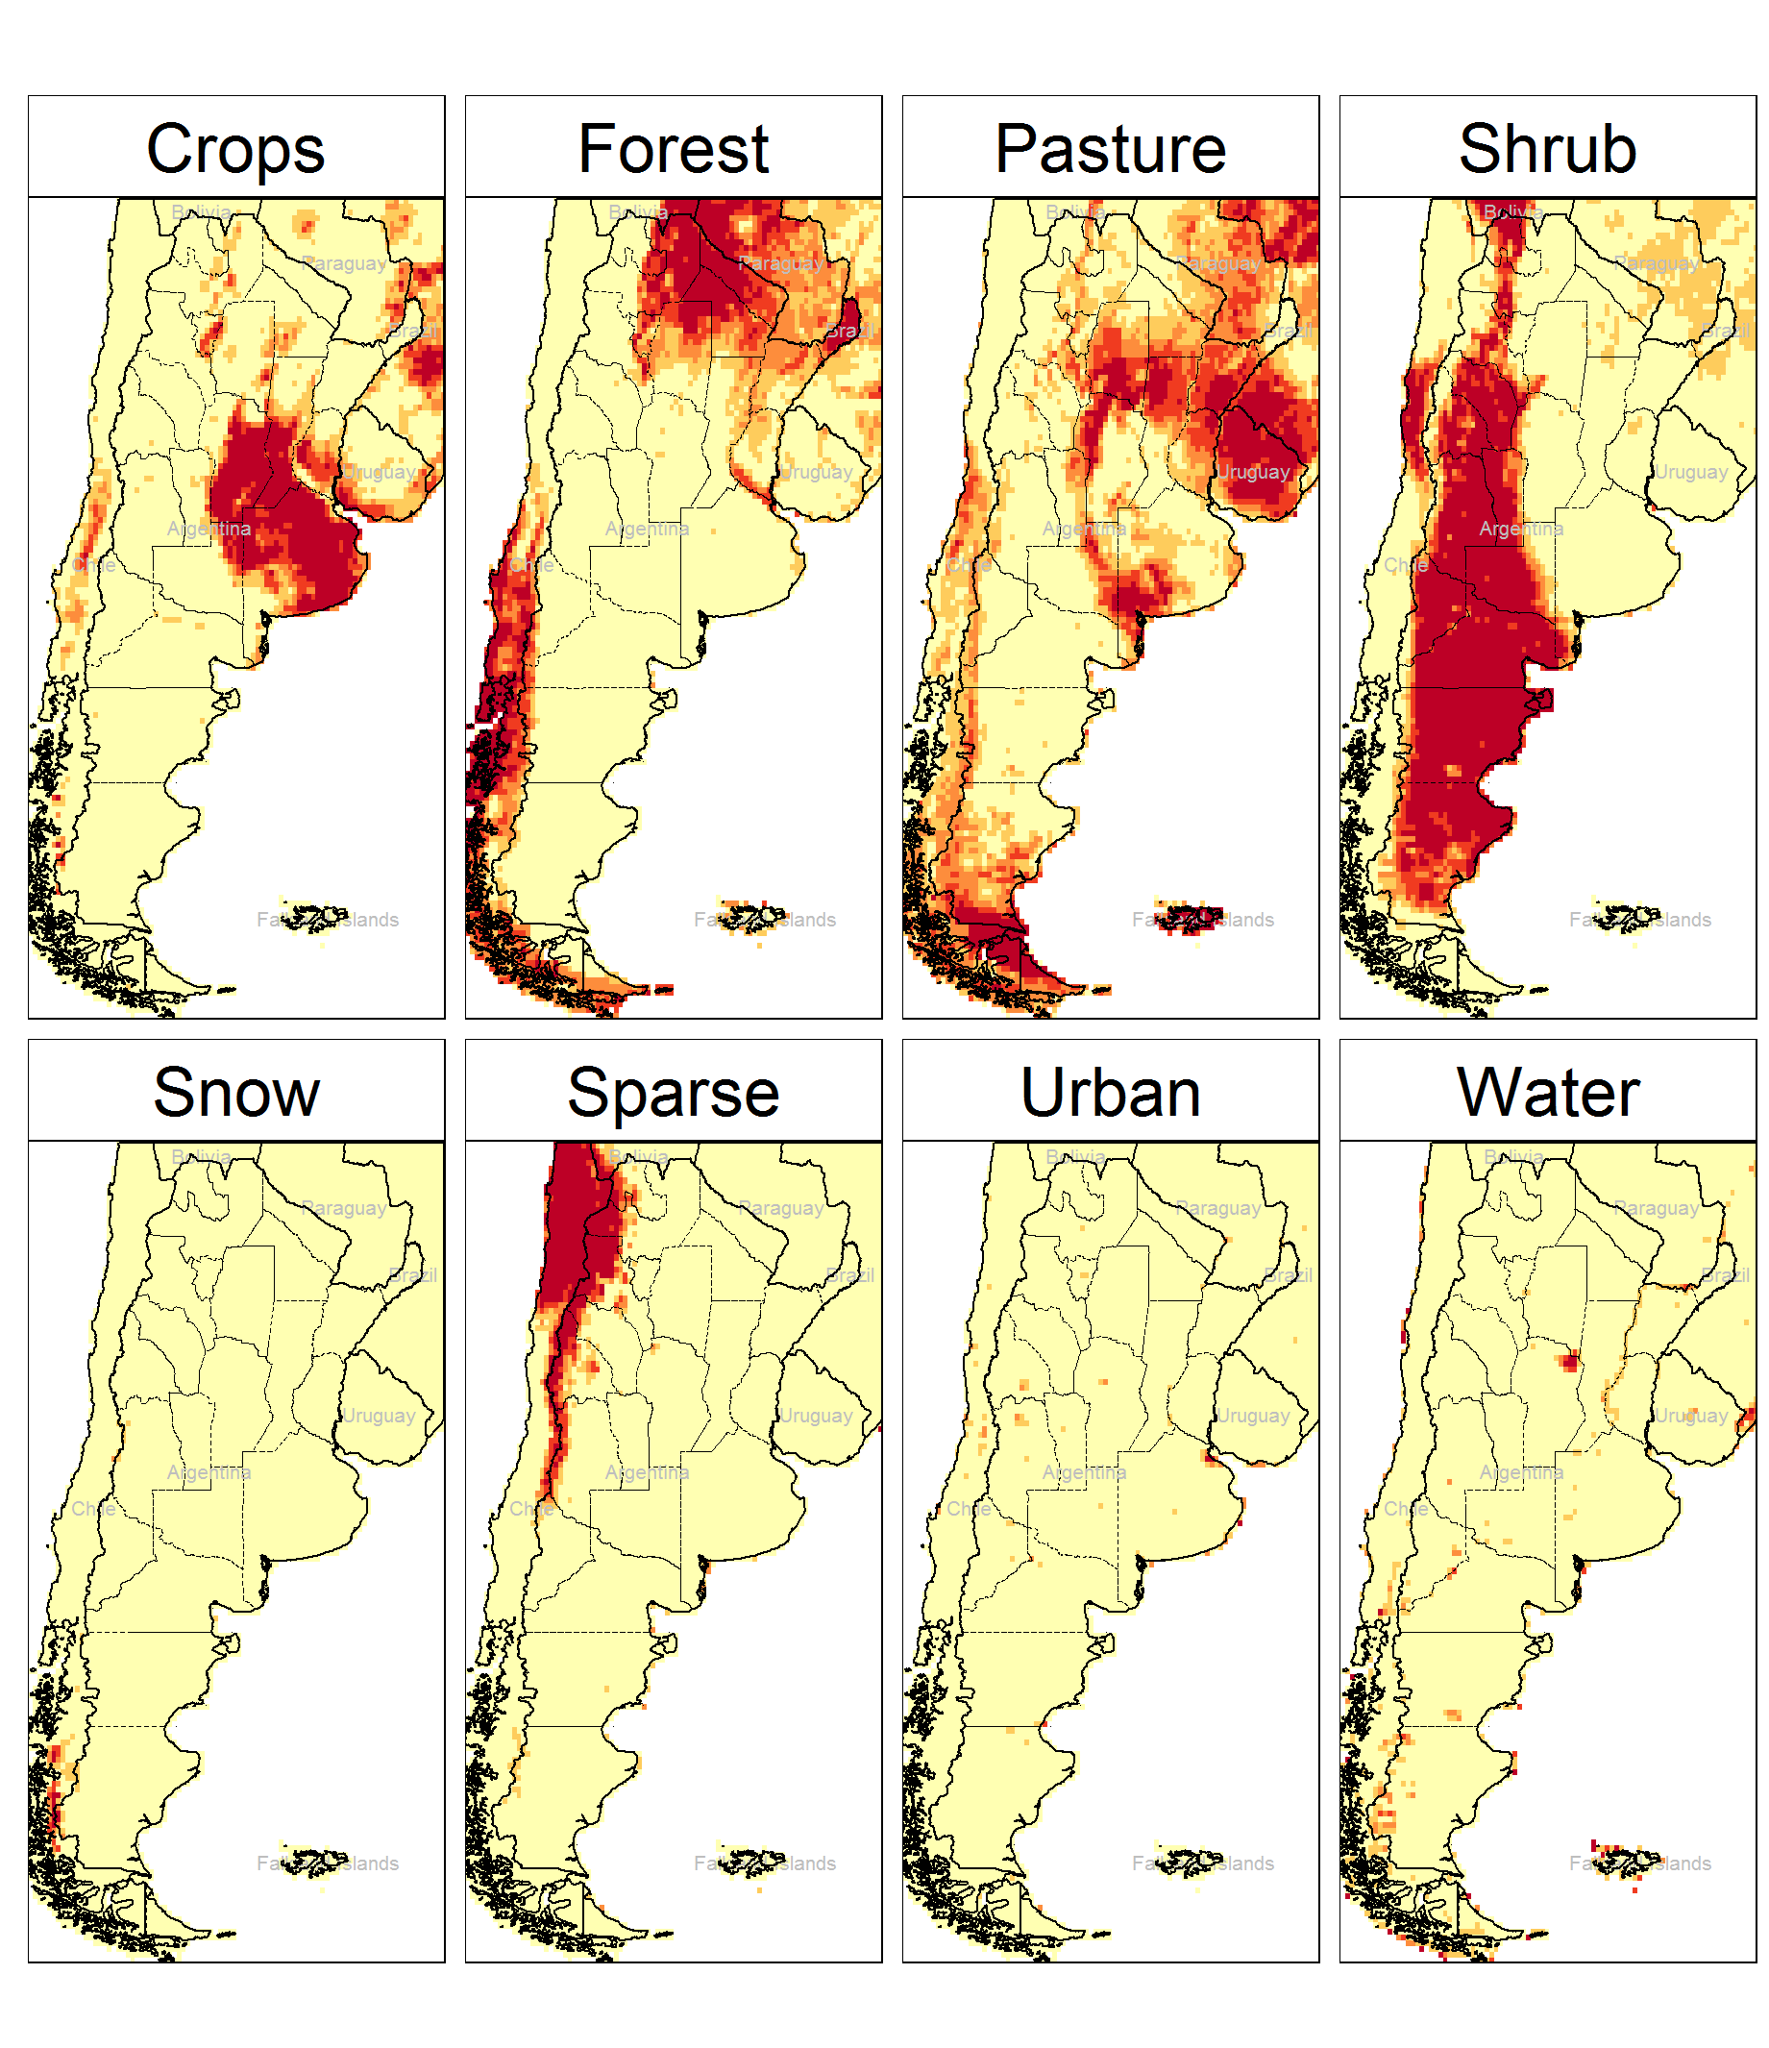
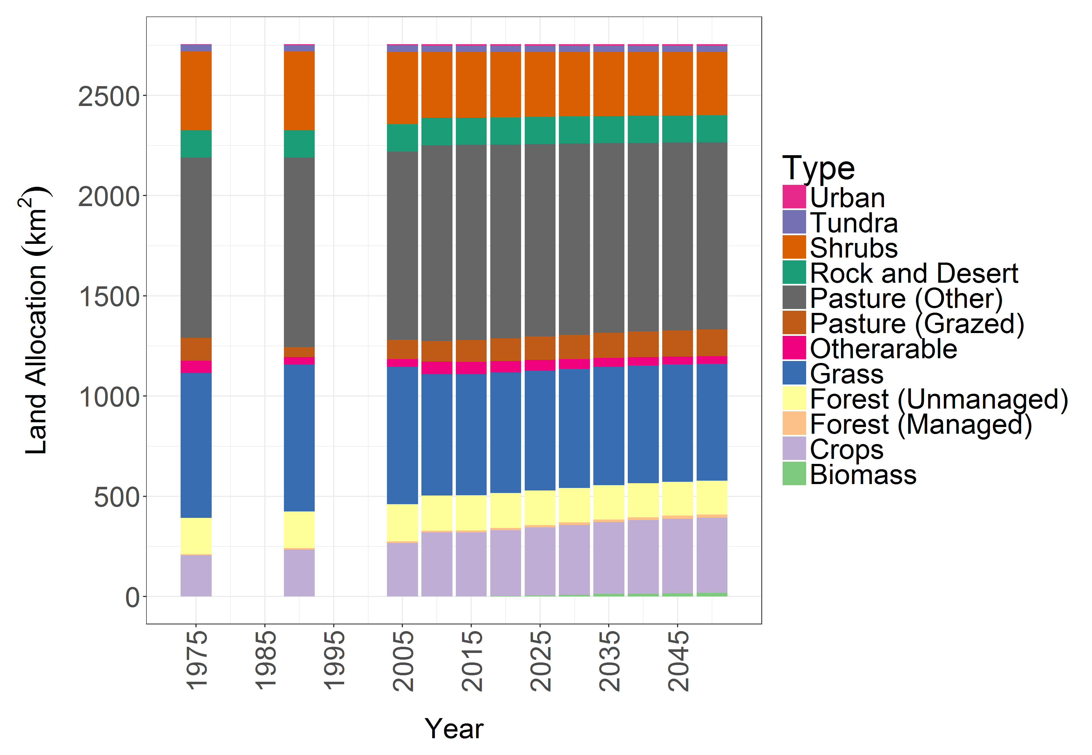
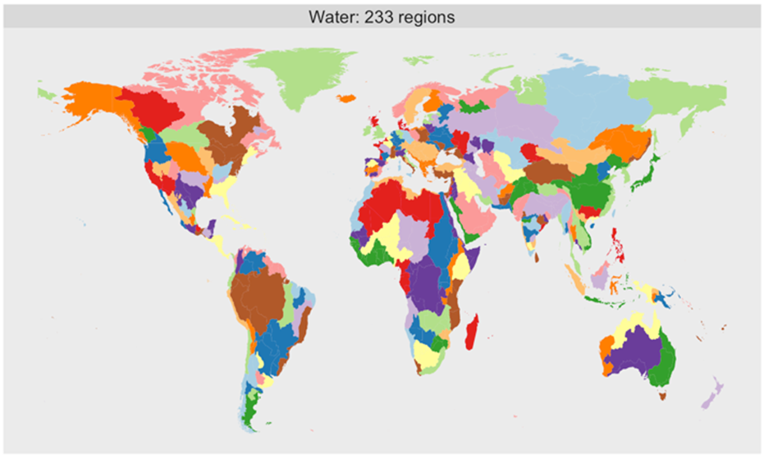




GCAM
GCAM is a global long-term integrated assessment model
GCAM links Economic, Energy, Land-use, Water, and Climate systems
Regional – 5 year
Energy
Downscaling Tools
32 Energy Economy Regions
Gridded – Monthly
Water
384 Land Regions
Land-Use
235 Water Basins

Slide 5
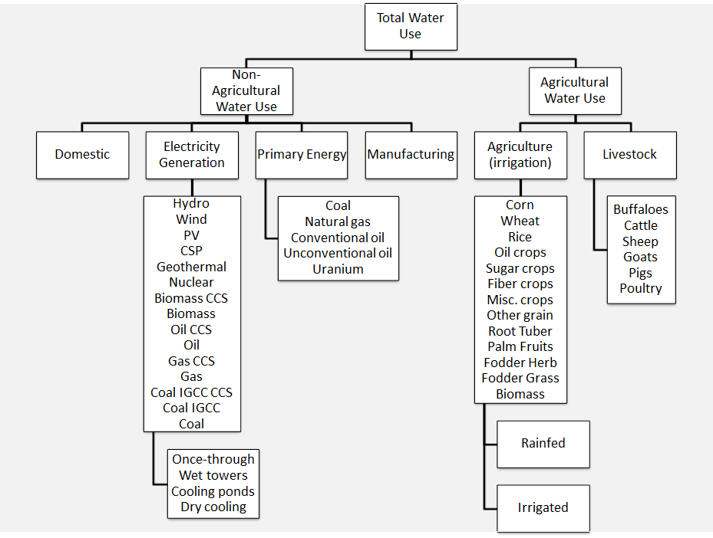
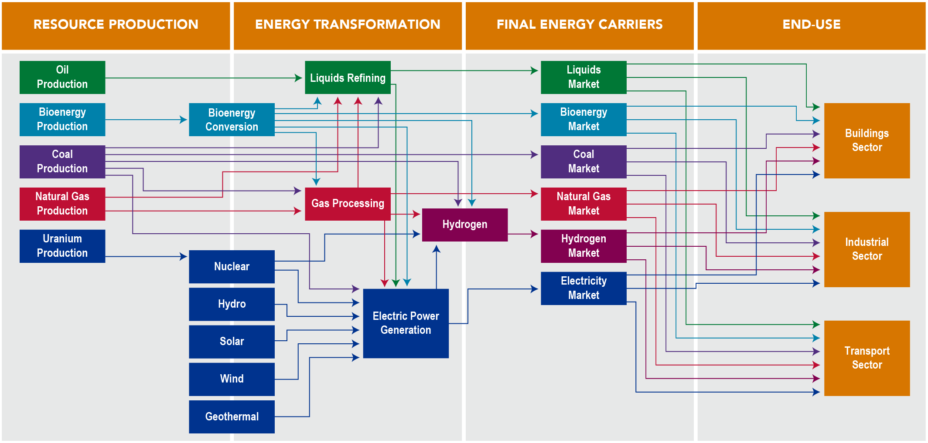
GCAM - Systems
Water
The Energy System
Land
GCAM Documentation: http://jgcri.github.io/gcam-doc/toc.html

Slide 6
GCAM – Data Flow
Modeled Scenario
Population
Labor Productivity
Scenario Assumptions
Technology Characteristics
Model Equations, Relationships, and Parameters
Population
Policies
Labor Productivity
Emissions
Technology Characteristics
Prices
Energy Supplies and Demands
Policies
Agricultural Production
Land Use
Concentrations and Temperature

Slide 7
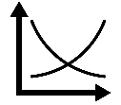
GCAM – Modeling Framework
Market Equilibrium Solution

Slide 8
Tools and Resources for Running GCAM
Stash: has code and files for GCAM (master branch and lots of different projects)
Confluence: a collaboration website with shared information on projects and GCAM, how-to articles, and core model proposals
GitHub: GCAM code and files also available here; users outside of PNNL can access it and ask questions
R: program used for running the data system locally
PIC: PNNL’s remote server that runs GCAM (or whatever else you want to run). Accessed using WinSCP and communicated with through Putty
Links
GCAM Documentation: http://jgcri.github.io/gcam-doc/
GCAM on Stash: https://stash.pnnl.gov/projects/JGCRI/repos/gcam-core/browse
GCAM issues on GitHub: https://github.com/JGCRI/gcam-core/issues/

Slide 9
General GCAM Process
1) CSV files are created manually, or by an exogeneous R script
2) The CSV inputs are processed in "chunks"
3) Chunk outputs (also CSVs) are converted into XML files using a batch script
4) XML files are listed in the configuration file
5) GCAM is run using a configuration file

Slide 10
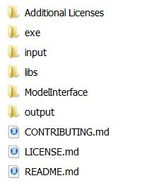
Folder Structure
Model executable and configurations
Model input files
Result viewing software
Output Folder

Slide 11
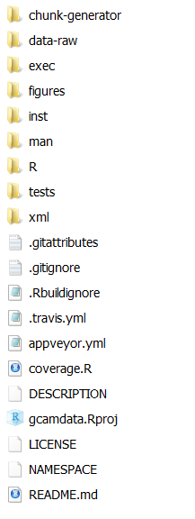
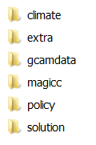

Input Files
Raw Input Files
Processing Code
Raw Input Data
xmls
GCAM data building
R package

Slide 12
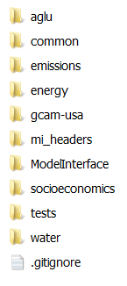
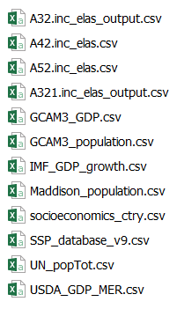

Input Files R data system (Raw Input Data)
https://github.com/JGCRI/gcamdata
./gcamFolder/input/gcamdata
Raw Input Data
> 300 files

Slide 13
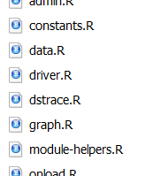
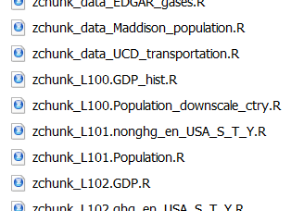
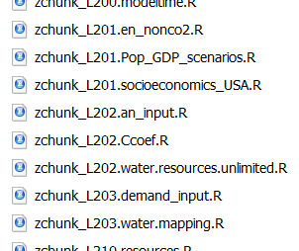
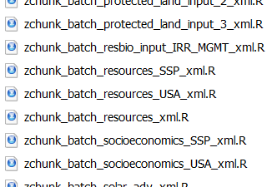
Input Files R data system (Data processing functions)
./gcamFolder/input/gcamdata
Constants
Assumptions
Level 1
Initial Processing
Level 2
Initial Processing
> 300 files
xml
processing

Slide 14
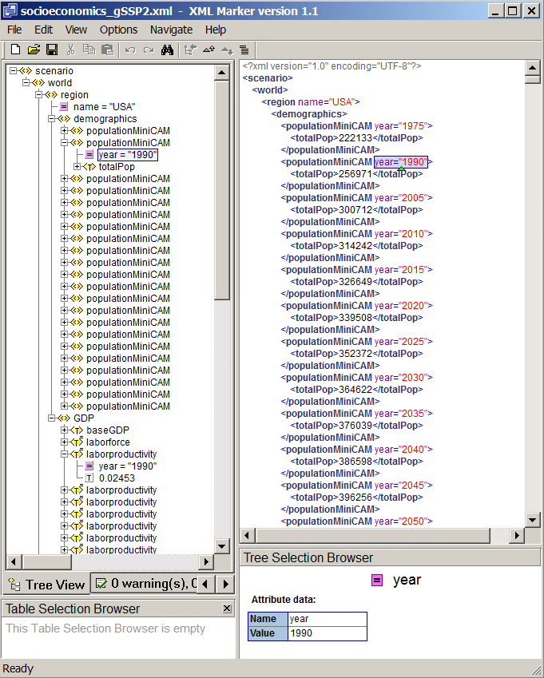
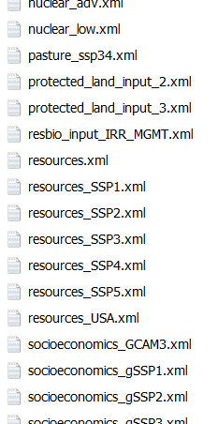
Input Files R data system (XMLs)
XML nested structure
./gcamFolder/input/gcamdata
Region
Parameter
Year
Value

Slide 15
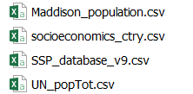


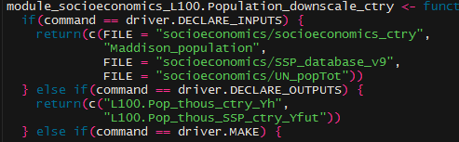
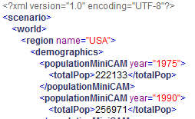
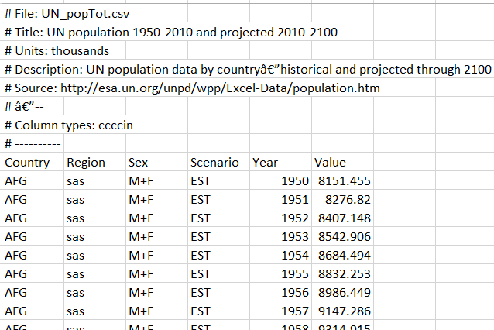

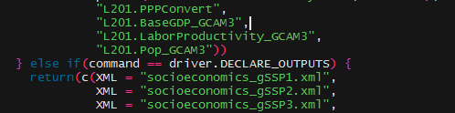
Input Files - Example Raw Data to XML
Raw Input Data
R processing
XML Generation
To GCAM
configuration.xml

Slide 16
Assignment: Build the data system locally
Clone from Stash (https://stash.pnnl.gov/projects/JGCRI/repos/gcam-core/browse)
Git Bash in the folder where you want to clone GCAM
git clone https://YOUR-USERNAME@stash.pnnl.gov/scm/jgcri/gcam-core.git destination-subdirectory
Go to input/gcamdata and open gcamdata.Rproj
Load the data system
Click “install and restart” or library(gcamdata) or ctrl + shift + l
Run the driver
driver()
Update: Solution to Error: ../GCAM_DATA_MAP.Rd:15: Bad \link text
removing ‘../Documents/R/win-library/4.0/gcamdata’
In R/data.R: remove the \link from chunk_inputs, chunk_outputs, and dstrace
Example: \link{\code{chunk_inputs}} becomes just \code{chunk_inputs}
Then, do Build > Document, and Install and Restart

