Slide 1
GCAM Training Session 2
Notes:
Stock Image

Slide 2
Before We Begin…
Any questions from last session?
What is the GCAM data system?
The GCAM data system processes input data into a format that is used to run GCAM (XML). “Running” the data system is not running GCAM, it is producing inputs that are used to run GCAM.

Slide 3
Session Overview
1) Chunk Structure
2) Building XMLs
3) Debugging
4) Editing Chunks
5) Dstrace
6) Prebuilt Data

Slide 4
Chunk Structure
There are three types of chunks:
Processing: process the raw input CSVs, and outputs of other chunks.
zchunk_L101.Population.R
zchunk_L201.Pop_GDP_scenarios.R
Batch: process CSVs into XMLs
zchunk_batch_socioeconomics_SSP_xml.R
Other: contain constants, functions, information needed for the data system to function and stay in check, etc.
constants.R
module-helpers.R

Slide 5
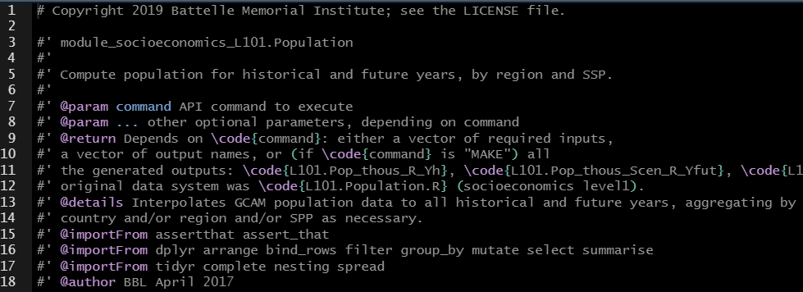
Chunk Structure – Processing 1
zchunk_L101.Population.R
chunk name
description
outputs
function scoping

Slide 6
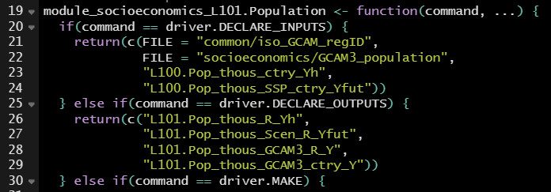
Chunk Structure – Processing 2
zchunk_L101.Population.R
inputs
outputs

Slide 7
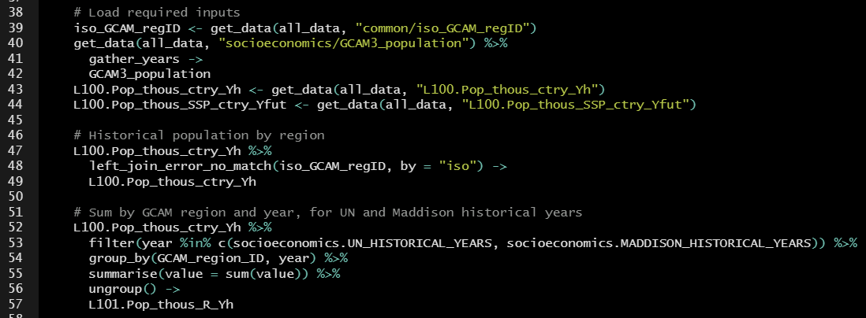
Chunk Structure – Processing 3
zchunk_L101.Population.R
processing

Slide 8
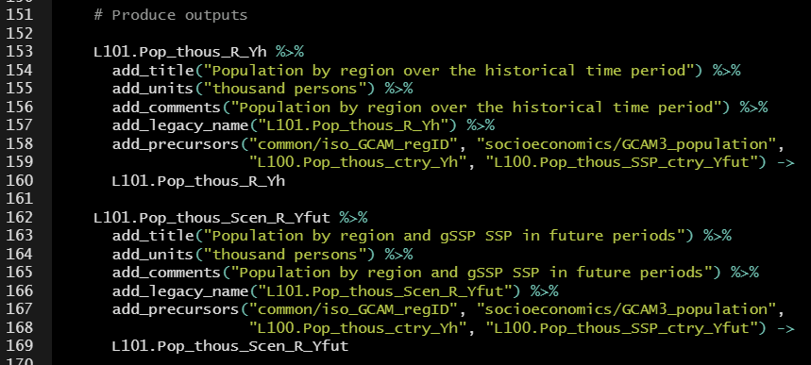
Chunk Structure – Processing 4
zchunk_L101.Population.R
processed table
output table name
precursors – inputs needed to make the table
return data – list all outputs of the chunk

Slide 9
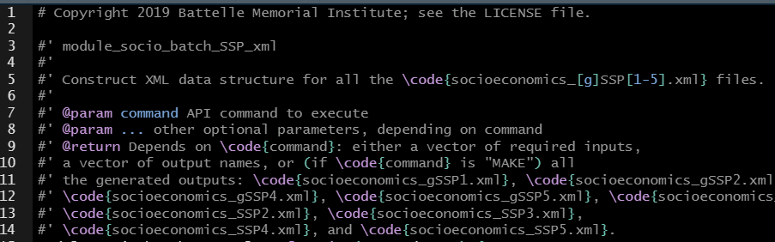
Chunk Structure – Batch 1
zchunk_batch_socioeconomics_SSP_xml.R
chunk name
description
outputs

Slide 10
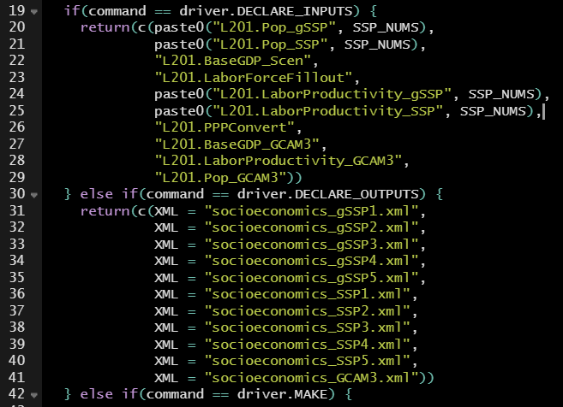
Chunk Structure – Batch 2
zchunk_batch_socioeconomics_SSP_xml.R
inputs
outputs

Slide 11
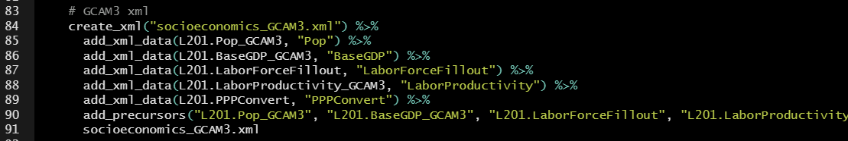
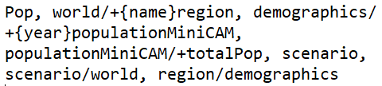
Chunk Structure – Batch 3
zchunk_batch_socioeconomics_SSP_xml.R
adding tables to create the XML
Line 85:
add_xml_data is a function.
L201.Pop_GCAM3 is an input table.
“Pop” is the name of a header.
Headers tell the XML how to format the table columns.
From ModelInterface_headers.txt

Slide 12
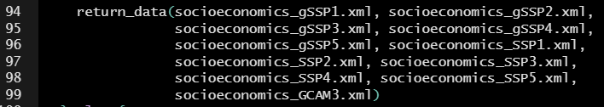
Chunk Structure – Batch 4
zchunk_batch_socioeconomics_SSP_xml.R
return data –
list all XMLs created by the batch chunk

Slide 13
Building XMLs
The driver() function is used to run the data system and build XMLs.
To build all XMLs
driver()
To build a single XML
driver( stop_after = “module_X_batch_xml” )
Note: when you run driver(), all XMLs in the input>gcamdata>xml directory will be replaced.

Slide 14
Debugging
When we write new chunks or change old chunks, we debug them to make sure they will properly run in the data system.
1) Open the relevant chunk in gcamdata.Rproj.
2) ctrl + shift + l this loads the datasystem
3) driver( stop_before = “module_X” ) -> x
4) debug( gcamdata:::module_X )
5) gcamdata:::module_X( “MAKE”, x )
In debug mode, any time something fails and you make a change to fix it, you need to save your chunk, reload the data system, and go through these steps again.

Slide 15
Editing Chunks
Sometimes we want to edit chunks at our leisure, and not debug after every change.
1) Open the relevant chunk in gcamdata.Rproj.
2) ctrl + shift + l
3) driver( stop_before = “module_X” ) -> x
4) all_data <- list(x)[[1]]

Slide 16
Dstrace
Function to trace data files through the data system
Tells you what data objects feed into other data objects
dstrace(object_name, direction = "upstream", graph = FALSE, gcam_data_map = GCAM_DATA_MAP, previous_tracelist = NULL, recurse = TRUE, ...)
Examples:
dstrace("L100.FAO_ag_Exp_t")
dstrace("L100.FAO_ag_Exp_t", direction = "downstream")
dstrace("L100.FAO_ag_Exp_t", direction = "both", graph = TRUE)

Slide 17
Dstrace
Function to trace data files through the data system
Tells you what data objects feed into other data objects
dstrace(object_name, direction = "upstream", graph = FALSE, gcam_data_map = GCAM_DATA_MAP, previous_tracelist = NULL, recurse = TRUE, ...)
Examples:
dstrace("L100.FAO_ag_Exp_t")
dstrace("L100.FAO_ag_Exp_t", direction = "downstream")
dstrace("L100.FAO_ag_Exp_t", direction = "both", graph = TRUE)
Name of object to trace (can be either a data object or a code chunk)
Trace direction ("upstream", the default; "downstream"; or "both"), character

Slide 18
Proprietary and Prebuilt Data
A few chunks in the data system rely on proprietary data from the International Energy Agency (IEA) and Community Emissions Data System (CEDS). These can’t be publicly posted online.
When the proprietary data files are not available, prebuilt versions of the data are used.
Link to proprietary data: https://stash.pnnl.gov/projects/JGCRI/repos/gcam-proprietary-data/browse

