Slide 1
GCAM Training Session 3
Notes:
Stock Image

Slide 2
Session Overview
1) Setting up GCAM on PIC
2) Running a Single Configuration File
3) Running a Batch Configuration File
4) Querying Results
5) Folder Structure and Run Output
6) Activity: two GCAM runs on PIC (reference and policy scenario)

Slide 3
Setting up GCAM on PIC
Log into WinSCP and PuTTY
Load supporting tools for compiling GCAM and building R data system
In PuTTY, cd to the directory where you want GCAM
Set up a personal folder in the pic/projects/GCAM folder
Clone GCAM
git clone https://your-username@stash.pnnl.gov/scm/jgcri/gcam-core.git destination-subdir
If you want a branch besides master, check out that branch
cd gcam-core → git checkout branch-name
Make Hector
make install_hector
Build GCAM
make gcam –j 12
Step by step instructions: https://confluence.pnnl.gov/confluence/pages/viewpage.action?spaceKey=JGCRI&title=Setting+up+GCAM+on+PIC

Slide 4
Running the data system on PIC
Navigate to the gcamdata folder
$ cd input/gcamdata
Run R
$ R <enter>
Install devtools (only need to do this the first time)
install.packages ("devtools")
Install package dependencies
devtools::install_deps()
Update all when prompted
Load the gcamdata package
devtools::load_all()
Run the driver
driver(write_outputs = FALSE, write_xml = TRUE)

Slide 5
Parts of a Configuration File
Files
Designate the batch file
Change the policy target file
Change the database output name and location
Scenario Components
Contains the XML inputs (climate model, socioeconomics, energy, land, water, non-CO2, solution file)
Strings
Scenario Name, no spaces or special characters
Debug region
Bools
To enable batch mode and target finder
Ints
Change the period the model stops running

Slide 6
Pre-Run
To avoid having to load the modules in Putty every time you execute a run:
In WinSCP: Options > Preferences > Panels > Show Hidden Files
root/qfs/people/your user
.bashrc
#User specific aliases and functions (add module loads here)
module load git
module load svn/1.8.13
module load R/3.3.3
module load java/1.8.0_31
module load gcc/6.1.0

Slide 7
Pre-Run
Place the run-gcam.zsh file in your exe folder.
In this file, you can change the time allotted for the model to run, as well as the project allocation code.
You will need to copy this file to the exe folder when you clone new branches.
#SBATCH -A allocation code goes here
#SBATCH -t run time in minutes goes here
#SBATCH -N 1 (this is the number of nodes to run on, keep as 1)

Slide 8
Running a Single Configuration
In Putty, navigate to the exe folder of the branch you want to run
$ cd branch/exe
Call the run-gcam.zsh file to run GCAM
$ sbatch –J configuration.xml run-gcam.zsh
Here, you will change "configuration.xml" to whatever configuration file you want to run
The run-gcam.zsh has the time limit for your run, and the project allocation code
Optional: to keep track of your run's progress
$ watch –n 60 squeue –u username
The "60" will update the window every 60 seconds

Slide 9
Folder Structure and Run Output
For a Single Configuration:
branch/exe/
slurm-XXXXXXXX.out
Contains a period-by-period log of model calibration and solution errors
We want to see "All model periods solved correctly. Model run completed."
logs folder
Contains several output files that contain various information from GCAM
DebugSCENARIO_NAME.xml
Large XML that shows what GCAM is "seeing" for the specified debug region
branch/output
database_basexdb
This is where the GCAM output is that can be used in Model Interface and rgcam

Slide 10
Running GCAM in batch mode
Detailed tutorial available at https://docs.google.com/document/d/1aURCiSaKkbDFUSLpCnT7K5uNyws5ThxIQMr7E3bIWWc/edit#heading=h.cssp0x15n55k
Folder structure
For each branch of GCAM you are working on, you will have:
A copy of the GCAM branch cloned from Stash [GCAM-Branch]
A folder for runs on that branch [Branch-Runner]
Within that folder, will have a separate folder for each run [Experiment]
When you start a run, all input files in the Experiment folder will sync to the GCAM-Branch

Slide 11
Running GCAM in batch mode
In your home directory, clone the branch of GCAM you would like to run (GCAM-Branch)
Compile GCAM and run the data system
In the same directory, create a folder for runs on this branch (Branch-Runner)
Call it something like “running_[GCAM-Branch]”
Within your Branch-Runner directory, create a sub-directory for each experiment you want to run (Experiment)
Add all the batch scripts to the Experiment directory

Slide 12
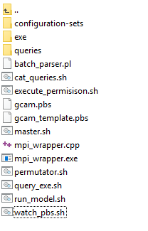
Overview of batch scripts
Master.sh
Runs the other scripts, and is called by hand
Permutator.sh
Generates the configuration files that the model will run (from the files in the configuration-sets directory)
Gcam_template.pbs
Tells PIC how to run the scenario and who to charge it to
Run_model.sh
Runs the model and queries it once the run has finished
Watch_pbs.sh
This script “squeues” PIC to see when the job is running
Cat_queries.sh
Concatenates individual queries into single files in the output directory
Execute_permission.sh
Grants execute permission to all other files in the directory
Query_exe.sh
Used to query and concatenate results from previously finished runs

Slide 13
Running GCAM in batch mode, cont.
Update batch scripts with your information
master.sh:
RUN_DIR_NAME=[Experiment]
WORKSPACE_DIR_NAME=[HOME_path]/[GCAM-Branch]
SCRATCH=[HOME_path]/[Branch-Runner]
#SBATCH --mail-user [your_email@pnnl.gov]
gcam.pbs
#SBATCH -A [PIC_charge_name]
#SBATCH --mail-user [your_email@pnnl.gov]
gcam-template.pbs
#SBATCH -A [PIC_charge_name]
watch_pbs.sh
queue -u [user_ID]
cat_queries.sh
#SBATCH –A [PIC_charge_name]
6. Grant execute permission to the scripts
Right click → Properties → select all X boxes and click OK

Slide 14
Running GCAM in batch mode, cont.
In the Experiment directory, create a subdirector called configuration-sets
Copy “configuration_ref.xml” from [GCAM-Branch]/exe/ into this folder
Create a new text file called “batch.xml” (or copy the example version)
Open configuration-sets/configuration_ref.xml
Cut all value tags (<Value … </Value>) within scenario components.
Paste them into the batch.xml file between the “Ref” FileSet tags within the “Ref” ComponentSet tags
In batch.xml, replace the files within the FileSets between “Component1” ComponentSet to whatever files you want to include in your batch
The permutator script will make every combination of the file sets (these are also how the scenarios get named)
Save and close batch.xml

Slide 15
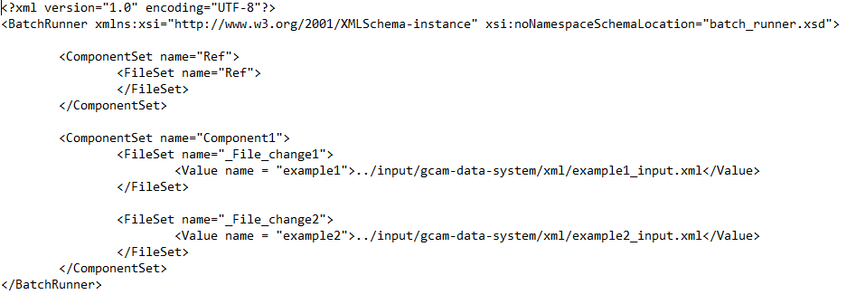
Running GCAM in batch mode, cont.
Each FileSet within a ComponentSet gets combined with each of the the FileSets in all the other ComponentSets
In this example, scenarios generated would be
Ref_File_change1
Ref_File_change2
10. In configuration_ref.xml
Change the xmldb-location value tag to “db/database_basexdb”
Comment out the “scenario name” value tag
Rename the file “config.xml”
Save and close

Slide 16
Starting the batch run
In PUTTY, cd to your [Experiment] directory
Start the run by entering
./master.sh configuration-sets/config.xml configuration-sets/batch.xml
Answer the questions
“Generate permutations (y/n)?” y
“Write files to disk(y/n)?” y
“First task number to run (normally 0)?” 0, if you want to start from the first scenario
“Last task number to run (normally same as number of permutations -1)?” number of permutations -1, if you want to run all scenarios
“Number of cores to use?” Normally choose between n and 2n (n = # of permutations)
“Run x tasks on cluster (y/n)?” y
“Would you like to be notified when the job is done? (y/n)” y, if you want to get an email
An exe_X folder will be generated for each scenario
You can see the run progress by opening output_X.txt

Slide 17
Running queries in batch mode
Open [Experiment]/exe/
Add any batch queries that you would like to run on your scenarios
Each file should be an individual query
Open [Experiment]/exe/xmldb_batch.xml
Alter the “queryFile” names and “outFile” names to match the names of your queries
Additional commands can be added in this same format
If you add the queries and xmldb_batch file before starting the run, they should run automatically
If you want to query after the run is finished, go to your Experiment directory in PuTTY and call
./query_exe.sh xmldb_batch.xml

Slide 18
Folder Structure and Run Output
In batch mode:
branch/exe_X/
output_X.txt
log of model calibration and solution errors. Still want to see "All model periods solved correctly. Model run completed."
logs folder
DebugSCENARIO_NAME.xml
Large XML that shows what GCAM is "seeing" for the specified debug region
Csv files for each of your queries (for that scenario only)
branch/exe_X/db/
database_basexdb
Database of all GCAM output for that scenario
branch/output/
Csv files of query results combined for all scenarios

Slide 19
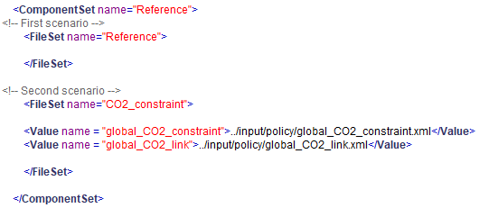
Running Reference and Policy Scenario
To run these two scenarios in batch mode:
Add the policy files to the GCAM-Branch folder
Set up the batch.xml file with the xml inputs for Ref and Policy in separate FileSets, and name the scenarios accordingly
Start the runs

