Slide 1
GCAM Training Session 4
Notes:
Stock Image

Slide 2
Session Overview
1) GCAM outputs on PIC
2) Model Interface
3) rgcam
4) Common issues

Slide 3
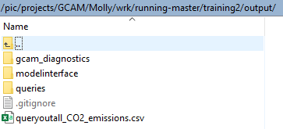
GCAM Outputs on PIC
When running automated GCAM batches on PIC, results of your queries will be written to csv files in the output folder of your experiment directory
To run additional queries:
add your new query files to the exe folder and xmldb_batch.xml file
Call ./query_exe.sh xmldb_batch.xml
Download the csv files to local (click Download, or drag and drop to the folder where you want them)
Can then import them into R to process the results, make plots, etc.
Results are in wide format

Slide 4

GCAM Outputs on PIC
In the configuration file, check where the database of results is being written to!
When running using the automated batch scripts:
will write the outputs of each individual scenario in a separate database, in the exe_X folder.
Changing the xmldb-location to the main folder, e.g.
will write the outputs of all scenarios in one database.
This can be more convenient if you want to download the database and use rgcam, but querying on PIC by adding queries to the exe folder only works with the first setup.

Slide 5
Model Interface
Model Interface (MI) is a program that comes with the Release Version of GCAM, and is used to view GCAM output.
To download MI: https://github.com/JGCRI/gcam-core/releases/tag/gcam-v5.2
Download the .zip for your operating system, and extract all files.

Slide 6
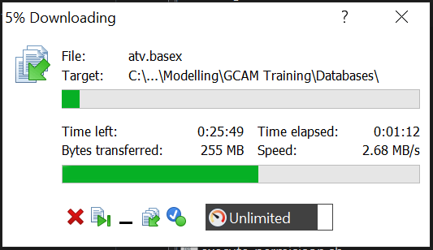
Model Interface
To view GCAM results in MI, we first need to copy our database from remote to local.
Simply drag your database from the remote (right) side of WinSCP to your preferred folder on the local (left) side of WinSCP.
This transfer can take some time, especially when there are multiple scenarios in your database.

Slide 7
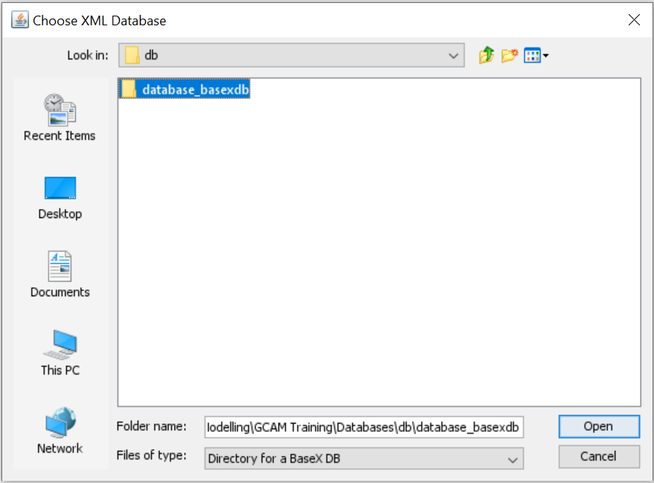
Model Interface
run-model-interface.bat
File > Open > DB Open
Depending on how you set up your run, sometimes the database_basexdb folder will contain all of your scenarios. Other times they will be in multiple databases, which is addressed later.
The batch file to run MI is in gcam-v5.2-Windows-Release-Package\ModelInterface
Select the database you want to open

Slide 8
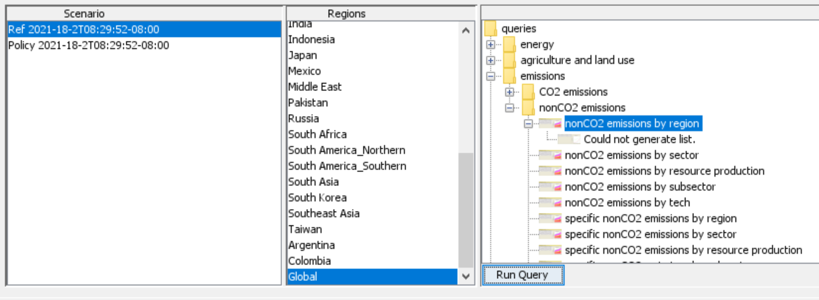
Model Interface
Our batch had two scenarios, “Ref” and “Policy”, which can be seen here.
To view results, select a scenario, region, and a query.
The current selections would show nonCO2 emissions, globally, for the Reference scenario.

Slide 9
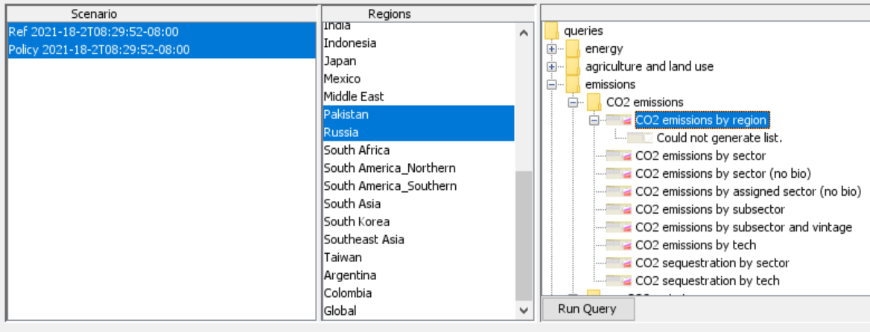
Model Interface
You can also select multiple scenarios, regions, and queries at the same time.
This selection would show CO2 emissions, for Pakistan and Russia, for both the Reference and Policy scenarios.

Slide 10
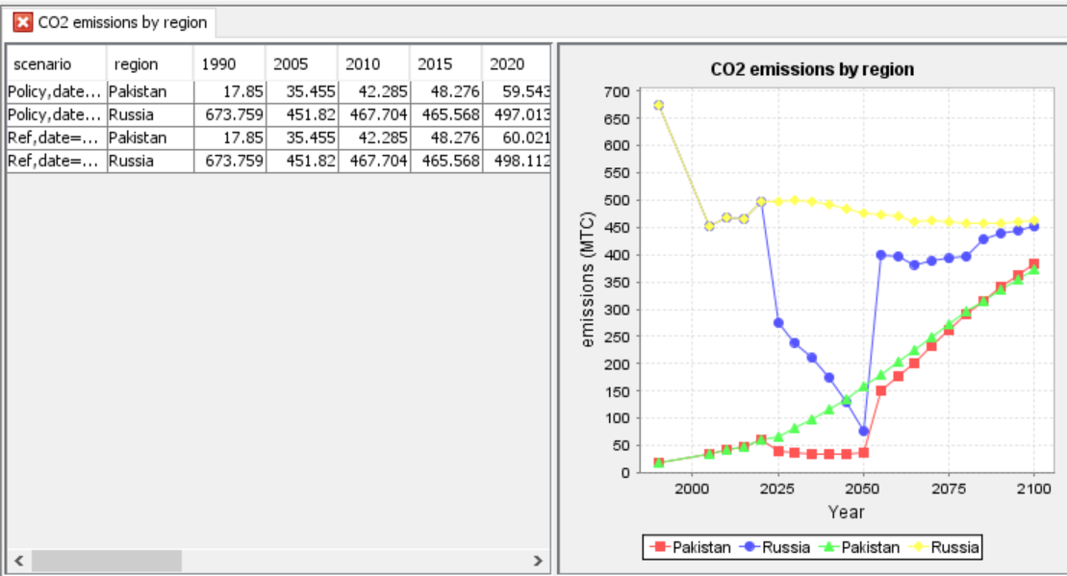
Model Interface
After pressing the “Run Query” button, MI will generate a table and figure.
As you can see, MI is a great initial visualization tool, but it is not perfect. In the figure to the right, we can’t definitively distinguish between the Reference and Policy results (though can assume emissions are lower in the policy scenario).

Slide 11
rgcam
When you query on PIC in batch mode, .csvs are returned in wide format and must be individually copied to local, read into R, and manipulated to make figures.
Rgcam is an R package that makes querying and visualizing GCAM output easier.
To install rgcam, open an R session and run:
install_github('JGCRI/rgcam', build_vignettes=TRUE)
Additional rgcam information: https://github.com/JGCRI/rgcam

Slide 12
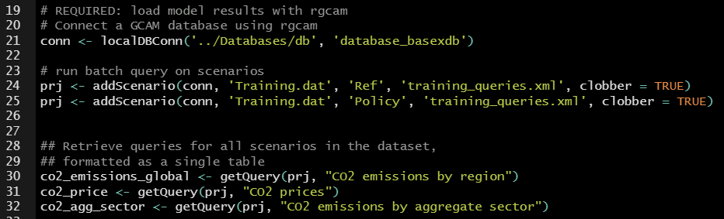
rgcam – Connecting a Database
path to your database, database name

Slide 13

rgcam – Connecting a Database
Running
conn <- localDBConn('../Databases/db', 'database_basexdb’)
connects your database to rgcam and lists the scenarios it contains.

Slide 14
rgcam – Querying Scenarios
path to your database, database name
listing your scenarios: Project Name Scenario Name XML with queries

Slide 15
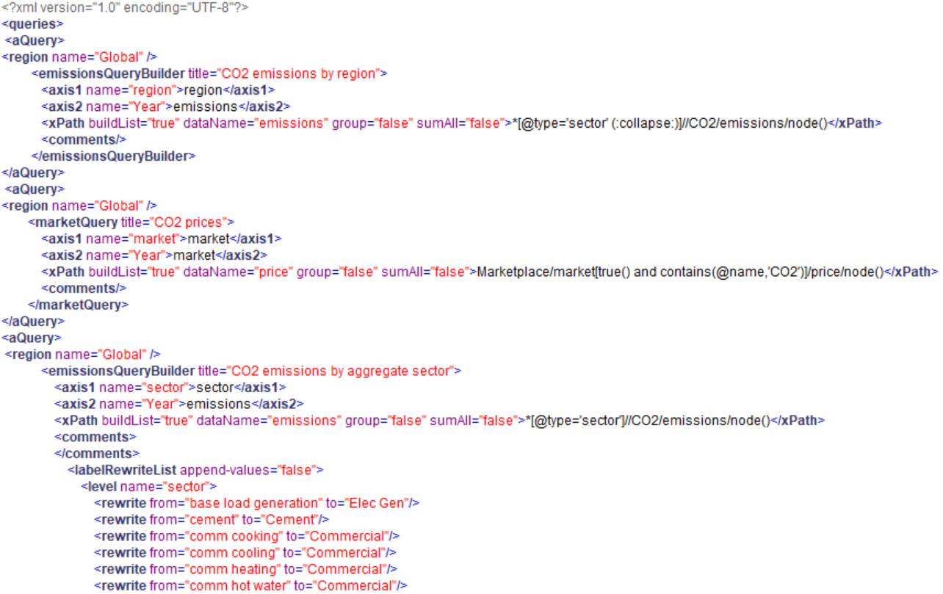
rgcam – Querying Scenarios
region to get query for (can list multiple)
This is part of the training_queries.xml
query name
(used in rgcam)

Slide 16
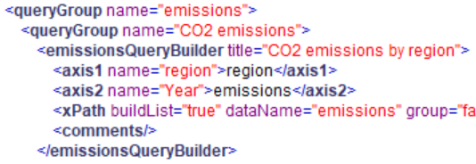
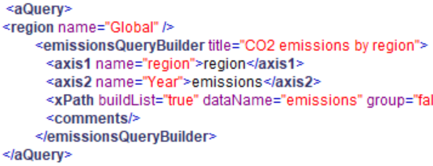
rgcam – Querying Scenarios
To add new queries to our XML used in rgcam, we can utilize the Main_queries.xml. In the directory you cloned GCAM master, the Main_queries.xml can be found in output > queries.
Simply copy + paste the queries you want from Main_queries.xml into you XML used in rgcam, add regions, <aQuery> before, and </aQuery> after.
Main_queries.xml
training_queries.xml

Slide 17
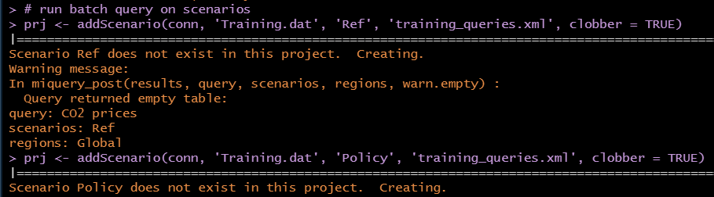
rgcam – Querying Scenarios
Running
prj <- addScenario(conn, ‘Training.dat’, ‘Ref’, ‘training_queries.xml’, clobber = TRUE)
batches the queries in “training_queries.xml” for the specified scenario (Ref), and brings them into the project
“training_queries.xml” has a query to retrieve CO2 prices. Since the Reference scenario does not have a CO2 price, it returns an empty table.

Slide 18
rgcam
path to your database, database name
listing your scenarios: Project Name Scenario Name XML with queries
retrieving queries and assigning them to objects

Slide 19
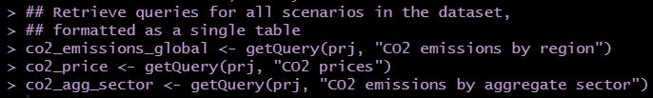
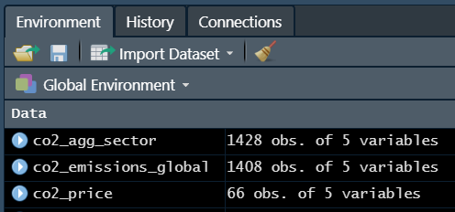
rgcam
Running
co2_emissions_global <- getQuery(prj, “CO2 emissions by region”)
retrieves the query data and assigns it to a dataframe, which is added to our environment. Each table contains data for all scenarios in long format.

Slide 20
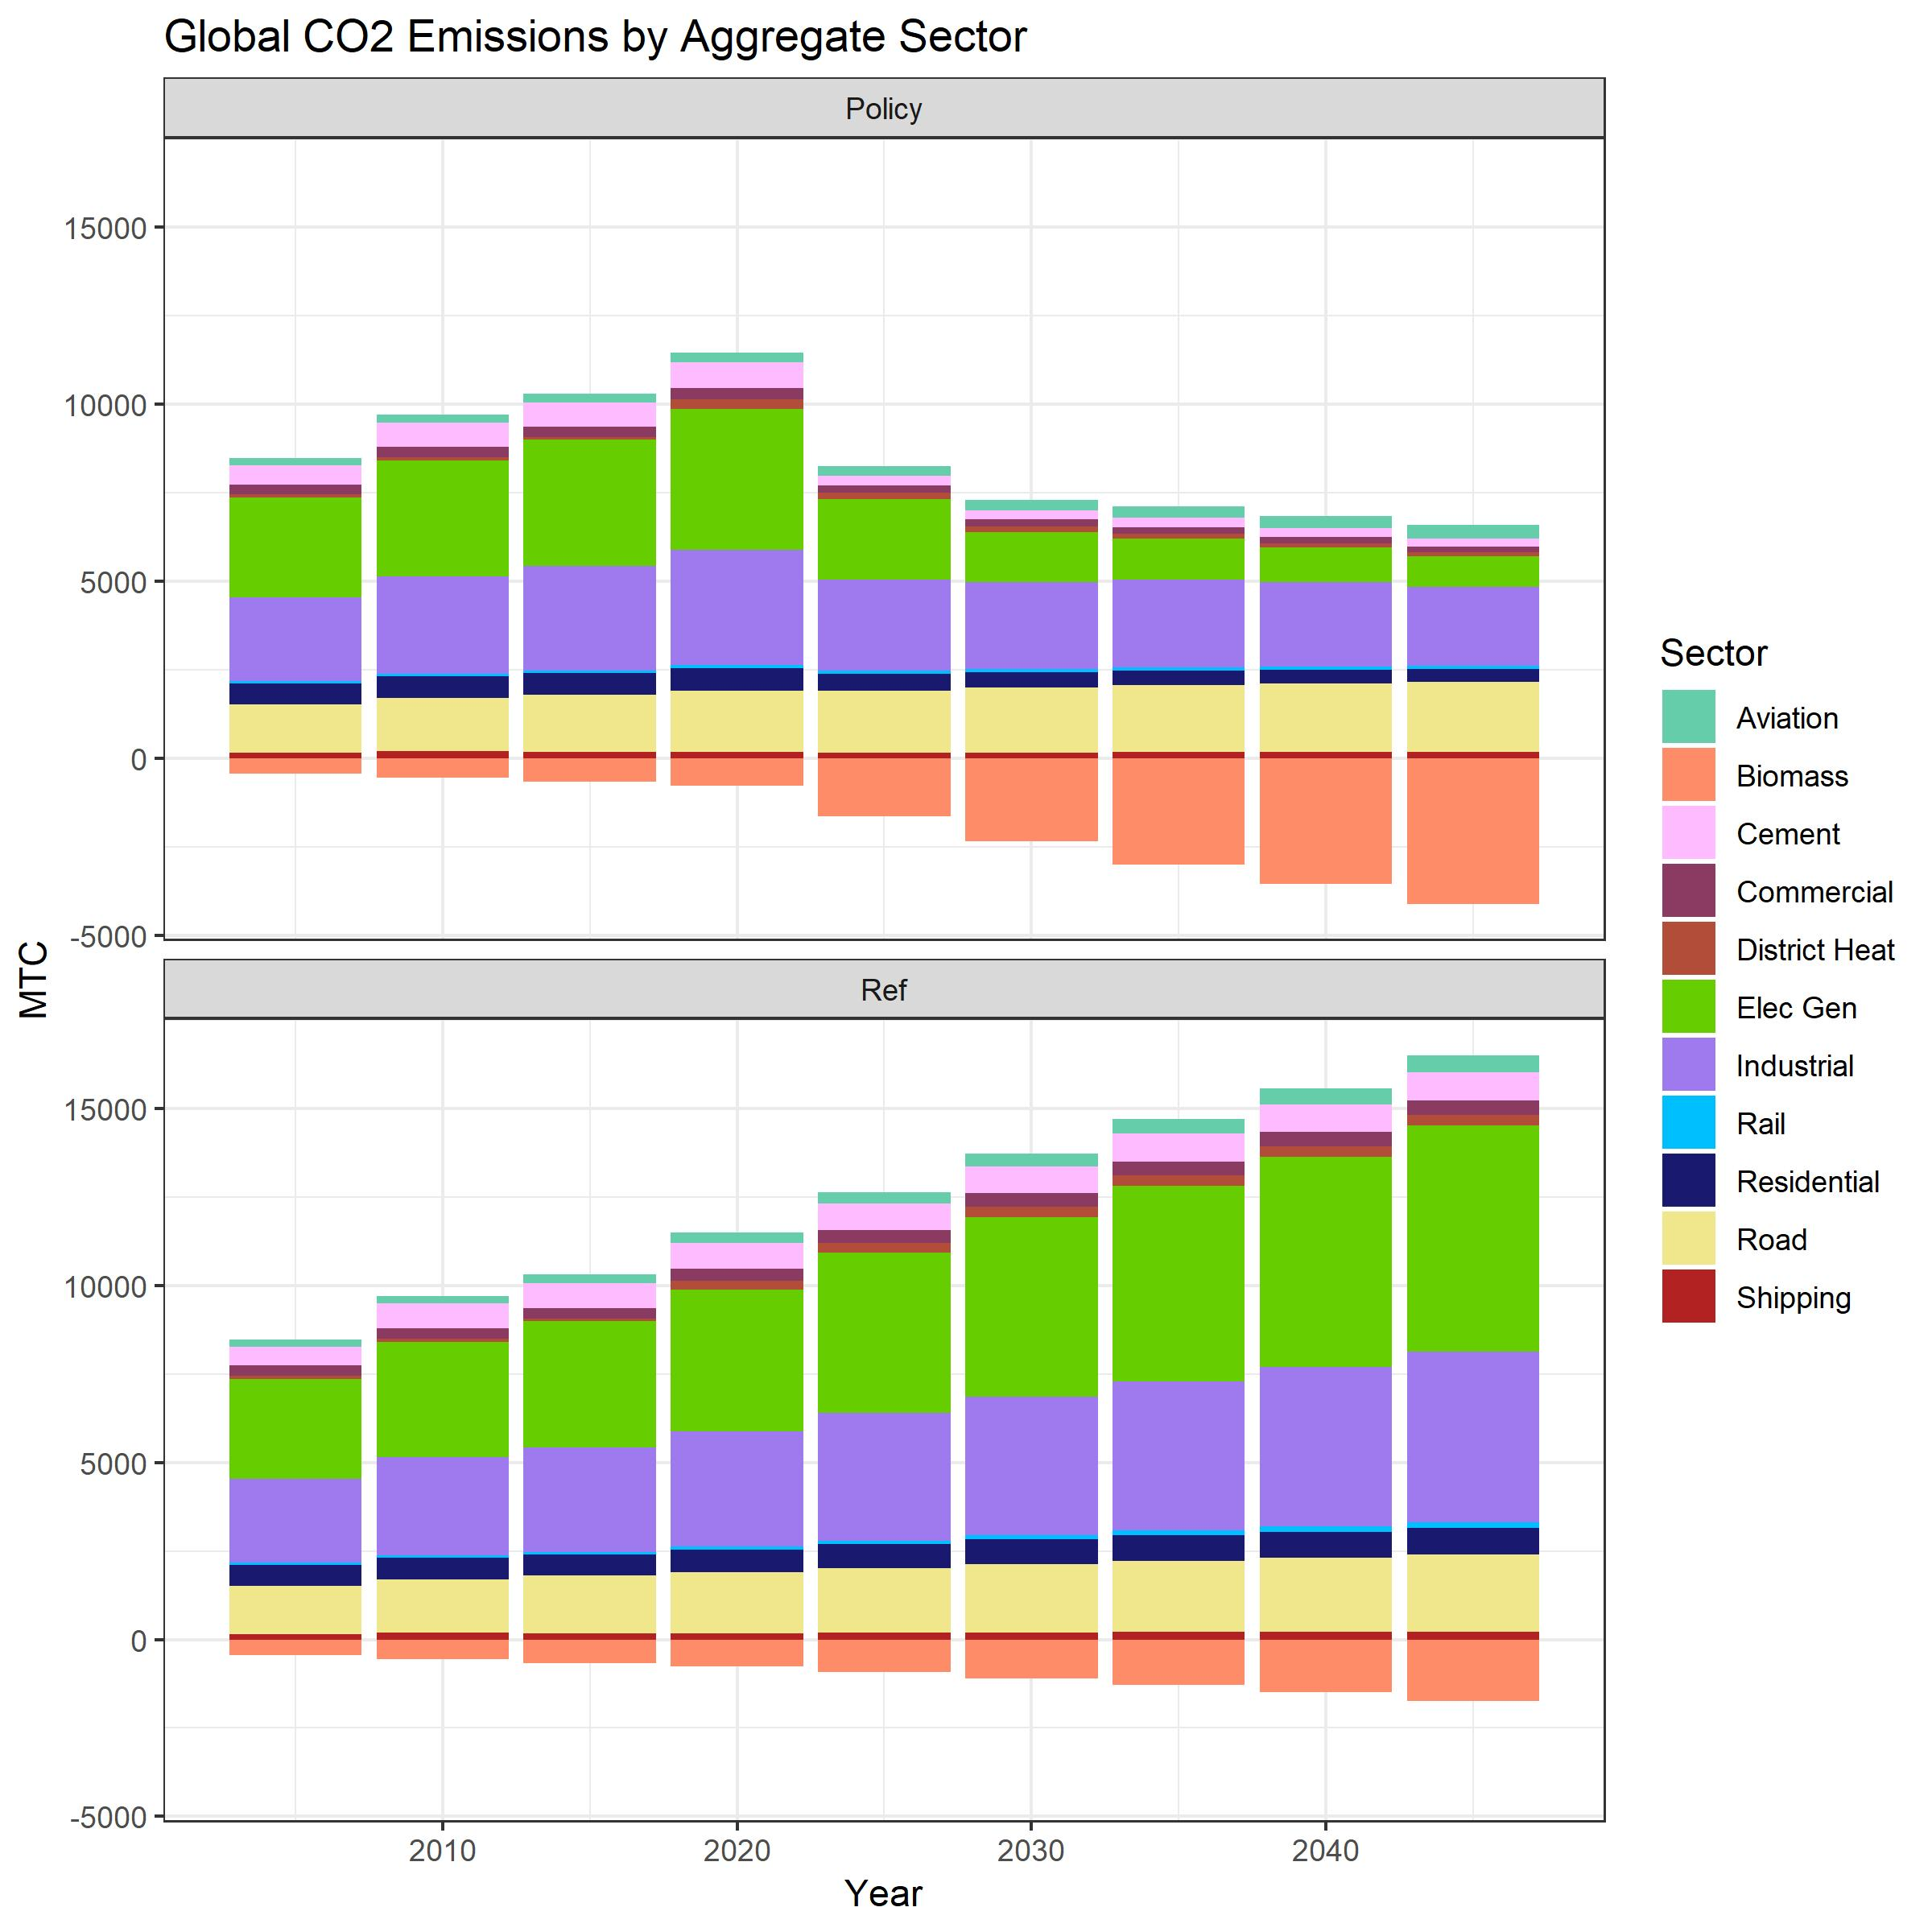
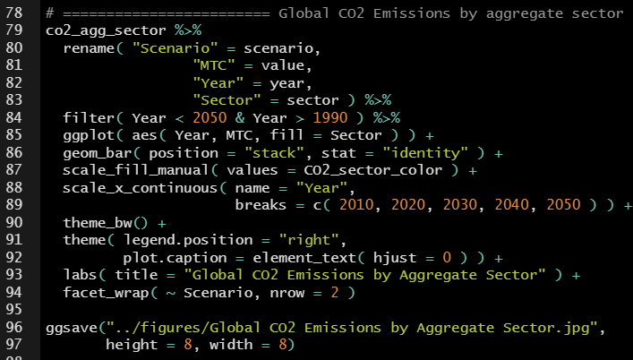
rgcam
Now we can easily visualize our data, and add new queries and scenarios whenever we need to.

Slide 21
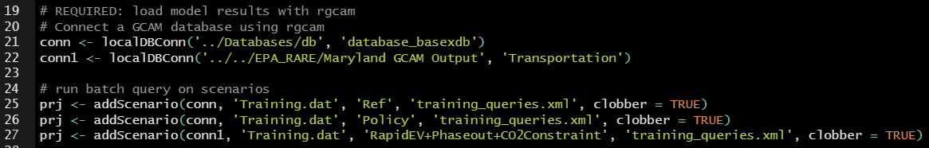
rgcam - Using Scenarios from Multiple Databases
When running GCAM on PIC, you will often end up with multiple databases that you want to compare in rgcam.
This can be done directly in rgcam by connecting a new database and adding scenarios from that database to our project.
Here, we can see that on Line 22 “conn1” is connected to a database called “Transportation”.
On Line 27, we are adding a scenario “RapidEV+Phaseout+CO2Constraint” from “conn1” to the same “prj”, and using the same “training_queries.xml”.

Slide 22
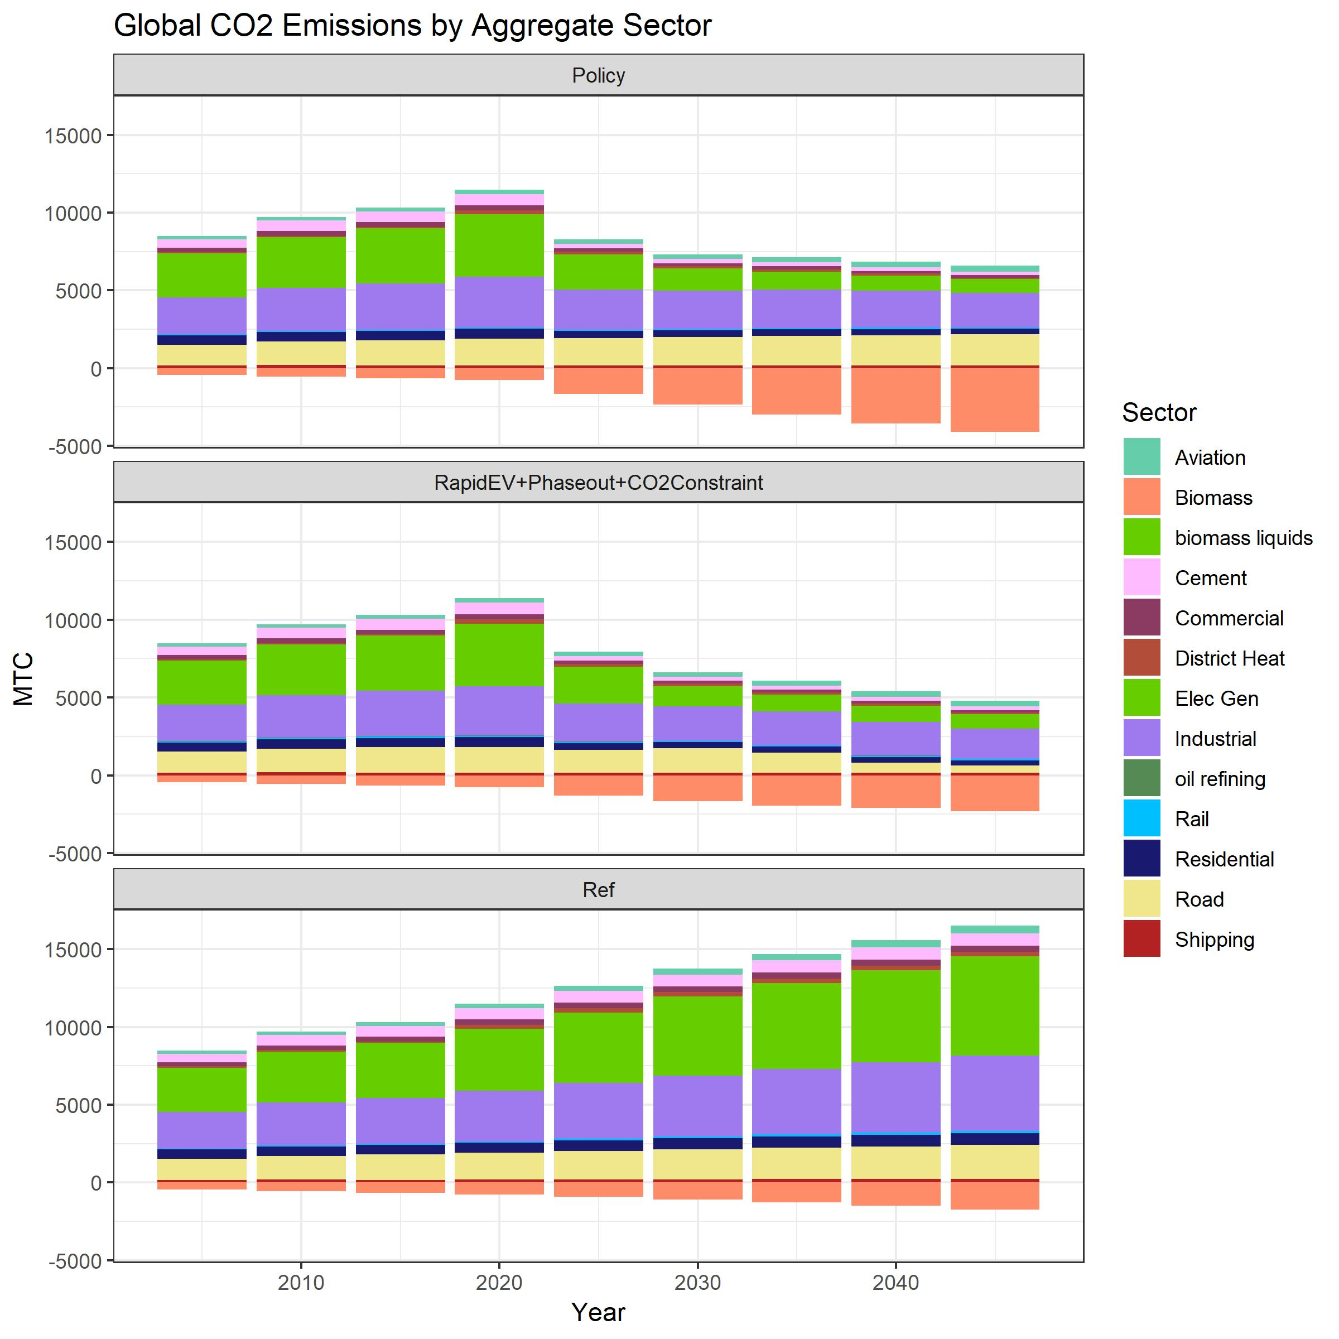
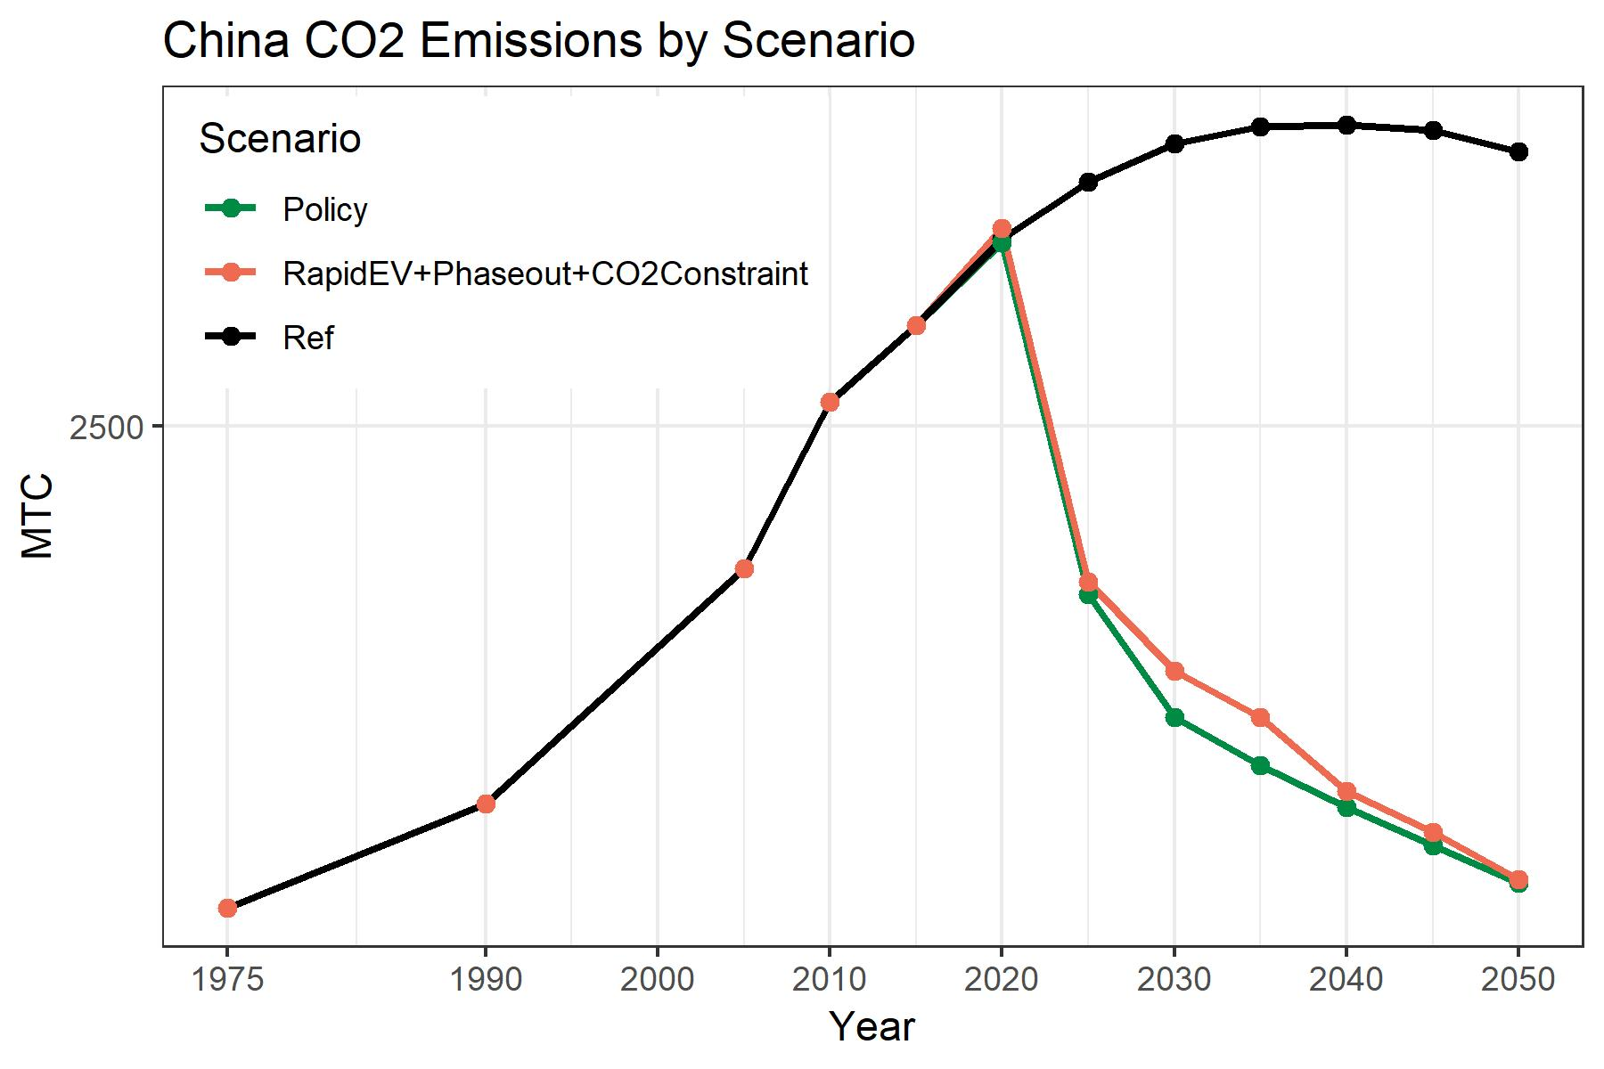
rgcam - Using Scenarios from Multiple Databases
When we rerun our rgcam script, our figures will now include three scenarios instead of two.

Slide 23
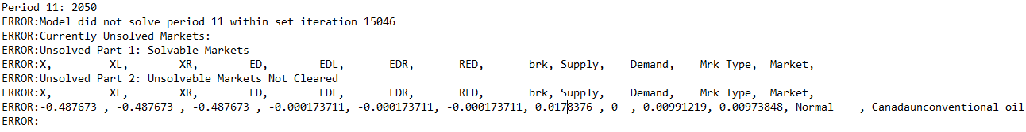


Common errors – model not solving
Solution errors occur when GCAM cannot find a set of prices where supply and demand are equal for all commodities.
Solution errors can be difficult to diagnose
One thing to try is to increase the iteration count in the solver configuration file (input/solution/cal_broyden_config.xml)
The default number of iterations per period is 2500; solution issues can sometimes be resolved by increasing this

Slide 24
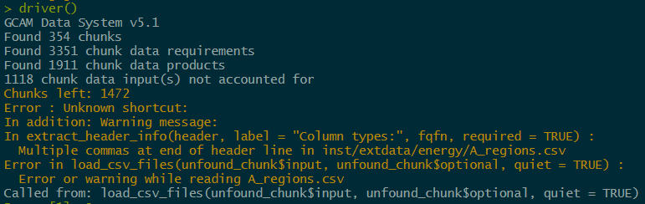
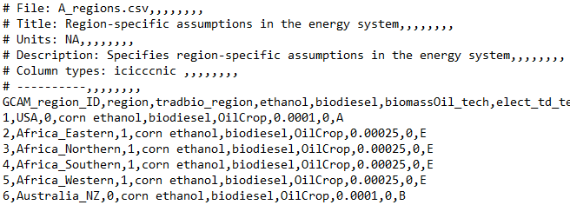






Common errors – trailing commas in csv files
When you edit a csv input file, there will be trailing commas in the header
These cause an error when you run the data system
To fix this, open the csv file with a text editor after making your changes, delete the commas in the header, and save the file
Delete these!

Slide 25
Resources for running GCAM and resolving errors
Ask on Slack, or search previous posts
Helpful channels: #gcam, #gcam-help, #gcam-data-system, #pic
Master list of JGCRI guides
https://docs.google.com/document/d/19AX4Rvdj3vW59ag9N4-4Wz3DYB0viTjLrjItEIa_WTE/edit#
GCAM overview and tutorial from 2019 Annual Meeting:
http://www.globalchange.umd.edu/data/annual-meetings/2019/GCAM_Overview-PM_20191106.pdf
http://www.globalchange.umd.edu/data/gcam/GCAM_tutorial_2019.pdf
GCAM documentation
http://jgcri.github.io/gcam-doc/
GCAM issues on GitHub
https://github.com/jgcri/gcam-core/issues
Ask a coworker

