Slide 1
GCAM Training 2 Walkthrough

Slide 2
Contents
Links & Pre-requisites
Installation
Folder structure
Inputs
Model run
Outputs

Slide 3
Links & Pre-requisites
Links
GCAM Official Documentation: http://jgcri.github.io/gcam-doc/
GCAM User Guide: http://jgcri.github.io/gcam-doc/user-guide.html
GCAM github page: https://github.com/JGCRI/gcam-core
GCAM datasystem R package: https://github.com/JGCRI/gcamdata
ModelInterface: https://github.com/JGCRI/modelinterface
Webinar 1 Link: https://register.gotowebinar.com/recording/2893695101765080835
Pre-requisites
8 GB RAM
Install Java 64 https://www.java.com/en/download/windows-64bit.jsp
Install R https://cran.r-project.org/ and R Studio https://www.rstudio.com
Install Windows XML Maker http://symbolclick.com/xmlmarker_1_1_setup.exe

Slide 4
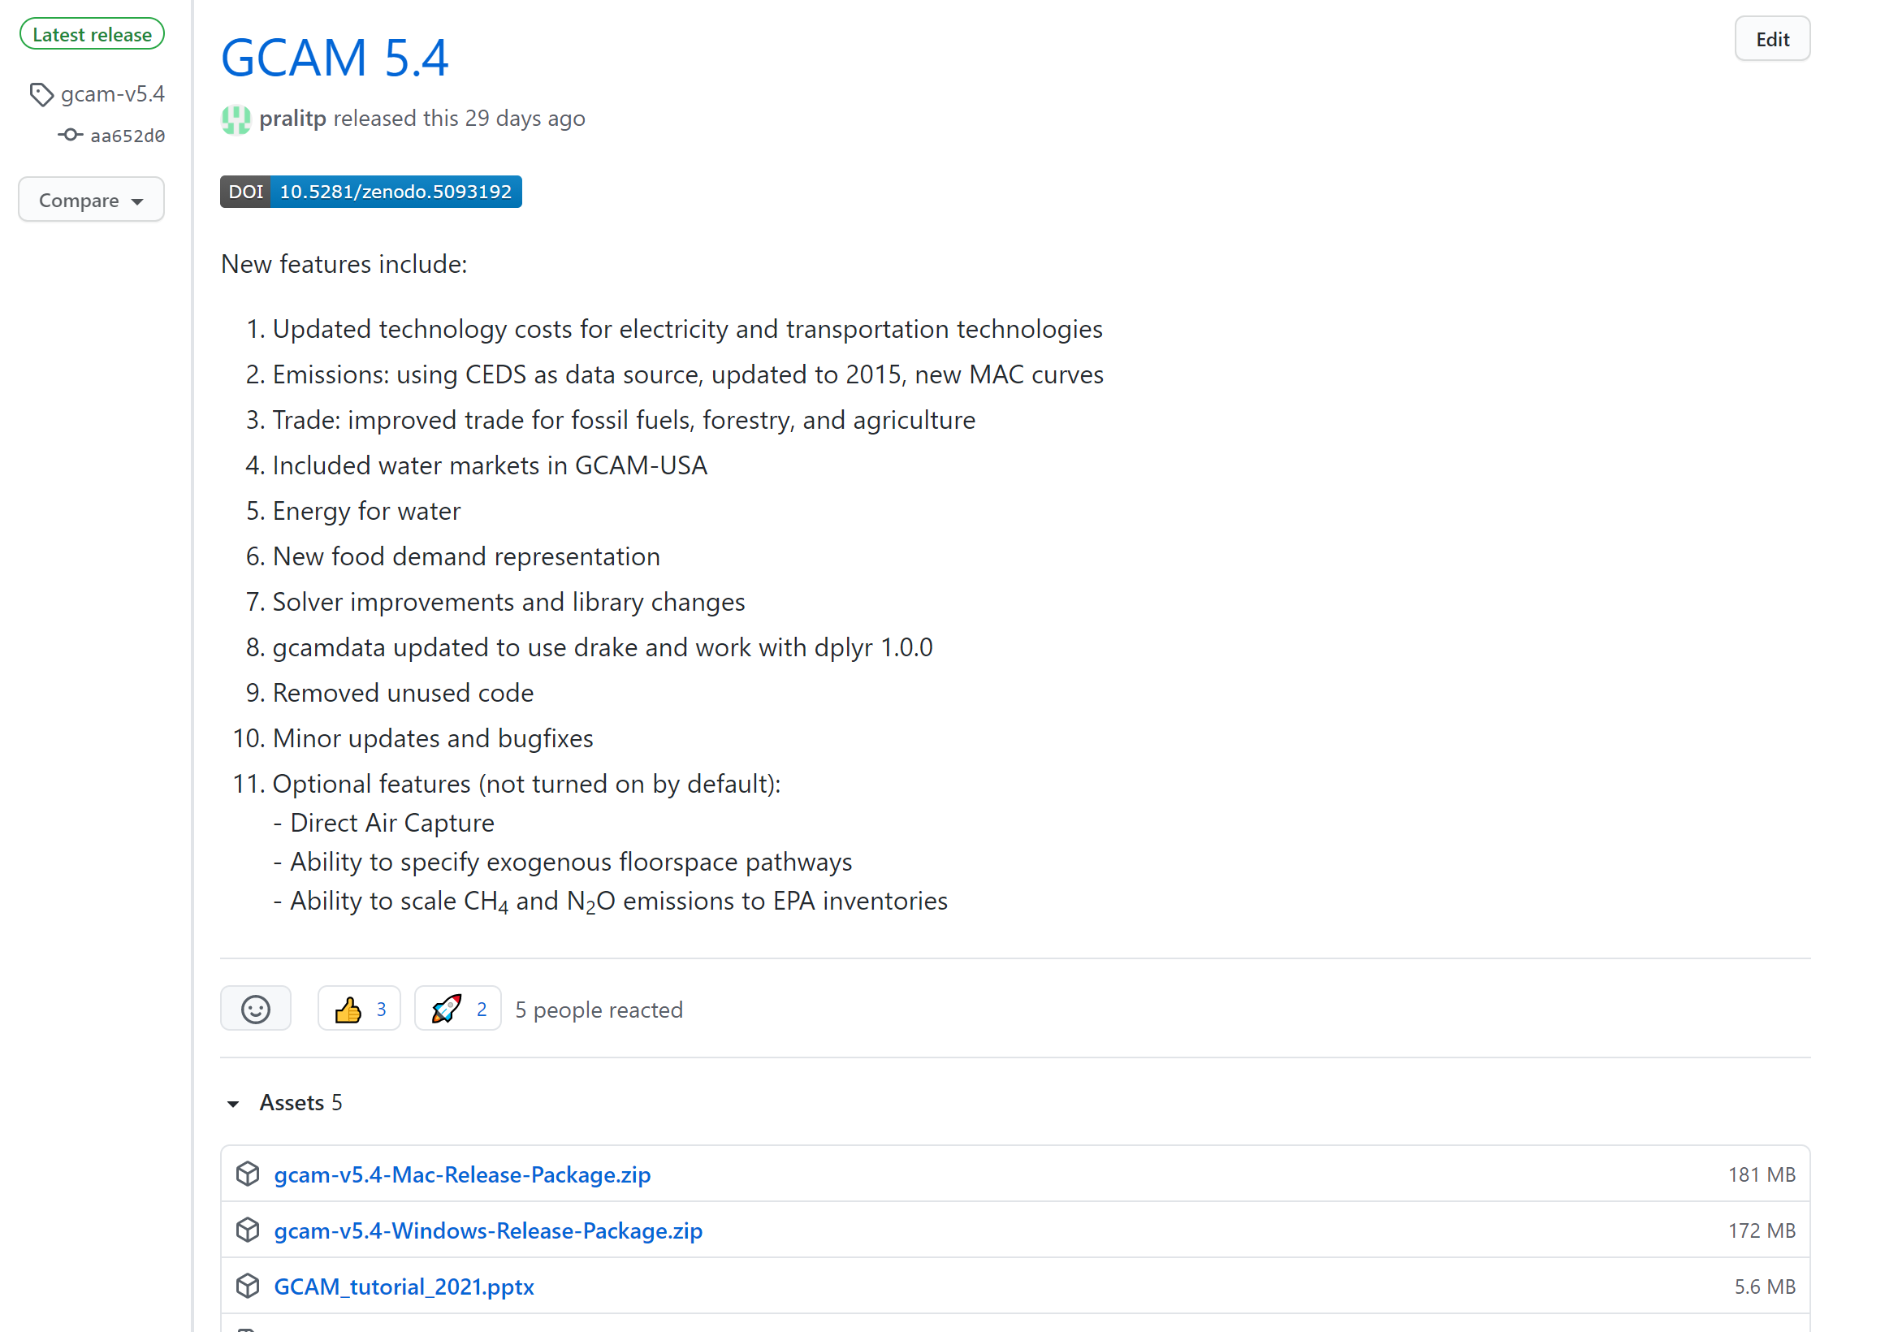
Installation
Unzip compiled version provided OR
Download release version: https://github.com/JGCRI/gcam-core/releases

Slide 5
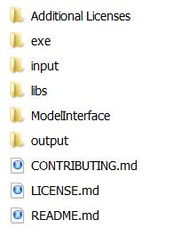
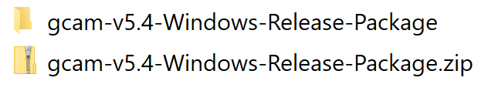
Folder Structure
Model executable and code
Download and unzip
Model input files
Result viewing software
Output Folder

Slide 6
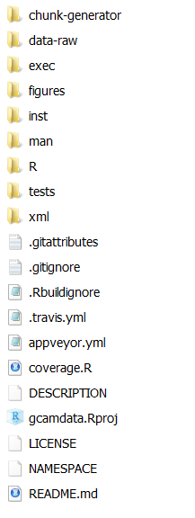
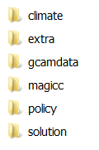

Input Files
Raw Input Files
Processing Code
Raw Input Data
xmls
GCAM data building
R package

Slide 7
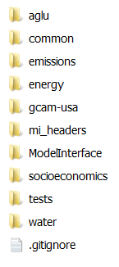
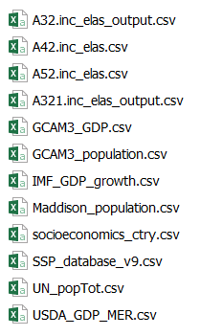

Input Files R data system (Raw Input Data)
https://github.com/JGCRI/gcamdata
./gcamFolder/input/gcamdata
Raw Input Data
> 300 files

Slide 8
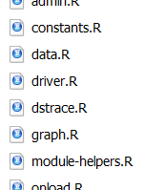
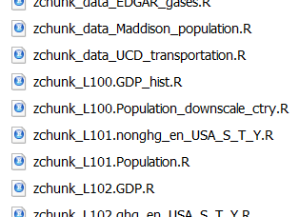
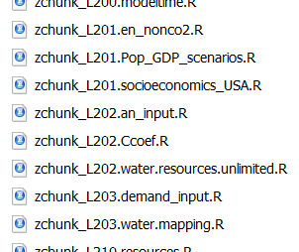
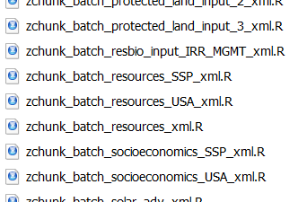
Input Files R data system (Data processing functions)
./gcamFolder/input/gcamdata
Constants
Assumptions
Level 1
Initial Processing
Level 2
Initial Processing
> 300 files
xml
processing

Slide 9
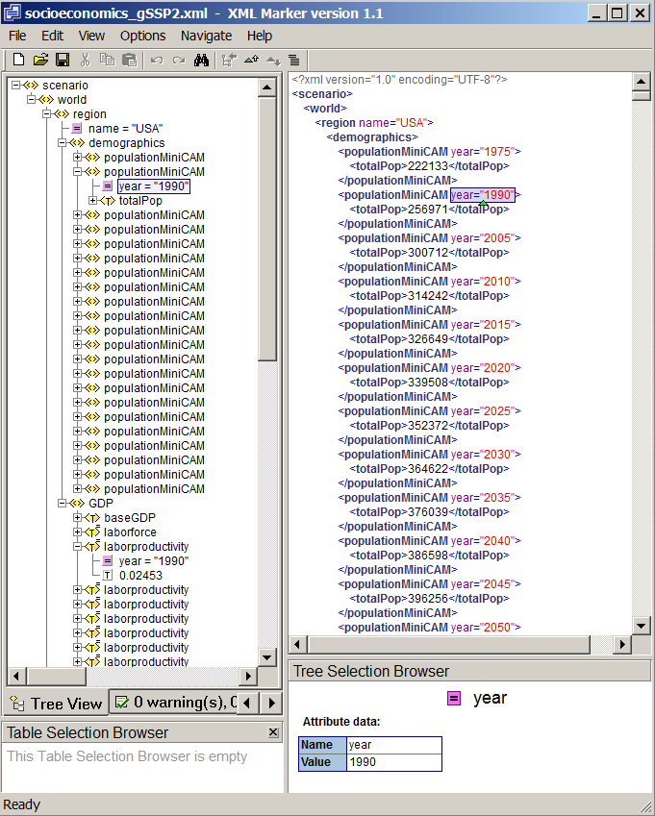
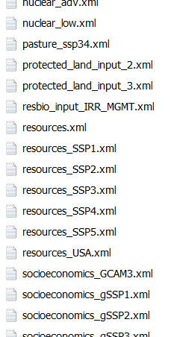
Input Files R data system (XMLs)
XML nested structure
./gcamFolder/input/gcamdata
Region
Parameter
Year
Value

Slide 10
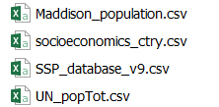


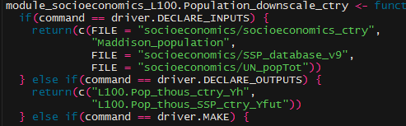
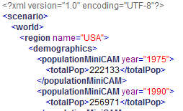
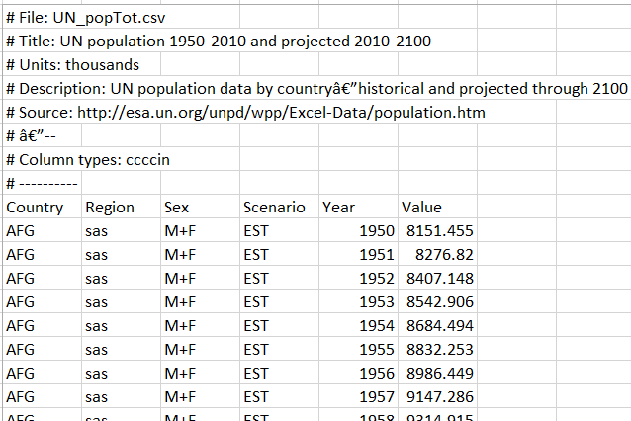

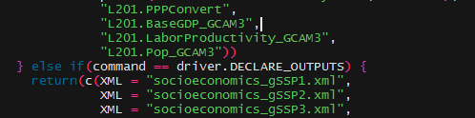
Input Files - Example Raw Data to XML
Raw Input Data
R processing
XML Generation
To GCAM
configuration.xml

Slide 11
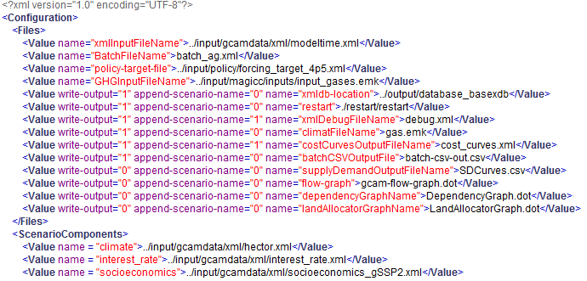
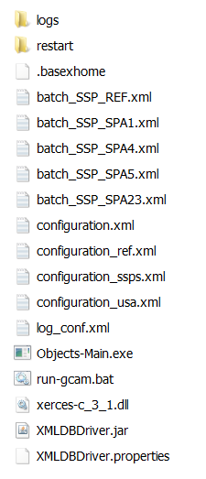
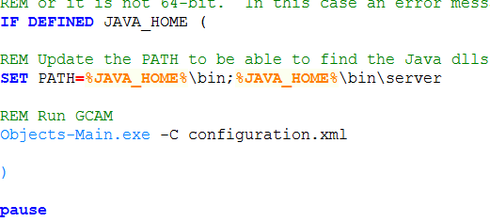
Model Run – exe folder
Configuration file
Run GCAM file

Slide 12
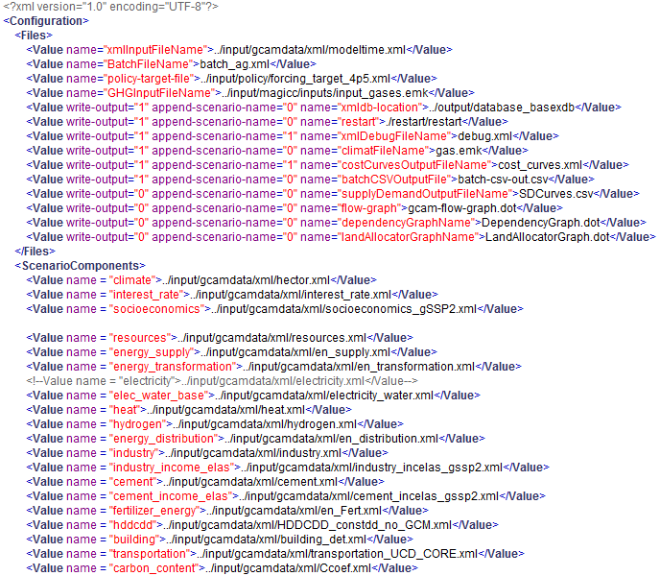
Model Run – configuration.xml
Setup Key
Model Inputs &
Options
XML Generation
configuration.xml
Output database location
Output database name
Input xml list
Scenario Name
BatchMode
Number of Periods
http://jgcri.github.io/gcam-doc/user-guide.html

Slide 13
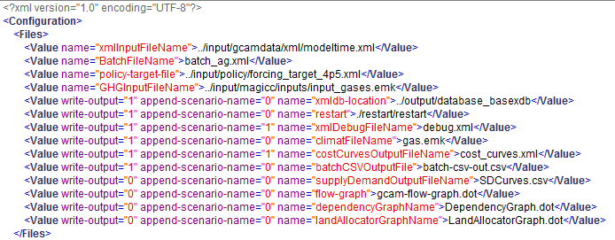
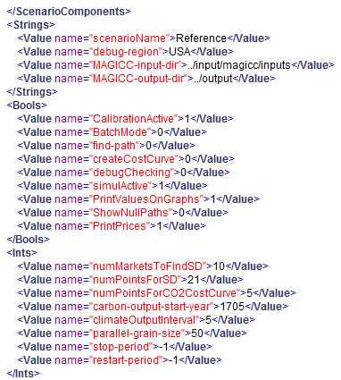
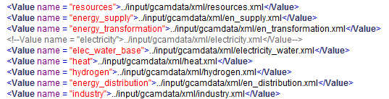
Model Run - Configuration
Output Database Name and Location
Scenario Options
Scenario Name
Batch Mode
Reference case .xml input files
Periods
-1 | All
1 | 1975
2 | 1990
3 | 2005
4 | 2010
5 | 2015
6 | 2020

Slide 14

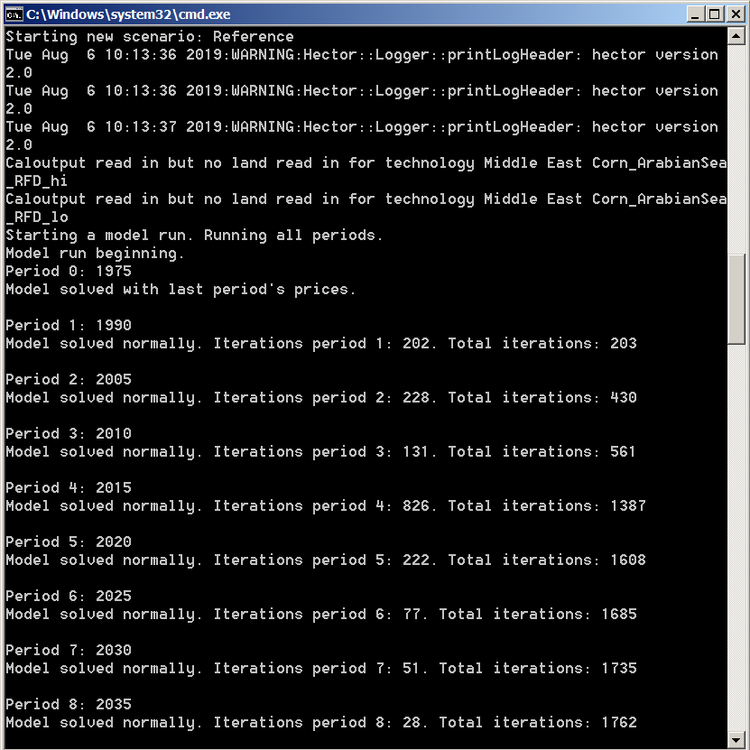
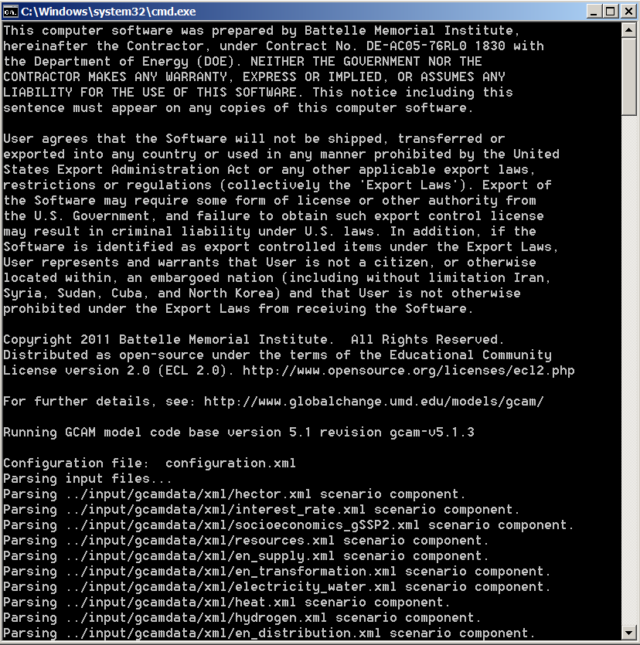
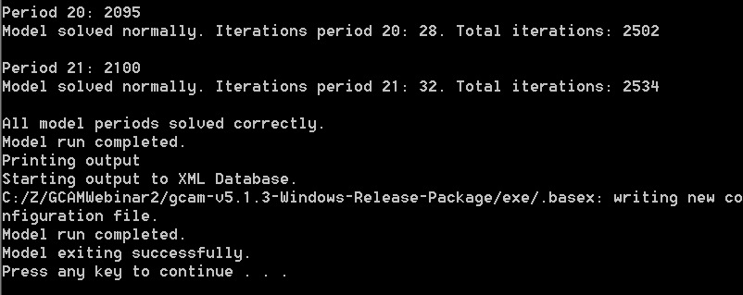
Model Run - Execution
Similar for
mac/linux/unix
OS systems
./gcamFolder/exe/

Slide 15
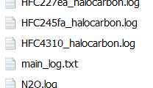
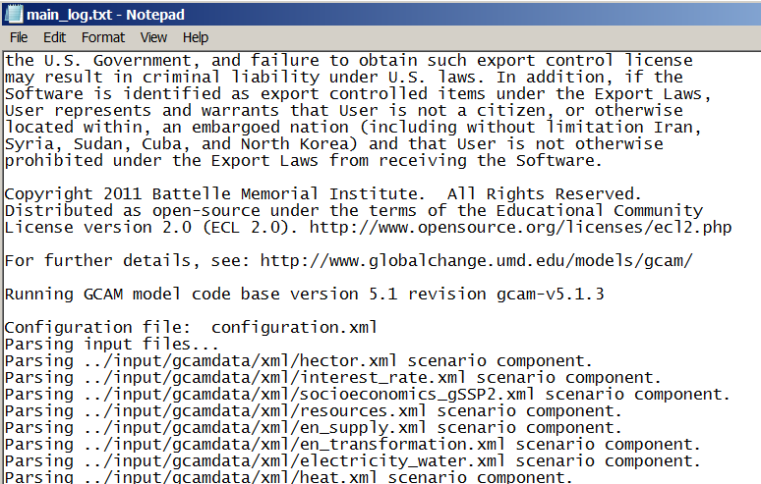
Model Run – Logs

Slide 16
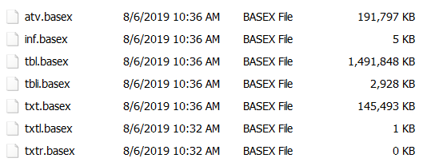
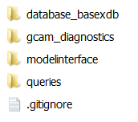

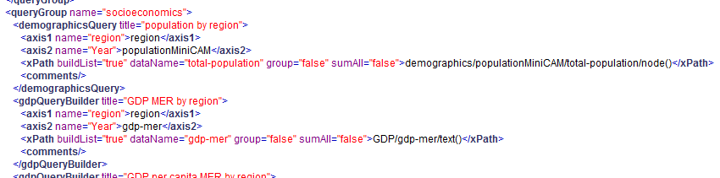
Outputs – Database/Queries

Slide 17
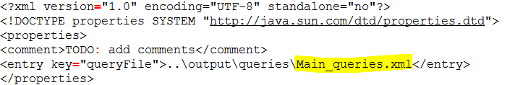
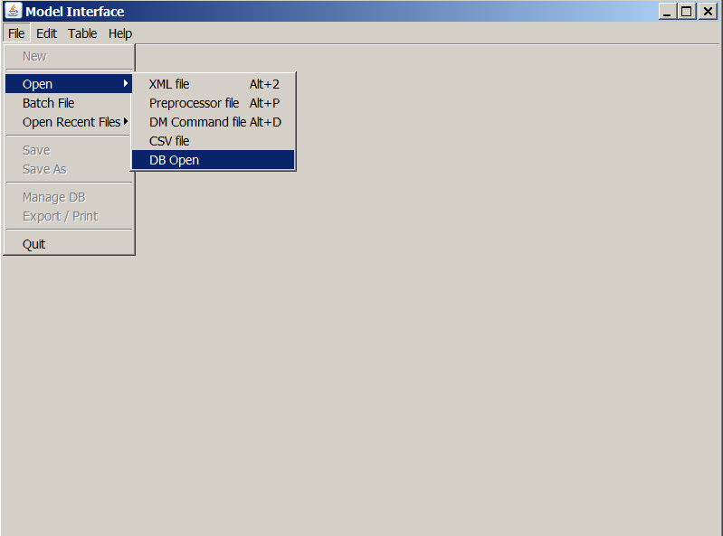

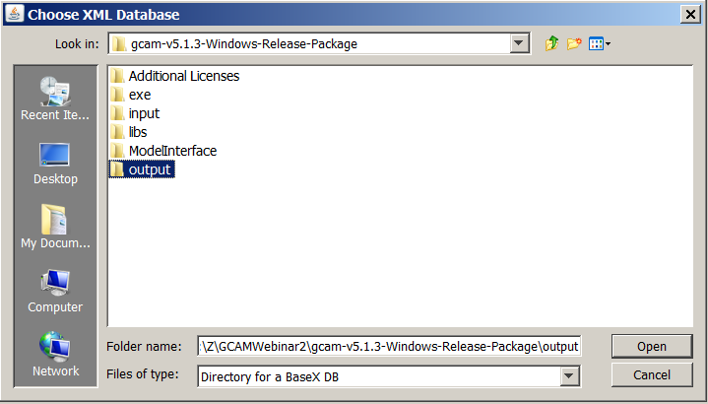
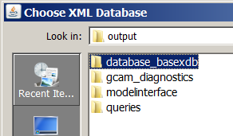
Outputs – Model Interface (View Results)

Slide 18
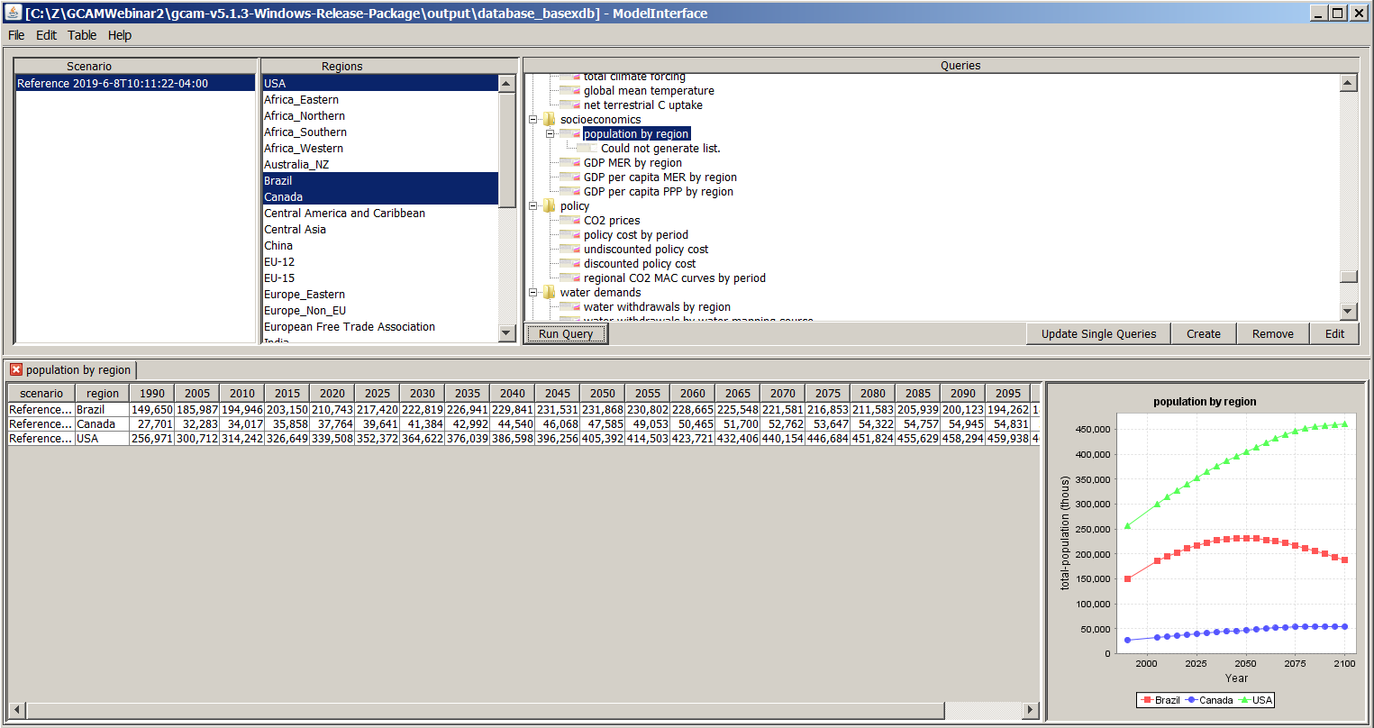
Outputs – Model Interface (View Results)
Scenario Name
Queries (Main_Queries.xml)
Regions
Query
Scenario name
Region
Periods
Charts

Slide 19
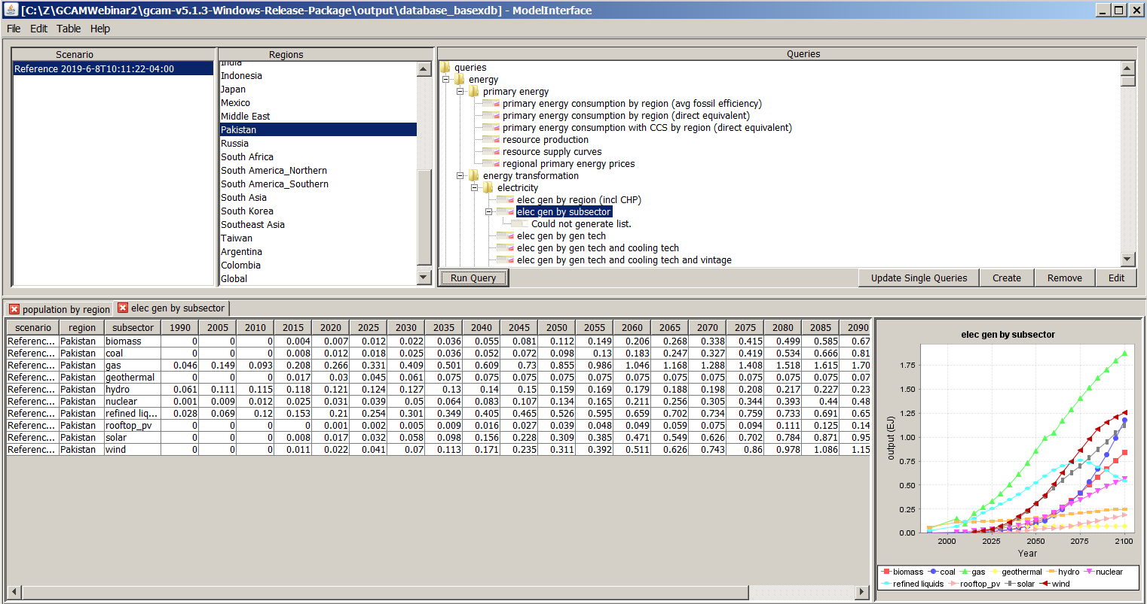
Outputs – Model Interface (View Results)
Scenario Name
Queries (Main_Queries.xml)
Regions
Queries
Scenario name
Region
Periods
Charts

Slide 20
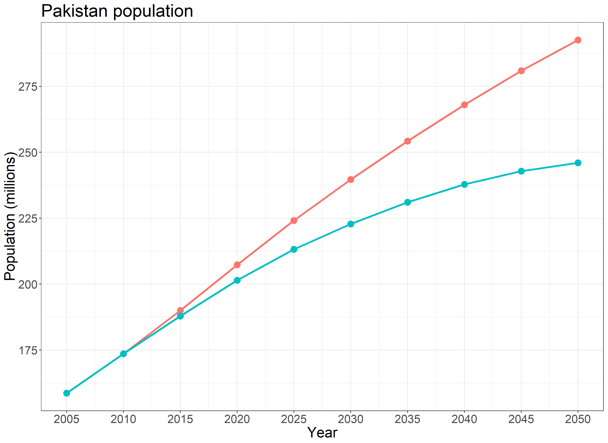
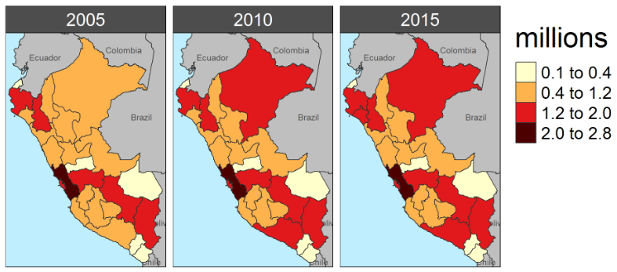

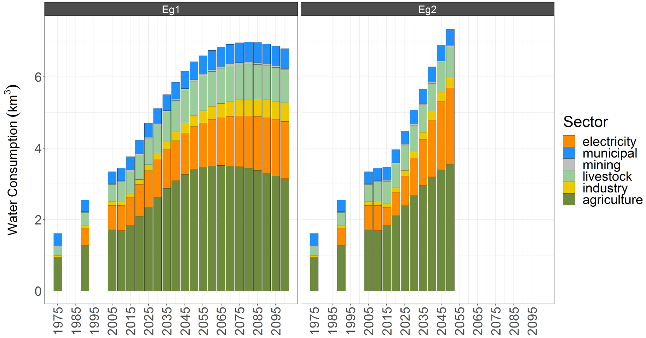
Final Result – Post Processing
Outputs are
post-processed
to get final figures

Slide 21

Summary
1. input: Raw Input Files, R datasystem
2. exe: configuration.xml, Model options, model run
3. output: logs and database
4. ModelInterface: view results

