Slide 1
GCAM Sectoral Modeling Overview
Neal Graham, Gokul Iyer, Xin Zhao
2025 GCAM Annual Meeting: Training Sessions
On Behalf of the PNNL GCAM Team
Notes:
Stock Image

Slide 2
Session Outline
GCAM (Global Change Analysis Model) Basics
Coverage, Modeling Approach, Uses and Interpretation
GCAM Energy Sectors
GCAM Agriculture and Land Use Sectors
GCAM Water Sectors

Slide 3
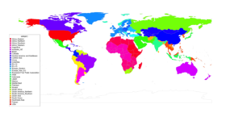

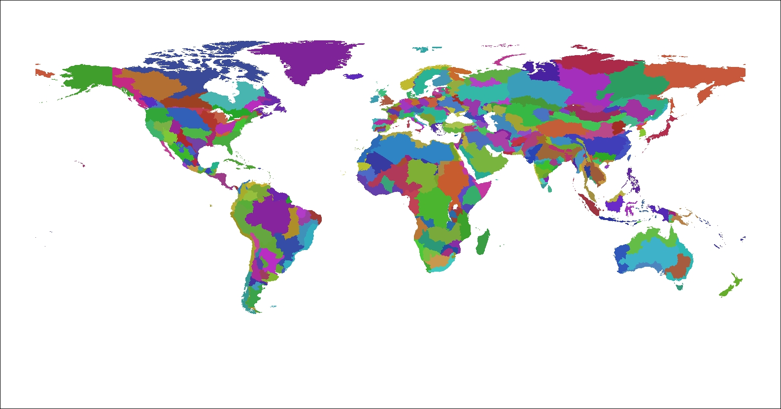
GCAM explores the interactions among multiple human and Earth systems
Global Coverage
32 Energy & Economy Regions
GCAM economically and physically links long-term (to year 2100) Energy, Agriculture, Land, Water, and CO₂ and other GHG Emissions and air pollutants.
GCAM incorporates PNNL’s Hector, a Reduced Complexity Earth System Model for computation of atmospheric concentration results.
235 Water Basins
391 Land Regions
32 Energy/Economic regions
391 Land regions based on water basins
GCAM-USA (50 State)

Slide 4
GCAM Scope and Coverage
Global Coverage
GCAM is a multisector, multi-regional, dynamic model that economically and physically links energy, agriculture and water production, consumption, and trade.
GCAM models dynamic demand growth in response to regional population and economic activity.
GCAM includes technology detail in energy production, transformation and final demand sectors.
GCAM includes physical representations of crop management practices in the agriculture sector.
Includes all commercial and natural lands in each land region.
GCAM includes dynamic economic modeling of the water sector linked to energy and agriculture.
GCAM computes a detailed accounting of emissions of CO₂ and other important gases.
32 Energy & Economy Regions
235 Water Basins
391 Land Regions
32 Energy/Economic regions
391 Land regions based on water basins
GCAM-USA (50 State)

Slide 5
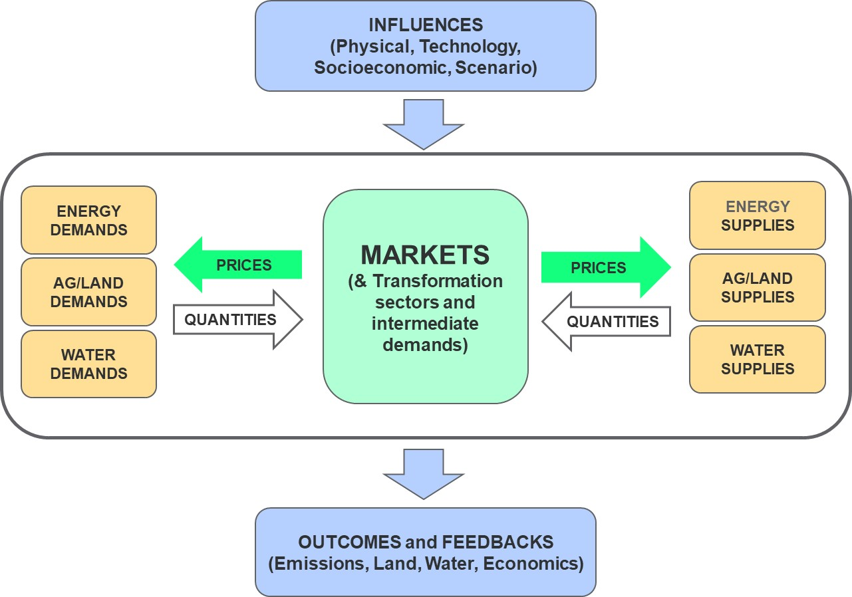
GCAM Modeling Approach: Economic Equilibrium with Physical Detail
GCAM solves each future period by finding the set of prices so that all modeled markets are “cleared.”
GCAM uses a recursive dynamic rather than an intertemporal optimal approach.
GCAM’s non-linear system of equations is solved by finding the set of prices so that all supplies equal all demands.
Economic equilibrium in GCAM means that physical quantities of the sectors it covers are balanced and allocated economically efficiently.
Prices are the signals by which the multiple sectors communicate scarcity and demands and dynamically respond to each other.

Slide 6
Logit Choice Mechanism for Economic Decisions
Logit approach assumes a distribution of realized costs/profits due to heterogeneous conditions.
Market share based on probability that a technology has the least cost.
Non-linear technology competition
Historical calibration influences future competition through the “share-weight” (α)
Exponent reflects a non-constant elasticity term
In general, GCAM production functions, supplies and demands, and markets are non-linear.
Increasing marginal costs.
Diminishing returns to scale.
Linear constraints are not needed to bound solution.
6

Slide 7
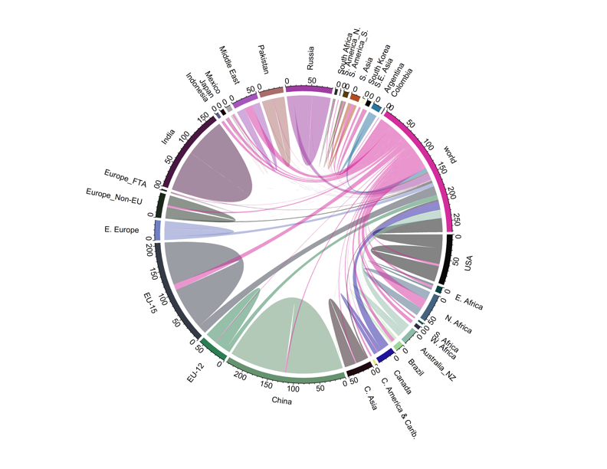
Regional Teleconnections and Economic Trade
Wheat in GCAM: Regional Markets with Global Trade
Trade and teleconnections are key to understanding dynamic impacts and outcomes: globally and in the US.
Critical to several research areas:
Trade in energy and important minerals,
Regional energy and food prices/access
GCAM now has trade capabilities on par with prominent trade models.
GCAM can parameterize the full range from simple global trade, detailed bilateral trade, regional trading blocs, to Zero trade.
Imports from World
Exports to World
Demand
Production

Slide 8
GCAM Results are a function of scenario input assumptions
Modeled Scenario
Population
Labor Productivity
Scenario Assumptions
Technology Characteristics
Model Equations, Relationships, and Parameters
Population
Policies
Labor Productivity
Emissions
Technology Characteristics
Prices
Energy Supplies and Demands
Policies
Agricultural Production
Land Use
Concentrations and Temperature

Slide 9
GCAM Results are a function of scenario input assumptions
Design Philosophy – flexible, data-driven modeling so that the input assumptions and parameters are open to users and can generate very different scenario results.
This is an obvious goal probably shared by all such models, but it is worth noting.
Example.
Based on varying assumptions about cost and resources for renewable, fossil, and nuclear power, generate very different scenarios of the future energy mix
To the extent possible, make important “constraints” and “drivers” based on user-controlled input assumptions rather than be subsumed into the model structure.
For example, assumptions about amount of land allowed for commercial expansion for agriculture and bioenergy production.
Or additional costs for integrating a higher share of variable renewable energy.
GCAM has an international user base and has been downloaded thousands of times.
GCAM has been used extensively by PNNL and collaborators in several countries such as India, Canada, China, Spain, Pakistan, and Colombia.

Slide 10
What’s inside the GCAM?

Slide 11
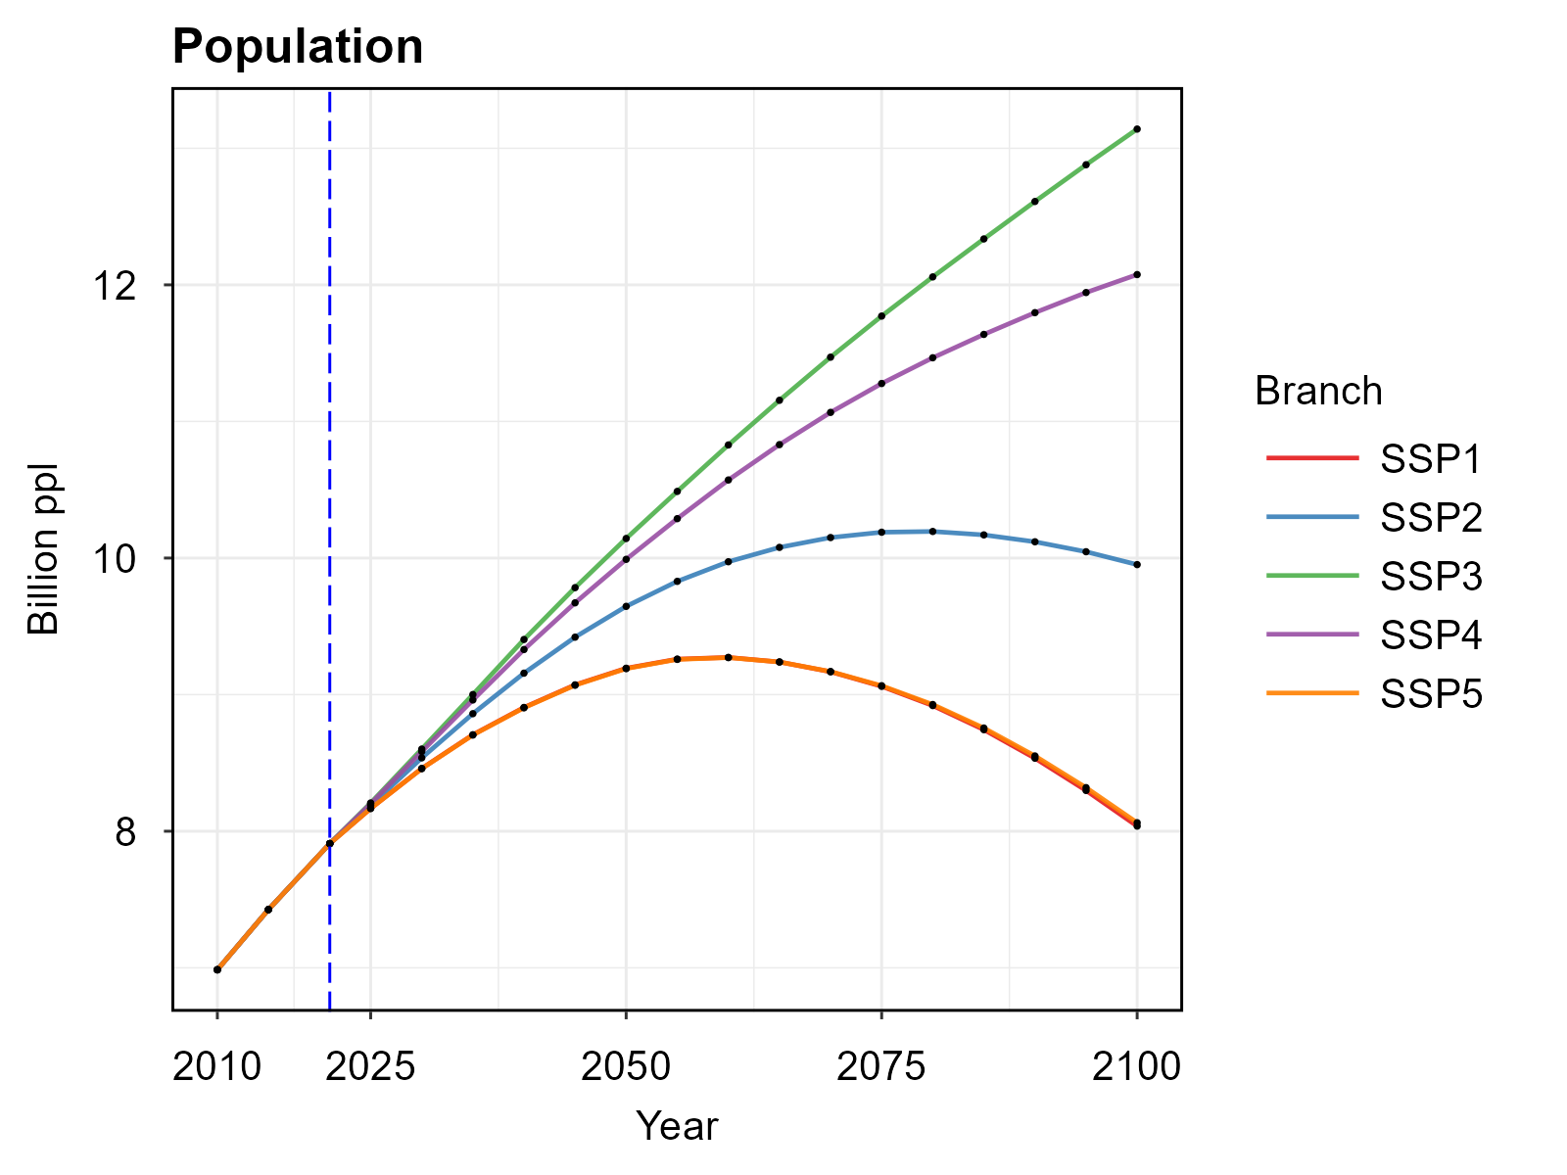
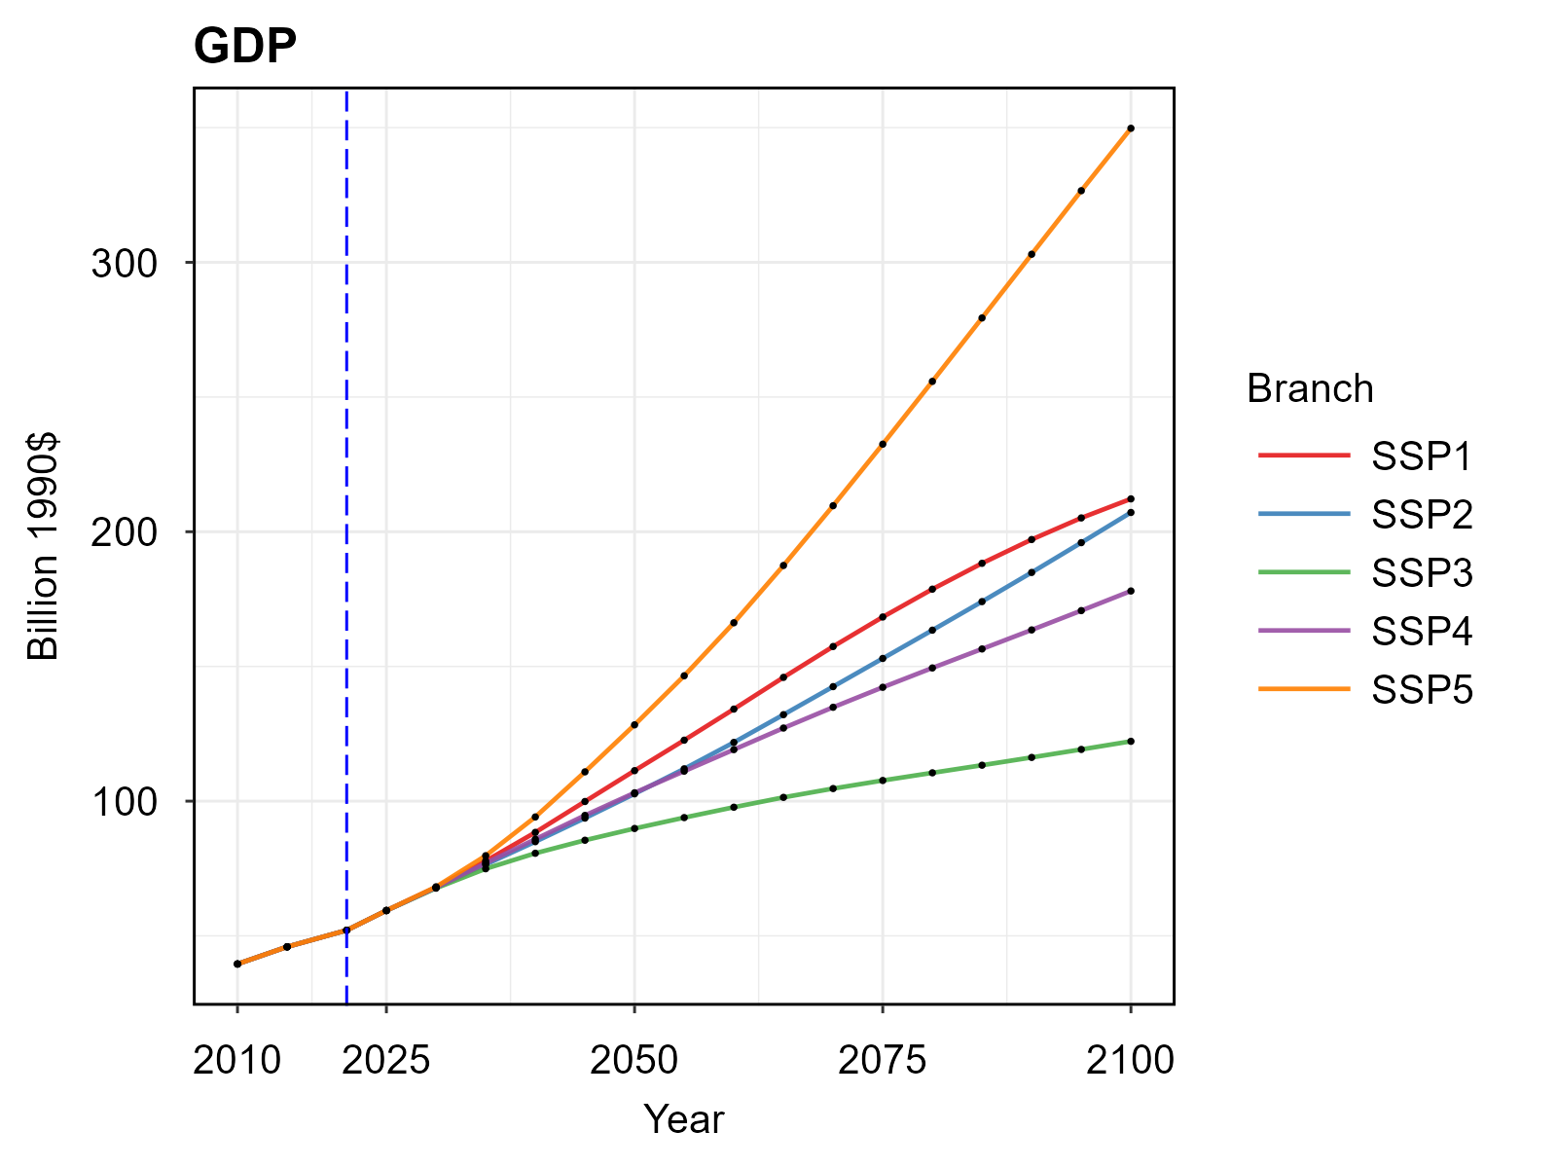
Socioeconomic drivers
2021
SSP3
2021
SSP5
SSP4
SSP2
SSP1
SSP4
SSP5
SSP3
SSP1
Population and GDP set the scale for the economy
Population, labor force, and GDP were recently updated to SSP database v3
Labor productivity and total factor productivity were calibrated to per capita GDP growth.

Slide 12
GCAM Energy Sector Modeling

Slide 13
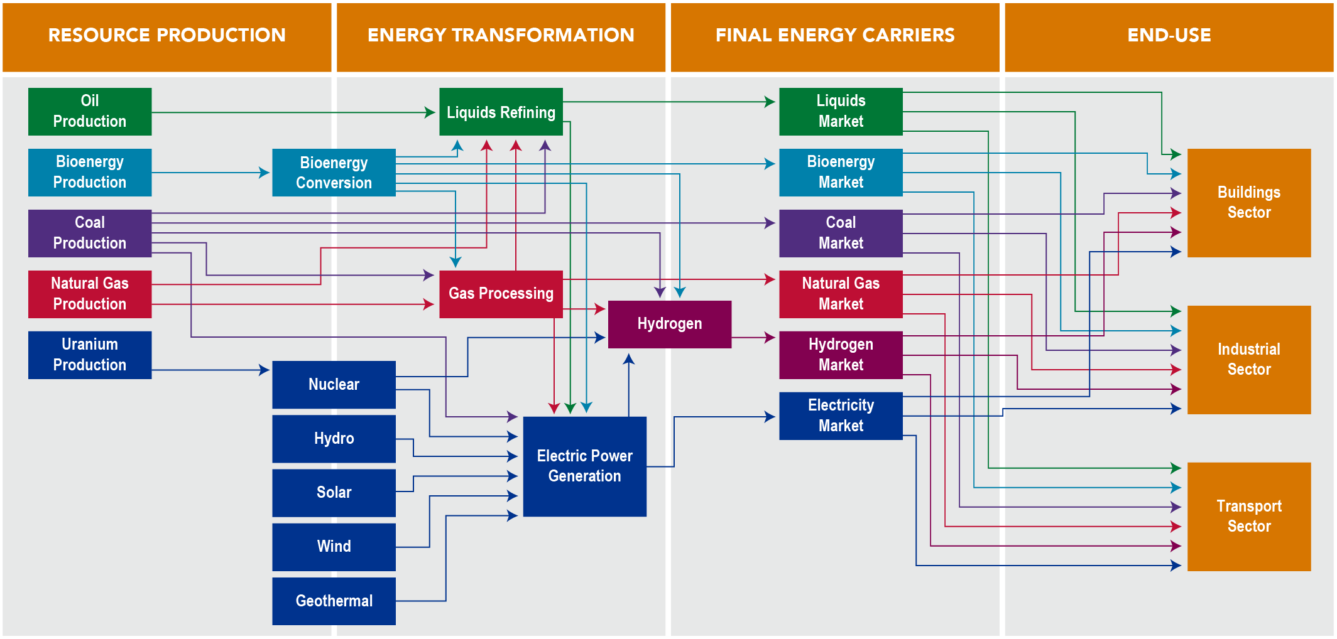
GCAM Energy System

Slide 14
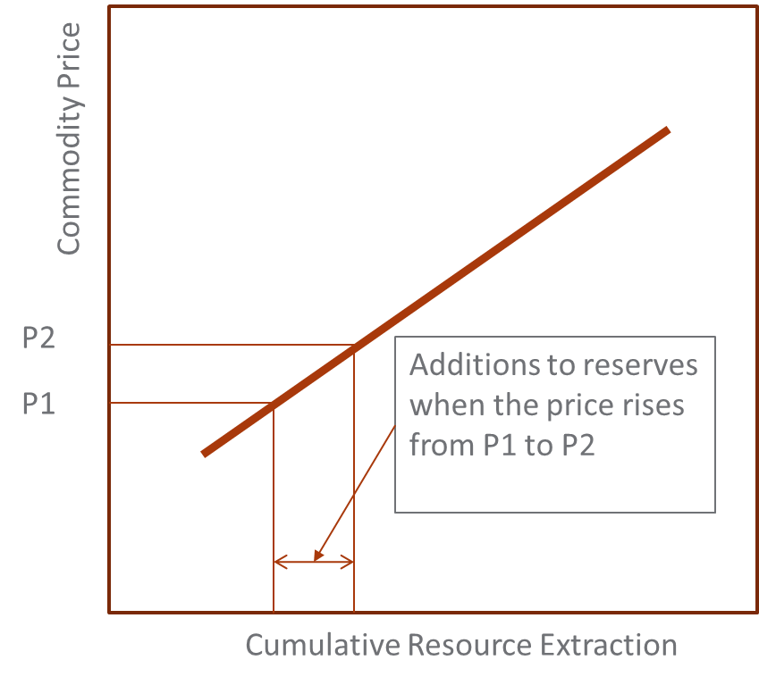
GCAM Fossil Resources: Resource-Reserve model
Production occurs out of reserves
Reserves are constantly being depleted and enhanced
Additions to reserves depends on the resource supply schedule
Resources are the ultimately available abundance in the Earth’s crust
GCAM assumes production of reserves to occur over a well / mine lifetime appropriate for each fuel
Technical change is applied to model decreasing extraction costs of the “resource” in future years

Slide 15
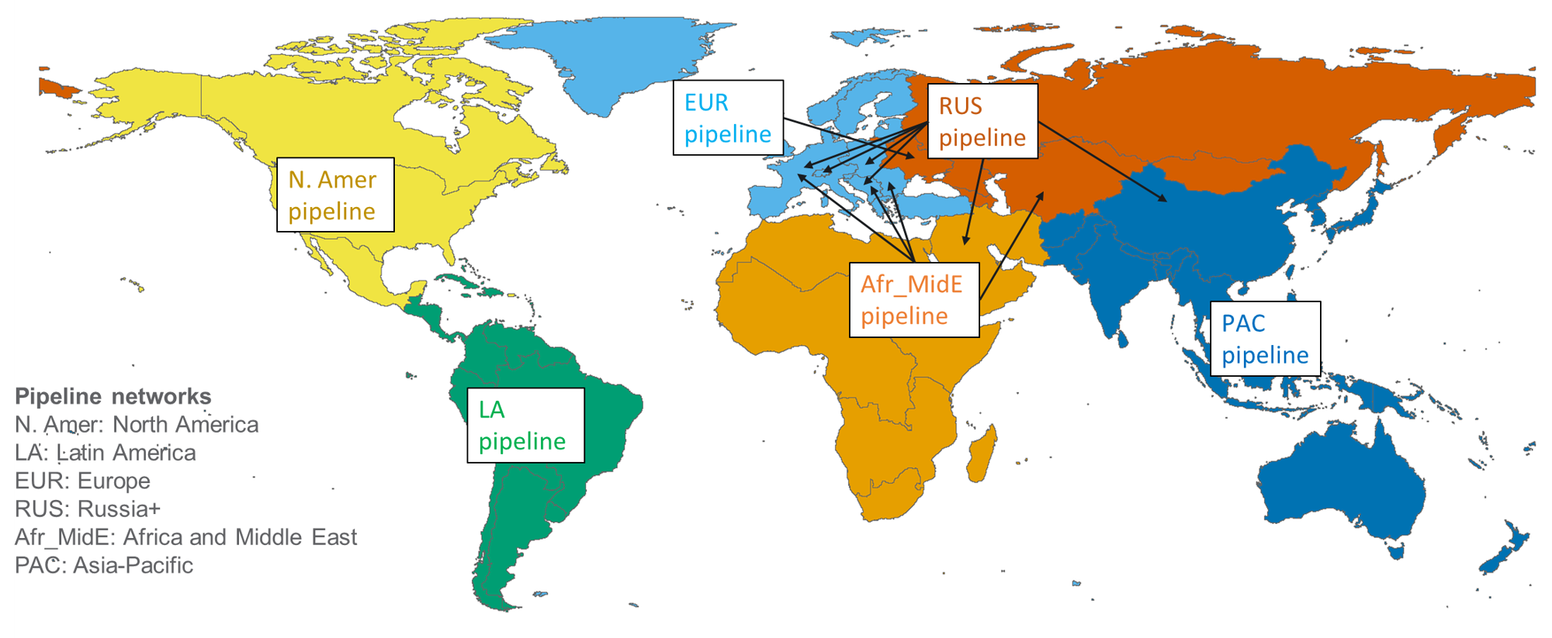
GCAM Natural Gas Pipeline and LNG Trade
Natural gas is traded via LNG (globally) and in 6 regional pipeline networks
Armington trade structure: gross exports and imports are distinguished
Other fossil fuels are traded globally using an Armington structure
Natural gas pipeline trade modeling in GCAM

Slide 16
GCAM Renewable Resources
GCAM’s renewable resources include onshore wind, offshore wind, solar, geothermal, hydropower, and biomass; some regions are also assigned a “traditional biomass” resource
Supply curves for onshore wind, offshore wind, and rooftop PV represent increasing costs as most efficient sites are used first
Solar PV and CSP are modeled as unlimited resources
Wind, PV, and CSP technologies include options with and without dedicated storage
The costs of producing electricity from renewable energy forms consist of the sum of resource costs described above, capital and O&M costs, and in some cases, intermittency costs

Slide 17
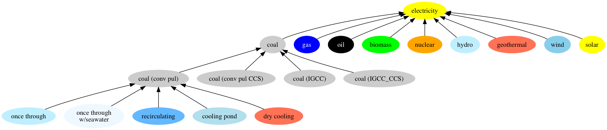
GCAM Electricity Generation
Power production depends on existing plants—run full lifetime as long as operating costs are covered
Natural and economic retirements are modeled
New capacity coming online is chosen based on levelized costs
Cost includes capital, fixed and variable O&M, resource/ fuel prices, and intermittency costs (for intermittent renewables w/o storage)
Multiple technology options, e.g. 4 types of coal plants, includes options w/ and w/o CCUS, different types of cooling systems
This is a partial schematic for illustrative purposes and may not represent all details

Slide 18
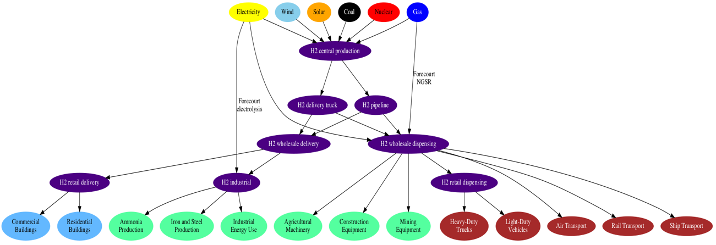
GCAM Hydrogen
GCAM includes endogenous representation of supply and demand of hydrogen (H2)
H2 can be produced through 10 “central” production technologies, as well as 2 “forecourt” (i.e. on-site) production technologies
Production might occur using coal, gas, and biomass include CCS options
GCAM also includes details on hydrogen transmission & distribution (including energy consumption & loss rates for different T&D modes)
This is a partial schematic for illustrative purposes and may not represent all details
Notes:
Overhaul the structural representation of distribution so as to better estimate the heterogeneous prices paid by various end-use purposes, which are largely a function of the temperatures and pressures at which hydrogen is transported and stored
Distinguish between pipeline-based distribution and liquid hydrogen truck-based distribution

Slide 19
GCAM Industrial Sector
GCAM Industry
Iron & Steel
Cement
Chemicals
Fertilizer
Aluminum
Construction
Mining
Energy Use
Agricultural Energy Use
Pulp and paper
Other industry includes machinery, textile and leather, other non-metallic minerals, and other non-ferrous metal.
Food processing
Other industry

Slide 20
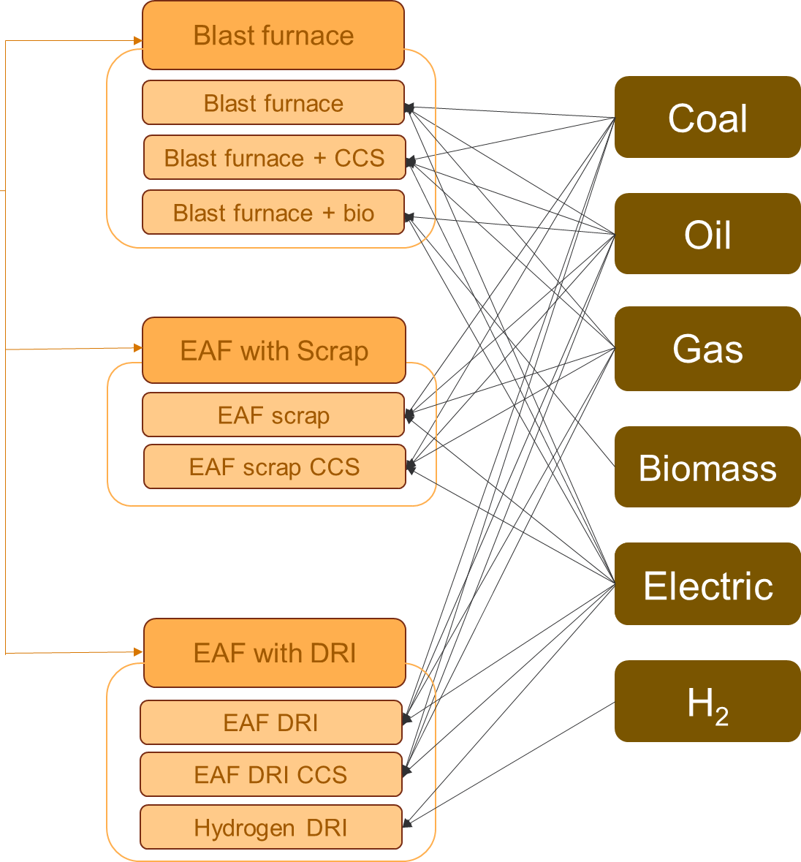
GCAM Iron and Steel Technologies
GCAM Industry
Iron & Steel
Cement
Chemicals
Fertilizer
Aluminum
Construction
Mining
Energy Use
Agricultural Energy Use
Pulp and paper
Food processing
Other industry

Slide 21
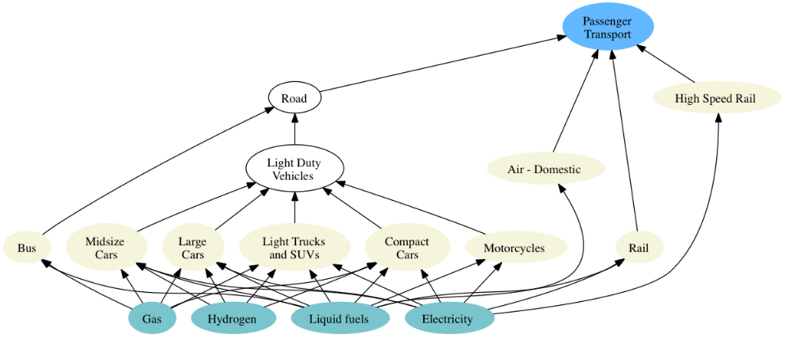
GCAM Transportation
The transportation sector in GCAM is subdivided into four final demands: long-distance passenger air travel, (other) passenger travel, international freight shipping, and (other) freight
The passenger sector includes competition across different modes (e.g., road, rail), sub-modes (e.g., bus, light duty vehicle), size classes, and drivetrain technologies
The choice among modes of transportation in the passenger sector is a function of the cost of travel, the time it takes, and income
The demand for transportation services (e.g., passenger-km, tonne-km) in a region is a function of per-capita GDP, income elasticity, service price, price elasticity, and population growth

Slide 22
GCAM Buildings
GCAM disaggregates the building sector into residential and commercial sectors
Residential floorspace and energy are further disaggregated by income deciles
GCAM models three aggregate services (heating, cooling, and other) in residential and commercial buildings
Each service includes different mix of fuels supplying energy
Demand for floorspace and energy satiate as income increases
Satiation level of building energy service demand per unit floorspace is a function of HDD/CDD, building shell conductance, floor-to-surface ratio of buildings, and internal gain heat from other building services

Slide 23
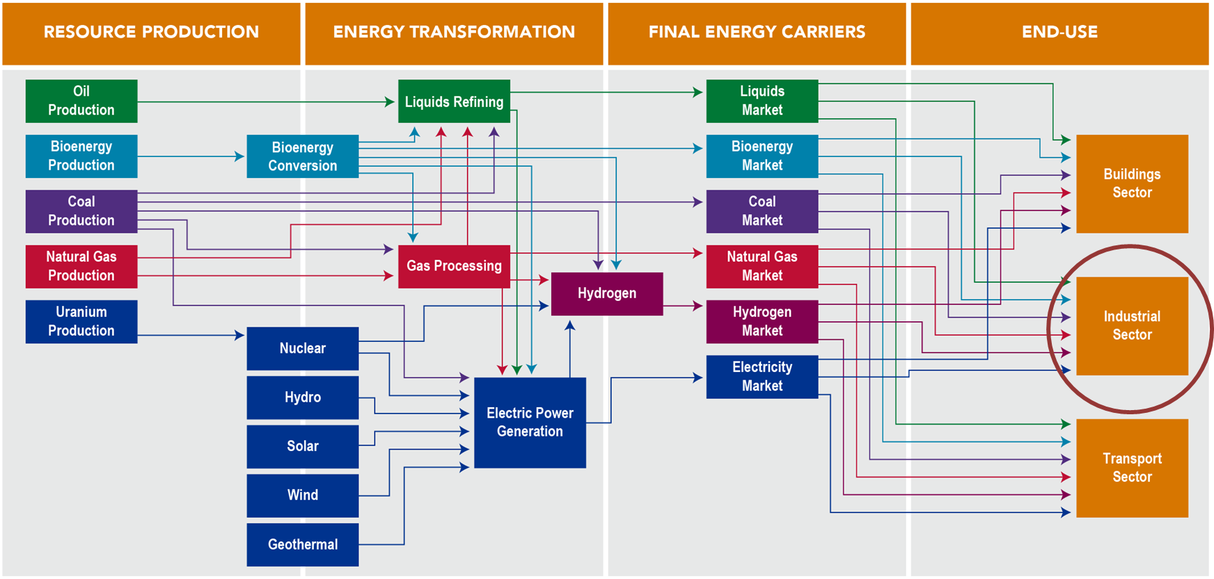
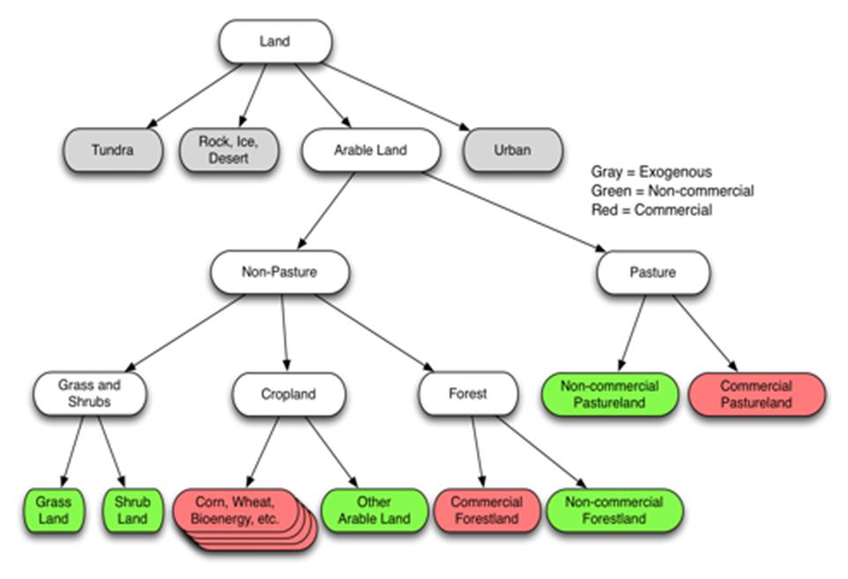
GCAM Integration of systems
Agriculture-Land-Use
Energy
Energy and agriculture-land-use systems are coupled in code:
Bioenergy
Pulp & Paper
Food Processing
Fertilizers

Slide 24
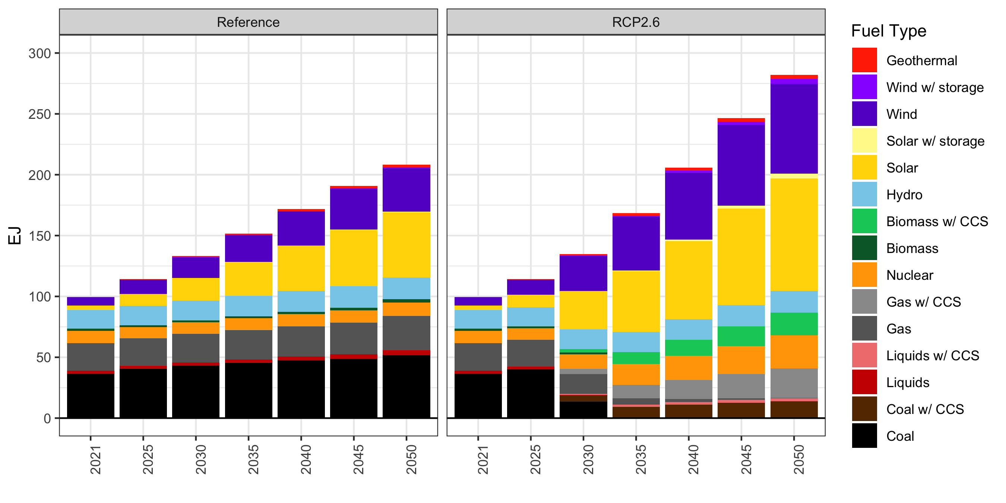
GCAM results from Reference: Electricity Generation

Slide 25
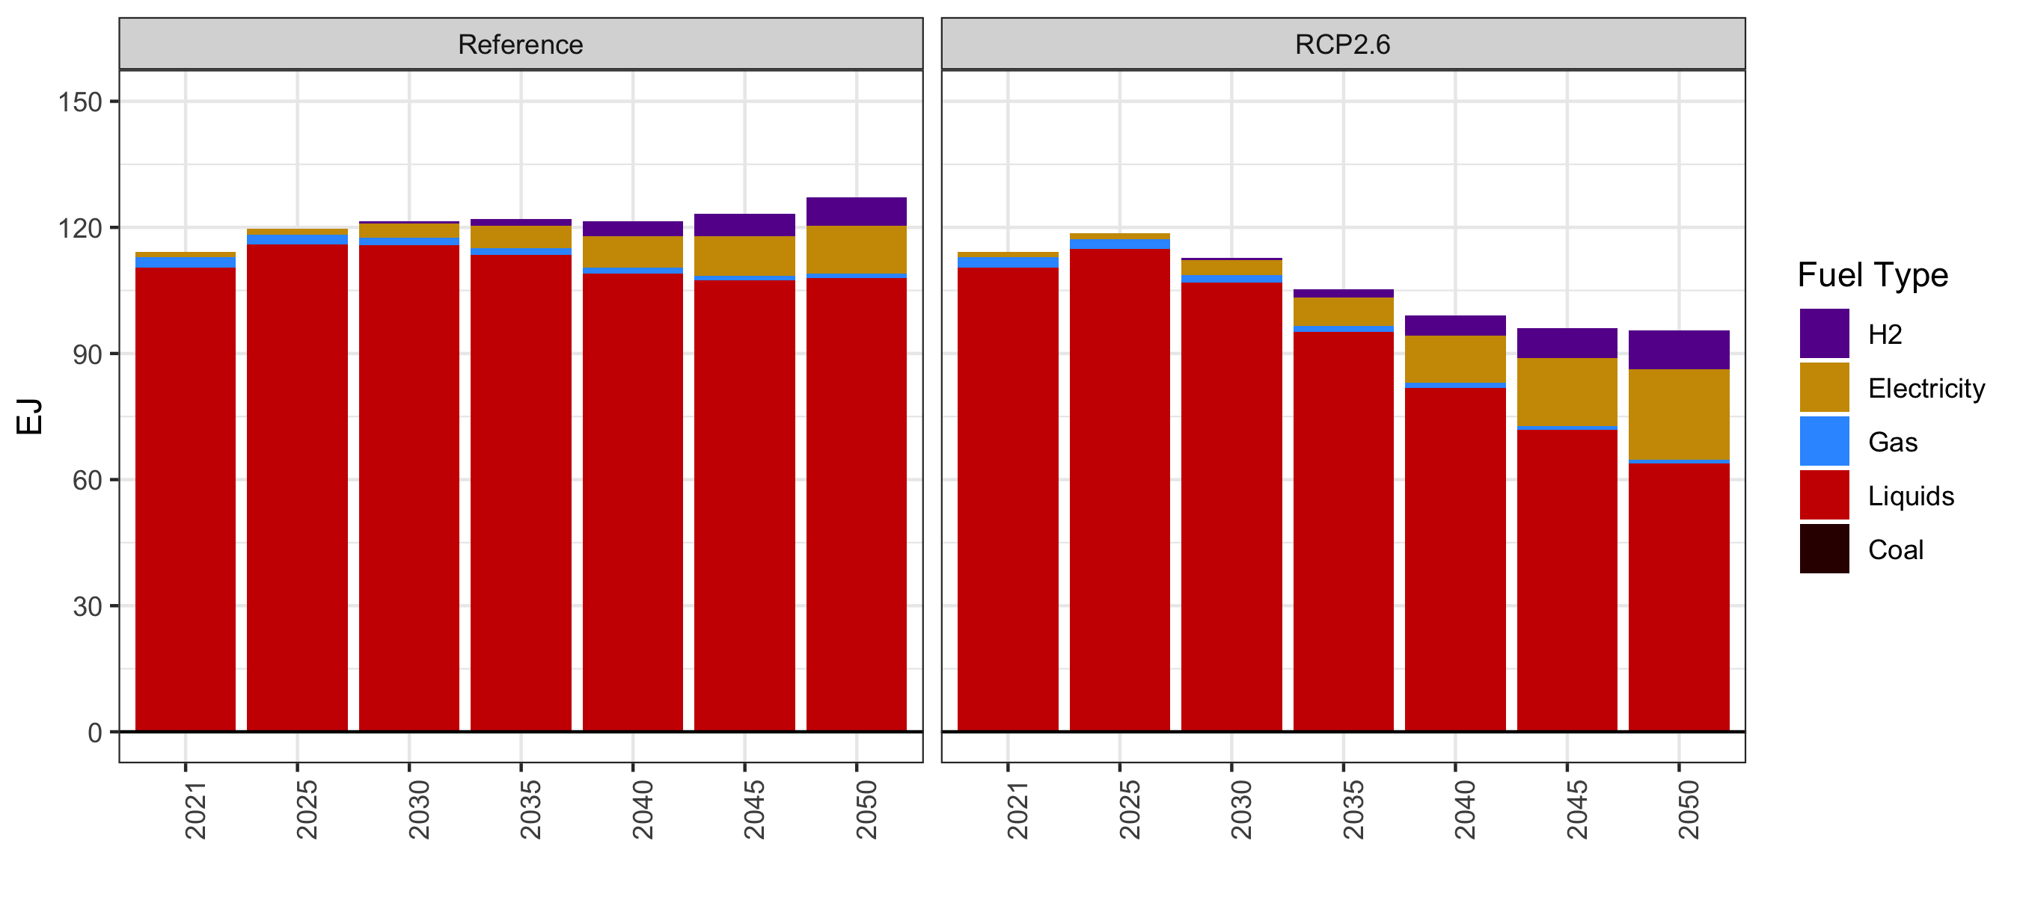
GCAM results from Reference: Transportation final energy

Slide 26
GCAM Agriculture and Land Use Modeling

Slide 27
GCAM Land Use Regions
GCAM has 384 land use regions (396 with Ukraine breakout), formed by the intersection of 32 geopolitical regions and 235 water basins.
A good balance among computational feasibility, data availability, and decision-making needs.
Demeter: downscale land use projections to grids (e.g., 0.05-degree)

Slide 28
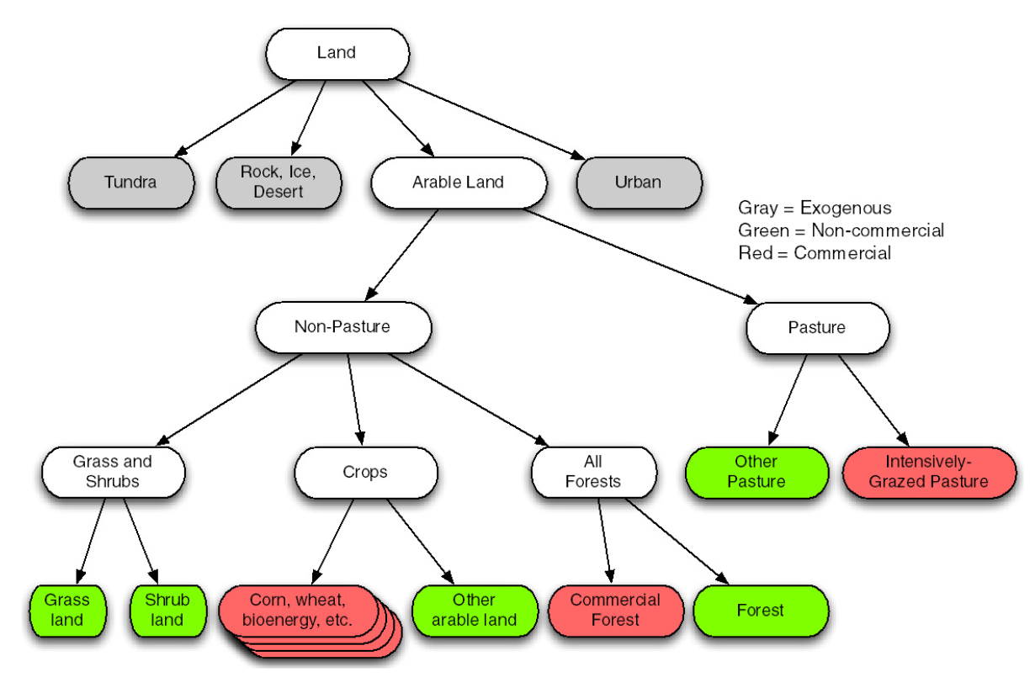
GCAM Land Use Categories (within each land use region)
All land cover and use, including all commercial land uses as well as non-commercial natural lands, are represented in GCAM.
~80 land types if including agricultural technologies
Calibrated to data in historical base years (moirai & gcamfaostat).
Economic responses
Nested logit structure
Explain how land is used differently
Future land competition
New land types
Purpose-grown energy crops
Wise et al. (2014)

Slide 29
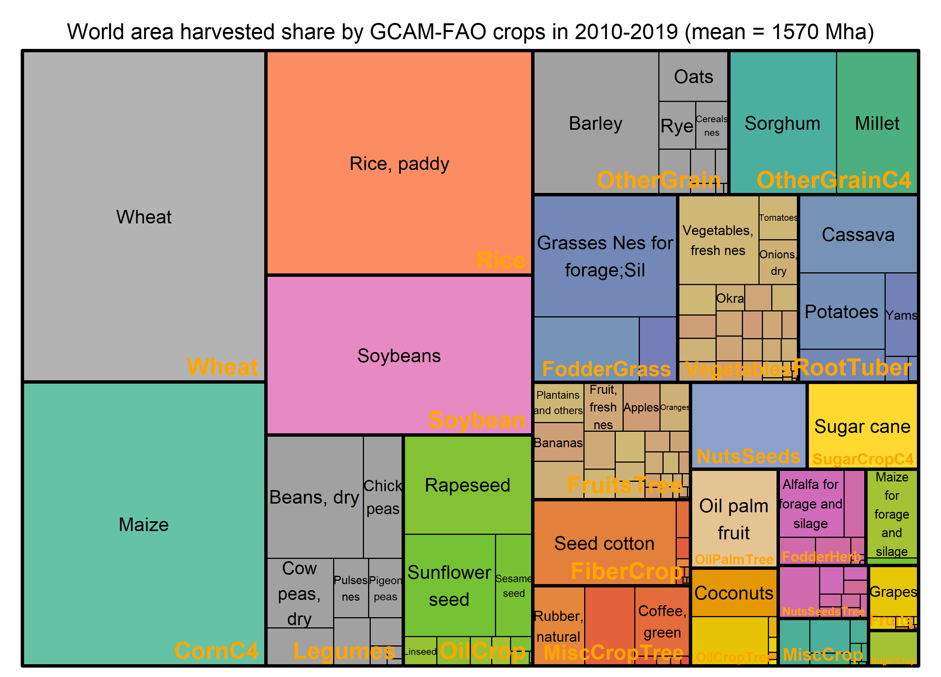
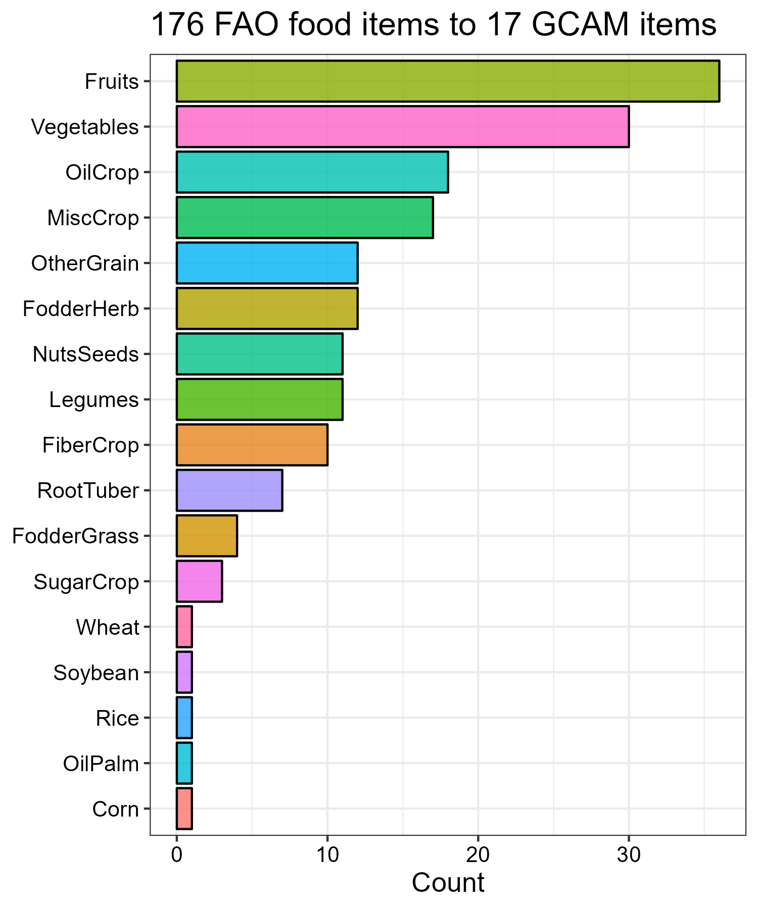
World harvested area
gcamfaostat; FAOSTAT

Slide 30
Economic Competition for Irrigation and Intensification
For each crop, we have competing practices, each with a different yield, cost, and base year allocation. (hi = higher tech)
Irrigated production demands and pays for water linked to GCAM water supply modeling in each region.
Changes in price or cost will alter the shares of each practice, enabling price-induced intensification.
Corn
Irrigated
Rainfed
Corn_IRR_Hi
Corn_IRR_
Lo
Corn_RFD_Hi
Corn_RFD_
Lo

Slide 31
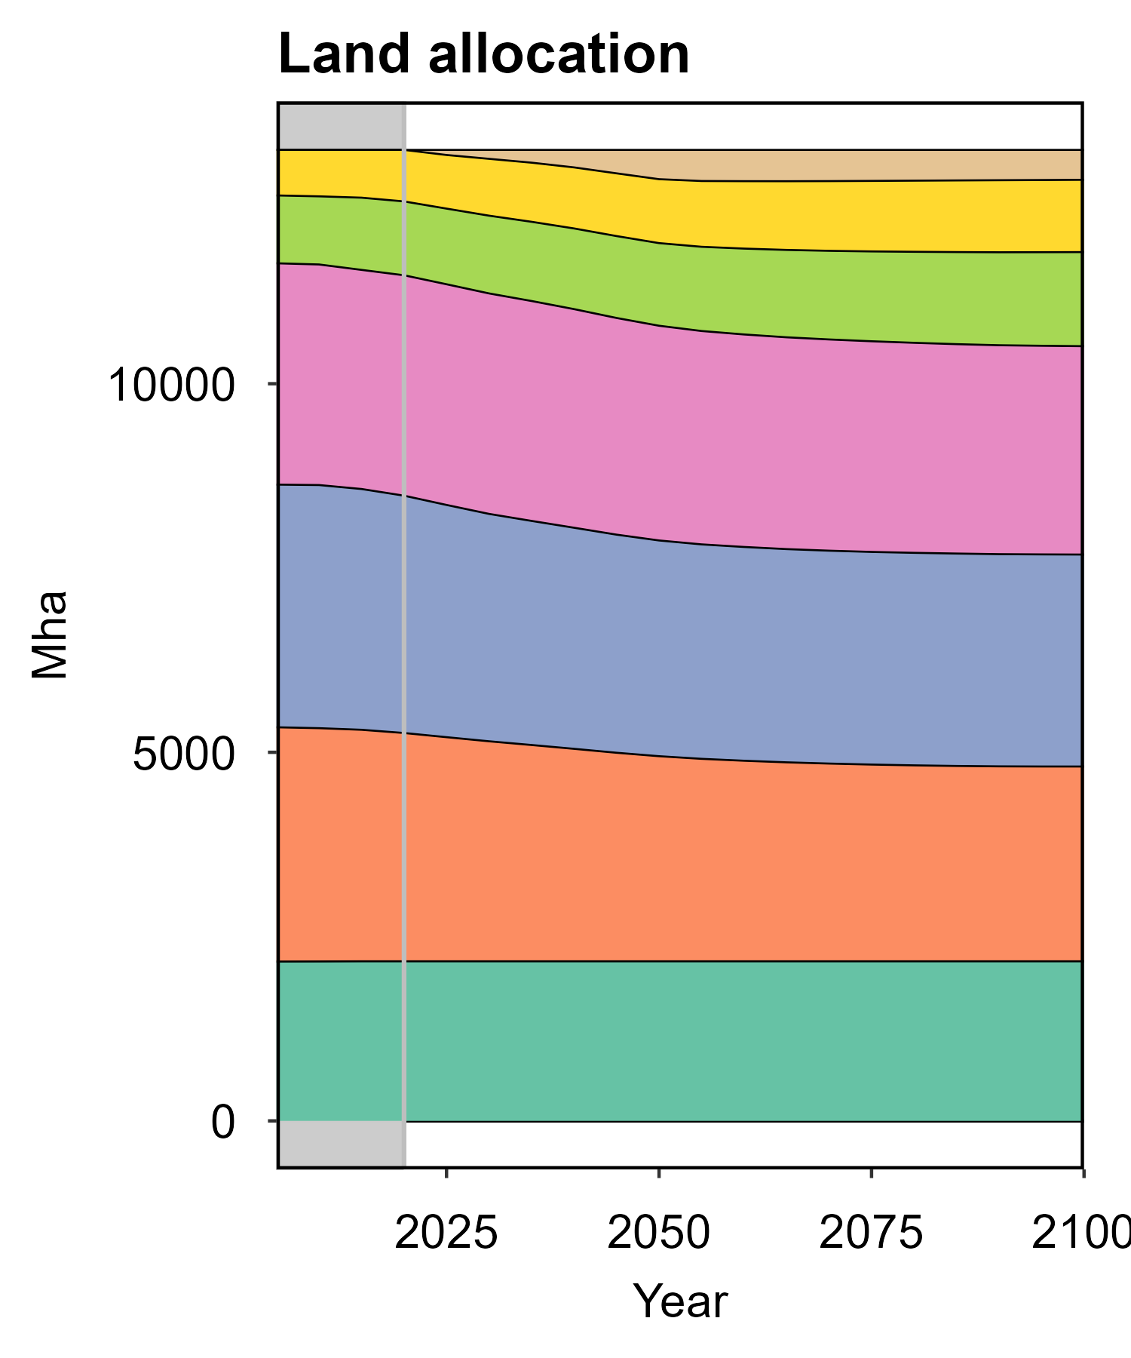
GCAM reference projections (by 2100) Land allocation
2020
Energy crops
Cropland
Staple crops
Non-staples
Forest
Pasture
Grass & Shrub
Others
Data source: GCAM

Slide 32
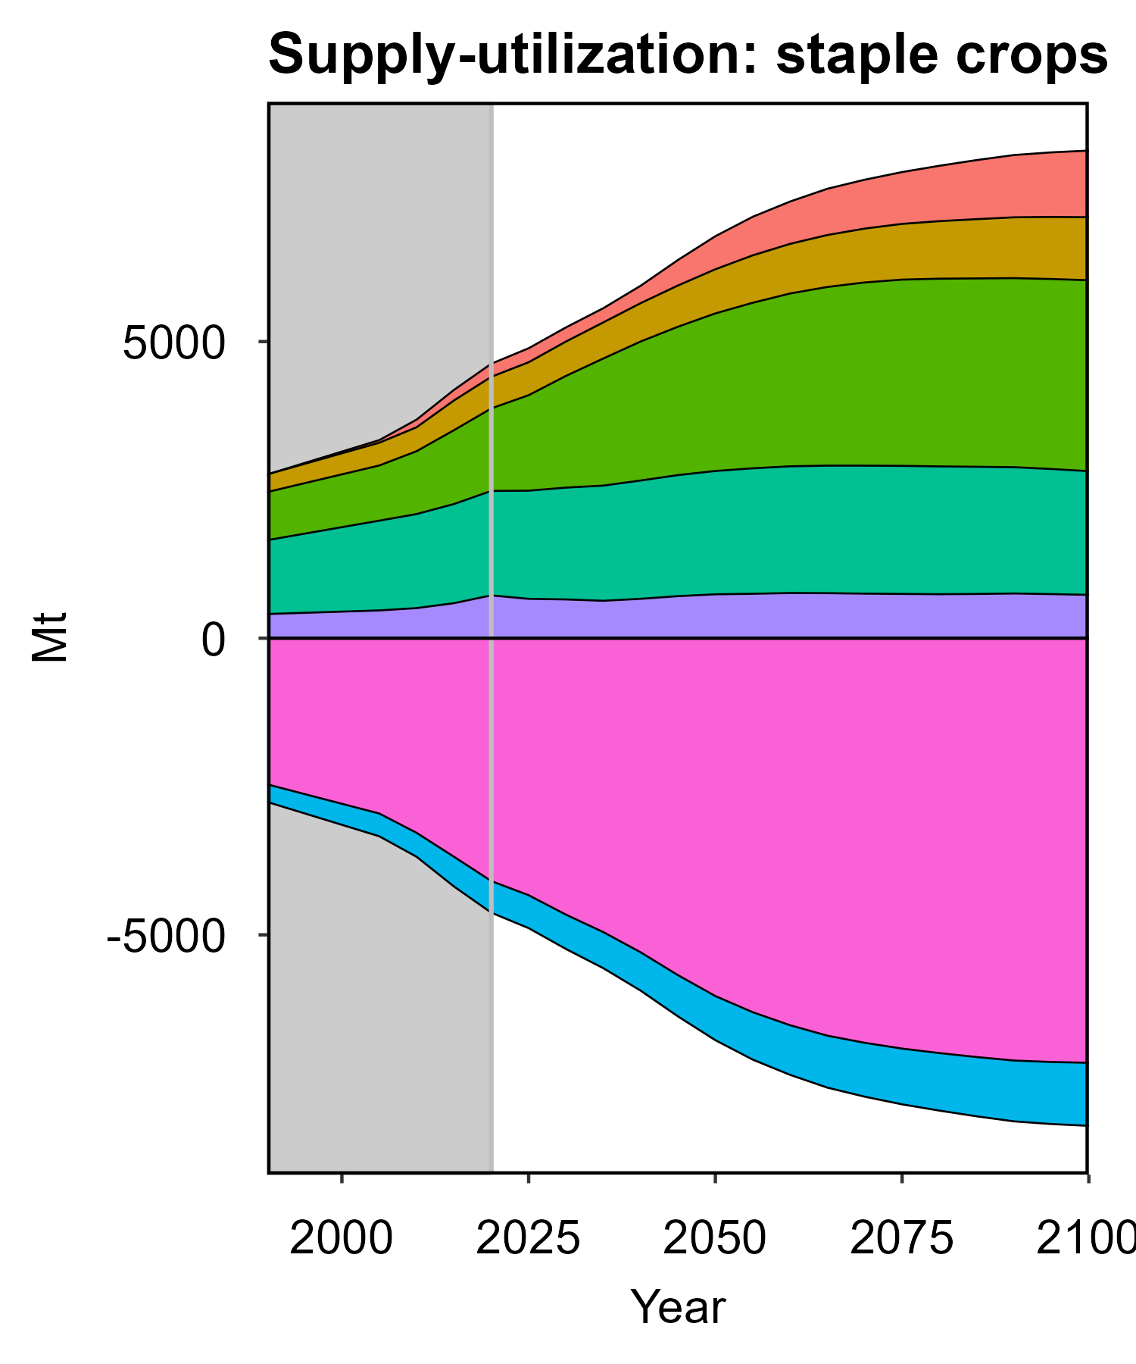
GCAM reference projections (by 2100) Land allocation and agricultural market
2020
Energy crops
Biofuels
Cropland
Staple crops
Export
Non-staples
Feed
Demand
Forest
Food
Others
Pasture
Grass & Shrub
Production
Supply
Others
Import
Data source: GCAM v7.2

Slide 33
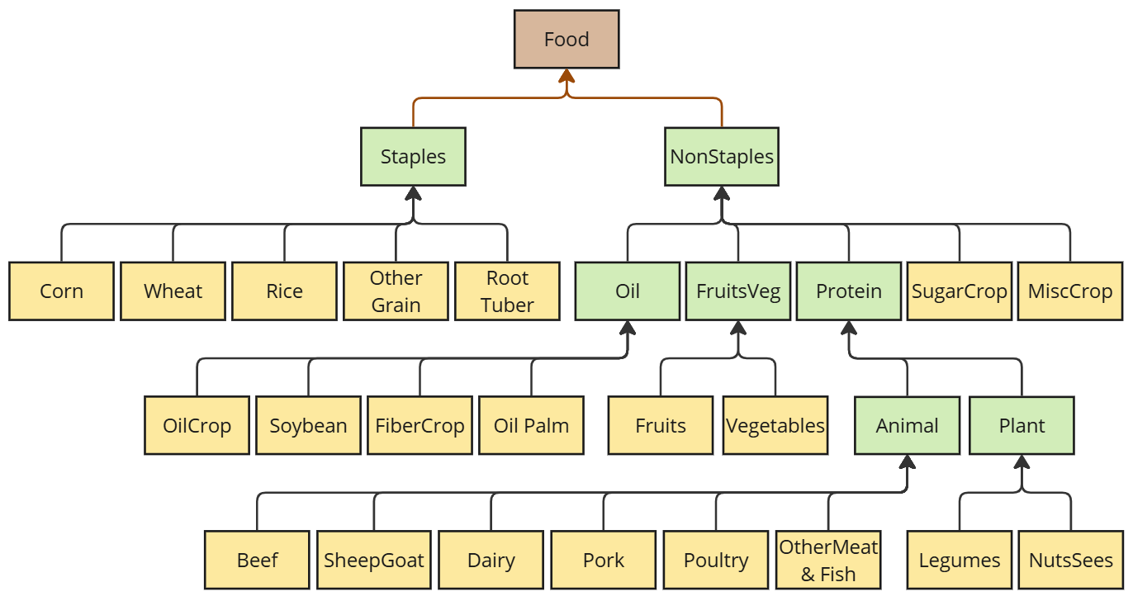
Food demand
Edmonds et al. 2017
Ambrosia
Calories-based logit competition

Slide 34
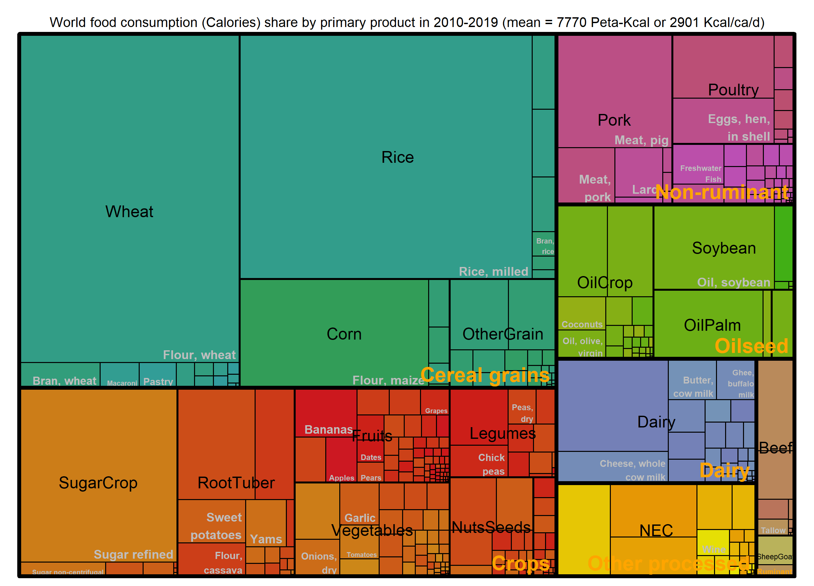
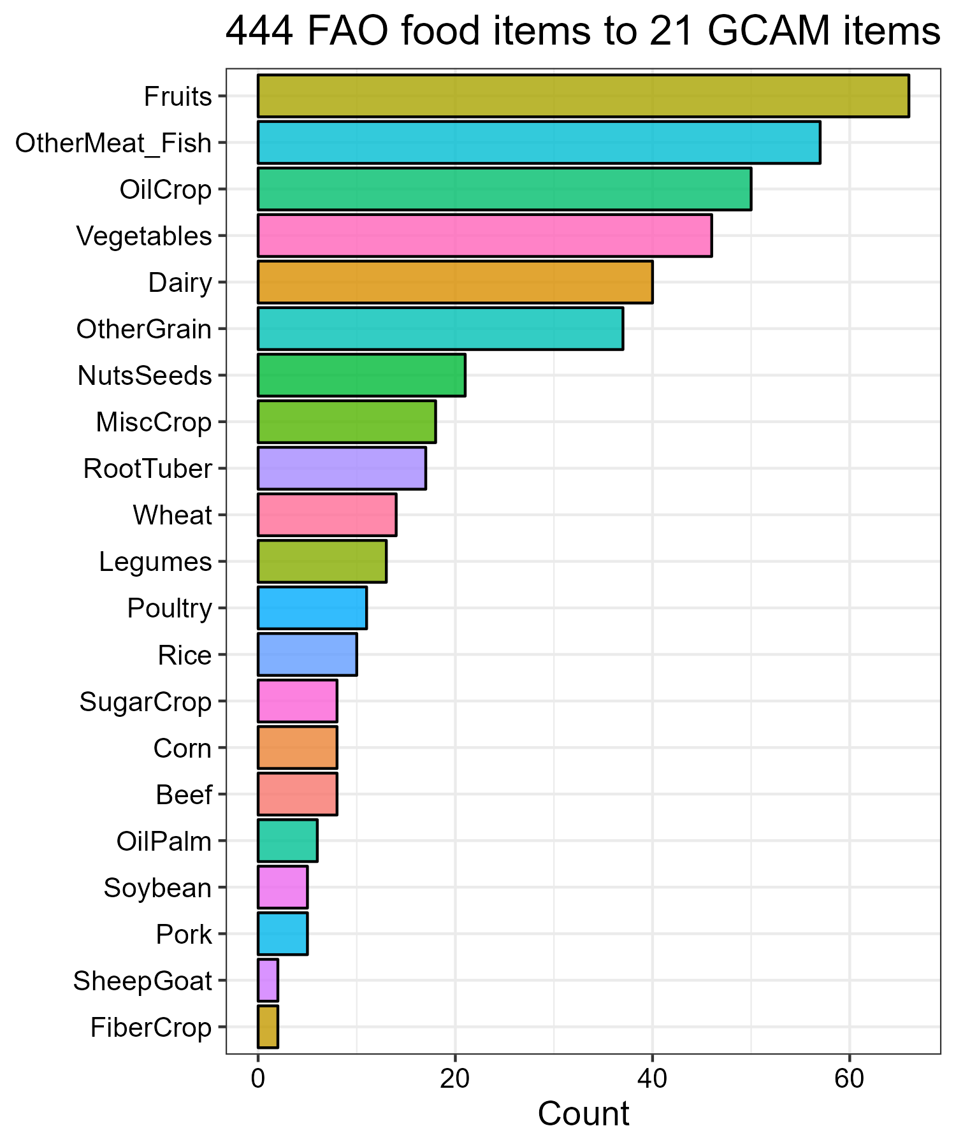
World food availability (dietary energy supply) Mean = 7770 Peta-Kcal; 2900 Kcal/ca/d
gcamfaostat; FAOSTAT

Slide 35
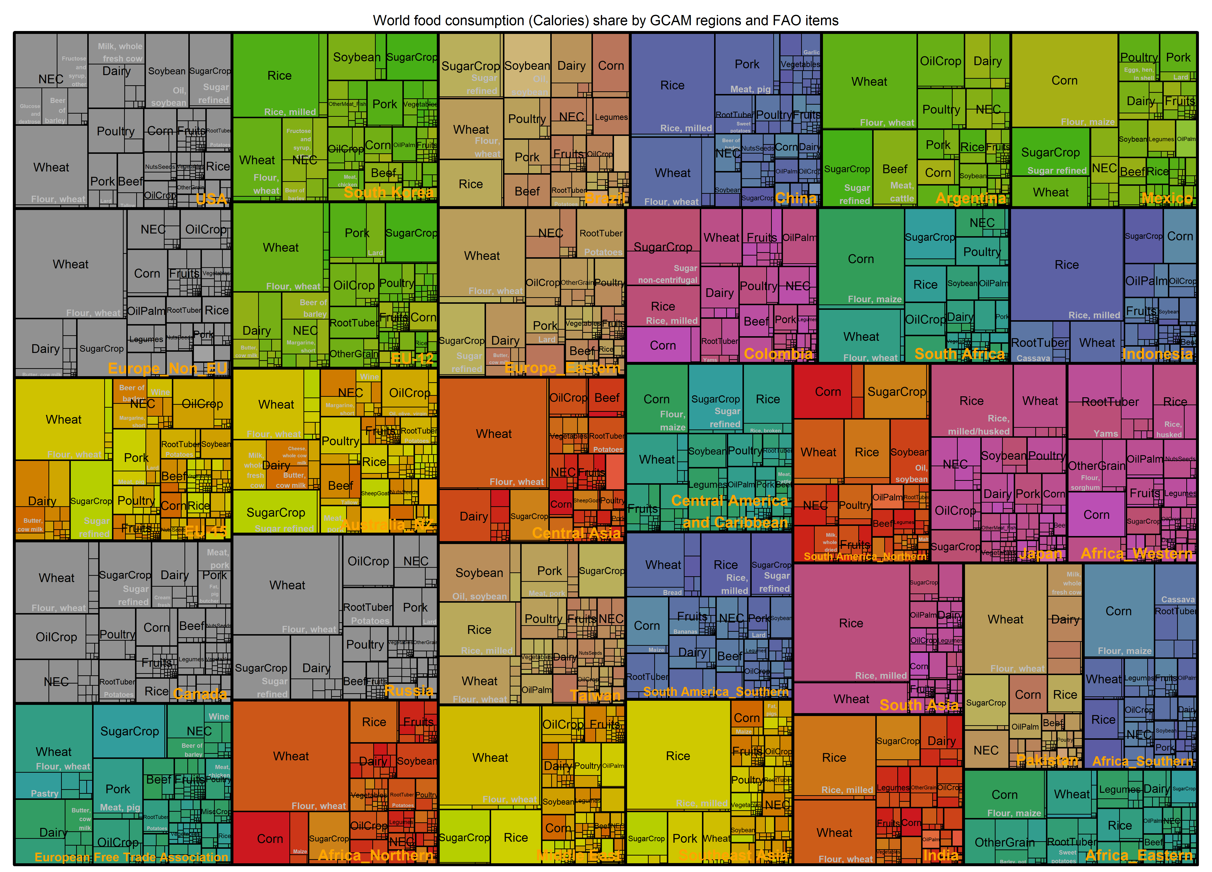
3500 kcal/ca/day
Per capita food calorie supply
2500 kcal/ca/day
gcamfaostat; FAOSTAT

Slide 36
The Agricultural System: Calibration
As with all GCAM sectors and activities, GCAM functions in the agriculture and land use system are calibrated to historical values.
Base year
E.g., last base year 2021 (2020-2022)
Solve the modeling in calibration mode to determine calibration parameters
Regional crop and forest production, demand, land allocation, irrigation water, fertilizer demand, crop and forest product trade, as well as other inter-industry demands and technology choices are all calibrated.
Then the model reproduces that Base Year exactly.

Slide 37
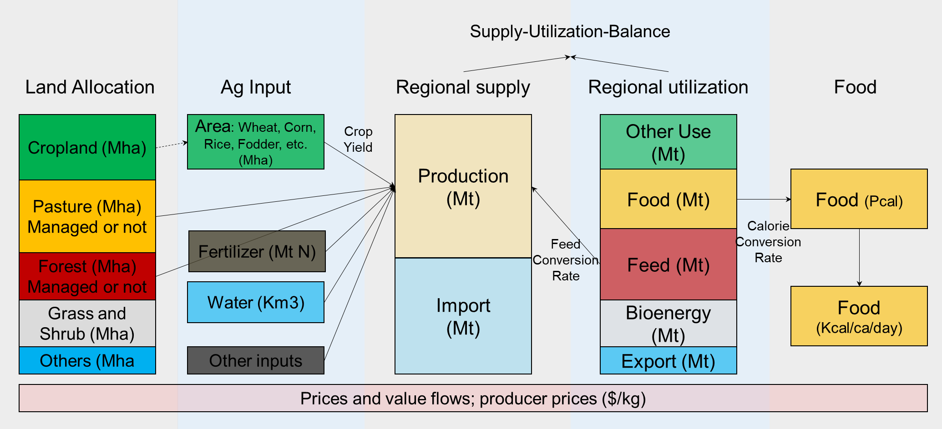
Multisectoral Linkages: Agri-food economics
Physical flows and value flows
Endogenous vs. exogenous variables?

Slide 38
Multisectoral Linkages: Agri-food economics
+ Energy & Water
E
E
E
Energy demand in production & bioenergy supply
Water demand

Slide 39
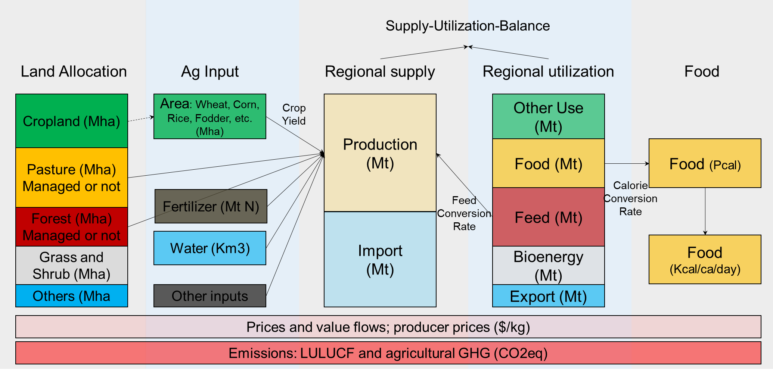
Multisectoral Linkages: Agri-food economics
+ Energy & Water + Emissions
Emissions and Earth system (hector) outcomes are dependent on economic outcomes.

Slide 40
Land Use Change and Agricultural Emissions
Land use change emissions (anthropogenic)
Namely, LULUCF or AFOLU CO2 emissions
In a land unit (region-basin) in t compared to t-1
If land has not changed in a period, no LULUCF from this period (could still be from historical change)
If land is changed, we calculate both soil carbon changes and vegetative carbon changes.
Agricultural emissions (CH4, N2O, NOx, SO2, VOCs, NH3)
Base year values are calibrated to match the inventory (CEDS)
Derive emissions factors (emissions per unit of activity) for all crops and animals, as well as some land sources (savannah burning, deforestation, forest fires)
Future emission factors may be changing according to the EPA MAC curves.

Slide 41
Examples of some relevant questions
[Supply] Biophysical or policy shocks on agriculture (crop/livestock/forestry), e.g., yield, labor productivity, land protection, etc.
[Demand] Bioenergy mandates, dietary change, & food waste reduction
[Trade] Globalization and trade disruption, e.g., market integration, trade bans, etc.
Virtual water/land trade
[Emissions] How food system emissions evolve and the drivers of them.
Potentials of af(re-)forestation and bioenergy in combination with carbon capture and storage
[Economics] Value chains along food and forest processing
[SDG] How to feed 9 billion people in 2050 and MSD implications

Slide 42
GCAM Water Sector Modeling

Slide 43
What’s inside the GCAM?

Slide 44
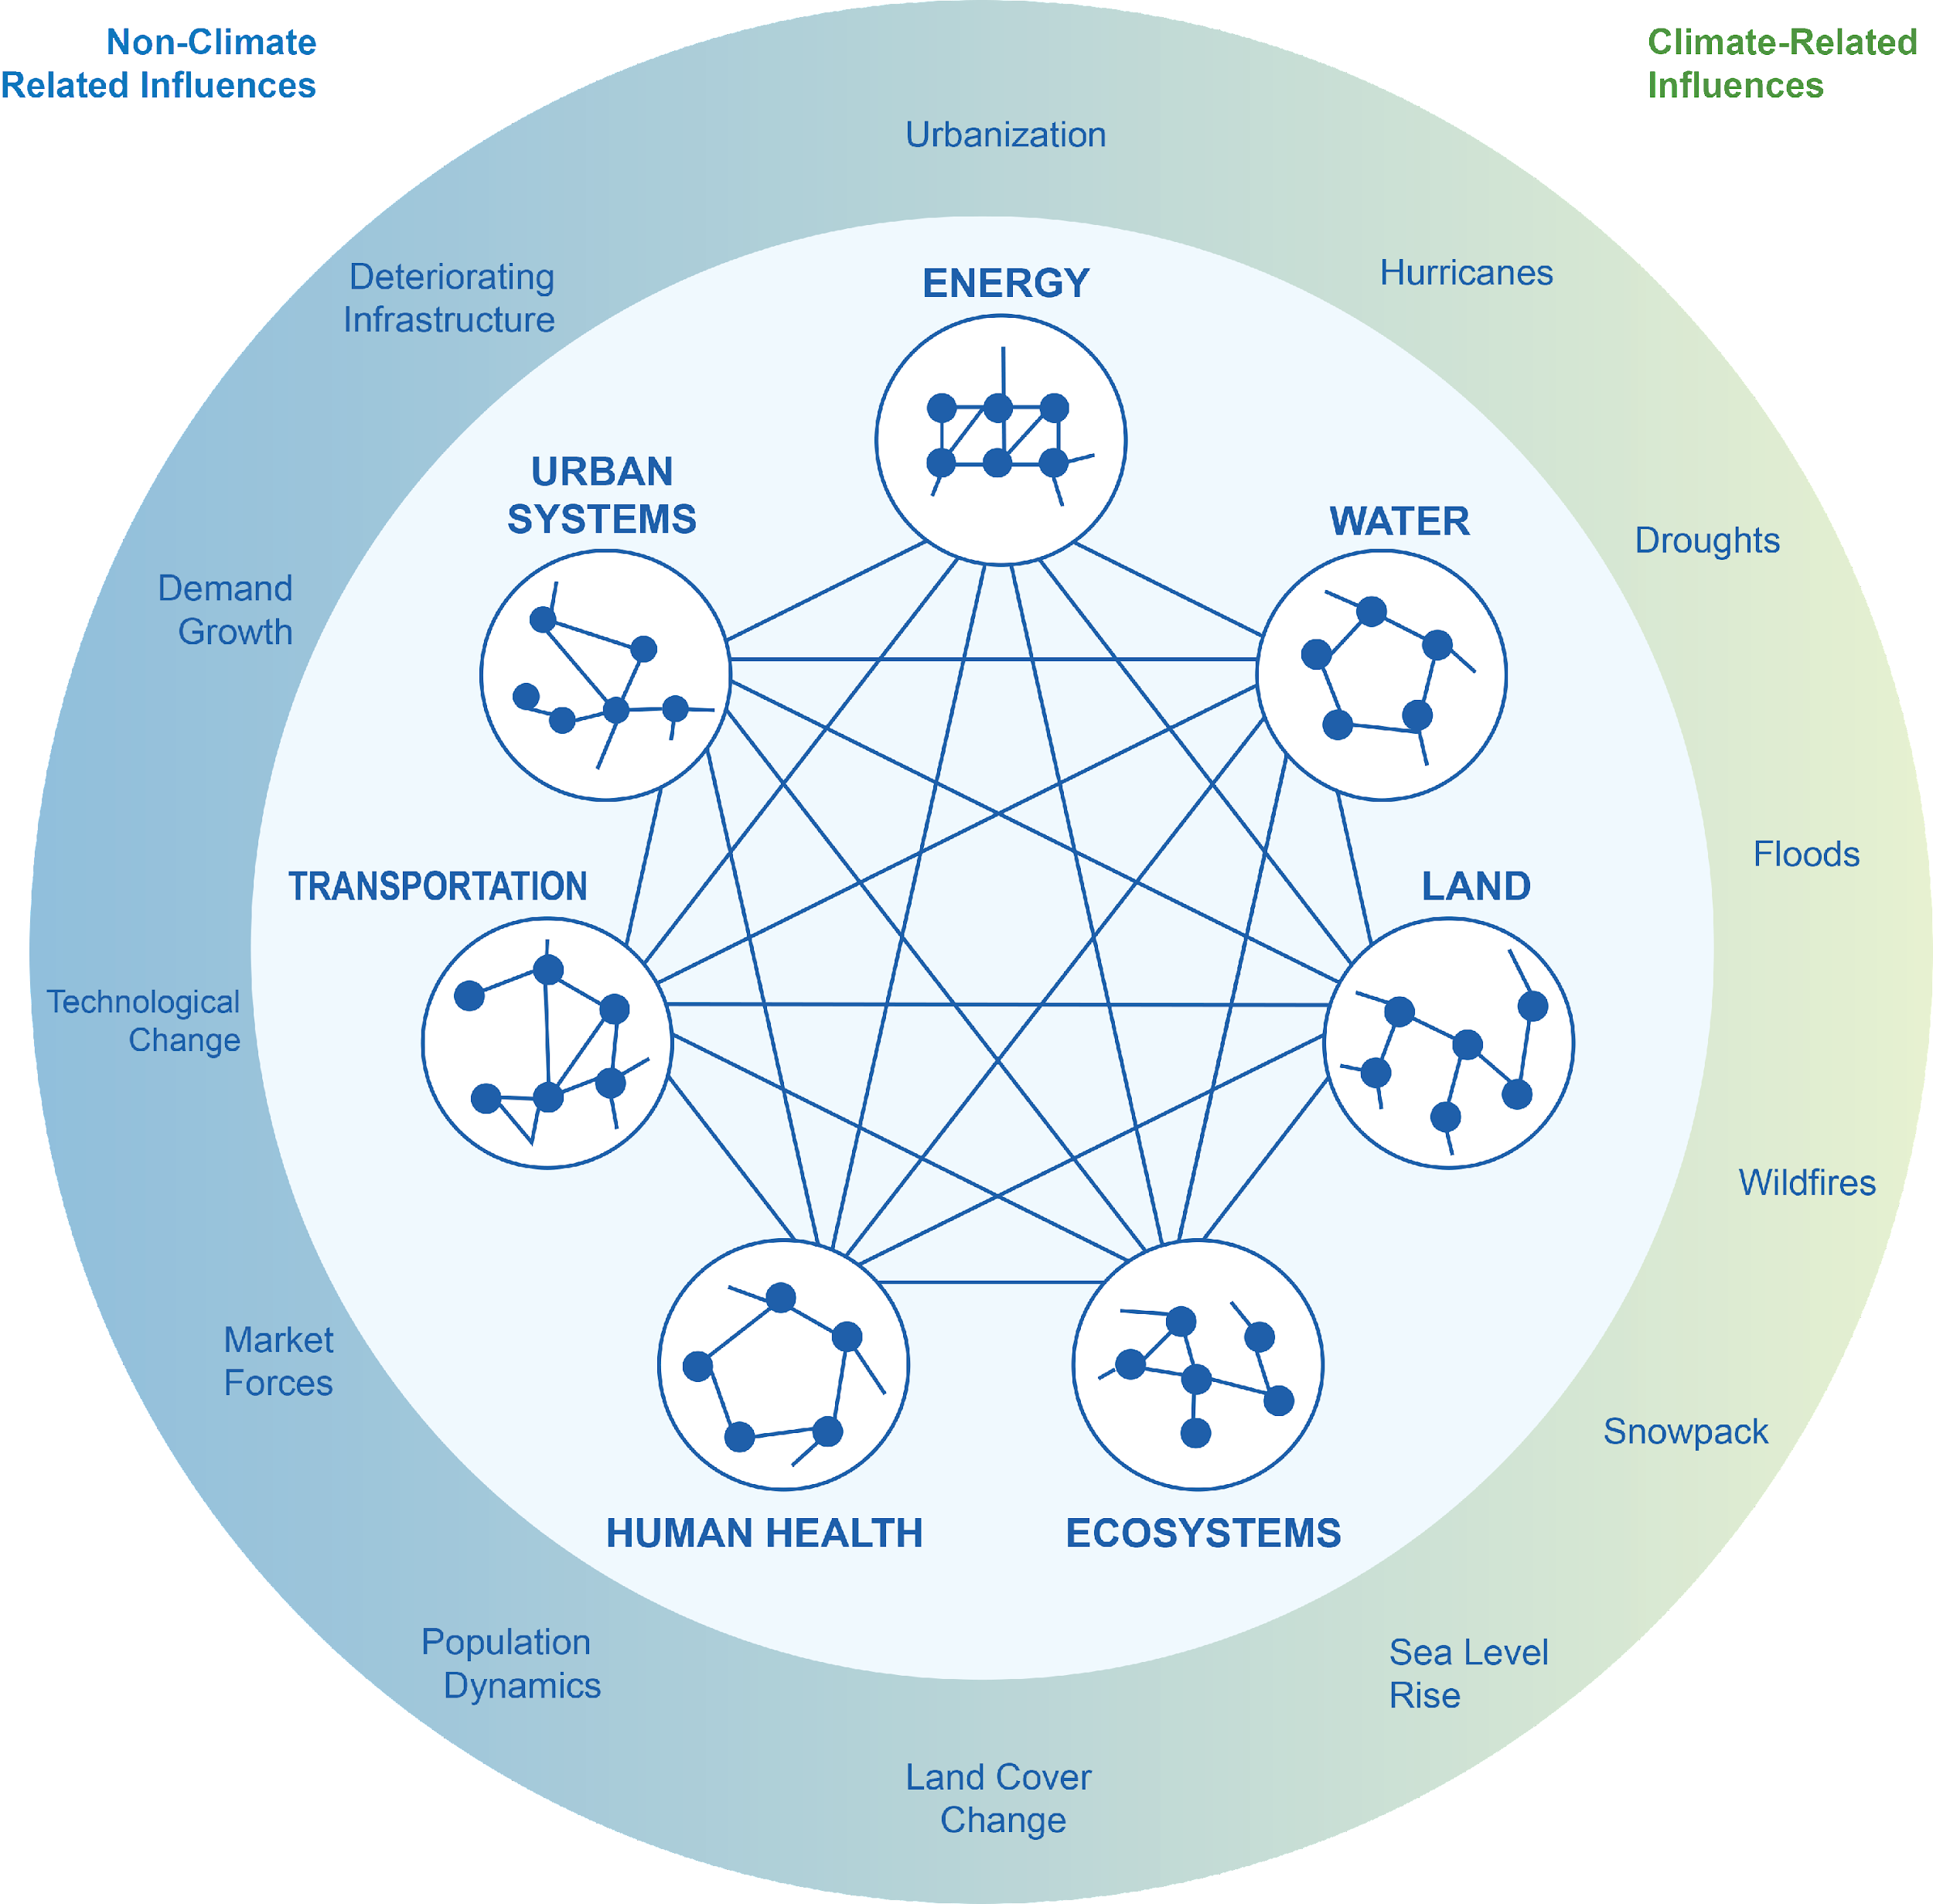
Why Include Water?
Energy, water, land and other system elements are highly interconnected
Humans produce more emissions, which alter climate, resulting in altered water availability and increasing energy system requirements
Population grows, demanding more energy, land for food, and water for the food and energy
Source: Clarke et al. (2018)

Slide 45
Water Supply in GCAM

Slide 46
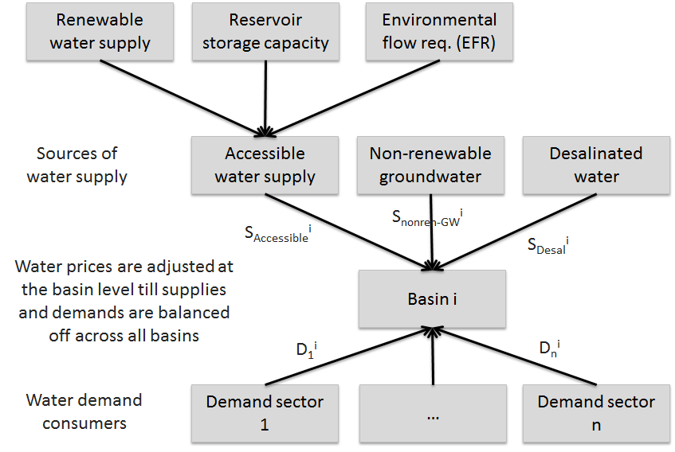
Basin-scale Water Allocation Mechanism in GCAM

Slide 47
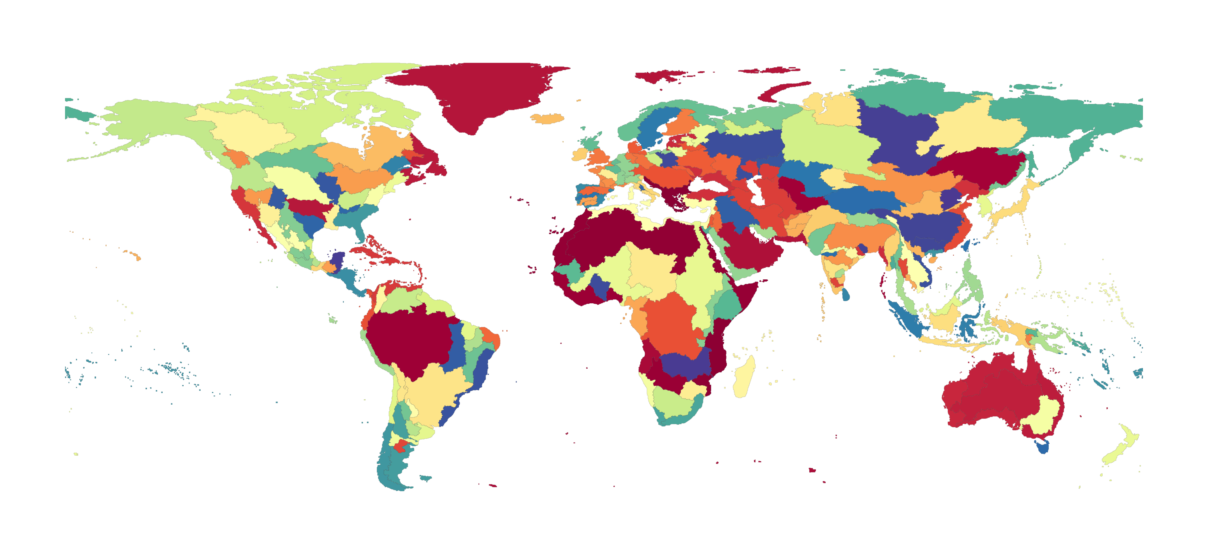
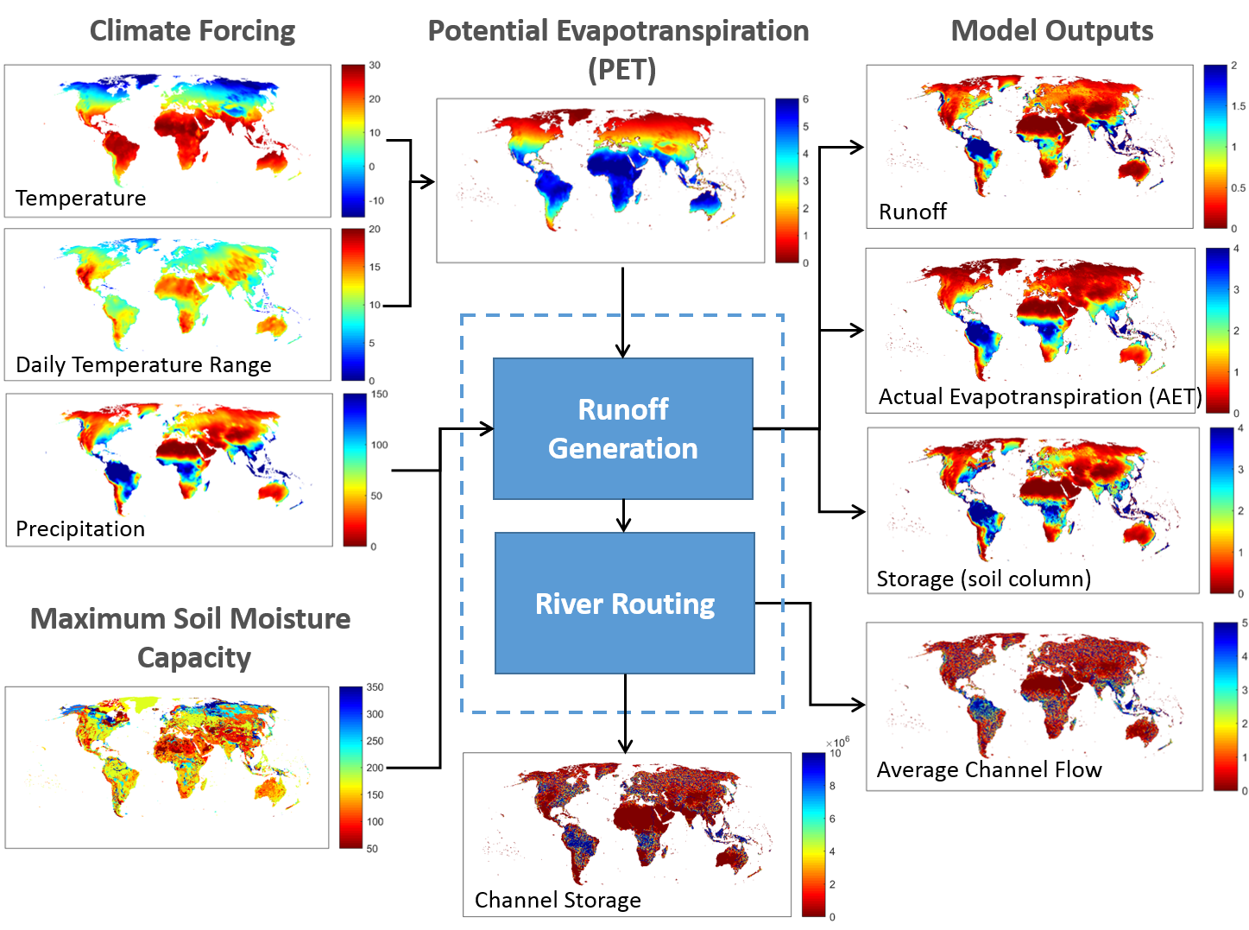
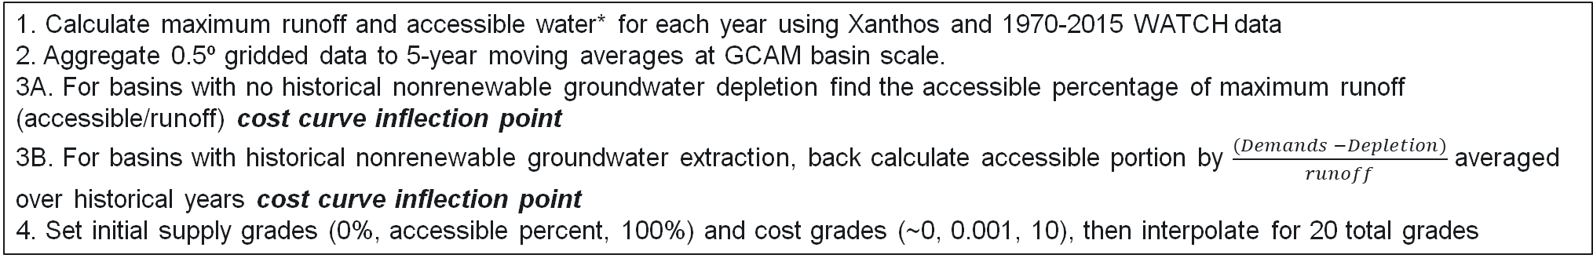
Surface Water Supply and Cost Curves in GCAM
Xanthos Processing
235 GCAM Basins
Price $
Price $
Availability [%]
Availability [%]
1. Calculate maximum runoff and accessible water* for each year using Xanthos and 1970-2015 WATCH data
2. Aggregate 0.5º gridded data to 5-year moving averages at GCAM basin scale.
3A. For basins with no historical nonrenewable groundwater depletion find the accessible percentage of maximum runoff (accessible/runoff) cost curve inflection point
3B. For basins with historical nonrenewable groundwater extraction, back calculate accessible portion by $\frac{(Demands −Depletion)}{runoff}$ averaged over historical years cost curve inflection point
4. Set initial supply grades (0%, accessible percent, 100%) and cost grades (~0, 0.001, 10), then interpolate for 20 total grades

Slide 48

Groundwater Supply and Cost Curves in GCAM
Superwell
Derived unit cost of groundwater extraction over time at 50km grid cells
Estimates of groundwater availability from previous studies on porosity, depth-to-groundwater, and aquifer thickness in addition to WHYMAP
Constrained to only allow for 25% use of all physical water estimated in aquifer
Calculations within require an assumption of confined aquifer, however results assumed to be from unconfined aquifer
Increasing Depth
Price $
$$∆t$$
Cost Grade
Aggregate unit costs from Superwell 50km grid to GCAM basin scale and transform into 24 unique cost grades
Historical groundwater depletion from WaterGap is placed into grade_hist which is pulled during historical calibration
Added to GCAM as a subresource with price interactions with renewable water cost curves.

Slide 49
Surface Water and Groundwater Price Interaction
Renewable Cost Curve
Basin A
Groundwater Cost Curve
Basin A
Water withdrawals come from cheap renewable sources first.
If demands exceed the accessible portion in any given timestep, a price interaction between groundwater and renewable water occurs where water is drawn from the cheaper source first.
Price $
Price $
Availability [%]
Cost Grade
Price $
Price $
Availability [%]
Cost Grade

Slide 50
Surface Water and Groundwater Price Interaction
Renewable cost curve
Basin A
Groundwater cost curve
Basin A
Water withdrawals come from cheap renewable sources first.
If demands exceed the accessible portion in any given timestep, a price interaction between groundwater and renewable water occurs where water is drawn from the cheaper source first.
As groundwater is exhausted in low-cost grades, the point of interaction between renewable and groundwater is pushed to higher prices
More water than is deemed accessible must be pulled in order to start the price interaction with groundwater
Price $
Price $
Availability [%]
Cost Grade
Price $
Price $
Availability [%]
Cost Grade

Slide 51
Water Demand in GCAM

Slide 52
Understanding the Types Water Demand in GCAM
Water Withdrawals: water diverted or withdrawn from a surface water or groundwater source.
Water Consumption: water use that permanently withdraws water from its source; water that is no longer available because it has evaporated, been transpired by plants, incorporated into products or crops, consumed by people or livestock, or otherwise removed from the immediate water environment.
Biophysical Water Consumption: total water required for crop evapo-transpiration; the sum of blue (runoff + groundwater) and green (soil moisture) water
Seawater: water from the oceans, including brackish estuaries, that is withdrawn for cooling thermo-electric power plants, used in primary energy production, or as an input for desalination.

Slide 53
Sectoral Water Demands in GCAM
Total Water Use
Non-Agricultural Water Use
Irrigation
Livestock
Agricultural Water Use
Domestic
Electricity Generation
Primary Energy
Manufacturing
Hydropower
Wind
PV
CSP
Geothermal
Nuclear
Biomass (+CCS)
Oil (+CCS)
Gas (+CCS)
Coal (+CCS)
Once-Through
Dry Cooling
Cooling Ponds
Wet Towers
Coal
Natural Gas
Conventional Oil
Unconventional Oil
Uranium
Corn
FiberCrop
FodderGrass
FodderHerb
Fruits
Legumes
MiscCrop
NutsSeeds
OilCrop
OilPalm
OtherGrain
Rice
RootTuber
Soybean
SugarCrop
Vegetables
Wheat
Biomass
Beef
Dairy
Pork
Poultry
SheepGoat

Slide 54
Sectoral Water Demand Coefficients
Domestic (see Hejazi et al., 2013 for more):
Historical withdrawal values sourced from FAO AQUASTAT which are asssumed to grow with population and GDP. Technological change also assumed.
Consumption coefficients derived from Shiklomanov 2000 and indicates only the water that is used by consumers in a way that it is not returned to the immediate water environment.
Electricity Generation (see Davies et al., 2013 & Kyle et al., 2013 for more):
Demand coefficients for five cooling types derived from Macknick et al., 2011. Cooling system options compete in a calibrated logit nest, similar to the competition between fuels within this sector with capital costs for cooling systems coming from NETL 2008

Slide 55
Sectoral Water Demand Coefficients
Primary Energy Mining (see Hejazi et al,. 2014 for more):
Bottom-up estimates of water demand per unit energy produced for each fuel type. Methodology uses values from Maheu 2009, less the fraction of seawater (Middle East 95%, all other regions 43% (Kenny et al., 2009).
Withdrawals are found as the consumption coefficient multiplied by an exogenous value of 3.3 (Solley et al., 1998).
Manufacturing:
Self-supplied surface and groundwater to industrial manufacturers. Sourced from FAO AQUASTAT. Excludes water for cooling.
Agriculture:
Green and Blue water footprints are derived from Mekonnen and Hoekstra 2011 by crop and region. Additionally, water losses and water use efficiencies in irrigation technologies are assumed to be regionally heteorgenous and are dervied from Rohwer et al. 2007.
Livestock:
No distinction between withdrawals and consumption. Includes animal drinking water, plus any other water used by the animal production operations. Dervived from Mekonnen and Hoekstra 2010 with animal stocks from FAO

Slide 56
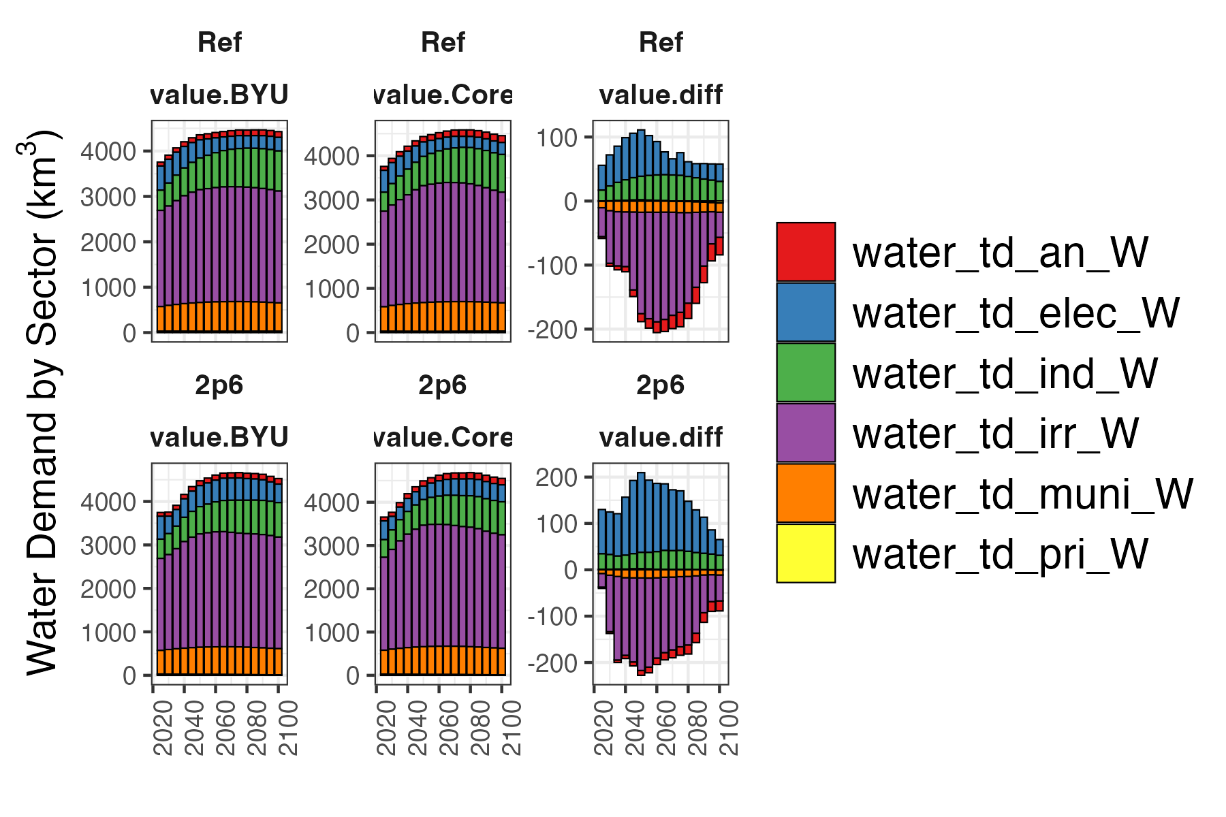
Recent Water Demand Results

Slide 57
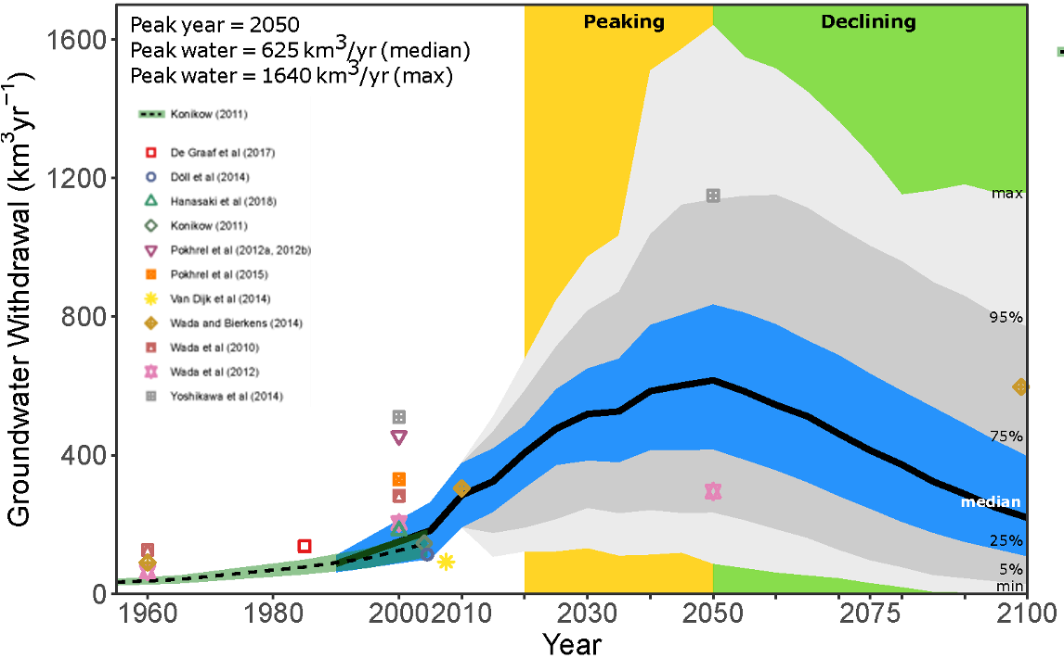
Recent Water Demand Results
Niazi et al., 2024, Nat. Sus.

Slide 58
Thank you!
Gokul.Iyer@pnnl.gov Xin.Zhao@pnnl.gov Neal.Graham@pnnl.gov https://jgcri.github.io/gcam_training/gcam.html

Slide 59
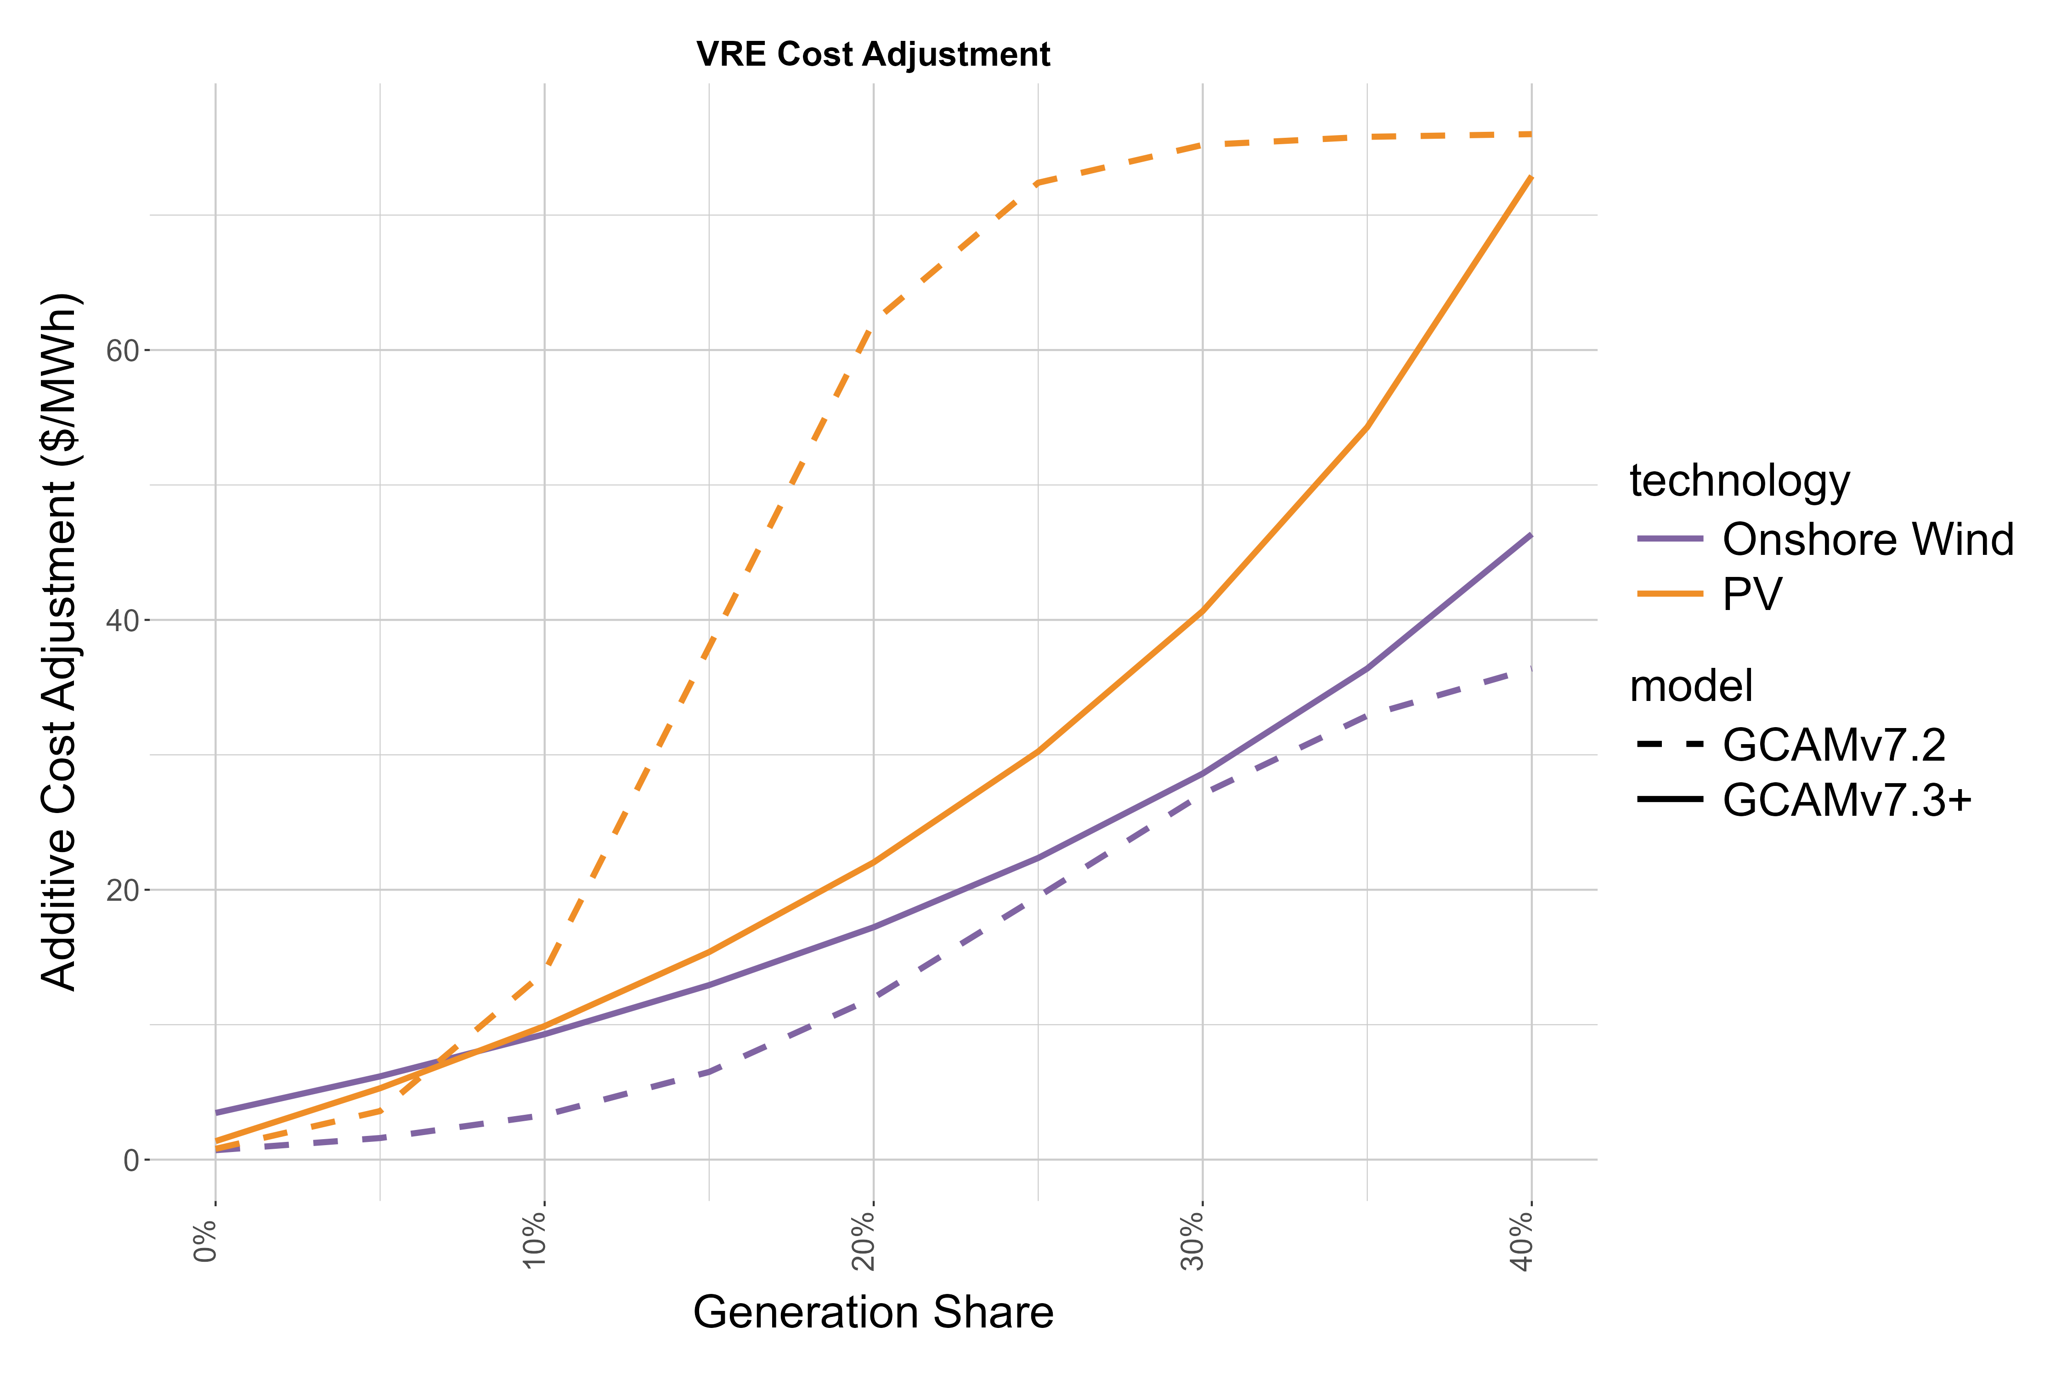
GCAM Renewable Integration
We have updated our approach to modeling renewable intermittency that considers the economic value that technologies provide toward the various spatiotemporal electricity system requirements, including energy, firm capacity, and operating reserves
The approach uses the profitability-adjusted LCOE (PLCOE) to reflect technology competition and the changing relative value of variable renewable energy (VRE) generation at different levels of market share
PLCOE is equal to a technology’s LCOE divided by its value factor (VF), where VF is defined as a technology’s total value per unit of generated electricity divided by the average system electricity price
From another perspective, a technology’s PLCOE is equal to the LCOE of a hypothetical “average value” technology (with total value per unit electricity equal to the average system electricity price)
Value factors for wind and solar technologies (without on-site storage) are parameterized as a linear function of market share within each GCAM region, based on recently published work with the Regional Electricity Deployment System (ReEDS) model
The additive intermittency cost for VRE technologies is equal to (LCOE/VF - LCOE), which increases exponentially with market share because the VF relationship is assumed to be a linear function of market share

Slide 60
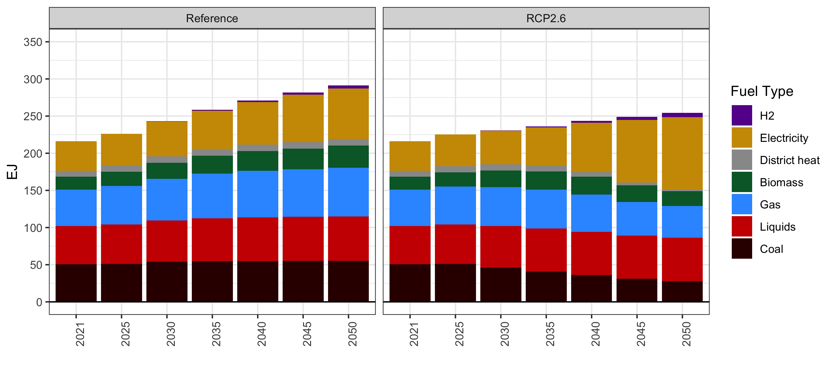
GCAM results from Reference: Industrial final energy

Slide 61
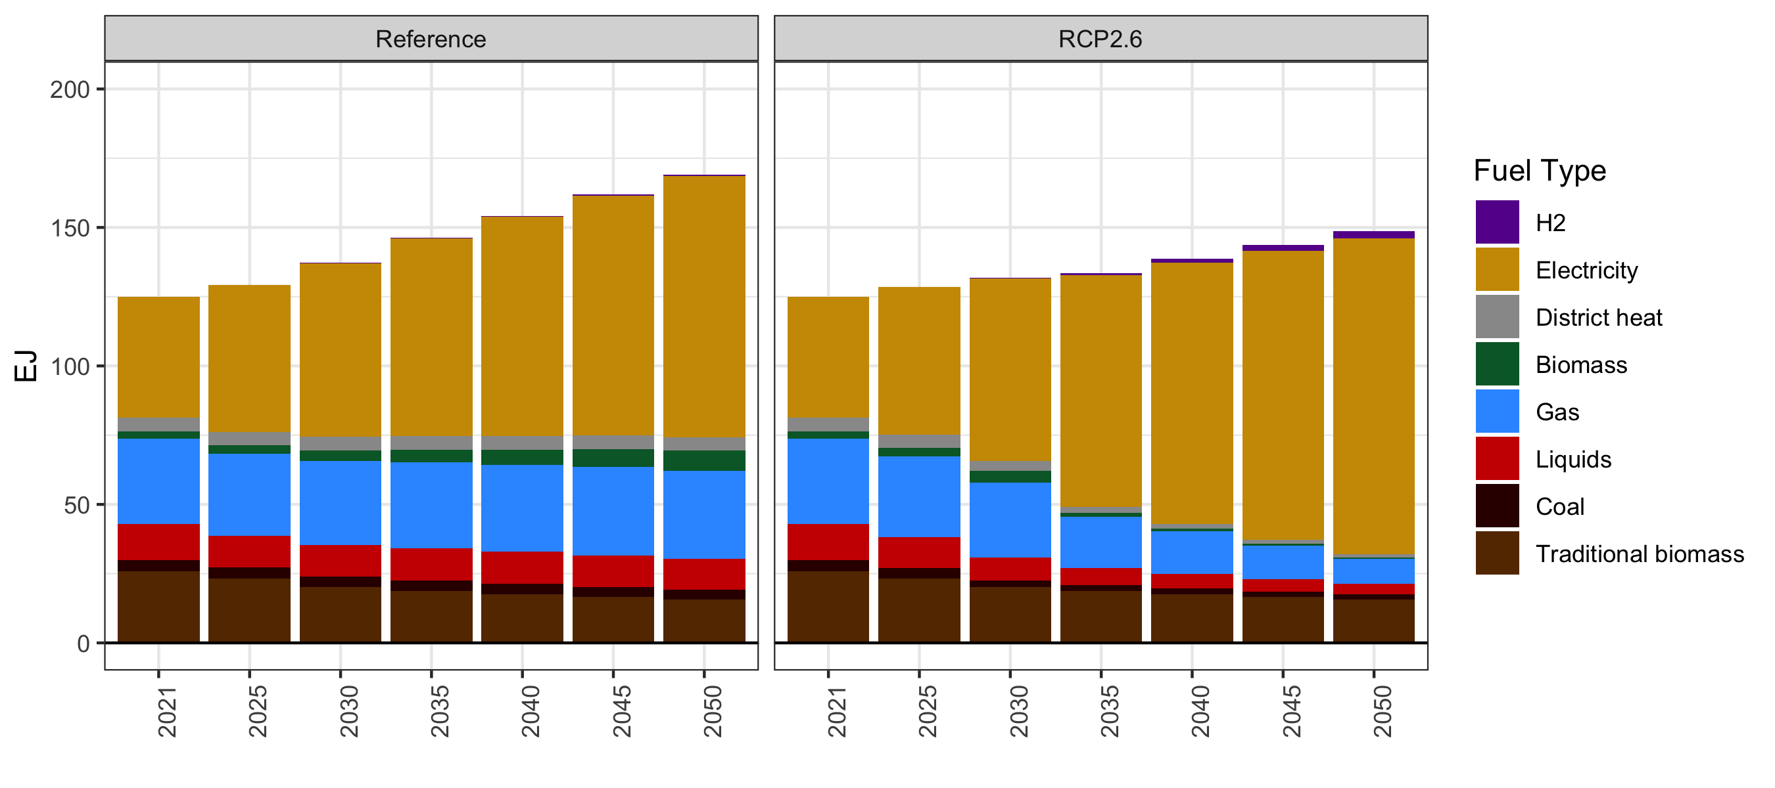
GCAM results from Reference: Buildings final energy

