Slide 1
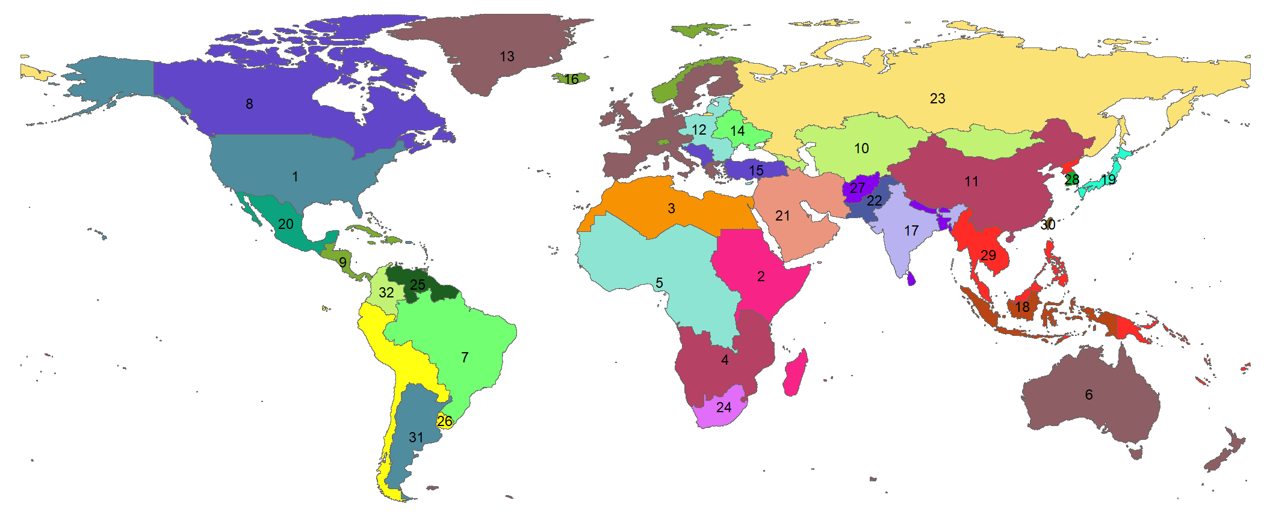
GCAM 32 Regions
USA
Africa_Eastern
Africa_Northern
Africa_Southern
Africa_Western
Australia_NZ
Brazil
Canada
Central America and Caribbean
Central Asia
China
EU-12
EU-15
Europe_Eastern
Europe_Non_EU
European Free Trade Association
South Africa
South America_Northern
South America_Southern
South Asia
South Korea
Southeast Asia
Taiwan
Argentina
Colombia
India
Indonesia
Japan
Mexico
Middle East
Pakistan
Russia

